Slide 1
http://xkcd.com/1014/
Image Processing 101
Fredo Durand
MIT EECS
6.815/6.865

Slide 2
From: http://www.devx.com/projectcool/Article/19987/0/page/2
The small green squares are the same color. Hold your hand to the screen and block out the adjacent blocks, showing only the two green square, and you'll see how dramatic the chromatic induction effect is.
From: http://www.devx.com/projectcool/Article/19987/0/page/2
These two brown shades are different colors—yet the square blocks appear to be the same shade of brown. It is only when your eye follows the line down that you see how different the shades are. Cover the bottom part of the illustration with your hand and look only at the brown boxes to see the way the chromatic induction effect impacts the way you see color.
Image Processing 101
Fredo Durand
MIT EECS
6.8370/6.8371

Slide 3
C++ and Image Processing 101
Fredo Durand
MIT EECS
6.8370/6.8371

Slide 4
Administrivia
Pset 0 is out and due Wednesday (in 1 days)
  But weight is 0 for final grade
Accounts to pset system have been sent
  Contact us if you don’t have one.
Make sure you
  join piazza
  have an account on the magical system

Slide 5
Debugging

Slide 6
Debugging
Doubt everything
Debug pieces in isolation
  Binary search/divide and conquer
Display/print everything - save images
  In particular intermediate results
Create simple inputs
  where you can easily manually compute the result
  e.g. constant image, edge image, rectangle, etc.
  use small images (e.g. 3x3)
  including (especially) inputs to intermediate stages
  use input thats isolate different failure modes
Change one thing at a time
  e.g. to verify that a given command has the effect you want, modify it to break it

Slide 7
Debugging — seg fault
Often occurs much later than the actual problem
Probably due to some array (vector) operation
  print indices and array size
  Assert that index is between 0 and size
    possibly in some debug mode to avoid performance penalty in release mode
Could also be due to initialized pointer, but we’ll avoid pointers

Slide 8
Debugging - DO NOT
Write whole code before testing
  Instead, test each intermediate step once it is implemented
Stare at the code and try to guess how it behaves
  Instead, display as much intermediate info to make sure

Slide 9
Basic image processing

Slide 10
Domain, range

Slide 11
Domain vs. range
2D plane: domain of images
  x, y Cartesian coordinates
color value: range (R³ for us)
  stores the red, green and blue components in
  im(y, x, 0), im(y, x, 1), im(y, x, 2), respectively

Slide 12

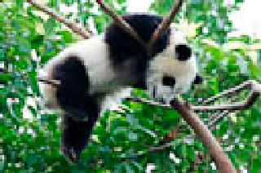

Basic types of operations
Point operations:
range only
Each pixel is treated the same, doesn’t depend on other pixels, only on the input color

Slide 13

Basic types of operations
Point operations:
range only
Domain
operations
Only moves pixels around, doesn’t change colors,
just where they are

Slide 14

Basic types of operations
Point operations:
range only
Domain
operations
Neighborhood operations:
domain and range

Slide 15
Basic types of operations
Point operations:
range only
Pset 1
Domain
operations
Pset 3 or 4
Neighborhood operations:
domain and range
Pset 2

Slide 16
Images in C++

Slide 17
Digital Images
Can be encoded as 2D arrays of RGB triplets
Formally:
  The domain is the 2D plane
  The range is the RGB space
Other color spaces are possible and will be used
Values often encoded as 8 or 16 bit integers
  But we will use floats in [0...1] to make life easier

Slide 18
Arrays
C++ vector
  dynamically sized
  templatized by type, float in our case
Created with
data = std::vector<float>(size,initialValue);
  for a float array with an initial value
References:
  http://www.codeguru.com/cpp/cpp/cpp_mfc/stl/article.php/c4027/C-Tutorial-A-Beginners-Guide-to-stdvector-Part-1.htm
  http://www.cplusplus.com/reference/vector/vector/

Slide 19
1D to 3D
vectors only have one 1D index

Slide 20
1D to 3D
vectors only have one 1D index
turn 2D index into 1D one through strides
  pixel at x, y, stored at y*width+x
  width is called the “stride”
3D index x, y, c where c is the color channel:
  c*width*height+y*width+x
0
1
2
3
0
1
2
3
4
5
6
7
8
9
10
11
12
13
14
15
4
5
6
7
1D vector encoding
8
9
10
11
12
13
14
15
2D array

Slide 21
Our Image class
Stores in planes of color channels
  size width*height*channels
  float
number of dimensions
  could be used to represent 2D images with a single channel, or even 1D arrays
size of various dimensions
name string

Slide 22
Our Image class
Access data using im(x, y, c)
  weird for C++, but more coherent with Halide

Slide 23
File formats
We’ll use PNG
  simpler to read (no need for libjpeg)
  can be converted to and from with online tools
  unfortunately a little slow to read
  unfortunately a little big
We’ll talk about how JPEG works later

Slide 24
Light & perception

Slide 25
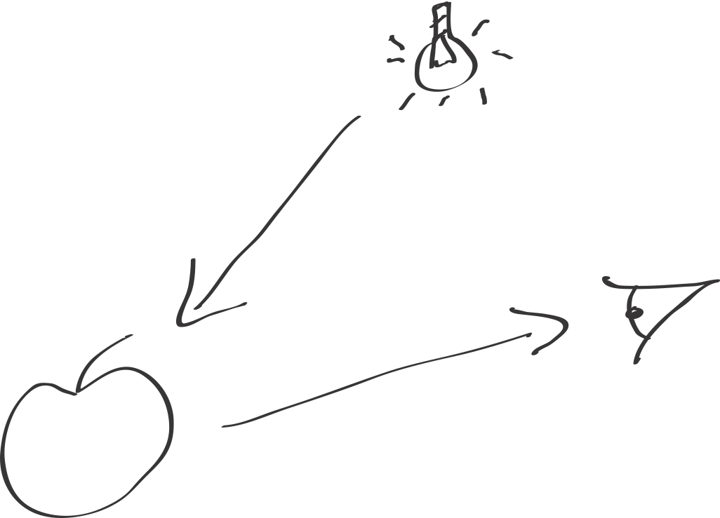
Light matter, eyes
Light from sources is reflected by objects and reaches the eye.
The amount of light from the source gets multiplied by the object reflectance
  on a per-wavelength basis

Slide 26
Human perception
Our eyes have an uncanny ability to discount the illumination
  Only objects really matter for survival
  Light is only useful to understand if you’re a photographer or to choose your sun lotion

Slide 27
Illusion by Adelson
A & B have exactly the same tone

Slide 28
Illusion by Adelson
A & B have exactly the same tone

Slide 29
Mechanism to discount light
Light adaptation
  We recenter our neural response around the current average brightness
  neural + chemical + pupil
Chromatic adaptation
  eliminate color cast due to light sources
    e.g. Daylight is white but tungsten is yellowish
  Related to white balance - more soon
  and Spanish Castle illusion

Slide 30


Contrast is about ratios
Contrast between 1 & 2 is the same as between 100 & 200
Useful to discount the multiplicative effect of light
0.1 to 0.2
0.4 to 0.8

Slide 31
Exposure
On cameras, exposure (shutter speed, aperture, ISO) has a multiplicative effect on the values recorded by the sensor.
Changes the “brightness”, not contrast
http://photographystepbystep.com/exposure-2/auto-bracketing/

Slide 32
Take-home message
Multiplication and ratios matters
  Lot of perceptual aspects of images are invariant to a multiplication by a scalar.
  Contrast is about ratios

Slide 33
White balance

Slide 34
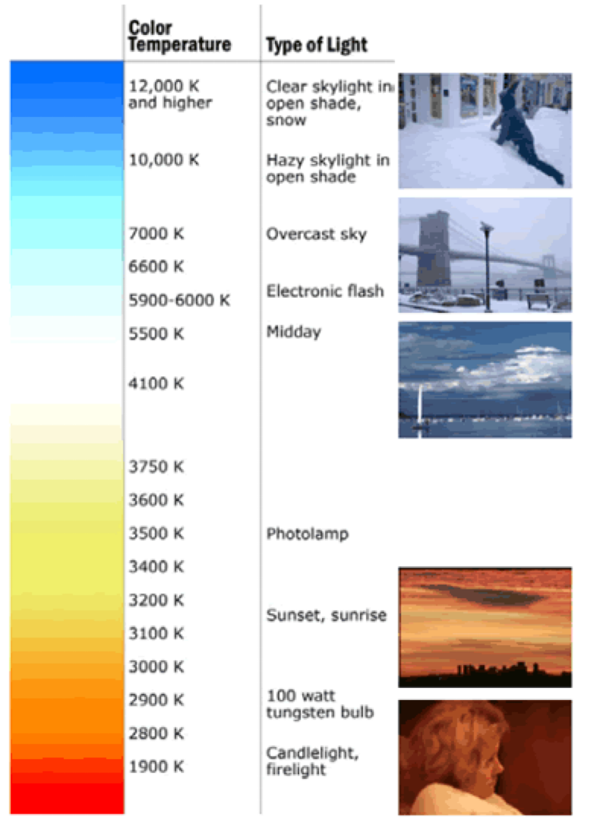
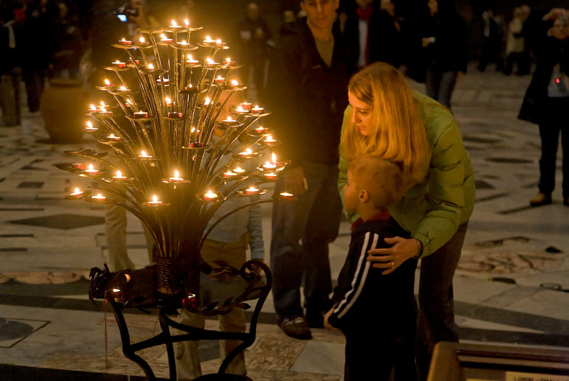
White balance &
Chromatic adaptation
Different illuminants have different color temperature
Our eyes adapt to this:
Chromatic adaptation
  We actually adapt better in brighter scenes
  This is why candlelit scenes still look yellow
www.shortcourses.com/guide/guide2-27.html

Slide 35
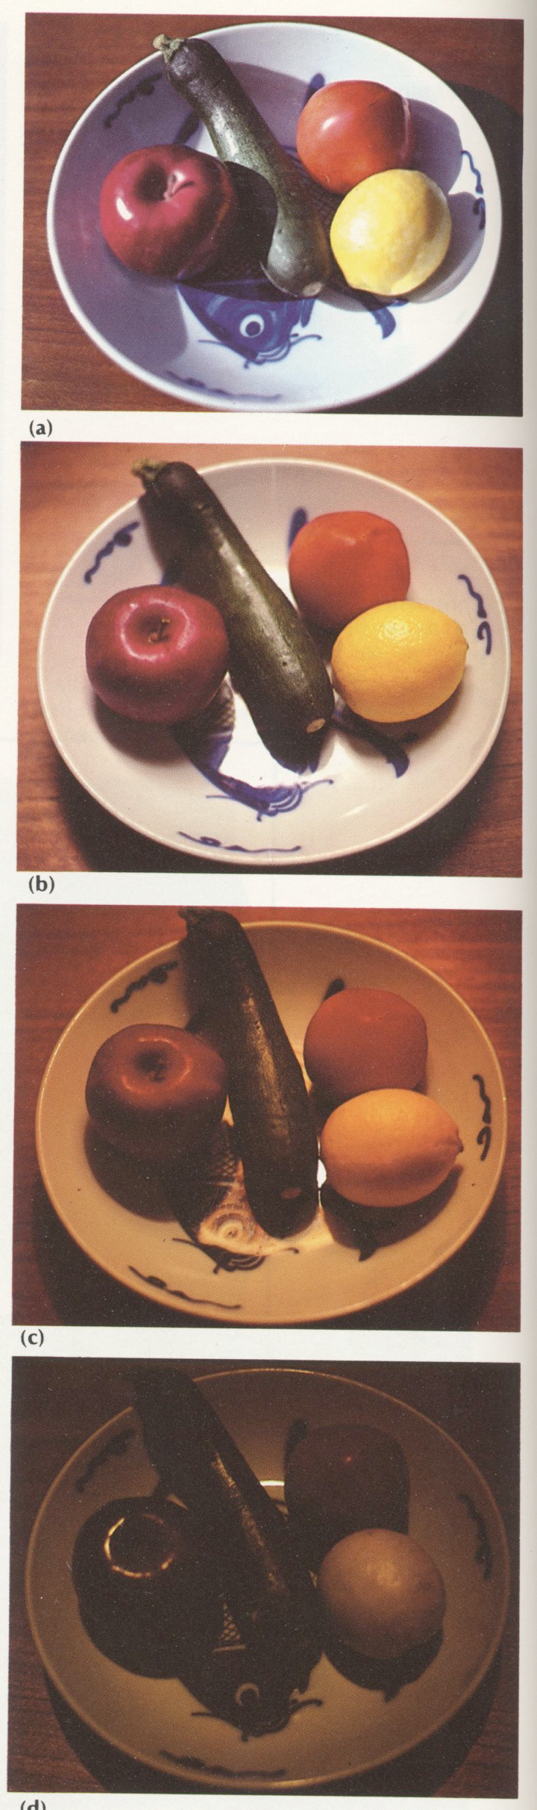
White balance problem
When watching a picture on screen or print, we adapt to the illuminant of the room, not that of the scene in the picture
The eye cares more about objects’ intrinsic color, not the color of the light leaving the objects
We need to discount the color of the light source
Same object,
different illuminants

Slide 36
White balance & Film
Different types of film for fluorescent, tungsten, daylight
Need to change film!
Electronic & Digital imaging are more flexible

Slide 37
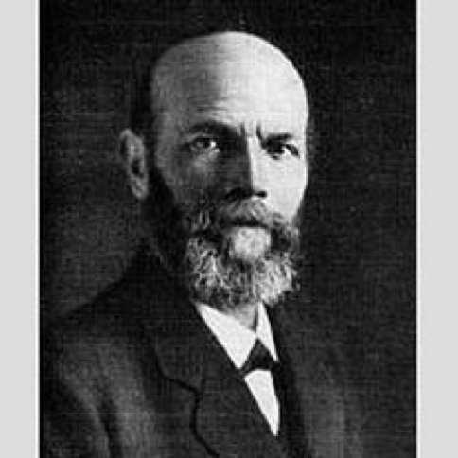
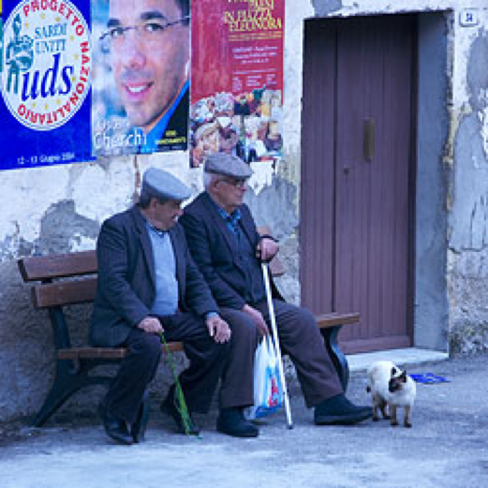
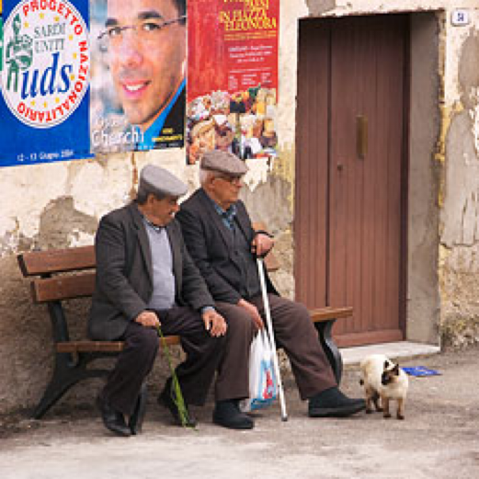
Von Kries adaptation
Multiply each channel by a gain factor
  R’=R*kr
  G’=G*kg
  B’=B*kb
http://www.cambridgeincolour.com/tutorials/white-balance.htm

Slide 38
Von Kries adaptation
Multiply each channel by a gain factor
Note that the light source could have a more complex effect
  Arbitrary 3x3 matrix
  More complex spectrum transformation
http://www.cambridgeincolour.com/tutorials/white-balance.htm

Slide 39
White balance challenge
How do we find the scaling factors for r, g, and b?

Slide 40
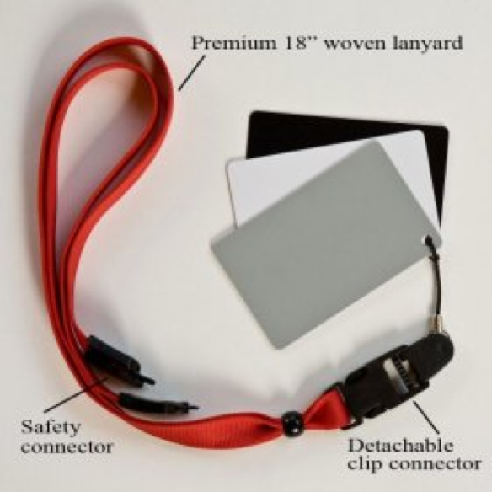
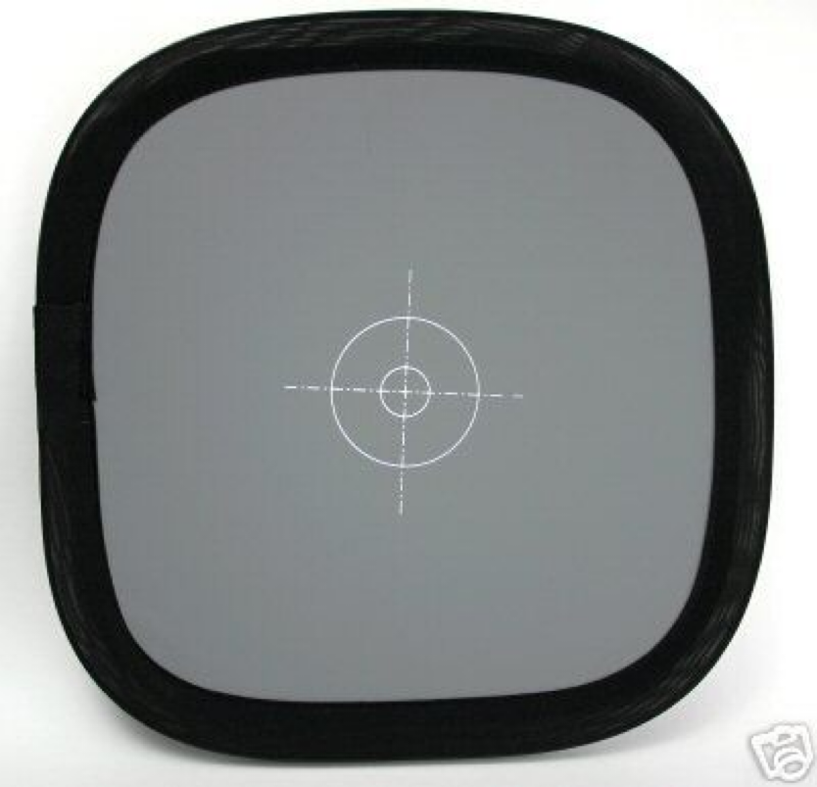
Best way to do white balance
Grey card:
Take a picture of a neutral object
(white or gray)
Deduce the weight of each channel
If the object is recoded as r_{w}, g_{w}, b_{w}
use weights k/r_{w}, k/g_{w}, k/b_{w}
where k controls the exposure

Slide 41
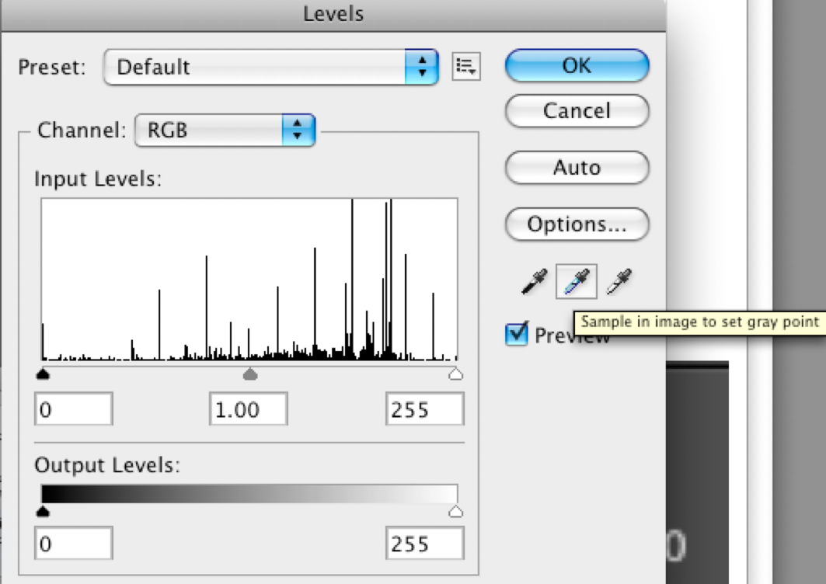
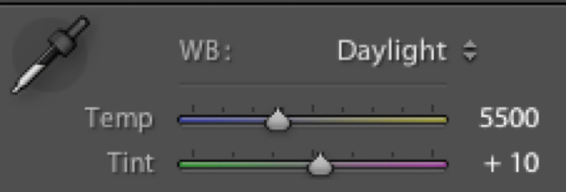
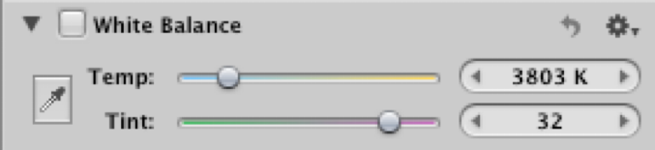
Lightroom demo
Most photo editing software lets you click on a neutral object to achieve white balance
In “Levels” in Photoshop
In “basic” in Lightroom
In Adjustments in Aperture
You also often have presets such as daylight, tungsten

Slide 42
Party name tags
Provide excellent white references!
imwrite(im/im[300, 214])

Slide 43
Without grey cards
We need to “guess” which pixels correspond to white objects

Slide 44
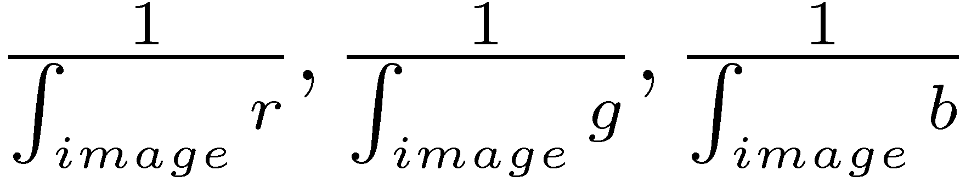
Grey world assumption
Assume average color in the image is grey
Use weights proportional to
Usually assumes 18% grey to set exposure

Slide 45
Brightest pixel assumption
Highlights usually have the color of the light source
  At least for dielectric materials
White balance by using the brightest pixels
  Plus potentially a bunch of heuristics
  In particular use a pixel that is not saturated/clipped

Slide 46
Light with color control
http://www.robgalbraith.com/bins/content_page.asp?cid=7-11666-11979
Gel on flash

Slide 47
Refs
Work on color constancy
  http://gvi.seas.harvard.edu/paper/perceptionbased-color-space-illuminationinvariant-image-processing
  http://gvi.seas.harvard.edu/paper/color-subspaces-photometric-invariants
  http://people.csail.mit.edu/billf/papers/BayesJOSA.pdf
  https://drive.google.com/file/d/1id74VNDL8ACrrWf6vYgN2M4kS8gd4n7w/view
  https://arxiv.org/abs/1611.07596
Still an open problem!
  Especially for multiple illuminants

Slide 48
Questions?
from xkcd

Slide 49
Take home messages
Discounting the illumination is useful
Ratios matter
Optical illusions are not optical but fun

Slide 50
Gamma

Slide 51
Relevant info is about ratios
Contrast between 1 & 2 is the same as between 100 & 200
Useful to discount the multiplicative effect of light
0.1 to 0.2
0.4 to 0.8

Slide 52

Linearity and gamma
Images are usually gamma encoded
Instead of storing the light intensity x,
they store
to get more precision in dark areas
for 8-bit encoding
1/
stored value
gamma compression curve
real value

Slide 53
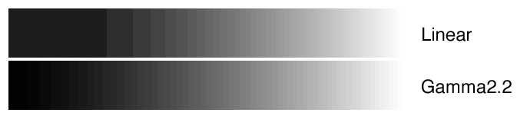
Linearity and gamma
Images are usually gamma encoded
Instead of storing the light intensity x,
they store
to get more precision in dark areas
1/
6 bit encoding for emphasis:

Slide 54
Concretely, gamma encoding
If the camera records an amount of light that is x at a given pixel
What gets stored is encoded as
When displaying an image, the OS or display or driver inverts the mapping
1/

Slide 55
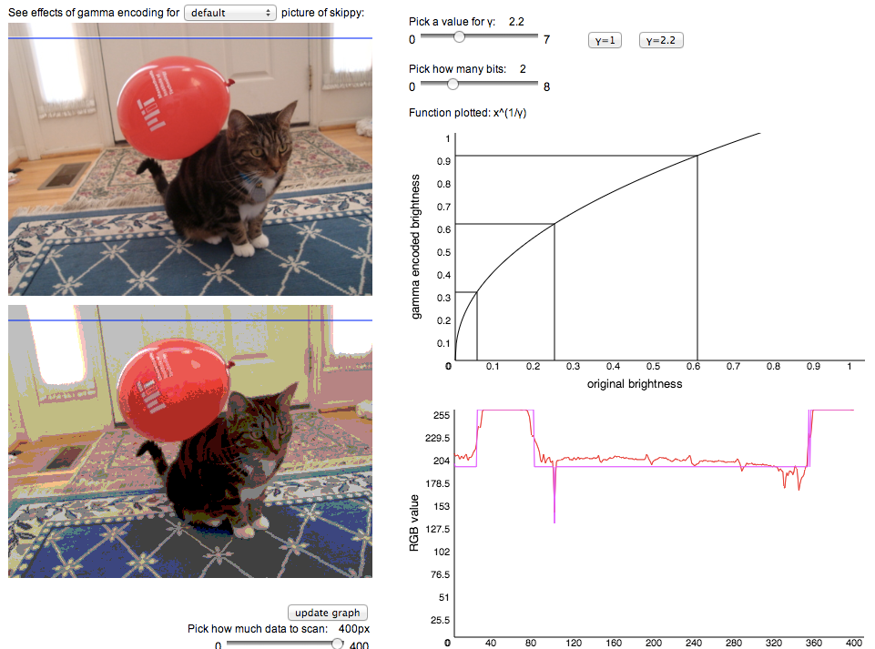
Gamma demo
http://miki3.csail.mit.edu:3000/static/gammavis/
  thank you Lili & Charlotte & Monde

Slide 56
Other motivation: noise
Much image noise has variance proportional to image values (Poisson noise)
Gamma=2 makes signal noise ratio uniform

Slide 57
Linearity and gamma
Half (well, more like 25$) of image processing works better in linear space
  If linearity is important
  e.g. white balance, deblurring, HDR merging
Half (well, 75%) work better in gamma space
  closer to logarithmic scale, uniform noise, uniform treatment over brightness
  e.g. edge detection, corner detection
Sometimes you need log
  when dynamic range is really high
  e.g. tone mapping

Slide 58
In the real world
  e.g. Adobe Lightroom ‘s first processing steps are in linear space, then converts to some gamma space
  Most practitioners (don’t even know images are gamma encoded and) work in gamma encoded space

Slide 59
Gamma in the analog world
Film has gamma
  For both encoding and for compensating for different contrast perception at different brightness levels
Old-style TVs had gamma
  The response of Cathod Ray Tubes (CRT) happens to naturally decode gamma
  (because of the way the electron gun accelerates and focuses electrons, plus the phosphors response)

Slide 60
Take home message
Images are usually gamma-encoded
  gamma 2.2
  provides better quantization
  sometimes good for algorithms
  sometimes bad
    convert to linear values!

Slide 61
How to capture linear images
http://kimojohnson.org/blog/linear.html

Slide 62
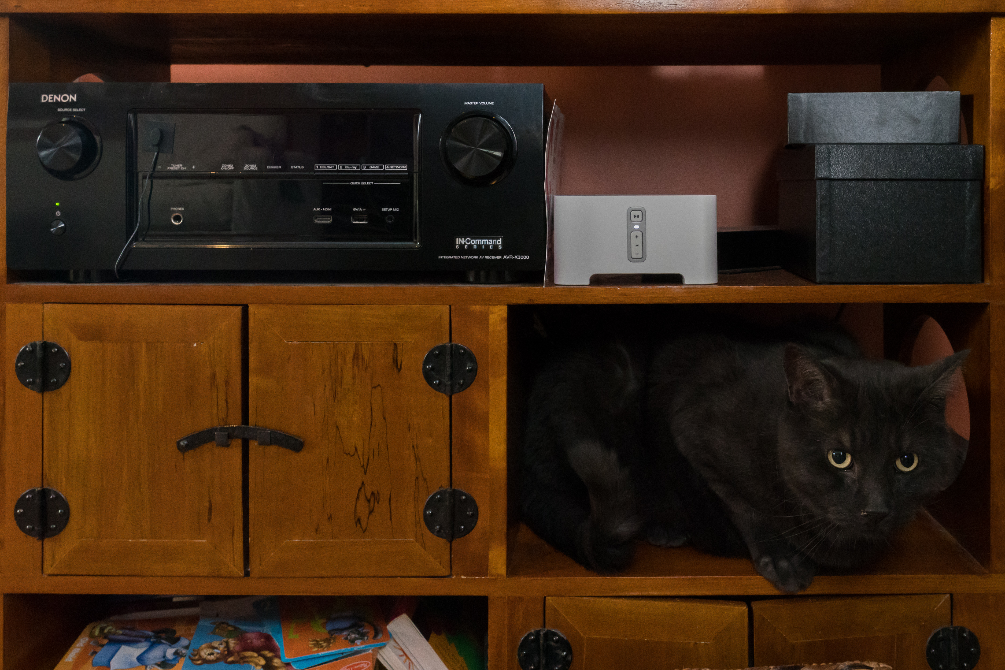
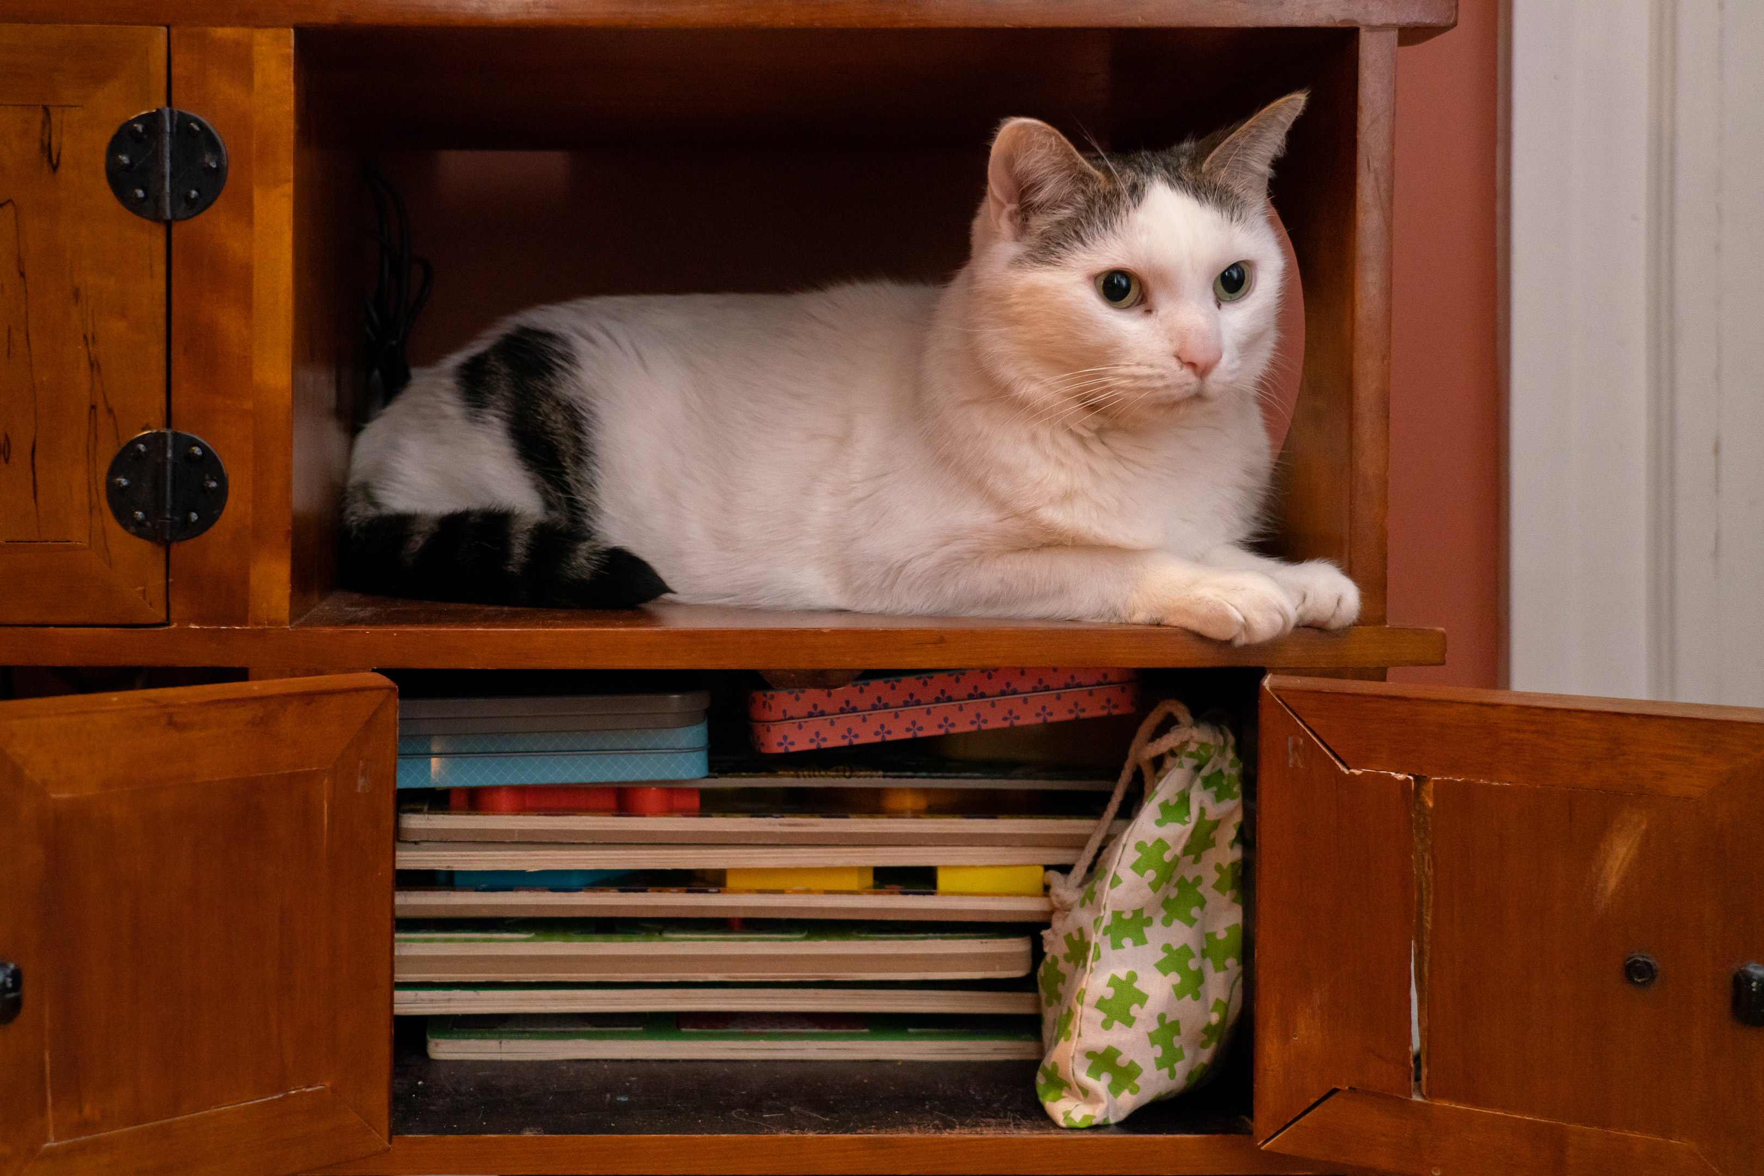
Questions?
Tsessebe
Ouistiti

Slide 63
POINT OPERATION

Slide 64
Point operations
for each pixel : Rout, Gout, Bout=f(Rin, Gin, Bin)
  and f is the same for all pixels
Often discussed for greyscale version:
  Lout=f(Lin)

Slide 65
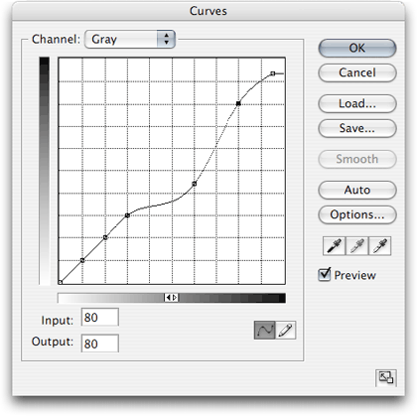
Curves
In many photo editors
output
input

Slide 66
Pset 0 & 1
Exposure change (brightness)
Contrast: change ratios
Luminance chrominance
  ability to change luminance/brightness independent of color
  save pure-color information
    need to respect multiplicative factors

Slide 67
Histograms

Slide 68
Histogram
For each value (e.g. 0-255)
how many pixels have this value?
Cumulative histogram: for each value x, how many pixels have a value smaller than x
#pixels
pixel value
http://en.wikipedia.org/wiki/Histogram_equalization

Slide 69
Very useful on camera
Allows you to tell if you use the dynamic range entirely

Slide 70
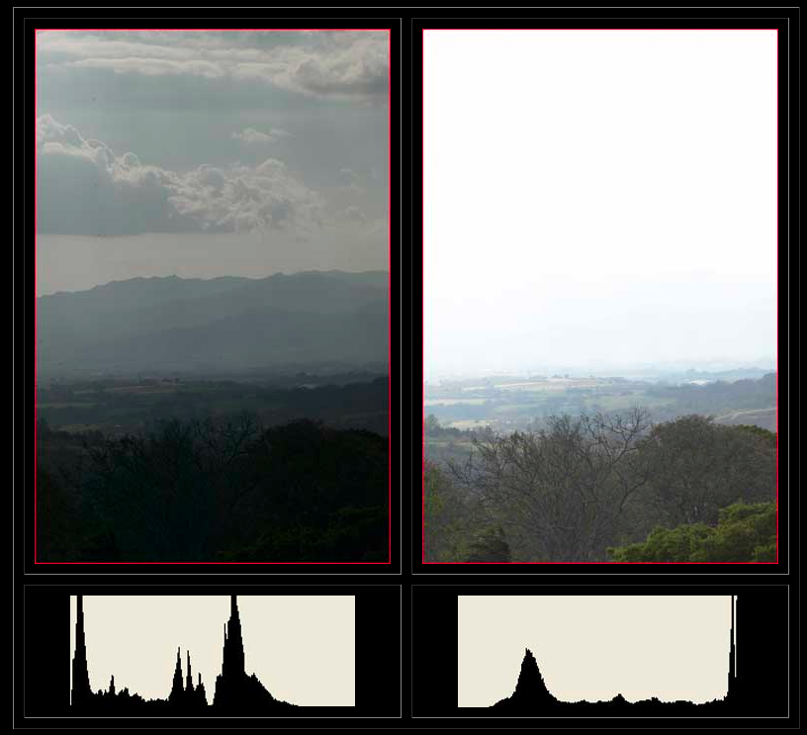
Bad: bright values under-used
(underexposure)
Bad: bright values saturate
(overexposure)
http://www.luminous-landscape.com/tutorials/understanding-series/understanding-histograms.shtml

