Slide 1
Convolution
Fredo Durand
MIT EECS 6.8370/6.871

Slide 2
Do the flip earlier.

Slide 3
Administrivia
PSet 0 has weight 0 (still do it!!)
PSet 1 due next Wednesday
Pset system miki3
  Contact us if you don’t have an account
How is it going?

Slide 4
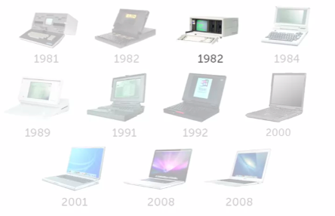
Morphing
http://www.huffingtonpost.com/2015/02/17/evolution-laptop-gif_n_6698160.html?fb_action_ids=10205121595892118&fb_action_types=og.likes

Slide 5
C++ questions/issues?

Slide 6
Color issues

Slide 7
Unrelated but really cool
http://www.petapixel.com/2012/02/15/the-amazing-photo-manipulation-art-of-erik-johansson/

Slide 8
Photo session
Hopefully done

Slide 9
POINT OPERATION

Slide 10
Point operations
for each pixel : Rout, Gout, Bout=f(Rin, Gin, Bin)
  and f is the same for all pixels
Often discussed for greyscale version:
  Lout=f(Lin)

Slide 11
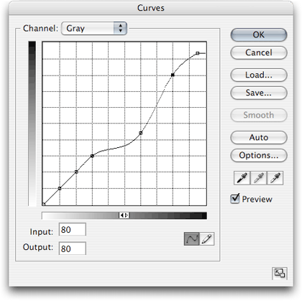
Curves
In many photo editors
output
input

Slide 12
Pset 0 & 1
Exposure change (brightness)
Contrast: change ratios
Luminance chrominance
  ability to change luminance/brightness independent of color
  save pure-color information
    need to respect multiplicative factors

Slide 13
Histograms

Slide 14
Histogram
For each value (e.g. 0-255)
how many pixels have this value?
Cumulative histogram: for each value x, how many pixels have a value smaller than x
#pixels
pixel value
http://en.wikipedia.org/wiki/Histogram_equalization

Slide 15
Very useful on camera
Allows you to tell if you use the dynamic range entirely

Slide 16
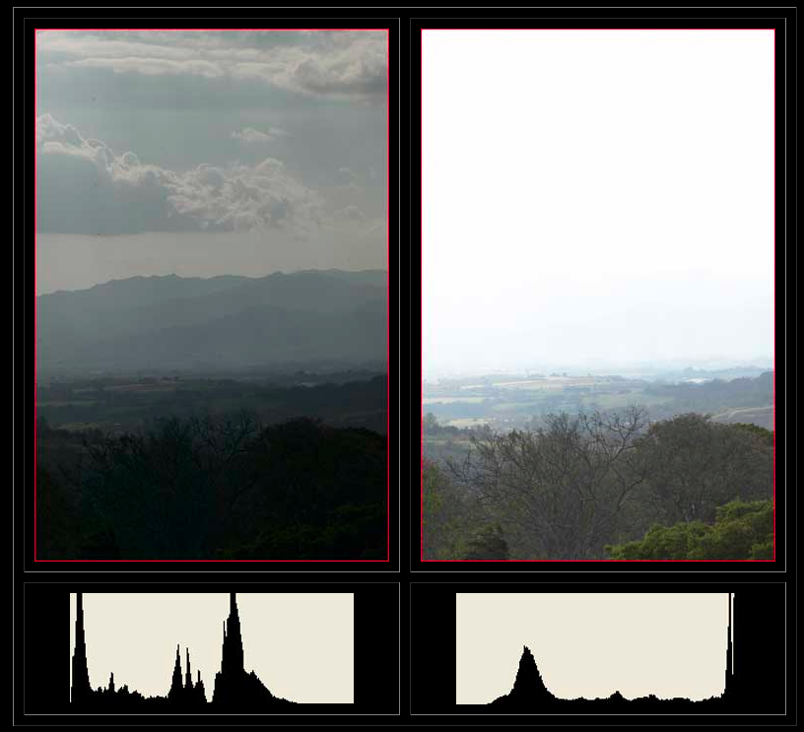
Bad: bright values under-used
(underexposure)
Bad: bright values saturate
(overexposure)
http://www.luminous-landscape.com/tutorials/understanding-series/understanding-histograms.shtml

Slide 17
Blur, sharpen

Slide 18
Image processing motivation
Sharpen images
Downsample images
Fake depth of field
Smooth out noise, skin blemishes
...
We must understand convolution!

Slide 19
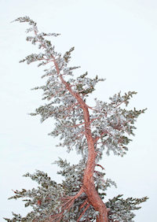
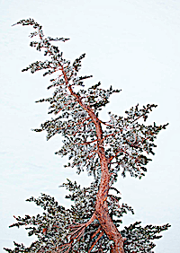

Sharpening

Slide 20
Blur in optics
Diffraction
Lens aberrations
Object movement
Camera shake
Can we remove blur computationally?
  Inverse the blur equation
  deconvolution
  later!

Slide 21
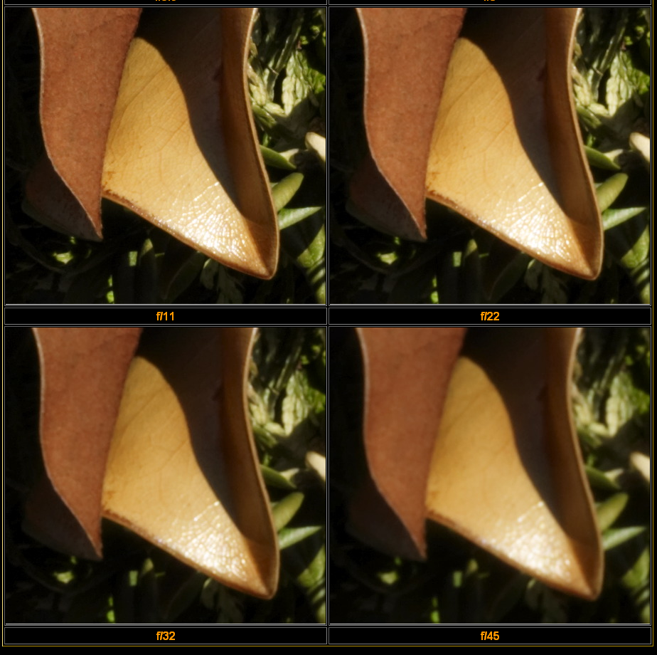
Lens diffraction
http://luminous-landscape.com/tutorials/understanding-series/u-diffraction.shtml
(heavily cropped)
See also http://www.cambridgeincolour.com/tutorials/diffraction-photography.htm

Slide 22
Blur example: spherical aberration
Pixel value: weighted average of local color
object with
color variation
Sensor
lens

Slide 23
Remove optical artifacts
Calibrate lenses and remove blur
e.g. DXO

Slide 24
Simplified model of blur
Blur is the same everywhere in the image
  Shift invariant
For generalizations, see e.g.
  http://www.di.ens.fr/willow/research/deblurring/

Slide 25
C in CNNs

Slide 26
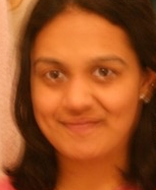
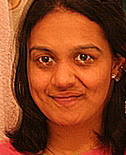
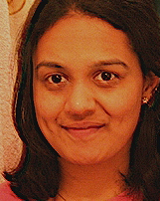
Fergus et al’s algorithm
Original
Naïve Sharpening
Their algorithm
Notes:
Double image in eyes

Slide 27
Questions?

Slide 28
Convolution 101

Slide 29
Blur as convolution
Replace each pixel by a linear combination of its neighbors.
  only depends on relative position of neighbors
The prescription for the linear combination is called the “convolution kernel”.
10
5
3
0
0
0
4
5
1
0
0.5
0
7
1
1
7
0
1
0.5
Local image data
kernel
Modified image data
(shown at one pixel)

Slide 30
Linear shift-invariant filtering
Replace each pixel by a linear combination of its neighbors.
  only depends on relative position of neighbors
The prescription for the linear combination is called the “convolution kernel”.
  same kernel for all pixels
10
5
3
0
0
0
4
5
1
0
0.5
0
7
1
1
7
0
1
0.5
Local image data
kernel
Modified image data
(shown at one pixel)

Slide 31
Example of linear
NON-shift invariant transformation?
e.g. neutral-density graduated filter (darken high y, preserve small y)
J(x,y)=I(x,y)*(1-y/ymax)
Formally, what does linear mean?
  For two scalars a & b and two inputs x & y:
  F(ax+by)=aF(x)+bF(y)
What does shift invariant mean?
  For a translation T:
  F(T(x))=T(F(x))
  If I blur a translated image,
  I get a translated blurred image

Slide 32
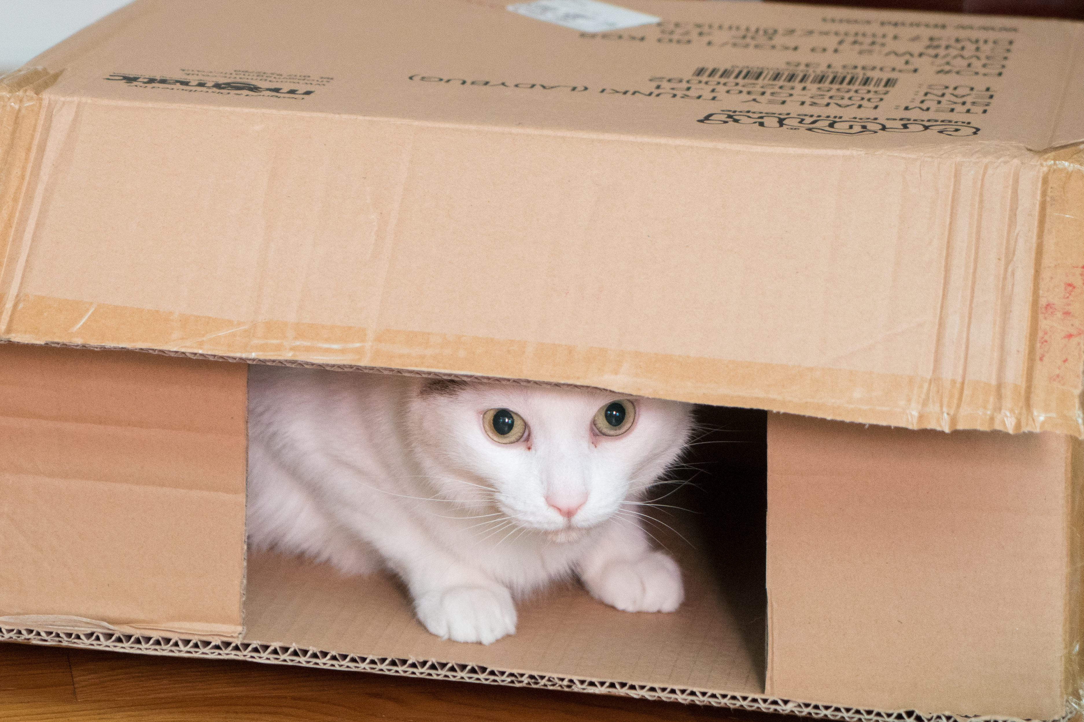
Questions?

Slide 33
Why linearity matters
If blur is a linear operation
We can try to debut by inverting a linear system
We have tools to tell us how doable it may be
  Spoiler alert: not always easy
Side note: makes it important to know if your image is gamma-encoded

Slide 34
Convolution algorithm
Set output image to zero
For x, y in output image
  for x’, y’ in kernel
    out[x, y]+=input[x+x’, y+y’]*kernel[x’, y’]
(this assumes the kernel coordinates are centered)
Yes, there is a “flip” missing
10
5
3
0
0
0
4
5
1
0
0.5
0
7
1
1
7
0
1
0.5
Local image data
kernel
Modified image data
(shown at one pixel)

Slide 35
Questions?
Set output image to zero
For x, y in output image
  for x’, y’ in kernel
    out[x, y]+=input[x+x’, y+y’]*kernel[x’, y’]
  (this assumes the kernel coordinates are centered)
10
5
3
0
0
0
4
5
1
0
0.5
0
7
1
1
7
0
1
0.5
Local image data
kernel
Modified image data
(shown at one pixel)

Slide 36
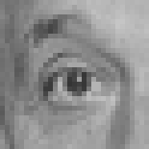
Convolution (warm-up slide)
?
1.0
coefficient
0
Pixel offset
original

Slide 37
Convolution (warm-up slide)
1.0
coefficient
0
Pixel offset
original
Filtered
(no change)

Slide 38

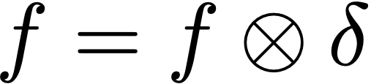
Convolution (warm-up slide)
1.0
coefficient
0
Pixel offset
original
Filtered
(no change)

Slide 39
Convolution
1.0
?
coefficient
0
Pixel offset
original

Slide 40
shift
1.0
coefficient
0
Pixel offset
original
shifted

Slide 41
Convolution
?
coefficient
0.3
0
Pixel offset
original

Slide 42

Blurring
coefficient
0.3
0
Pixel offset
original
Blurred (filter
applied in both dimensions).

Slide 43
Blur examples
8
2.4
impulse
coefficient
0.3
original
0
filtered
Pixel offset

Slide 44
Blur examples
8
2.4
impulse
coefficient
0.3
original
0
filtered
Pixel offset
8
8
edge
4
coefficient
4
0.3
original
0
filtered
Pixel offset

Slide 45
Questions?

Slide 46
Formally

Slide 47
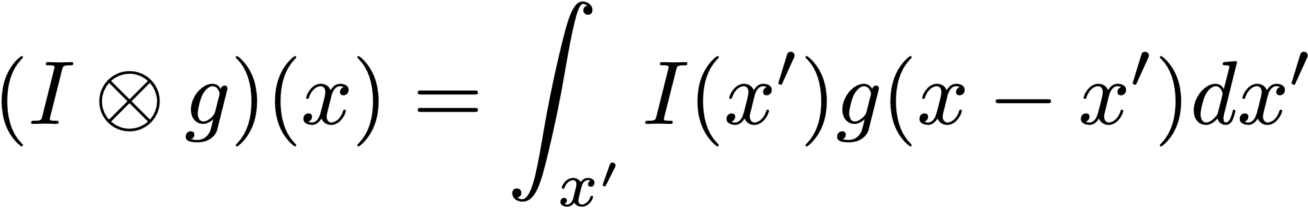


More formally: Convolution
I

Slide 48
Demo
http://math.mit.edu/daimp/ConvFlipDrag.html

Slide 49
Questions?
I

Slide 50
What’s up with flipping?

Slide 51
Simpler flip
f(x-1)
  does it translate to the left or to the right?

Slide 52
Simpler flip
f(x-1)
  translates to the right!
  Because it’s where we’re reading values from, not where values are going to.
  Same phenomenon happens with convolutions.

Slide 53
Point Spread Function
Run convolution on Impulse
1.0
coefficient
original
0
0
Pixel offset

Slide 54
Convolution & probability
Convolution was first used by Laplace to study the probability of the sum of two random variables

Slide 55


Random variables
X
50%
Y
50%
40%
30%
20%
10%
-1
0
1
-1
0
1

Slide 56
Random variables
Probability?
How can X+Y=0?
  X=-1, Y=1
  X=0, Y=0
  X=1, Y=-1
P(X=-1)*P(Y=1)
P(X=0)*P(Y=0)
P(X=1)*P(Y=-1)
X
50%
Y
50%
40%
30%
20%
10%
-1
0
1
-1
0
1

Slide 57
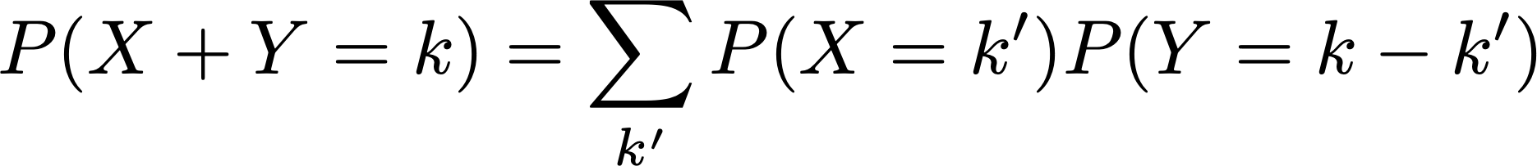
Sum of random variables
X
50%
Y
50%
40%
30%
20%
10%
-1
0
1
-1
0
1

Slide 58
Questions?
X
50%
Y
50%
40%
30%
20%
10%
-1
0
1
-1
0
1

Slide 59

Point Spread Function & flip
-1
0
1
-1
0
1

Slide 60
Point Spread Function & flip
-1
0
1
2
-1
0
1
...
...
...

Slide 61
Point Spread Function & flip
-1
0
1
2
-1
0
1
Remember: it’s always the inverse transform
Forward model: light goes from x to x+x’
Backward model: light at x comes from x-x’

Slide 62
Blur example: spherical aberration
Pixel value: weighted average of local color
object with
color variation
Sensor
lens

Slide 63
Without the flip
Called correlation
Won’t matter most of the time because our kernels are symmetric
  except e.g. derivative

Slide 64
Other differences
Convolution is associative
Convolution is a little nicer in the Fourier domain

Slide 65
Questions?

Slide 66
Impulse response

Slide 67
Impulse response

Slide 68
Normalization

Slide 69
Symmetry

Slide 70
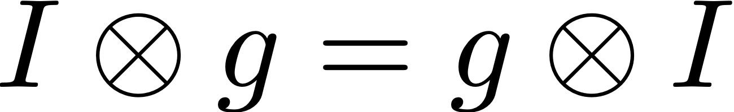
Commutativity

Slide 71
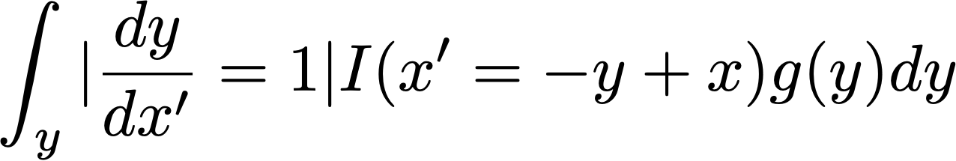
Commutativity
use y=x-x’
It doesn’t matter which one you flip!
Similar to probability situation, as long as the sum is x

Slide 72
Nitty-gritty stuff

Slide 73
Our images aren’t infinite

Slide 74
Our images aren’t infinite
Zero (black) padding
Edge padding
Mirror padding

Slide 75
Edge Padding
  def clipX(im, x): return min(width(im)-1, max(x, 0))
  def clipY(im, y): return min(height(im)-1, max(y, 0)
  def getSafePix(im, y, x):
  return im[clipY(im, y), clipX(im, x)]

Slide 76
Centering the kernel
Our images are defined with 0,0 in the upper left corner
Kernels are usually assumed to be centered in the center

Slide 77
Normalization
As a rule of thumb, you want kernels to be normalized when you want the output to preserve the overall brightness of the image.
But not always (e.g. gradient)

Slide 78
Best input to debug convolution
Impulse

Slide 79
Blur zoo

Slide 80
Demo applet
http://graphics.stanford.edu/courses/cs178/applets/convolution.html

Slide 81
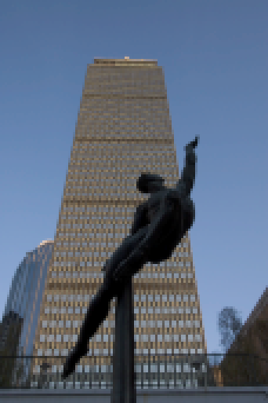
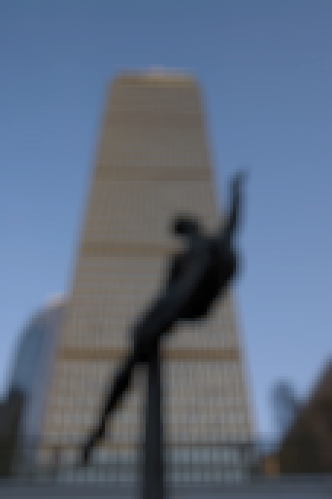


Box filter

Slide 82


Nice and smooth: Gaussian

Slide 83
Gaussian formula
http://en.wikipedia.org/wiki/Gaussian_function

Slide 84
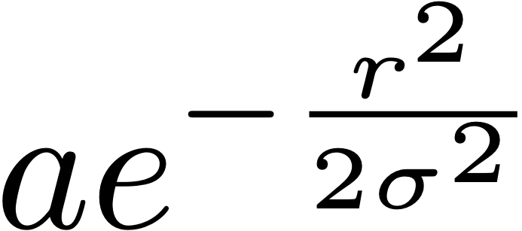
Gaussian formula
http://en.wikipedia.org/wiki/Gaussian_function
r is the distance to the center
a is a normalization constant
  I usually just normalize my kernels after the fact
σ is the standard deviation and controls the width of the Gaussian

Slide 85
Gaussian formula
http://en.wikipedia.org/wiki/Gaussian_function
Gaussians have an infinite support
  >0 everywhere
But are often truncated
  I recommend 3σ

Slide 86
Truncation
For computational tractability/efficiency
consider Gaussian is zero beyond 3sigma

Slide 87

Questions?

Slide 88
Sharpening

Slide 89
How can we sharpen?
Blurring was easy
Sharpening is not as obvious

Slide 90
How can we sharpen?
Blurring was easy
Sharpening is not as obvious
Idea: amplify the non-blurring part of an image
out = input +k*(input-blur(input))

Slide 91
im=imread('tree.png'); imwrite(im, 's-in.png')
blur=a3.gaussianBlur(im, 2); imwrite(blur, 's-blur.png')
high=im-blur; imwrite(high, 's-high.png')
for k in numpy.arange(0, 2.0, 0.25): imwrite(im+k*high, 's-sharpened'+str(int(k*10))+'.png')
You can overdo it (which I did)

Slide 92
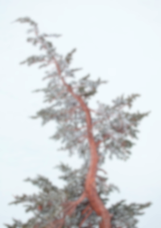
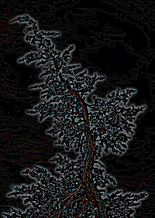
Sharpening
Input
blurred
-
=
High pass
Input
High pass
Sharpened image
+k*
=

Slide 93
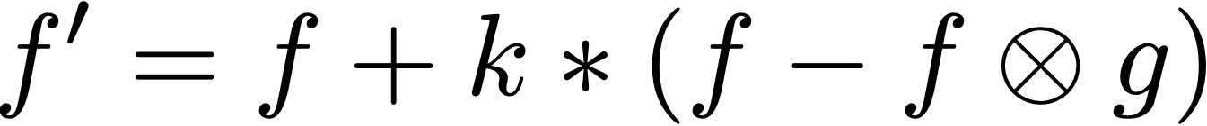
Sharpening: kernel view
Recall
f is the input
f’ is a sharpened image,
g is a blurring kernel
k is a scalar controlling the strength of sharpening

Slide 94

Sharpening: kernel view
Recall
Denote the Dirac kernel (pure impulse)
Notes:
f'=f + k*(f - f\otimes g)

Slide 95
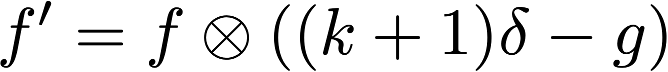
Sharpening: kernel view
Recall
Sharpening is also a convolution
k
Notes:
f'=f + k*(f - f\otimes g)

Slide 96
Sharpening kernel
Note: many other kernels exist
(just like we saw multiple blurring kernels)
blue: positive
red: negative

Slide 97
Intuition
Amplify the difference between a pixel and its neighbors
blue: positive
red: negative

Slide 98
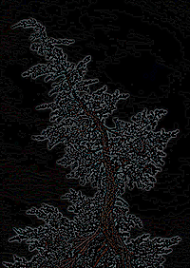
Questions?
-
=
+k*
=

Slide 99
(remember blurring)
coefficient
0.3
0
Pixel offset
original
Blurred (filter
applied in both dimensions).

Slide 100
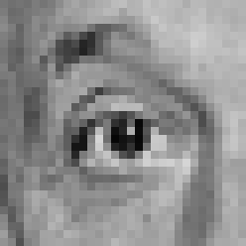
Sharpening
2.0
0.33
0
0
Sharpened original
original

Slide 101
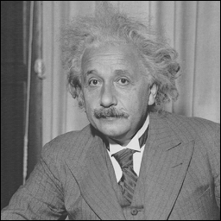
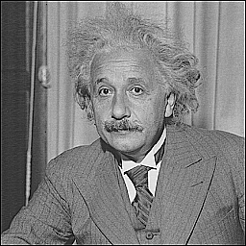
Sharpening
before
after

Slide 102
Unsharp Mask

Slide 103
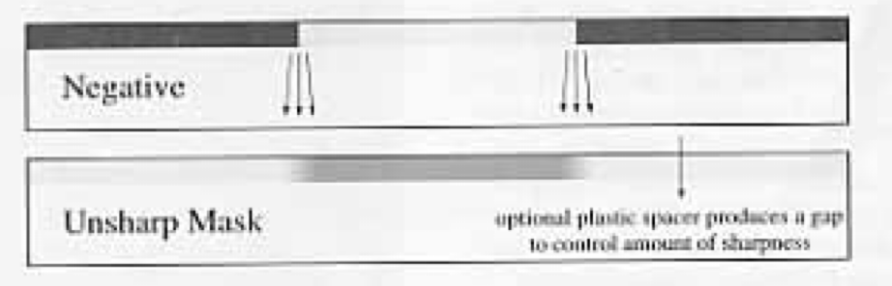
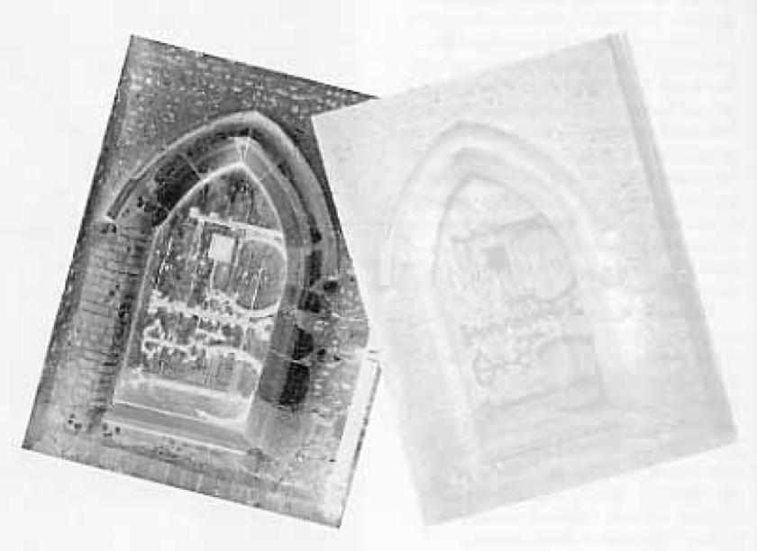
Unsharp mask
Sharpening is often called “unsharp mask” because photographers used to sandwich a negative with a blurry positive film in order to sharpen
http://www.tech-diy.com/UnsharpMasks.htm

Slide 104
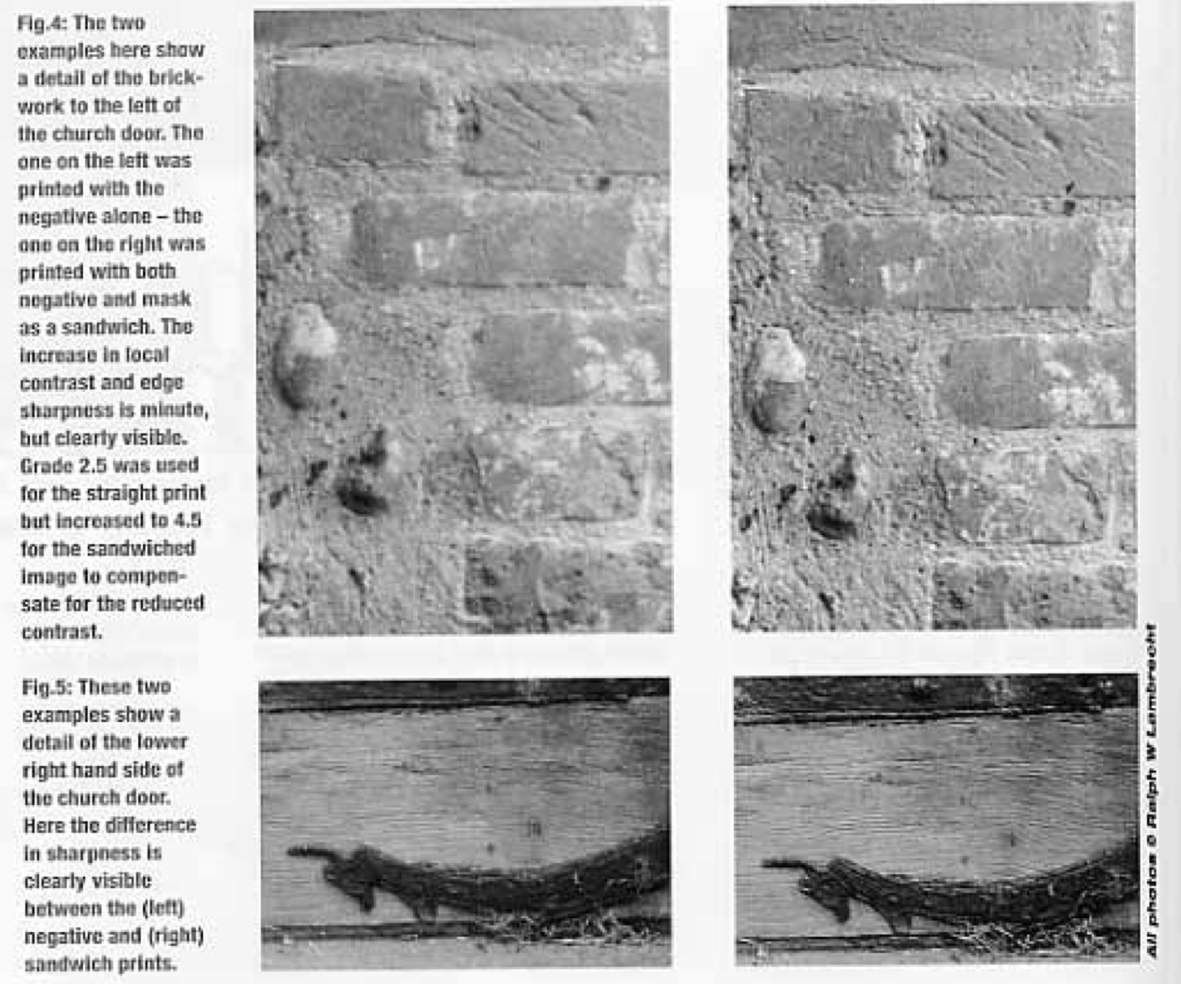
http://www.tech-diy.com/images/unsharp2.jpg

Slide 105
Unsharp mask
http://en.wikipedia.org/wiki/Unsharp_masking
http://www.largeformatphotography.info/unsharp/
http://www.tech-diy.com/UnsharpMasks.htm
http://www.cambridgeincolour.com/tutorials/unsharp-mask.htm

Slide 106
Fourier motivation

Slide 107
Studying convolutions
Convolution is complicated
  and hard to inverse
But at least it’s linear
(f+kg)­ h = f­h +k (g­h)
We want to find a better expression
  Let’s study functions whose behavior is simple under convolution

Slide 108
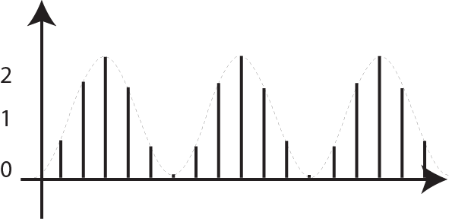


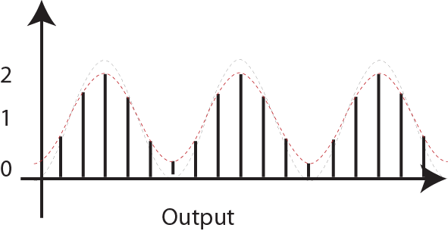
Blurring: convolution
Convolution
sign
Input
Kernel
Same shape, just reduced contrast!!!
This is an eigenvector
(output is the input multiplied by a constant)

Slide 109
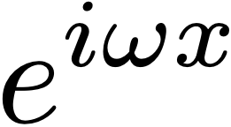

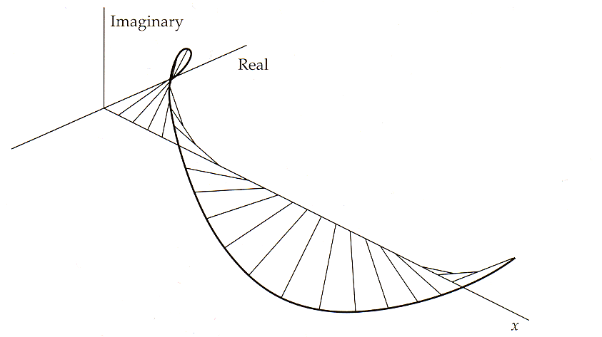
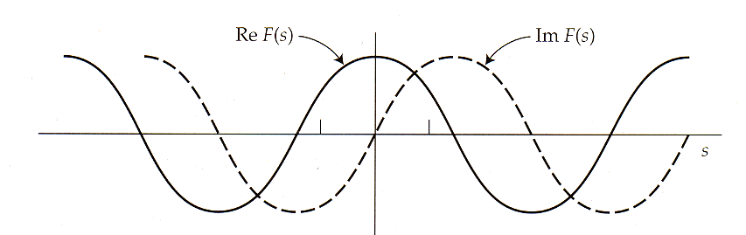
Eigenvectors
More precisely, the eigenvectors are
aka

Slide 110
Big Motivation for Fourier analysis
Sine waves are eigenvectors of the convolution operator

Slide 111
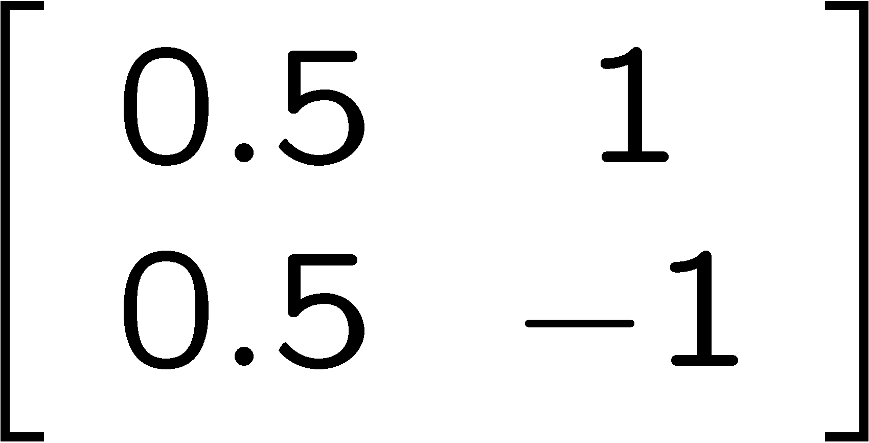
Fourier as change of basis
Shuffle the data to reveal other information
E.g., take average & difference: matrix
Basis
function 1
Basis
function 1
Basis
function 2
3
3
2
2
1
1
0
0
Basis
function 2
Geometric
interpretation
Signal
After rotation
Pseudo-
Fourier

Slide 112
Fourier as change of basis
Same thing with infinite-dimensional vectors
Basis
function 1
Basis
function 1
Basis
function 2
Basis
function 2
Geometric
interpretation
Signal
After rotation
Pseudo-
Fourier

Slide 113
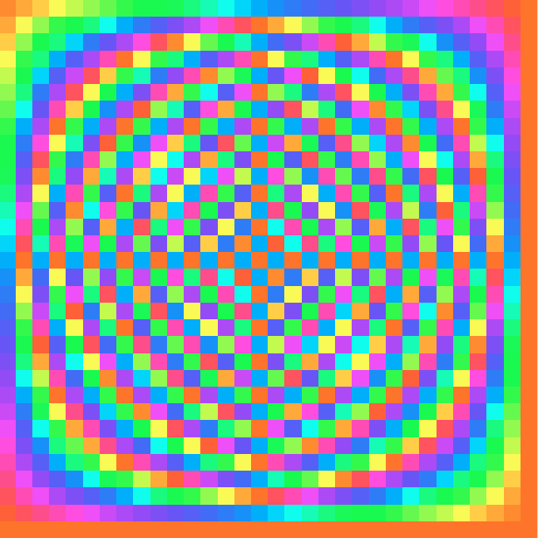
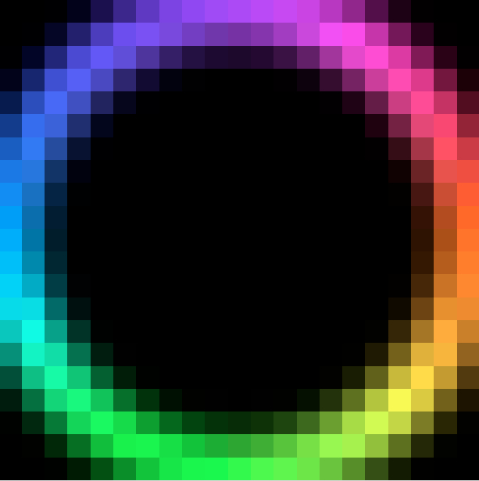
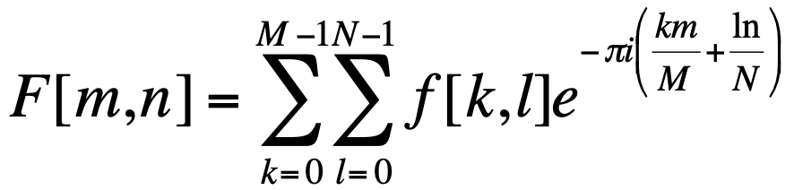
Fourier transform visualization
imaginary
j
real
1
color key
Fourier transform matrix
input signal
Slide: Bill Freeman

Slide 114
Question?

Slide 115
Sharpening++

Slide 116


Problem with excess
Haloes around strong edges

Slide 117
oversharpening
1.7
11.2
8
8
coefficient
-0.25
-0.3
original
Sharpened
(differences are
accentuated; constant
areas are left untouched).

Slide 118
Bells and whistles
Apply mostly on luminance
Old Clarity in Adobe Camera Raw
  As far as I understand, apply only for mid-tones
  Avoids haloes around black and white points
Only apply at edges
  To avoid the amplification of noise
Sharpening chrominance as well
  But with very large blur

Slide 119
Lightroom demo

Slide 120
Cost

Slide 121
Convolution cost?
Set output image to zero
For y, x in output image
  for y’, x’ in kernel
    out[y, x]+=input[y+y’, x+x’]*kernel[y’, x’]
Cost?
    input.width * input.height * kernel.width * kernel.height

Slide 122
Separable filters

Slide 123
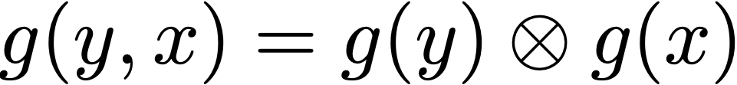
Separability
The kernel can be decomposed into the convolution of a horizontal and a vertical filter.
Example: box
  g’(x)= if (-k < x < k) , 0 otherwise
  (separability doesn’t require the two 1D kernels to be the same, but it’s the case here)
=

Slide 124

Separable blur
First blur horizontally using g(x)
Then blur vertically using g(y)

Slide 125
Separable Convolution cost?
For y, x in output image
  for y’, x’ in kernel
    out[y, x]+=input[y+y’, x+x’]*kernel[y’, x’]
Horizontal cost?
Vertical cost?
Total
    input.width * input.height * kernel.width
    input.width * input.height * kernel.height
    input.width * input.height *( kernel.height+kernel.width)
    instead of
    input.width * input.height *( kernel.height*kernel.width)

Slide 126
Good news
Gaussians are separable too
See Pset 3!

Slide 127
Oriented filters

Slide 128




Gradient: finite difference
horizontal gradient [[-1, 1]]
vertical gradient: [[-1], [1]]
Horizontal gradient
Gradient magnitude
Vertical gradient

Slide 129
Gradient: finite difference
horizontal gradient [[-1, 1]]
vertical gradient: [[-1], [1]]

Slide 130
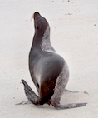
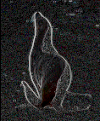
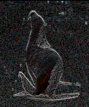
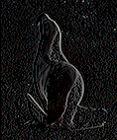
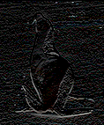
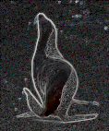
Gradient: finite difference
horizontal gradient [[-1, 1]]
vertical gradient: [[-1], [1]]
Horizontal gradient
(absolute value)
Vertical gradient
(absolute value)
Gradient magnitude

Slide 131
Gradient
e.g. Sobel
  http://en.wikipedia.org/wiki/Sobel_operator
Horizontal gradient
Vertical gradient
Magnitude

Slide 132












Oriented filters
Gabor filters at different
scales and spatial frequencies
top row shows anti-symmetric
(or odd) filters, bottom row the
symmetric (or even) filters.
Notes:
Gabor filters are just another way to generate spots and bars.

Slide 133
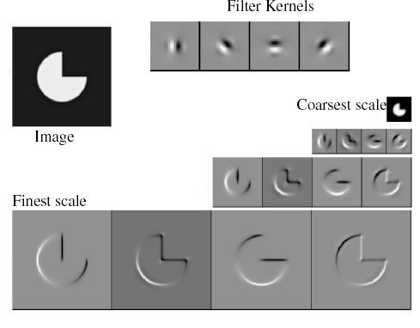
Filtered images
Reprinted from “Shiftable MultiScale Transforms,” by Simoncelli et al., IEEE Transactions
on Information Theory, 1992, copyright 1992, IEEE

Slide 134
Stopped here in lecture.

Slide 135
Properties of convolution

Slide 136
Shift invariant
Color issues

Slide 137
Bilinear, symmetric

Slide 138
Iterated Gaussian filtering

Slide 139
Iterated filtering

Slide 140
Matrix perspective

Slide 141
Correlation vs. convolution

Slide 142
Float vs. int

Slide 143
Normalize

Slide 144
Performance

Slide 145
Normalize

Slide 146
Fast convolution with FFT
Convolution cost in primal: O(K²N²)
  where K is the width of kernel and N the width of image
Convolution cost in Fourier: O(N²)
  because it is diagonal (simple multiplication)
This suggests it might be valuable to perform convolution in the Fourier domain using an FFT
  But we need to take into account the FFT’s cost

Slide 147
Convolution with FFT
Perform Fourier transform of image & kernel
Multiply Fourier coefficients
Perform inverse Fourier transform of result

Slide 148
Convolution in primal versus FFT
2-d FFT: O(N²logN)
  where N is number of pixels on a side
Convolution: K² N²
  where K² is number of samples in kernel
Say N=2¹⁰, K²=100.
FFT~ 3x20 2²⁰, while convolution ~ 100 2²⁰
Rule of thumb: if kernel is smaller than 10-20 pixels, FFT is not worth the extra headache
  But good for larger kernels

Slide 149
Recall: Words of wisdom
Careful with the FFT:
it assumes a cyclic signal
Oftentimes, the answer you get mostly shows wraparound artifacts
For convolution: various options such as mirroring the image or duplicating the boundary values
For analysis: Proper windowing is needed
  e.g. multiply function by a smooth function that falls off away from the center so that the boundary is zero

Slide 150
Fast recursive box filter

Slide 151
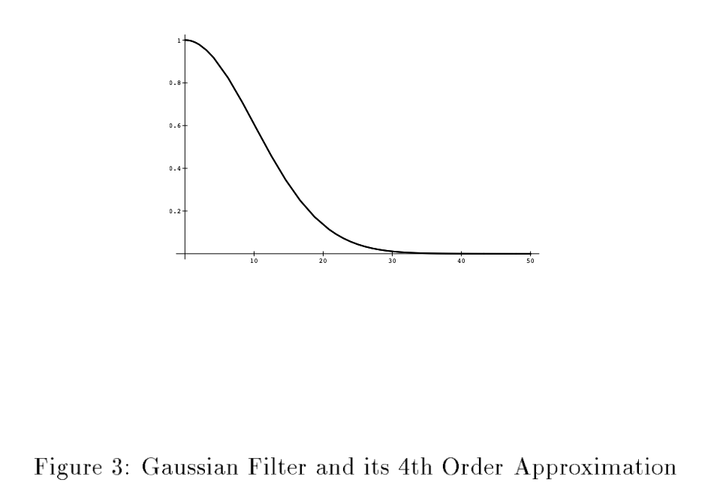
Other acceleration
Recursive filters
  http://citeseerx.ist.psu.edu/viewdoc/summary?doi=10.1.1.35.5904
  Recursively Implementing the Gaussian and its Derivatives (1993), by Rachid Deriche

Slide 152
Reconstruction as convolution

Slide 153
Downsampling

Slide 154
Deblurring

Slide 155
References
http://www.youtube.com/watch?v=IW4Reburjpc
http://en.wikipedia.org/wiki/Convolution
http://math.mit.edu/daimp/ConvFlipDrag.html
http://www.jhu.edu/signals/lecture1/frames.html
http://graphics.stanford.edu/courses/cs178/applets/convolution.html

