Slide 1
http://www.petapixel.com/2012/04/17/advanced-camera-sensor-technologies-explained-with-beer/
http://image-sensors-world.blogspot.com/2012/03/sensors-and-beer.html

Slide 2
Noise and denoising
http://www.cambridgeincolour.com/tutorials/image-noise.htm
Fredo Durand
MIT EECS 6.8370/6.8371

Slide 3
Found on the web, random
http://www.petapixel.com/2012/02/16/how-before-and-after-photos-are-often-faked-using-trickery-and-photoshop/

Slide 4
Resampling discussion

Slide 5
How was the pset?

Slide 6
Bicubic
motion retiming
video stabilization
perspective correction
view synthesis (photosynth)
Dynamic time warping

Slide 7
Bicubic Resampling

Slide 8
Misc.

Slide 9
Show noise, multiple images
Convergence of denoising
Types of noise, image pipeline
denoising by averaging
  alignment
Denoising by spatial averaging
Bilateral filtering

Slide 10
Pset 1
Due Wednesday 9pm
Actually counts
PSet partners: https://psetpartners.mit.edu/

Slide 11
This is not over sharpening

Slide 12
Noise

Slide 13
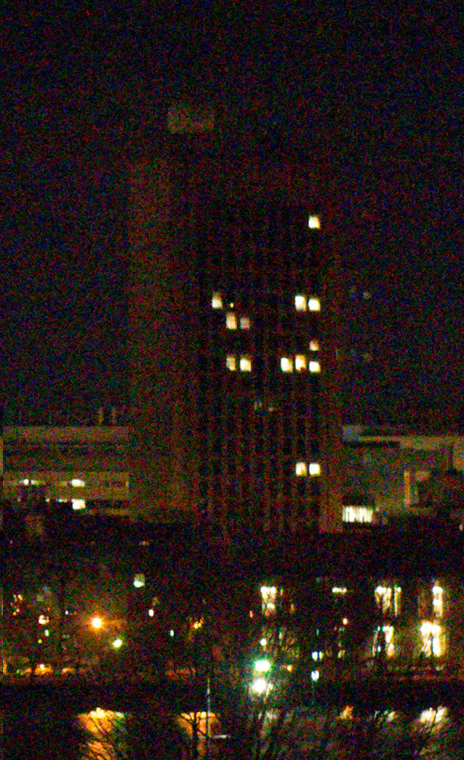
Noisy image
Usually for dark conditions

Slide 14
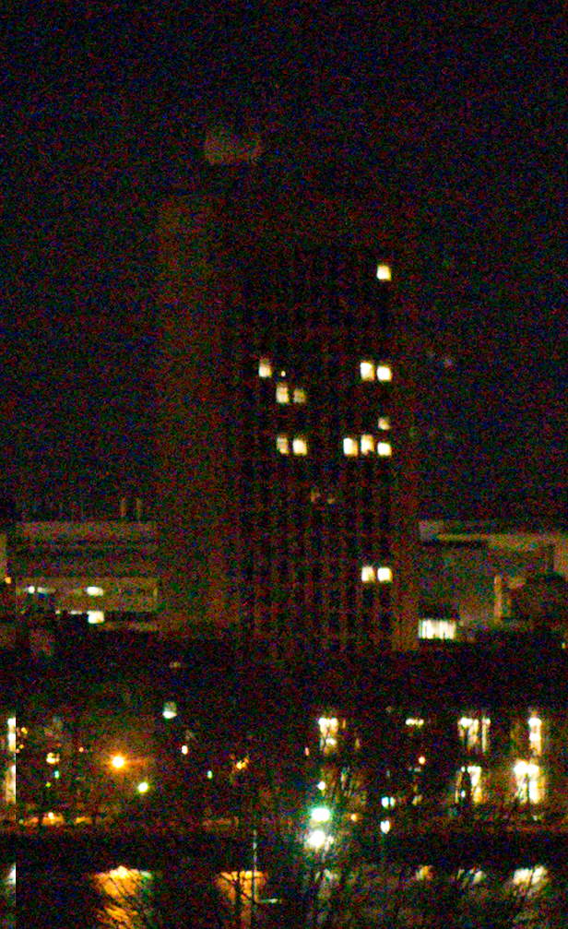
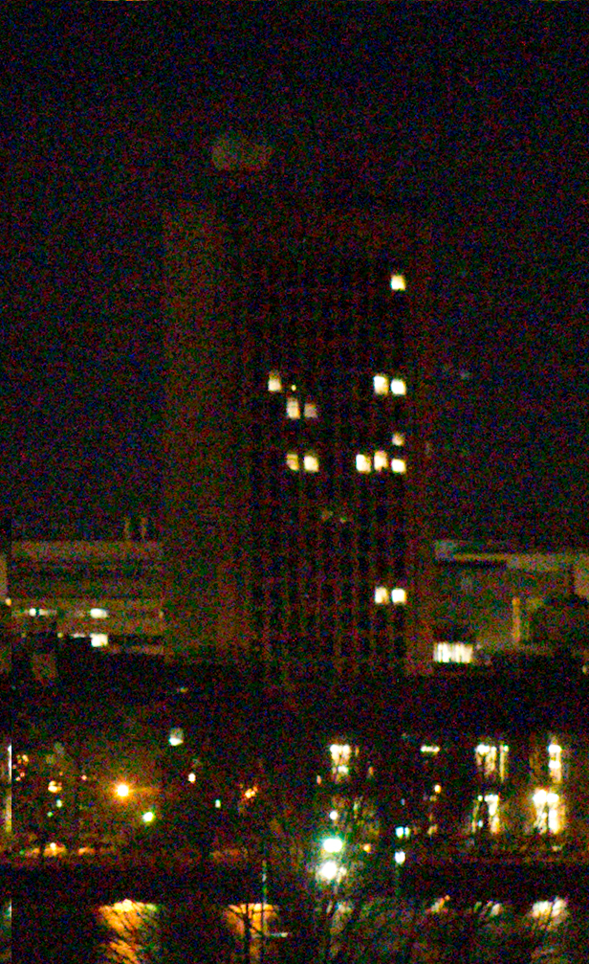
Noise
Fluctuation when taking multiple shots

Slide 15
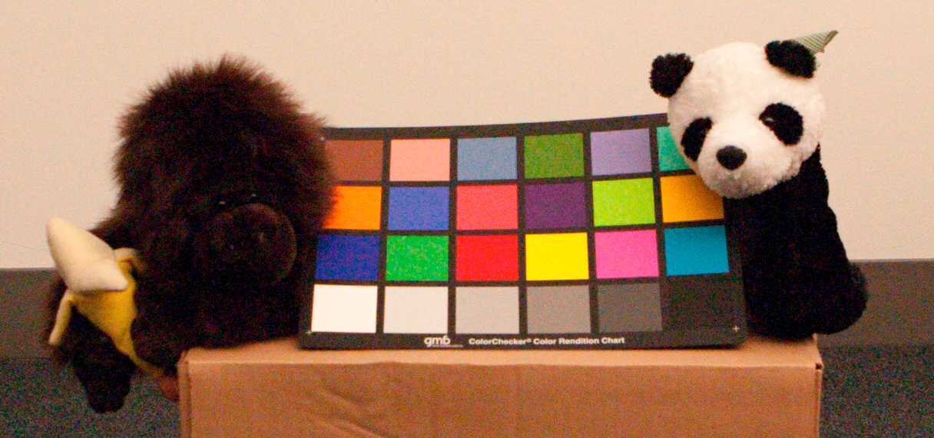
Canon 1D mark IIN at ISO 3200

Slide 16

Histogram of grey patch
Should be single values for RGB (constant color)

Slide 17
Recap
Noise exists
Noise can be observed:
  fluctuation over time
  fluctuation over space when should be constant
Noise is annoying

Slide 18
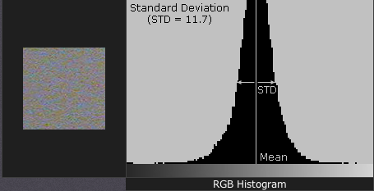
Grey patch
Should have a constant pixel value
Noise causes a fatter histogram
http://www.cambridgeincolour.com/tutorials/image-noise-2.htm

Slide 19
Scanline

Slide 20
Denoising by averaging

Slide 21
Averaging
mean=constantIm(height, width, [0, 0, 0])
for i in imageList:
mean+=imSeq[i]
mean/=len(imageList)

Slide 22
1 image

Slide 23
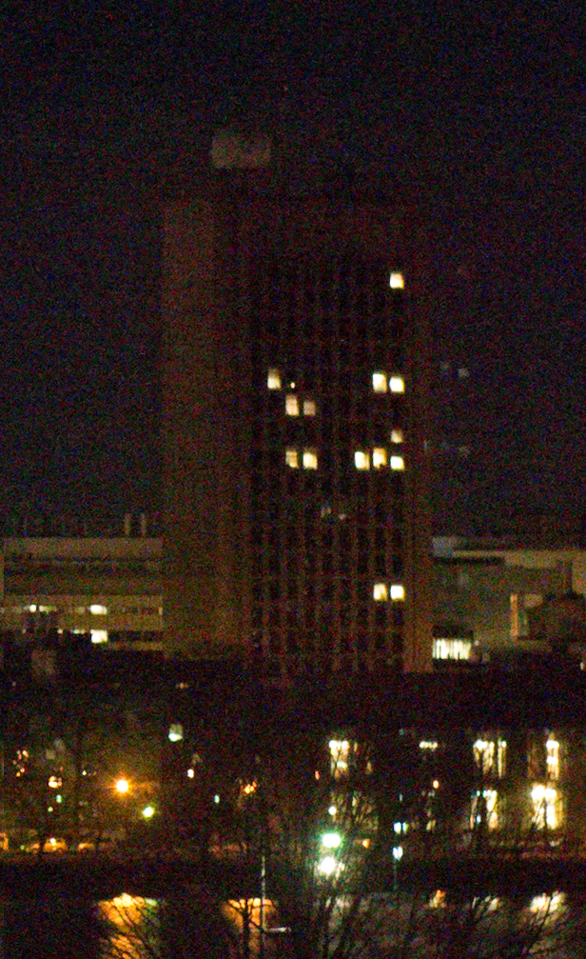
3 images

Slide 24
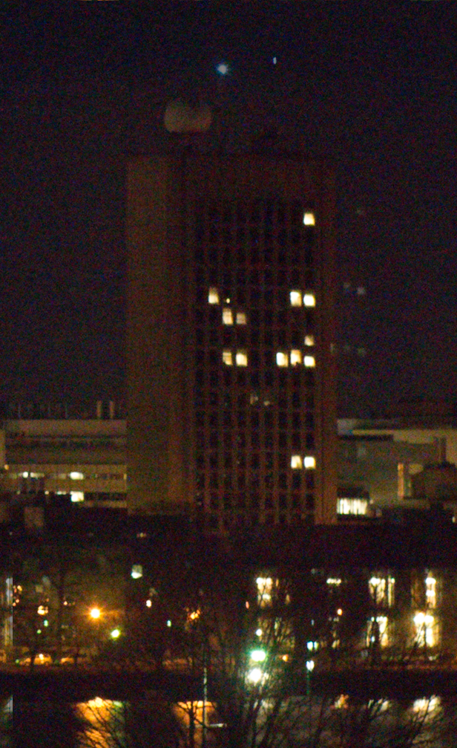
5 images

Slide 25
Statistical/probabilistic perspective

Slide 26
Noise statistics / probability
Denote pixel values like random variables X
Poll about basic definitions

Slide 27
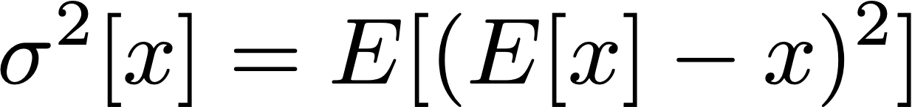
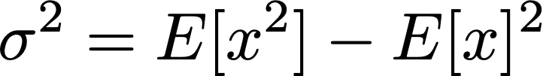

Noise statistics / probability
Denote pixel values like random variables X
Mean: E[x], the true measurement
Variance = ~ average squared error
  more precisely: average squared difference to mean
Standard deviation : square root of variance
  In same unit as measurement

Slide 28
Estimating the variance
Notes:
\mu_N=\frac{1}{N}\sum x_i

Slide 29
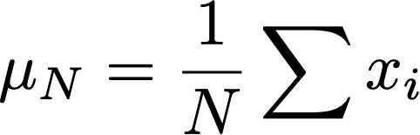
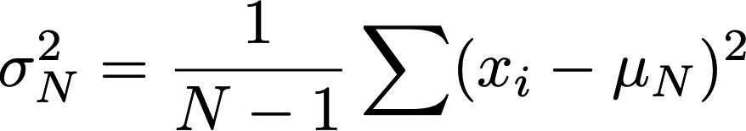
Estimating the variance
Notes:
\mu_N=\frac{1}{N}\sum x_i

Slide 30
Estimating the variance
Divide by N-1, not by N
  called Bessel correction: Removes bias
    Otherwise,
    variance would be underestimated on average
    Intuition: we use the same samples for estimating the mean and variance, introduces correlation that underestimate variance
  e.g. http://en.wikipedia.org/wiki/Unbiased_estimation_of_standard_deviation
Notes:
\mu_N=\frac{1}{N}\sum x_i

Slide 31
Example with coin flip, N=2
We do 2 coin flips
Try to estimate mean & variance
Sometimes will be wrong
  e.g. if we get 0 twice, we’ll think variance is zero
  but we’d like to be right on average
    called unbiased

Slide 32
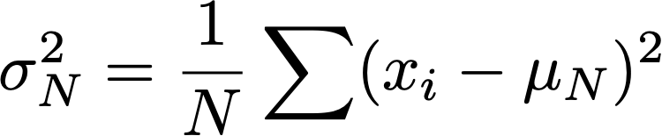
Example with coin flip, N=2
4 scenarios: (0,0) ; (0, 1) ; (1, 0) ; (1, 1)
=> mean estimates: 0 ; 0.5 ; 0.5 ; 1
  average of the mean estimations: 0.5, equal to true mean, estimator is unbiased
true variance: 0.25
sum square difference to mean: 0; 0.5; 0.5; 0
estimator 0, 0.25, 0.25, 0
  0.125 on average, biased
estimator 0, 0.5, 0.5, 0
  0.25 on average, unbiased

Slide 33
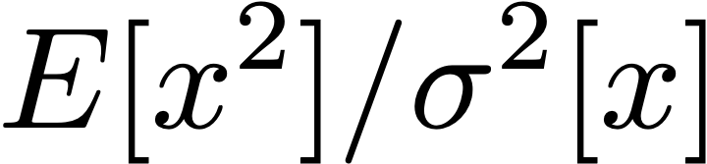
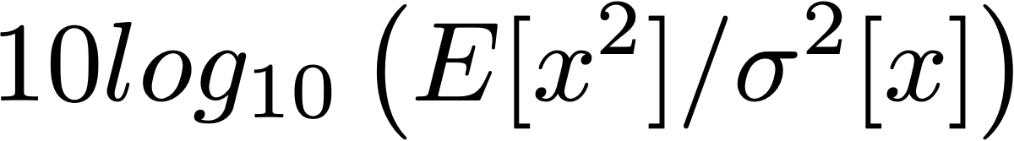
SNR
Signal noise ratio
Often shown as log, in db:
For calibration, 30db is a good PSNR

Slide 34

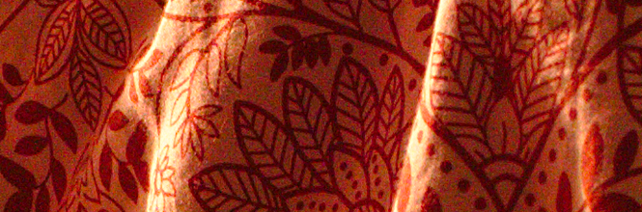
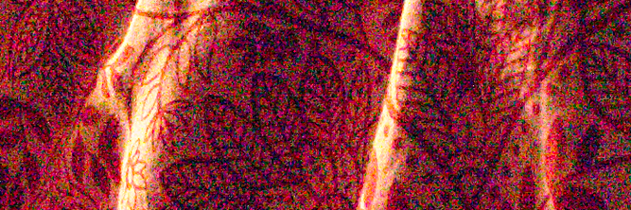
PSNR
in terms of the max value of the signal/sensor
PSNR=29.4477 db
PSNR=25.8187 db
PSNR=17.1598db
http://www.darktable.org/2012/12/profiling-sensor-and-photon-noise/

Slide 35
SNR in practice
Careful, sometimes variance is zero (for no good reason) and will break things.
  practical hack: take the max of sigma^2 and a small number, e.g. 1e-6

Slide 36
Questions

Slide 37
Basic probability tools

Slide 38
Goal
Analyze how mean and variance evolve when we denoise by averaging multiple frames
Formula for average:

Slide 39
Expected value
E[kx]=
E[x+y]=
E[xy]=
Notes:
E[xy]=\int_y \int_x xy p(x,y) dx dy

Slide 40
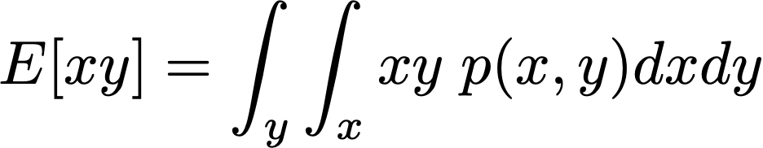
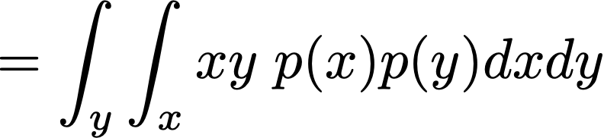
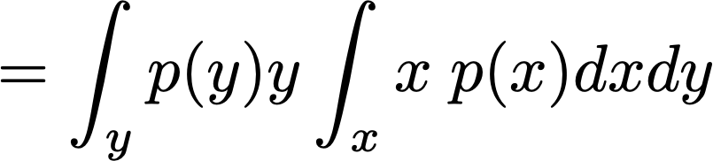
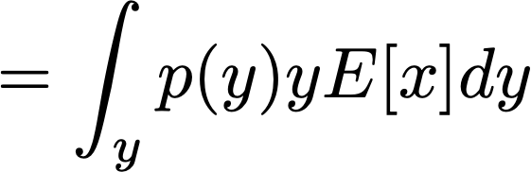

Expected value
E[kx]=kE[x]
E[x+y]=E[x]+E[y]
E[xy]=E[x]E[y] when they are uncorrelated
Notes:
E[xy]=\int_y \int_x xy p(x,y) dx dy

Slide 41
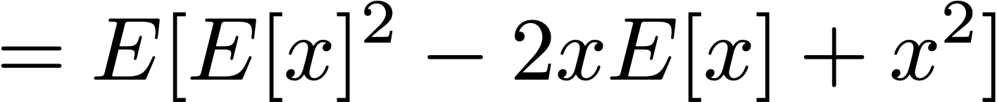
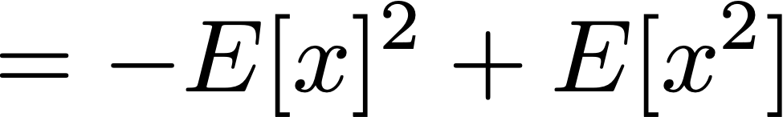
Variance identity
Notes:
\sigma^2[x]=E[(E[x]-x)^2]

Slide 42
Variance identity
Notes:
\sigma^2[x]=E[(E[x]-x)^2]

Slide 43
Variance properties
Multiplication by k:
Addition of two random variables
Notes:
\sigma^2[kx]=E[(kx)^2]-E[kx]^2 = k^2 \sigma^2[x]
\sigma^2[x+y]=E[(x+y)]^2 -E[x+y]^2
=E[x^2]+E[y^2]+E[2xy]- E[x]^2-E[y]^2 -2E[x]E[y]

Slide 44

Variance properties
Multiplication by k:
Addition of two random variables
uncorrelated:
E[xy]=E[x]E[y]
Notes:
\sigma^2[kx]=E[(kx)^2]-E[kx]^2 = k^2 \sigma^2[x]
\sigma^2[x+y]=E[(x+y)]^2 -E[x+y]^2
=E[x^2]+E[y^2]+E[2xy]- E[x]^2-E[y]^2 -2E[x]E[y]

Slide 45
Take home message
Noise/measurement as random variable
Mean, variance, standard deviation
Variance:
  multiplication by k => k²
  addition => addition
SNR, log of SNR

Slide 46
Convergence

Slide 47
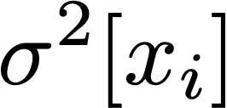
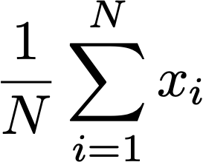
Convergence of averaging
Assume images are IID random measurements
variance for one pixel i:
Average:
What is the variance of the average?
  i.e. how fast does it converge wrt N
  As often: more human-readable value is stddev but derivation is easier with variance
Notes:
=\left(\frac{1}{N}\right)^2 \sum_{i=1}^N \sigma^2[x_i]

Slide 48
Preliminary: Variance identity
Notes:
\sigma^2[x]=E[(E[x]-x)^2]

Slide 49
Variance identity
Notes:
\sigma^2[x]=E[(E[x]-x)^2]

Slide 50
Variance properties
Multiplication by k:
Addition of two independent random variables
Notes:
\sigma^2[kx]=E[(kx)^2]-E[kx]^2 = k^2 \sigma^2[x]
\sigma^2[x+y]=E[(x+y)]^2 -E[x+y]^2
=E[x^2]+E[y^2]+E[2xy]- E[x]^2-E[y]^2 -2E[x]E[y]

Slide 51
Variance properties
Multiplication by k:
Addition of two independent random variables
uncorrelated:
E[xy]=E[x]E[y]
Notes:
\sigma^2[kx]=E[(kx)^2]-E[kx]^2 = k^2 \sigma^2[x]
\sigma^2[x+y]=E[(x+y)]^2 -E[x+y]^2
=E[x^2]+E[y^2]+E[2xy]- E[x]^2-E[y]^2 -2E[x]E[y]

Slide 52
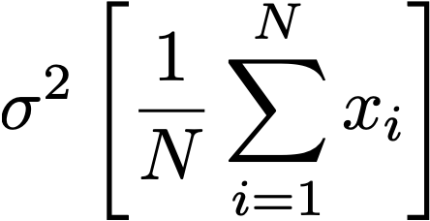
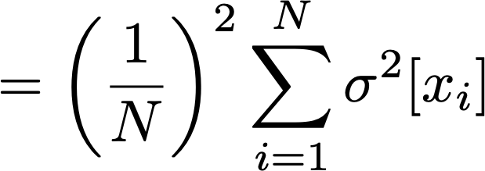
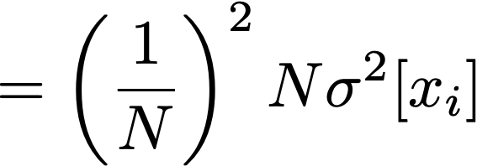

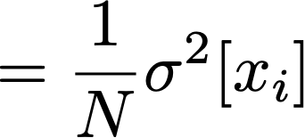
Convergence
Assume images are IID random measurements
variance for one image:
Average:
Notes:
=\left(\frac{1}{N}\right)^2 \sum_{i=1}^N \sigma^2[x_i]

Slide 53
IMPORTANT RESULT
Denoising by averaging:
  variance is reduced as 1/N
  “error” (in stddev) is reduced by sqrt(N)

Slide 54
Questions?

Slide 55
Alignment

Slide 56
Brute force
Pset 4!
Try all possible shifts within /- maxOffset
Keep the one with minimum sum of square differences

Slide 57
Casio EXF1, Google HDR+, etc.
Can do denoising by aligning and averaging N images
HDR+, Nightsight
E.g. https://ai.googleblog.com/2014/10/hdr-low-light-and-high-dynamic-range.html
https://ai.googleblog.com/2018/11/night-sight-seeing-in-dark-on-pixel.html

Slide 58
Denoising from a single image

Slide 59
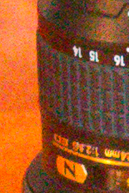
Denoising from 1 image
We can’t take average over multiple images
Noisy input

Slide 60
Denoising from 1 image
We can’t take average over multiple images
Very vast topics
Lots of approaches
Most practically used:
  pyramid-based
  Bilateral-filter adjacent
In research
  Patch similarity (BM3D)
  Deep learning
Noisy input

Slide 61
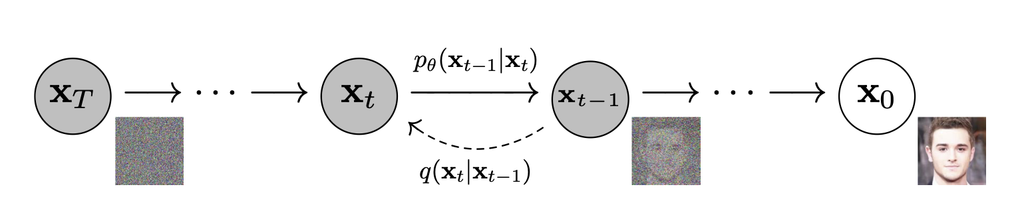
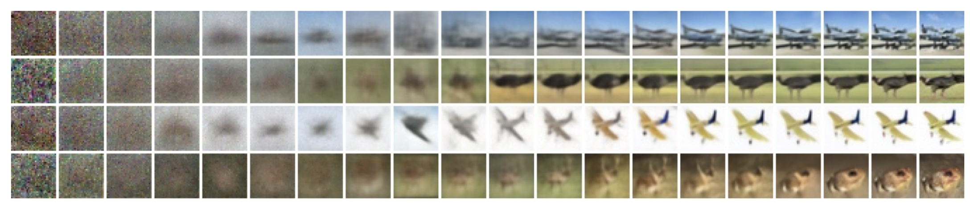
Denoising Diffusion models
Dall-E and stable diffusion are based on denoising ideas.
https://arxiv.org/pdf/2006.11239v2.pdf

Slide 62
Denoising from 1 image
We can’t take average over multiple images
Idea 1: take a spatial average
  Most pixels have roughly the same color as their neighbor
  Noise looks high frequency => do a low pass
First, let’s try Gaussian blur
Noisy input

Slide 63
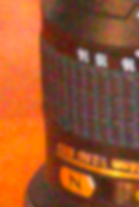
Gaussian blur
Noise is mostly gone
But image is blurry
  duh!
(to be fair, median filtering
would look better)
After Gaussian blur

Slide 64
Bilateral filtering

Slide 65
Gaussian blur
Noise is mostly gone
But image is blurry
  duh!
Problem: not all neighbors have the same color
Bilateral filter idea: only consider neighbors that have values similar enough
After Gaussian blur

Slide 66

Bilateral filter
Tomasi and Manduci 1998]
  http://www.cse.ucsc.edu/~manduchi/Papers/ICCV98.pdf
Developed for denoising
Related to
  SUSAN filter [Smith and Brady 95]
  http://citeseer.ist.psu.edu/smith95susan.html
  Digital-TV [Chan, Osher and Chen 2001]
  http://citeseer.ist.psu.edu/chan01digital.html
  sigma filter http://www.geogr.ku.dk/CHIPS/Manual/f187.htm
Full survey: http://people.csail.mit.edu/sparis/publi/2009/fntcgv/Paris_09_Bilateral_filtering.pdf

Slide 67


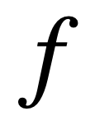


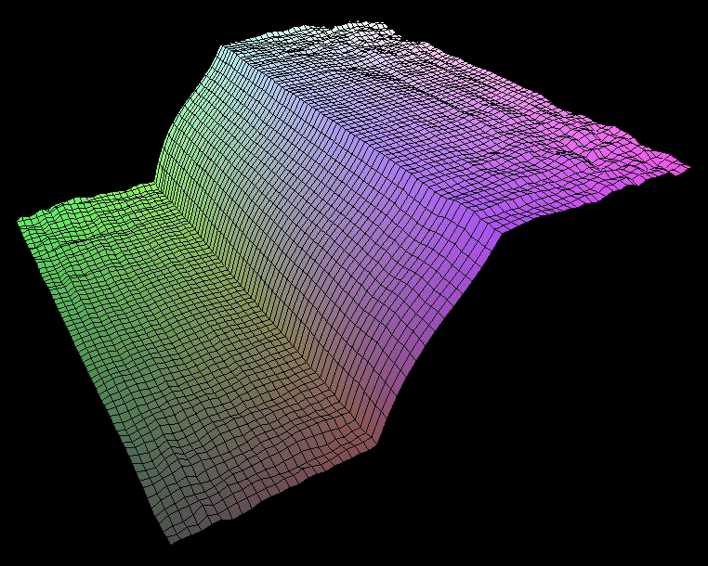
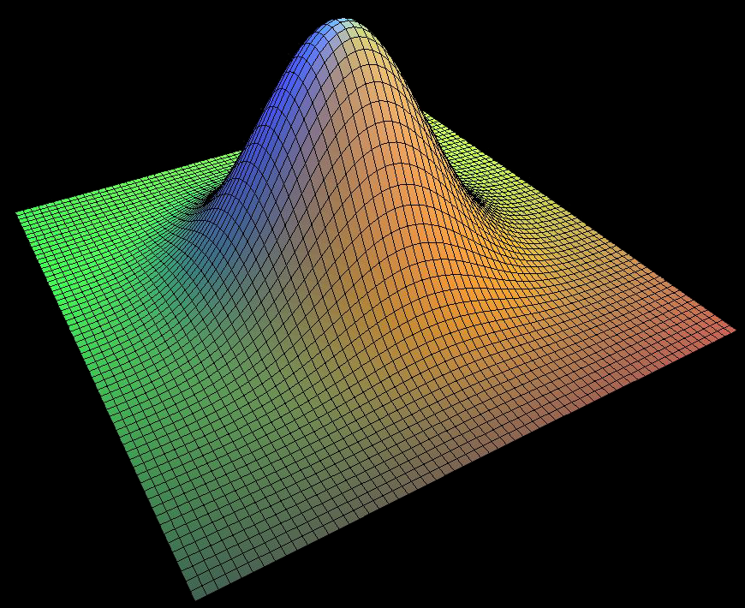
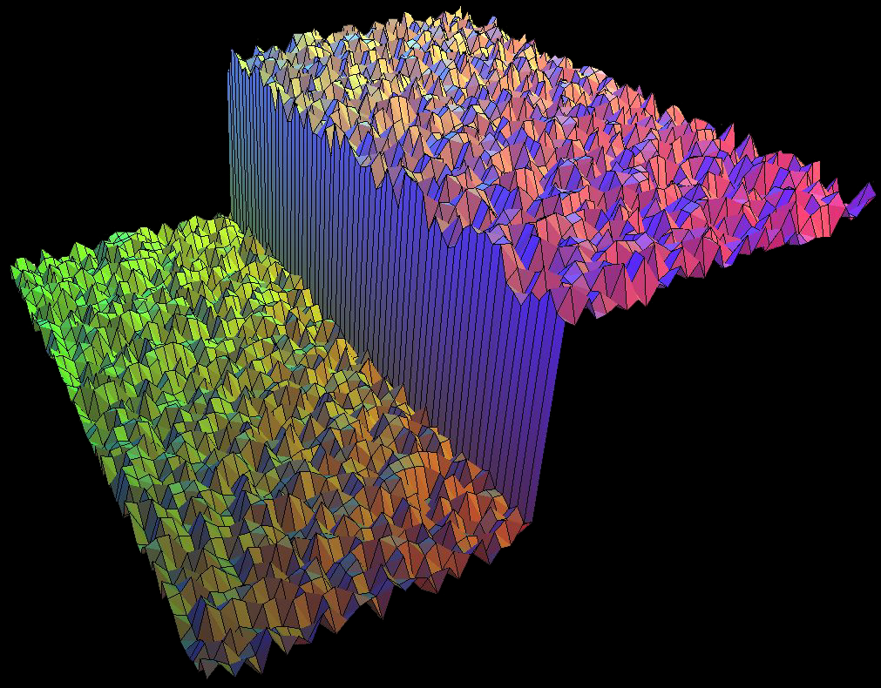
Start with Gaussian filtering
Here, input is a step function + noise
output
input

Slide 68
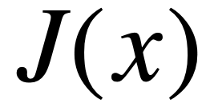

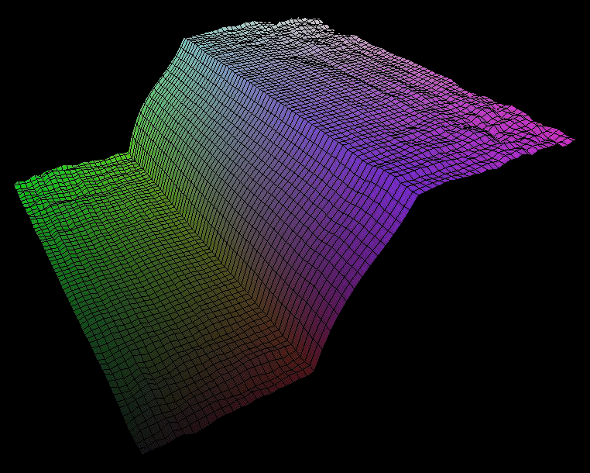
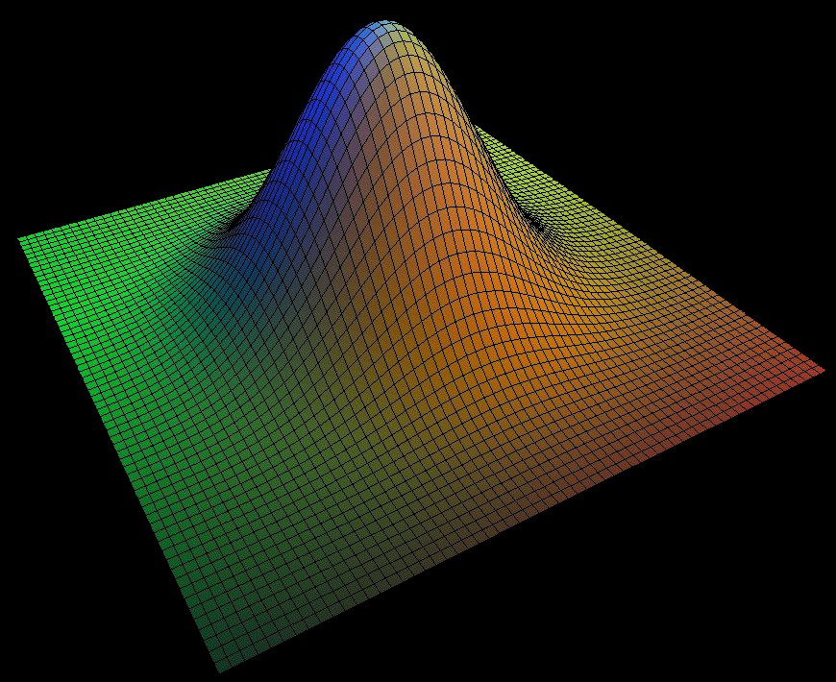
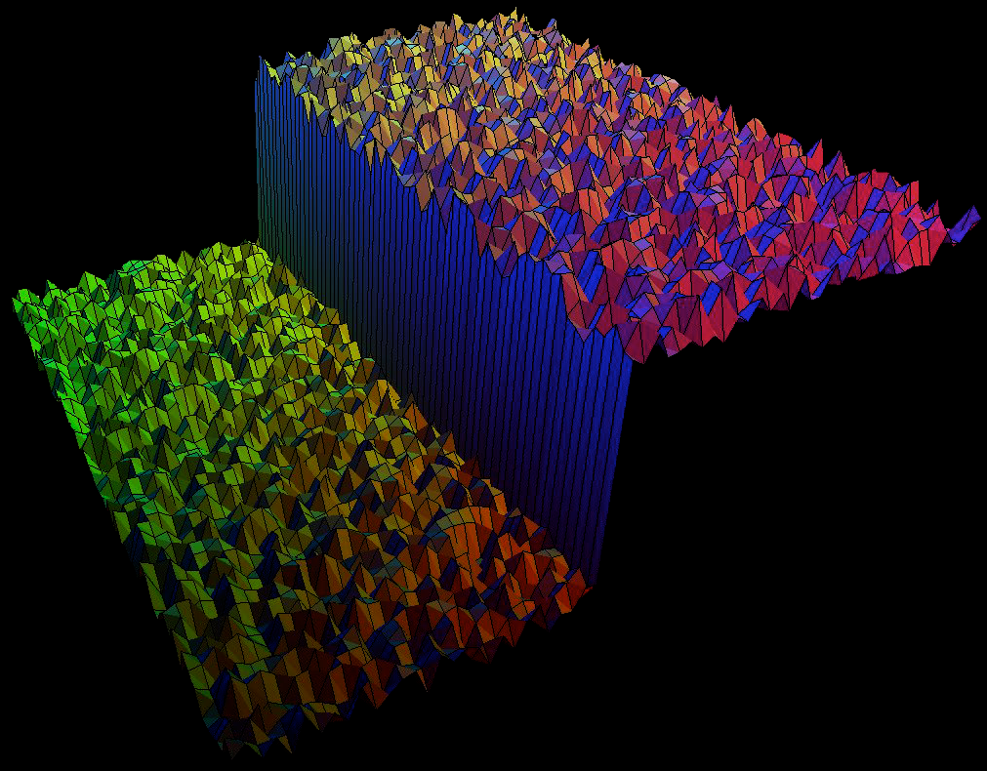
Gaussian filter as weighted average
Weight for ξ depends on distance to x
x
x
x
x
output
input

Slide 69

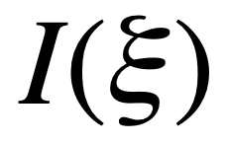
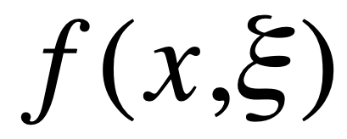
Gaussian filter as weighted average
Weight for ξ depends on distance to x
x
x
x
x
output
input

Slide 70
The problem of edges
Does give us useful information about the value at x
I(x)
I(x)
x
x
I(x)
output
input

Slide 71
The problem of edges
Here, “pollutes” our estimate J(x)
It is too different
I(x)
I(x)
x
x
I(x)
output
input

Slide 72
The problem of edges
Here, “pollutes” our estimate J(x)
Basic idea: reject or at least give it a low weight
I(x)
I(x)
I(x)
x
x
I(x)
output
input

Slide 73
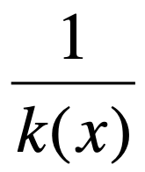
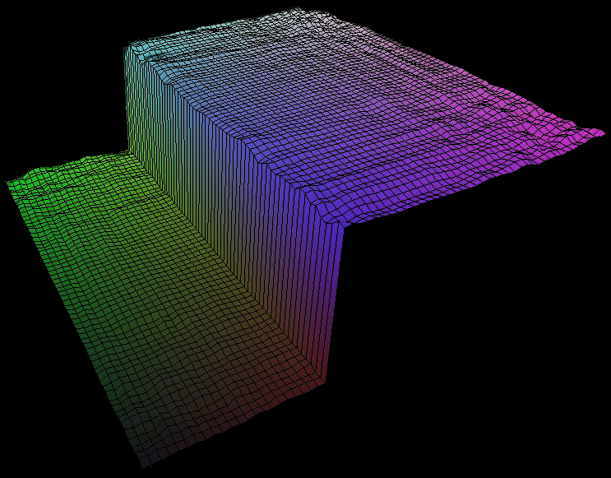
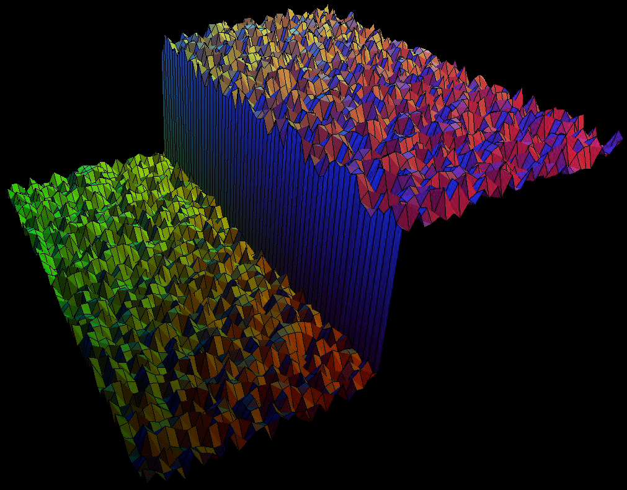
Principle of Bilateral filtering
[Tomasi and Manduchi 1998]
I(x)
x
I(x)
output
input

Slide 74

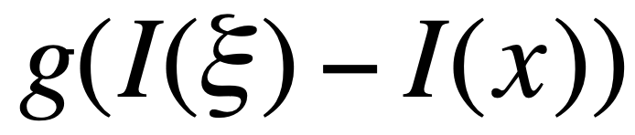
Principle of Bilateral filtering
[Tomasi and Manduchi 1998]
Penalty g on the intensity difference
  g is small when intensity difference is high
I(x)
x
I(x)
output
input

Slide 75
Bilateral filtering
[Tomasi and Manduchi 1998]
Spatial Gaussian f
x
x
x
output
input

Slide 76
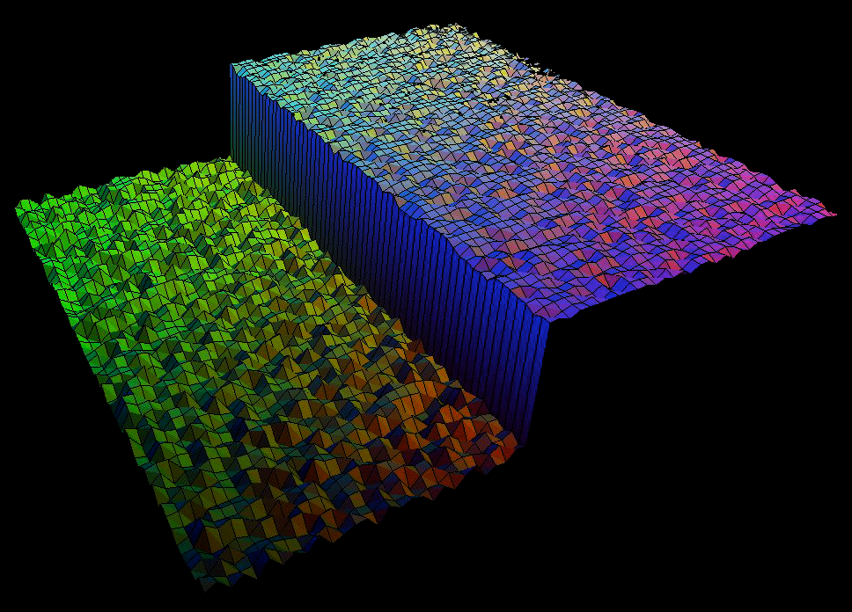
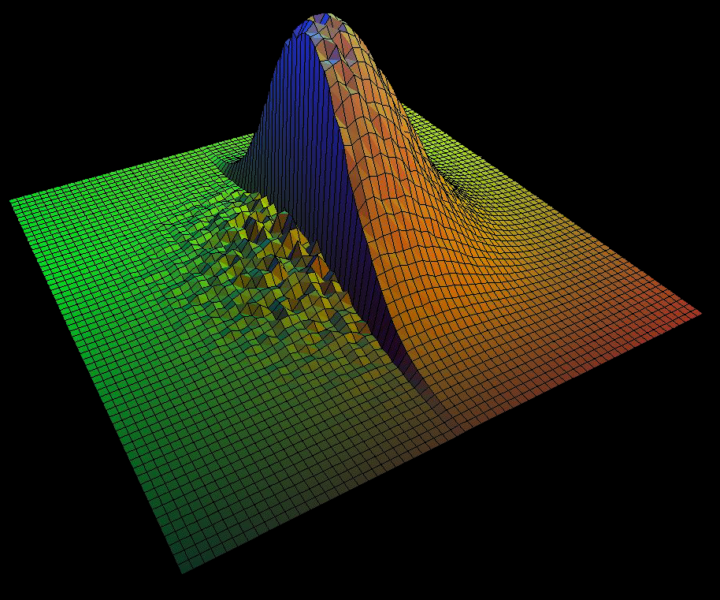
Bilateral filtering
[Tomasi and Manduchi 1998]
Spatial Gaussian f
Gaussian g on the intensity difference
I(x)
x
I(x)
output
input

Slide 77


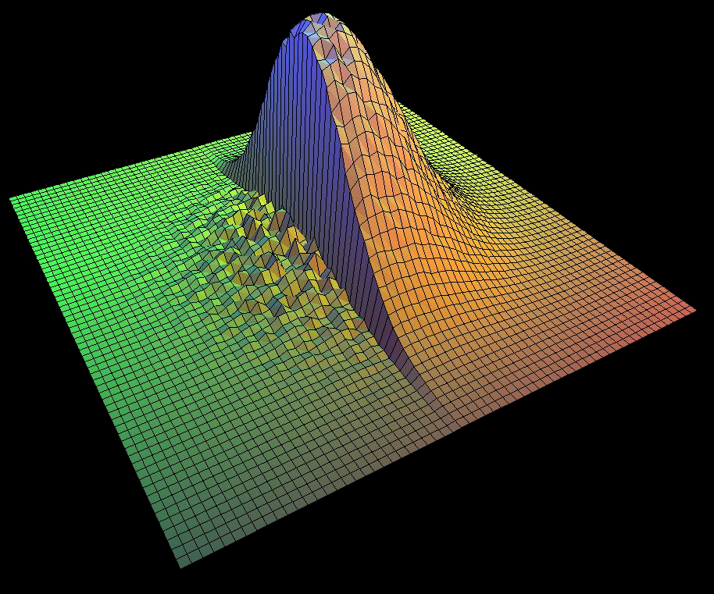
Normalization factor k
For convolution, we can normalize the kernel
But here, the weights change for each pixel
needs a per-pixel normalization 1/k(x)
output
input

Slide 78
Normalization factor k
sum of the weights (just like for any weighted average)
different for each pixel!
k(x)=
output
input

Slide 79
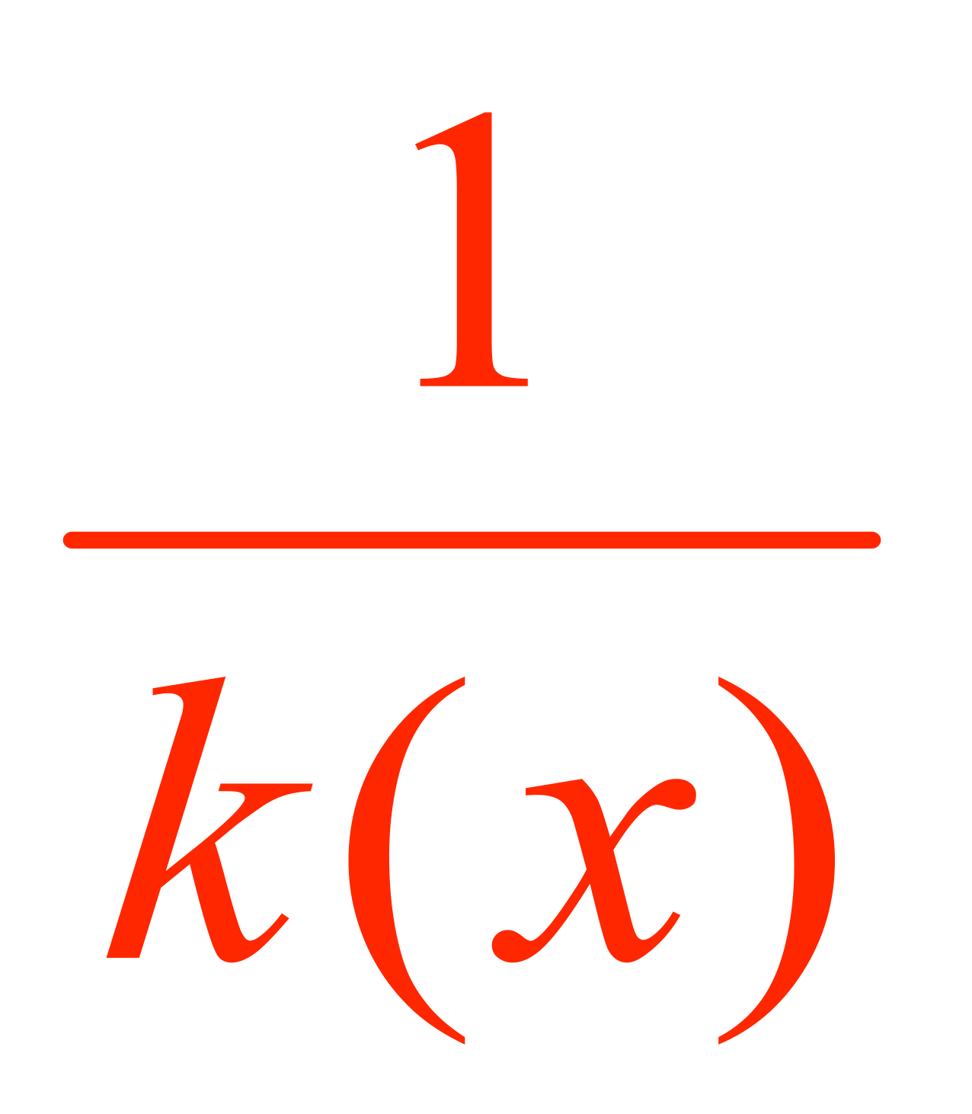








Bilateral filtering is non-linear
[Tomasi and Manduchi 1998]
The weights are different for each output pixel!
  Not a shift-invariant linear convolution
output
input

Slide 80
Normalization factor
[Tomasi and Manduchi 1998]
k(x)=
output
input

Slide 81
Let’s dissect the equation
k(x)=
output
input

Slide 82
Pseudocode
precompute spatial weight f
For each output pixel p
  initialize sums to zero
  for each input pixel q in neighborhood
    compute range weight g(Ip-Iq)
    add f(p-q)* g(Ip-Iq)*I(q) to sum
    add f(p-q)* g(Ip-Iq) to sum of weights
  output pixel = sum/sum of weights

Slide 83
Range distance
For RGB images:
use 3D distance in RGB to compute Gaussian

Slide 84
IMPORTANT
Unlike the spatial Gaussian, you should not precompute weights for the range Gaussian
Just recompute the Gaussian function for each pixel intensity difference.
There are ways to tabulate, just don’t worry about them
  (we will cover accelerations for the bilateral filter later)
Do not try to reuse your convolution code.

Slide 85
Bilateral filtering debug
Large range variance should yield Gaussian blur
Tiny range variance should leave edges unaffected
Try half white - half black image.
  maybe add noise

Slide 86
Truncation IN SPACE
Same as for Gaussian
  can use 2sigma instead of 3sigma if performance is an issue.
  Only truncate spatial Gaussian!!!
    Range Gaussian needs to be recomputed for each pair of pixels

Slide 87
Color/intensity distance

Slide 88

Bilateral filter
Noisy input
After bilateral filter

Slide 89
Recap: bilateral denoising
Spatial averaging
Don’t go across strong edges
  non-linear term based on intensity difference

Slide 90
Chrominance vs. luminance

Slide 91
Can we do better?
chroma noise
Noisy input
After bilateral filter

Slide 92
Chroma noise
Our visual system has different spatial frequency response to chrominance vs. luminance
Perform Bilateral filtering in YUV
Bigger spatial filter in U & V

Slide 93
Photoshop demo!

Slide 94
Normal RGB Bilateral filter
Noisy input
After bilateral filter

Slide 95

YUV bilateral filter
Noisy input
After YUV bilateral filter

Slide 96
Comparison
Noisy input
Bilateral filter
YUV bilateral filter

Slide 97
Bilateral filtering
Also used to remove skin blemishes in portraits
  Surface blur in photoshop
    Although box spatial kernel instead of Gaussian
Useful for lots of other things
  More in future lectures
  In particular, tone mapping for contrast reduction and high-dynamic-range imaging

Slide 98


Photoshop surface blur
Note the radius and threshold controls
  same as sigma_domain and sigma_range

Slide 99
Pset 3

Slide 100
Pset 3
Convolution
Separable
Unsharp mask
Gradient
Denoising
YUV denoising (6.865)

Slide 101
Other approaches to denoising

Slide 102
Denoising
Shrinkage/Bayesian coring in the wavelet/pyramid domain
  Donoho et al. ; Simoncelli & Adelson
  Still one of the most popular in practice
NL means, BM3D
  Buades et al. : Bilateral in the space of patches
Deep learning
Limits of denoising
  http://www.wisdom.weizmann.ac.il/~levina/

Slide 103
References

Slide 104
http://www.cambridgeincolour.com/tutorials/image-noise.htm
http://www.cambridgeincolour.com/tutorials/image-noise-2.htm
http://www.clarkvision.com/imagedetail/does.pixel.size.matter2/
http://www.clarkvision.com/articles/digital.sensor.performance.summary/
http://books.google.com/books?id=OYFYt5C4N94C&pg=PA405&dq=binomial+film+grain+noise#v=onepage&q=binomial%20film%20grain%20noise&f=false
http://en.wikipedia.org/wiki/Image_noise
http://www.picturecode.com/noise.htm
http://www.instructables.com/id/Avoiding-Camera-Noise-Signatures/
http://www.photoxels.com/tutorial_noise.html
http://people.csail.mit.edu/hasinoff/hdrnoise/hasinoff-sensornoise-tutorial-iccp10.pptx
http://theory.uchicago.edu/~ejm/pix/20d/tests/noise/
http://www.imatest.com/docs/noise/
http://www.cambridgeincolour.com/tutorials/image-averaging-noise.htm
http://www.petapixel.com/2012/02/21/a-simple-explanation-of-how-iso-works-in-digital-photography/

