Slide 1
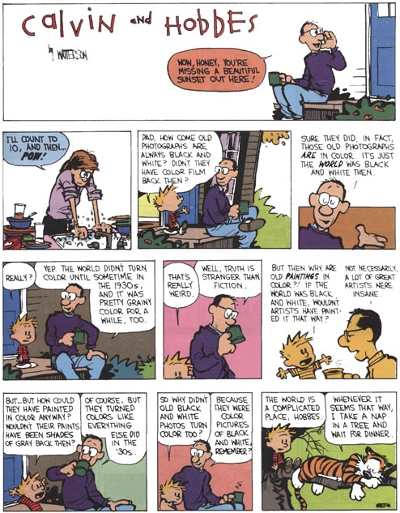
Color

Slide 2
https://petapixel.com/2026/05/20/youve-probably-never-seen-a-full-spectrum-color-photo/
https://www.youtube.com/watch?v=-DyrBDsKA5s
https://www.jonhilty.com/lippmann

Slide 3
3 notions of primary colors
Add subtractive synthesis
Add Bill’s cartoon version
Go back to 2 lectures

Slide 4
Admin
Make sure you are registered for the right class (grad vs. undergrad)
  Make sure miki3 also knows

Slide 5
Color
Fredo Durand
MIT EECS 6.8370/6.8371

Slide 6
Plan
metamers, color blindness
XYZ, color matching
Gamut
3x3 matrices
other color spaces
Lab
spatial vision
JPEG

Slide 7
Unrelated: Speckle imaging

Slide 8
Motivations

Slide 9
Color
What does RGB really measure?
Can RGB record all colors?
Isn’t color about wavelength anyway?
How does this relate to human eyes?
What are the primary colors? Red Green and Blue? Red Yellow and Blue ? Red, Green Yellow and Blue ?

Slide 10
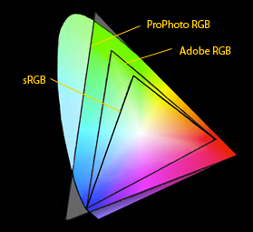
Different RGBs
Different coverage of space of all possible colors

Slide 11
RGB
Can RGB record all colors?
  not without negative values!
How does RGB relate to cone measurements?
  Why not use cone measurements?
Are distances meaningful in RGB?
  What is the limit of color discrimination?
sRGB=
{0.3811,0.5783,0.0402}
{0.1967,0.7244,0.0782}
{0.0241,0.1288,0.8444}
LMS

Slide 12
Perceptually uniform
In this diagram, 2D distance correspond to human ability to discriminate two colors
RGB is deformed non linearly
http://upload.wikimedia.org/wikipedia/commons/2/21/Lab_color_space.png

Slide 13
RGB
Can RGB record all colors?
  not without negative values!
How does RGB relate to cone measurements?
  Why not use cone measurements?
Are distances meaningful in RGB?
  What is the limit of color discrimination?
Why are there so many RGBs?
sRGB=
{0.3811,0.5783,0.0402}
{0.1967,0.7244,0.0782}
{0.0241,0.1288,0.8444}
LMS

Slide 14
Other color representations
RGB
YUV
Cones LMS
XYZ
Lab
...

Slide 15
Color space
Way to encode color as perceived by humans
  as opposed to physical full-spectrum color
Usually using 3 numbers (coordinates)
For example, we have used RGB, YUV, and talked about cone responses
Many many different color spaces
  with ways to convert from one to another

Slide 16
Why different color spaces
Different applications/goals
  measure color
  reproduce color
  predict if colors are visible/different
  adjust colors (saturation, contrast)
Legacy
  info was not available, refinement of definition
Contradicting objectives and constraints
  perceptual vs. radiometric
  linear vs. non-linear
  various stages of human vision

Slide 17
Color science & engineering
Do two color match?
  spectral distribution
  threshold
Measure color
Encode color
Reproduce a color
Adjust color (saturation, contrast, etc.)

Slide 18
Different color encodings
Cones: LMS
RGB: ?
are they the same?
Why not?
Plus in fact, the most standard color space is so-called XYZ
RGB=
{0.3811,0.5783,0.0402}
{0.1967,0.7244,0.0782}
{0.0241,0.1288,0.8444}
LMS

Slide 19
Color spaces zoo
RGB: many flavors
Color opponent
  luminance, red-green, blue-yellow
HSV: hue saturation value (or luminance)
perceptually uniform
LMS: cones
XYZ: the big standard, color matching
linear vs. non-linear
  linear, gamma, cubic root, log
measurement vs. perception

Slide 20
Today
Focus on color matching
  measure a color, reproduce it

Slide 21
Color matching

Slide 22
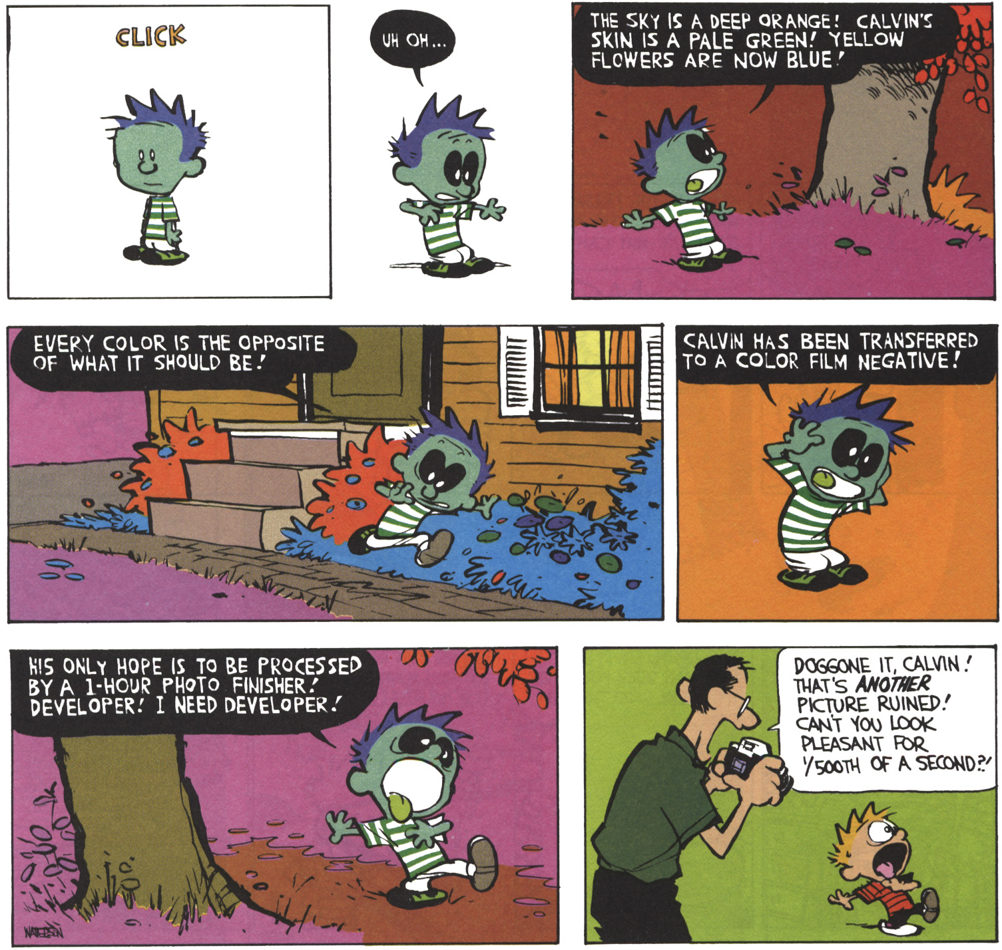
Questions?

Slide 23
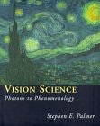
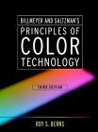
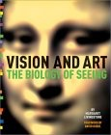
Selected Bibliography
Vision Science
by Stephen E. Palmer
MIT Press; ISBN: 0262161834
760 pages (May 7, 1999)
Billmeyer and Saltzman's Principles of Color Technology, 3rd Edition
by Roy S. Berns, Fred W. Billmeyer, Max Saltzman
Wiley-Interscience; ISBN: 047119459X
304 pages 3 edition (March 31, 2000)
Vision and Art : The Biology of Seeing
by Margaret Livingstone, David H. Hubel
Harry N Abrams; ISBN: 0810904063
208 pages (May 2002)

Slide 24
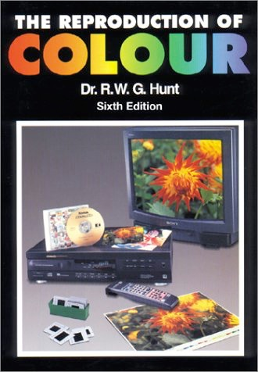
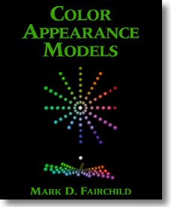
Selected Bibliography
The Reproduction of Color
by R. W. G. Hunt
Fountain Press, 1995
Color Appearance Models
by Mark Fairchild
Addison Wesley, 1998

Slide 25
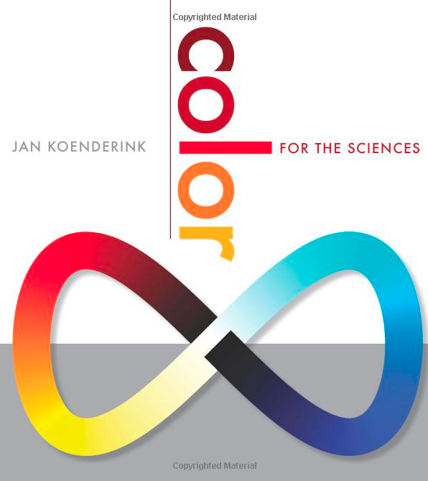
Selected Bibliography

Slide 26
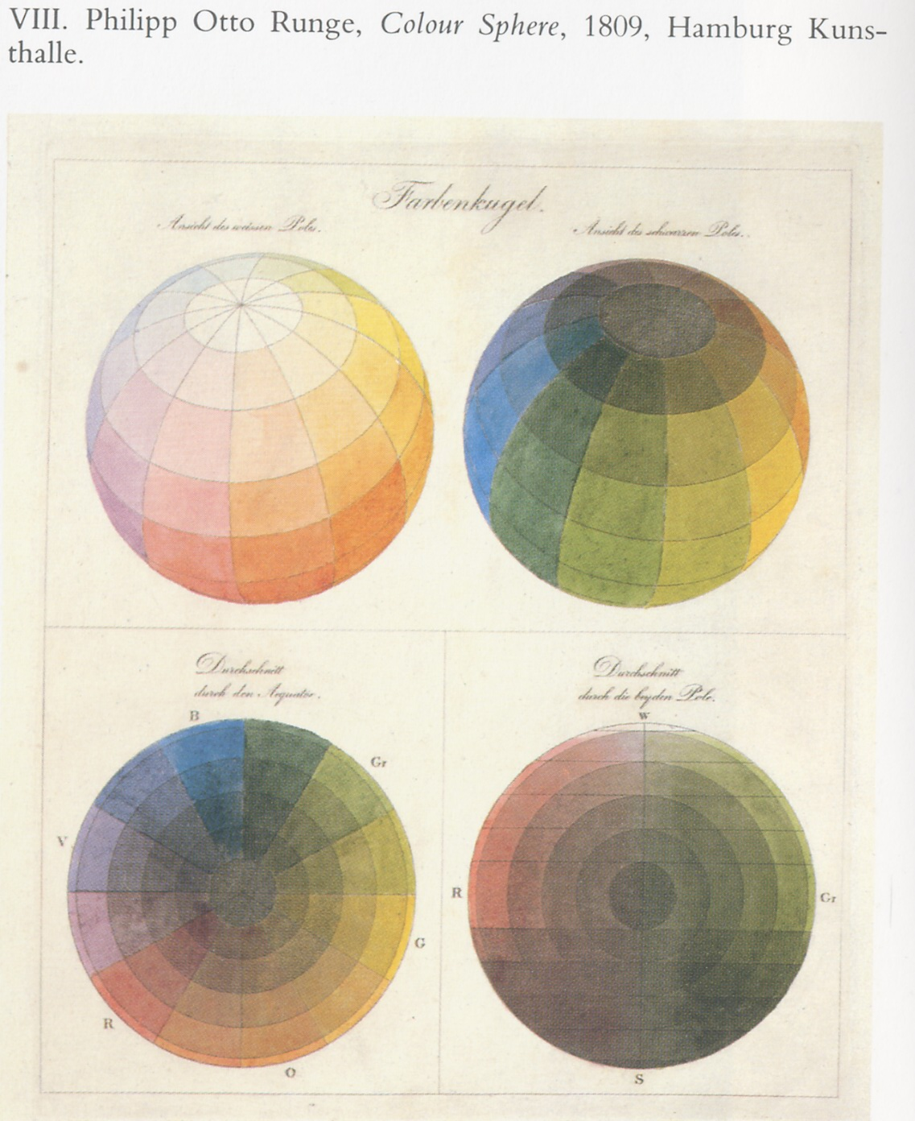
Questions?

Slide 27
Color perception
sensor
percept
spatial
ability to see difference (discrimination)
Do these color match?
How do I encode & communicate color?
How do we build color measurement and reproduction technology?

Slide 28
Lightroom

Slide 29
Why is green so important
http://hyperphysics.phy-astr.gsu.edu/hbase/vision/rodcone.html
CIE brightness
  sum of 3 cones
blue is out of focus

Slide 30
But surprisingly, more L cones

Slide 31
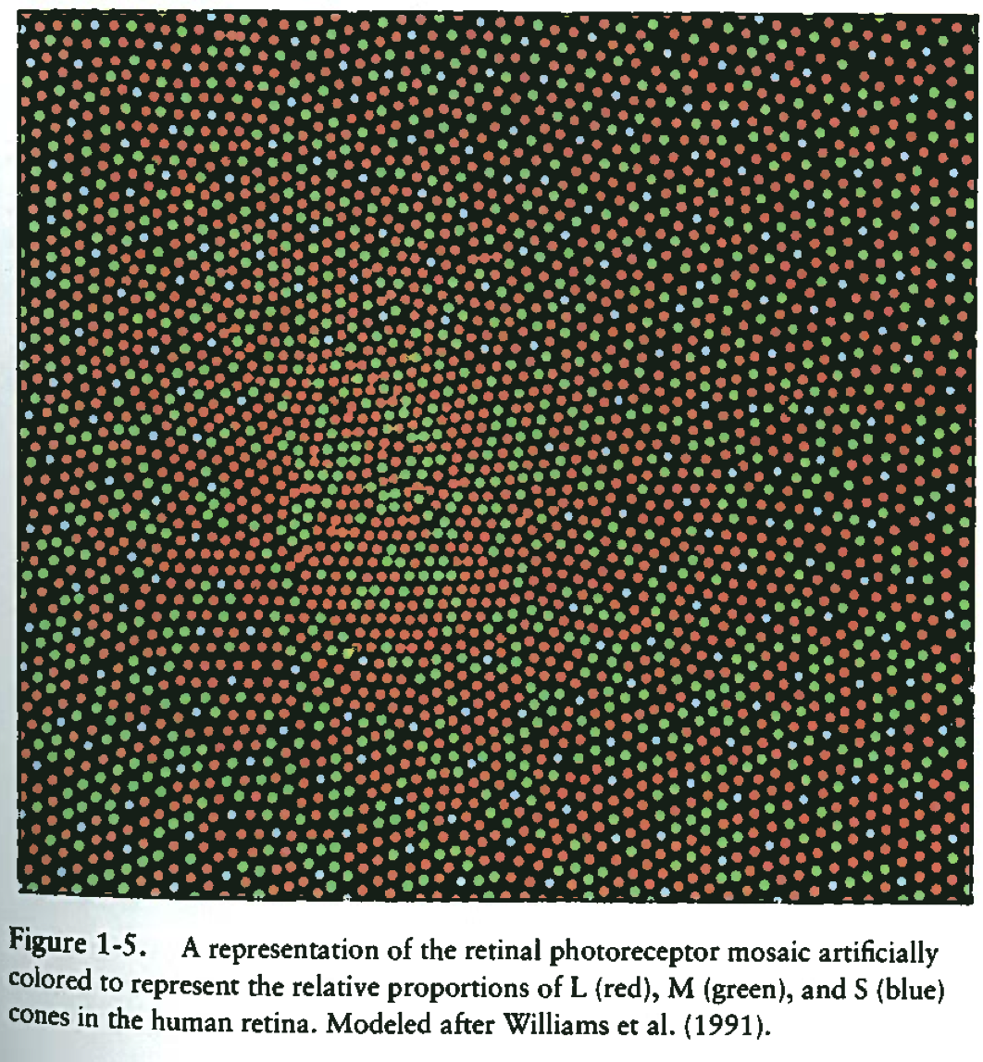
From Fairchild’s book.

Slide 32
http://www.blueconemonochromacy.org/what-is-bcm/eye-retina-and-cones-2/
http://webvision.med.utah.edu/book/part-iii-retinal-circuits/s-cone-pathways/
http://www.opticsinfobase.org/josa/abstract.cfm?uri=josa-57-11-1289
http://www.cvrl.org/database/text/intros/introdens.htm
http://www.cvrl.org/database/text/density/lmintro.htm

Slide 33
Motivations
Various color spaces
Percepts
Devices, ability to reproduce colors
What do we need color spaces for
  encode images (better quantization)
  manipulate images (e.g. saturation, etc.)
  reproduce color (camera to projector), different filters, lasers
  GUI
  predict differences

Slide 34
Check out the demo applets
http://graphics.stanford.edu/courses/cs178-10/applets/locus.html
http://graphics.stanford.edu/courses/cs178-10/applets/colormatching.html
http://graphics.stanford.edu/courses/cs178-10/applets/threedgamut.html
http://graphics.stanford.edu/courses/cs178-10/applets/gamutmapping.html
http://graphics.stanford.edu/courses/cs178-10/applets/colormixing.html
http://graphics.stanford.edu/courses/cs178-10/applets/gamma.html

Slide 35
Bad news
Measurement (sensing) and reproduction (display) involve different spectral profiles.
LMS is more about sensing
  The output of cone receptors
RGB is more about display
  The input to your screen or video projector
But it’s all more complicated than this.
  We need to understand color reproduction principles

Slide 36
How can we reproduce color?
Good news: we don’t need to reproduce full spectra
  3 numbers suffice
Bad news: reproducing all perceived colors is tough
  Those 3 numbers might need to get negative

Slide 37
Physical colors: spectra

Slide 38
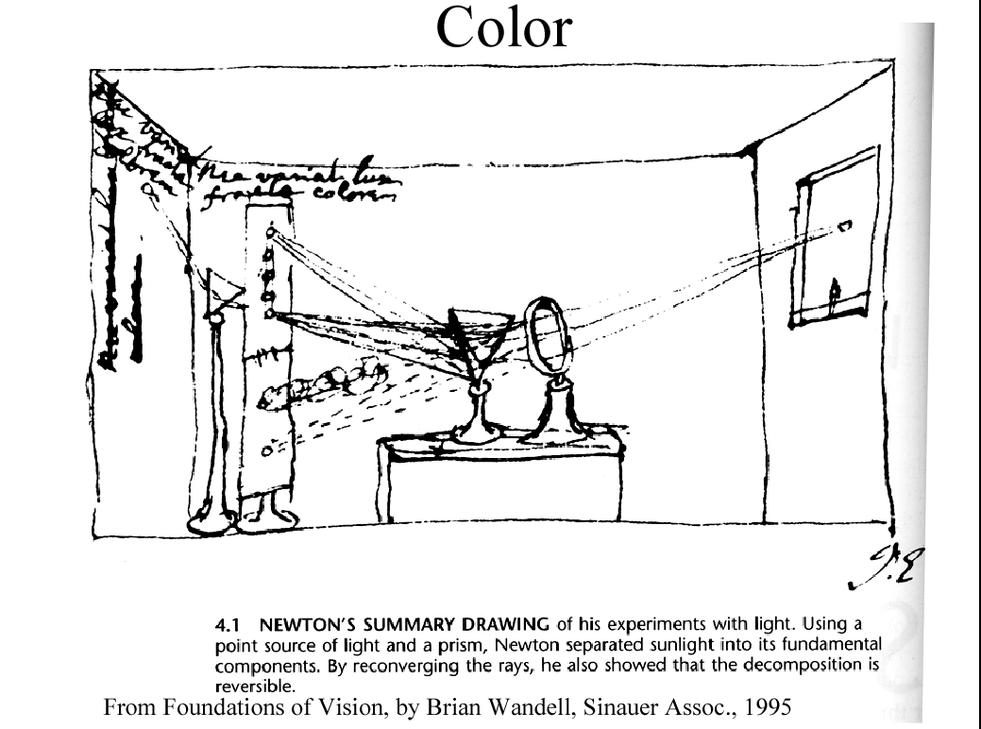
color

Slide 39
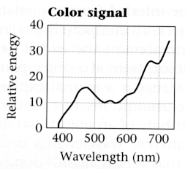
Spectrum
Light is a wave
Visible: between 450 and 700nm

Slide 40
Spectrum
Light is characterized by its spectrum:
amount of energy at each wavelength
This is a full distribution:
  one value per wavelength (infinite number of values)

Slide 41
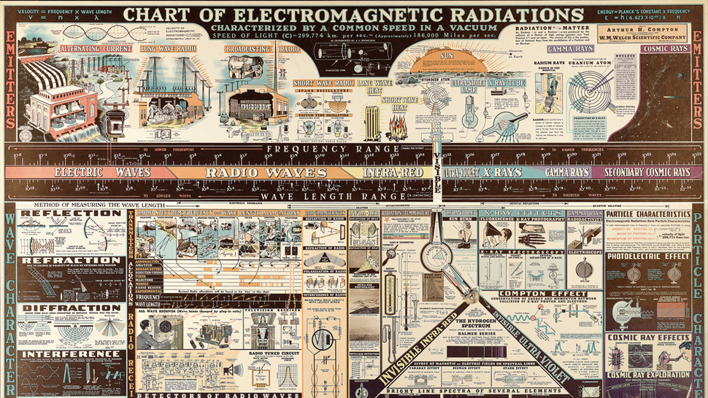
http://gizmodo.com/a-1944-infographic-on-electromagnetic-radiation-makes-l-1019197061

Slide 42
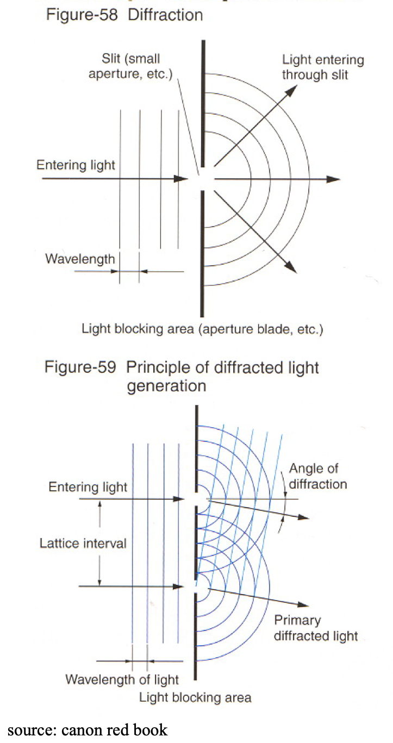
Spectrum demo
Diffraction grating:
  shifts light as a function of wavelength
  Allows you to see spectra
  In particular, using a slit light source, we get a nice band showing the spectrum
See the effect of filters
See different light source spectra
Source: Canon red book

Slide 44
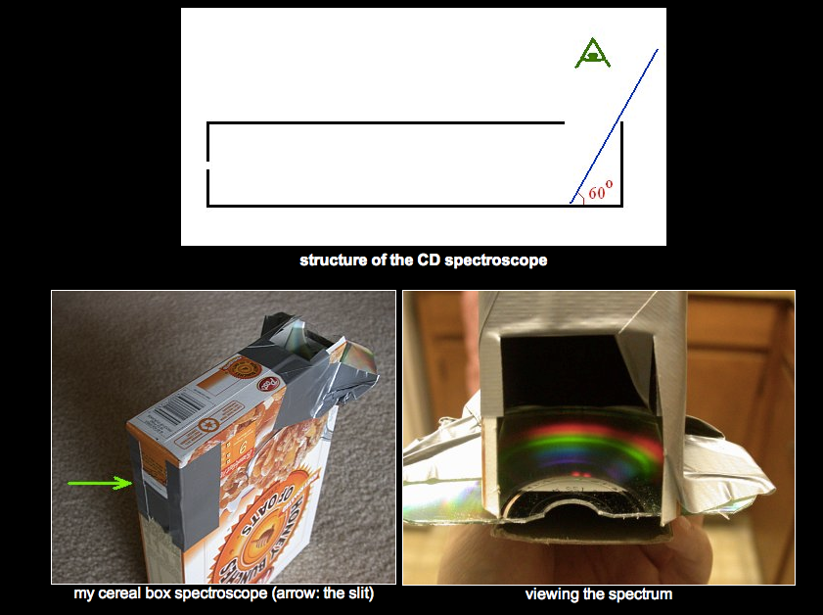
CD spectrograph
http://www.cs.cmu.edu/~zhuxj/astro/html/spectrometer.html

Slide 45
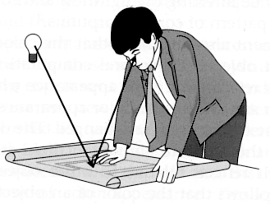
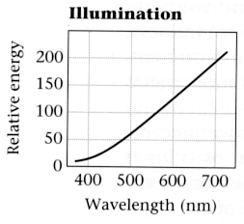
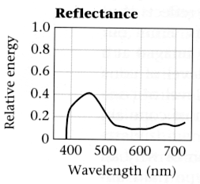
Light-matter interaction
Where spectra come from:
  - light source spectrum
  - object reflectance (aka spectral albedo)
  get multiplied wavelength by wavelength
There are different physical processes that explain this multiplication
  e.g. absorption, interferences
.*
=
Foundations of Vision, by Brian Wandell, Sinauer Assoc., 1995

Slide 46
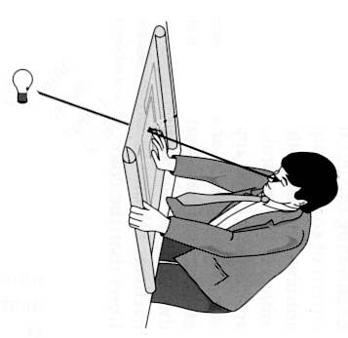
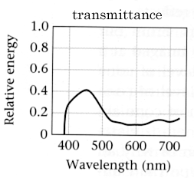
Alternative: transmittance
  Also get multiplied
.*
=
Foundations of Vision, by Brian Wandell, Sinauer Assoc., 1995

Slide 47
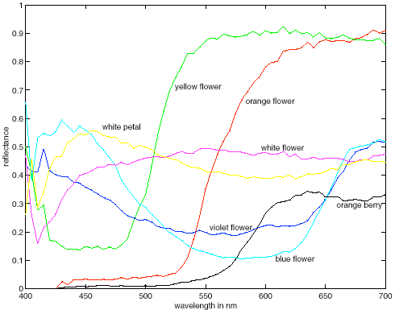
Examples of reflectance spectra
Spectral albedoes for several different leaves, with color names attached. Notice that different colours typically have different spectral albedo, but that different spectral albedoes may result in the same perceived color (compare the two whites). Spectral albedoes are typically quite smooth functions. Measurements by E.Koivisto.
Forsyth, 2002
Slide from Bill Freeman

Slide 48
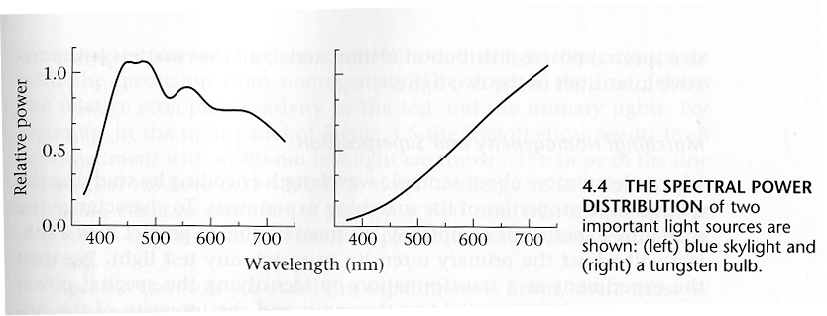
Examples of illumination spectra
Blue sky
Tungsten light bulb
Important consequence:
the spectrum leaving an object depends on the illumination
Foundations of Vision, by Brian Wandell, Sinauer Assoc., 1995

Slide 49
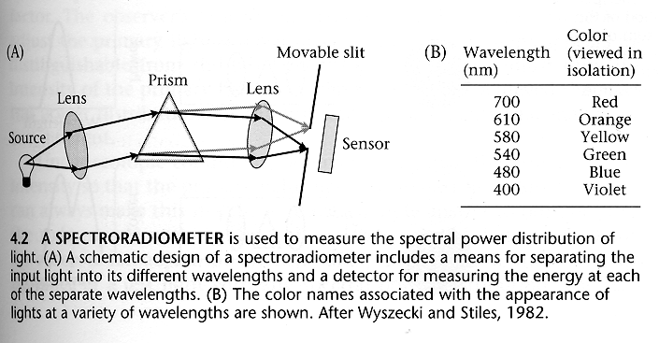
How to measure those spectra:
Spectrophotometer
(just like Newton’s diagram…)
Foundations of Vision, by Brian Wandell, Sinauer Assoc., 1995

Slide 50
Questions?
So far, physical side of colors: spectra
  an infinite number of values
  (one per wavelength)

Slide 51
Plan
Spectra
Cones and spectral response
Color blindness and metamers
Color matching
Color spaces

Slide 52
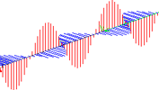
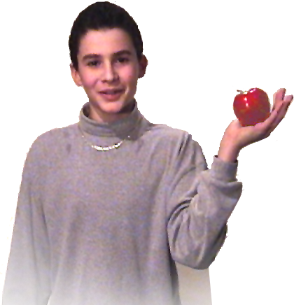
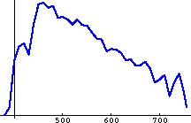
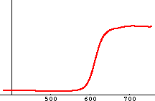

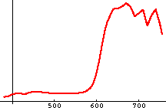
What is Color?
Electromagnetic Wave
Spectral
Power
Distribution
Illuminant D65
Reflectance
Spectrum
(nm)
Spectral
Power
Distribution
Slide from Victor Ostromoukhov

Slide 53
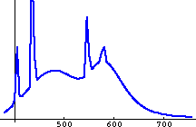
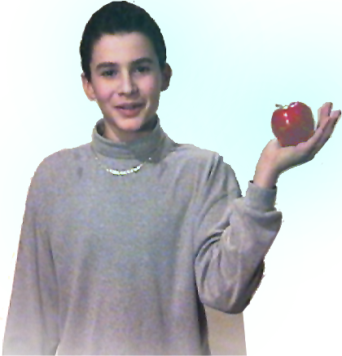
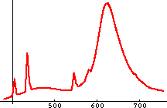
What is Color?
Neon Lamp
Spectral
Power
Distribution
Illuminant F1
Reflectance
Spectrum
Spectral
Power
Distribution
Under D65
Spectral
Power
Distribution
Under F1
Slide from Victor Ostromoukhov

Slide 54
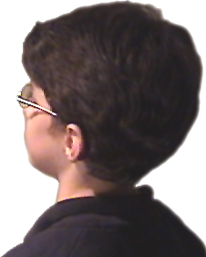
What is Color?
Observer
Stimulus
Slide from Victor Ostromoukhov

Slide 55
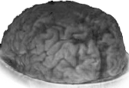

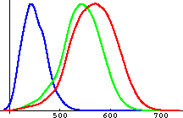
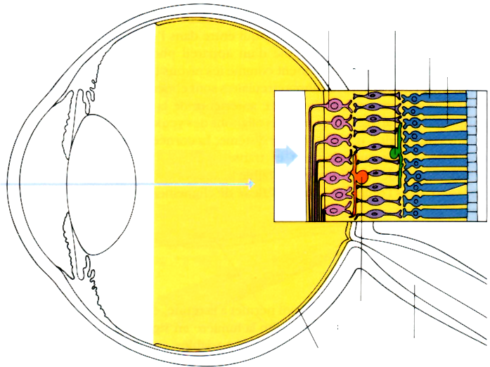
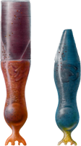
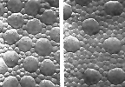
What is Color?
M
L
Spectral
Sensibility
of the
L, M and S
Cones
S
Ganglion
Cells
Horizontal
Cells
Rod
Bipolar
Cells
Cone
Light
Light
Amacrine
Cells
Rods
Cones
Distribution of
Cones and Rods
Retina
Optic Nerve
Slide from Victor Ostromoukhov

Slide 56
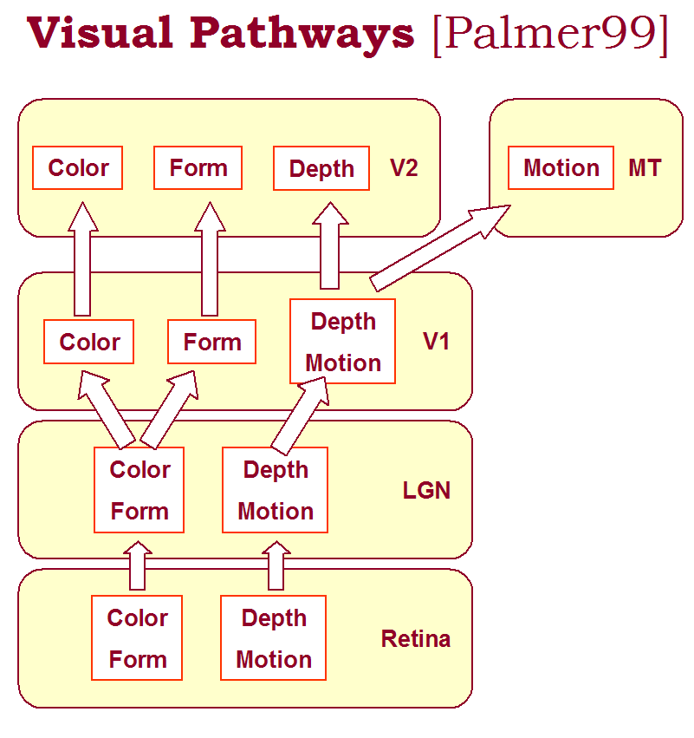



What is Color?
Right LGN
Left LGN
Visual
Cortex
LGN = Lateral Geniculate Nucleus
Slide from Victor Ostromoukhov

Slide 57
Cones
We focus on low-level aspects of color
  Cones and early processing in the retina
We won’t talk about rods (night vision)
M
L
Spectral
Sensibility
of the
L, M and S
Cones
S
Ganglion
Cells
Horizontal
Cells
Rod
Bipolar
Cells
Cone
Light
Light
Amacrine
Cells
Rods
Cones
Distribution of
Cones and Rods
Retina
Optic Nerve

Slide 58
Summary (and time for questions)
Spectrum: infinite number of values
  can be multiplied
  can be added
Light spectrum multiplied by reflectance spectrum
  spectrum depends on illuminant
Human visual system is complicated

Slide 59
Questions?

Slide 60
Plan
What is color
Cones and spectral response
Color blindness and metamers
Fundamental difficulty with colors

Slide 61
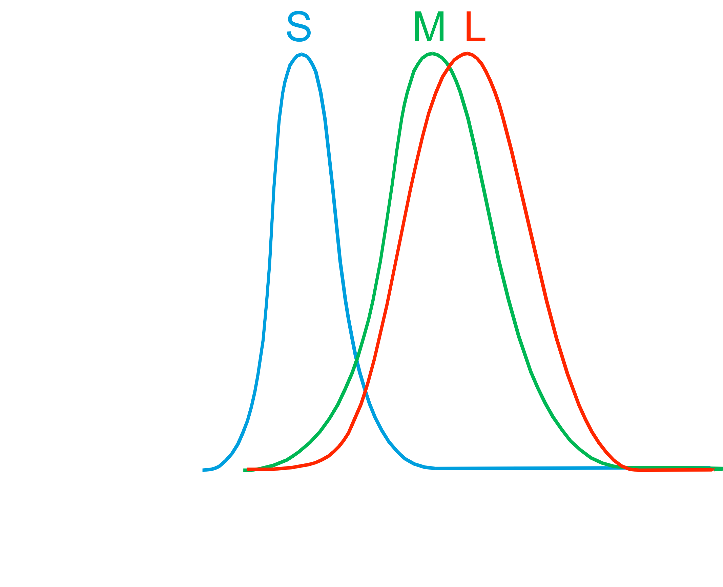
Cone spectral sensitivity
Short, Medium and Long wavelength
Response for a cone:

Slide 62
Cone spectral sensitivity
Short, Medium and Long wavelength
Response for a cone
=∫ _{λ} stimulus(λ) * response(λ) dλ

Slide 63
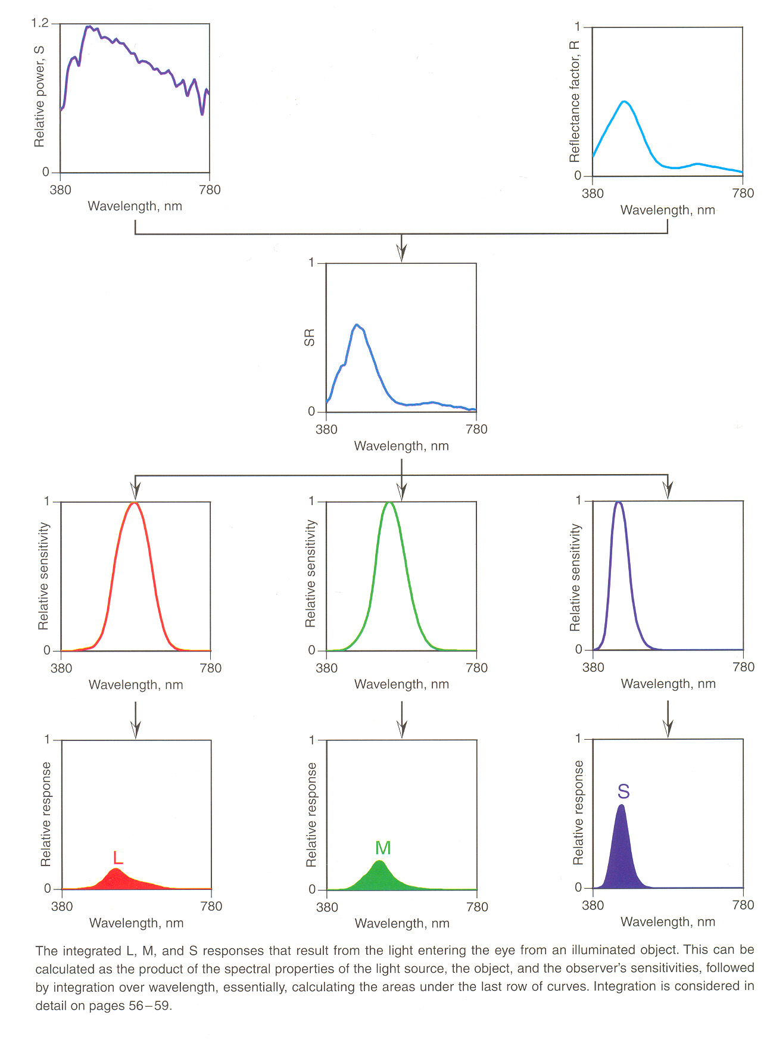
Cone response

Slide 64
Cone response
Start from infinite number of values
(one per wavelength)
End up with 3 values (one per cone type)
Stimulus
Cone responses
Multiply wavelength by wavelength
Integrate
1 number
1 number
1 number

Slide 65
For matrix lovers
Spectrum: big long vector size N where N=∞
Cone response: 3xN matrix of individual responses

Slide 66
For matrix lovers
Spectrum: big long vector size N where N=∞
Cone response: 3xN matrix of individual responses
observed
spectrum
cone spectral
response
S
M
kind of RGB
L

Slide 67
For geometry lovers
Spectrum: point in infinite dimensional space
Human vision: 3D linear subspace
Projection
infinite set of bases
spectrum
cone subspace (3D)

Slide 68
Big picture
Light
reflectance
It’s all linear!
multiply
Stimulus
Cone responses
Multiply wavelength by wavelength
Integrate

Slide 69
Big picture
Light
reflectance
It’s all linear!
  multiply
  add
But
  non-orthogonal basis
  infinite dimension
  light must be positive
Depends on light source
multiply
Stimulus
Cone responses
Multiply wavelength by wavelength
Integrate

Slide 70
Questions?
Light
reflectance
multiply
Stimulus
Cone responses
Multiply wavelength by wavelength
Integrate

Slide 71
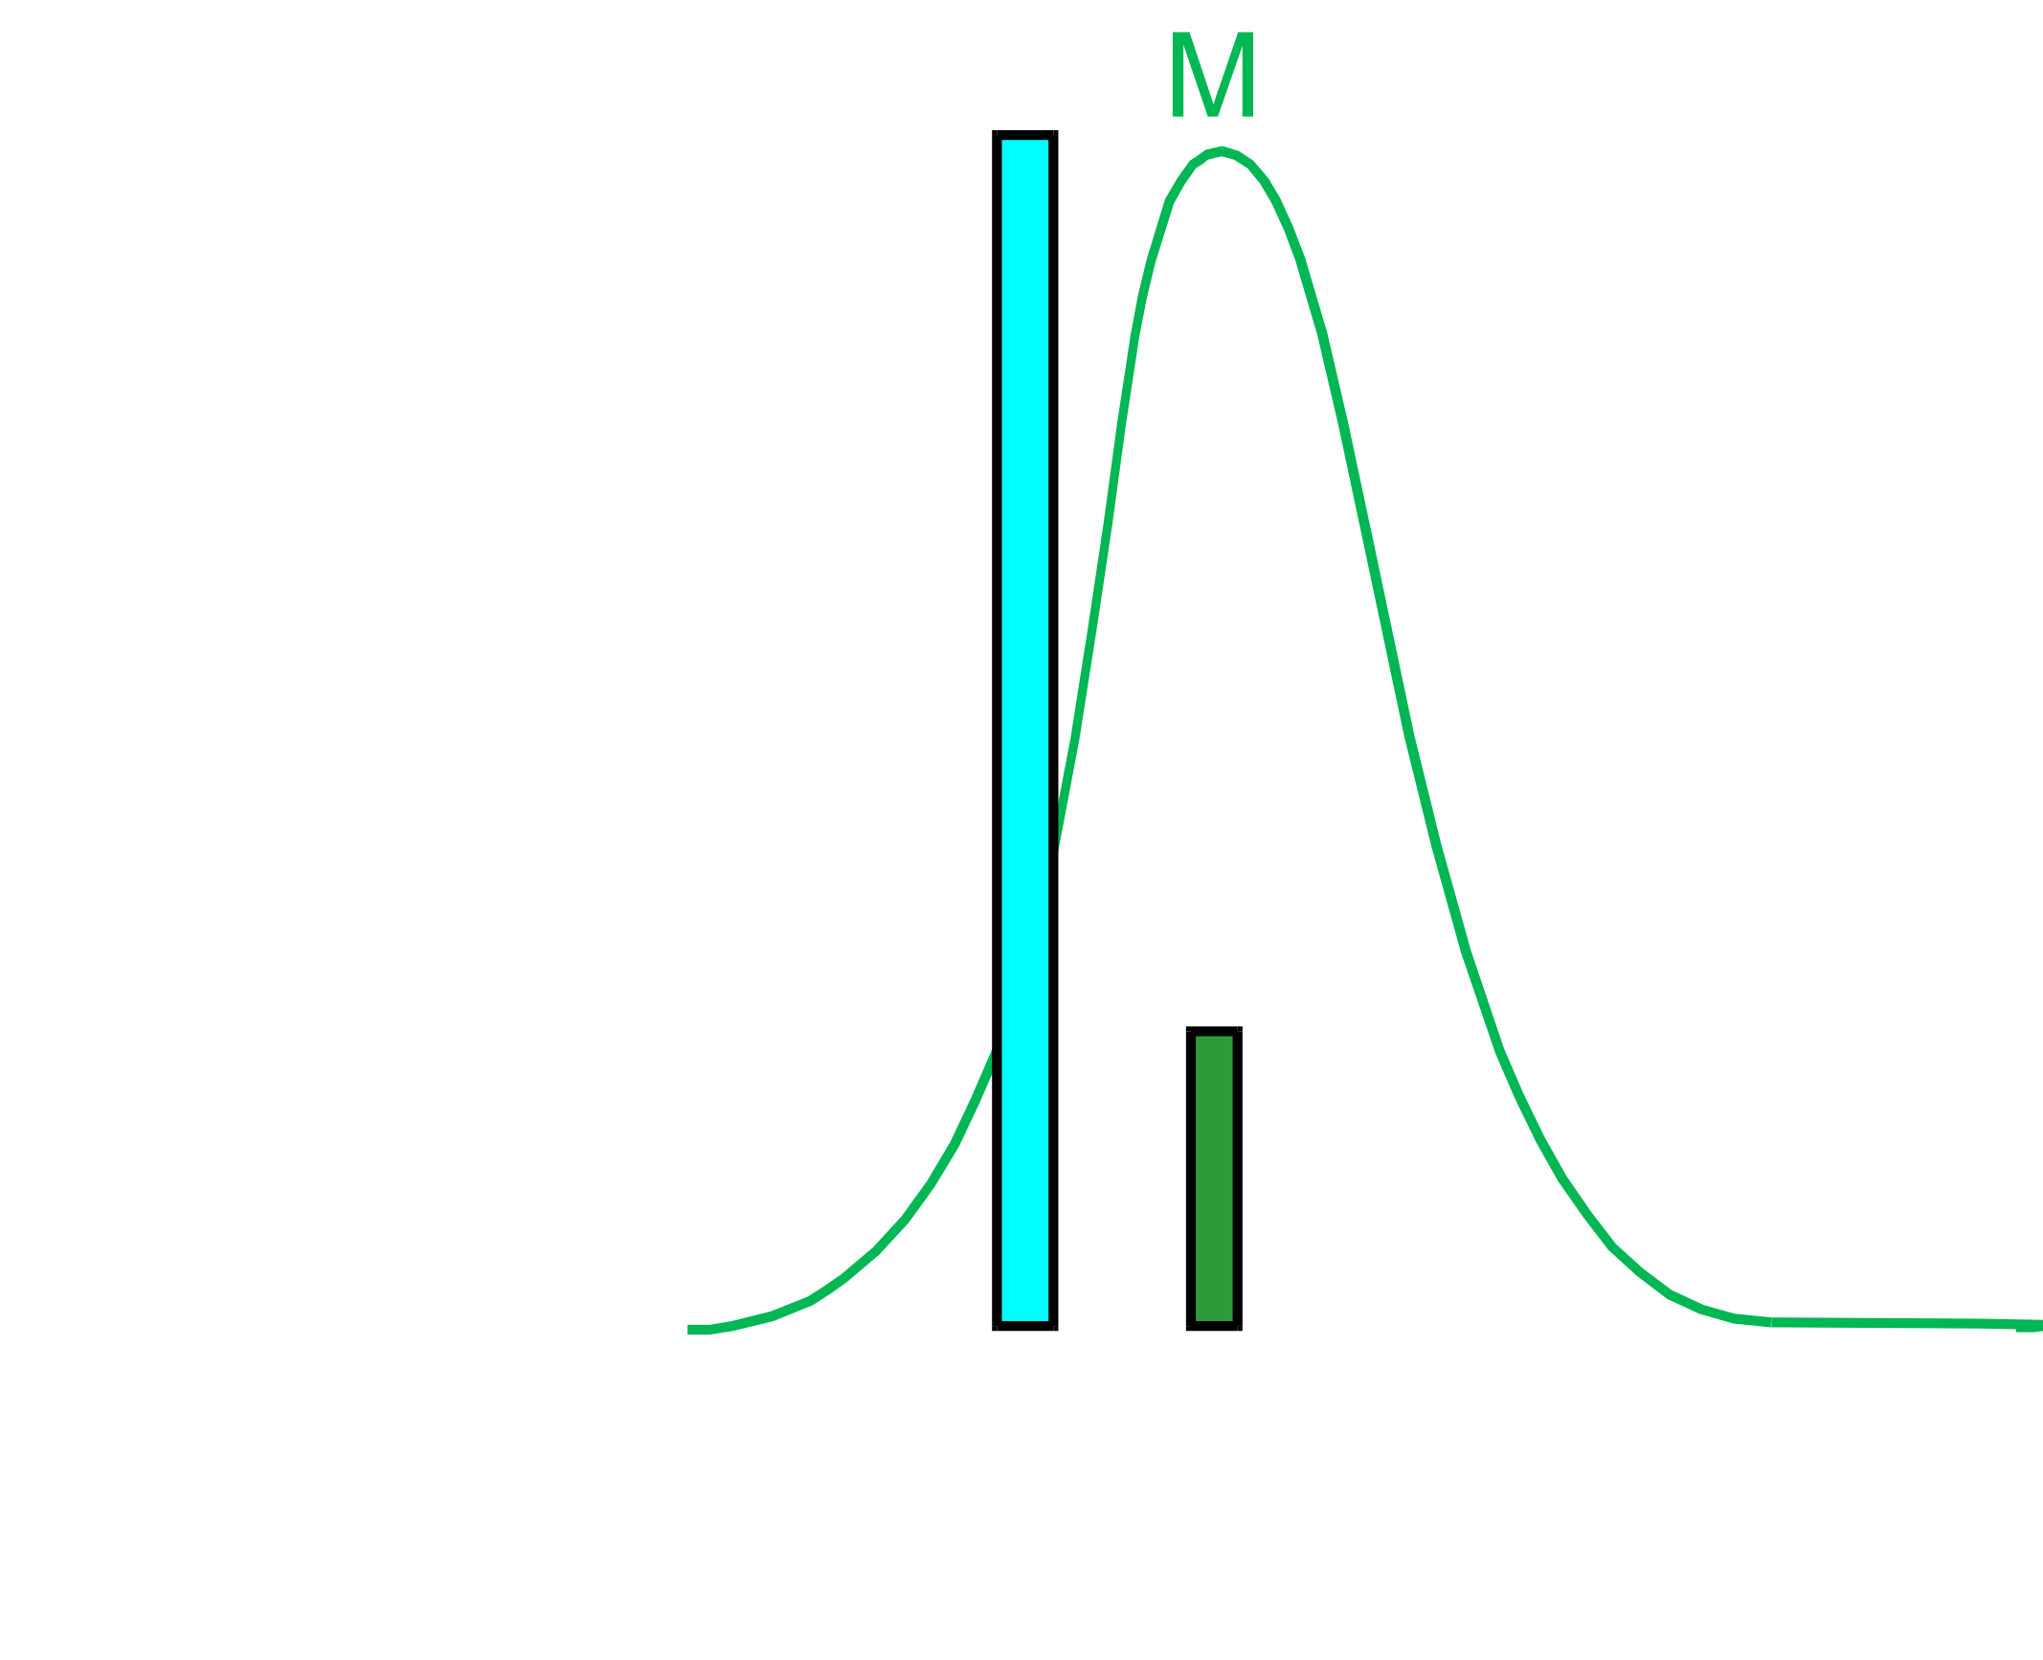
A cone does not “see” colors
Different wavelength, different intensity
Same response

Slide 72
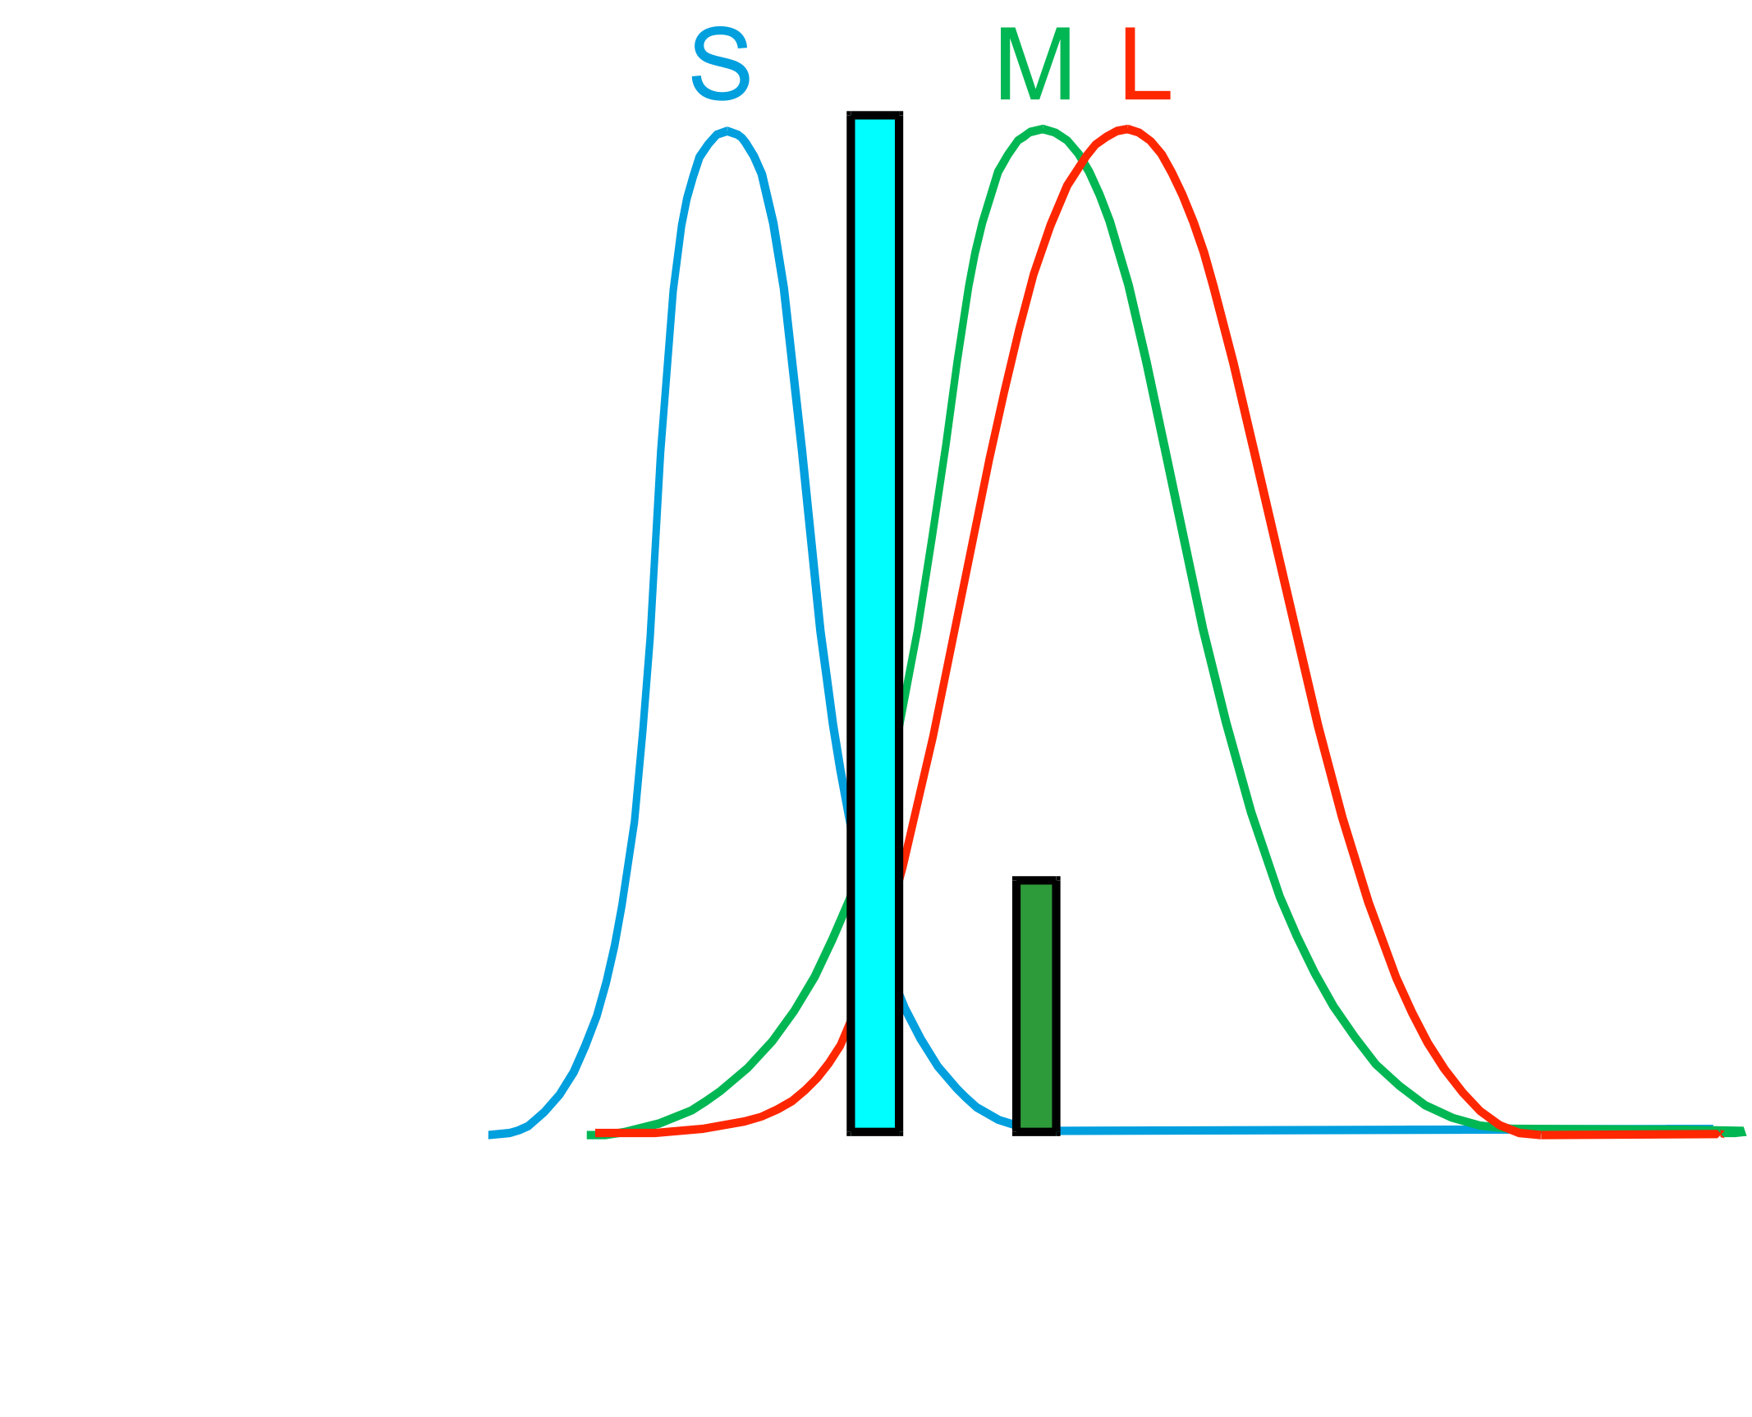
Response comparison
Different wavelength, different intensity
But different response for different cones

Slide 73
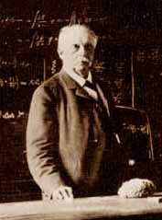
von Helmholtz 1859: Trichromatic theory
Colors as relative responses
(ratios)
Violet
Blue
Green
Yellow
Orange
Red
Violet
Blue
Green
Yellow
Orange
Red
Receptor Responses
Short wavelength receptors
Medium wavelength receptors
Long wavelength receptors
400 500 600 700
Wavelengths (nm)

Slide 74
References on different cones
http://hyperphysics.phy-astr.gsu.edu/hbase/vision/rodcone.html
http://www.blueconemonochromacy.org/what-is-bcm/eye-retina-and-cones-2/
http://webvision.med.utah.edu/book/part-iii-retinal-circuits/s-cone-pathways/
http://www.opticsinfobase.org/josa/abstract.cfm?uri=josa-57-11-1289
http://www.cvrl.org/database/text/intros/introdens.htm
http://www.cvrl.org/database/text/density/lmintro.htm

Slide 75
Metamers & color blindness

Slide 76
Plan
Spectra
Cones and spectral response
Color blindness and metamers
Color matching
Color spaces

Slide 77
Cone spectral sensitivity
Short, Medium and Long wavelength
Response for a cone
=∫ _{λ} stimulus(λ) * response(λ) dλ

Slide 78
Cone distribution
From Fairchild’s book.

Slide 79
Why is green so important
http://hyperphysics.phy-astr.gsu.edu/hbase/vision/rodcone.html
CIE brightness
  sum of 3 cones
blue is out of focus

Slide 80
Cone response
Start from infinite number of values
(one per wavelength)
End up with 3 values (one per cone type)
Stimulus
Cone responses
Multiply wavelength by wavelength
Integrate
1 number
1 number
1 number

Slide 81
Response comparison
Different wavelength, different intensity
But different response for different cones

Slide 82
Response comparison
Different wavelength, different intensity
But different response for different cones
differentiated

Slide 83
Color blindness
Classical case: 1 type of cone is missing (e.g. M)
Makes it impossible to distinguish some spectra
Normal observer
Color blind
differentiated
Same responses

Slide 84
Color blindness – more general
Dalton
~14%% male, 2% female
Genetic
Dichromate (2% male)
  One type of cone missing
  L (protanope), M (deuteranope),
  S (tritanope)
Anomalous trichromat
  Shifted sensitivity
More at, e.g. http://en.wikipedia.org/wiki/Color_blindness

Slide 86
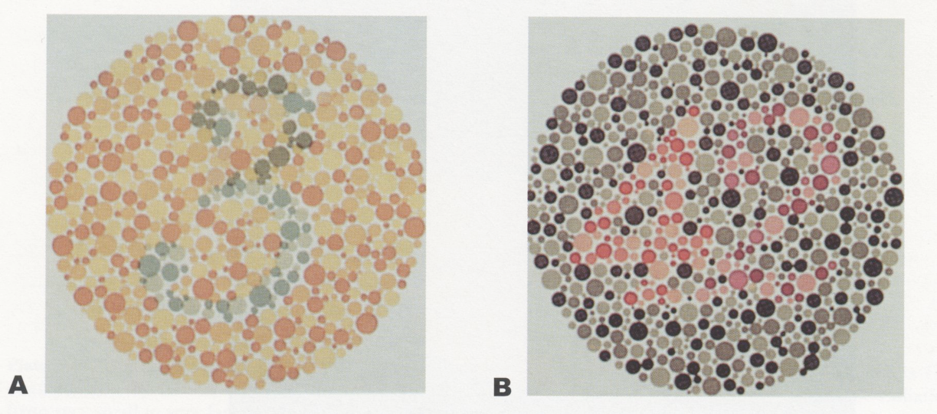
Color blindness test

Slide 87
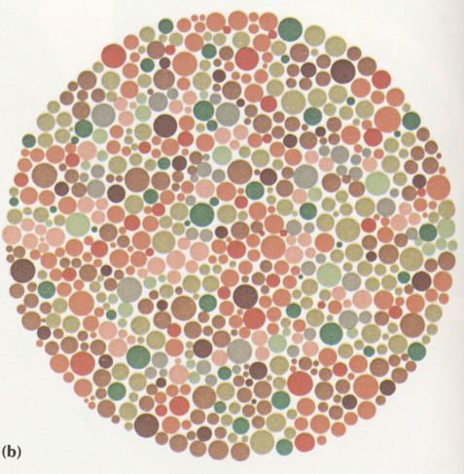
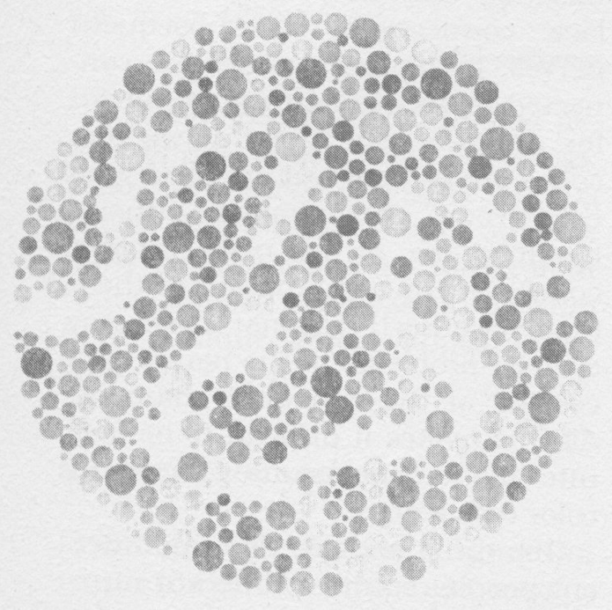
Color blindness test
Maze in subtle intensity contrast
Visible only to color blinds
Color contrast overrides intensity otherwise

Slide 88
Questions?
Links:
  Vischeck shows you what an image looks like to someone who is colorblind.
  http://www.vischeck.com/vischeck/
  Daltonize, changes the red/green variation to brightness and
  blue/yellow variations.
  http://www.vischeck.com/daltonize/
  http://www.vischeck.com/daltonize/runDaltonize.php

Slide 89
Metamers

Slide 90
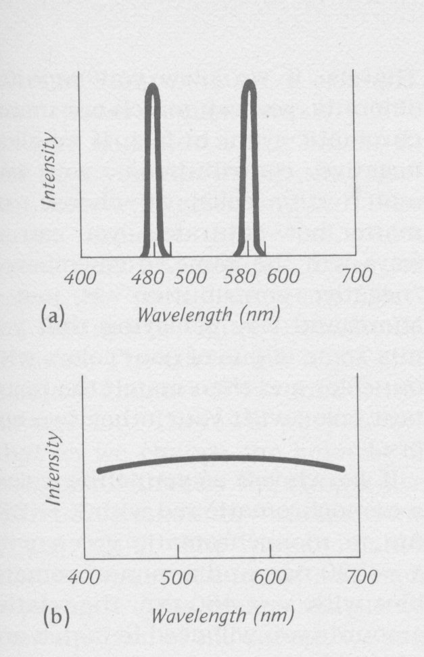
Metamers
We are all color blind!
These two different spectra elicit the same cone responses
Called metamers

Slide 91
Metamers
Essentially, we have projected from an infinite-dimensional spectrum to a 3D space:
we loose information
infinite set of bases
spectrum
spectrum
cone subspace (3D)

Slide 92
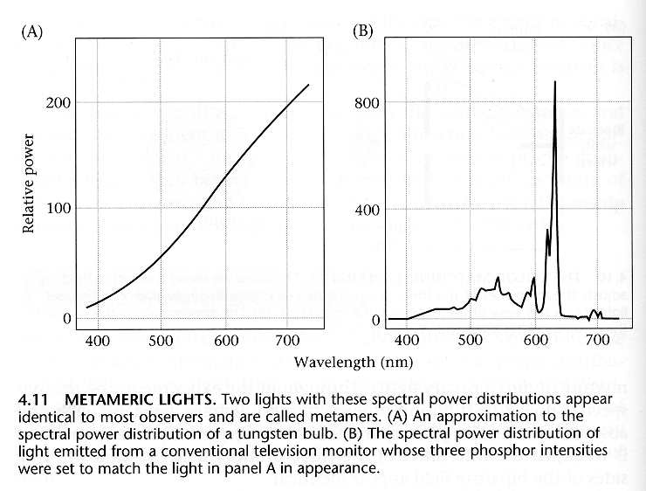
Metameric lights
Foundations of Vision, by Brian Wandell, Sinauer Assoc., 1995

Slide 93
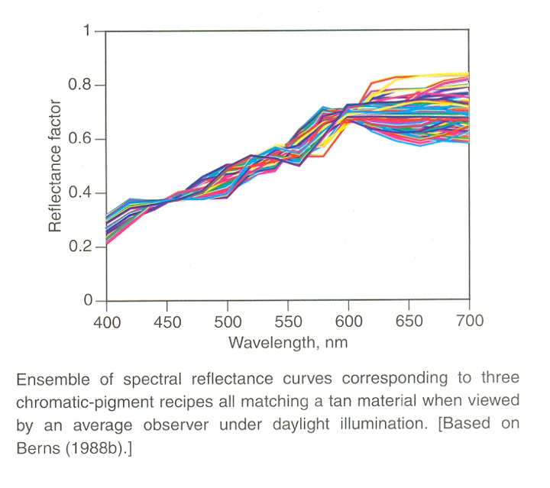
There is an infinity of metamers

Slide 94

Good news: color reproduction
3 primaries are
(to a first order) enough to reproduce all colors

Slide 95
Recap
Spectrum: infinite number of values
projected according to cone spectral response
=> 3 values
metamers: spectra that induce the same response
(physically different but look the same)
Questions?

Slide 96

Metamers allows for color matching
Reproduce the color of any test lamp
with the mixture of 3 given primary lights

Slide 97
Questions?

Slide 98
Metamerism & light source
Metamers under a given light source
May not be metamers under a different lamp

Slide 99

Illuminant metamerism example
Two grey patches in Billmeyer & Saltzman’s book look the same under daylight
but different under neon or halogen
(& my camera agrees ;-)
Daylight
Scan (neon)
Hallogen

Slide 100


Bad consequences: printing
http://www.inkjetart.com/2000p/metamerism.html
under 5000 degree Kelvin lighting
under cold cathode lamp

Slide 101
Bad consequence: cloth matching
Clothes appear to match in store (e.g. under neon)
Don’t match outdoor

Slide 102
Recap
Spectrum is an infinity of numbers
Projected to 3D cone-response space
  for each cone, multiply per wavelength and integrate
  a.k.a. dot product
Metamerism: infinite-D points projected to the same 3D point
(different spectrum, same perceived color)
  affected by illuminant
  enables color reproduction with only 3 primaries

Slide 103

Questions?
Meryon (a colorblind painter), Le Vaisseau Fantôme

Slide 104
Analysis & Synthesis
Now let’s talk about technology
We want to measure & reproduce color
as seen by humans
No need for full spectrum
Only need to match up to metamerism

Slide 105
Analysis & Synthesis
http://www.iriscam.info/PIXELS.html

Slide 106
Analysis & Synthesis
Focus on additive color synthesis
We’ll use 3 primaries (e.g. red green and blue) to match all colors
What should those primaries be?
How do we tell the amount of each primary needed to reproduce a given target color?
http://www.iriscam.info/PIXELS.html

Slide 107
Additive Synthesis - wrong way

Slide 108
Additive Synthesis - wrong way
Take a given stimulus and the corresponding responses s, m, l (here 0.5, 0, 0)

Slide 109
Additive Synthesis - wrong way

Slide 110
Additive Synthesis - wrong way
Use it to scale the cone spectra (here 0.5 * S)
You don’t get the same cone response!
(here 0.5, 0.1, 0.1)

Slide 111
What’s going on?
The three cone responses are not orthogonal
i.e. they overlap and “pollute” each other

Slide 112
Geometry

Slide 113
CIE color matching

Slide 114
Standard color spaces
We need a well-agreed color space
Many possible definition
  Including cone response (LMS)
  Unfortunately not really used,
  (because not known when colorimetry was invented)
The good news is that color vision is linear and
3-dimensional, so any new color space based on color matching can be obtained using 3x3 matrix
  But there are also non-linear color spaces
  (e.g. Hue Saturation Value, Lab)

Slide 115
Overview
Most standard color space: CIE XYZ
LMS and the various flavors of RGB are just linear transformations of the XYZ basis
  3x3 matrices

Slide 116
Difficulty with color science
The good:
  Lots of well-principled linear algebra
The bad
  non-orthogonal, non-negative
The ugly
  Historical reasons have multiplied the number of arbitrary choices

Slide 117

CIE
Commission Internationale de l’Eclairage
(International Lighting Commission)
Circa 1920
First in charge of measuring brightness for different light chromaticities (monochromatic wavelength)
Then color
  CIE XYZ space:
  most standard color space ever

Slide 118

CIE
First in charge of measuring brightness for different light chromaticities
Predict brightness of arbitrary spectrum (linearity)

Slide 119
Questions?

Slide 120
Why not measure cone sensitivity?
M
L
Less directly measurable
  electrode in photoreceptor?
  not available when color spaces were defined
Most directly available measurement:
  notion of metamers & color matching
  directly in terms of color reproduction:
  given an input color,
  how to reproduce it with 3 primary colors?
  Commission Internationale de l’Eclairage
  (International Lighting Commission)
  Circa 1920
Spectral
Sensibility
of the
L, M and S
Cones
S

Slide 121

CIE color matching
Given an input color,
how to reproduce it with 3 primary colors?
  (Idea by Maxwell)
Primaries

Slide 122
CIE color matching
Primaries (synthesis) at 435.8, 546.1 and 700nm
  Chosen for robust reproduction, good separation in red-green
  Don’t worry, we’ll be able to convert it to any other set of primaries (Linear algebra to the rescue!)
Resulting 3 numbers for each input wavelength are called tristimulus values
Primaries

Slide 123
Now, our interactive feature!
You are...
THE LAB RAT

Slide 125

Applet
http://graphics.stanford.edu/courses/cs178-10/applets/colormatching.html

Slide 126

Color Matching Problem
Some colors cannot be produced using only positively weighted primaries
Solution: add light on the other side!

Slide 127

CIE color matching
Meaning of these curves: a monochromatic wavelength λ can be reproduced with
b(λ) amount of the 435.8nm primary,
+g(λ) amount of the 546.1 primary,
+r(λ) amount of the 700 nm primary
This fully specifies the color
perceived by a human
Careful: this is not your usual rgb

Slide 128
CIE color matching
Meaning of these curves: a monochromatic wavelength λ can be reproduced with
b(λ) amount of the 435.8nm primary,
+g(λ) amount of the 546.1 primary,
+r(λ) amount of the 700 nm primary
This fully specifies the color
perceived by a human
However, note that one of
the responses can be
negative
  Those colors cannot be
  reproduced by those 3 primaries.

Slide 129
CIE color matching: what does it mean?

Slide 130
CIE color matching: what does it mean?
If I have a given spectrum X
I compute its response to the 3 matching curves
(multiply and integrate)
I use these 3 responses to
scale my 3 primaries
(435.8, 546.1 and 700nm)
I get a metamer of X
(perfect color reproduction)

Slide 131
Relation to cone curves
Project to the same subspace
  b, g, and r are linear combinations of S, M and L
Related by 3x3 matrix.
Unfortunately unknown at that time. This would have made life a lot easier!

Slide 132
CIE color matching
Primaries (synthesis) at 435.8, 546.1 and 700
Measure matching curves
as function of wavelength
(analysis)
Note that the primaries
(monochromatic
435.8, 546.1 and 700nm)
are not the same as
the matching curve!!!)

Slide 133
Illustration of negative numbers
Meaning of these curves: a monochromatic wavelength λ can be reproduced with
b(λ) amount of the 435.8nm primary,
+g(λ) amount of the 546.1 primary,
+r(λ) amount of the 700 nm primary
This fully specifies the color
perceived by a human

Slide 134
Recap
Spectra : infinite dimensional
Cones: 3 spectral responses
Metamers: spectra that look the same
(same projection onto cone responses)
CIE measured color response:
  chose 3 primaries
  tristimulus curves to reproduce any wavelength
Questions?

Slide 135
How to build a measurement device?
Idea:
  Start with light sensor sensitive to all wavelength
  Use three filters with spectra b, r, g
  measure 3 numbers
This is pretty much what the eyes do!

Slide 136

CIE’s problem
Idea:
  Start with light sensor sensitive to all wavelength
  Use three filters with spectra b, r, g
  measure 3 numbers
But for those primaries, we need negative spectra

Slide 137

CIE’s problem
Obvious solution:
use cone response!
  but unknown at the time
=>new set of tristimulus curves
  linear combinations of b, g, r
  pretty much add enough b and g
  until r is positive

Slide 138


CIE XYZ space
The most standard color space
Based on tristimulus curves
Y corresponds to luminance/brightness
Linear transform compared to RGB or LMS

Slide 139
XYZ to RGB & back
e.g. http://www.brucelindbloom.com/index.html?Eqn_RGB_XYZ_Matrix.html
sRGB to XYZ XYZ to sRGB
Adobe RGB to XYZ XYZ to Adobe RGB
NTSC RGB to XYZ XYZ to NTSC RGB
0.412424 0.212656 0.0193324
0.357579 0.715158 0.119193
0.180464 0.0721856 0.950444
3.24071 -0.969258 0.0556352
-1.53726 1.87599 -0.203996
-0.498571 0.0415557 1.05707
0.576700 0.297361 0.0270328
0.185556 0.627355 0.0706879
0.188212 0.0752847 0.991248
2.04148 -0.969258 0.0134455
-0.564977 1.87599 -0.118373
-0.344713 0.0415557 1.01527
0.606734 0.298839 0.000000
0.173564 0.586811 0.0661196
0.200112 0.114350 1.11491
1.91049 -0.984310 0.0583744
-0.532592 1.99845 -0.118518
-0.288284 -0.0282980 0.898611

Slide 140
CIE XYZ space: QUESTIONS?
The most standard color space
Based on tristimulus curves
Y corresponds to luminance/brightness
Linear transform compared to RGB or LMS

Slide 141
CIE XYZ
The most widely recognized color space
Linear transform of the original tristimuls curves
Y corresponds to brightness
(1924 CIE standard
photometric observer)
No negative value of
matching curve
But no physically-realizable
primary
(negative values in primary
rather than in matching curve)

Slide 142
Recap
CIE has performed color matching experiments
  chose primaries for reproduction (synthesis)
  for each wavelength, how much of each primary do we need
    => 3 analysis curves
  Then a little bit of linear algebra to make everything positive
    => 3 new analysis curves
Gives us XYZ color space
Linear transform to/from LMS, RGB

Slide 143
Chromaticity diagram

Slide 144
Color matching experiment
Monochromatic
light
Primaries at
435.8, 546.1
and 700nm

Slide 145
Color matching experiment 1

Slide 146
Color matching experiment 1
p₁ p₂ p₃

Slide 147
Color matching experiment 1
p₁ p₂ p₃

Slide 148
Color matching experiment 1
The primary color amounts needed for a match
p₁ p₂ p₃

Slide 149
Color matching experiment 2

Slide 150
Color matching experiment 2
p₁ p₂ p₃

Slide 151
Color matching experiment 2
p₁ p₂ p₃

Slide 152
Color matching experiment 2
The primary color amounts needed for a match:
We say a “negative” amount of p₂ was needed to make the match, because we added it to the test color’s side.
p₁ p₂ p₃
p₁ p₂ p₃
p₁ p₂ p₃

Slide 153
LMS to XYZ matrix
I so wish that’s what they had done!

Slide 154
CIE XYZ
The most widely recognized color space
A number of the motivations are historical
Now we’re stuck with it ;-)
But remember, it is always
good to agree on a standard
Although, well, there are
two versions of CIE XYZ
(1931 and 1964)
We’ll ignore this!

Slide 155
Chromaticity diagrams: motivation
3D space are tough to visualize
Chrominance is our notion of color, as opposed to brightness/luminance
Recall that our eyes correct for multiplicative scale factors
  discount light intensity

Slide 156


Chromaticity diagrams
Project XYZ to 2D
normalize against by X + Y + Z:
  equivalent to perspective projection to plane X+Y+Z=1

Slide 157

Applet
http://graphics.stanford.edu/courses/cs178-10/applets/threedgamut.html

Slide 158
CIE XYZ -recap
THE standard for color specification
Lots of legacy decision - I wish it were LMS
Based on color matching
  3 monochromatic primaries
  Subjects matched every wavelength
  Tricks to avoid negative numbers
  These 3 values “measure”
  or describe a perceived color.

Slide 159

Other primaries
We want to use a new set of primaries
  e.g. the spectra of R, G & B in a projector or monitor
By linearity of color matching,
can be obtained from XYZ by a 3x3 matrix
one example RGB space

Slide 160
Other primaries
We want to use a new set of primaries
  e.g. the spectra of R, G & B in a projector or monitor
By linearity of color matching,
can be obtained from XYZ by a 3x3 matrix
This matrix tells us how to match the 3 primary spectra from XYZ using the new 3 primaries
one example RGB space

Slide 161
CIE color space
Can think of X, Y , Z as coordinates
Linear transform from typical RGB or LMS
Always positive
(because physical spectrum is positive and matching curves are positives)

Slide 162
Color gamut
Given 3 primaries
The realisable chromaticities lay in the triangle in xy chromaticity diagram
Because we can only add light, no negative light
C

Slide 163

http://graphics.stanford.edu/courses/cs178-10/applets/gamutmapping.html

Slide 164

RGB limitations
http://dba.med.sc.edu/price/irf/Adobe_tg/manage/images/gamuts.jpg
http://www.petrvodnakphotography.com/Articles/ColorSpace.htm

Slide 165
Recap
Metamers enable color reproduction
CIE defined XYZ using color matching experiments
Linear transform to/from RGB or LMS
Chromaticity diagram: 2D version,
remove luminance
Lack of negative numbers makes life hard

Slide 166
In summary
It’s all about linear algebra
  Projection from infinite-dimensional spectrum to a 3D response
  Then any space based on color matching and metamerism can be converted by 3x3 matrix
Complicated because
  Projection from infinite-dimensional space
  Non-orthogonal basis (cone responses overlap)
  No negative light
XYZ is the most standard color space
RGB has many flavors

Slide 167
Questions?
Metamers enable color reproduction
CIE defined XYZ using color matching experiments
Linear transform to/from RGB or LMS
Chromaticity diagram: 2D version,
remove luminance
Lack of negative numbers makes life hard

Slide 168
Questions?
Chromaticity of crayons
http://www.photo-mark.com/notes/2011/sep/20/crayon-colors/

Slide 169
Take home message
Cone spectra are non-orthogonal
Analysis spectrum (camera, eyes)
cannot be the same as synthesis one (display)
Impossible to encode all possible colors without something negative
  CIE XYZ only needs positive coordinates,
  but would need primaries with negative light
  RGB can use physical (non-negative) primaries,
  but needs negative coordinates for some colors

Slide 170
Warning: Tricky thing with color
Spectrum for the stimulus / synthesis
  Light, monitor, reflectance
Response curve for receptor /analysis
  Cones, camera, scanner

Slide 171
Warning: Tricky thing with color
Spectrum for the stimulus / synthesis
  Light, monitor, reflectance
Response curve for receptor /analysis
  Cones, camera, scanner
Usually not the same
Because cone responses are not orthogonal

Slide 172
Same as non-orthogonal bases
Non orthogonal bases are harder to handle
Can’t use dot product on same vector to infer coordinates
  Same problem as with cones, the i & j components pollute each other
j
x.i i + x.j j
x
x != x.i i + x.j j
i

Slide 173
Same as non-orthogonal bases
Non orthogonal bases are harder to handle
Can’t use dot product on same vector to infer coordinates
Need a so-called dual basis
  Same for color: different basis for analysis/ synthesis
^
j
j
x
^
^
x = x.i i + x.j j
i
^
Note that i has negative coordinates
^
i

Slide 174
Fundamental problems
Spectra are infinite-dimensional
Only positive values are allowed
Cones are non-orthogonal/overlap

Slide 175
Summary
Physical color
  Spectrum
  multiplication of light & reflectance spectrum
Perceptual color
  Cone spectral response: 3 numbers
  Metamers: different spectrum, same responses
    Color matching, enables color reproduction with 3 primaries
Fundamental difficulty
  Spectra are infinite-dimensional (full function)
  Projected to only 3 types of cones
  Cone responses overlap / they are non-orthogonal
    Means different primaries for analysis and synthesis
  Negative numbers are not physical

Slide 176
Questions?

Slide 177
Selected Bibliography
Vision Science
by Stephen E. Palmer
MIT Press; ISBN: 0262161834
760 pages (May 7, 1999)
Billmeyer and Saltzman's Principles of Color Technology, 3rd Edition
by Roy S. Berns, Fred W. Billmeyer, Max Saltzman
Wiley-Interscience; ISBN: 047119459X
304 pages 3 edition (March 31, 2000)
Vision and Art : The Biology of Seeing
by Margaret Livingstone, David H. Hubel
Harry N Abrams; ISBN: 0810904063
208 pages (May 2002)

Slide 178
Selected Bibliography
The Reproduction of Color
by R. W. G. Hunt
Fountain Press, 1995
Color Appearance Models
by Mark Fairchild
Addison Wesley, 1998

Slide 179
Selected Bibliography

Slide 180
Questions?

Slide 181
Color perception
sensor
percept
spatial
ability to see difference (discrimination)
Do these color match?
How do I encode & communicate color?
How do we build color measurement and reproduction technology?

Slide 182
Lightroom

Slide 183
Why is green so important
http://hyperphysics.phy-astr.gsu.edu/hbase/vision/rodcone.html
CIE brightness
  sum of 3 cones
blue is out of focus

Slide 184
But surprisingly, more L cones

Slide 185
From Fairchild’s book.

Slide 186
http://www.blueconemonochromacy.org/what-is-bcm/eye-retina-and-cones-2/
http://webvision.med.utah.edu/book/part-iii-retinal-circuits/s-cone-pathways/
http://www.opticsinfobase.org/josa/abstract.cfm?uri=josa-57-11-1289
http://www.cvrl.org/database/text/intros/introdens.htm
http://www.cvrl.org/database/text/density/lmintro.htm

Slide 187
Motivations
Various color spaces
Percepts
Devices, ability to reproduce colors
What do we need color spaces for
  encode images (better quantization)
  manipulate images (e.g. saturation, etc.)
  reproduce color (camera to projector), different filters, lasers
  GUI
  predict differences

Slide 188
Check out the demo applets
http://graphics.stanford.edu/courses/cs178-10/applets/locus.html
http://graphics.stanford.edu/courses/cs178-10/applets/colormatching.html
http://graphics.stanford.edu/courses/cs178-10/applets/threedgamut.html
http://graphics.stanford.edu/courses/cs178-10/applets/gamutmapping.html
http://graphics.stanford.edu/courses/cs178-10/applets/colormixing.html
http://graphics.stanford.edu/courses/cs178-10/applets/gamma.html

