Slide 1
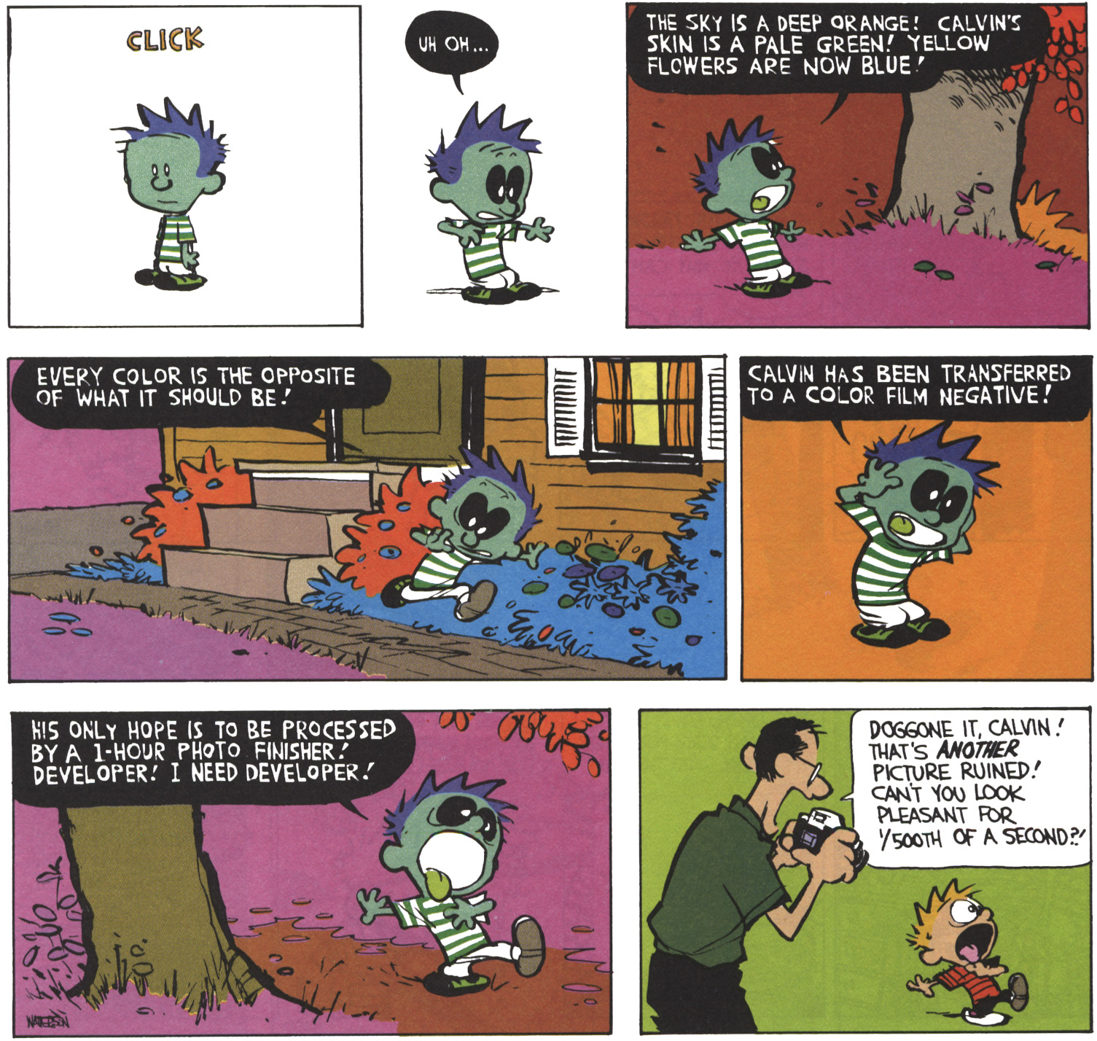
Questions?

Slide 2
Discuss gamma

Slide 3
Demosaicking
Fredo Durand
MIT EECS 6.8370/1

Slide 4
Clarification for pset 2
Flipping
  You will have to do the flip
  (use minus sign for x’, y’)
Centering kernels
  We will only use odd widths
Bilateral distance: 3D in RGB
  And remember to center it on current central pixel
  Use same range term for all 3 channels
Don’t precompute, don’t truncate rangeGaussian

Slide 5
Bayer mosaic

Slide 6
Sensor
http://www.currentprotocols.com/WileyCDA/CPUnit/refId-ns0204.html

Slide 7
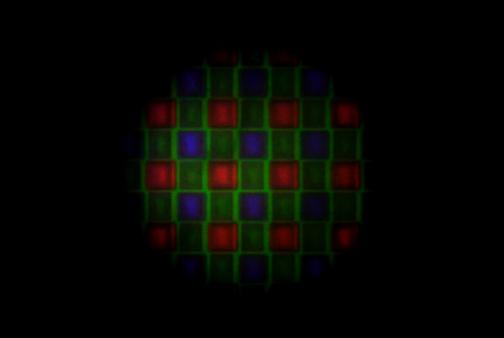
Microscope view of a CCD
By kevincollins123
http://www.flickr.com/photos/kevincollins123/4584180753/

Slide 8
http://www.flickr.com/photos/kevincollins123/4403895678/

Slide 9
Bayer RGB mosaic
Each photosite has a different color filter
Note that which one is the upper left color is arbitrary and depends on the camera

Slide 10
Bayer RGB mosaic
Why more green?
    We have 3 channels and square lattices don’t like odd numbers
    It’s the spectrum “in the middle”
    More important to human perception of luminance

Slide 11
RAW files
Straight measurement from sensor
  right after A/D conversion(well, kind of)
Each photosite has only one value
  Filtered by R, G or B
Usually 12-14 bits per pixel
Linear encoding
  No gamma!
Can be read and converted using dcraw
  ./dcrawx86 -v -d pics/DSC_8274.nef
  http://www.mit.edu/~kimo/blog/linear.html

Slide 12
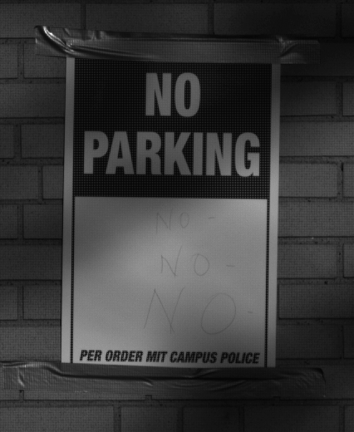


A RAW file
From a Nikon D70

Slide 13
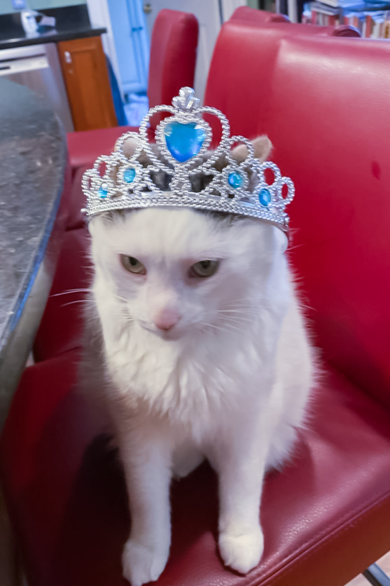
Questions?

Slide 14
Demosaicking

Slide 15
Demosaicing
Interpolate missing values
?
?
?
?
?
?
?
?
?
?
?
?
?
?
?
?
?
?
?
?
?
?
?
?
?
?
?
?
?
?
?
?
?
?
?
?
?
?
?
?
?
?
?
?
?
?
?
?
?
?
?
?
?
?
?
?
?
?
?
?
?
?
?
?
?
?
?
?
?
?
?
?

Slide 16
Demosaicing
Simplest solution: downsample!
  Nearest-neighbor reconstruction
  Problems:
    resolution loss
    color artifacts at edges

Slide 17
Linear interpolation
Average of the 4 or 2 nearest neighbors
  Linear (tent) kernel
For example:
newgreen=
?
?
?
?
?
?
?
?
?
?
?
?
?
?
?
?
?
?
?
?
?
?
?
?
?
?
?
?
?
?
?
?
?
?
?
?
?
?
?
?
?
?
?
?
?
?
?
?
?
?
?
?
?
?
?
?
?
?
?
?
?
?
?
?
?
?
?
?

Slide 18
Linear interpolation
Average of the 4 or 2 nearest neighbors
  Linear (tent) kernel
For example:
newgreen=0.25(up+left+right+down)
?
?
?
?
?
?
?
?
?
?
?
?
?
?
?
?
?
?
?
?
?
?
?
?
?
?
?
?
?
?
?
?
?
?
?
?
?
?
?
?
?
?
?
?
?
?
?
?
?
?
?
?
?
?
?
?
?
?
?
?
?
?
?
?
?
?
?
?

Slide 19
Better
Smoother kernels can also be used (e.g. bicubic) but need wider support
?
?
?
?
?
?
?
?
?
?
?
?
?
?
?
?
?
?
?
?
?
?
?
?
?
?
?
?
?
?
?
?
?
?
?
?
?
?
?
?
?
?
?
?
?
?
?
?
?
?
?
?
?
?
?
?
?
?
?
?
?
?
?
?
?
?
?
?

Slide 20
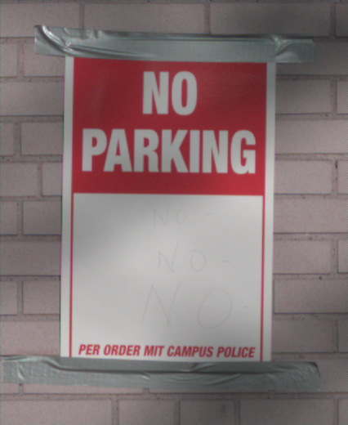
Results of simple linear

Slide 21
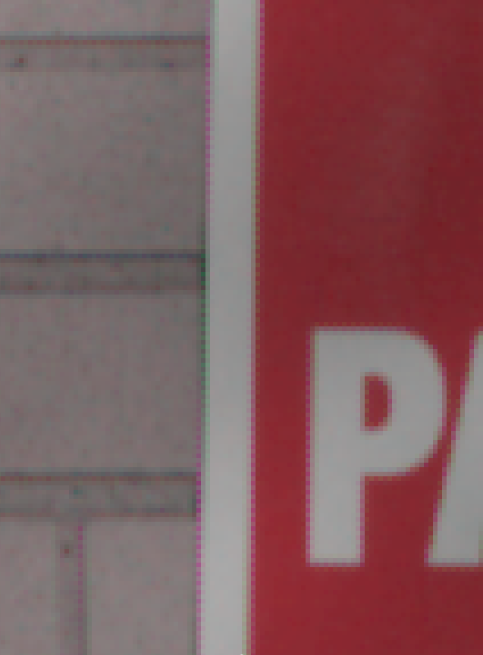
Results - not perfect

Slide 22
Questions?

Slide 23
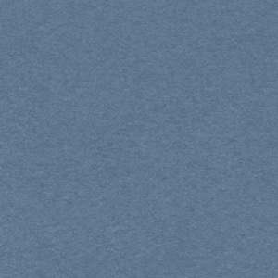
The problem
Imagine a black-on-white corner
Let’s focus on the green channel for now
?
?
?
?
?
?
?
?
?
?
?
?
?
?
?
?
?
?

Slide 24
The problem
Imagine a black-on-white corner
?
?
?
0
0
1
?
?
?
0
0
1
?
?
?
0
0
1
?
?
?
0
0
1
?
?
?
1
1
1
?
?
?
1
1
1

Slide 25
The problem
Imagine a black-on-white corner
?
?
?
0
0
1
0
0
0
.25
1
1
?
?
?
0
0
1
0
0
0
0
.75
1
?
?
?
0
0
1
0
0
0
.25
1
.1
?
?
?
0
0
1
.25
0
.25
0
.75
1
?
?
?
1
1
1
1
.75
1
.75
1
1
?
?
?
1
1
1
1
1
1
1
1
1

Slide 26
The problem
Imagine a black-on-white corner
?
?
?
0
0
1
0
0
0
.25
1
1
?
?
?
0
0
1
0
0
0
0
.75
1
?
?
?
0
0
1
0
0
0
.25
1
.1
?
?
?
0
0
1
.25
0
.25
0
.75
1
?
?
?
1
1
1
1
.75
1
.75
1
1
?
?
?
1
1
1
1
1
1
1
1
1

Slide 27
Yep, that’s what we saw

Slide 28
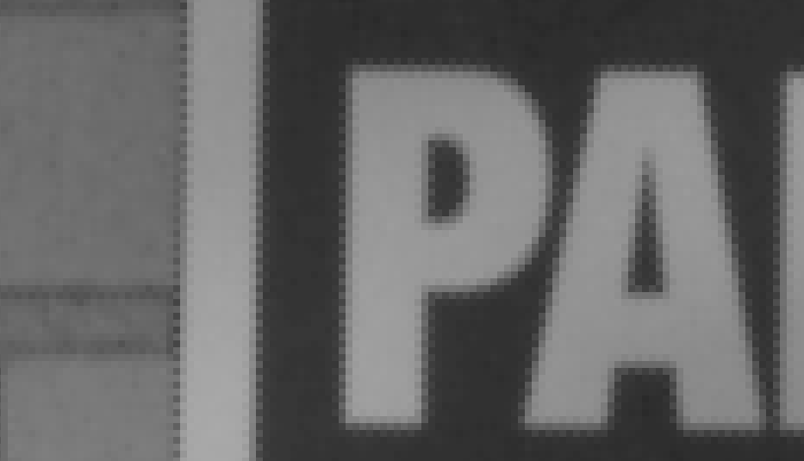
Green channel

Slide 29
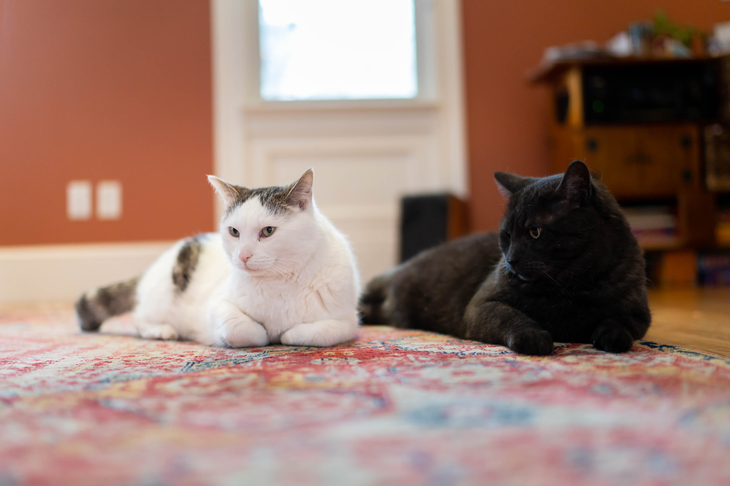
Questions?

Slide 30
Edge-based Demosaicking

Slide 31
Idea
Take into account structure in image
  Here, 1D edges
Interpolate along preferred direction
  In our case, only use 2 neighbors
0
0
1
0
0
1
0
0
1
0
0
1
1
1
1
1
1
1

Slide 32
Idea
Take into account structure in image
  Here, 1D edges
Interpolate along preferred direction
  In our case, only use 2 neighbors
0
0
1
0
0
1
0
0
1
0
0
1
1
1
1
1
1
1

Slide 33
How do we decide
Look at the similarity of recorded neighbors
  Compare |up-down| and |right-left|
  Be smart
  See pset 4
Called edge-based demosaicking
0
0
1
0
0
1
0
0
1
0
0
1
1
1
1
1
1
1

Slide 34
Green channel -- naive

Slide 35
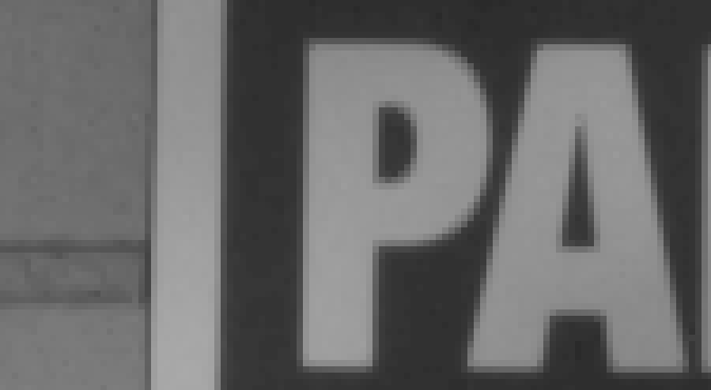
Green channel -- edge-based

Slide 36
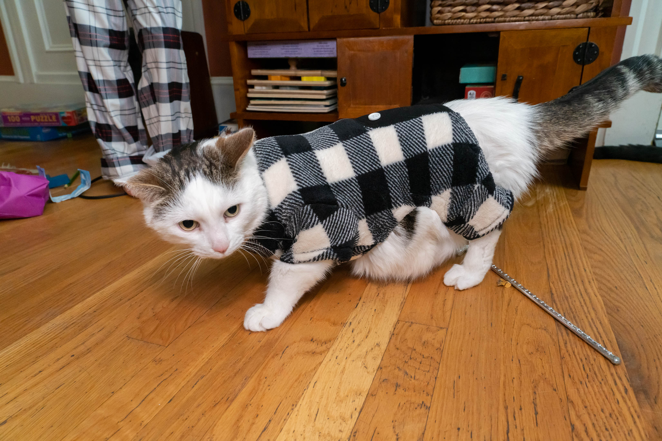

Slide 37
Challenge with other channels

Slide 38
Problem
What do we do with red and blue?
We could apply the edge-based principle
But we’re missing more information
But color transitions might be shifted

Slide 39
Example
Black on white corner
Notion of edge-based unclear for pixels in empty rows or columns
?
?
?

Slide 40
Example
Black on white corner
Even if we imagine we can do some decent job for each channel

Slide 41
Example
Black on white corner
Even if we imagine we can do some decent job for each channel
The channels don’t line up
  Because they are not recorded at the same location

Slide 42
Example
Bad color fringes!

Slide 43
Recall color artifacts

Slide 44
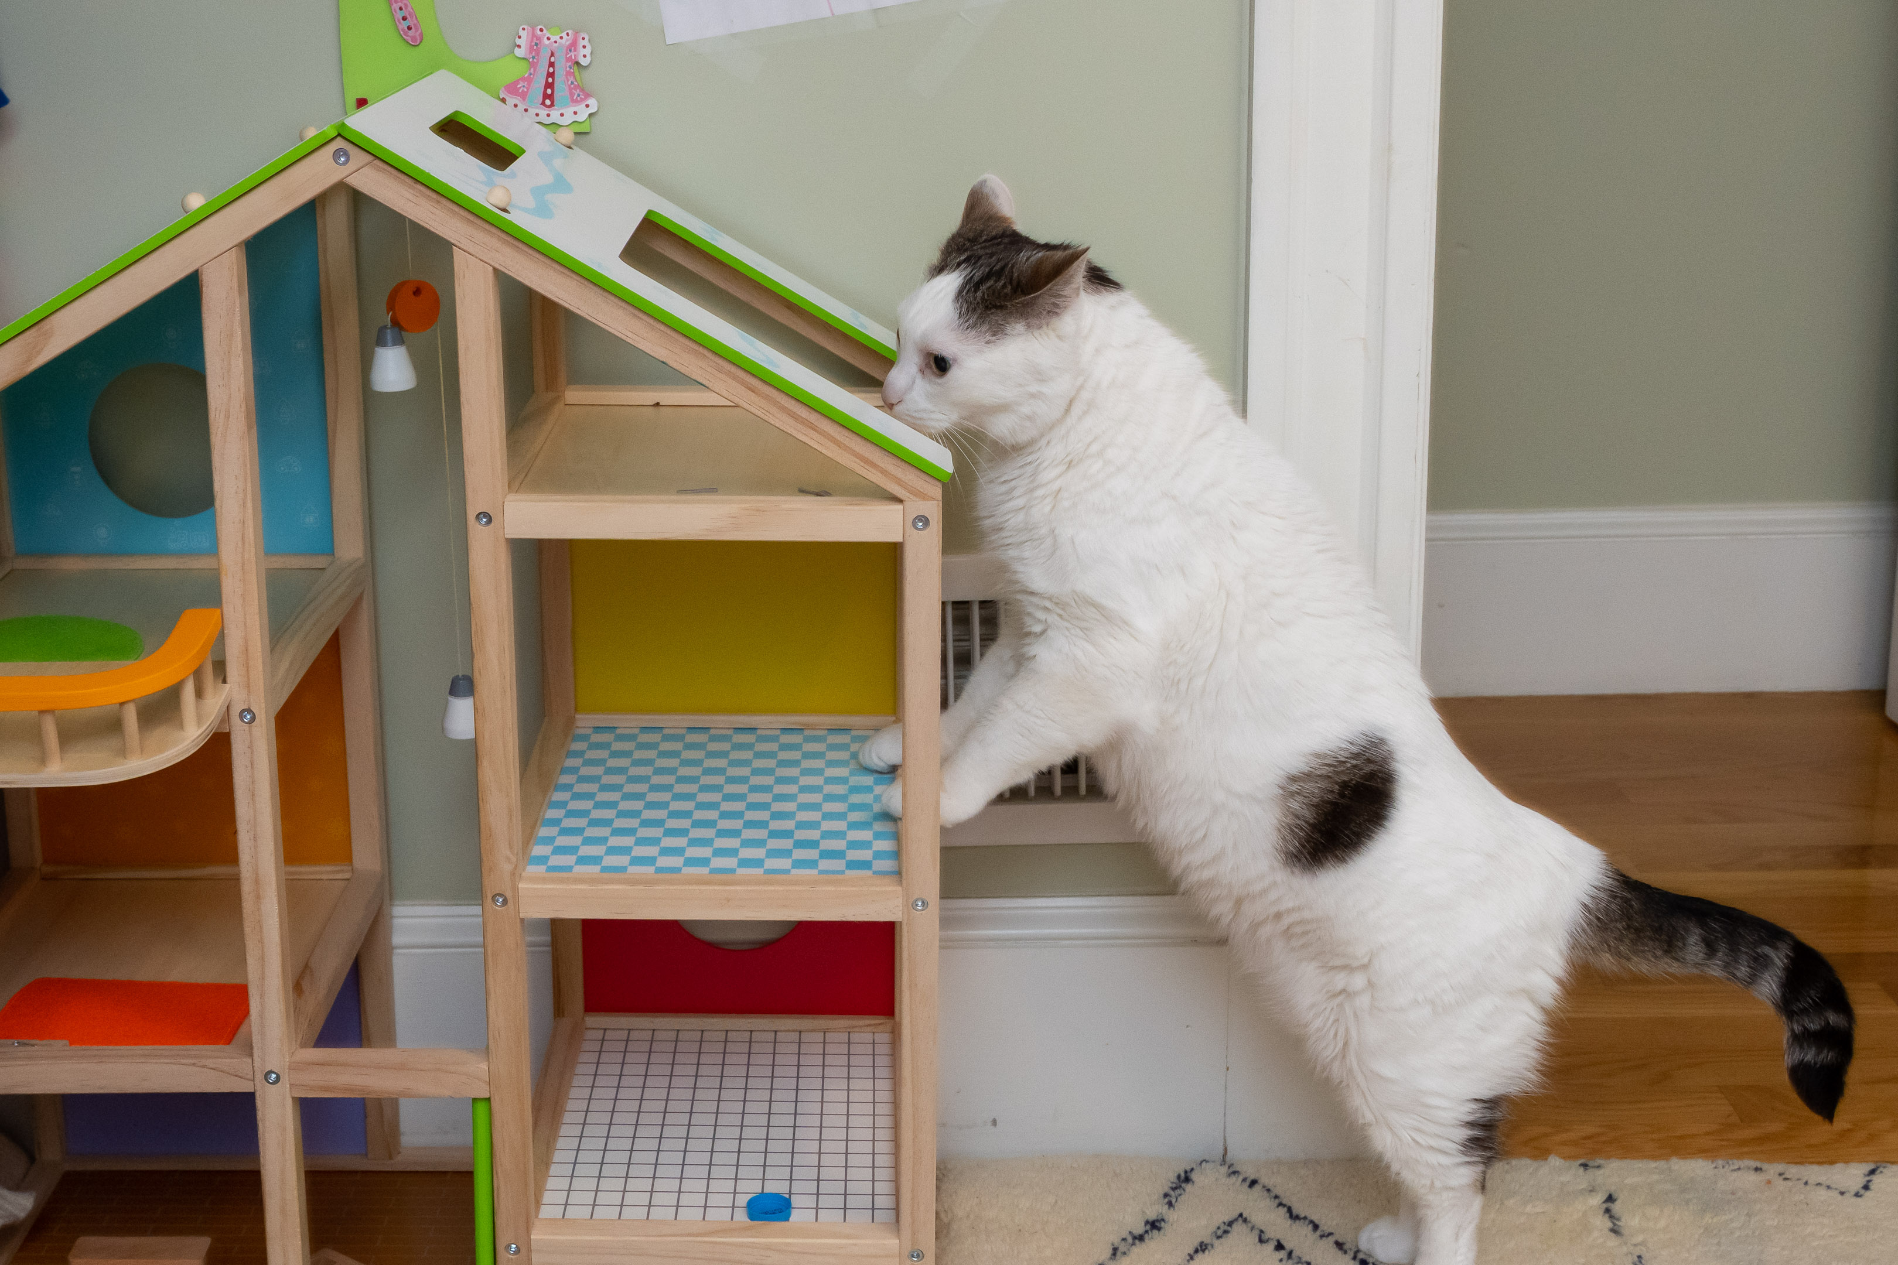
Questions?

Slide 45
Green-based Demosaicking

Slide 46
Green-based demosaicking
Green is a better color channel
  Twice as many pixels
  Often better SNR
  We know how to do edge-based green interpolation
Do the best job you can and get high resolution from green
Then use green to guide red & blue interpolation

Slide 47
Interpolate difference to green
Interpolate green
  using e.g. edge-based
For recorded red pixels
  compute R-G
At empty pixels
  Interpolate R-G naively
  Add G
Same for blue

Slide 48
Black on white corner

Slide 49
Measurements

Slide 50
Edge-based green

Slide 51
Red-Green difference
Zero everywhere!

Slide 52
Red-Green interpolation
Easy!

Slide 53
Add back green

Slide 54
Same for blue

Slide 55
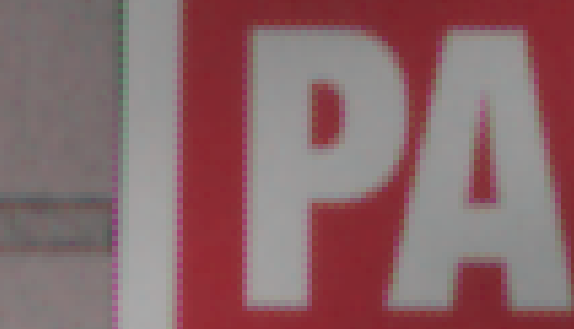
Fully naive

Slide 56
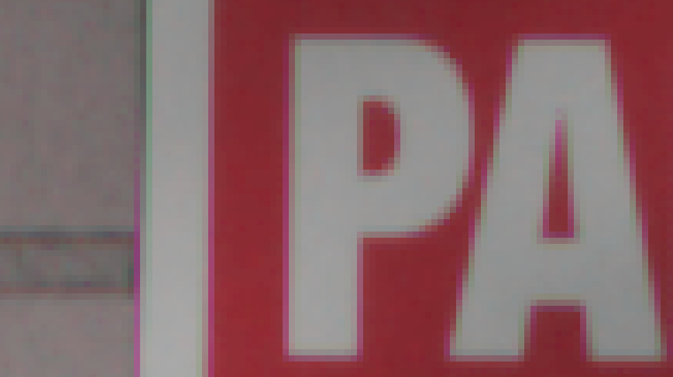
Edge-based green, naive red blue

Slide 57
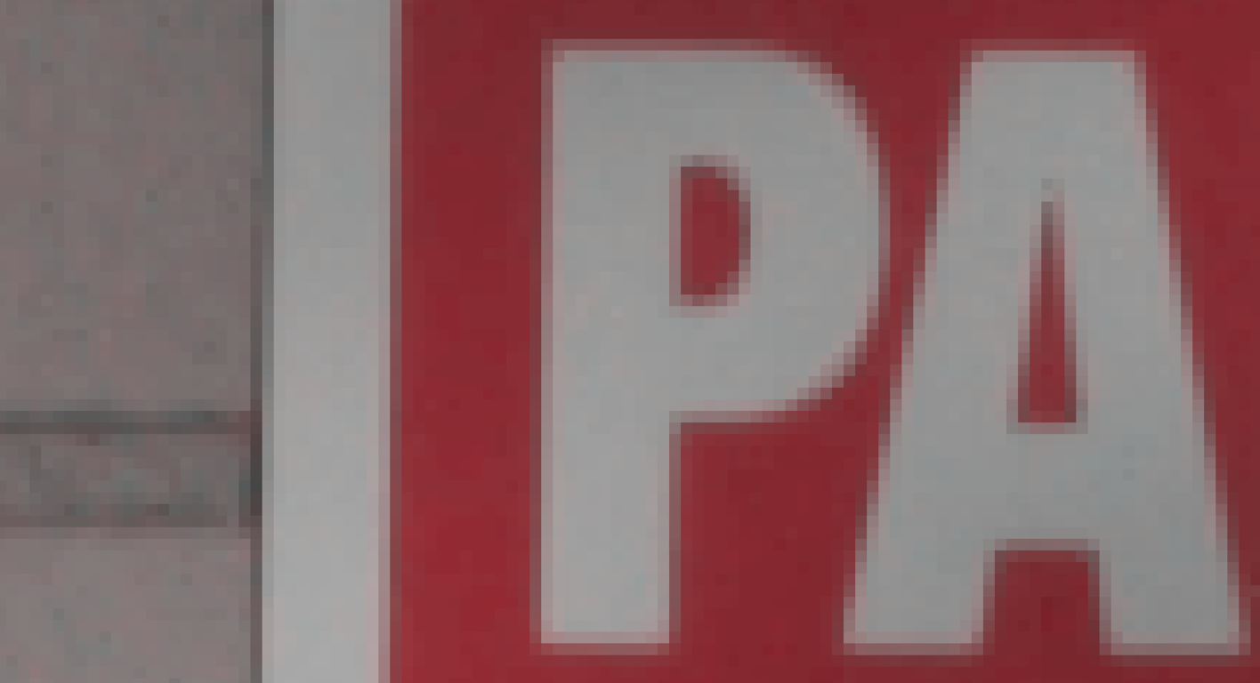
Green-based blue and red

Slide 58

Still not 100% perfect
But will be good enough for pset 4

Slide 59
Reference
What we do essentially follows
https://patents.google.com/patent/US5382976A/en
Inventor Robert H. Hibbard (Kodak)

Slide 60
Questions?

Slide 61
Alternative
Interpolate ratio

Slide 62
Challenges

Slide 63
Play with Lightroom
What have we implemented already?
  White balance
  exposure, brightness, contrast
  histogram
  sharpen
  saturate, vibrance
  crop, rotate
  denoise

Slide 64
Note that you get full bandwidth in the vertical and horizontal direction
Who can give me the 2D Fourier bandwidth?

Slide 65
antialiasing filter

Slide 66
Edge cases
http://www.luminous-landscape.com/contents/DNG-Recover-Edges.shtml
http://www.luminous-landscape.com/forum/index.php?topic=51328.0

Slide 67
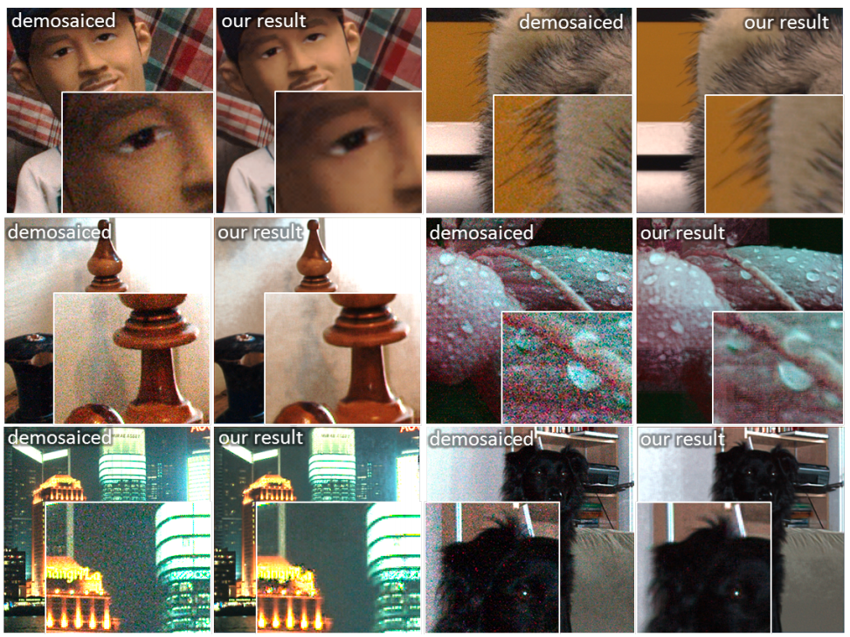
Denoising & Demosaicking
http://research.microsoft.com/en-us/UM/people/yasumat/papers/lowlight_CVPR11.pdf

Slide 68
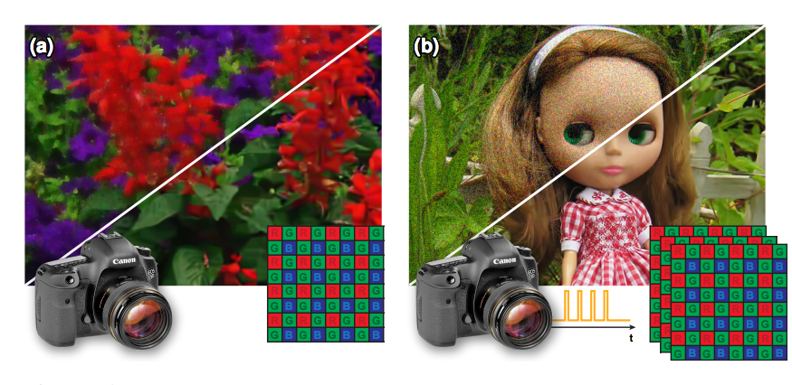
Demosaick+denoise+…
https://research.nvidia.com/publication/flexisp-flexible-camera-image-processing-framework

Slide 69
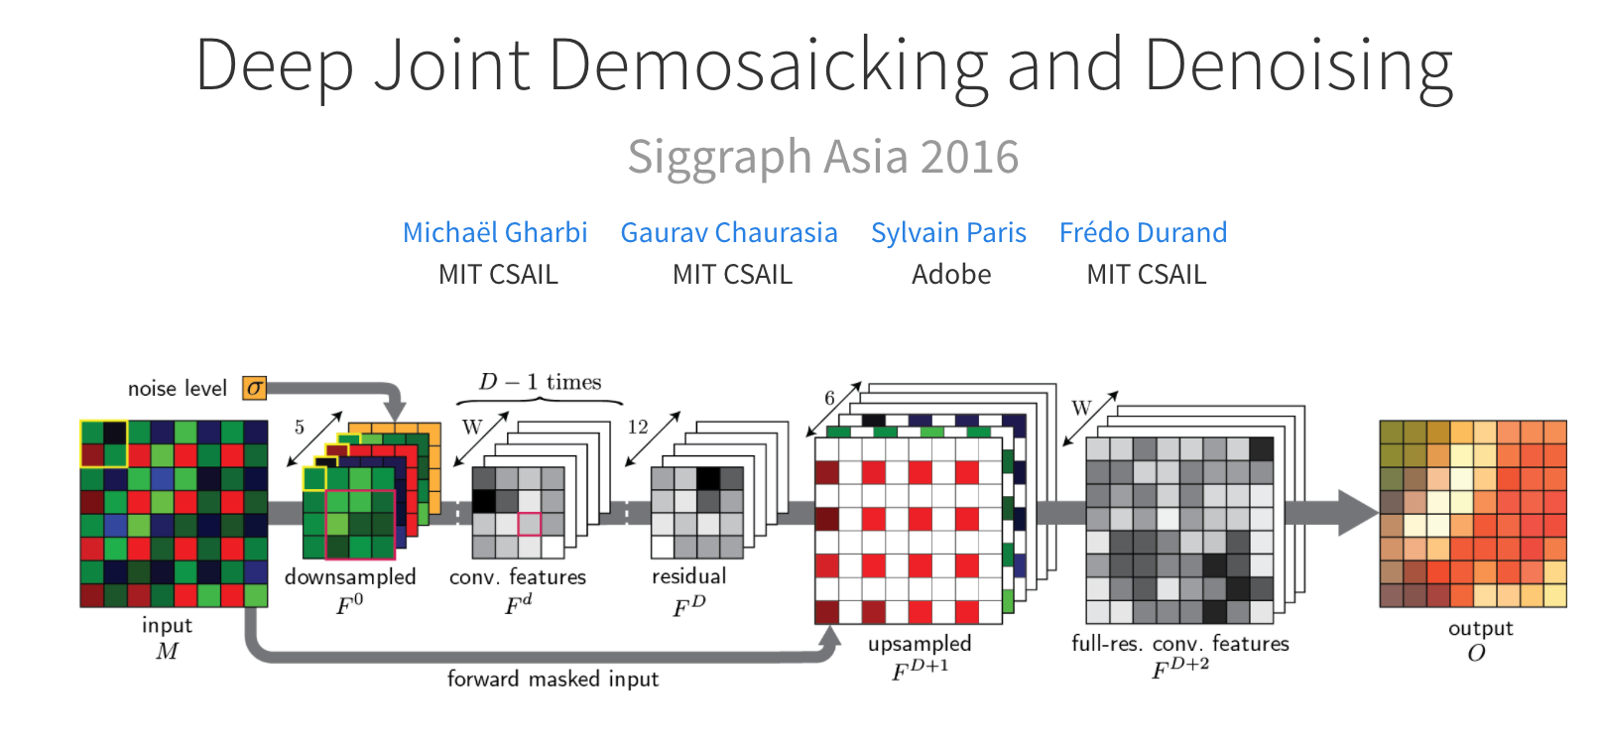
https://groups.csail.mit.edu/graphics/demosaicnet/
Now in Adobe Camera Raw/Photoshop/Lightroom

Slide 70
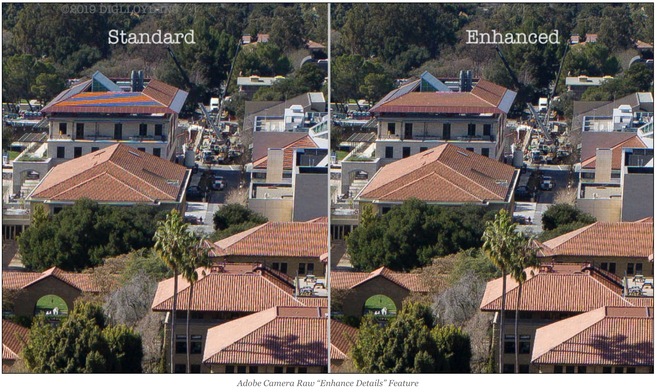
Adobe Camera Raw: Enhance Details
W
https://diglloyd.com/blog/2019/20190319_1150-Adobe-EnhanceDetails-commentary.html

Slide 71
Other Color Acquisition

Slide 72
Color sampling
Problem: a photosite can record only one number
We need 3 numbers for color
What can we do?

Slide 73
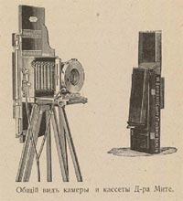

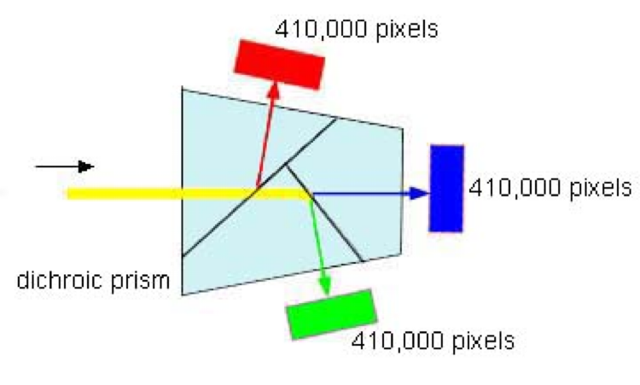
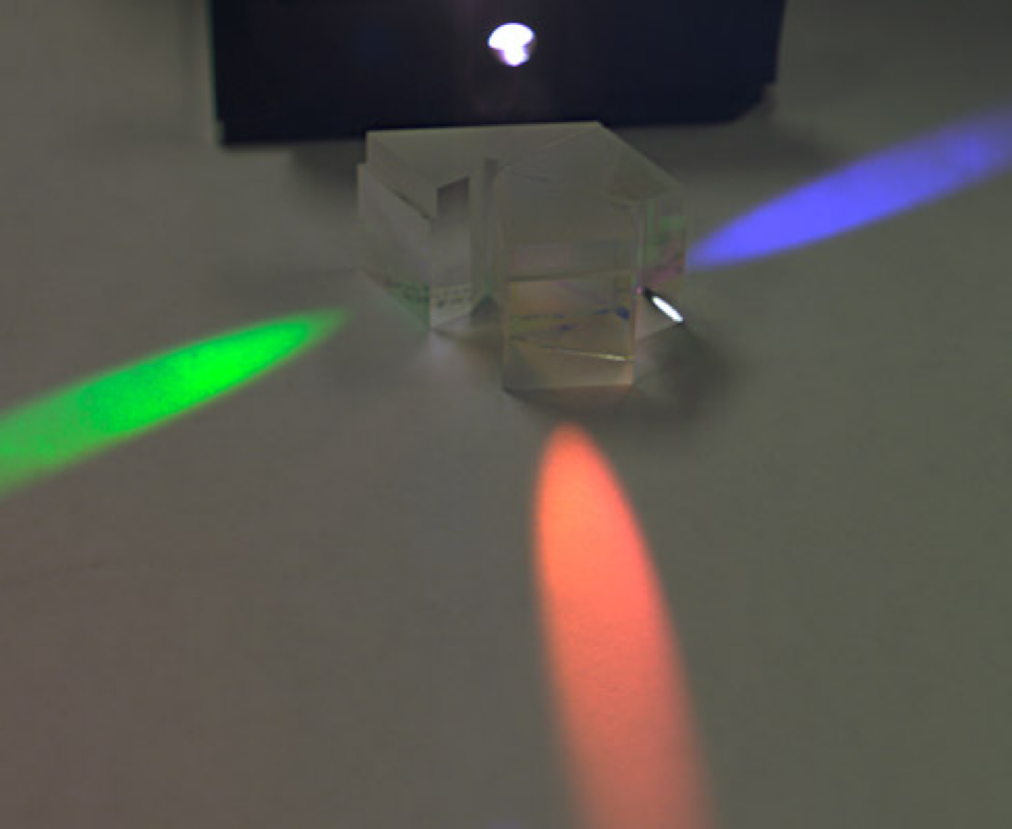
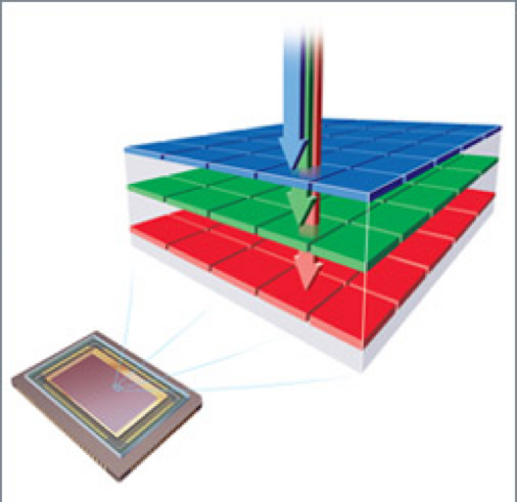
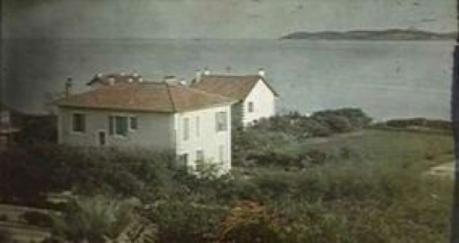
What are some approaches to sensing color images?
Scan 3 times
(temporal multiplexing)
Use 3 detectors
(3-ccd camera)
Use offset color samples (spatial multiplexing)
Multiplex in depth (Tripack film, Foveon)
Interferences (Lipmann)
Dicklyon at the English
Wikipedia project.

Slide 74
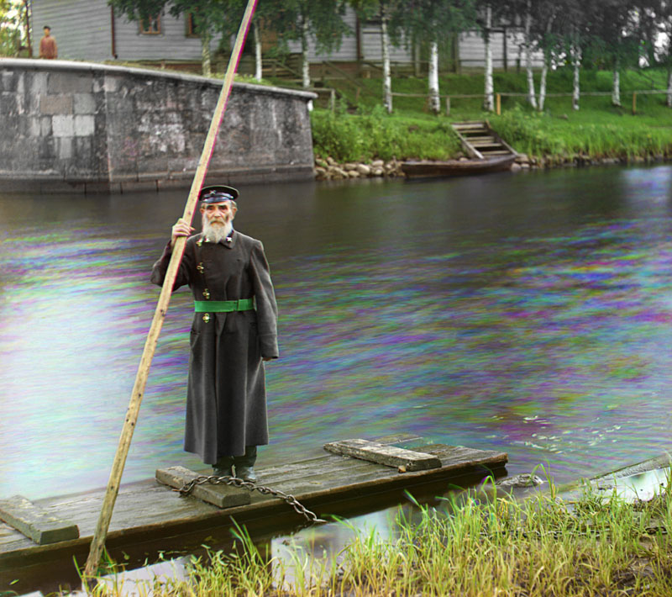
Temporal multiplexing
Examples:
  Drum scanners
  Flat-bed scanners
  Maxwell,
  Russian photographs from 1900’s
Pros:
  3 real values per pixel
  Can use a single sensor
Cons
  Only for static scenes, slow

Slide 75
Prokudin-Gorskii
Early 1900s
http://en.wikipedia.org/wiki/Prokudin-Gorskii
Pset 4 for 6.865

Slide 76
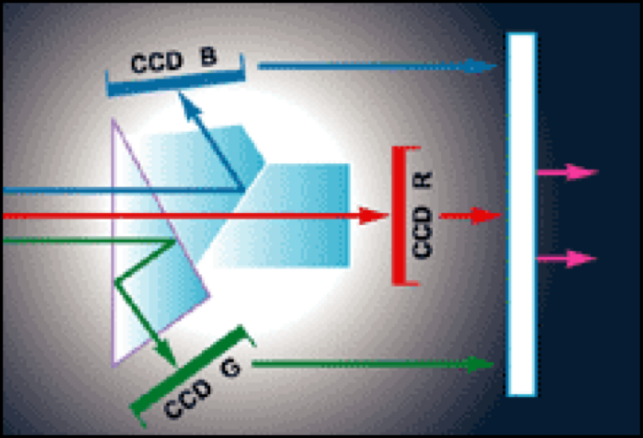
3-chip
High-end 3-ccd video cameras
Use separation prisms
  prisms that split wavelengths
Pros
  3 real values per pixel
  Little photon loss
Cons
  costly (needs 3 sensors)
  space
Dicklyon at the English
Wikipedia project.

Slide 77
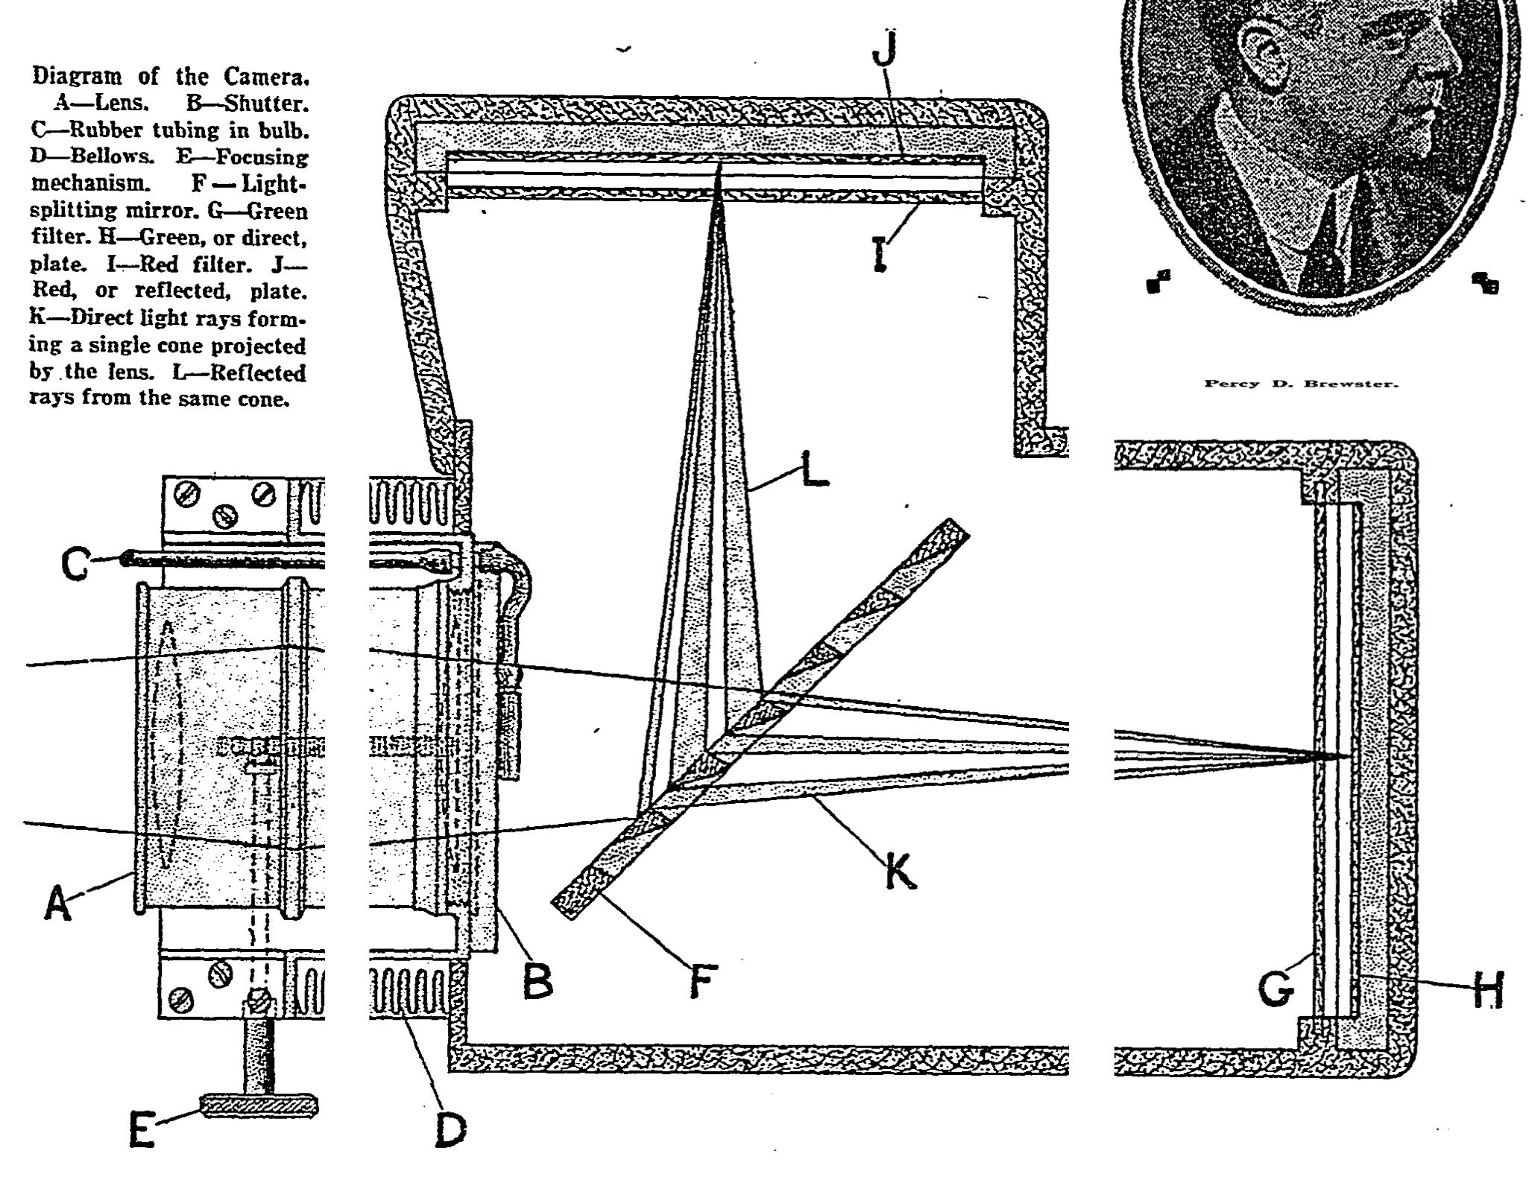
Brewster’s version
Swiss cheese mirror

Slide 78
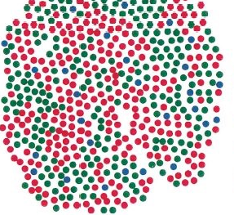
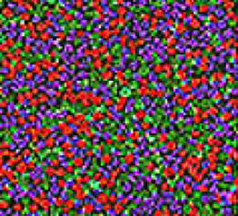
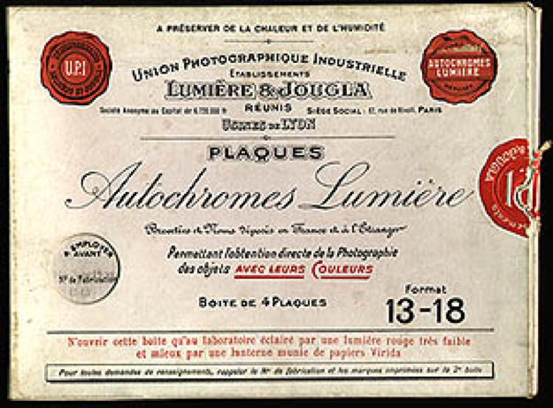
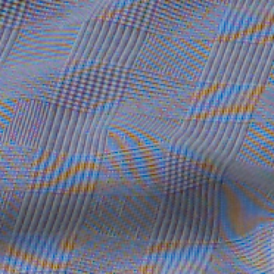
Spatial multiplexing
Human eye (cone mosaic)
Older color film (Autochrome)
Bayer mosaic or CFA (color filter array)
Most still cameras, most cheap camcorder,
some high-end video cameras (e.g. RED)
Pros
  single sensor
  well mastered technology, high resolution
Cons
  needs interpolation, color jaggies
  requires antialiasing filter (reduces sharpness)
  loss of light

Slide 79
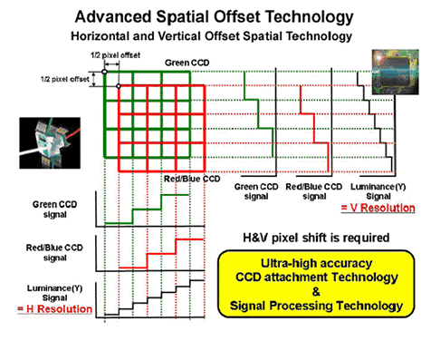
Combination: pixel shift
3-ccd with prisms + spatial multiplexing
The 3 ccds are shifted by 1/2 pixel to provided resolution increase
  usually selectable (not shifted for lower-res, shifted to get HD)
  Often horizontal only
From Panasonic

Slide 80
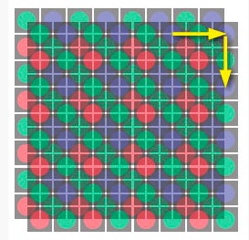
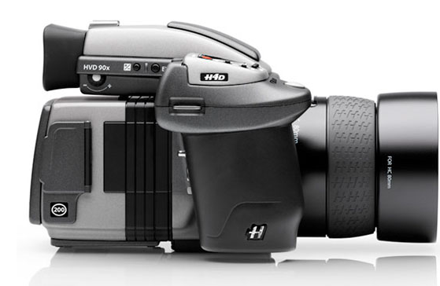
http://www.petapixel.com/2011/05/26/hasselblad-h4d-200ms-shoots-200mp-photos-with-a-50mp-sensor/

Slide 81
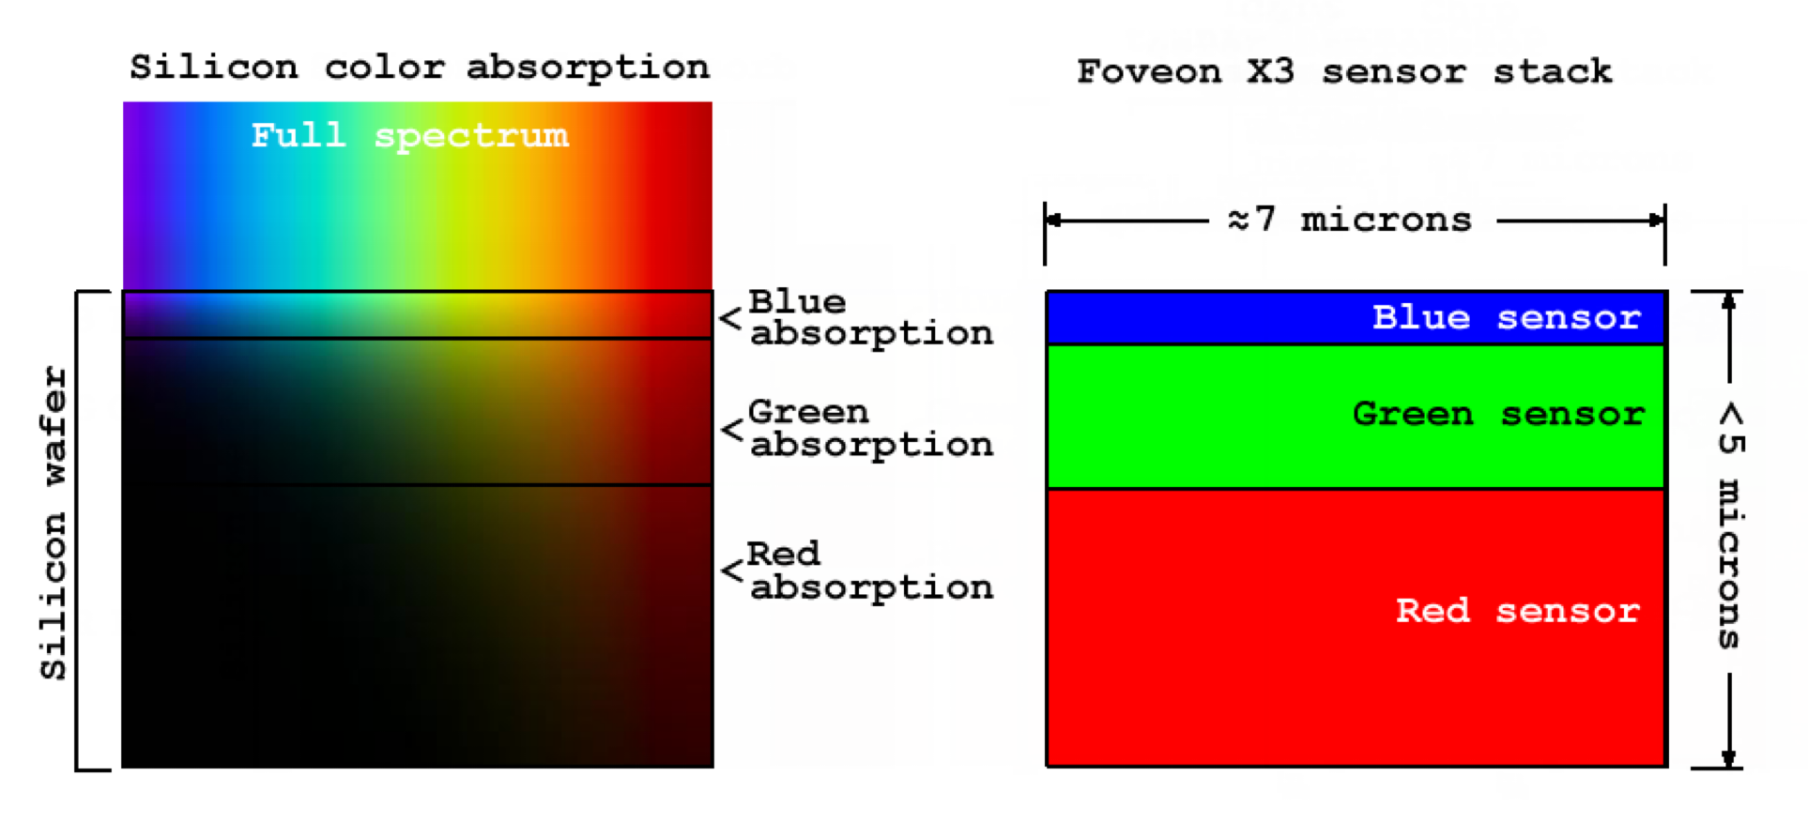
Depth multiplexing
(Foveon X3 sensor)
Leverage difference in absorption
per wavelength
Pros
  3 real numbers per pixel
  Less light loss
Cons
  Requires more color processing (3 numbers must be multiplied by matrix to get RGB)
  Tends to be noisier (because color processing and because shallow blue layer)
  Lower resolution these days

Slide 82
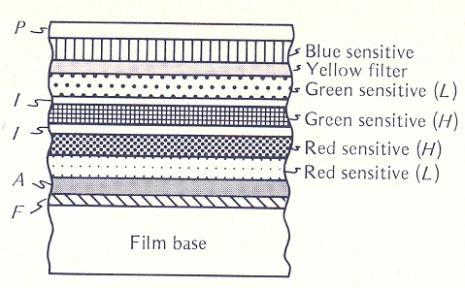
Depth multiplexing
Good old color film (tripack)

Slide 83
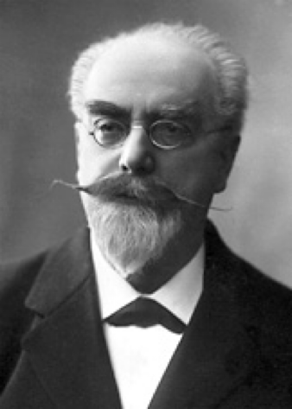
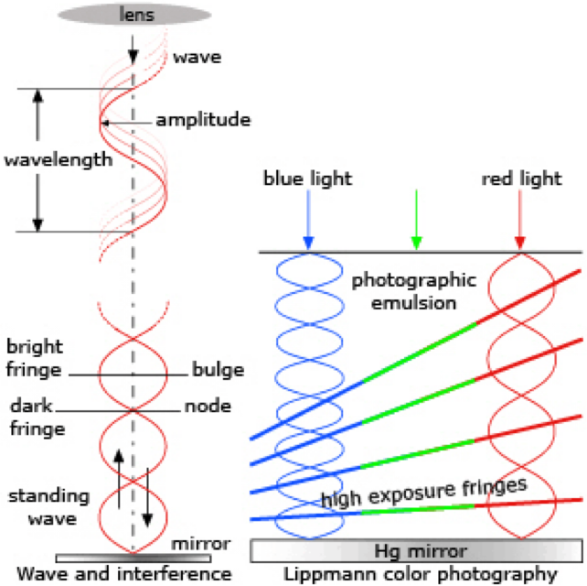
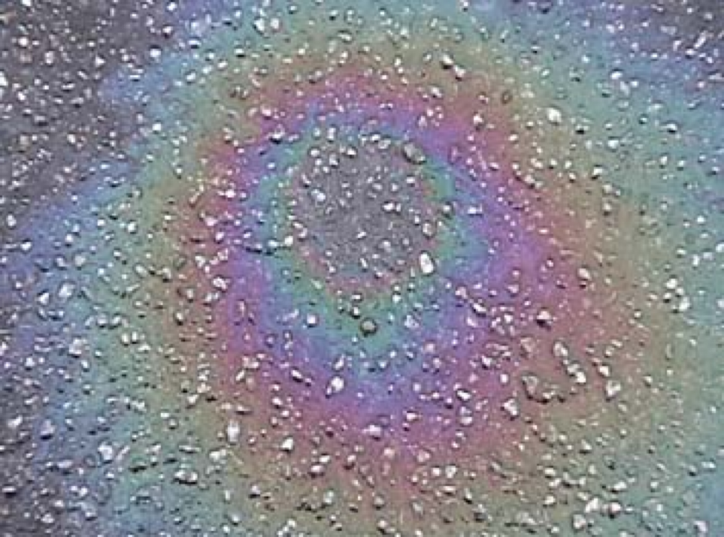
Interferences (Lippmann process)
Metal mirror to create interferences
  ancestor of holography
  similar to colors in thin oil film
http://nobelprize.org/nobel_prizes/physics/articles/biedermann/index.html

Slide 84

Interferences (Lippmann process)
Metal mirror to create interferences
  ancestor of holography
  similar to colors in thin oil film
Pros
  Full spectrum!!!!!
  Gets you the Nobel if you invent it ;-)
Cons
  Needs high-resolution sensor/film
  limited field of view for display
http://nobelprize.org/nobel_prizes/physics/articles/biedermann/index.html
'Saint-Maxime'', 1891-1899
Photographer: Gabriel Lippmann (1845-1929)

Slide 85
Recap & Questions?
Scan 3 times
(temporal multiplexing)
Use 3 detectors
(3-ccd camera)
Use offset color samples (spatial multiplexing)
Multiplex in depth (Tripack film, Foveon)
Interferences (Lipmann)
Dicklyon at the English
Wikipedia project.

Slide 86
Demosaicking inversion
http://research.microsoft.com/en-us/UM/people/yasumat/papers/cvpr2010_Takamatsu.pdf

Slide 87
Links
What we do essentially follows https://patents.google.com/patent/US5382976A/en , Inventor Robert H. Hibbard (Kodak)
http://citeseerx.ist.psu.edu/viewdoc/download?doi=10.1.1.141.634&rep=rep1&type=pdf
  http://www.unc.edu/~rjean/demosaicing/demosaicing.pdf — NEEDS TO BE FIXED
http://www.pages.drexel.edu/~par24/rawhistogram/40D_Demosaicing/40D_DemosaicingArtifacts.html
http://www.guillermoluijk.com/tutorial/dcraw/index_en.htm
http://www.cambridgeincolour.com/tutorials/RAW-file-format.htm
http://www.cambridgeincolour.com/tutorials/camera-sensors.htm

Slide 88
More
http://www.ists.dartmouth.edu/library/edf0205.pdf
http://ieeexplore.ieee.org/iel5/79/30519/01407714.pdf?isnumber=30519&prod=JNL&arnumber=1407714&arSt=+44&ared=+54&arAuthor=Gunturk%2C+B.K.%3B+Glotzbach%2C+J.%3B+Altunbasak%2C+Y.%3B+Schafer%2C+R.W.%3B+Mersereau%2C+R.M.

