Slide 1
High-Dynamic-Range Imaging
& Tone Mapping
Fredo Durand
MIT EECS 6.8370/6.8371

Slide 2


National voter registration day
https://mit.turbovote.org

Slide 3
Performance
-O3 in makefile
Loop order
Learn Halide ;-)

Slide 4
We all have bugs

Slide 5
Debugging
Doubt everything
Debug pieces in isolation
  Binary search/divide and conquer
Display/print everything - save images
  In particular intermediate results
Create simple inputs
  where you can easily manually compute the result
  e.g. constant image, edge image, rectangle, etc.
  use small images (e.g. 3x3)
  including (especially) inputs to intermediate stages
  use input thats isolate different failure modes
Change one thing at a time
  e.g. to verify that a given command has the effect you want, modify it to break it

Slide 6
Debugging — seg fault
Often occurs much later than the actual problem
Probably due to some array (vector) operation
  print indices and array size
  Assert that index is between 0 and size
    possibly in some debug mode to avoid performance penalty in release mode
Could also be due to initialized pointer, but we’ll avoid pointers

Slide 7
Debugging: e.g. convolution
Try constant image
Try impulse
  try asymmetric kernels, e.g. shift
Try half plane (half black half white)
Use 1D kernels, maybe 3x3

Slide 8
Bilateral filtering
Large range variance should yield Gaussian blur
Tiny range variance should leave edges unaffected
Try half white - half black image.
  maybe add noise

Slide 9
Debugging: next p-set
alignment debugging
  Test difference code
    is it actually small at correct translation? Same image?
  Test translation code
  Create synthetic inputs, e.g. rectangle shifted by 1 or 2 pixels
demosaicking
  slightly harder to generate synthetic inputs
  constant image
  rectangle
  tiny crops of an image, do calculation manually

Slide 10
Primary colors

Slide 11
Dichroic prism

Slide 12
The dynamic range challenge

Slide 13

Light, exposure and dynamic range
Exposure: how bright is the scene overall?
Dynamic range: contrast in the scene
  Range between darkest and brightest pixel
  (usually as a ratio or db)
Bottom-line problem:
display/print have limited contrast

Slide 14
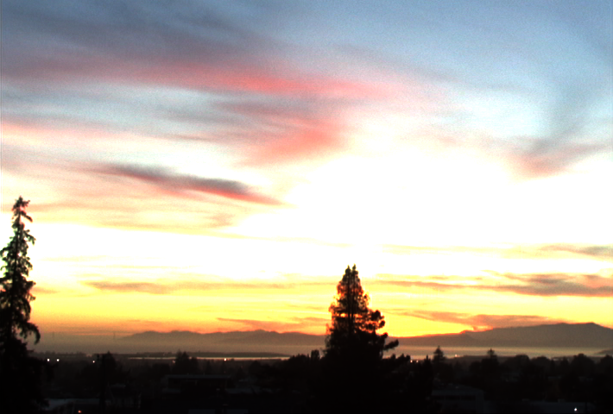
Examples
Inside is too dark
Outside is too bright
Sun overexposed
Foreground too dark

Slide 15
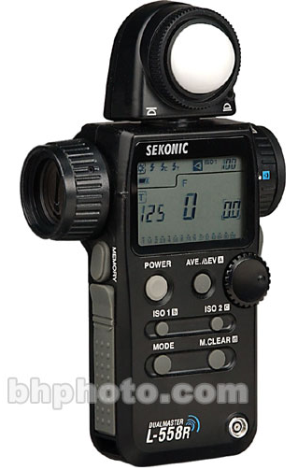
Real world dynamic range
Eye can adapt from ~ 10⁻⁶ to 10⁶ cd/m²
Often 1 : 100,000 in a scene
10⁻⁶
10⁶
Real world
High dynamic range
spotmeter

Slide 16
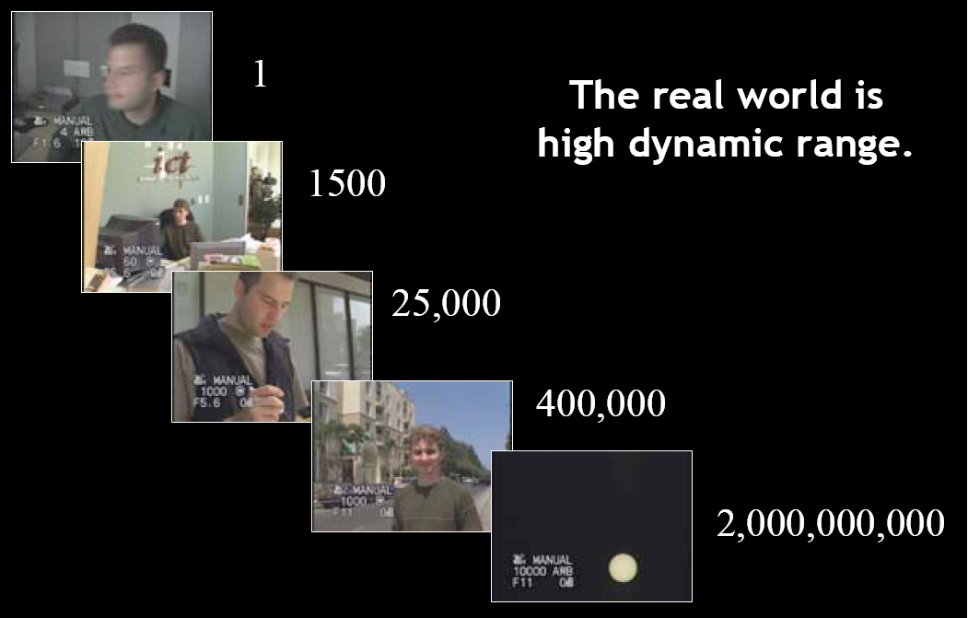
The world is high dynamic range
Slide from Paul Debevec

Slide 17
Picture dynamic range: Guess!
pure black
10⁻⁶
pure white
10⁶
Real world
10⁻⁶
10⁶
Picture

Slide 19
Picture dynamic range
Typically 1: 20 or 1:50
  Black is ~ 50x darker than white
Max 1:500
10⁻⁶
10⁶
Real world
10⁻⁶
10⁶
Picture
Low contrast

Slide 20
Picture dynamic range: Guess!
pure black
10⁻⁶
pure white
10⁶
Real world
10⁻⁶
10⁶
Picture

Slide 22
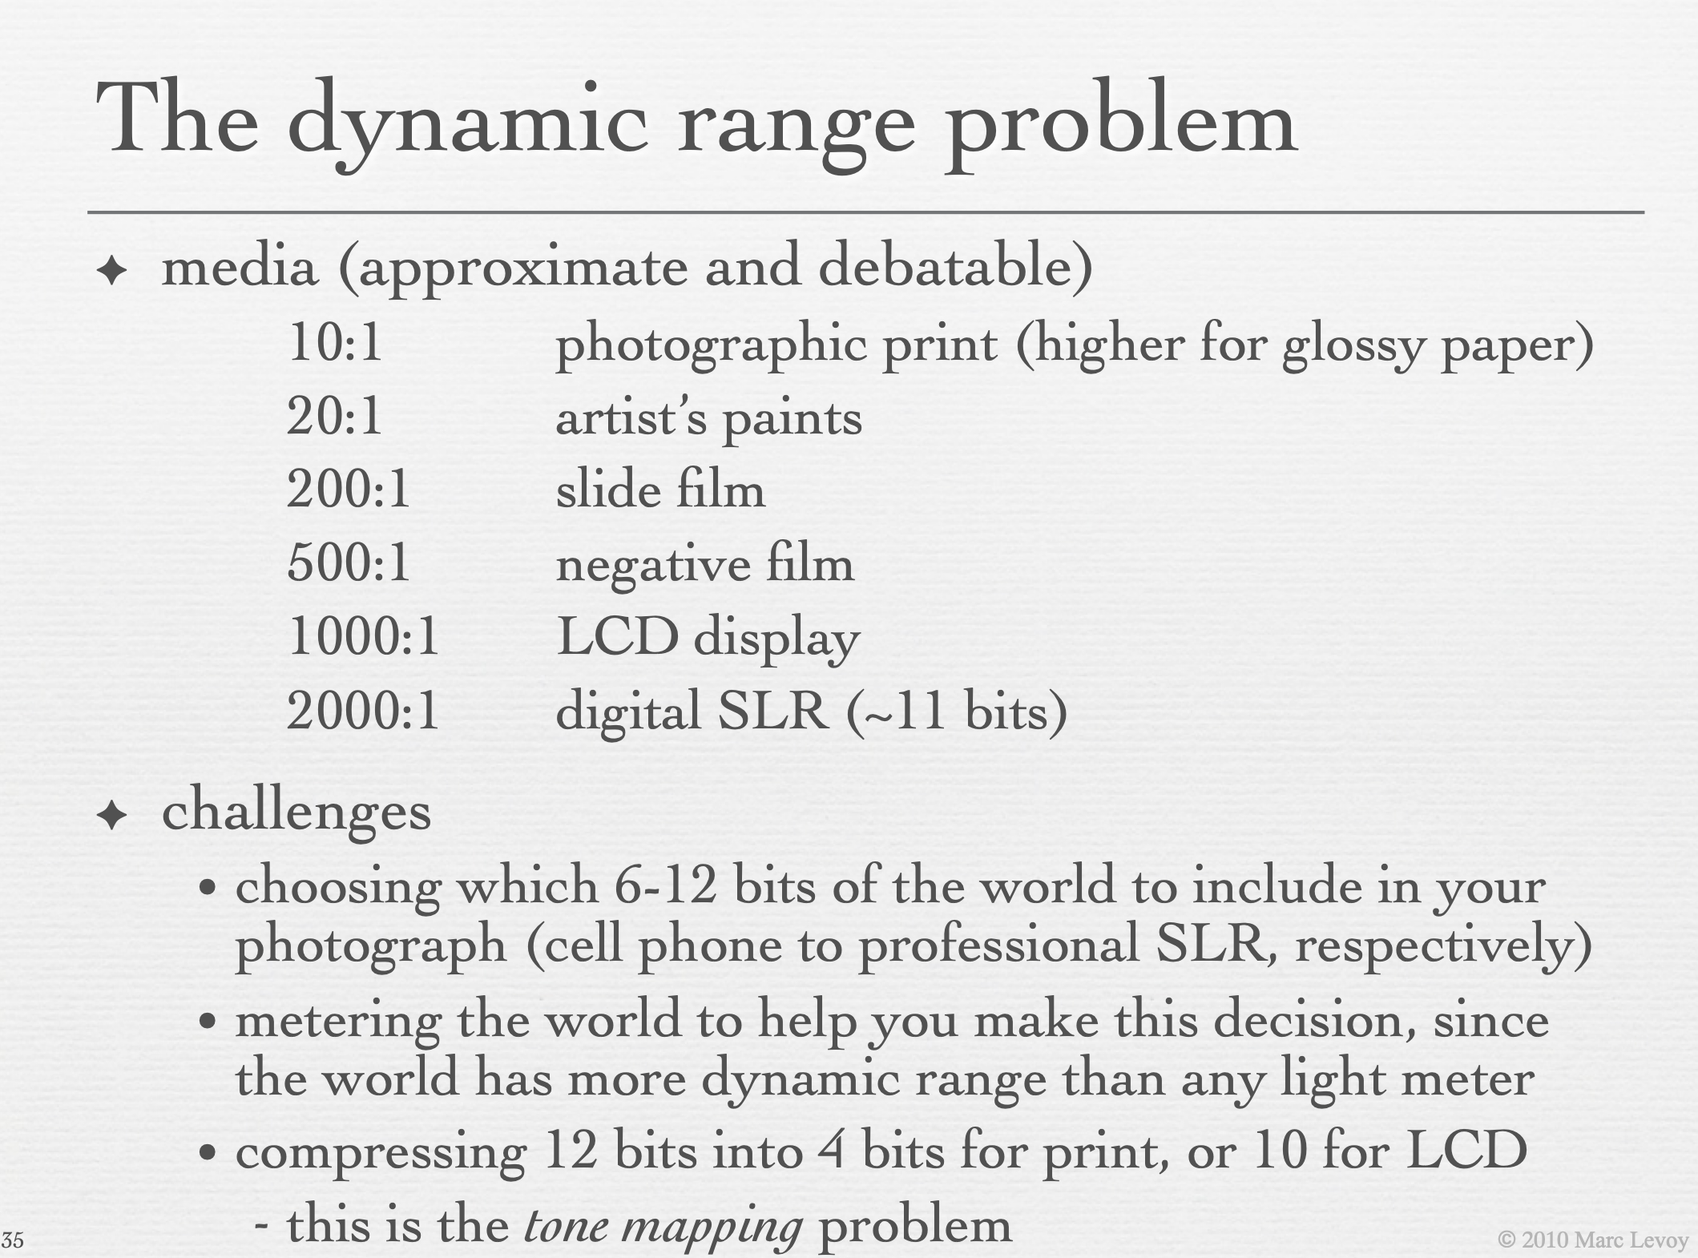

Slide 23
Picture dynamic range
Typically 1: 20 or 1:50
  Black is ~ 50x darker than white
10⁻⁶
10⁶
Real world
10⁻⁶
10⁶
Picture
Low contrast

Slide 24
Problem 1: record the information
The range of illumination levels that we encounter is 10 to 12 orders of magnitudes
Negatives/sensors can record 2 to 3 orders of magnitude
10⁻⁶
Real scenes
10⁶
10⁰
10³
Negative/sensor

Slide 25
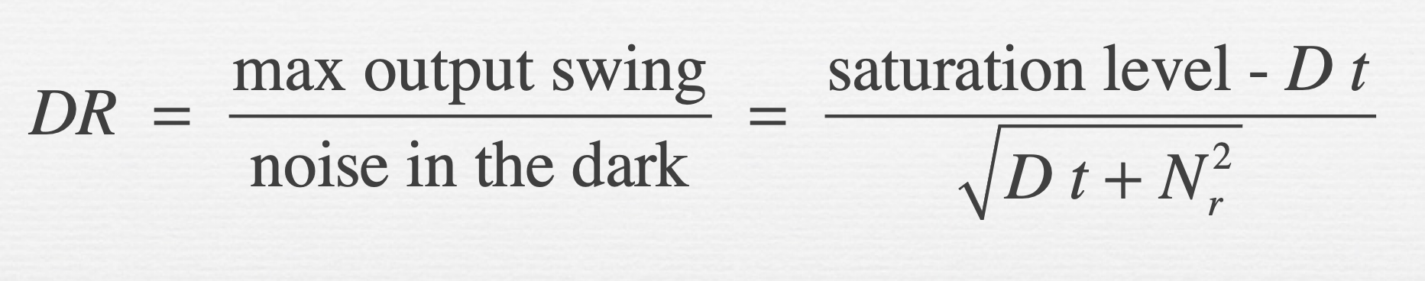

Slide 26
Problem 2: Display the information
Match limited contrast of the medium
Preserve details
10⁻⁶
High dynamic range
10⁶
Real world
10⁻⁶
10⁶
Picture
Low contrast

Slide 27
Without HDR & tone mapping

Slide 28
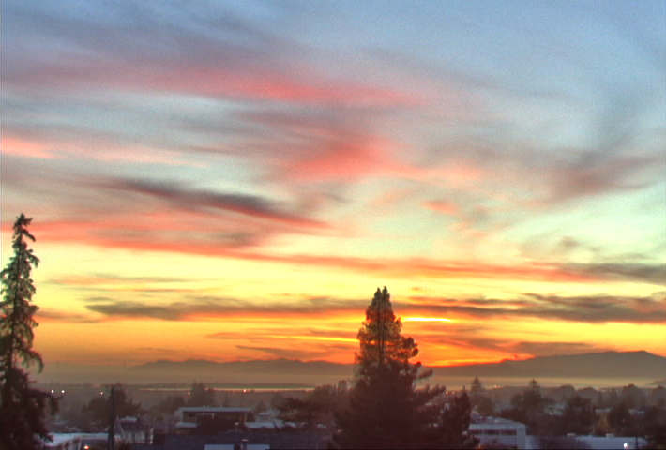
With HDR & tone mapping

Slide 29
http://www.stuckincustoms.com/2011/04/30/hdr-before-after/

Slide 30
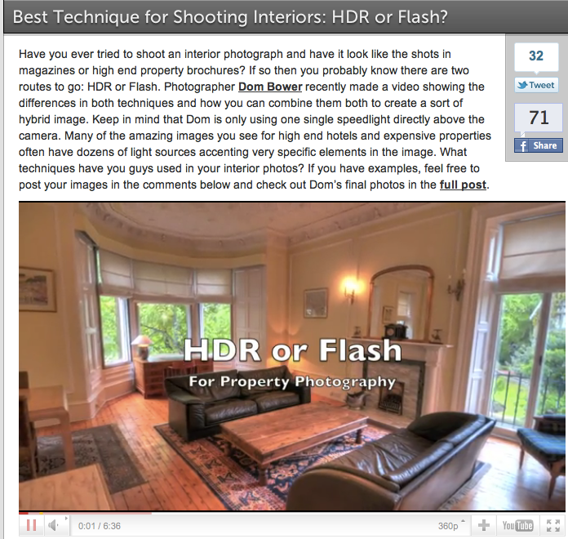
http://fstoppers.com/best-technique-for-shooting-interiors-hdr-or-flash

Slide 31
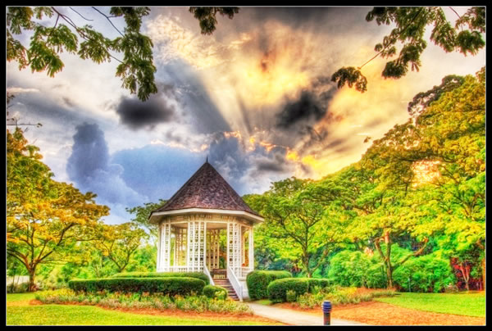
Can be extreme
By Anthony Wong, http://abduzeedo.com/20-beautiful-hdr-pictures-part-3

Slide 32
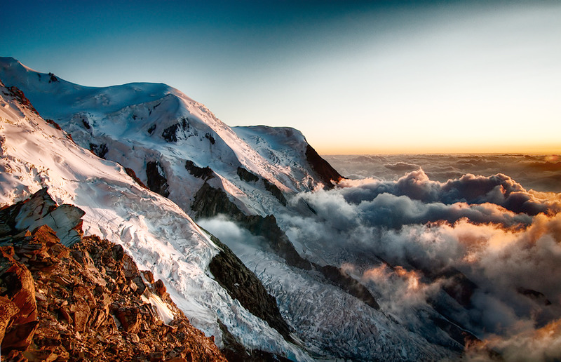
Not always cheesy
By Alexandre Buisse
http://luminous-landscape.com/essays/hdr-plea.shtml

Slide 33
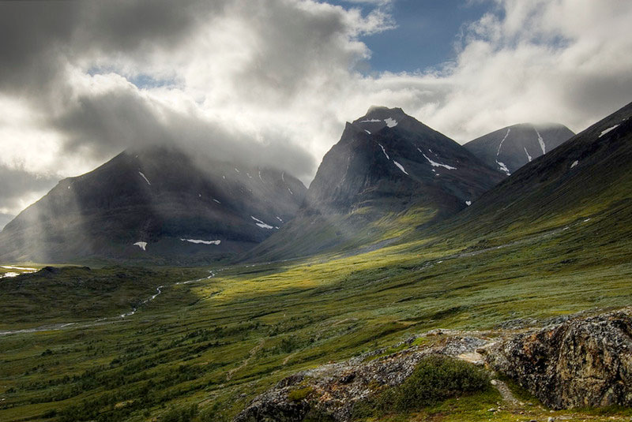
Not always cheesy
By Alexandre Buisse
http://luminous-landscape.com/essays/hdr-plea.shtml

Slide 34
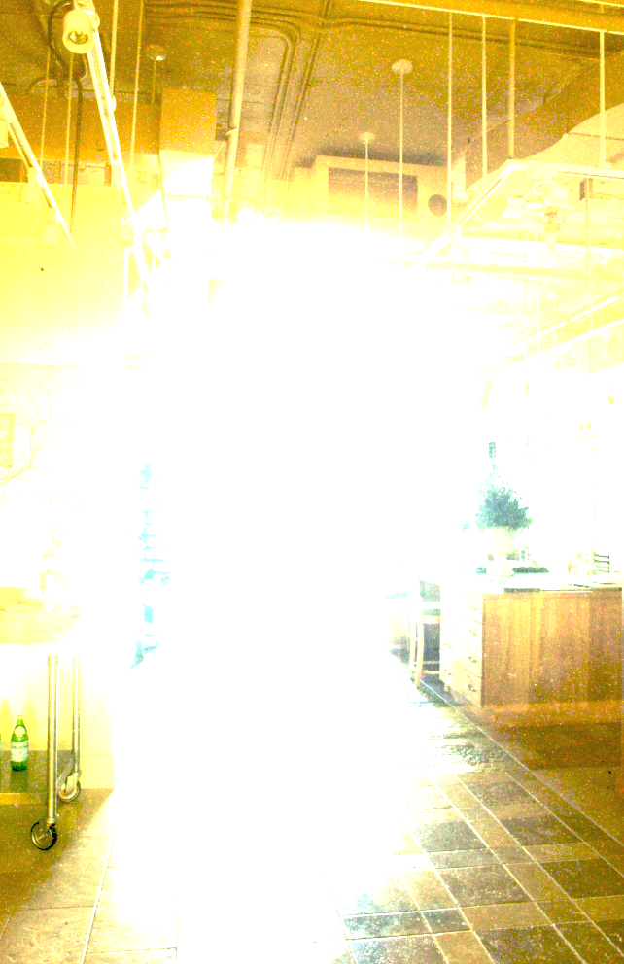
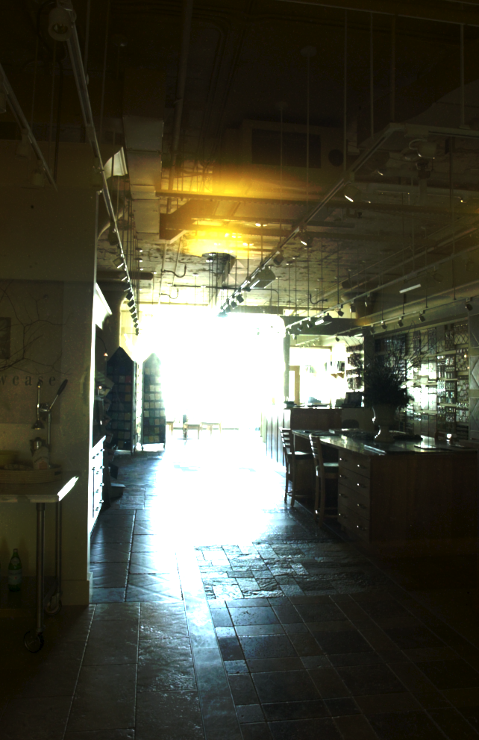
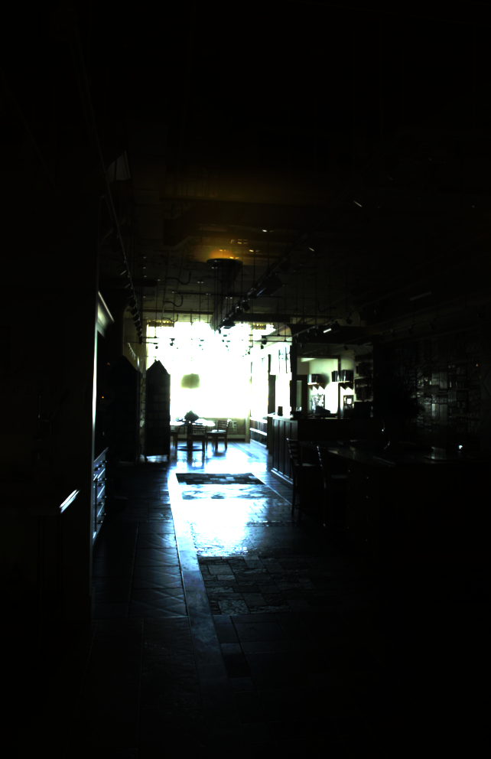
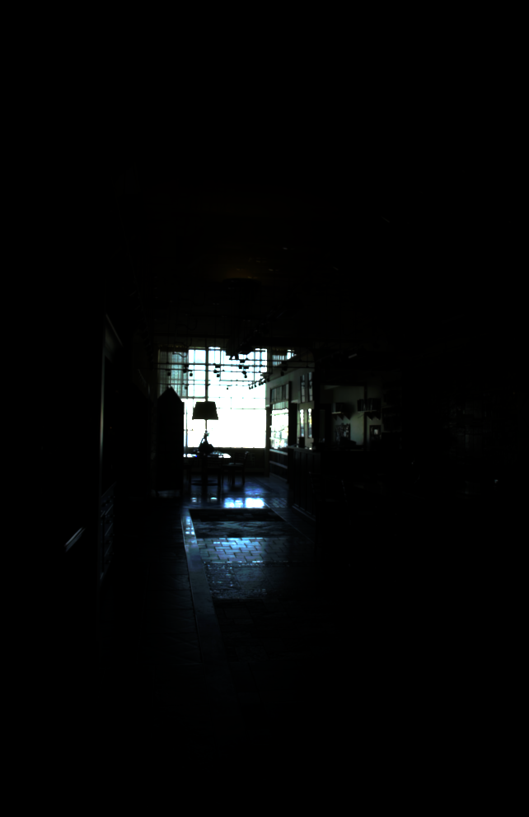
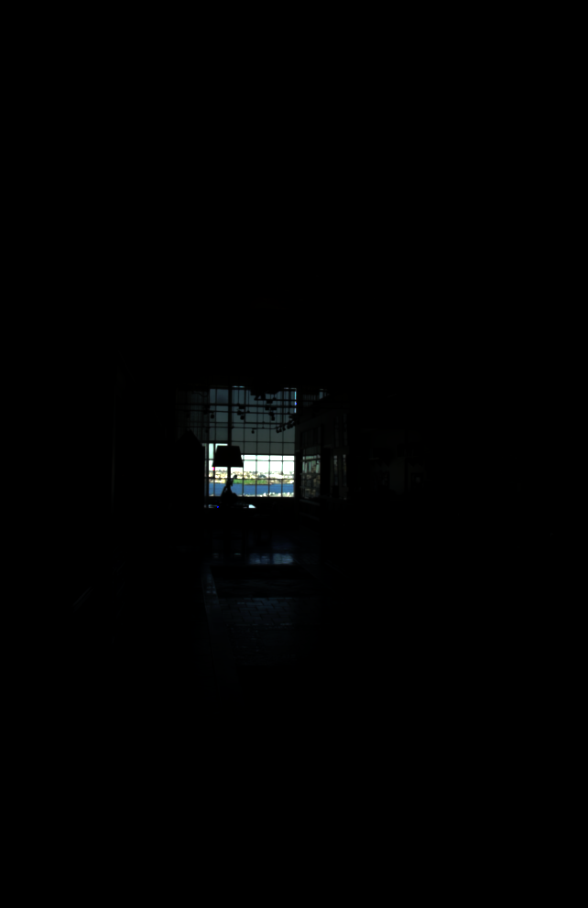
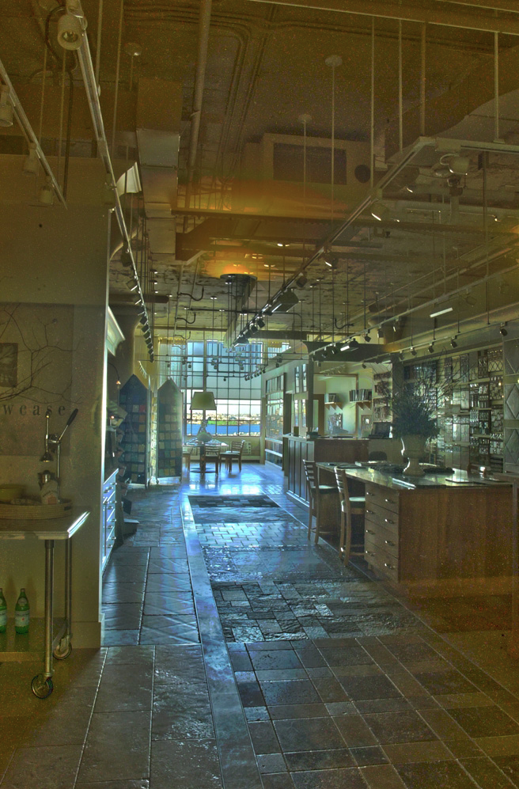
Plan
Multiple-exposure High-Dynamic-Range imaging
Tone mapping using the bilateral filter

Slide 35
At the end of these slides
How traditional photography deals with dynamic range.

Slide 36
Multiple exposures

Slide 37
Multiple exposure photography
Sequentially measure all segments of the range
10⁻⁶
High dynamic range
10⁶
Real world
10⁻⁶
10⁶
Picture
Low contrast

Slide 38
Multiple exposure photography
Sequentially measure all segments of the range
10⁻⁶
High dynamic range
10⁶
Real world
10⁻⁶
10⁶
Picture
Low contrast

Slide 39
Multiple exposure photography
Sequentially measure all segments of the range
10⁻⁶
High dynamic range
10⁶
Real world
10⁻⁶
10⁶
Picture
Low contrast

Slide 40
Multiple exposure photography
Sequentially measure all segments of the range
10⁻⁶
High dynamic range
10⁶
Real world
10⁻⁶
10⁶
Picture
Low contrast

Slide 41
Multiple exposure photography
Sequentially measure all segments of the range
10⁻⁶
High dynamic range
10⁶
Real world
10⁻⁶
10⁶
Picture
Low contrast

Slide 42
Multiple exposure photography
Sequentially measure all segments of the range
10⁻⁶
High dynamic range
10⁶
Real world
10⁻⁶
10⁶
Picture
Low contrast

Slide 43
How do we vary exposure?

Slide 44
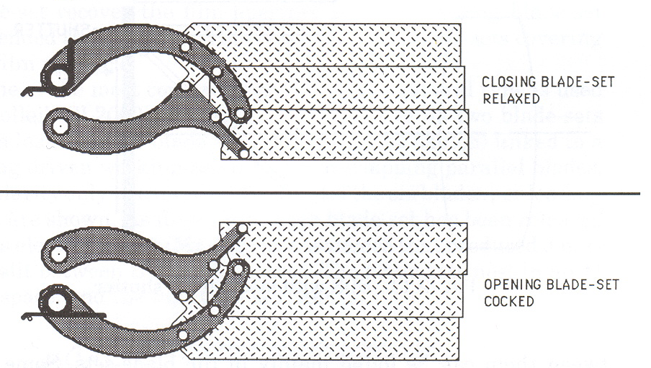
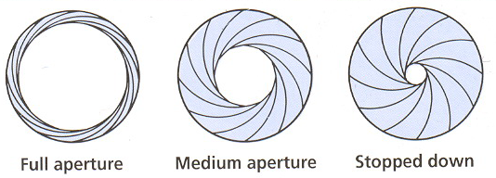
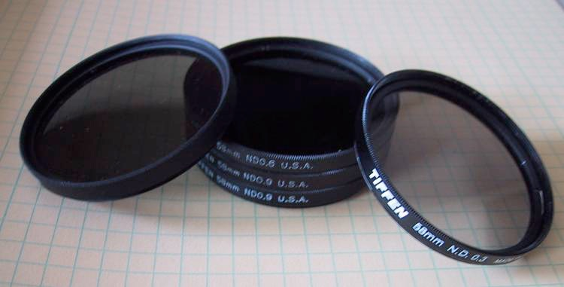
How do we vary exposure?
Options:
  Shutter speed
  Aperture
  ISO
  Neutral density filter
Slide inspired by Siggraph 2005 course on HDR

Slide 45
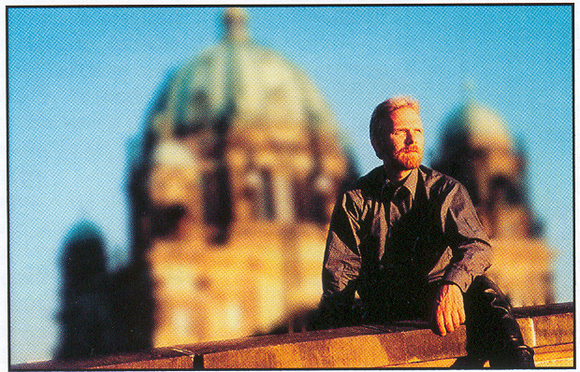
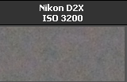
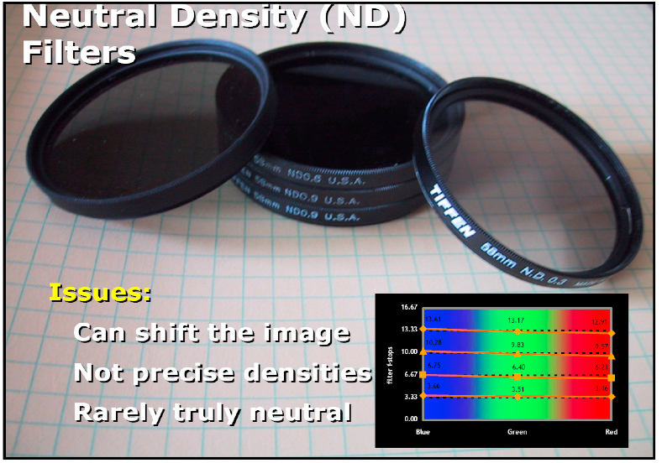
Tradeoffs
Shutter speed
  Range: ~30 sec to 1/4000sec (6 orders of magnitude)
  Pros: reliable, linear
  Cons: sometimes noise for long exposure
Aperture
  Range: ~f/1.4 to f/22 (2.5 orders of magnitude)
  Cons: changes depth of field
  Useful when desperate
ISO
  Range: ~100 to 1600 (1.5 orders of magnitude)
  Cons: noise
  Useful when desperate
Neutral density filter
  Range: up to 4 densities (4 orders of magnitude)
  & can be stacked
  Cons: not perfectly neutral (color shift),
  not very precise, need to touch camera (shake)
  Pros: works with strobe/flash,
  good complement when desperate
Slide after Siggraph 2005 course on HDR

Slide 46
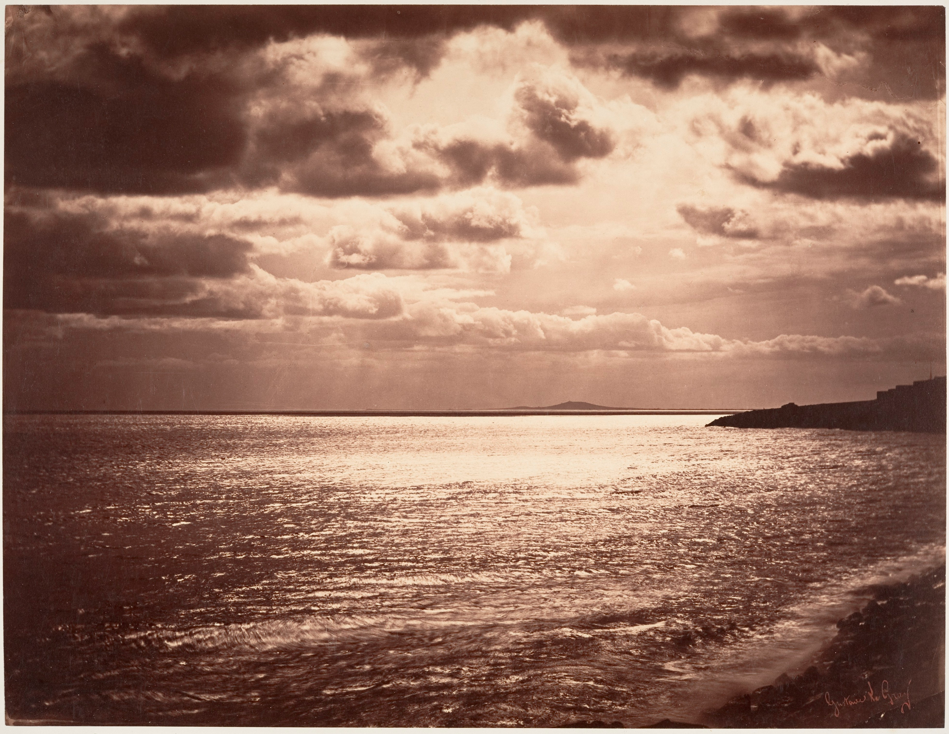
Gustave Le Gray, 1857
http://www.metmuseum.org/collection/the-collection-online/search/283124

Slide 47
HDR merging: linear case

Slide 48
Problem statement
We have N images
  Images are encoded linearly
  Only the exposure changes: no motion
We want 1 single HDR image
  encoded with same Image class
  one value per x, y, c
  values may be >1

Slide 49
Getting linear images
http://www.mit.edu/~kimo/blog/linear.html
http://www.luminous-landscape.com/forum/index.php?topic=25064
http://www.guillermoluijk.com/tutorial/dcraw/index_en.htm
./dcrawx86 -v -H 0 -g 2.2 0 -o 1 DSC_*nef

Slide 50
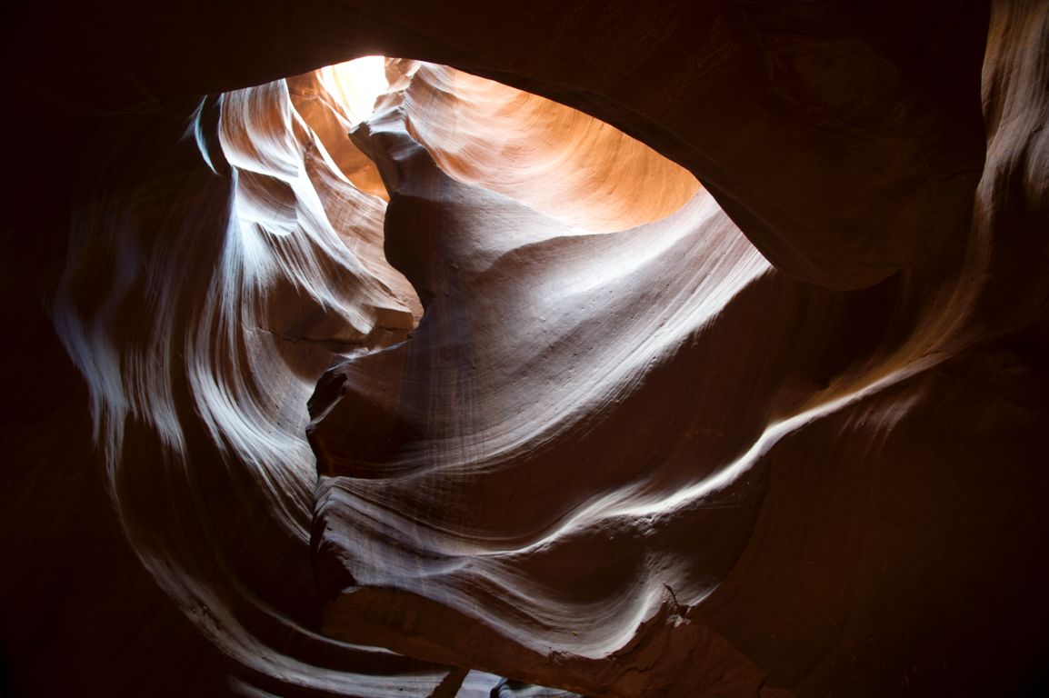
Image formation: photons to floats
Scene radiance L(x,y) reaches the sensor at a pixel x, y
Value of pixel?
  depends on shutter speed, aperture, ISO
    multiplicative factor
  clips if >1
  noise gets added

Slide 51
Image formation
Scene radiance L(x,y) reaches the sensor at a pixel x, y
For each image i,
radiance gets multiplied by exposure factor ki
  depends on shutter speed, ISO, etc
Noise n gets added
values above 1 get clipped
  depends on photosite well capacity
  Ii(x, y)=clip(ki L(x,y)+n)

Slide 52
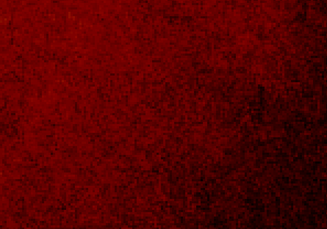
Dynamic range
In the highlights, we are limited by clipping
  Value >1 saturate to 1
In the shadows, we are limited by noise
Brightened
many times

Slide 53

Merging HDR
  Ii(x, y)=clip(ki L(x,y)+n)
• 1
• 1
• 1
• 1
• 1
• 2
• 2
• 2
• 2
• 2
• 3
• 3
• 3
• 3
• 3

Slide 54
Merging HDR
  Ii(x, y)=clip(ki L(x,y)+n)
For each pixel
  figure out which images are useful
  scale values appropriately according, ideally, to ki
  Voila!
• 1
• 1
• 1
• 1
• 1
• 2
• 2
• 2
• 2
• 2
• 3
• 3
• 3
• 3
• 3

Slide 55
Questions?
  Ii(x, y)=clip(ki L(x,y)+n)
For each pixel
  figure out which images are useful
  scale values appropriately according, ideally, to ki
  Voila!
• 1
• 1
• 1
• 1
• 1
• 2
• 2
• 2
• 2
• 2
• 3
• 3
• 3
• 3
• 3

Slide 56
Which images are useful
Eliminate clipped pixels
  e.g. >0.99
Eliminate pixels that are too dark / too noisy
  e.g. <0.002
• 1
• 1
• 1
• 1
• 1
• 2
• 2
• 2
• 2
• 2
• 3
• 3
• 3
• 3
• 3

Slide 57
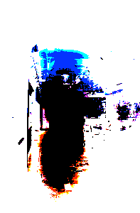
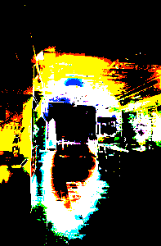
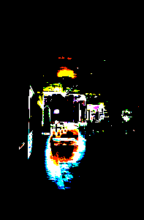
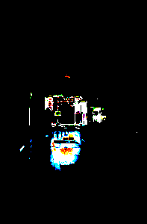
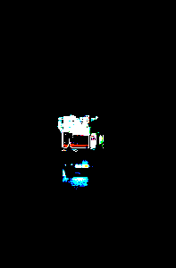
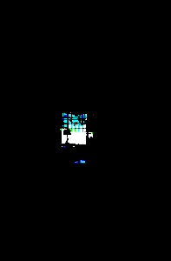
Eliminate bad pixels
In PSet 5
We compute a weight map for each image
We use binary weights (0 or 1)
  But can be extended to full scalar
  In particular for better handling noise
Weights can be different for different channels

Slide 58
Weight map
We compute a weight map for each image

Slide 59
Naive python thresholding
for y, x, c in imIter(im)
  if im[y, x, c]<threshold: out[y, x, c]=0
  else out[y, x, c]=1

Slide 60
Smart numpy logical indexing
Smart numpy code:
  out=ones(im.shape)
  out[im<thresholding]=0
affects only the locations in the array where the condition is true
Note that we can use two different arrays (im and out)

Slide 61
Assembling HDR

Slide 62
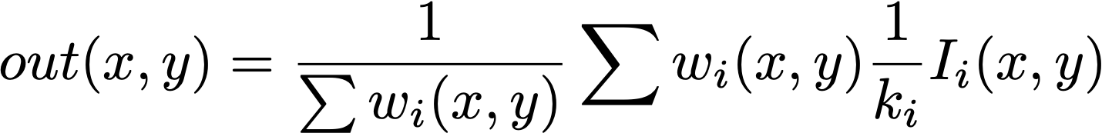
Assembling HDR
Figure out scale factor between images
  From exposure data
  Or by looking at ratios Ii(x,y)/Ij(x,y)
    but only when both are good
Compute weight map wi for each image
Reconstruct full image using weighted combination per pixel

Slide 63
Computing ki
• 1
• 1
• 1
• 1
• 1
• 2
• 2
• 2
• 2
• 2
• 3
• 3
• 3
• 3
• 3

Slide 64
Computing ki
compute ki/kj for adjacent exposures
just look at ratio of corresponding pixels
  only for useful pixels
• 1
• 1
• 1
• 1
• 1
• 2
• 2
• 2
• 2
• 2
• 3
• 3
• 3
• 3
• 3

Slide 65
Computing ki in pset 5
Only up to global scale factor
Actually compute ki/kj for pairs of images
Focus on pixels where
  no clipping occurs & noise is negligible
Ii(x, y)=ki L(x,y)
get ki/kj by considering Ii/Ij
If linearity holds, should be the same for all pixels
Use median for extra robustness

Slide 66
Computing ki in pset 5
  Ii(x, y)=clip(ki L(x,y)+n)
Only up to global scale factor, e.g. ki/k0
Actually compute ki/kj for pairs of images
ki/kj=median(Ii(x,y)/Ij(x,y)
  for pixels st. wi(x,y)>0 AND wj(x,y)>0
Then compute ki/k0 by chaining these ratios

Slide 67
  Cleaner way
You could use a (robust) regression to avoid computing ratios
Would also make it easy to directly model uncertainty due to noise
Also generalizes to full non-linear response
  See Debevec and Malik 96

Slide 68
Special cases
Some pixels might be underexposed or overexposed in all images
Simple solution: don’t eliminate dark pixels in the brightest image or bright pixels in the darkest one.
  Pay attention: dark pixels in the brightest (and vice versa), not other way around.
  Careful is you implement it by changing the thresholds that values 0.0 (resp. 1.0) are actually kept
• 1
• 1
• 1
• 1
• 1
• 2
• 2
• 2
• 2
• 2
• 3
• 3
• 3
• 3
• 3
I call this the brightest image
I call this the darkest image

Slide 70
In the end: HDR image
Encoded with same image class
One single float value per x, y, c
numbers may be >1

Slide 71
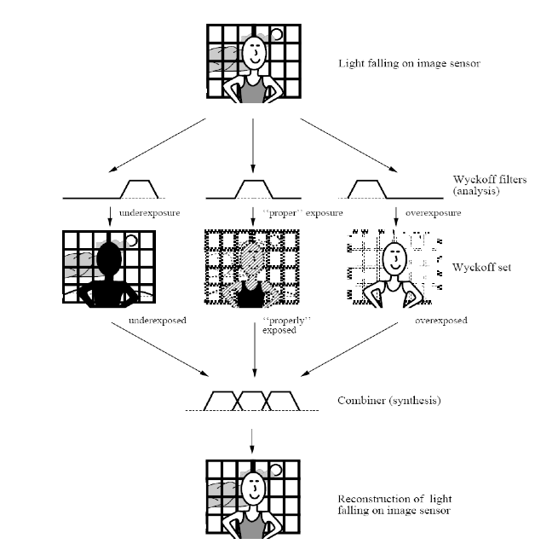
HDR combination papers
Steve Mann http://genesis.eecg.toronto.edu/wyckoff/index.html
Paul Debevec http://www.debevec.org/Research/HDR/
Mitsunaga, Nayar , Grossberg http://www1.cs.columbia.edu/CAVE/projects/rad_cal/rad_cal.php
http://people.csail.mit.edu/hasinoff/hdrnoise/

Slide 72
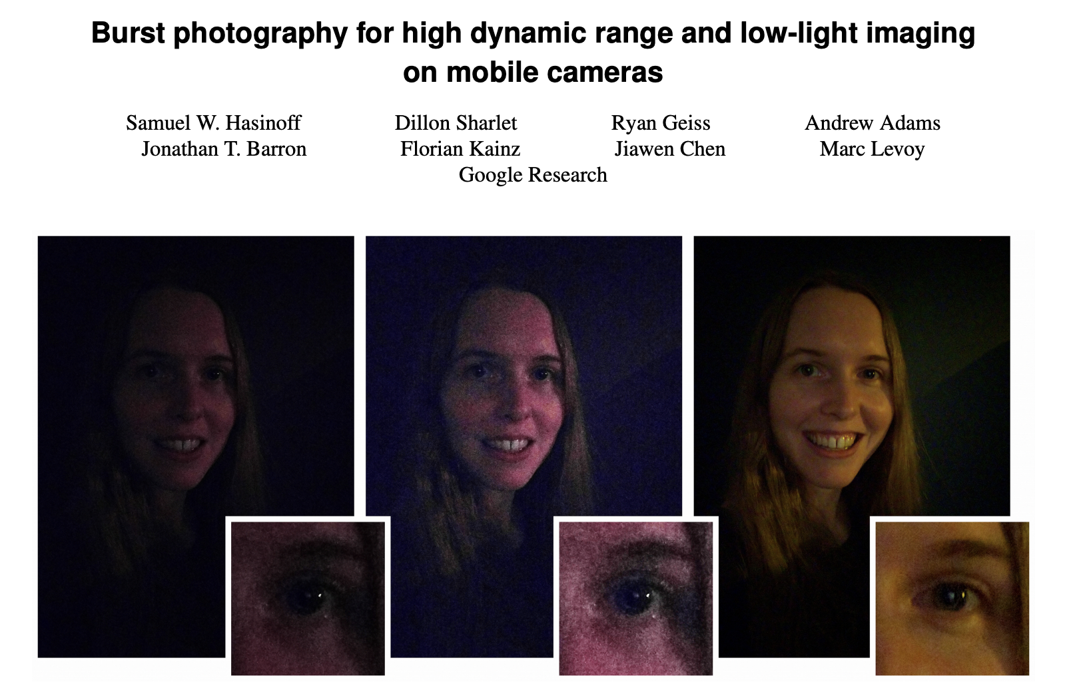
HDR+ on Android
http://static.googleusercontent.com/media/hdrplusdata.org/en//hdrplus.pdf
https://ai.googleblog.com/2018/02/introducing-hdr-burst-photography.html

Slide 73
HDR image

Slide 74
What is it, how to view it, what range do we actually get
Pixel peeping
File format
in python: how can we save it?

Slide 75
Traditional Darkroom

Slide 76
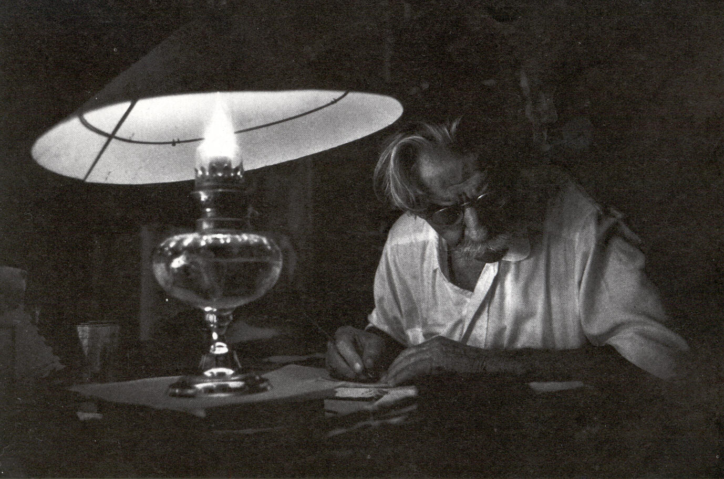
Limited dynamic range can be good!
W. Eugene Smith photo of Albert Schweitzer
5 days to print!
Things can be related because the intensity is more similar
Balance, composition

Slide 77
Negative and response curve
Negatives typically afford 3 orders of magnitude
More than printing paper
shoulder region provides a little more dynamic range (but less precision there)
max density
shoulder region
Density
Linear region
slope:gamma
Log exposure

Slide 78
Response curve manipulation
Traditional photography
  Chemicals and duration of development
  Paper grade (~γ)
  Flashing the paper before printing
  Various chemicals on paper
  Note: you have one curve for negative, one for paper
  Usually they have inverse gamma (but not strictly, enables contrast control)
Digital
  Curve tool

Slide 79
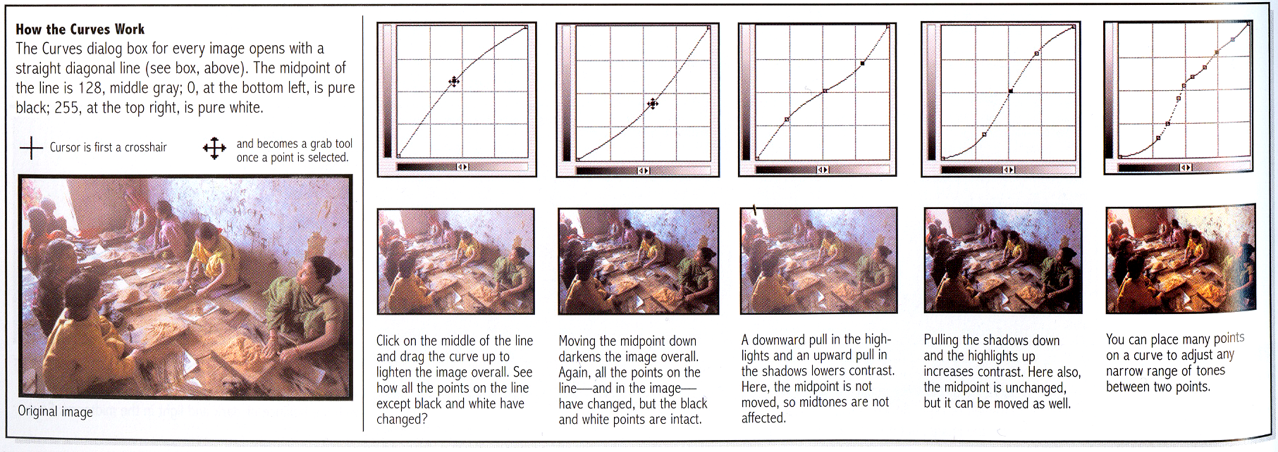
Photoshop curves
Specify an arbitrary remapping curve
Especially useful for black and white
From Photography by London et al.

Slide 80
Examples of curves
Brighten
Darken
Contrast

Slide 81
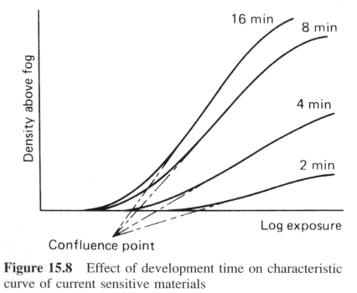
Chemical curves: developt time
From The Manual of Photography, Jacobson et al.

Slide 82
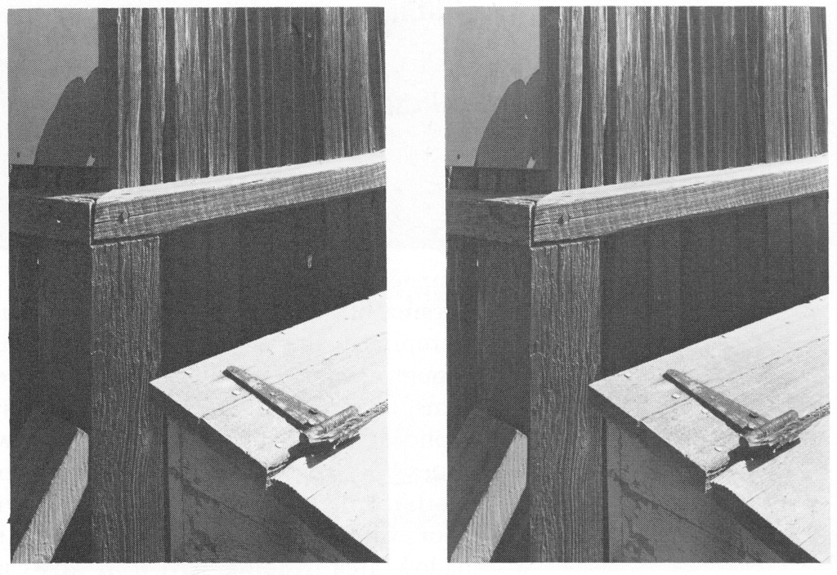
Reduced development
Normal development
Contraction (short development)
Source: Ansel Adams

Slide 83
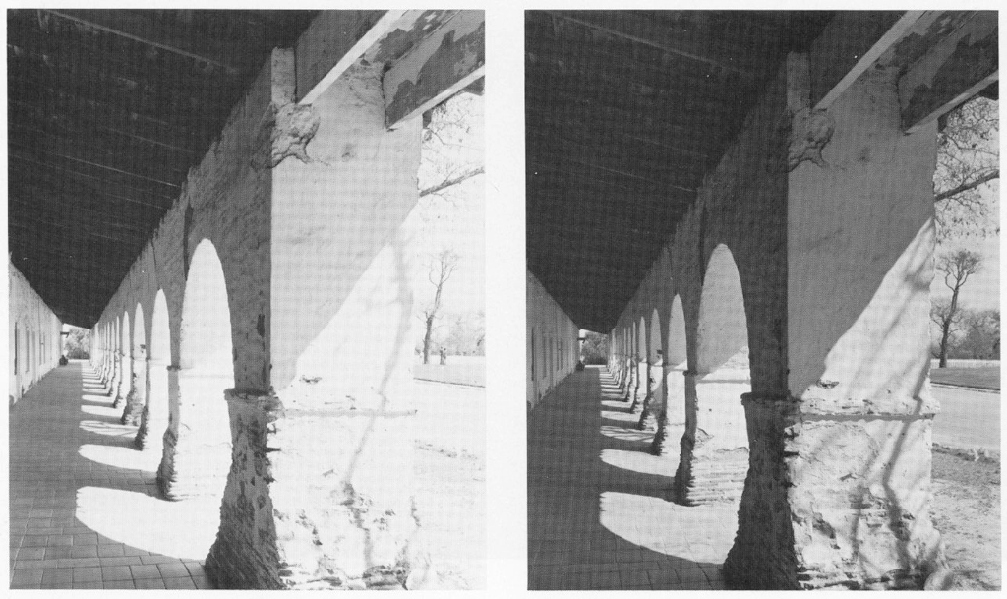
Two solutions
One development solution
Two development solution:
the dark areas are the same,
but bright areas are different
Source: Ansel Adams

Slide 84
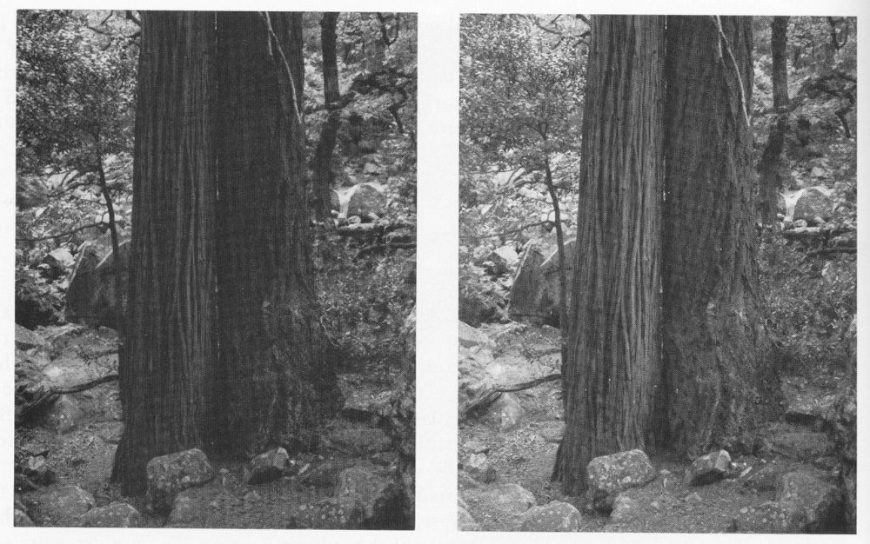
Pre-exposure
Briefly expose negative to a uniform light
Raises the values of everything (in particular puts dark values above the low-contrast toe of response curve)
Without pre-exposure
With pre-exposure
Source: Ansel Adams

Slide 85
Paper
Paper grade = contrast (think γ)
Multigrade paper
  For black and white
  grade depends on wavelength
  Use filters to choose grade

Slide 86
Questions?

Slide 87
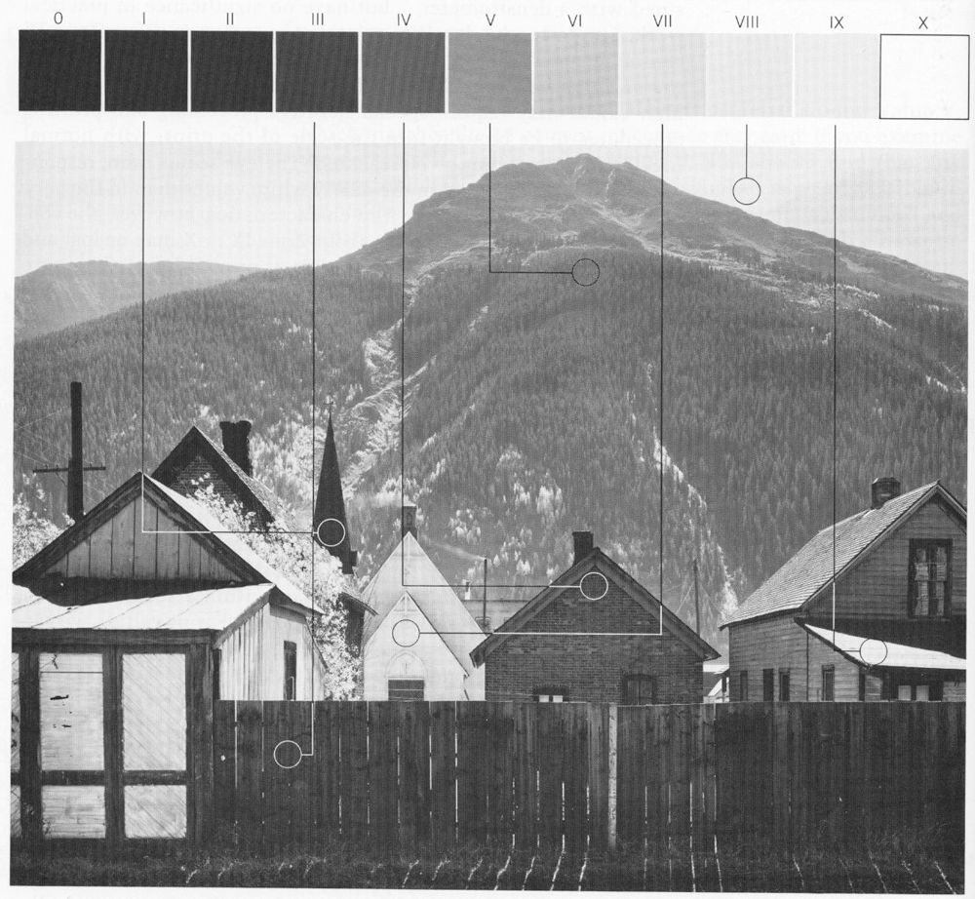
The Zone system
Formalism for exposure, density: essentially curves
Zone = intensity range, in powers of two
In the scene, on the negative, on the print
Source: Ansel Adams

Slide 88
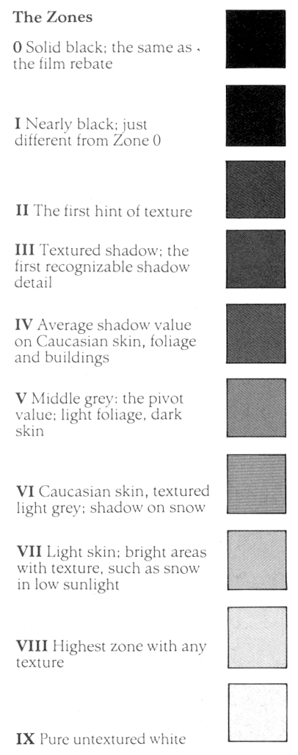
The Zones

Slide 89
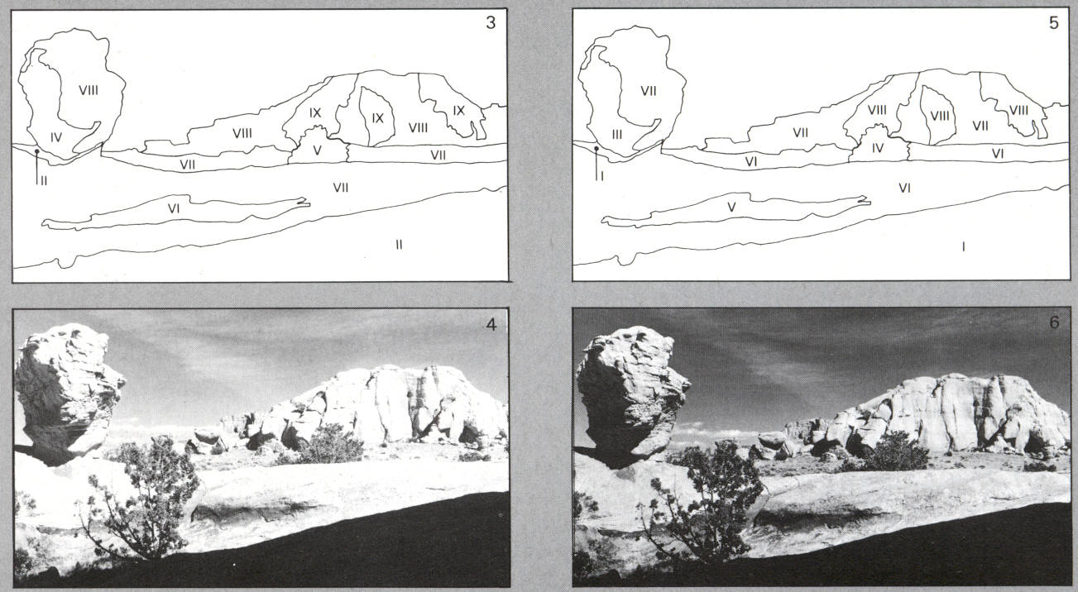
The Zone system
You decide to put part of the system in a given zone
Decision: exposure, development, print

Slide 90
X
IX
VIII
VII
VI
V
IV
III
II
I
0
0
I
II
III
IV
V
VI
VII
VIII
IX
X

Slide 91
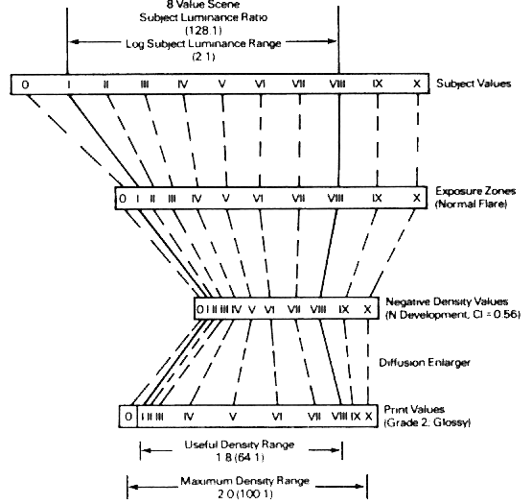
Recap for film
Take picture
Develop negative
Print

Slide 92
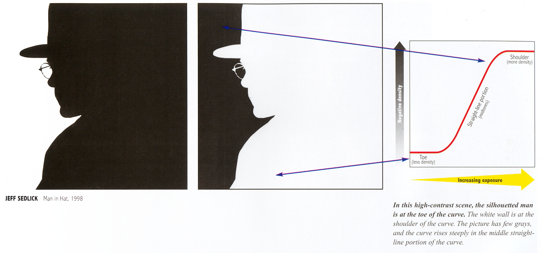
Limited dynamic range can be good!
From Photography by London et al.

Slide 93
Contrast modification by the curve?
Look at the remapping in log-log
Slope = local exponent=contrast modification
log
log

Slide 94
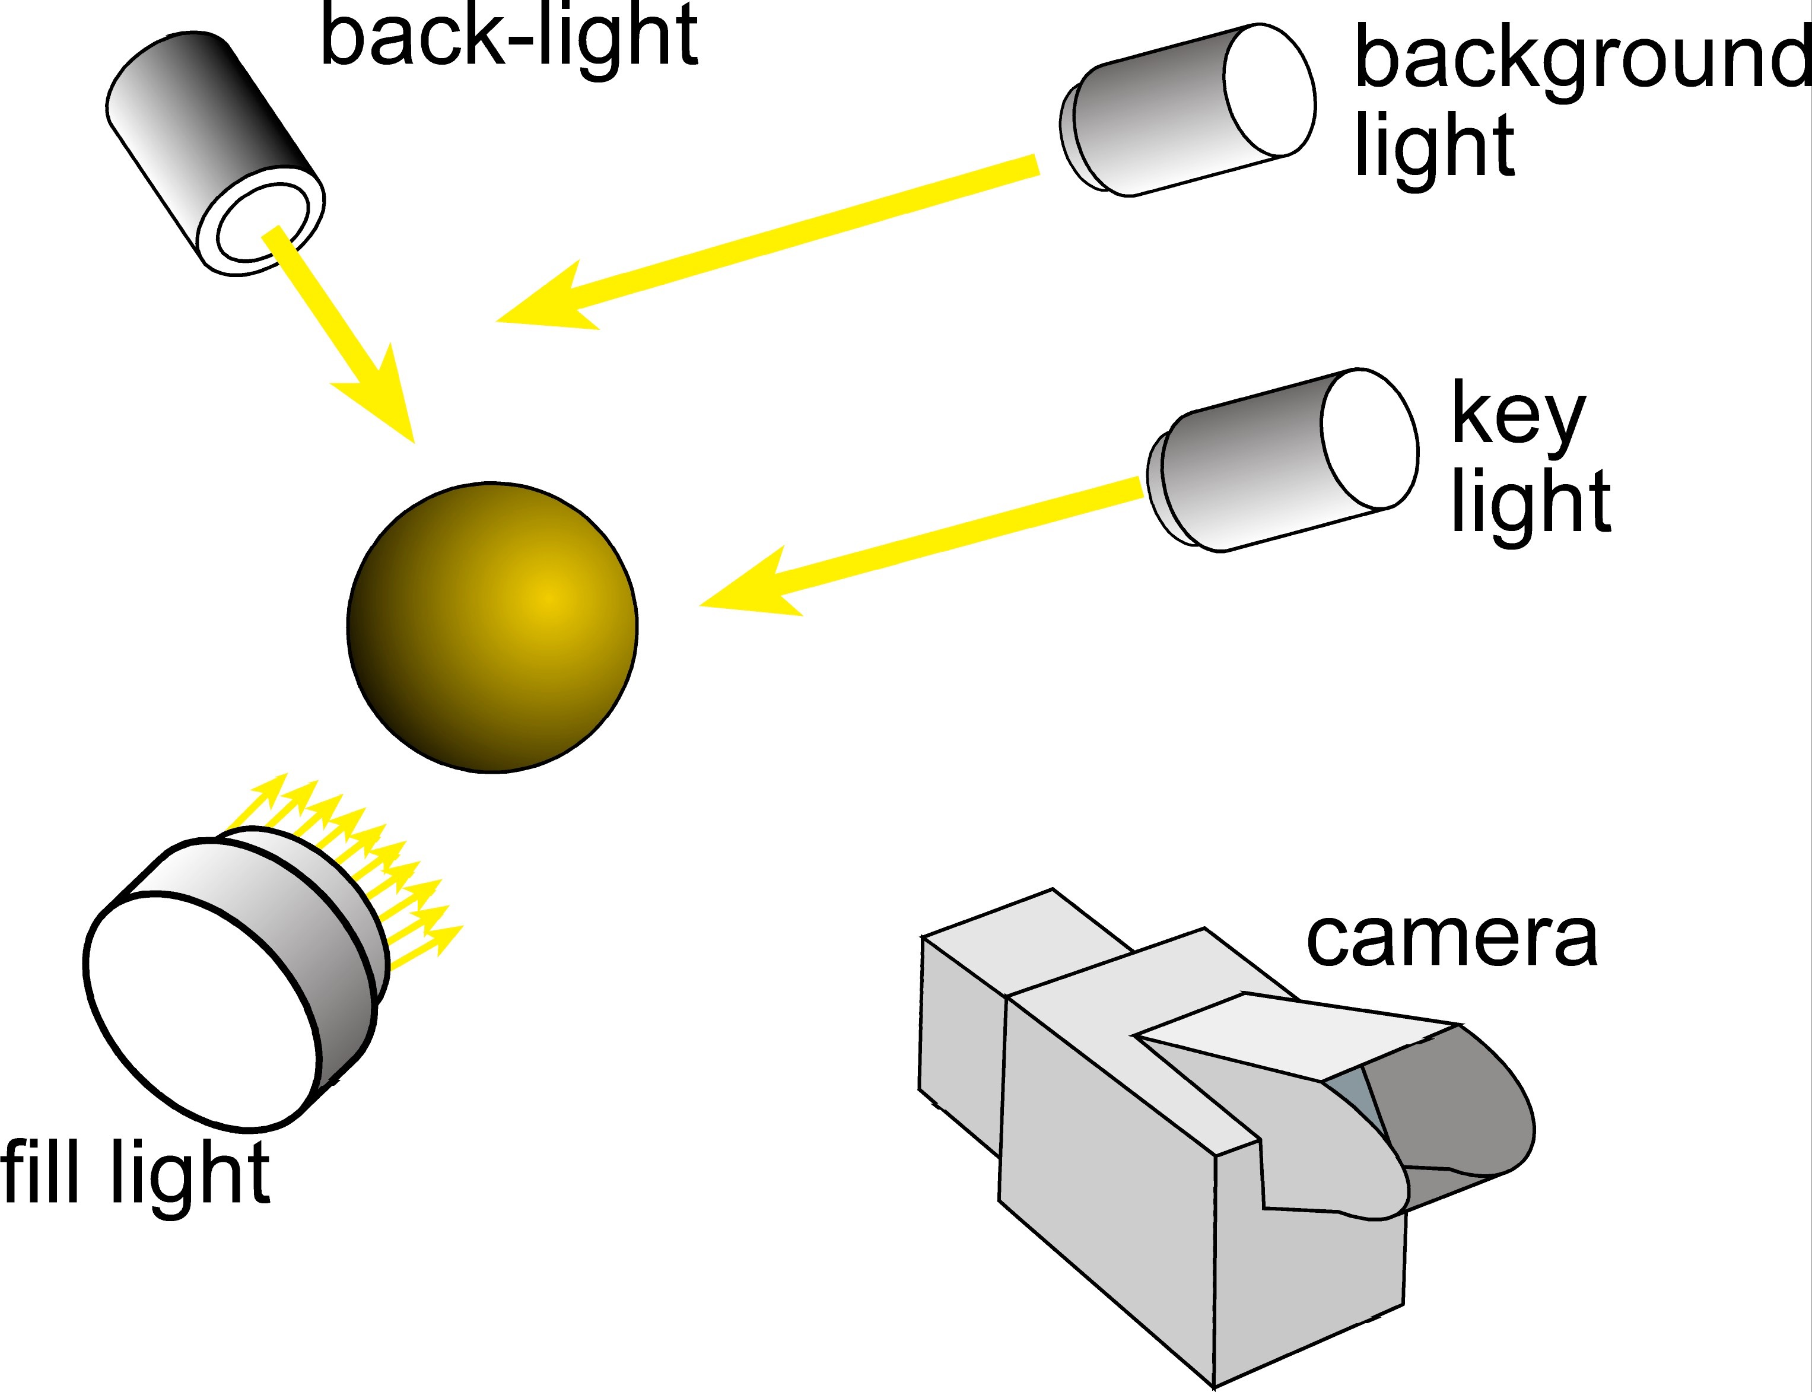
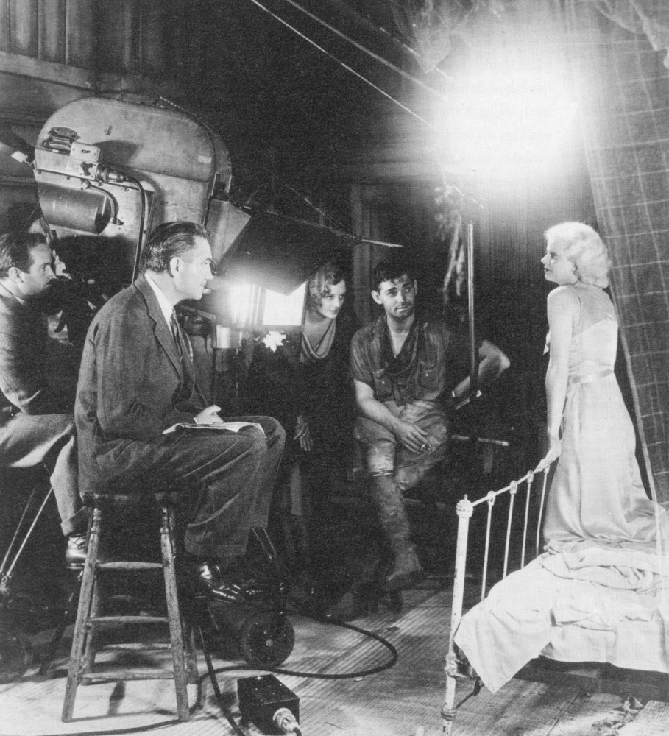
Lighting
E.g. 3-point lighting
  Reduce dynamic range
  Emphasize silhouettes
  ! 3D cues
Goals of lighting:
  Manage dynamic range
  Reveal shape, layout, material
  Tell story

Slide 95
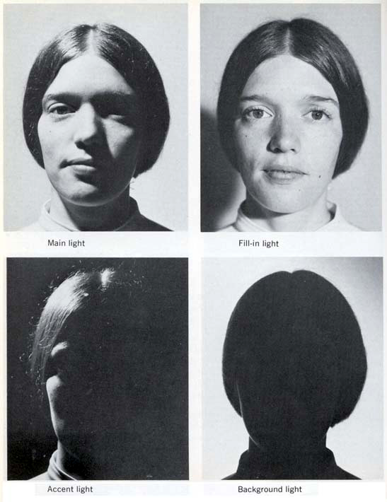
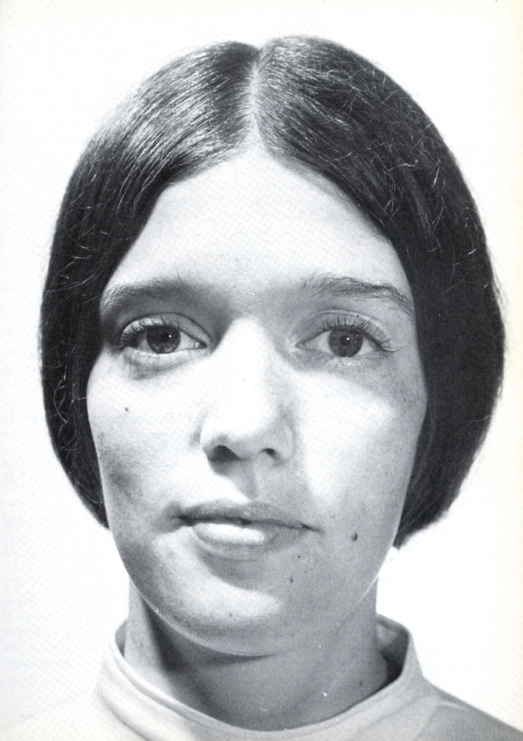
Portrait lighting

Slide 96
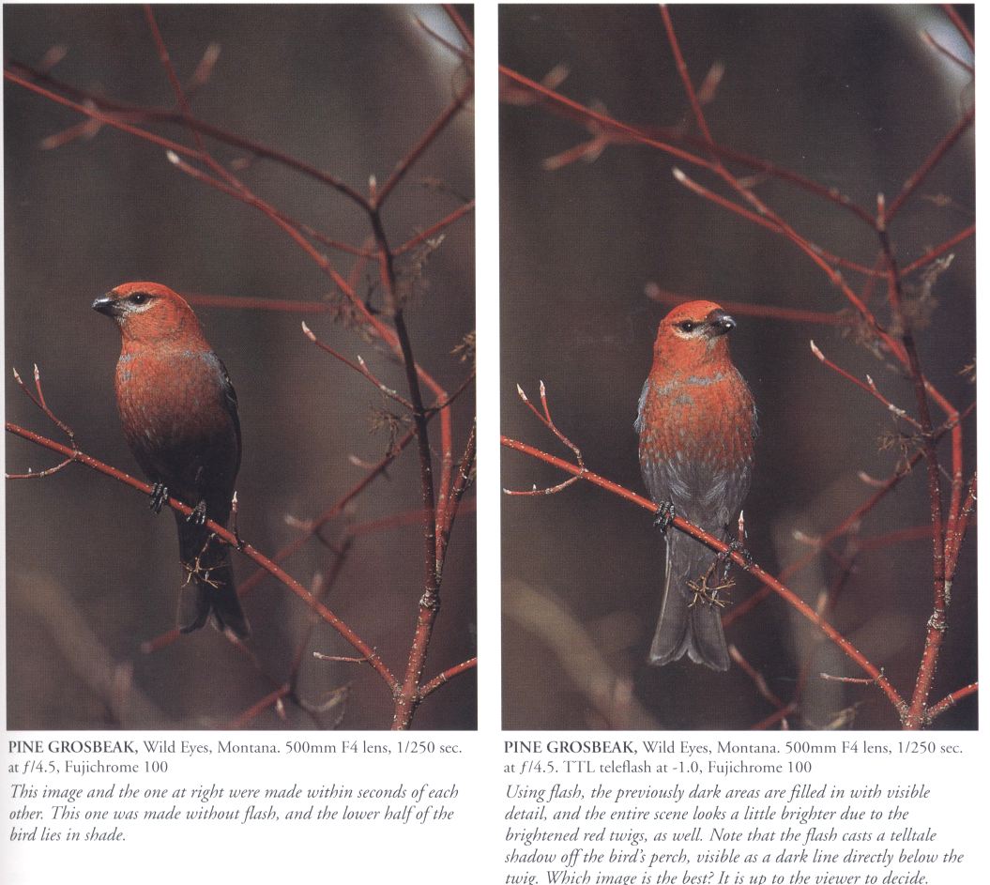

Fill-in flash

Slide 97

Without flash

Slide 98

With fill flash

Slide 99


Fill-in flash

Slide 100


Fill-in flash
Use flash to reduce contrast
Exposure for outside
Exposure for inside
Average exposure
Using fill flash
From Le Livre de la Photo Couleur (Larousse)

Slide 101




Interior photography
Balancing exterior and interior is challenging!

Slide 102
Questions?

Slide 103


Filtering: black and white
Red/orange/yellow filters darken the sky
No filter
With red filter
Source: Ansel Adams

Slide 104


Graduated neutral density
No filter: sky is too bright
Vertical neutral
density gradient

Slide 105

Graduated ND & landscape
Art Wolfe: In the late evening light, I composed this image using a graduated neutral-density filter to bring the overall exposure into alignment, thus preserving the detail in the clouds in the sky and the reflections on the water.
http://www.artwolfe.com/

Slide 106

Graduated ND & landscape
Art Wolfe: Here I had to use a combination of filters and settings that greatly reduced my chance of success. I used my zoom to bring in Denali and the moose. A polarizing filter brought out the rich colors of the tundra and darkening the sky and a graduated, neutral-density filter to bring the entire scene into the same exposure.
http://www.artwolfe.com/

Slide 107
Alternative: Black card
http://hanjies.blogspot.com/2009/10/black-card-photography-part-i.html

Slide 108


Graduated ND & landscape

Slide 109
Questions?

Slide 110

Dodging and burning
During the print
Hide part of the print during exposure
  Makes it brighter
From The Master Printing Course, Rudman

Slide 111


Dodging and burning
From Photography by London et al.

Slide 112



Dodging and burning
Must be done for every single print!
Straight print
After dodging and burning

Slide 113


Dodging and burning
Source: Ansel Adams

Slide 114

From Photography by London et al.

Slide 115

Dodging & burning is difficult!
Source: Rudman

Slide 116
Advanced versions
Dodging card
  Precisely cut out shapes in the image
Multigrade paper
  Dodge/burn with different filter/grade
  Vary local contrast (not only brightness)
Focus
  Change focus of enlarger and doge and burn
  Local control of sharpness
Locally paint chemical on print
  Can have a multiplicative, additive or exponential effect depending on chemical

Slide 117

Questions?
Gordon Parks

Slide 118
Digital dodge-burn and graduated ND
Use adjustment layer and gradient tool
  Use curve adjustment layer
  Modulate its effect using the layer mask
Just paint in black
  On a separate layer
  With a low opacity
Multiple exposure photography
  Use a tripod
  “Bracket” your exposure
  Stack exposures as layers in photoshop
  Use layer masks to select which region comes from which exposure

Slide 119



What have we learnt?
Log is good
Luminance is different from chrominance
Separate components:
  Low and high frequencies
Strong edges are important
Large-scale
Output
Detail
Color

Slide 120






References

Slide 121
Other tone mapping references
J. DiCarlo and B. Wandell, Rendering High Dynamic Range Images http://www-isl.stanford.edu/%7Eabbas/group/papers_and_pub/spie00_jeff.pdf
Choudhury, P., Tumblin, J., "The Trilateral Filter for High Contrast Images and Meshes". http://www.cs.northwestern.edu/~jet/publications.html
Tumblin, J., Turk, G., "Low Curvature Image Simplifiers (LCIS): A Boundary Hierarchy for Detail-Preserving Contrast Reduction.'' http://www.cs.northwestern.edu/~jet/publications.html
Tumblin, J., "Three Methods For Detail-Preserving Contrast Reduction For Displayed Images'' http://www.cs.northwestern.edu/~jet/publications.html
Photographic Tone Reproduction for Digital Images
Erik Reinhard, Mike Stark, Peter Shirley and Jim Ferwerda http://www.cs.utah.edu/%7Ereinhard/cdrom/
Ashikhmin, M. ``A Tone Mapping Algorithm for High Contrast Images'' http://www.cs.sunysb.edu/~ash/tm.pdf
Retinex at Nasa http://dragon.larc.nasa.gov/retinex/background/retpubs.html
Gradient Domain High Dynamic Range Compression Raanan Fattal, Dani Lischinski, Michael Werman http://www.cs.huji.ac.il/~danix/hdr/
Li et al. : Wavelets and activity maps http://web.mit.edu/yzli/www/hdr_companding.htm

Slide 122
Tone mapping code
http://www.mpi-sb.mpg.de/resources/pfstools/
http://scanline.ca/exrtools/
http://www.cs.utah.edu/~reinhard/cdrom/source.html
http://www.cis.rit.edu/mcsl/icam/hdr/

Slide 123
Refs
http://people.csail.mit.edu/sparis/bf_course/
http://people.csail.mit.edu/fredo/PUBLI/Siggraph2002/
http://www.hdrsoft.com/resources/dri.html
http://www.clarkvision.com/imagedetail/dynamicrange2/
http://www.debevec.org/HDRI2004/
http://www.luminous-landscape.com/tutorials/hdr.shtml
http://www.anyhere.com/gward/hdrenc/
http://www.debevec.org/IBL2001/NOTES/42-gward-cic98.pdf
http://www.openexr.com/
http://gl.ict.usc.edu/HDRShop/
http://www.dpreview.com/learn/?/Glossary/Digital_Imaging/Dynamic_Range_01.htm
http://www.normankoren.com/digital_tonality.html
http://www.anyhere.com/
http://www.cybergrain.com/tech/hdr/

Slide 124

Available in HDRShop
Slide from Siggraph 2005 course on HDR

Slide 125
From Being Undigital by Mann & Picard

Slide 126
Questions?

