Slide 1
HDR and the Bilateral Grid
Fredo Durand
MIT EECS 6.8370/6.8371

Slide 2
Office hours

Slide 3

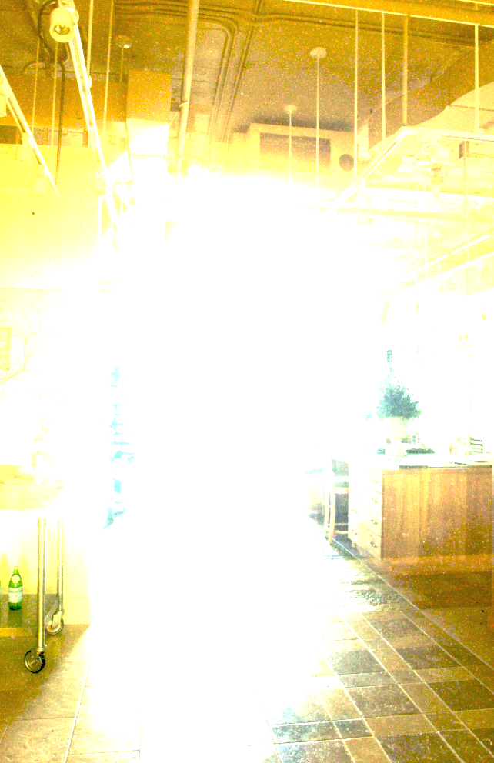
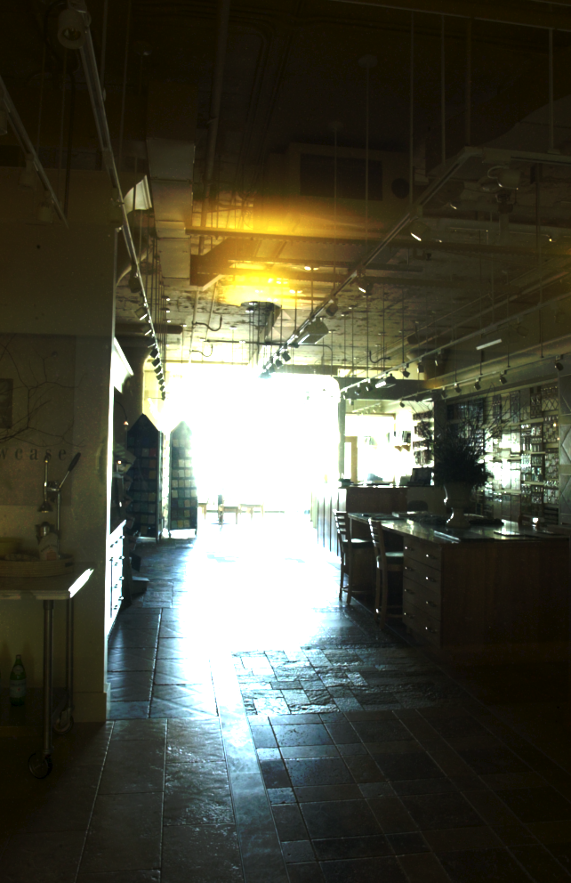
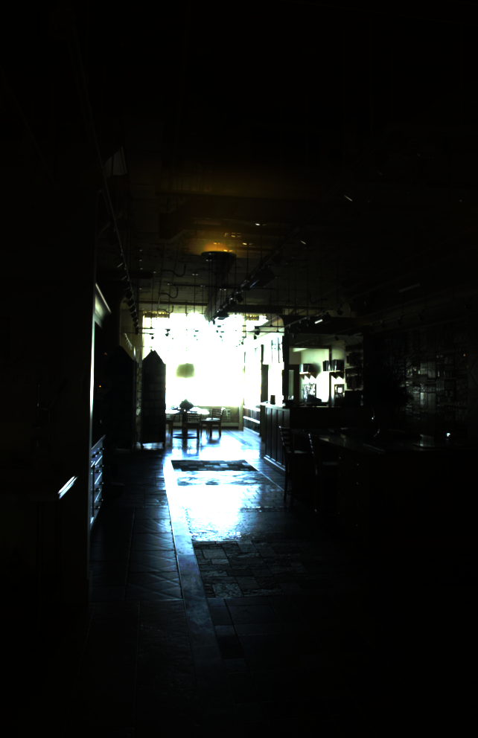
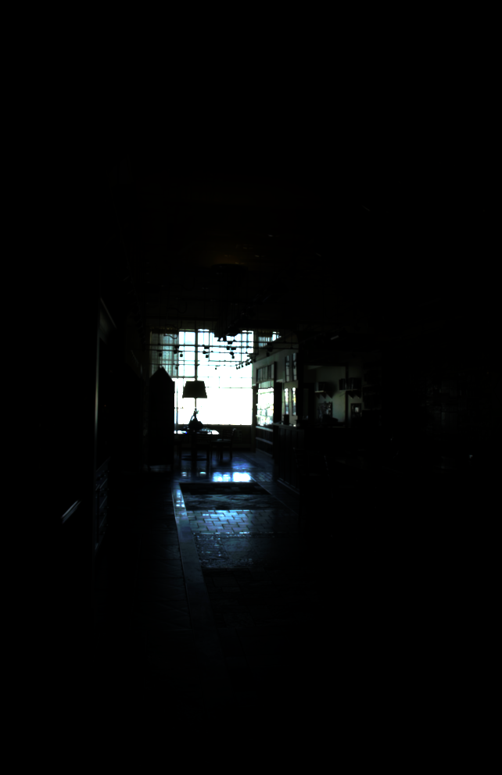
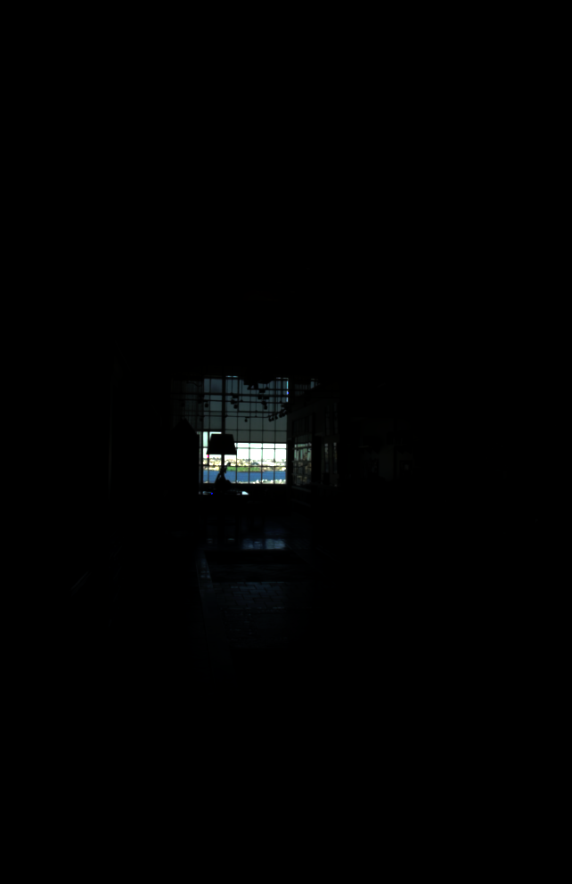
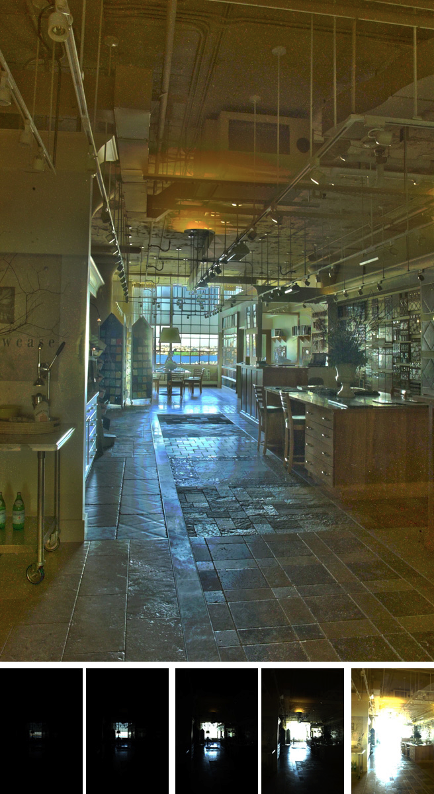
Today
Multiple-exposure High-Dynamic-Range imaging
Tone mapping using the bilateral filter

Slide 4
Spatial color vision

Slide 5
Contrast Sensitivity
Sine Wave grating
What contrast is necessary to make the grating visible?
How does it change with spatial frequency

Slide 6






Slide 7


Slide 8

Contrast Sensitivity Function
Campbell-Robson Chart
decreasing contrast
increasing spatial frequency

Slide 9
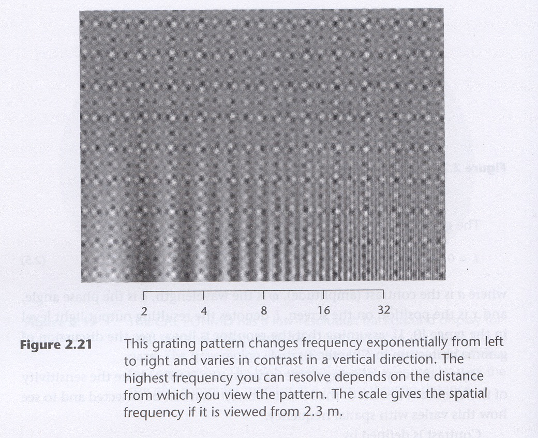
Contrast Sensitivity Function (CSF)

Slide 10
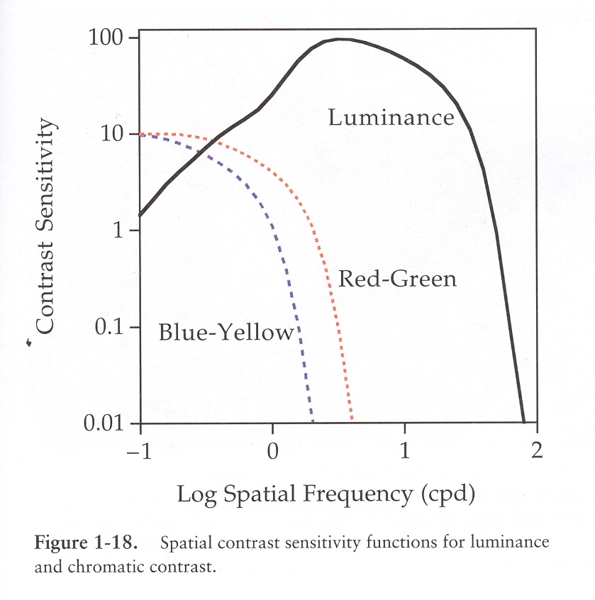
Contrast Sensitivity Function (CSF)

Slide 11
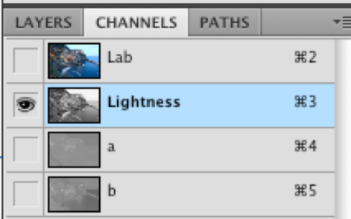
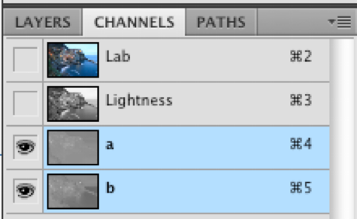
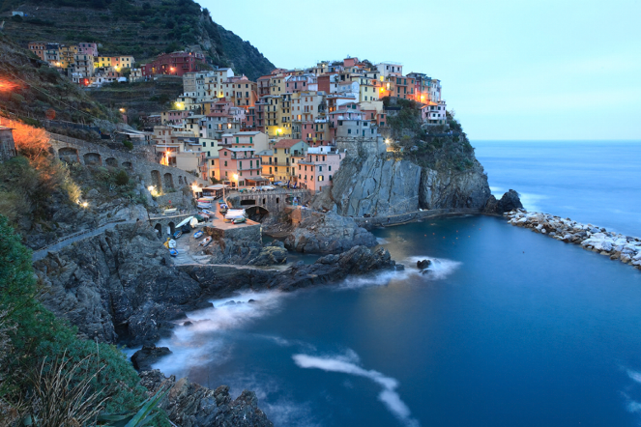
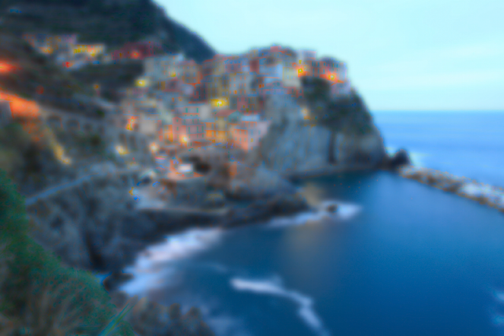

Photoshop demo
Image > Mode > Lab color
Go to channel panel, select Lightness
Filter > Blur > Gaussian Blur , e.g. 4 pixel radius
  very noticeable
Undo, then select a & b channels
Filter > Blur > Gaussian Blur , same radius
  hardly visible effect
Original
Blur Lightness
Blur a & b

Slide 12
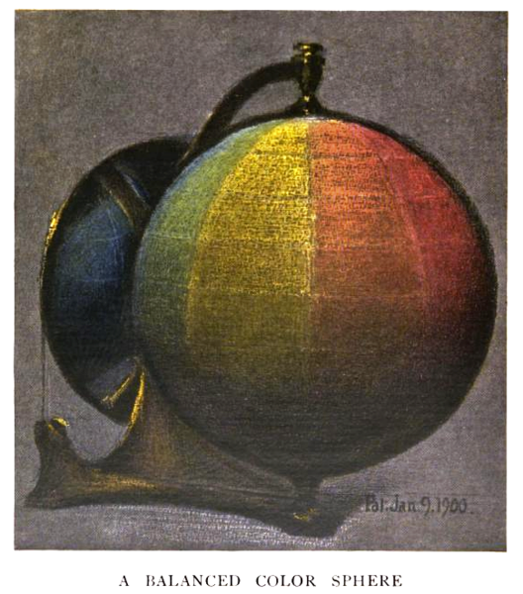
Questions?

Slide 13
JPEG

Slide 14
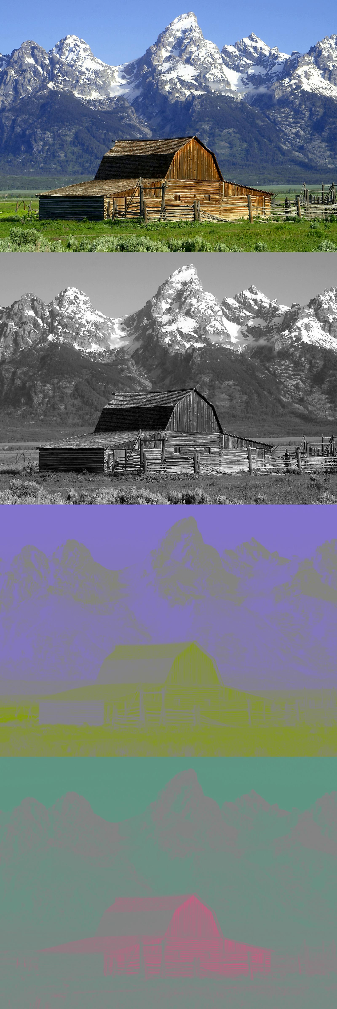
Opponents and image compression
JPG, MPG, television
Color opponents instead of RGB
  YCrCB, similar to YUV
Compress color more than luminance
  downsample by factor of two for jpeg
  less bandwidth for TV
Exploit contrast sensitivity function
  Compress high frequencies more

Slide 15
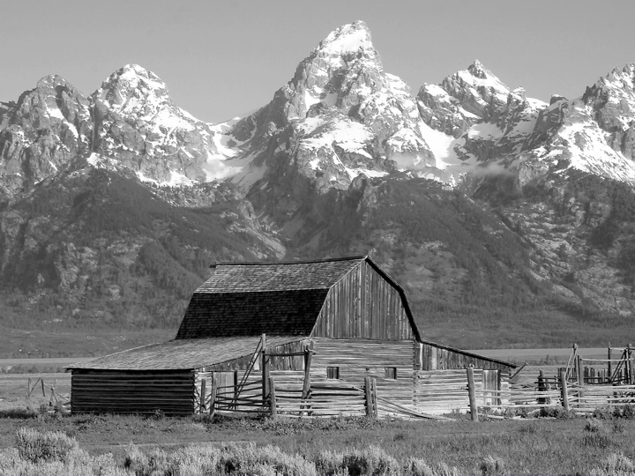
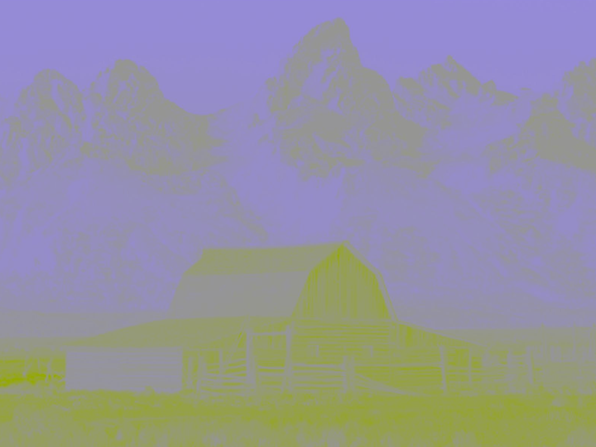
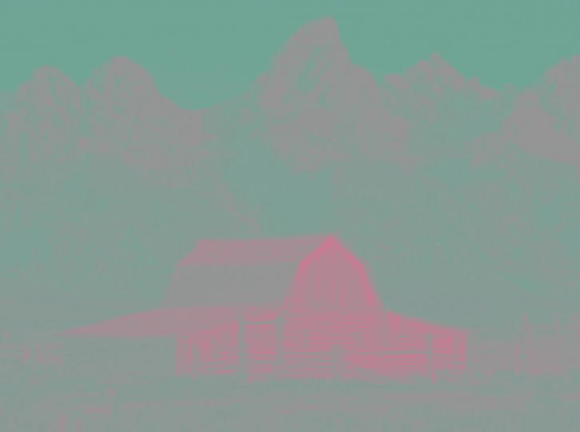
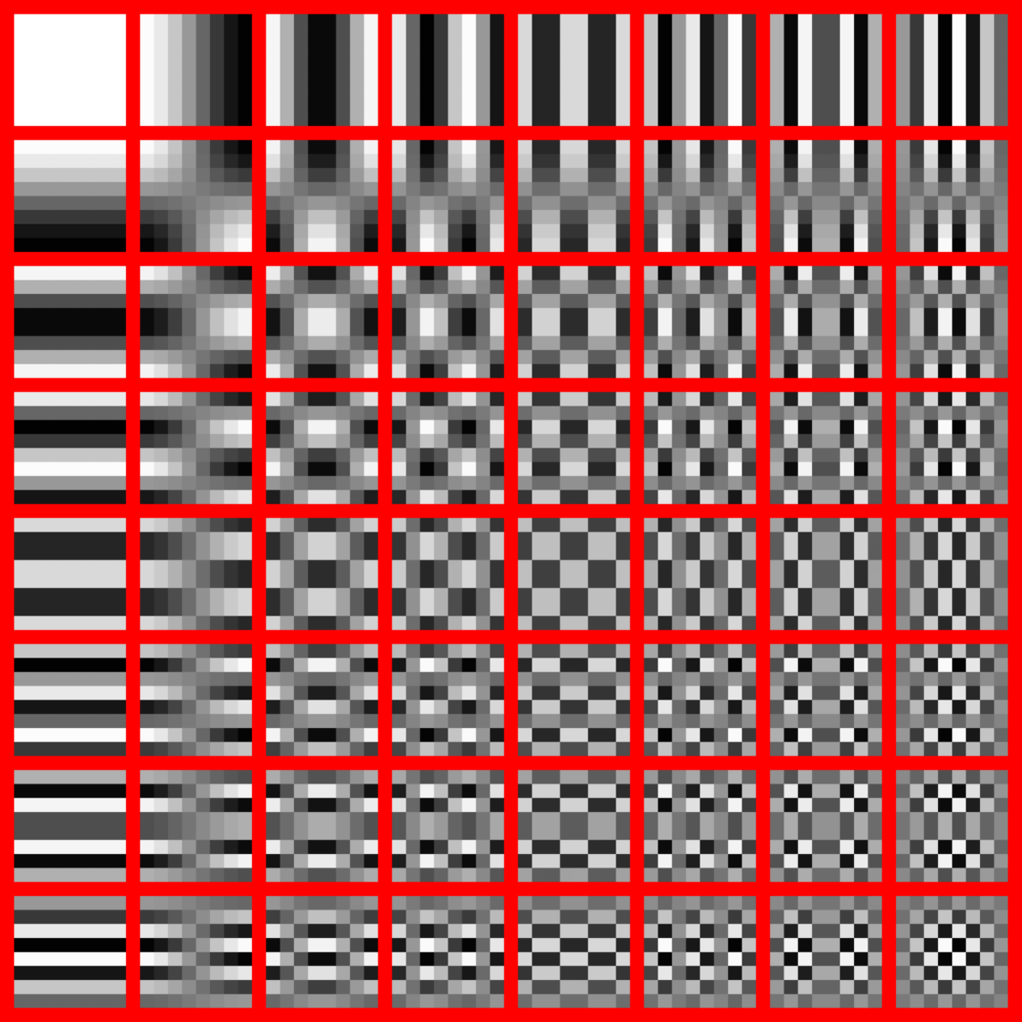
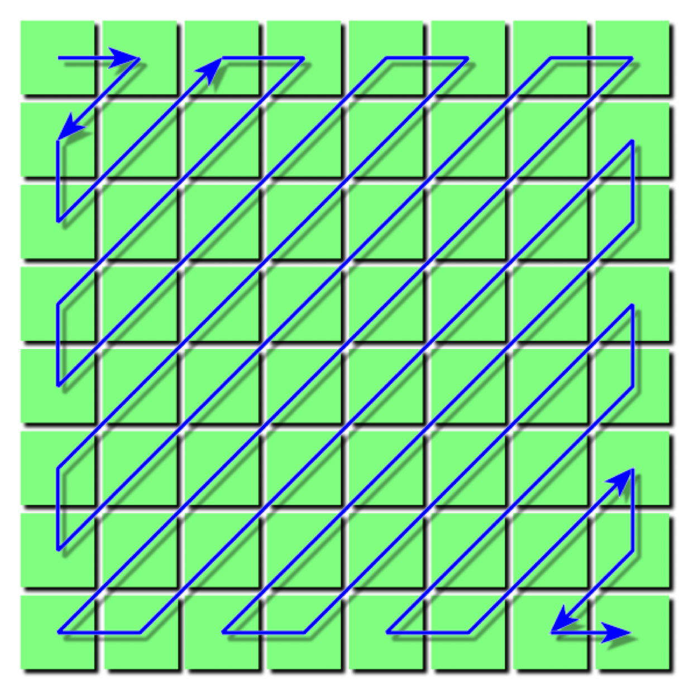
JPEG Compression
convert to YCbCr
  half the resolution for Cr & Cb
Perform Discrete Cosine Transform
to work in frequency space
  Local DCT, 8x8 pixel blocks
Use CSF for quantization
  more bits for frequencies
  with more sensitivity (medium)
Other usual coding tricks
  entropy coding, smart order of blocks

Slide 16
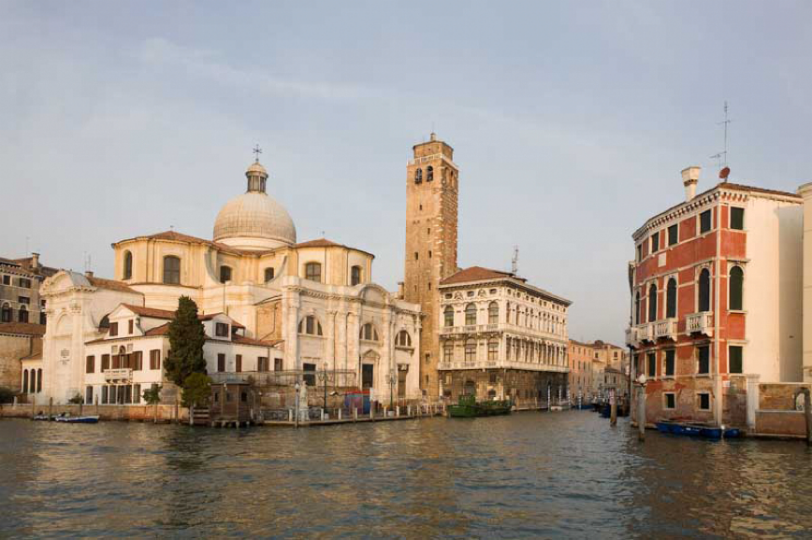
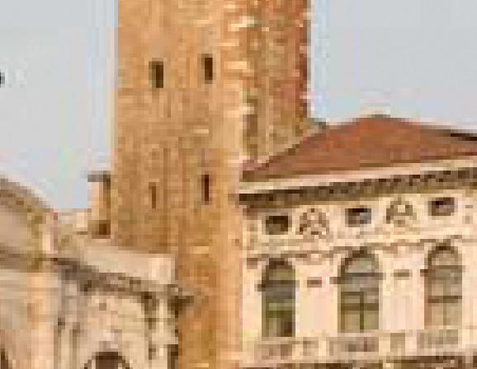
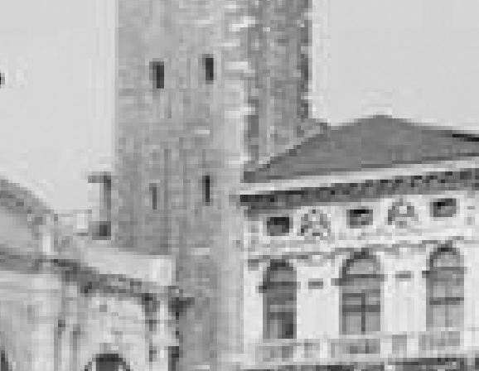

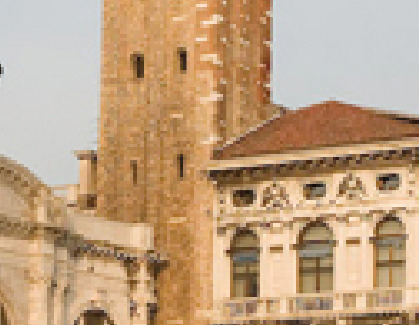


Example
800 x 533 image
RGB
Lightness
a
Low quality JPEG (0 in Photoshop, 172 KB)
High quality JPEG (12 in Photoshop, 460 KB)

Slide 17

Questions?

Slide 18
Tone mapping

Slide 19
Today
Multiple-exposure High-Dynamic-Range imaging
Tone mapping using the bilateral filter

Slide 20
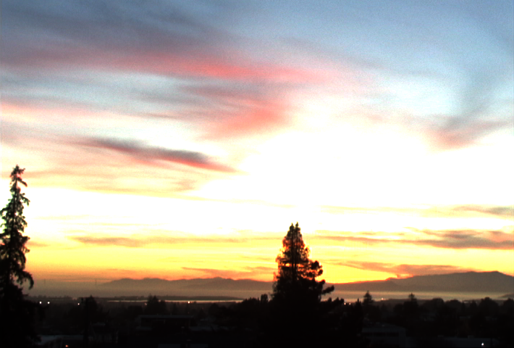
The second half: contrast reduction
Input: high-dynamic-range image
  (floating
  point
  per
  pixel)

Slide 21
Naïve technique
Scene has 1:10,000 contrast, display has 1:100
Simplest contrast reduction?

Slide 22
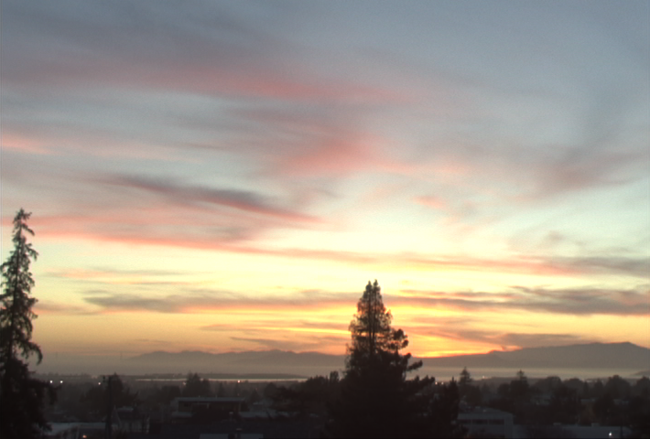
Naïve: Gamma compression
X −> X^{γ} (where γ=0.5 in our case)
But… colors are washed-out. Why?
applied independently on R, G & B
Input
Gamma

Slide 23
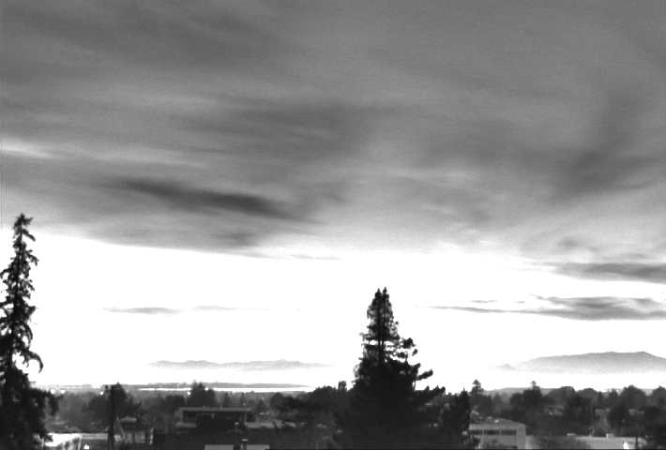
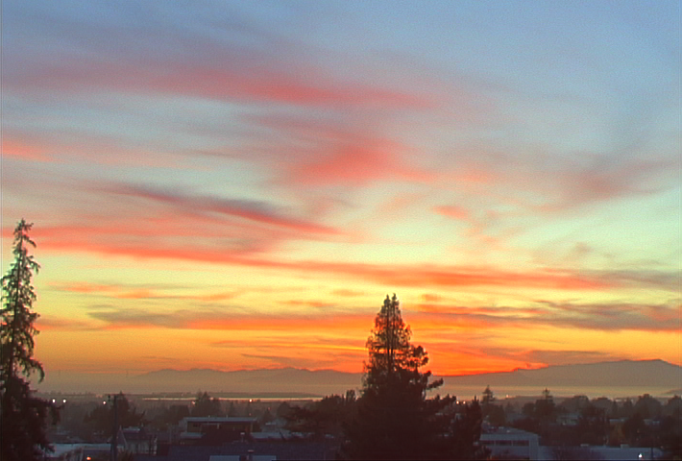
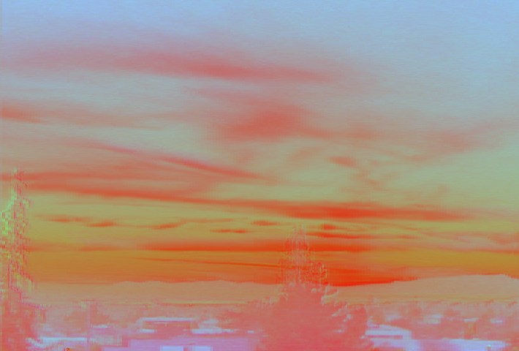
Gamma compression on intensity
Colors are OK,
but details (intensity high-frequency) are muddy
Intensity
Gamma on intensity
Color

Slide 24
Contrast Sensitivity Function (CSF)

Slide 25
Gamma compression on intensity
Colors are OK,
but details (intensity high-frequency) are muddy
Intensity
Gamma on intensity
Color

Slide 26

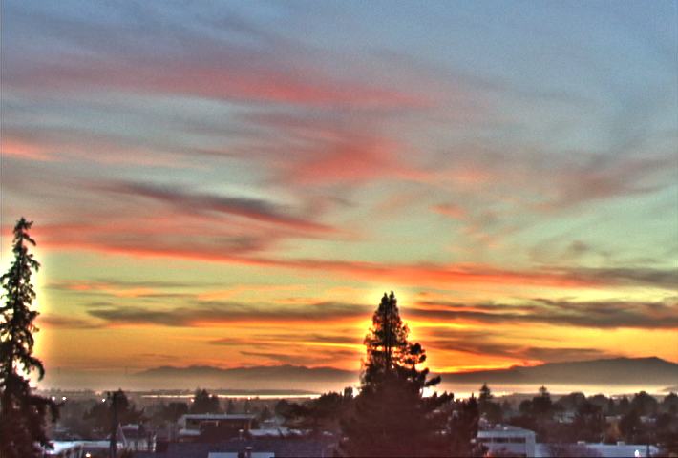
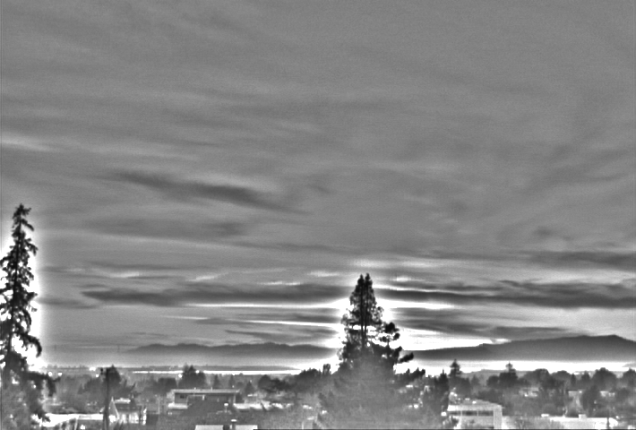
Oppenheim 1968, Chiu et al. 1993
Reduce contrast of low-frequencies
Keep mid and high frequencies
Low-freq.
Reduce low frequency
High-freq.
Color

Slide 27
Homomorphic filtering
Oppenhein, in the sixties
Images are the product of illumination and albedo
  Similarly, many sounds are the product of an envelope and a modulation
Illumination is usually slow-varying
Perform albedo-illumination using low-pass filtering of the log image
http://www.cs.sfu.ca/~stella/papers/blairthesis/main/node33.html
See also Koenderink "Image processing done right"
http://www.springerlink.com/(l1bpumaapconcbjngteojwqv)/app/home/contribution.asp?referrer=parent&backto=issue,11,53;journal,1538,3333;linkingpublicationresults,1:105633,1

Slide 28
The halo nightmare
For strong edges
Because they contain high frequency
Low-freq.
Reduce low frequency
High-freq.
Color

Slide 29
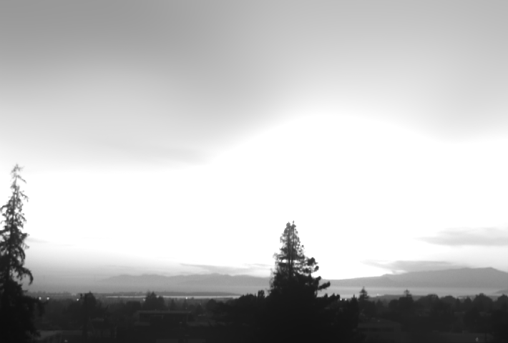
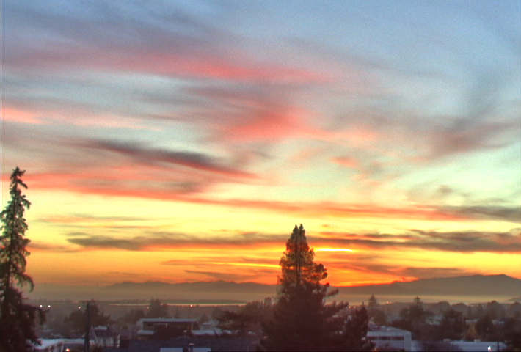
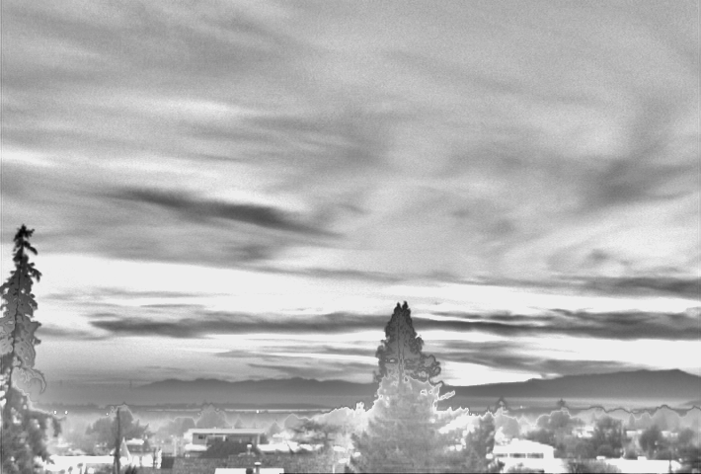
Our approach
Do not blur across edges
Non-linear filtering
Large-scale
Output
Detail
Color

Slide 30
Bilateral filter
Tomasi and Manduci 1998]
  http://www.cse.ucsc.edu/~manduchi/Papers/ICCV98.pdf
Developed for denoising
Related to
  SUSAN filter [Smith and Brady 95]
  http://citeseer.ist.psu.edu/smith95susan.html
  Digital-TV [Chan, Osher and Chen 2001]
  http://citeseer.ist.psu.edu/chan01digital.html
  sigma filter http://www.geogr.ku.dk/CHIPS/Manual/f187.htm
Full survey: http://people.csail.mit.edu/sparis/publi/2009/fntcgv/Paris_09_Bilateral_filtering.pdf

Slide 31
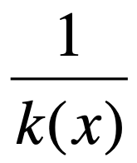
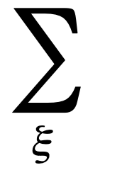
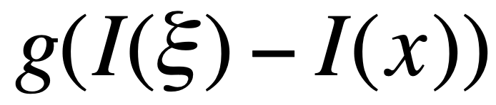
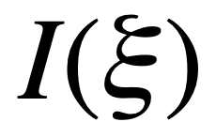

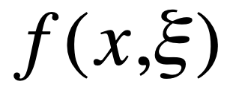

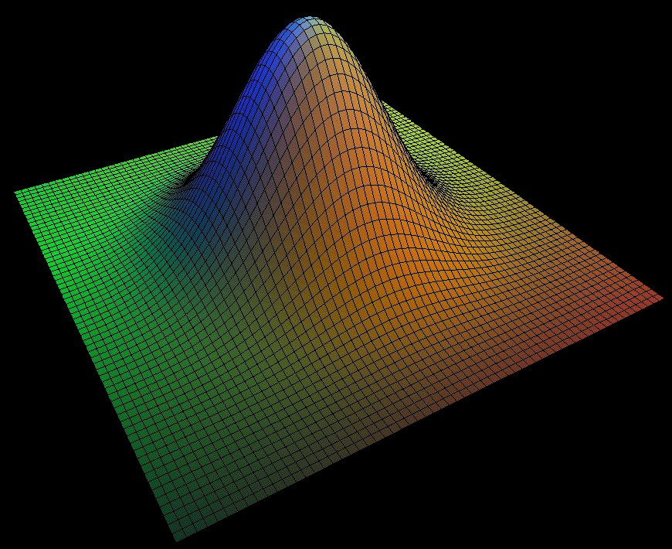
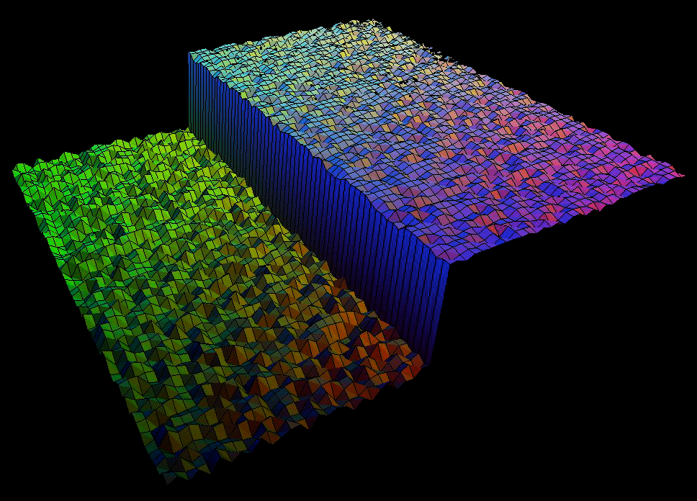
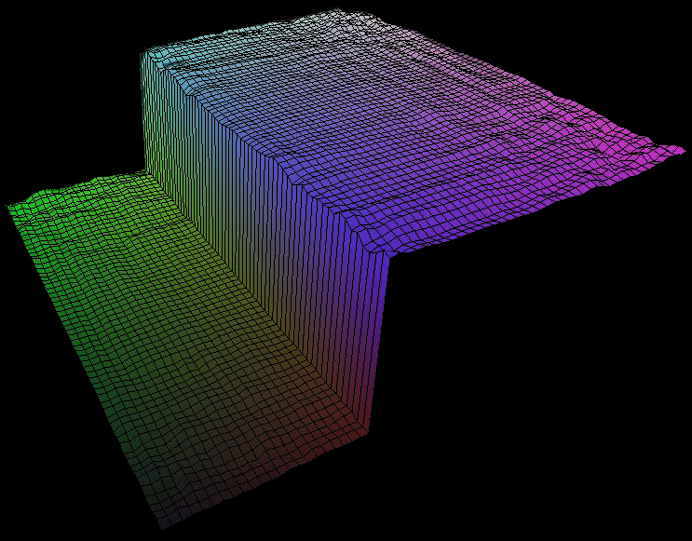
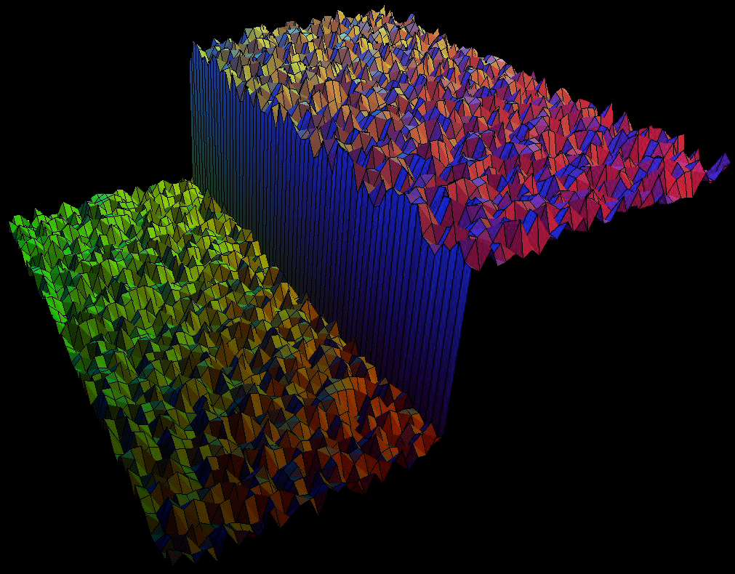
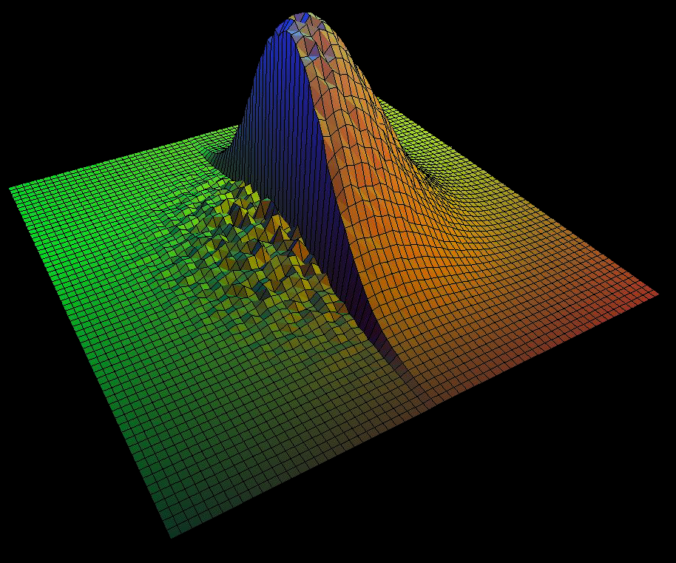
Bilateral filtering
[Tomasi and Manduchi 1998]
Spatial Gaussian f
Gaussian g on the intensity difference
I(x)
x
I(x)
output
input

Slide 32

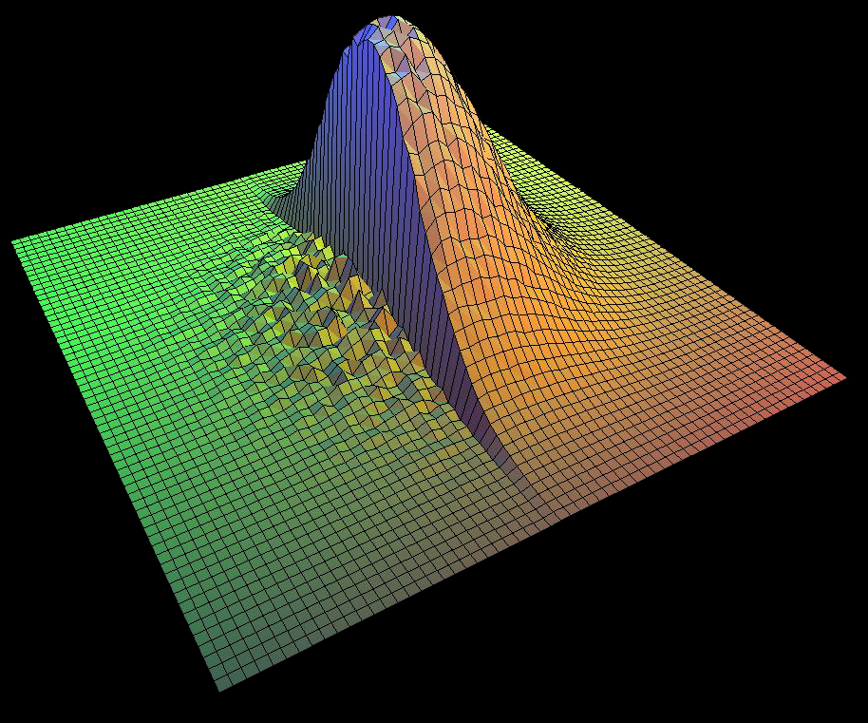
Normalization factor
[Tomasi and Manduchi 1998]
k(x)=
output
input

Slide 33
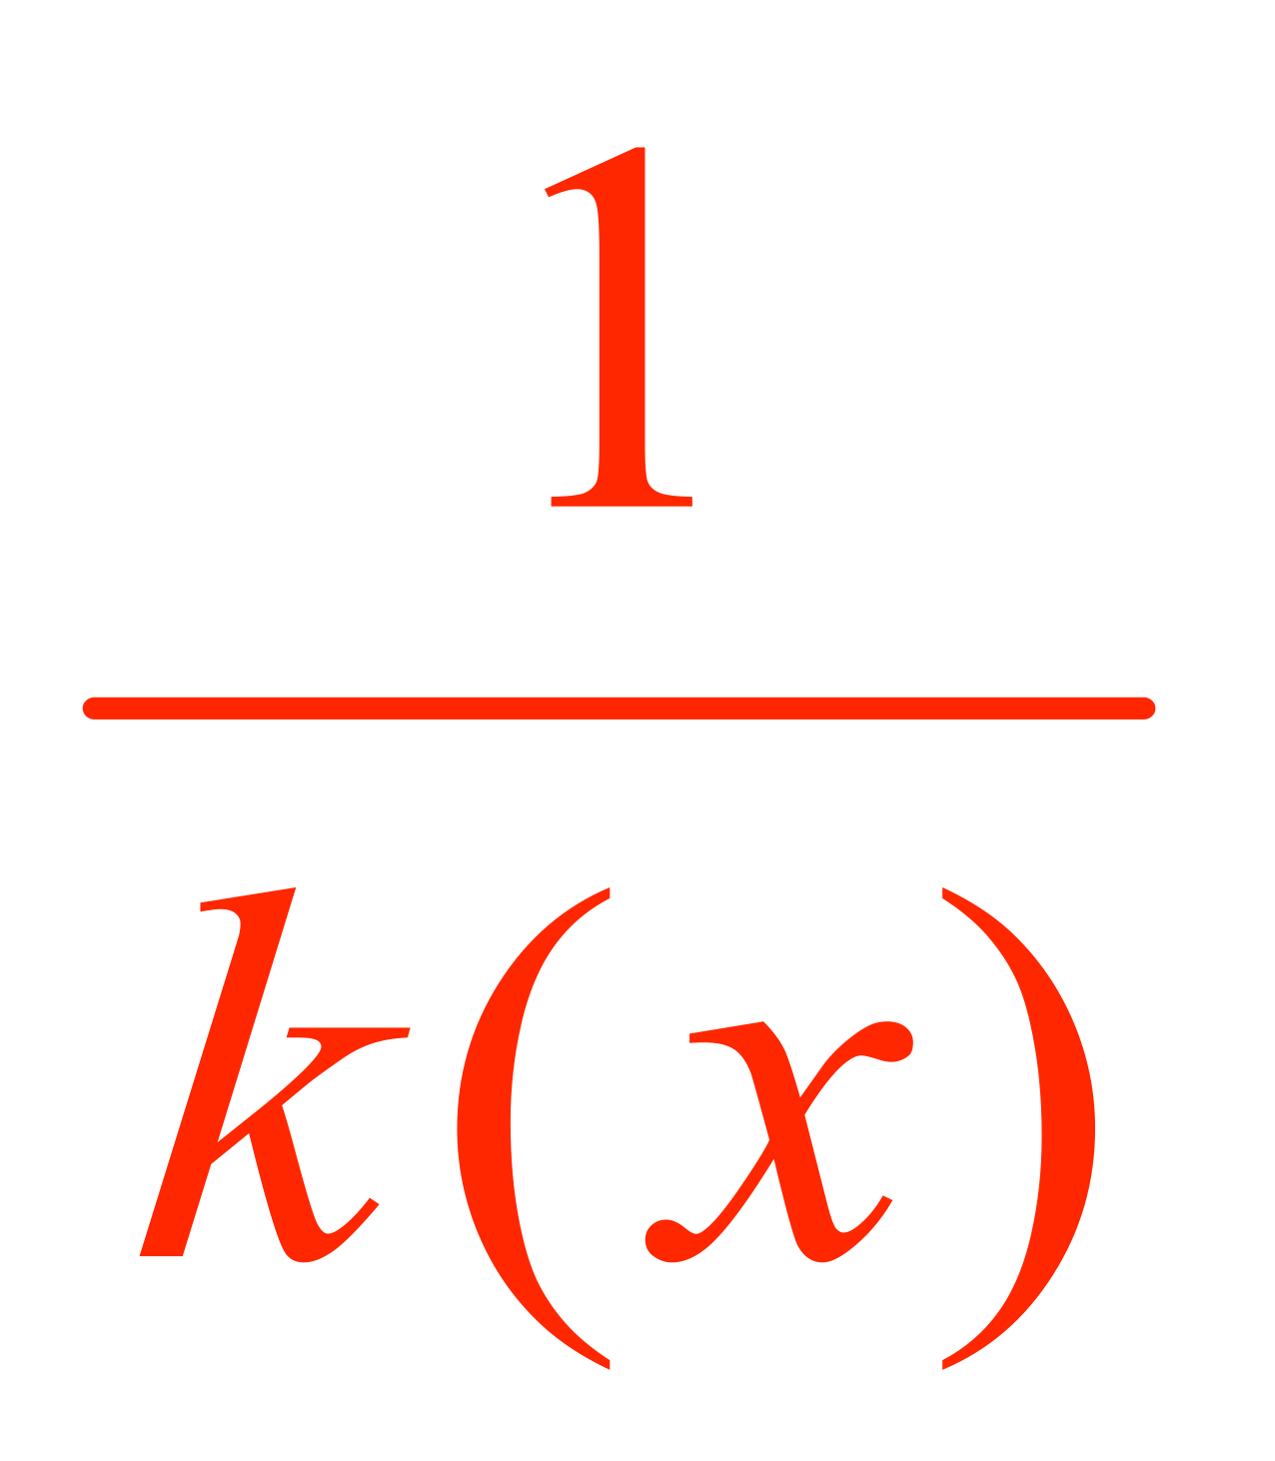
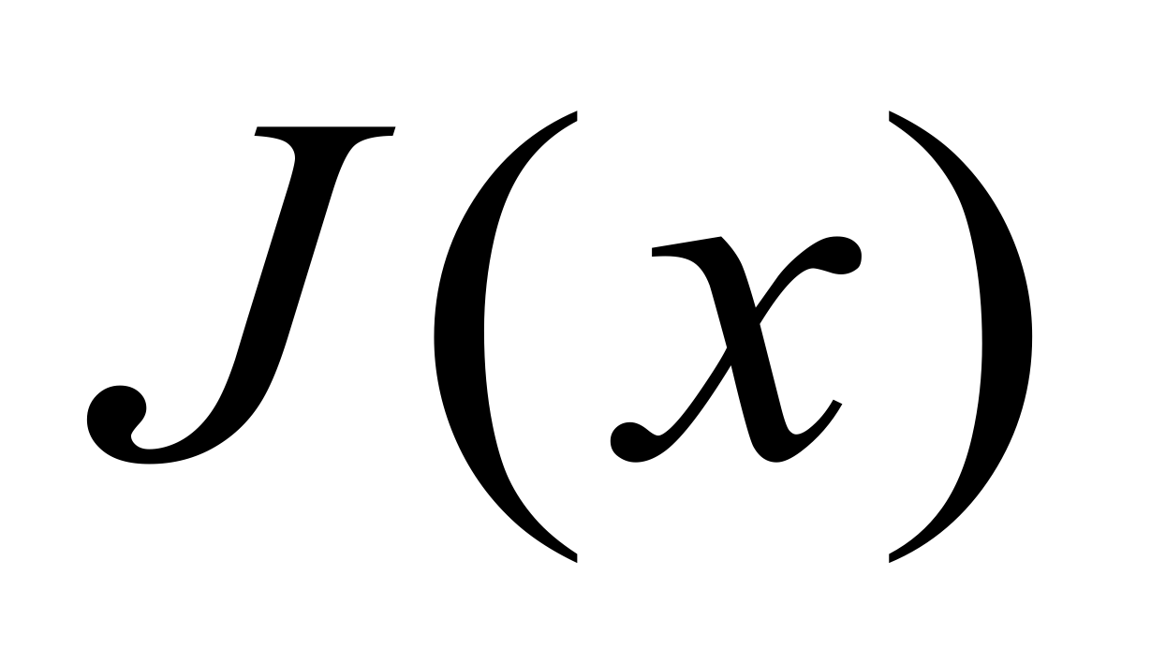


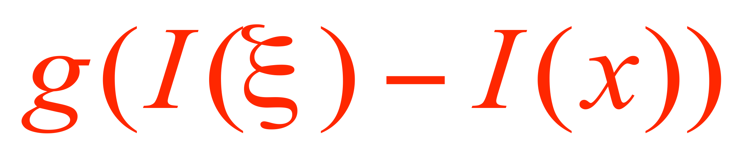


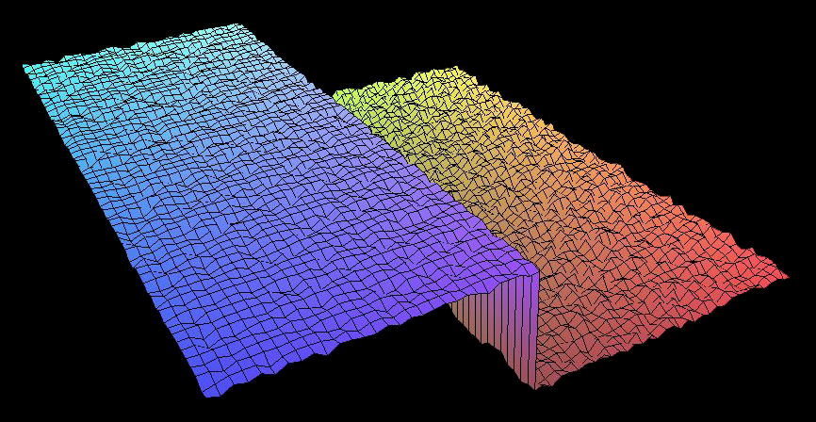
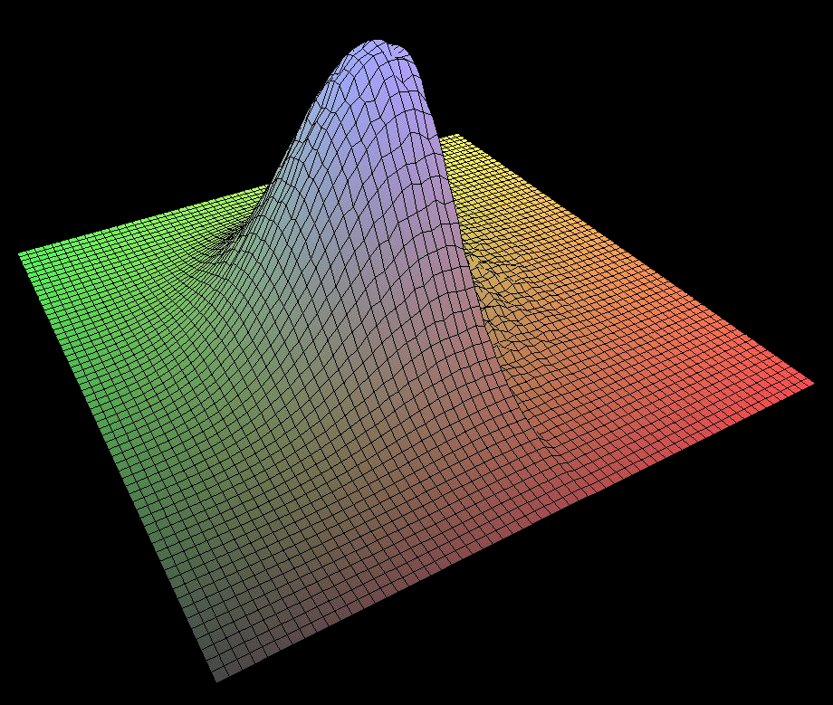
Bilateral filtering is non-linear
[Tomasi and Manduchi 1998]
The weights are different for each output pixel
output
input

Slide 34
NEEDS WORK TO MAKE GAUSSIAN DETAILS CLEARER
SHOW EFFECT OF SIGMAS

Slide 35
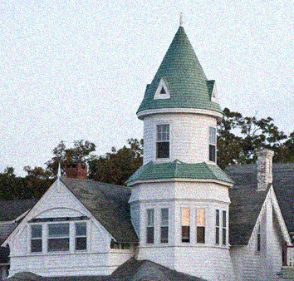

Basic denoising
Noisy input
Bilateral filter 7x7 window

Slide 36


Recall bilateral denoising
Noisy input
After bilateral filter

Slide 37
Contrast reduction
Input HDR image
Contrast too high!

Slide 38
Contrast reduction
Input HDR image
Intensity
intensity
= 0.4R+0.7G+0.01B
Color
R’=R/intensity
G’=G/intensity
B’=B/intensity
important to use ratios
(makes it luminance invariant)

Slide 39


Contrast reduction
Input HDR image
Intensity
Large scale
Bilateral
Filter
in log
Color
Spatial sigma: 2 to 5% image size
Range sigma: 0.4 (in log 10)

Slide 40
What is large scale
Some notion of average luminancxe around a pixel
previously: Gaussian-blurred log luminance
Now bilaterally-filtered log luminance

Slide 41
Contrast reduction
Input HDR image
Intensity
Large scale
Bilateral
Filter
in log
Detail
Color
Detail = log intensity - large scale
(residual)

Slide 42

Contrast reduction
Input HDR image
Intensity
Large scale
Large scale
Reduce
contrast
Bilateral
Filter
in log
Detail
Color

Slide 43
Contrast reduction
Input HDR image
Intensity
Large scale
Large scale
Reduce
contrast
Fast
Bilateral
Filter
Detail
Detail
Preserve!
Color

Slide 44
Contrast reduction
Input HDR image
Output
Intensity
Large scale
Large scale
Reduce
contrast
Fast
Bilateral
Filter
Detail
Detail
Preserve!
Color
Color

Slide 45
Log domain
Very important to work in the log domain
Recall: humans are sensitive to multiplicative contrast
With log domain, our notion of “strong edge”
always corresponds to the same contrast

Slide 46
Reduction
To reduce contrast of base (large-scale) layer
  scale in the log domain
  ➔ γ exponent in linear space
Set a target range: target=log₁₀ (10)
Compute current range in the base (log) layer:
max-min
Deduce γ using an elaborate operation known as division: γ=target / (max-min)
You finally need to normalize so that the biggest value in the (linear) base is 1 (0 in log):
  Offset the compressed base by its max

Slide 47
Contrast reduction in log domain
Set target large-scale contrast (e.g. log₁₀ 100)
  i.e. in linear output,
  we want 1:100 contrast for large scale
Compute range of input large scale layer:
  largeRange = max(inLogLarge) – min (inLogLarge)
Scale factor k= log₁₀ (100) / largeRange
Normalize so that the biggest value is 0 in log
outLog= inLogDetail +
k(inLogLarge – max(inLogLarge))

Slide 48
Contrast reduction
Could target full image contrast/brightnes
In practice easier to focus on large scale

Slide 49
Contrast reduction in log domain
Set target large-scale contrast (e.g. log₁₀ 100)
  i.e. in linear output,
  we want 1:100 contrast for large scale
Compute range of input large scale layer:
  largeRange = max(inLogLarge) – min (inLogLarge)
Scale factor k= log₁₀ (100) / largeRange
Normalize so that the biggest value is 0 in log
Optional: amplify detail by detailAmp
outLog= detailAmp*inLogDetail +
k(inLogLarge – max(inLogLarge))

Slide 50
Final output
From last slide:
outLog= detailAmp*inLogDetail +
k(inLogLarge – max(inLogLarge))
outIntensity=10^{outLog}
Recall that R’,G’,B’ is the intensity-normalized RGB color
outR=outIntensity * R’
outG=outIntensity * G’
outB=outIntensity * B’

Slide 51
Recap
Input HDR image
Output
Intensity
Large scale
Large scale
Reduce
contrast
Fast
Bilateral
Filter
IN LOG
Detail
Detail
Preserve!
Color
detail=
input log - large scale
Color

Slide 52
Bells and whistles: increase detail
Input HDR image
Output
Intensity
Large scale
Large scale
Reduce
contrast
Fast
Bilateral
Filter
IN LOG
Detail
Detail
Amplify
Color
detail=
input log - large scale
Color

Slide 53
Alternative explanation
Explanation 1 (previous slides):
  outLog =k inLogLarge + inLogDetail (ignoring offset)
Explanation 2
  outLog = k inLogIntensity + (1-k) detail
  Reduce contrast of full intensity layer
  Add back some detail
Same final effect since
  inLogDetail+inLogLarge scale = inLogIntensity
  But different philosophy:
  decomposition vs. add back detail

Slide 55

Crossing lines
The bilateral filter is influenced by pixels across thin line
Good for tone mapping

Slide 56
The following slides were not used in lecture

Slide 57
What matters
Spatial sigma: not very important
Range sigma: quite important
Use of the log domain for range: critical
  Because HDR and because perception sensitive to multiplicative contrast
  CIELab might be better for other applications
Luminance computation
  Not critical, but has influence
  see our Flash/no-flash paper [Eisemann 2004] for smarter function

Slide 58


Tone mapping evaluation
User experiments to evaluate competing tone mapping
  Ledda et al. 2005 http://www.cs.bris.ac.uk/Publications/Papers/2000255.pdf
  Kuang et al. 2004 http://www.cis.rit.edu/fairchild/PDFs/PRO22.pdf
Interestingly, the former concludes bilateral is the worst, the latter that it is the best!
  They choose to test a different criterion: fidelity vs. preference
More importantly, they focus on algorithm and ignore parameters
From Kuang et al.
Adapted from Ledda et al.

Slide 59



Alternative explanation
Contrast reduction w/ intrinsic layers
[Tumblin et al. 1999]
For 3D scenes: Reduce only illumination layer
Illumination layer
Compressed
Reflectance layer
Output

Slide 60

Dirty vision for cool graphics
Three wrongs make one right
Analyze image
  Intrinsic image: albedo & illumination
  Simple bilateral filter
Modify
  In our case, reduce contrast of large-scale (illumination)
Recombine
  Get final image

Slide 61



Related tools
Photoshop “Local adaptation”
Lightroom Fill Light
  or shadow
Lightzone Relight
  RIP
Ginger HDR
  http://vimeo.com/32901501

Slide 62
NB: useful for single image
Modern SLRs give you 13 stops of dynamic range
Can benefit from tone mapping

Slide 63

Up to a point
Noise gets amplified in the shadows

Slide 64

Live demo
Xx GHz Pentium Whatever PC

Slide 65
Questions?

Slide 66
Bilateral Grid

Slide 67

Back to bilateral tone mapping
Input HDR image
CHALLENGE:
SPEED
Output
Intensity
Large scale
Large scale
Reduce
contrast
Bilateral
Filter
Detail
Detail
Preserve!
Color
Color

Slide 68
Speed
Direct bilateral filtering is slow (minutes)
Fast algorithm: bilateral grid (in a few slides
  http://groups.csail.mit.edu/graphics/bilagrid/
  http://people.csail.mit.edu/sparis/publi/2009/ijcv/Paris_09_Fast_Approximation.pdf
  http://graphics.stanford.edu/papers/gkdtrees/

Slide 69


Showing off
tone mapping took 4.61149096489 seconds

Slide 70



Bilateral Filter:
Weighted Average of Pixels
Depends on spatial distance
and intensity difference
  Pixels across edges have almost no influence
p
q
range
space
range
normalization
space

Slide 71


Review: Gaussian (Bell curve)
σ (standard deviation) determines width
Can be normalized
  here, to be 1 at 0
  or to make area under curve 1 (multiply by )
Nice smooth way to have high influence around center and then decrease rapidly beyond

Slide 72



A Gentle Introduction to Bilateral Filtering and its Applications
Efficient Implementations
of the Bilateral Filter
Sylvain Paris – MIT CSAIL

Slide 73
Outline
Brute-force Implementation
Separable Kernel [Pham and Van Vliet 05]
Box Kernel [Weiss 06]
Bilateral Grid [Paris and Durand 06]

Slide 74


Brute-force Implementation of Bila.
For each pixel p
  For each pixel q
    Compute
V E R Y S L O W !
More than 10 minute per image

Slide 75
Example on a 1D Scanline
For every pixel, look at every pixel.

Slide 76
Example on a 1D Scanline
For every pixel, look at every pixel.

Slide 77
Example on a 1D Scanline
For every pixel, look at every pixel.

Slide 78

Complexity
Complexity = “how many operations are needed, how this number varies”
S = space domain = set of pixel positions
| S | = cardinality of S = number of pixels
  In the order of 1 to 10 millions
Brute-force implementation:

Slide 79


Better Brute-force Implementation
Idea: Far away pixels are negligible,
truncate the Gaussian
  usually truncate at 3σ or 4σ
For each pixel p
  For each pixel q such that || p – q || < constant × σ_{s}
looking at all pixels
looking at neighbors only

Slide 80

Discussion
Complexity:
Fast for small kernels: σ_{s} ~ 1 or 2 pixels
BUT: slow for larger kernels
neighborhood area

Slide 81
Questions?

Slide 82
Outline
Brute-force Implementation
Separable Kernel [Pham and Van Vliet 05]
Box Kernel [Weiss 06]
Bilateral Grid [Paris and Durand 06]

Slide 83


Bilateral Grid: basic motivation
[Paris and Durand 06, Chen et al. 07]
When we smooth, we reduce complexity of image => we should be able to do it at a lower resolution
y
y
Downsampling & Simple blur
x
x

Slide 84

Bilateral Grid: basic motivation
[Paris and Durand 06, Chen et al. 07]
When we smooth, we reduce complexity of image => we should be able to do it at a lower resolution
However, the bilateral filter preserves sharp edges and a low resolution image does not
Idea: add a 3rd dimension to the image so that intensity difference are handled well
y
Bilateral Grid
intensity
x
y
x

Slide 85
3D gaussian
The bilateral filter uses the 3D distance
With the bilateral grid, this becomes a 3D blur

Slide 86

Bilateral Grid
[Paris and Durand 06, Chen et al. 07]
Idea v2.0: The product of spatial and intensity Gaussian defines a 3D Gaussian in x, y, I
close in space
1D image
pixel
intensity
far in range
pixel position

Slide 87
Bilateral Grid
[Paris and Durand 06, Chen et al. 07]
Idea v2.0: The product of spatial and intensity Gaussian defines a 3D Gaussian in x, y, I
close in space
1D image
pixel
intensity
far in range
pixel position

Slide 88

Bilateral Grid
[Paris and Durand 06, Chen et al. 07]
Idea 2.0: The product of spatial and intensity Gaussian defines a 3D Gaussian in x, y, I
space
range (intensity)
p

Slide 89
Fast bilateral filter idea
Represent image in
low-resolution 3D grid
3D blur combines space and intensity terms
intensity
x
y
space
range (intensity)

Slide 90
Questions?

Slide 91
Overview
Convert image to bilateral grid
  (x, y) pixel goes to x, y, I(x,y)
Blur the grid
  3D Gaussian combines 2D x,y term f and I term g
Convert back to 2D image space
y
intensity
Bilateral Grid
x
y
x

Slide 92




Bilateral Filter on the Bilateral Grid
Image scanline
Bilateral Grid
Intensity plot
Notes:
[Use coarser version]
First we create a bilateral grid from a 2d image
[less recipe like]
Emphasize that it’s a very simple gaussian blur
[don’t mention sparse constraints]
[give more of a roadmap: first we create the grid…]
[Slowly!]
On the left once again is our favorite image scanline and intensity plot
On the right is the bilateral grid again
For each pixel at position x, we look up its intensity value I
We put the value I itself into the grid at the grid location corresponding to (x,I)
And we do this for every pixel x
TODO:
Even coarser, a few samples on edge straddle one column
One bin that goes across the edge
Nearest neighbor problems, etc
Fold in big images and downsampling story in here
Need a downsmpling slide?
At an edge, you have to decide
With the grid, just keep both

Slide 93

Bilateral Filter on the Bilateral Grid
Image scanline
Bilateral Grid
Intensity plot
Bilateral Grid
Blurred bilateral grid (3D blur)
Blurred bilateral grid
Query grid with input image
Filtered scanline
Notes:
… now let me show you a video of our bilateral filter using the grid
Put the arrows on the left
Try it n just one column
Keep only (0,1) and (1,0)
Text: blur in grid is bilateral filter
Make some labels bold
Output scanline
Make the pixels on the left brighter
Re-state that downsampling is important
Next, we perform a *standard gaussian blur* on the bilateral grid
A gaussian blur on the bilateral grid is equivalent
to a bilateral filter in image space once we slice
<Next x4>
Recall the edge-aware property of the bilateral grid
A smooth function on the grid becomes piecewise-smooth in image space
There are some technical details that I didn’t mention about the bilateral filter
Please see the paper
let me show how fast our bilateral filter is

Slide 94

Grid creation
Convert image to bilateral grid
  (x, y) pixel goes to x, y, I(x,y)
Note that not all grid cells receive the same # of pixels
  empty cells shown in blue here
  store a weight to keep track of #pixel
  will give us normalization factor k in bilateral filter
y
Bilateral Grid
x
x

Slide 95
Bilateral Grid data structure
3D array indexed by x, y, intensity
Each cell stores
  a value (either RGB or just intensity)
  a weight (keeps track of #pixels)
Resolution depends on application
  For bilateral filter, depends on σs and σr
  (σ should be ~ the width of a cell)
x

Slide 96

Implementation details
Probably a good idea to have helper functions to index grid directly from image x, y and I
  i.e. do the downsampling with appropriate scale factors (here σs and σr)
where [] denotes
integer truncation

Slide 97
Blurring the grid
Same as in 2D
Each cell replaced by Gaussian-weighted average of neighbors
  if v is the value in grid, the blurred output b is:
intensity
x
y

Slide 98

Even smarter: separable
Blur one axis at a time
works because our blurring kernel is separable (defined as product along axes)
e.g. blur along x axis:
If we have chosen sf = 1 cell width, then the Gaussian is simply [1 4 6 4 1]/16
1
4
6
4
1

Slide 99



Why are Gaussians separable?
e.g. product of a Gaussian in x and one in y
gives you a radial Gaussian
*
=

Slide 100

Blurring
Blur BOTH the values and the weights
Recall original bilateral filter formulas
k(x) =

Slide 101
[Tomasi and Manduchi 1998]
k(x)=

Slide 102
Slicing: critical step
Read the grid at locations specified by input image
  Output at pixel x, y, is read from grid cell x, y, I(x, y)
Trilinear reconstruction
  because the grid is downsampled
Blurred bilateral grid
Query grid with input image
Filtered scanline

Slide 103
Linear reconstruction
Say we only have values v at integer x
We want to reconstruct at real-valued x’
Linear reconstruction:
  (1-x’+x)v(x, y)+(x’-x)v(x+1, y)]
x
x’
x+1

Slide 104
BiLinear reconstruction
Say we only have values v at integer x & y
We want to reconstruct at real-valued x’, y’
Bilinear reconstruction:
  (1-y’+y)[(1-x’+x)v(x, y)+(x’-x)v(x+1, y)] +
  (y’-y)[(1-x’+x)v(x, y+1)+(x’-x)v(x+1, y+1)]
x,y+1
x+1,y+1
x’,y’
x,y
x+1,y

Slide 105
Bilinear: order does not matter
Linear along x followed by linear along y
Linear along y followed by linear along x
Reduces to the same terms
  (1-y’+y)[(1-x’+x)v(x, y)+(x’-x)v(x+1, y)] +
  (y’-y)[(1-x’+x)v(x, y+1)+(x’-x)v(x+1, y+1)]
  (1-x’+x)[(1-y’+y)v(x, y)+(y’-y)v(x, y+1)] +
  (x’-x)[(1-y’+y)v(x+1, y)+(y’-y)v(x+1, y+1)]

Slide 106





Recap Fast Bilateral Filter with Bilateral Grid
higher dimensional functions
Gaussian blur
Higher
dimensional
value & weight
slicing

Slide 107



Fast Bilateral Filter with Bilateral Grid
higher dimensional functions
D O W N S A M P L E
Gaussian convolution
Heavily
downsampled
U P S A M P L E
division
slicing
Conceptual view,
not exactly
the actual algorithm

Slide 108
Bilateral Filter on the Bilateral Grid
RECAP
Image scanline
Bilateral Grid
Intensity plot
Notes:
[Use coarser version]
First we create a bilateral grid from a 2d image
[less recipe like]
Emphasize that it’s a very simple gaussian blur
[don’t mention sparse constraints]
[give more of a roadmap: first we create the grid…]
[Slowly!]
On the left once again is our favorite image scanline and intensity plot
On the right is the bilateral grid again
For each pixel at position x, we look up its intensity value I
We put the value I itself into the grid at the grid location corresponding to (x,I)
And we do this for every pixel x
TODO:
Even coarser, a few samples on edge straddle one column
One bin that goes across the edge
Nearest neighbor problems, etc
Fold in big images and downsampling story in here
Need a downsmpling slide?
At an edge, you have to decide
With the grid, just keep both

Slide 109
Bilateral Filter on the Bilateral Grid
RECAP
Image scanline
Bilateral Grid
Intensity plot
Blurred bilateral grid: both values & weights
Blurred bilateral grid
Query grid with
input image: output =
blurred value/blurred weight
Filtered scanline
Notes:
… now let me show you a video of our bilateral filter using the grid
Put the arrows on the left
Try it n just one column
Keep only (0,1) and (1,0)
Text: blur in grid is bilateral filter
Make some labels bold
Output scanline
Make the pixels on the left brighter
Re-state that downsampling is important
Next, we perform a *standard gaussian blur* on the bilateral grid
A gaussian blur on the bilateral grid is equivalent
to a bilateral filter in image space once we slice
<Next x4>
Recall the edge-aware property of the bilateral grid
A smooth function on the grid becomes piecewise-smooth in image space
There are some technical details that I didn’t mention about the bilateral filter
Please see the paper
let me show how fast our bilateral filter is

Slide 110
Pseudo code
For each pixel x, y
  add I(x,y) to grid cell x/σ, y/σ, I(x,y)/σ
  add 1 to weight of grid cell x σ, y σ, I(x,y) σ
Blur values & weights along X axis
Blur values & weights along Y axis
Blur values & weights along I axis
For each pixel x, y
  output = value(x/σ, y/σ, I(x,y)/σ)
  / weight(x/σ,y/σ,I(x,y)/σ)
Grid creation
Grid Blur
Slicing

Slide 111
Questions?

Slide 112
Real code
class bilaGrid:
def __init__(self, ref, sigmaS, sigmaR, factor=3.0):
self.sigmaS=sigmaS
self.sigmaR=sigmaR
self.fxy=1.0/sigmaS*factor
self.fr=1.0/sigmaR*factor
self.factor=factor
self.height=ref.shape[0]*self.fxy+2
self.width=ref.shape[1]*self.fxy+2
self.miniR=min(ref.flatten())
self.offsetr=-self.miniR*self.fr+0.5
self.range=(max(ref.flatten())-self.miniR)*self.fr+2
self.grid=zeros([self.height, self.width, self.range, 3])
self.weight=zeros([self.height, self.width, self.range])
self.ref=ref

Slide 113
Real code
def creation(self, im):
for y, x, in imIter(im):
self.grid[y*self.fxy+0.5, x*self.fxy+0.5, self.ref[y, x]*self.fr+self.offsetr]+=im[y, x]
self.weight[y*self.fxy+0.5, x*self.fxy+0.5, self.ref[y, x]*self.fr+self.offsetr]+=1.0
def blur(self):
self.grid=ndimage.filters.gaussian_filter(self.grid, [self.factor, self.factor, self.factor, 0])
self.weight=ndimage.filters.gaussian_filter(self.weight, [self.factor, self.factor, self.factor])
def slicing(self):
h=self.ref.shape[0]
w=self.ref.shape[1]
newy, newx=self.fxy*mgrid[0:h, 0:w]
coord=array([newy, newx, self.ref*self.fr+self.offsetr])
out=empty([h, w, 3])
weight=ndimage.map_coordinates(self.weight, coord, order=1)+0.0000000001
for i in xrange(3):
out[:, :, i]=ndimage.map_coordinates(self.grid[:, :, :, i], coord, order=1)/weight
return out

Slide 114
Scipy to the rescue
ndimage.filters.gaussian_filter(self.grid, [self.factor, self.factor, self.factor, 0])
applies separable Gaussian blur
with possibly-different stddev for each axis

Slide 115
Scipy to the rescue
ndimage.map_coordinates(self.grid[:, :, :, i], coord, order=1)
resamples the first argument at the locations given by the second one.
Can use various orders of interpolation
  I used 1 for tri-linear

Slide 116
Real code
def creation(self, im):
for y, x, in imIter(im):
self.grid[y*self.fxy+0.5, x*self.fxy+0.5, self.ref[y, x]*self.fr+self.offsetr]+=im[y, x]
self.weight[y*self.fxy+0.5, x*self.fxy+0.5, self.ref[y, x]*self.fr+self.offsetr]+=1.0
def blur(self):
self.grid=ndimage.filters.gaussian_filter(self.grid, [self.factor, self.factor, self.factor, 0])
self.weight=ndimage.filters.gaussian_filter(self.weight, [self.factor, self.factor, self.factor])
def slicing(self):
h=self.ref.shape[0]
w=self.ref.shape[1]
newy, newx=self.fxy*mgrid[0:h, 0:w]
coord=array([newy, newx, self.ref*self.fr+self.offsetr])
out=empty([h, w, 3])
weight=ndimage.map_coordinates(self.weight, coord, order=1)+0.0000000001
for i in xrange(3):
out[:, :, i]=ndimage.map_coordinates(self.grid[:, :, :, i], coord, order=1)/weight
return out

Slide 117
Bells and whistles
http://dspace.mit.edu/handle/1721.1/67030
only modify pixels according to sum of weights
avoids problems for pixels who have few neighbors in the same range
implemented as weighted average of input and standard bilateral filter

Slide 118

Deep learning with Bilateral grid
Gharbi et al. 2017
  https://groups.csail.mit.edu/graphics/hdrnet/

Slide 119
HDR encoding

Slide 120
HDR encoding
Most formats are lossless
Adobe DNG (digital negative)
  Specific for RAW files, avoid proprietary formats
RGBE
  24 bits/pixels as usual, plus 8 bit of common exponent
  Introduced by Greg Ward for Radiance (light simulation)
  Enormous dynamic range
OpenEXR
  By Industrial Light + Magic, also standard in graphics hardware
  16bit per channel (48 bits per pixel) 10 mantissa, sign, 5 exponent
  Fine quantization (because 10 bit mantissa), only 9.6 orders of magnitude
JPEG 2000
  Has a 16 bit mode, lossy

Slide 121
HDR formats
Summary of all HDR encoding formats (Greg Ward): http://www.anyhere.com/gward/hdrenc/hdr_encodings.html
Greg’s notes: http://www.anyhere.com/gward/pickup/CIC13course.pdf
http://www.openexr.com/
High Dynamic Range Video Encoding
(MPI) http://www.mpi-sb.mpg.de/resources/hdrvideo/

Slide 122
Optimal Weights

Slide 123
Problem setup
We may have multiple valid observations for a given pixel
They have different noise characteristics
How can we combine them optimally?
• 1
• 1
• 1
• 1
• 1
• 2
• 2
• 2
• 2
• 2
• 3
• 3
• 3
• 3
• 3

Slide 124
Simple cases
They have the same noise
  Just take the average: see pset 4
  Noise reduced by sqrt(N)
If one is a lot more noisy?
  Probably focus on the other one.
  But if we only use the less noisy one, we don’t get any noise reduction
  There has to be a way to use the second one at least a little bit.

Slide 125


Simple case
Two observations x & y of the same quantity
  with given variances
Compute estimate as ax+(1-a)y
What is the optimal a?

Slide 126


Minimize variance
Variance of the combination:
To minimize: derive, set to zero
Notes:
\sigma^2[ax+(1-a)y]=a^2\sigma^2[x]+(1-a)^2\sigma^2[y]
2a \sigma^2[x]-2(1-a)\sigma^2[y]=0
a\left( \sigma^2[x]+\sigma^2[y]]\right)=\sigma^2[y]
a=\frac{\sigma^2[y]}{\sigma^2[x]+\sigma^2[y]]}

Slide 127


Optimal combination
Put the x terms together
The optimal combination weights estimators according to the inverse of their variance
normalization term
Notes:
\frac{\sigma^2[x]\sigma^2[y]}{\sigma^2[x]+\sigma^2[y]}\left(\frac{1}{\sigma^2[x]} x+ \frac{1}{\sigma^2 y} y\right)

Slide 128
Verify for same variance

Slide 129

General formula
Weight each estimator by the inverse variance
Notes:
\frac{1}{\sum \frac{1}{\sigma^2[x_i]}}\sum \frac{x_i}{\sigma^2[x_i]}

Slide 130
Optimal HDR

Slide 131

Recall: Assembling HDR
Figure out scale factor between images
  From exposure data
  Or by looking at ratios Ii(x,y)/Ii(x,y)
    but only when both are good
Compute weight map wi for each image
  binary so far
reconstruct full image using weighted combination

Slide 132
Pixel noise and variance
Recall: noise is characterized by its variance
i.e. each pixel value comes from a true value plus some noise added
We can calibrate this noise by taking multiple exposures
or we can derive variance equations using pen and paper

Slide 133


Sources of noise
Photon noise
  Variance proportional to signal
  dominates for dark pixels
Read noise
  Constant variance
  Dominates for dark pixels
For a pixel value x:
  where a and depend on the camera and ISO

Slide 134
Optimal weights
Recall irradiance formula
and HDR merging formula
  Ii(x, y)=clip(ki L(x,y)+n)
Notes:
\sigma^2
[\frac{1}{k_i} I_i(x,y) ]=
\frac{1}{k_i^2}
\left[
a I_i(x,y)+\sigma^2_{read}
\right]

Slide 135


Optimal weights
Recall irradiance formula
and HDR merging formula
1/k amplifies signal and noise:
replace I by irradiance
  Ii(x, y)=clip(ki L(x,y)+n)
Notes:
\sigma^2
[\frac{1}{k_i} I_i(x,y) ]=
\frac{1}{k_i^2}
\left[
a I_i(x,y)+\sigma^2_{read}
\right]

Slide 136


Variance of one scaled image
If we only look at photon noise,
mostly proportional to scale factor
Ideally, should all be calibrated
Note that we ignored ISO variations
Notes:
\sigma^2
[\frac{1}{k_i} I_i(x,y) ]=
\frac{a}{k_i} L(x,y)+\frac{1}{k_i^2}\sigma^2_{read}

Slide 137


Improved weight maps
Old formula
Variance per pixel per image:
replace wi by w’i
  still use wi to reject dark and bright pixels
  but also weight by inverse variance

Slide 138




Improved weight maps
New formula
with
Which gives us
  a and L(x,y) are constant per pixel and present both in the main sum and the normalization. Get rid of them
  the two ki in the main sum cancel each other

Slide 139

Improved weight maps
New formula
  The radiant power reaching the pixel has disappeared. All pixels of a given exposure are weighted the same.
  This is because the relative photon noise changes similarly for all pixels between a pair of exposures
    Would be different with read noise
  ki has disappeared from the main sum. The images are not really rescaled to scene radiant power
    But they indirectly are because of the normalization
    Recall that ki and 1/ki used to both appear

Slide 140




Results
Naive weights
Weighted by 1/ki

Slide 141
Questions?
Naive weights
Weighted by 1/ki

Slide 142

References
http://www.macs.hw.ac.uk/bmvc2006/papers/372.pdf
http://people.csail.mit.edu/hasinoff/hdrnoise/
  full noise model
  exploit ISO
  Also optimizes the set of exposures
ideal HDR sensor
SNR-optimal
ISO 3200
(1/3200, 1/125, 1/5) sec
SNR (dB)
12 dB
std. exposure bracketing
ISO 100
(1/100, 1/25, 1/6) sec
log scene brightness

Slide 143






Results: “Nancy Church” (simulation)
tone-mapped merged HDR
Slide by Sam Hasinoff
2.8 dB
14.6 dB
dark region
ISO 100: (1/100, 1/25, 1/6) sec
ISO 3200: (1/3200, 1/125, 1/5) sec
standard exposure bracketing
our SNR-optimal
sequence
ground truth
Notes:
These results were simulated, starting from a ground truth HDR image,
using the noise properties from a real camera to generate the input, and then doing the merge.
You can see that the standard method, captured using exposure bracketing, is quite noisy in the darker parts of the scene.
By comparison, the optimal capture sequence found using our method is dramatically better quality.

Slide 144




















Results: “Desk” (real capture)
input
tone-mapped merged HDR
bright region
dark region (clipped)
dark region
standard exposure bracketing
1/200 s 1/400 s 1/800 s
ISO 100 ISO 100 ISO 100
5.9 dB
our SNR-optimal sequence
1/125 s 1/1600 s 1/6400 s
ISO 6400 ISO 6400 ISO 800
16.2 dB
“ground truth”
+15 more
……
20 s 1/3200 s
ISO 100 ISO 100
Notes:
We also performed experiments on real scenes.. where as a stand-in for ground truth, we captured and merged together a densely sampled set of images
In the top row, the standard capture method is again quite noisy in the darker parts of the scene.
In the second row, by capturing the optimal sequence, our method achieves dramatically better quality.
Taking a look at a bright region for comparison, the difference in quality is hardly noticeable. Even though our worst-case optimal sequence is at an SNR disadvantage for this part of the scene, it’s hard to tell these images apart, because they all meet a subjective threshold for acceptable SNR.
In practice, when faced with strong noise in the deep shadows, a common approach is just to clip the darkest part of the scene, setting everything to zero. Unfortunately, doing this means that dynamic range is thrown away, and detail in the darkest regions is lost.

Slide 145
HDR display

Slide 146

Exception: Sunnybrook HDR display
Slide from the 2005 Siggraph course on HDR

Slide 147

Slide from the 2005 Siggraph course on HDR

Slide 148

Slide from the 2005 Siggraph course on HDR

Slide 149

Slide from the 2005 Siggraph course on HDR

Slide 150

Slide from the 2005 Siggraph course on HDR

Slide 151
Questions?

Slide 152
Motion

Slide 153

Smarter HDR capture
Ward, Journal of Graphics Tools, 2003
http://www.anyhere.com/gward/papers/jgtpap2.pdf
Implemented in Photosphere http://www.anyhere.com/
Image registration (no need for tripod)
Lens flare removal
Ghost removal
Images Greg Ward

Slide 154


Image registration
How to robustly compare images of different exposure?
Use a black and white version of the image thresholded at the median
  Median-Threshold Bitmap (MTB)
Find the translation that minimizes difference
Accelerate using pyramid

Slide 155

Slide from Siggraph 2005 course on HDR

Slide 156

Slide from Siggraph 2005 course on HDR

Slide 157

Slide from Siggraph 2005 course on HDR

Slide 158

Slide from Siggraph 2005 course on HDR

Slide 159

Slide from Siggraph 2005 course on HDR

Slide 160

Slide from Siggraph 2005 course on HDR

Slide 161

Extension: HDR video
Kang et al. Siggraph 2003
http://portal.acm.org/citation.cfm?id=882262.882270

Slide 162

Extension: HDR video

Slide 163
HDR code
HDRShop http://gl.ict.usc.edu/HDRShop/ (v1 is free)
Columbia’s camera calibration and HDR combination with source code Mitsunaga, Nayar , Grossberg http://www1.cs.columbia.edu/CAVE/projects/rad_cal/rad_cal.php
Greg Ward Phososphere HDR browser and image combination with regsitration (Macintosh, command-line version under Linux) with source code http://www.anyhere.com/
Photoshop CS2
Idruna http://www.idruna.com/photogenicshdr.html
MPI PFScalibration (includes source code) http://www.mpii.mpg.de/resources/hdr/calibration/pfs.html
EXR tools http://scanline.ca/exrtools/
HDR Image Editor http://www.acm.uiuc.edu/siggraph/HDRIE/
CinePaint http://www.cinepaint.org/
Photomatix http://www.hdrsoft.com/
EasyHDR http://www.astro.leszno.net/easyHDR.php
Artizen HDR http://www.supportingcomputers.net/Applications/Artizen/Artizen.htm
Automated High Dynamic Range Imaging
Software & Images http://www2.cs.uh.edu/~somalley/hdri_images.html
Optipix http://www.imaging-resource.com/SOFT/OPT/OPT.HTM

Slide 164
HDR images
http://www.debevec.org/Research/HDR/
http://www.mpi-sb.mpg.de/resources/hdr/gallery.html
http://people.csail.mit.edu/fredo/PUBLI/Siggraph2002/
http://www.openexr.com/samples.html
http://www.flickr.com/groups/hdr/
http://www2.cs.uh.edu/~somalley/hdri_images.html#hdr_others
http://www.anyhere.com/gward/hdrenc/pages/originals.html
http://www.cis.rit.edu/mcsl/icam/hdr/rit_hdr/
http://www.cs.utah.edu/%7Ereinhard/cdrom/hdr.html
http://www.sachform.de/download_EN.html
http://lcavwww.epfl.ch/%7Elmeylan/HdrImages/February06/February06.html
http://lcavwww.epfl.ch/%7Elmeylan/HdrImages/April04/april04.html
http://books.elsevier.com/companions/0125852630/hdri/html/images.html

Slide 165
HDR photography
http://luminous-landscape.com/essays/hdr-plea.shtml
http://en.wikipedia.org/wiki/High_dynamic_range_imaging
http://www.cambridgeincolour.com/tutorials/high-dynamic-range.htm
http://www.luminous-landscape.com/tutorials/hdr.shtml

