Slide 1
http://gizmodo.com/watch-a-girl-age-into-an-old-woman-in-this-stunning-tim-1281522973

Slide 2
Domain Transforms, Warping & Morphing
Fredo Durand
MIT EECS
6.8370/6.8371

Slide 3
There is extra time at the end.

Slide 4
https://www.youtube.com/watch?v=v5CUXsCT9xU

Slide 5
Add applications from Maneesh
http://vis.berkeley.edu/courses/cs294-69-fa11/WWW/lectures-WWW/09-Warping.pdf

Slide 6
Piazza 101
Do not email us technical question
  But do email us about stuff such as extensions
Ask one question per post
Do not use the response field to say you have the same problem
Write answers in the response field

Slide 7
Pset question ?

Slide 8
Pset submission system
is experimental
  belt & suspenders: also use stellar
  send comments to Yichang
tests are just for your convenience
  grading will have more exhaustive tests

Slide 9
Pset 2
is out
is hard
some answers are in these slides

Slide 10
Photo session
After this lecture, at 2:30
  32-D424
  alternative:
  Thursday 4pm
  Friday 3:30pm
  let me know if you can’t make it

Slide 11
Example
This morning, I was iterating through all pixels and had messed up my bounds

Slide 12
http://entropymine.com/imageworsener/bicubic/
http://entropymine.com/resamplescope/notes/photoshop/
http://entropymine.com/imageworsener/resample/
separable!

Slide 13
Domain operations

Slide 14
Domain transform
Apply a function f from R² to R² to the image domain
if (x, y) had color c in the input,
f(x, y) has color c in the output

Slide 15
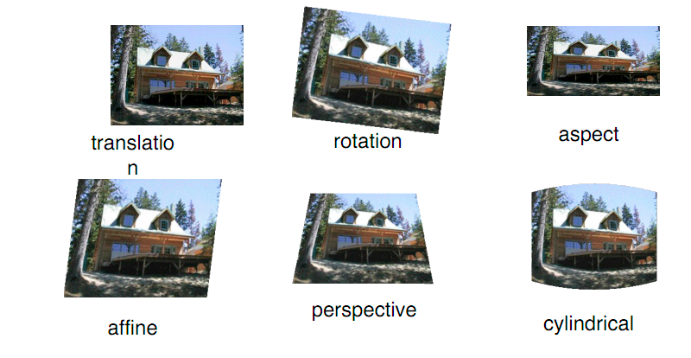
Transformation
Simple parametric transformations
  linear, affine, perspective, etc
illustration by Rick Szeliski

Slide 16
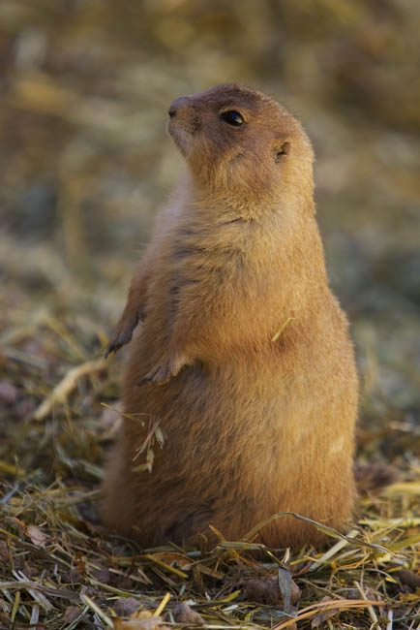
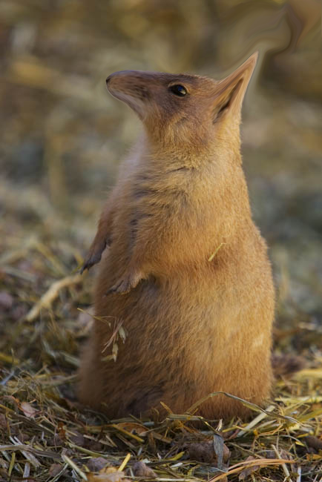
Warping
Imagine your image is made of rubber
warp the rubber
No prairie dogs were armed when creating this image

Slide 17

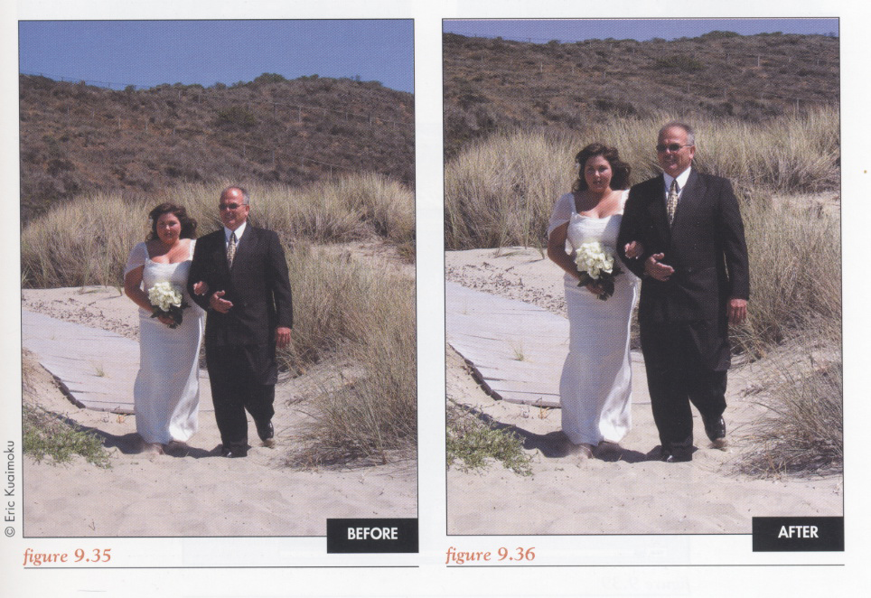
Application of warping: weight loss
Liquify in photoshop

Slide 18
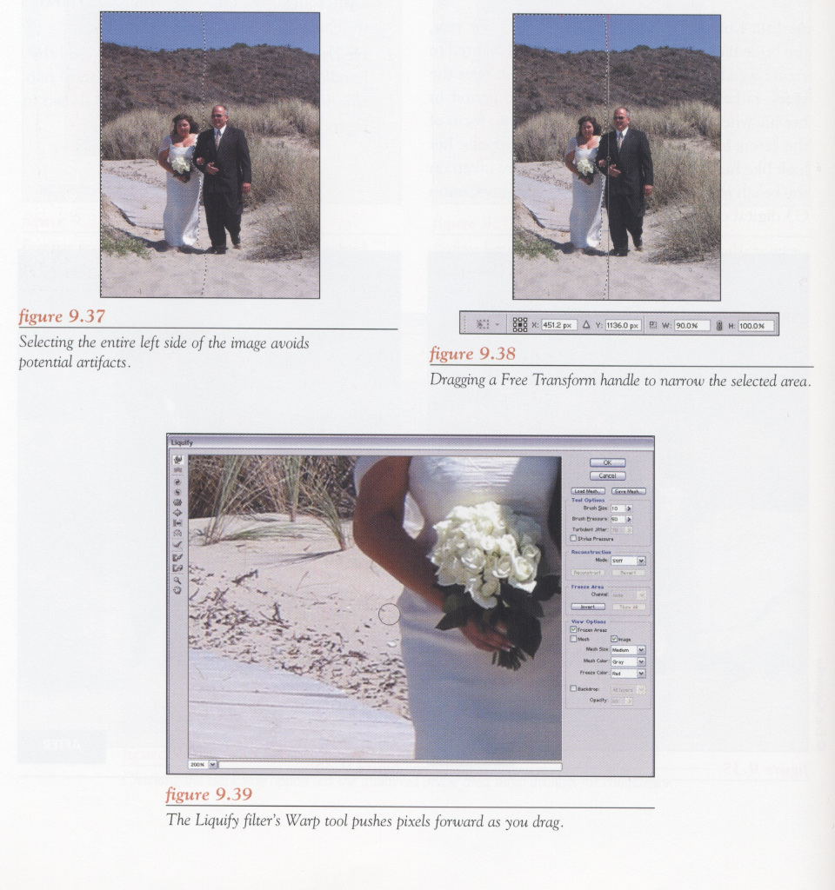

Slide 19
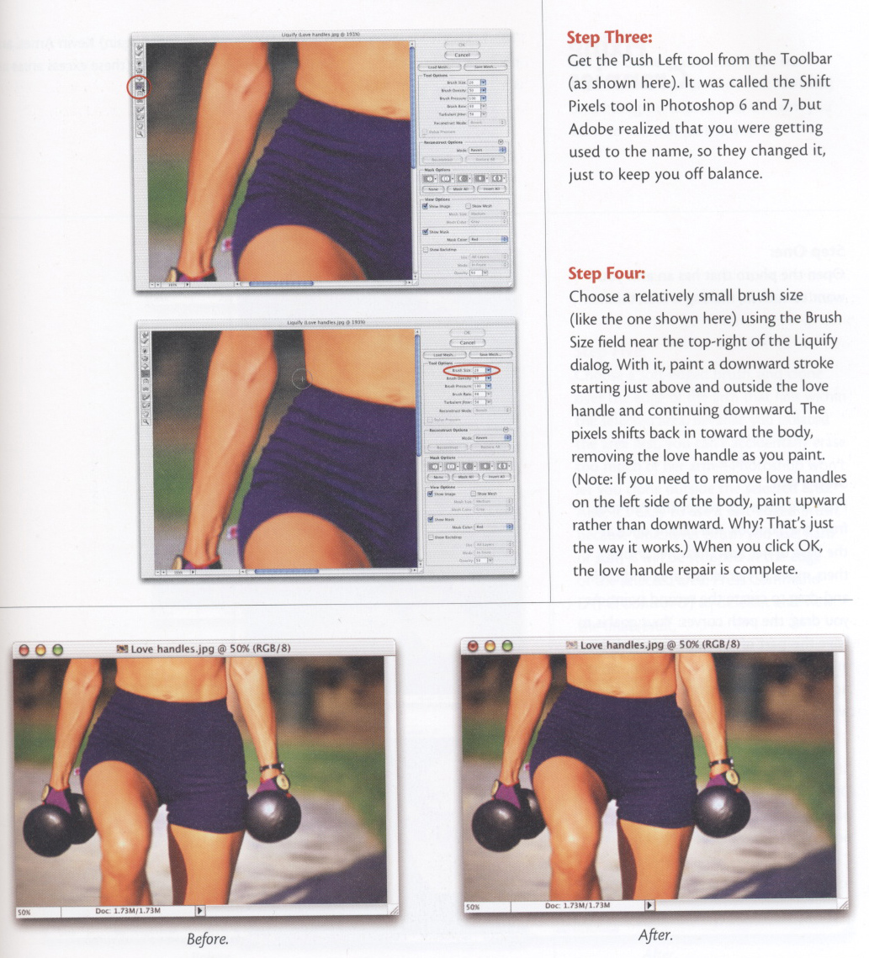

Slide 20
Domain transform

Slide 21
Warping
Assume we are given the spatial mapping
      How do we compute
      the warped image?

Slide 22
Careful: warp vs. inverse warp
How do you perform a given warp:
  Forward warp
    For each input pixel,
    compute output location
    and copy color there

Slide 23
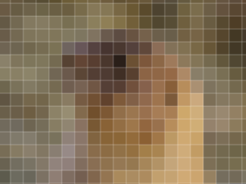
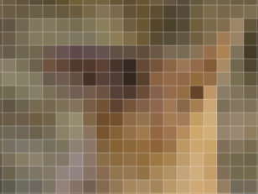
Forward warp and gaps
Gap

Slide 24
Careful: warp vs. inverse warp
How do you perform a given warp:
  Forward warp
    Potential gap problems
  Inverse lookup
  the most useful
    For each output pixel
      Lookup color at
      inverse-warped
      location in input

Slide 25
Domain transform issues
Apply a function f from R2 to R2 to the image domain
looks easy enough
But 2.5 big issues:
  which direction do we transform
  how do we deal with non-integer coordinates?
  And for warping: how do we specify f?

Slide 26
Questions?

Slide 27
Basic resampling

Slide 28
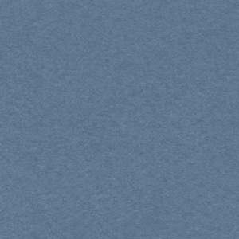
Naive scaling

Slide 29
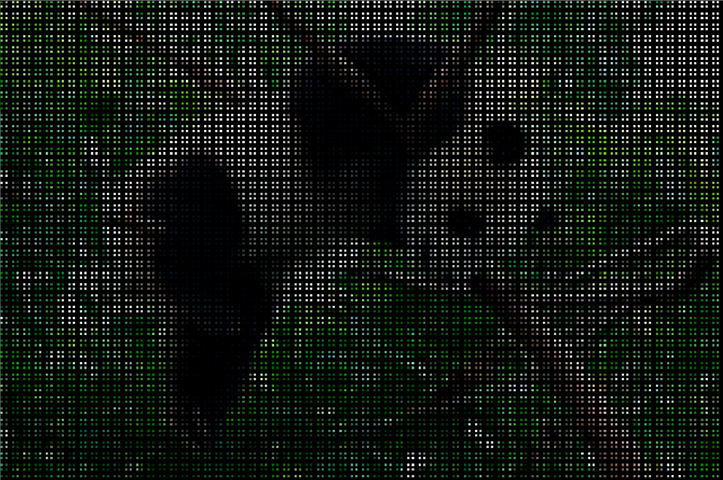
Naive scaling
Take all the pixels in input and transform them to their output location
  im[y, x] => out[k*y, k*x]
def scaleBAD(im, k):
out = constantIm(im.shape[0]*k, im.shape[1]*k, 0)
for y, x in imIter(im):
out[k*y, k*x]= im[y, x]
return out

Slide 30
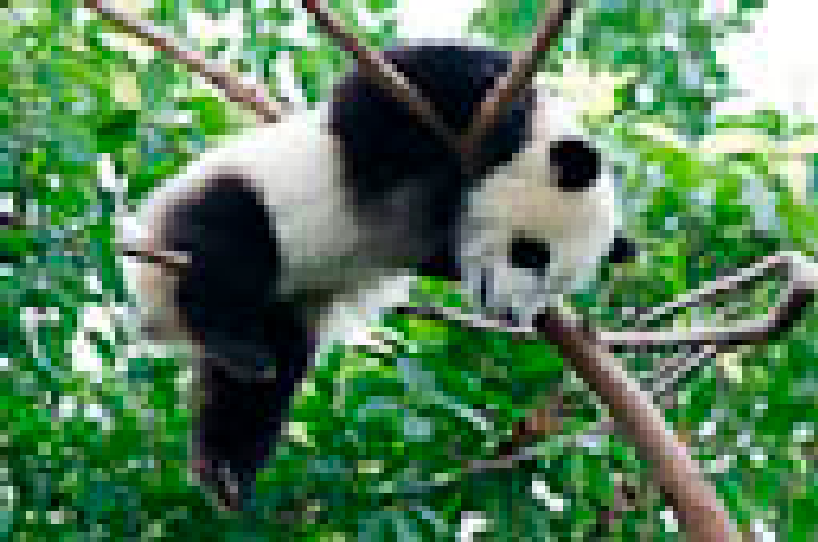
Use the inverse transform!!!!!
Main loop on output pixels
  out[y, x] <=im[y/k, x/k]
def scaleWithInverse(im, k):
out = constantIm(im.shape[0]*k, im.shape[1]*k, 0.0)
for y, x in imIter(out):
out[y,x]=im[y/k, x/k]
return out

Slide 31
Take-home message
Main loop over OUTPUT pixels
use INVERSE transform
Questions?

Slide 32
Remaining problem
A little too “blocky”
Because we round to the nearest integer pixel coordinates
  called nearest neighbor reconstruction

Slide 33
Linear reconstruction - 1D
im is now a 1D array along x
reconstruct im[1.3]
0
1
1.3
2
3

Slide 34
Linear reconstruction - 1D
im is now a 1D array along x
reconstruct im[1.3]
=0.7*im[1]+0.3*im[2]
0
1
1.3
2
3

Slide 35
Bilinear reconstruction
Take 4 nearest neighbors
Weight according to x & y fractional coordinates
Can be done using two 1D linear reconstructions along x then y (or y then x)

Slide 36
Bilinear
linear interpolation along x
linear interpolation along y
linear interpolation along x

Slide 37
Exercise
Prove it’s the same if you interpolate along y first

Slide 38
Recall nearest neighbor

Slide 39
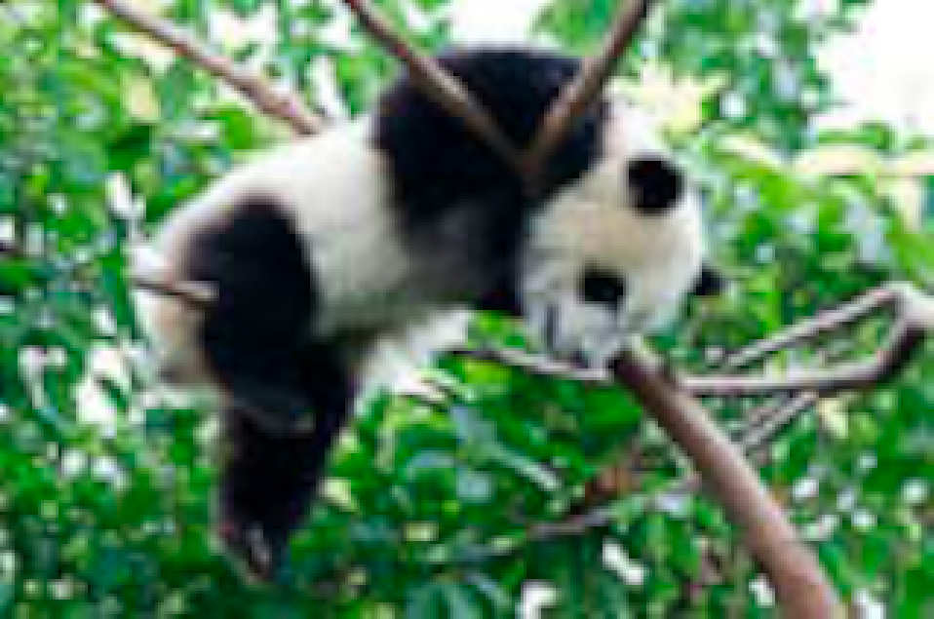
Bilinear

Slide 40
Take home messages
Main loop over OUTPUT pixels
  Makes sure you cover all of them
Use inverse transform
Reconstruction makes a difference
  Linear much better than nearest neighbor
Lookup

Slide 41
Questions?

Slide 42
General & Bicubic Resampling

Slide 43
Idea
Output is weighted average of neighbors in input
Weights given by ANALYTICAL convolution kernel
centered at non-integer coordinates (desired output location)

Slide 44
Idea in 1D

Slide 45
Reinterpreting bilinear
(Because earlier exposition does NOT generalize to bicubic)

Slide 46
How do we express the kernel?

Slide 47
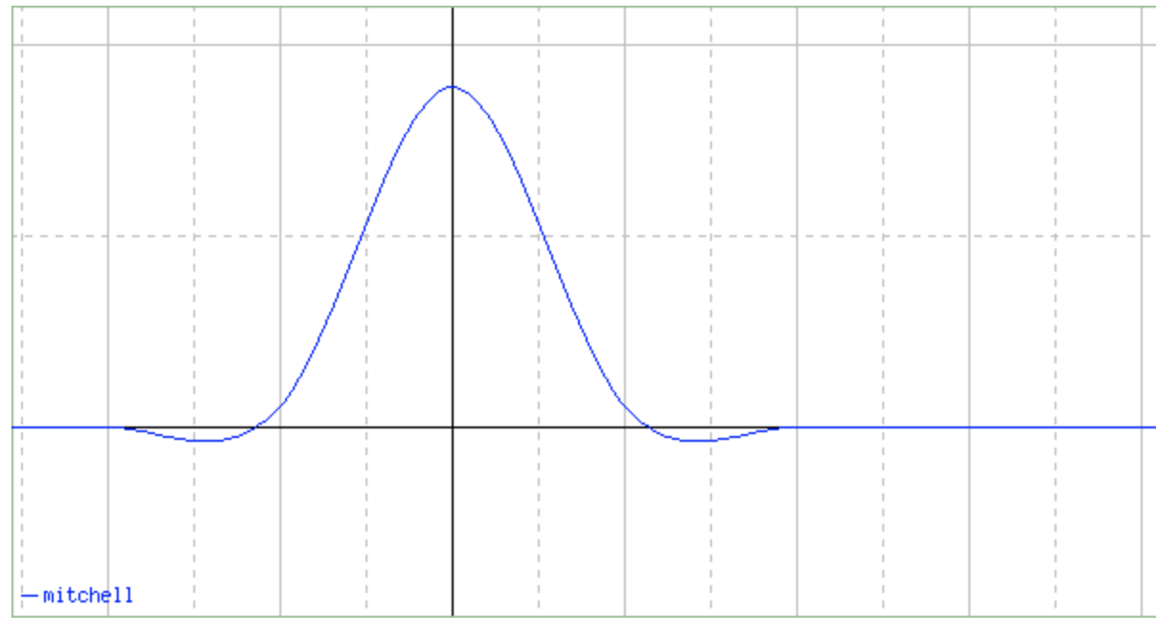
Some kernels
Lanczos: sinc(π x) sinc(π x/a)
Various bicubic
http://entropymine.com/imageworsener/bicubic/

Slide 48
What this is NOT
It is NOT about fitting a cubic to the data
Don’t believe what you see online or even in books

Slide 49
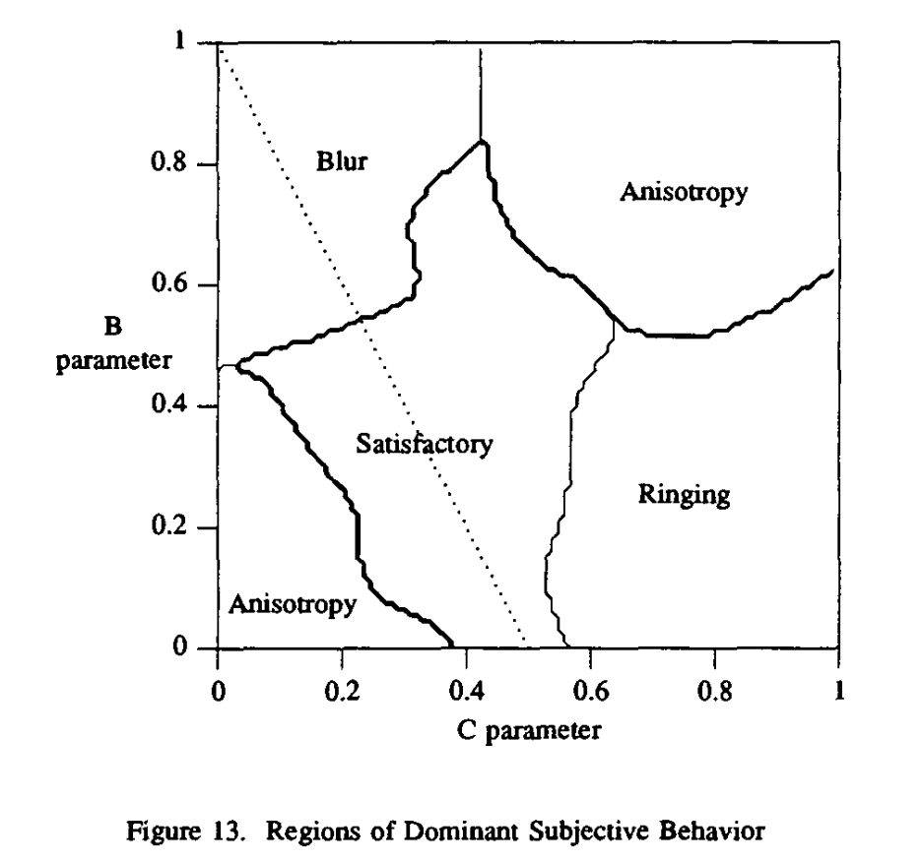
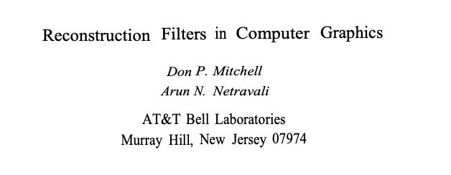
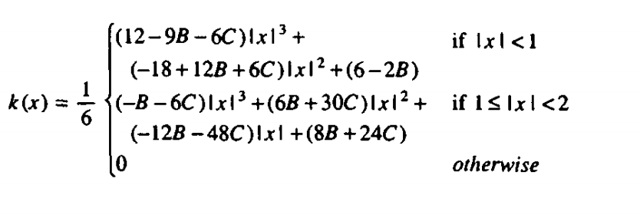
Mitchell/Netravali bicubic filterS
https://www.cs.utexas.edu/~fussell/courses/cs384g-fall2013/lectures/mitchell/Mitchell.pdf

Slide 50
Basic implementation
For each output pixel x, y
  Compute (fractional) inverse-transformed pixel coordinates f⁻¹(x,y)
    For each input pixel x’, y’ in neighborhood of f⁻¹(x,y)
      Compute kernel at f⁻¹(x,y)-(x’, y’)
      Accumulate kernel * I(x’, y’)
Note: in general you can’t pre-compute the kernel because the fractional values can be different for each pixel
  Although there are tricks

Slide 51
Kernel scaling
Always the same for upsampling
Proportional to scale factor for downsampling

Slide 52
In practice
separable (scale in x, then in y)
  Intermediate image of size (scale*width ; height)
  (anisotropically scaled)
basic implementation:
recompute weights for each pixel each neighbor
smarter: separable, precompute weights by row/column, take advantage of fractional or integer factors

Slide 53
Todo
bilinear will confuse you for bicubic
express bilinear as general convolution
separable means intermediate image of scale*width x height

Slide 54
Bilinear

Slide 55
Bicubic (Photoshop)
Ignore small color issues

Slide 56
Better reconstruction
Consider more than 4 pixels:
  bicubic, Lanczos, etc.
Try to sharpen edges
Use training database of low-res/high-res pairs
  http://people.csail.mit.edu/billf/superres/index.html
Deep learning

Slide 57
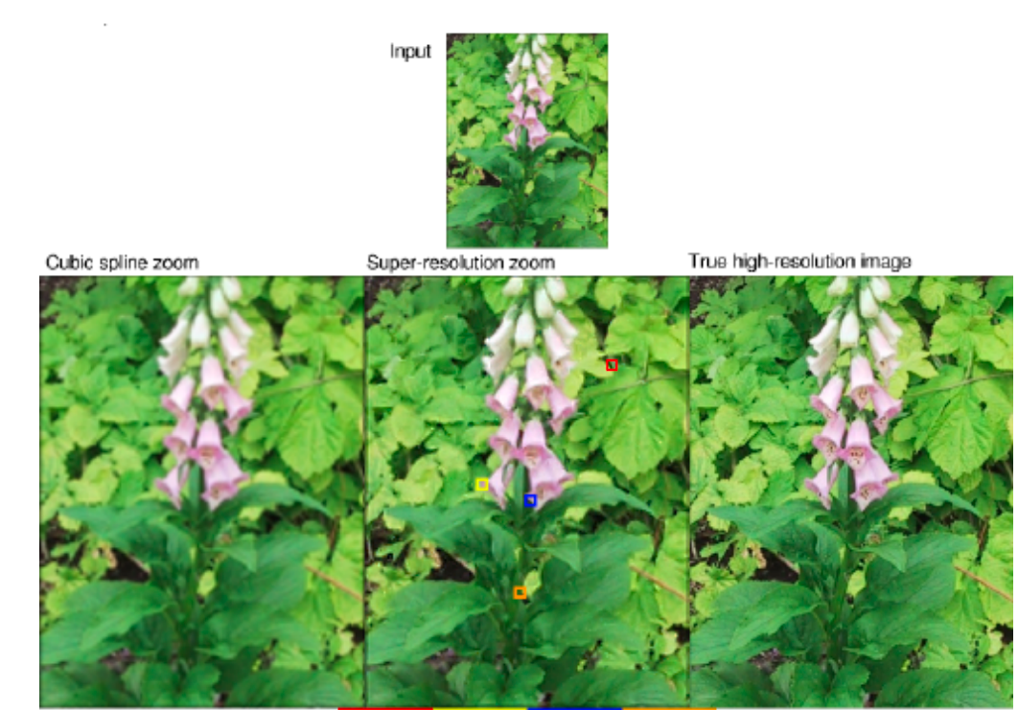
Bill Freeman’s super-resolution

Slide 58
Better reconstruction
Careful of fairness and bias when using ML
  https://www.theverge.com/21298762/face-depixelizer-ai-machine-learning-tool-pulse-stylegan-obama-bias
  https://thegradient.pub/pulse-lessons/

Slide 59
Questions?

Slide 60
Resources

Slide 61
http://szeliski.org/Book

Slide 62
Downsampling

Slide 63
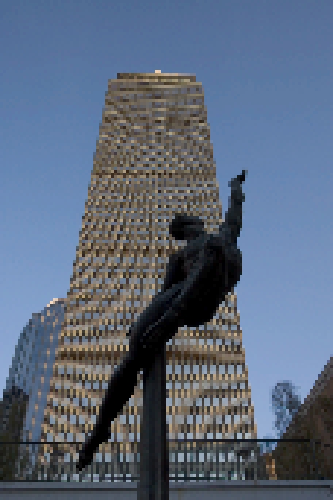
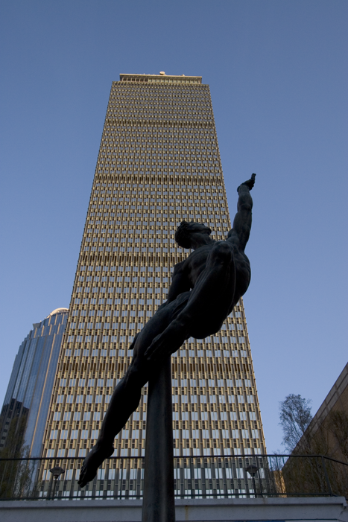
Downsampling
Using bilinear
Yikes! Herringbone patterns
Downsample by a scale of 0.2

Slide 64



Downsampling
Solution: blur the pattern to get average color over new pixels
Down
sample
Blur

Slide 65
In practice
Very similar to upsampling, usually same code
Just scale kernel up by scaling factor
  this means we average over more neighbors
Think how far you need to gather
For integer scale factor, can be precomputed

Slide 66
scipy is doing it wrong

Slide 67
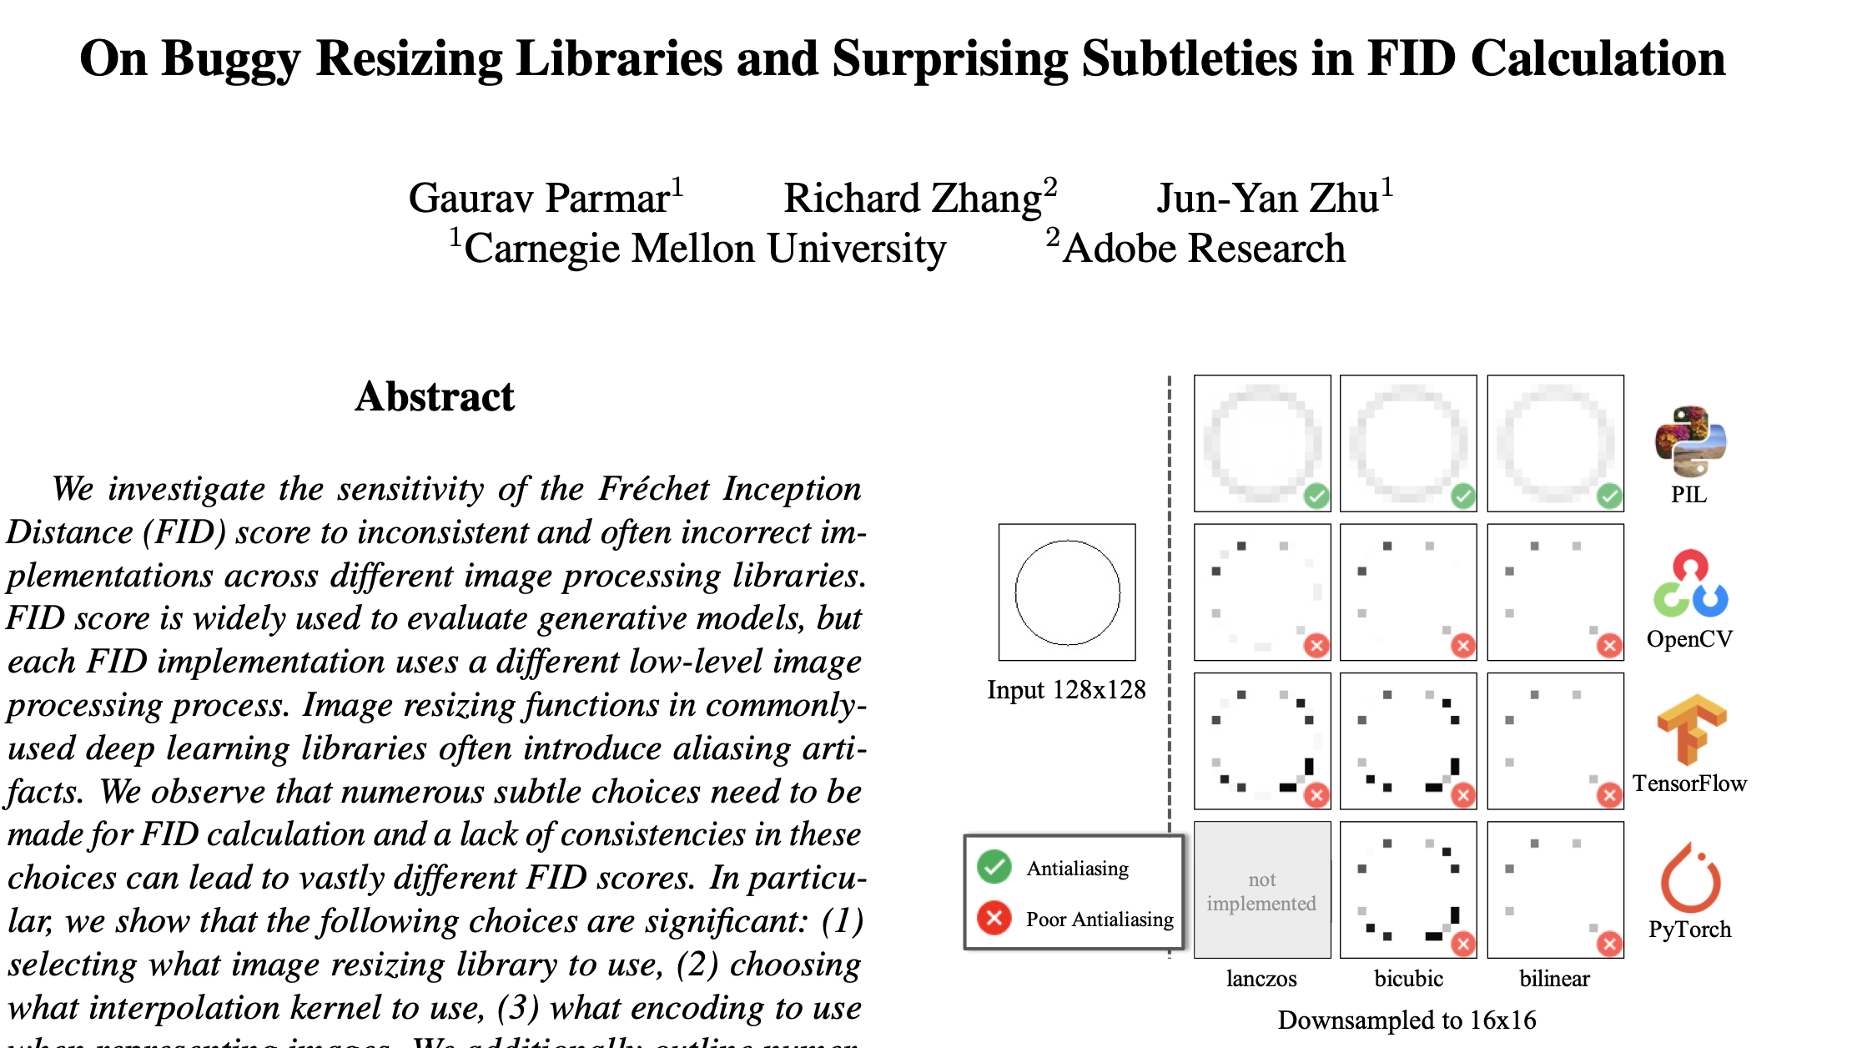
https://arxiv.org/pdf/2104.11222.pdf

Slide 68
https://twitter.com/sigfpe/status/1457157479071199238

Slide 69
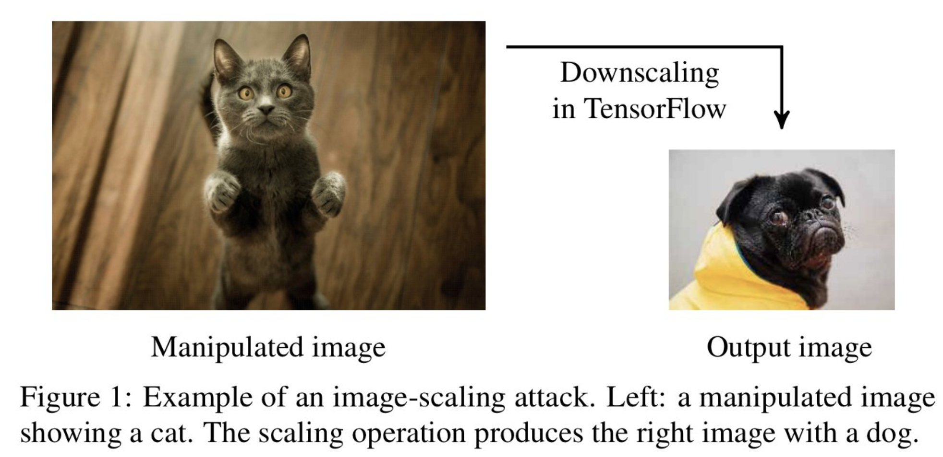
https://twitter.com/AlexTamkin/status/1456149826337263621?fbclid=IwAR3_IH-3KwU3mf3eWfajZ0HiI-gIOAtCGkOxb5JkvzFUwfMCqqrg_PVdz80

Slide 70
https://arxiv.org/pdf/2104.11222.pdf

Slide 71
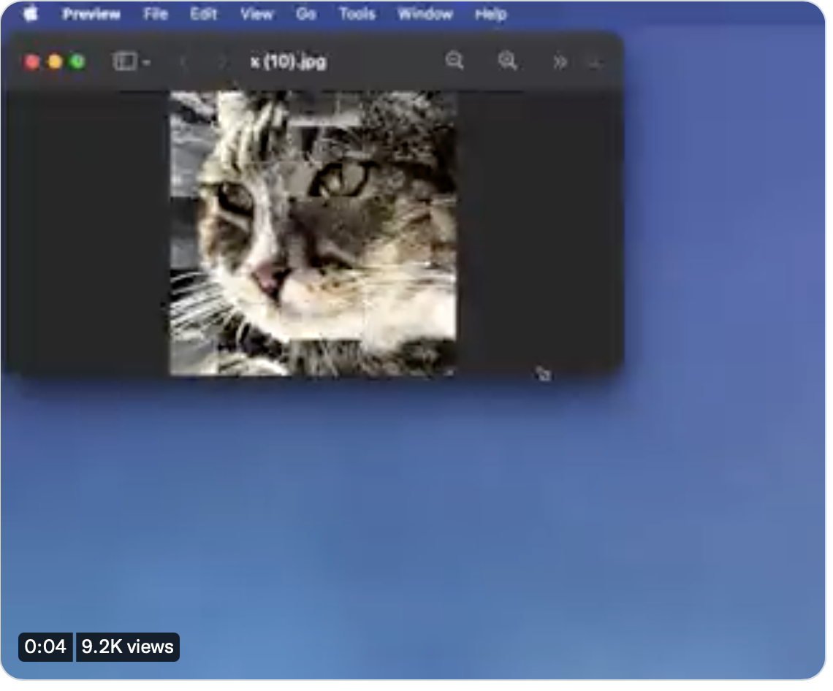
https://twitter.com/sigfpe/status/1457157479071199238

Slide 72
More info
http://web.stanford.edu/class/cs448f/lectures/1.2/Sampling.pdf
https://en.wikipedia.org/wiki/Bicubic_interpolation
http://entropymine.com/imageworsener/bicubic/
http://entropymine.com/imageworsener/resample/
separable!
upsampling is same, just clamp kernel scale factor to 1.0
downsampling not super easy to debug

Slide 73
Advice by Andrew Adams
I don't know of a good general reference, but I definitely have opinions on the right way to implement downsampling.
https://github.com/halide/Halide/blob/master/apps/resize/resize_generator.cpp
Downsampling is linear and separable, so the general idea is to explicitly compute the sparse matrix that downsamples a single row/col, then apply it to each row/col. The size of the sparse matrix is tiny relative to the image, so computing the weights and handling boundary conditions becomes approximately free.
In more detail to downsample in x:
1) For each x coordinate in the output, translate and scale the continuous downsampling kernel appropriately to have the right footprint on the input.
2) Sample that translated, scaled, continuous kernel at all integer locations on the x axis of the input space where it has non-zero values. You can compute closed-form expressions for the index of the first non-zero value and the maximum number of non-zero values, so it's easy to represent the sparse matrix as a simple max_kernel_taps x input_width table.
3) Renormalize each row of the matrix to sum to 1. I think you can avoid this if you're careful with the kernel, but this is also convenient way to handle boundary conditions if you want to just truncate the kernel at the image edges.
4) Optionally quantize the matrix and store it as integers that sum to a power of 2. Do this if your image is low precision and the machine you're on has high throughput for integer multiply-adds (e.g. a DSP). The example code doesn't do this. Forcing it to sum to a power of 2 is more complicated that just quantizing scaled values - you need error diffusion.
5) Apply this matrix to each row of the image. The bulk of the runtime is here.
You definitely want to downsample in y first, because that vectorizes nicely. Then you have less data to deal with for the downsample in x. If the downsampling factor is very large, you can vectorize the downsample in x along the reduction over the kernel, but if the downsample is large then the x pass takes nearly no time relative to the y pass, so it's not that important. You can also downsample in y, transpose, downsample in y, transpose, but I suspect it would be slower.
For rational downsampling factors the sparse matrix becomes periodic, but it's not really worth taking advantage of this - the matrix is likely to fit in cache so you're not going to be bandwidth-limited reading values from it.

Slide 74
Domain operations

Slide 75
Domain transform
Apply a function f from R² to R² to the image domain
if (y, x) had color c in the input,
f(y, x) has color c in the output

Slide 77
Domain transform issues
Apply a function f from R2 to R2 to the image domain
looks easy enough
But two big issues:
  which direction do we transform
  how do we deal with non-integer coordinates?
  And for warping: how do we specify f?

Slide 78
Basic programming tools

Slide 79
Loops & iterators
Bad news: we’ll need some for loop for resampling
iterators
    def imIter(im):
    for y in xrange(im.shape[0]):
    for x in xrange(im.shape[1]): yield y, x

Slide 80
Debug?

Slide 81
Padding problems
Sometimes, we try to read outside the image
  e.g. y, x are negative
  For example, we try to rotate an image
???

Slide 82
Black Padding
  def getBlackPadded(im, y, x):
  if (x<0) or (x>=im.shape[1]) or (y<0)
  or (y>= im.shape[0]):
  return numpy.array([0, 0, 0])
  else: return im[y, x]
0,0,0

Slide 83
Edge Padding
  def clipX(im, x): return min(width(im)-1, max(x, 0))
  def clipY(im, y): return min(height(im)-1, max(y, 0)
  def getSafePix(im, y, x):
  return im[clipY(im, y), clipX(im, x)]

Slide 84
Questions?

Slide 85
Padding

Slide 86
Loops & iterators
Bad news: we’ll need some for loop for resampling
iterators
    def imIter(im):
    for y in xrange(im.shape[0]):
    for x in xrange(im.shape[1]): yield y, x

Slide 87
Padding problems
Sometimes, we try to read outside the image
  e.g. y, x are negative
  For example, we try to rotate an image
???

Slide 88
Black Padding
  def getBlackPadded(im, y, x):
  if (x<0) or (x>=im.shape[1]) or (y<0)
  or (y>= im.shape[0]):
  return numpy.array([0, 0, 0])
  else: return im[y, x]
0,0,0

Slide 89
Edge Padding
  def clipX(im, x): return min(width(im)-1, max(x, 0))
  def clipY(im, y): return min(height(im)-1, max(y, 0)
  def getSafePix(im, y, x):
  return im[clipY(im, y), clipX(im, x)]

Slide 90
Questions?

Slide 91
Warping & Morphing

Slide 92

Important scientific question
How to turn Dr. Jekyll into Mr. Hyde?
How to turn a man into a werewolf?
Powerpoint cross-fading?

Slide 93
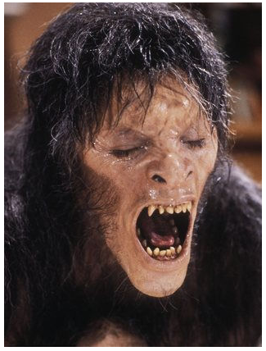
Important scientific question
How to turn Dr. Jekyll into Mr. Hyde?
How to turn a man into a werewolf?
Powerpoint cross-fading?
  or
  Image Warping and Morphing?
From An American Werewolf in London

Slide 94
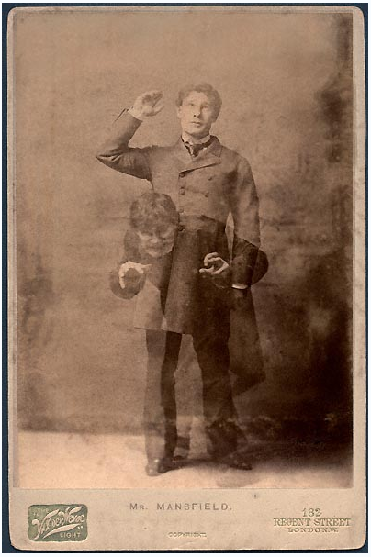
Digression: old metamorphoses
http://en.wikipedia.org/wiki/The_Strange_Case_of_Dr._Jekyll_and_Mr._Hyde
http://www.eatmybrains.com/showtopten.php?id=15
http://www.horror-wood.com/next_gen_jekyll.htm
Unless I’m mistaken, both employ the trick of making already-applied makeup turn visible via changes in the color of the lighting, something that works only in black-and-white cinematography. It’s an interesting alternative to the more familiar Wolf Man time-lapse dissolves. This technique was used to great effect on Fredric March in Rouben Mamoulian’s 1932 film of Dr. Jekyll and Mr. Hyde, although Spencer Tracy eschewed extreme makeup for his 1941 portrayal.

Slide 95
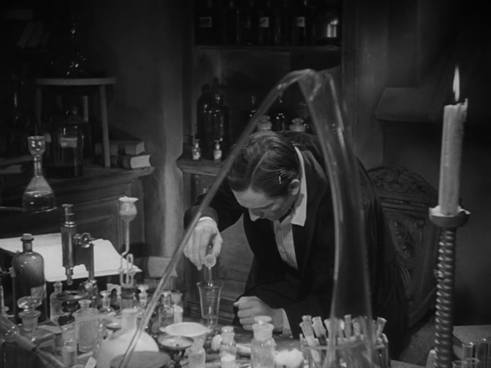
Dr. Jekyll and Mr. Hyde, 1932

Slide 96
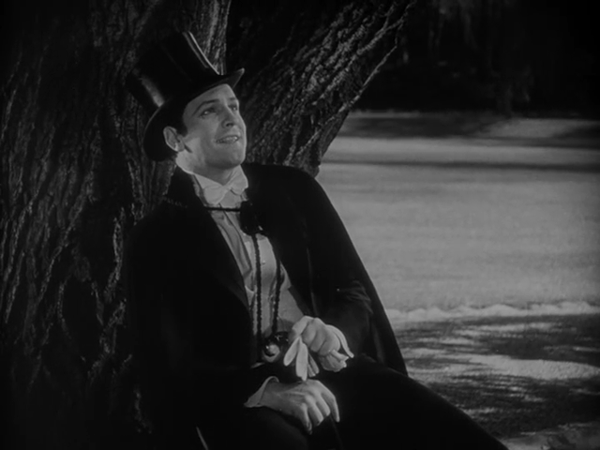
Dr. Jekyll and Mr. Hyde, 1932

Slide 97
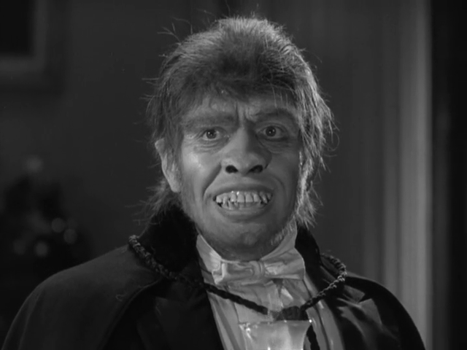
Dr. Jekyll and Mr. Hyde, 1932

Slide 98
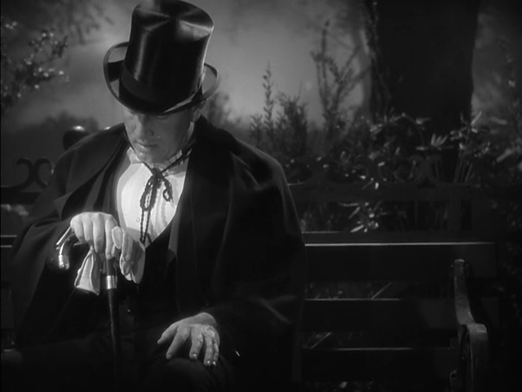
Dr. Jekyll and Mr. Hyde, 1941

Slide 99
https://filmschoolrejects.com/sh-the-octopus-transformation/
https://x.com/rainmaker1973/status/1983064162583368154?s=46&t=aUZMRTg07VYQGqu7K-19Lw
https://filmschoolrejects.com/sh-the-octopus-transformation/

Slide 100
Jekyll & Hide 1932:
  35:13
  ch18 1:06:45
  ch19 1:17:50
Jekyll & Hide 1941:
  ch20 1:25:13

Slide 101
Demo of morphing
http://www.creaceed.com/morphage/

Slide 102

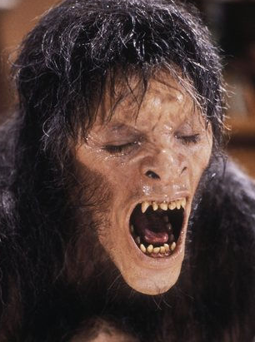
Challenge
“Smoothly” transform a face into another
Related: slow motion interpolation
interpolate between key frames

Slide 103
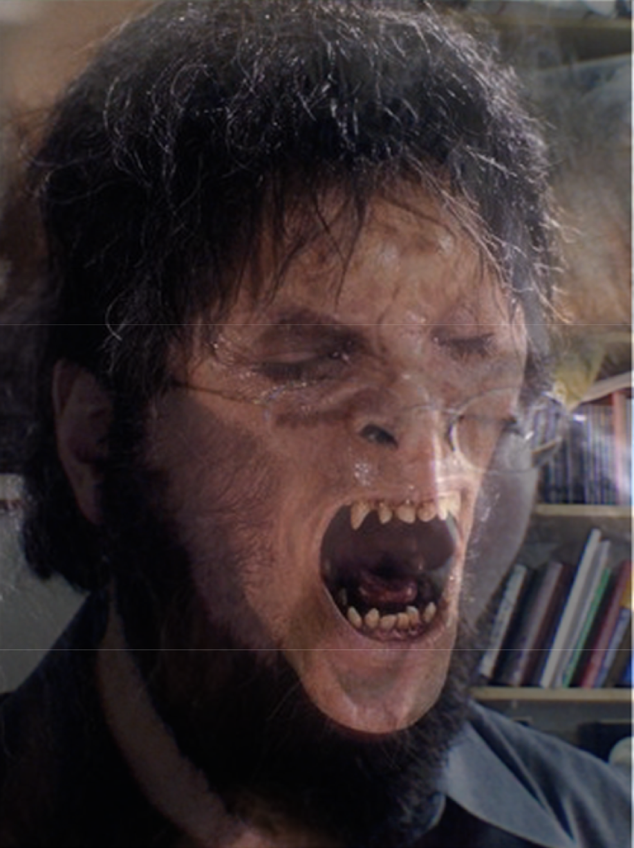
Averaging images
Cross-fading
  output[y, x]=t * im1[y, x] +(1-t) * im2[y, x]

Slide 104
Problem with cross fading
Features (eyes, mouth, etc) are not aligned
It is probably not possible to get a global alignment
We need to interpolate the LOCATION of features
  domain transform!

Slide 105
Averaging points (location)
P & Q are two 2D points (in the “domain”)
V= t P + (1-t) Q
P
V
Q

Slide 106
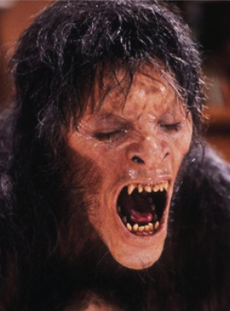
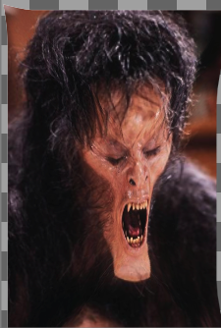
Warping
Move pixel spatially: C’(x,y)=C(f(x,y))
Leave colors unchanged

Slide 107
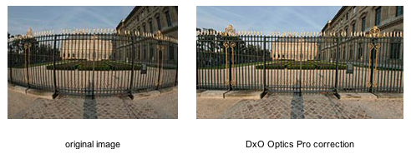
Warping
Deform the domain of images (not range)
Central to morphing
Also useful for
  Optical aberration correction
  Video stabilization
  Slimming people down
  ...

Slide 108
Other motivations
Morphable models for face recognition/processing
Video stabilization
Computer animation
Fix parallax in panorama stitching
Wide angle distortion correction
Image-based rendering (3D from images)
...

Slide 109
Recap & questions
Color (range) interpolation:
output[y, x]=t * im1[y, x] +(1-t) * im2[y, x]
Location (domain) interpolation: V= t P + (1-t) Q
Warping: domain transform out(x,y)=im(f ⁻¹(x,y))

Slide 110
Morphing: combine both
For each pixel
  Transform its location like a vector (domain)
  Then linearly interpolate colors (range)

Slide 111
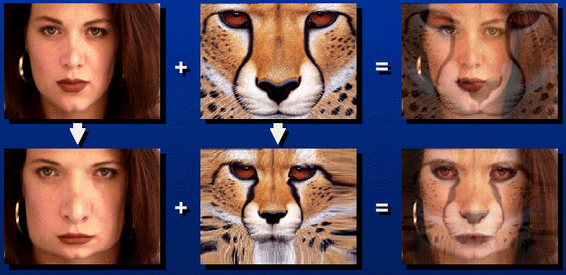
Morphing
Input: two images I₀ and I_{N+1}
Expected output: image sequence I_{i}, with i∈ 1..N
User specifies sparse correspondences on the images

Slide 112
Morphing
For each intermediate frame I_{t}
  Interpolate feature locations P^{t}_{i}= (1- t) P⁰_{i} + t P¹_{i}
  Perform two warps: one for I₀, one for I₁
    Deduce a dense warp field from the pairs of features
    Warp the pixels
  Linearly interpolate the two warped images
t=0
t=1
t=0.5

Slide 113
Warping

Slide 114
Warping
Imagine your image is made of rubber
warp the rubber
No prairie dogs were armed when creating this image

Slide 115
Warping
Assume we are given the spatial mapping
      How do we compute
      the warped image?

Slide 116
Careful: warp vs. inverse warp
How do you perform a given warp:
  Forward warp
    For each input pixel,
    compute output location
    and copy color there

Slide 117
Forward warp and gaps
Gap

Slide 118
Careful: warp vs. inverse warp
How do you perform a given warp:
  Forward warp
    Potential gap problems
  Inverse lookup
  the most useful
    For each output pixel
      Lookup color at
      inverse-warped
      location in input

Slide 119
Questions?

Slide 120
How do we specify the warp?
Before, we saw simple transformations
  linear, affine, perspective
But we want more flexibility

Slide 121
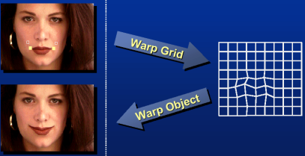
Image Warping – parametric
Move control points to specify a spline warp
Spline produces a smooth vector field
Slide Alyosha Efros

Slide 122
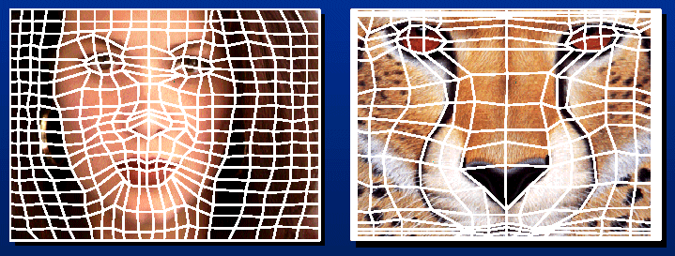
Warp specification - dense
How can we specify the warp?
  Specify corresponding spline control points
    interpolate to a complete warping function
But we want to specify only a few points, not a grid
Slide Alyosha Efros

Slide 123
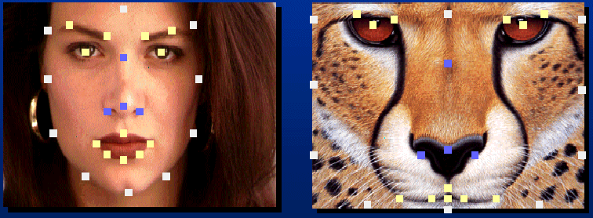
Warp specification - sparse
How can we specify the warp?
  Specify corresponding points
    interpolate to a complete warping function
    How do we do it?
How do we go from feature points to pixels?
Slide Alyosha Efros

Slide 124
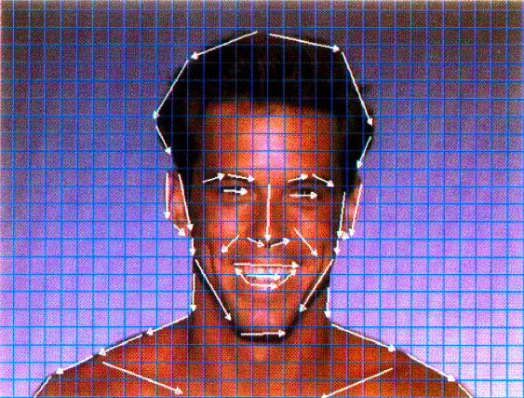
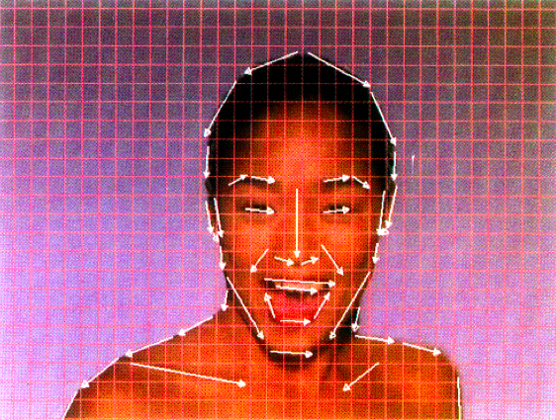
Beier and Neely
Specify warp based on pairs of segments
  http://dl.acm.org/citation.cfm?id=134003
  Feature-Based Metamorphosis, SIGGRAPH 1992
  Used in Michael Jackson’ Black and White Music Video
  Pset 2!!

Slide 125
Questions?

Slide 126
Segment-based warping

Slide 127
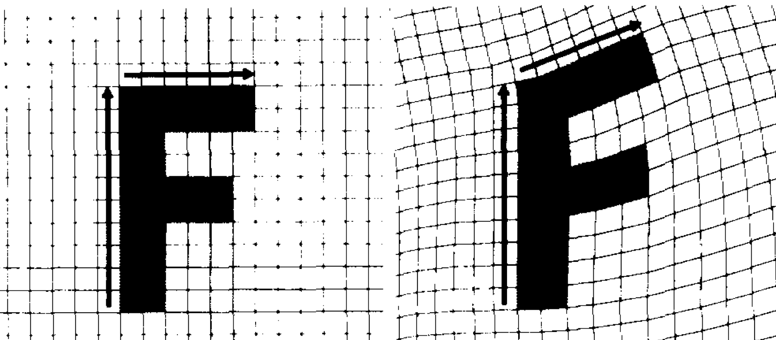
Problem statement
Inputs: One image, two lists of segments before and after, in the image domain
Goal: warp the image “following” the displacement of the segments
Input
after
Output
before
before
after

Slide 128
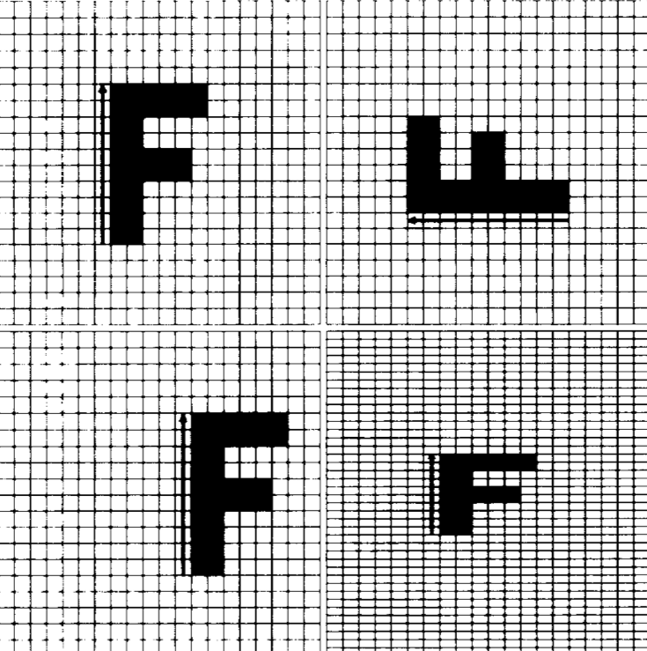
Idea
Each before/after pair of segment implies a planar transformation
  simple and affine
Input
Output 1
before
after
Single line transforms

Slide 129
Idea
Each before/after pair of segment implies a planar transformation
  simple and affine
Input
Output 1
Output 2
Output 3
Single line transforms

Slide 130
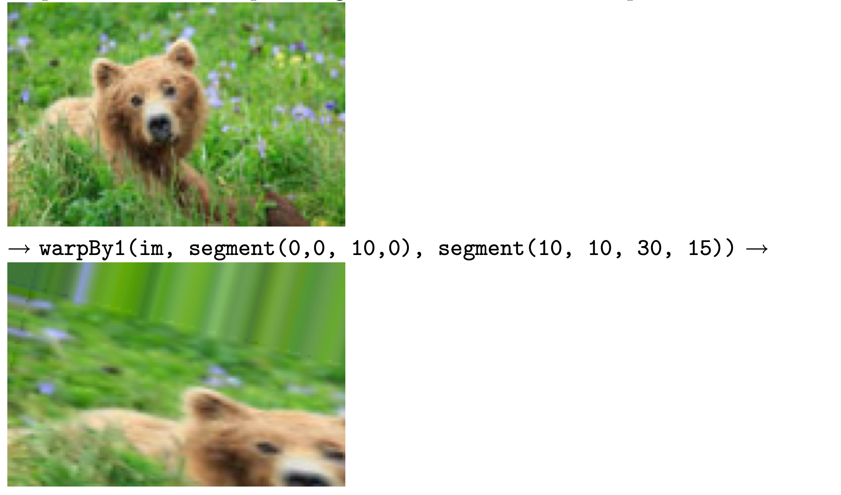
Test

Slide 131
Idea
Each before/after pair of segment implies a planar transformation
Then take weighted average of transformations
Input
Output 1
Input
Output
Output 2
Output 3
Single line transforms
Transform wrt 2 lines

Slide 132
Back to single segment
Each before/after pair of segment implies a planar transformation
  simple and affine
Input
Output 1
before
after
Single line transforms

Slide 133
Linear algebra refresher

Slide 134
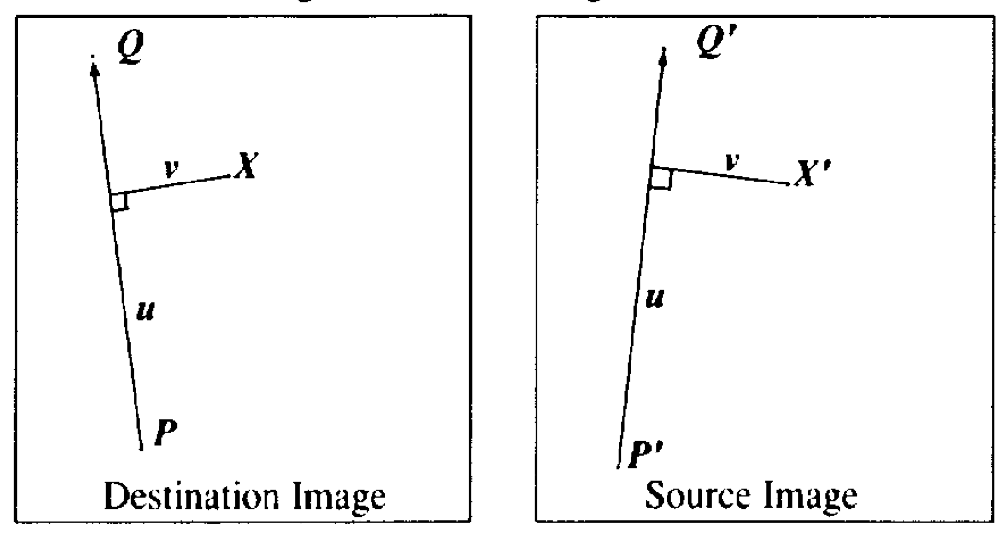
Transform wrt 1 segment
Define a coordinate system with respect to segment
  1 dimension, u, along segment
  1 dimension, v, orthogonal to segment

Slide 135
Transform wrt 1 segment
Define a coordinate system with respect to segment
  1 dimension, u, along segment
  1 dimension, v, orthogonal to segment
Compute u, v in one image
  The after one, because we use the inverse transform
Compute point corresponding to u, v in second image

Slide 136
Computing u, v
u = PX.PQ/||PQ||²
  this way u is 0 at P and 1 at Q
v=PX.perpendicular(PQ)/||PQ||
  where perpendicular(PQ) is PQ rotated by 90 degrees, and has length ||PQ||
  unlike u which is normalized, v is in distance units

Slide 137
Transforming a point given u, v
X’=P’+uP’Q+v perpendicular(P’Q’)/||P’Q’||
The u component is scaled according to segment scaling
But v is absolute (see output3)
  They say they tried to scale v as well but it didn’t work as well
Input
Output 1
Output 2
Output 3
Single line transforms

Slide 138
Questions?

Slide 139
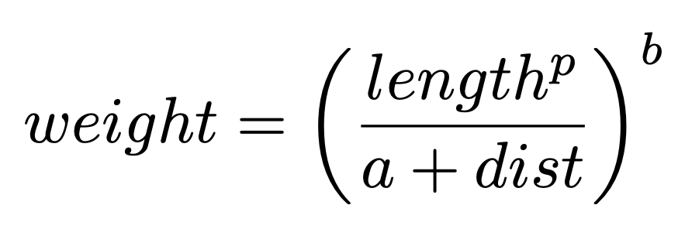
Multiple segments
For each point X
  For each segment pair s_before[i], s_after[i]
    Transform X into X’i according to this pair
  Compute weighted average of all transformed X’i
    weight according to distance to segments
Input
Output
where a, b, p
control the influence
Transform wrt 2 lines

Slide 140
Distance to a segment
Multiple cases...
  dot product, test >0, <1

Slide 141

Debugging: example
Debugging my distance function

Slide 142
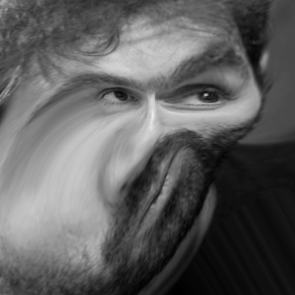
Questions?
More debugging

Slide 143
Debugging

Slide 144
Debugging
Doubt everything
Debug pieces in isolation
  Binary search/divide and conquer
Display/print everything
  In particular intermediate results
Create simple inputs
  where you can easily manually compute the result
  e.g. constant image, edge image, etc.
  use small images (e.g. 3x3)
  including (especially) inputs to intermediate stages
  use input thats isolate different failure modes
Change one thing at a time
  e.g. to verify that a given command has the effect you want, modify it to break it

