Slide 1
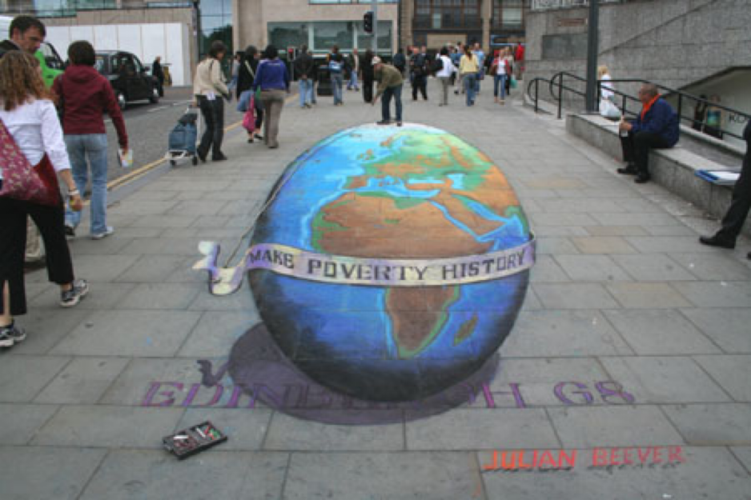
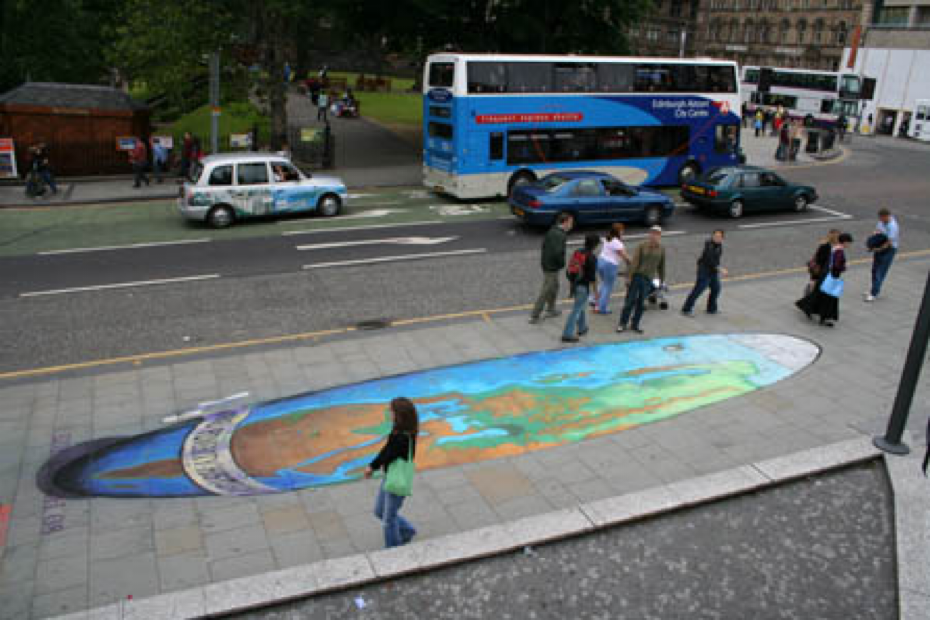
Features, Harris Corners
and Descriptors
Frédo Durand
MIT EECS 6.8370/6.8371
Julian Beever
e.g. http://users.skynet.be/J.Beever/
http://www.crystalinks.com/julian_beever.html

Slide 2
Class morph
[1] As a tipix window -- this starts playing once it loads, but you can stop it and explore it interactively. I think it's pretty nice to explore. http://goo.gl/JMj3Vr
[2] As a video: http://people.csail.mit.edu/adalca/classes/classmorph.mp4
[3] As each individual morph: http://people.csail.mit.edu/adalca/classes/6815_classmorph_results/

Slide 3
Avoid posting code on piazza

Slide 4


Slide 5
When is i ? When the camera is rotated by 90 degrees

Slide 6
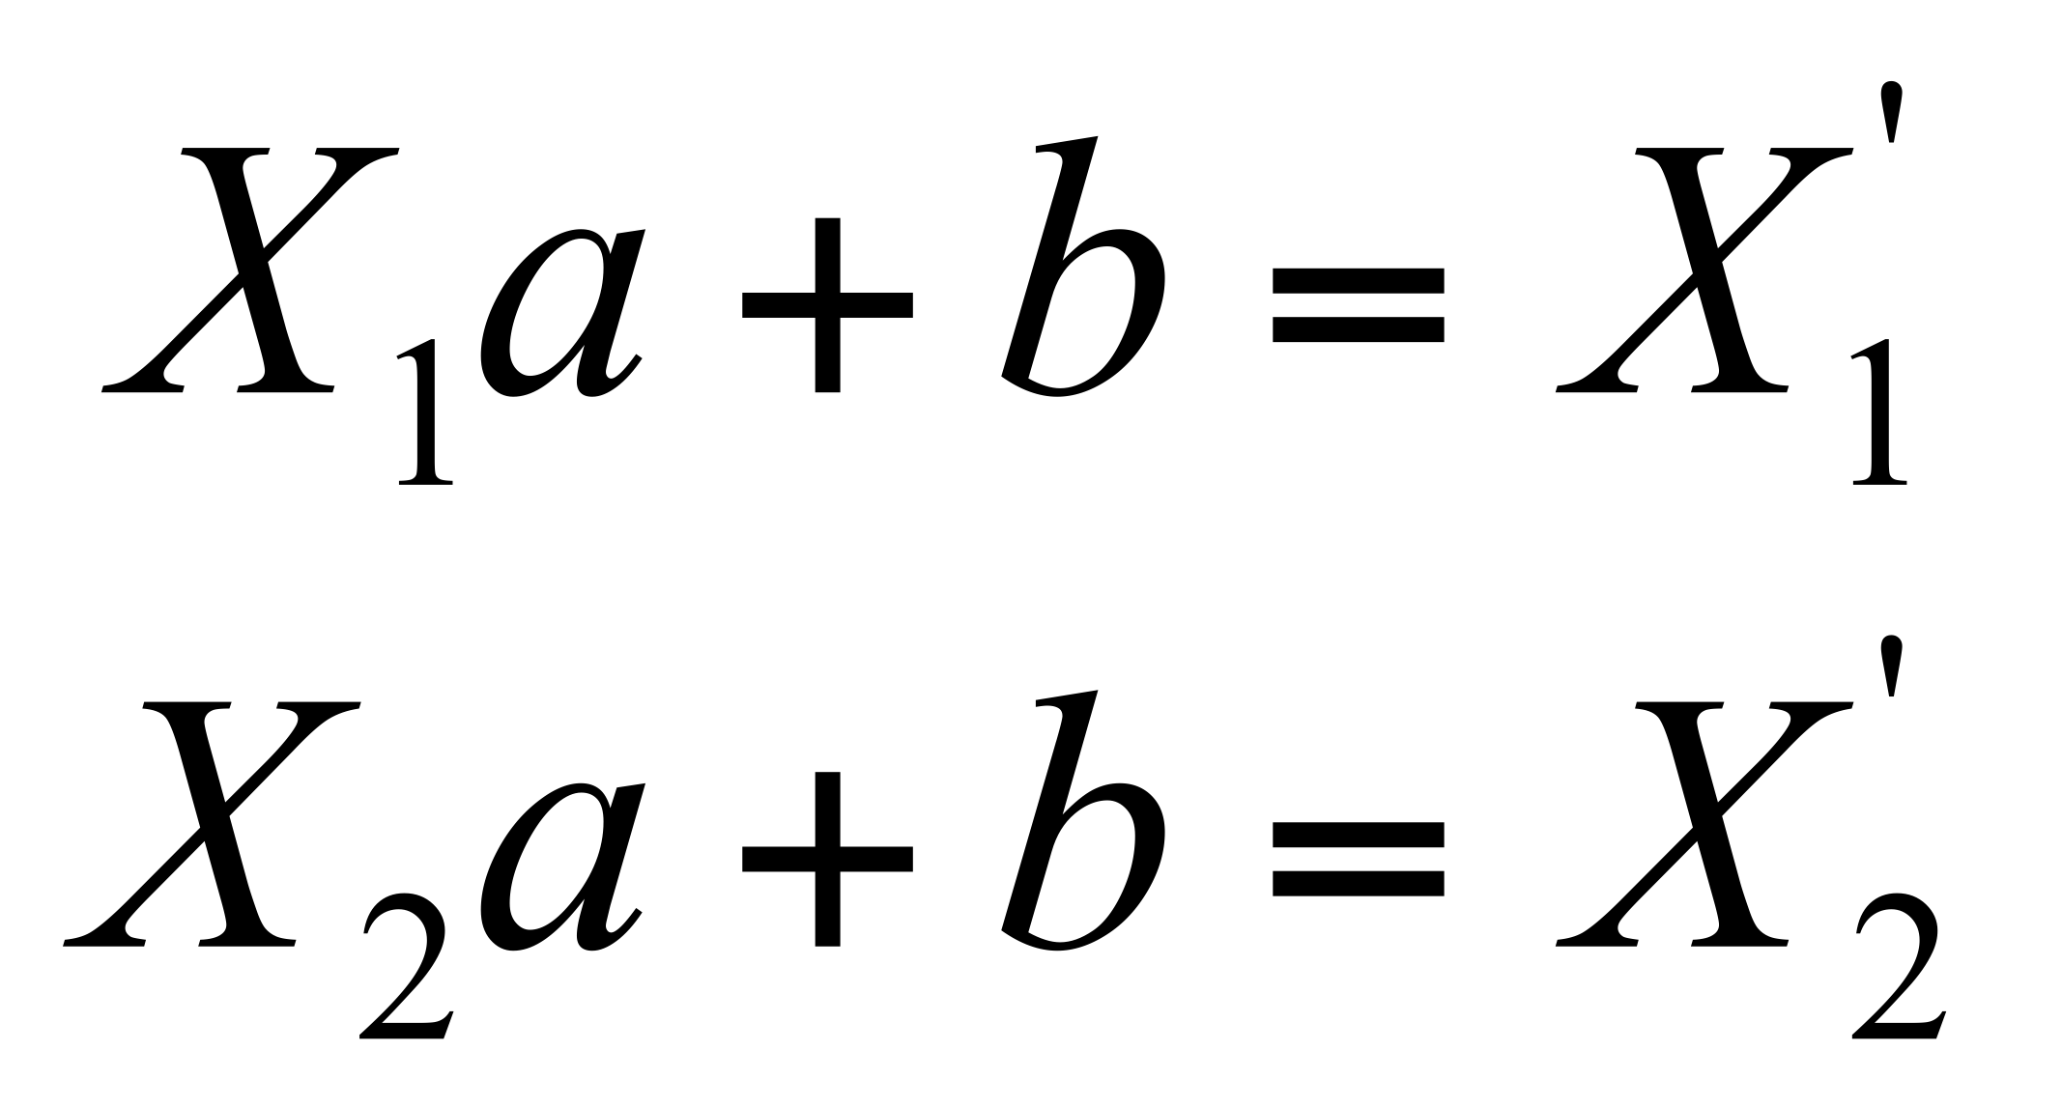
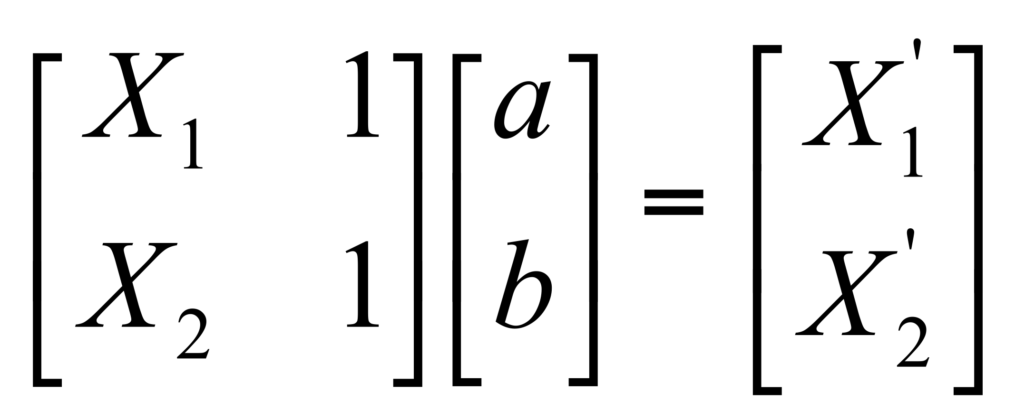
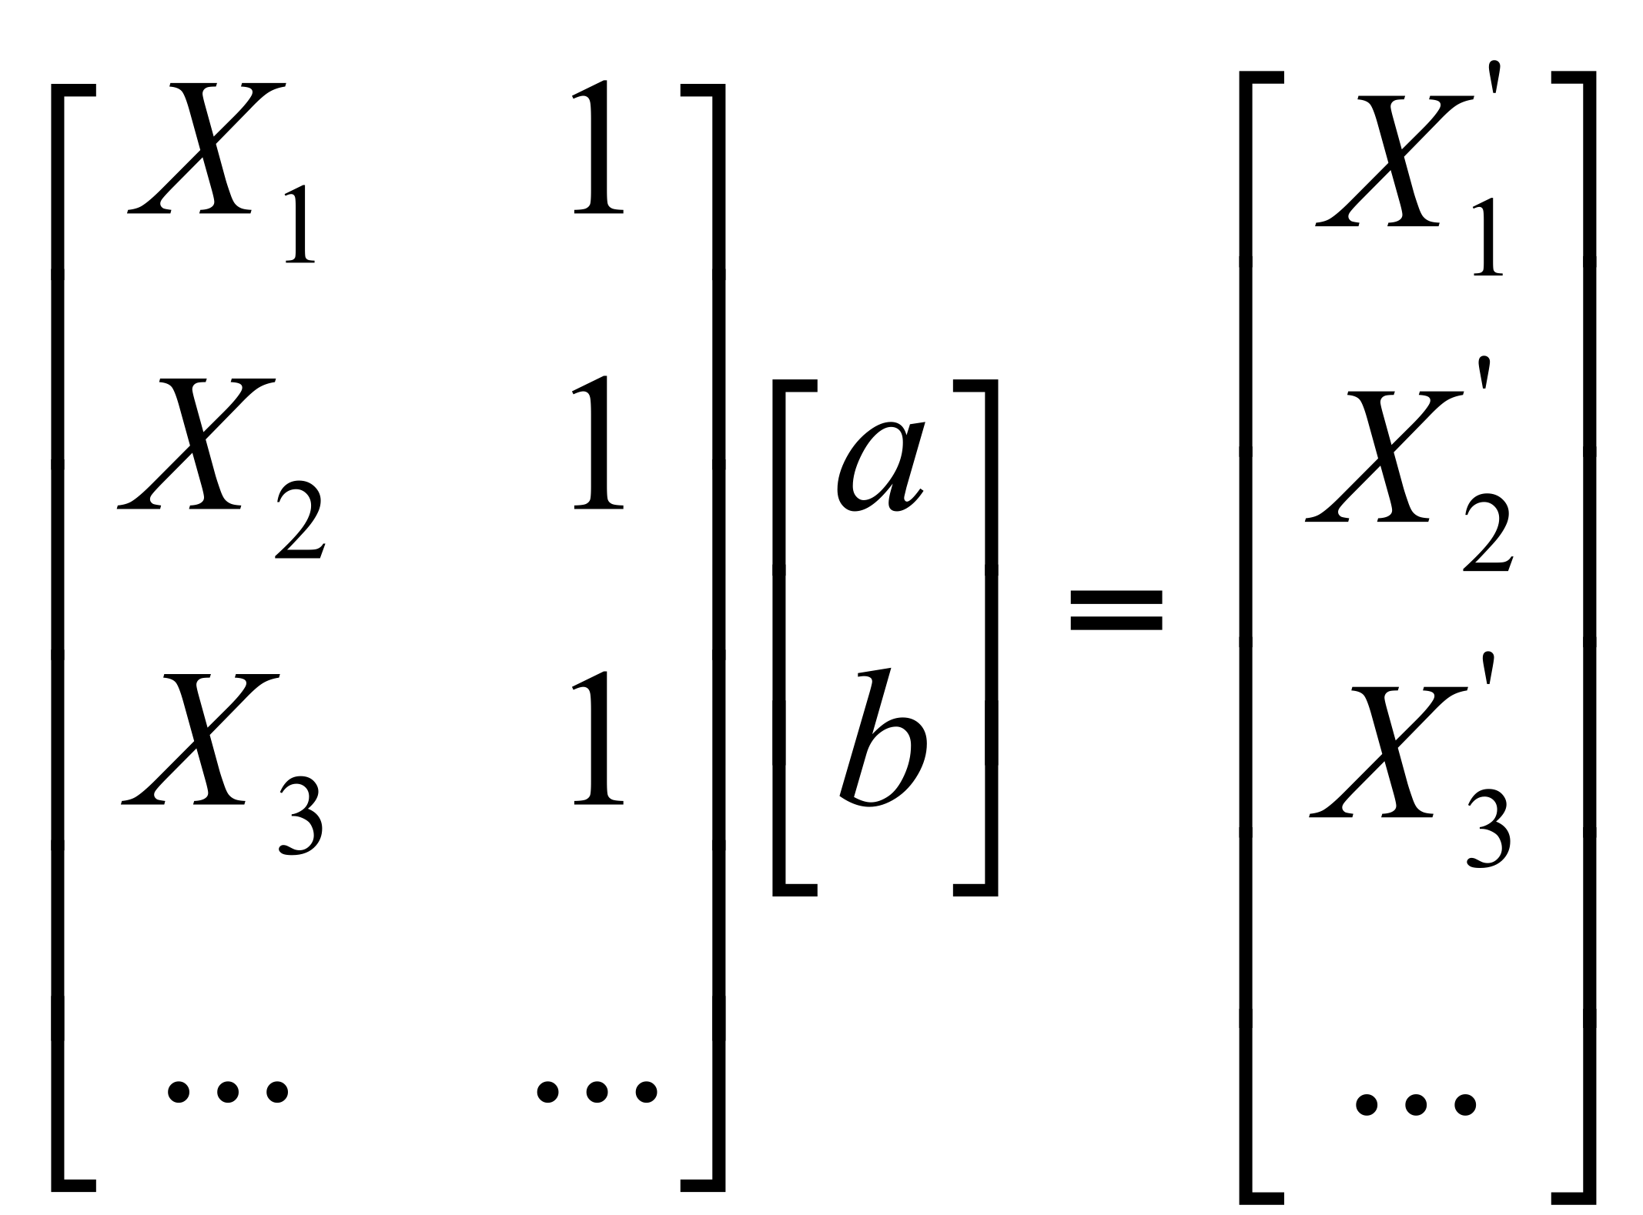
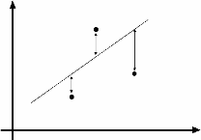

Least Squares Example
Say we have a set of data points (X1,X1’), (X2,X2’), (X3,X3’), etc. (e.g. person’s height vs. weight)
We want a nice compact formula (line) to predict X’s from Xs: Xa + b = X’
We want to find a and b
How many (X,X’) pairs do we need?
What if the data is noisy?
Ax=B
overconstrained

Slide 7
least square
Ax=b where A is rectangular (overconstrained)
Solve A^{T}A x =A^{T}b
=
=

Slide 8
Questions?
http://openphotovr.org/edit.html?id=hWJwBO1U

Slide 9
Do a demo with camera projectors like the Nikon.
anf maybe an extra camera taking a new virtual image

Slide 10
http://da.vidr.cc/projects/pixelstruct/
http://openphotovr.org/

Slide 11
Recap

Slide 12
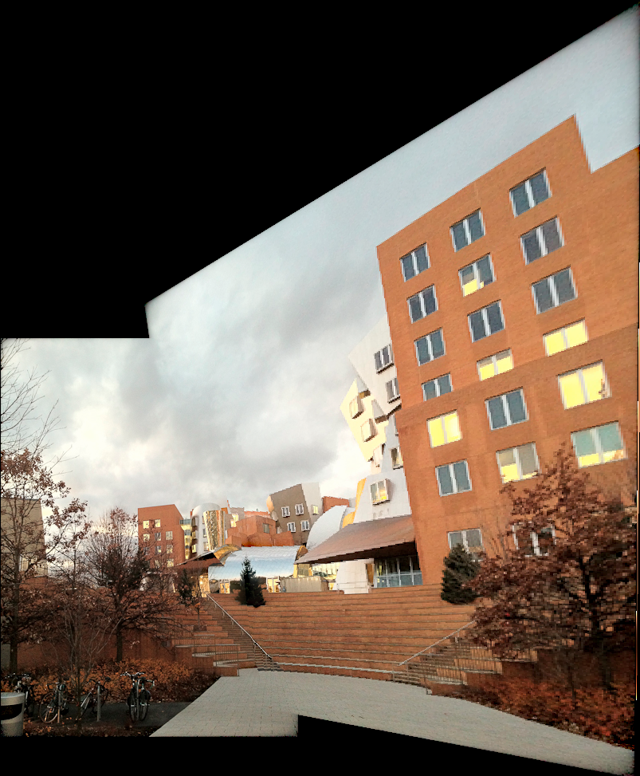

Manual linear panoramas
Create a virtual wide angle view from 2 images
Choose one image as reference
User gives 4 correspondences
Deduce homography matrix
Reproject (warp) second image into first one
p
p’
H

Slide 13
Under the hood
Homogenous coordinates
  encode 2D points with 3 coordinates (x, y, w)
  represents Euclidean points (x/w, y/w)
  make it easy to express perspective and to go between 3D and 2D
Homography
  3x3 matrix on homogenous coordinates
  represent any perspective mapping of a plane
  to apply a homography to a 2D point x, y:
  compute H(x, 1, y)^{T} and divide by third coordinate

Slide 14
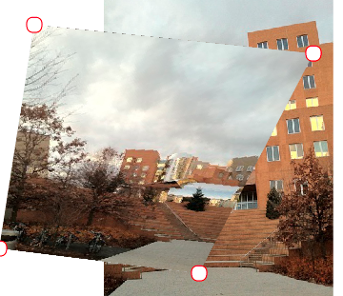
Demo
http://openphotovr.org/edit.html?id=33RwaQHm
If we change the p’, we get a different homography

Slide 15
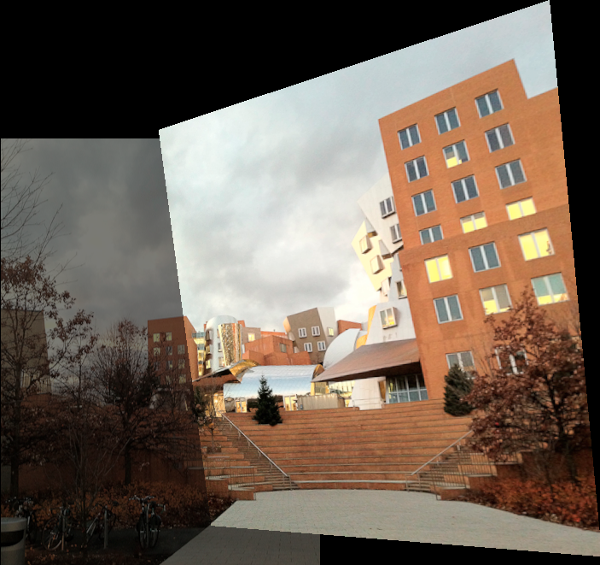
Homography
Different sets of p, p’ correspondences can yield the same homography
p
p’
H

Slide 16
Homography
Different sets of p, p’ correspondences can yield the same homography
p
p’
H

Slide 17
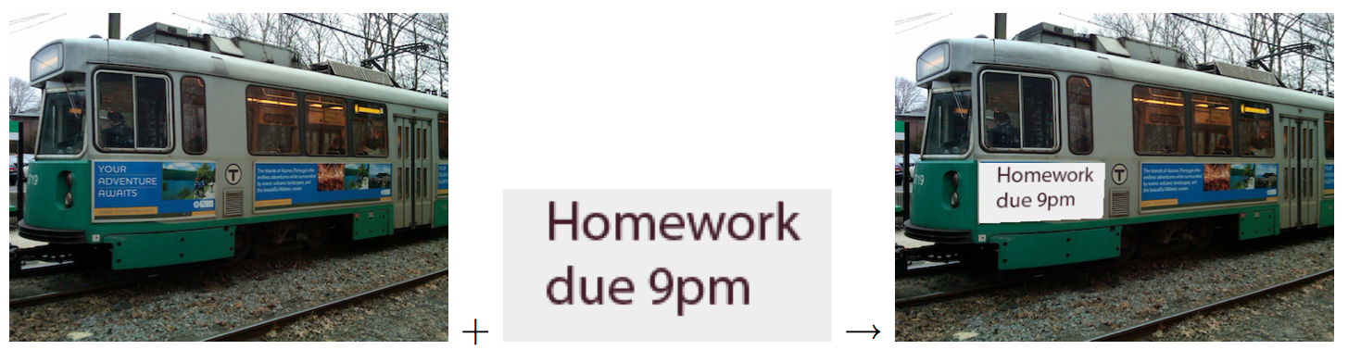
In pset 5
First use to warp from a plane to a 3D plane
Then use to warp pano inputs

Slide 18

Beware
Homographies are defined for the whole plane
  just apply the formula!
But we often only want to apply it inside the rectangle of the input
And as usual, recall forward vs. inverse warp

Slide 19
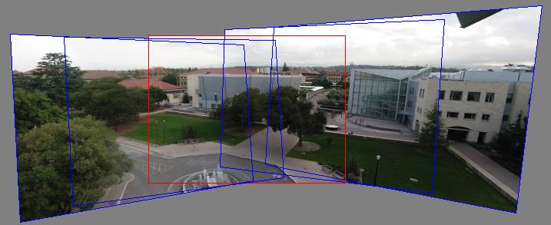
Multiple images
Pick one image (red)
Warp the other images towards it
(usually, one by one)
blend

Slide 20
Homography warp
For each output pixel
compute input location with homography matrix
  p’=Hp, followed by division
copy pixel color (with appropriate antialiasing)

Slide 21
Forward backward Homography
To know bbox:
  Go from corner in source space to output domain
To make sure we fill all output pixels
  loop over output pixels=> need inverse homography
Output
Source

Slide 22
Recap
Panorama = reprojection
3D rotation ➔ homography
  Homogeneous coordinates are kewl
Use feature correspondence
Solve linear problem
  Set of linear equations
Warp all images to a reference one
Use your favorite blending

Slide 23
Questions?

Slide 24
changing camera center
Does it still work?
synthetic PP
PP1
PP2

Slide 25
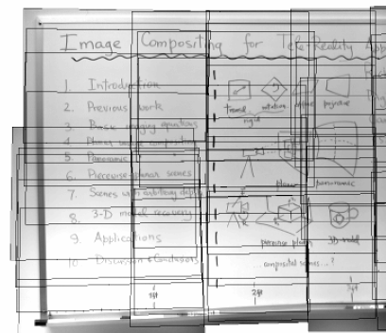
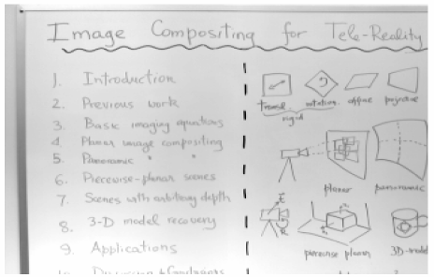
Only for Planar mosaic

Slide 26
Questions?

Slide 27
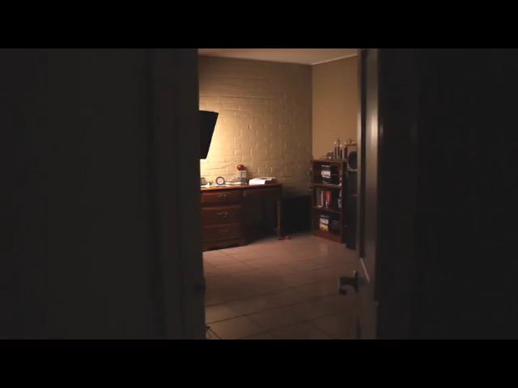
Applied homographies
https://www.youtube.com/watch?feature=player_embedded&v=tBNHPk-Lnkk#!

Slide 28
Gigapan demo
http://gigapan.org/

Slide 29
Perspective correction

Slide 30
Digression: perspective correction
Perspective makes
parallel lines converge
Sometimes objectionable
In particular, architecture
photography
  photo looks more formal
  if verticals stay vertical
But if lines are parallel
to the image plane,
parallel lines don’t converge

Slide 31
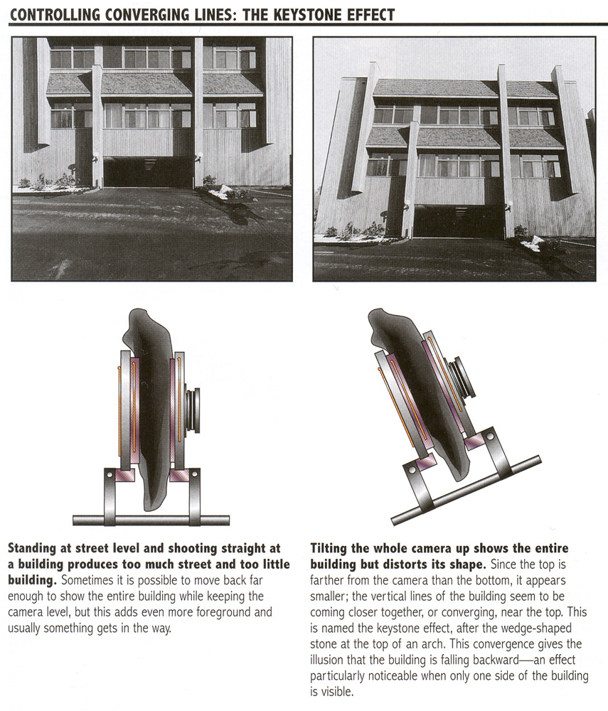
Perspective correction
From Photography, London et al.

Slide 32
From Photography, London et al.

Slide 33
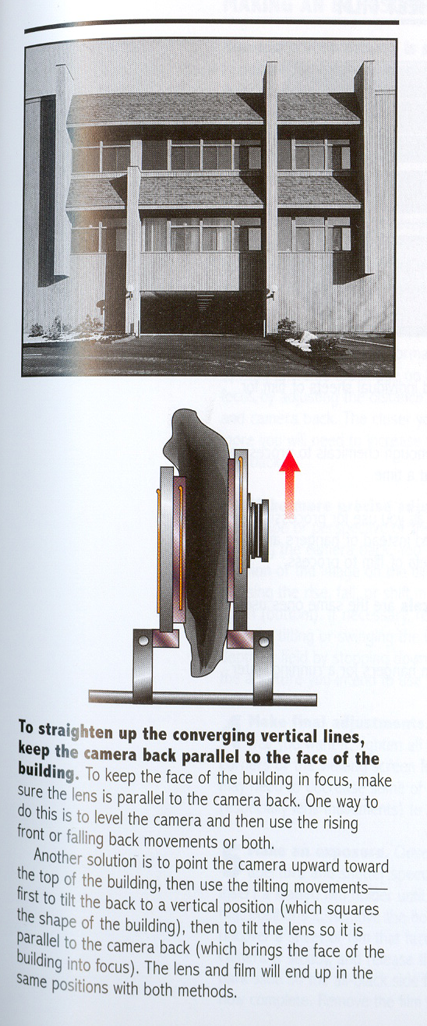
From Photography, London et al.

Slide 34
Lecture stopped here.

Slide 35
Tilt
Equivalent to using a
wider-angle view
and cropping
{
virtual
centered
sensor
{
physical
sensor
=crop
From Photography, London et al.

Slide 36
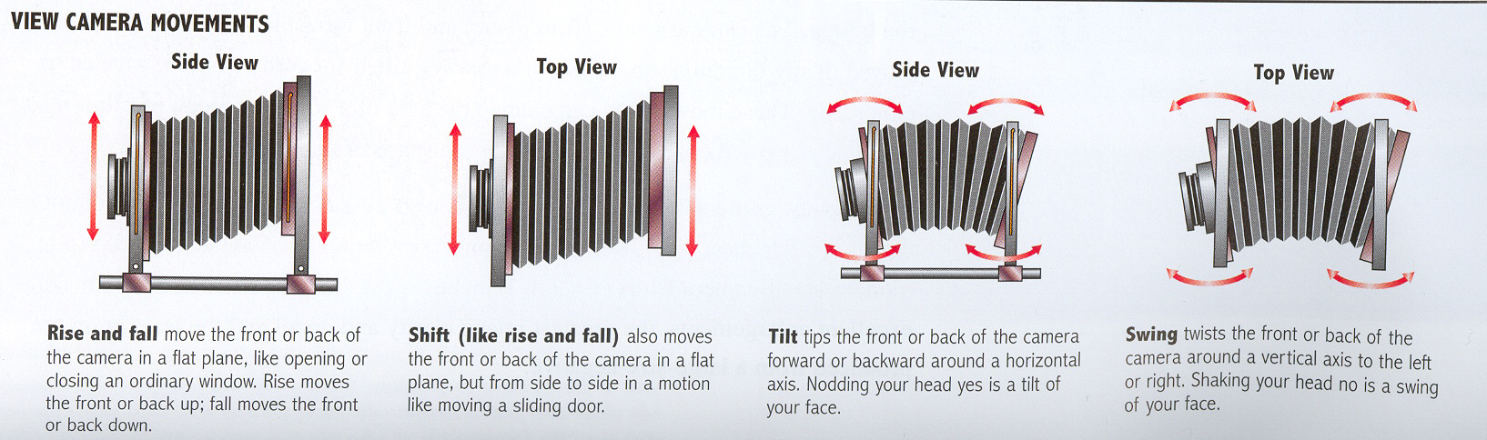
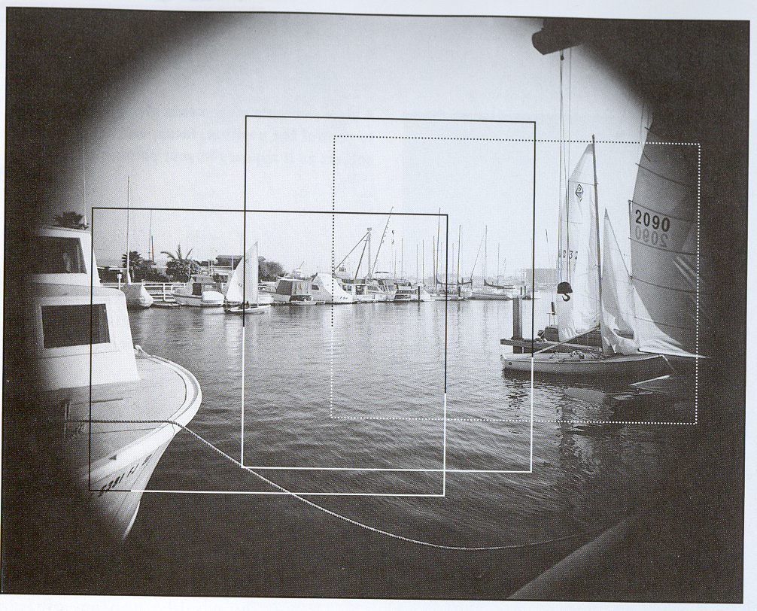
Perspective correction
The lens creates an image bigger than the sensor
Tilting and shifting aligns the sensor with the part we want
From Photography, London et al.

Slide 37
The two images are related by a homography
From Photography, London et al.

Slide 38
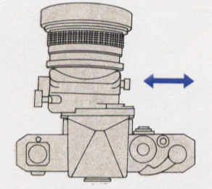
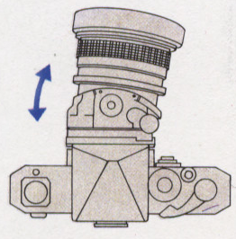
Tilt-shift lens
35mm SLR version

Slide 39
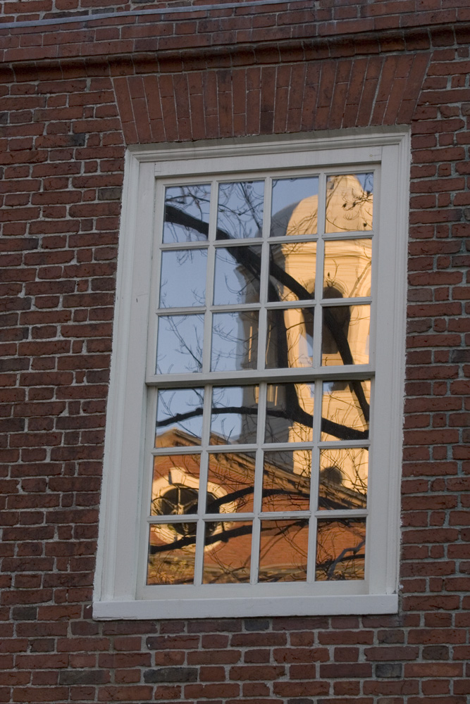
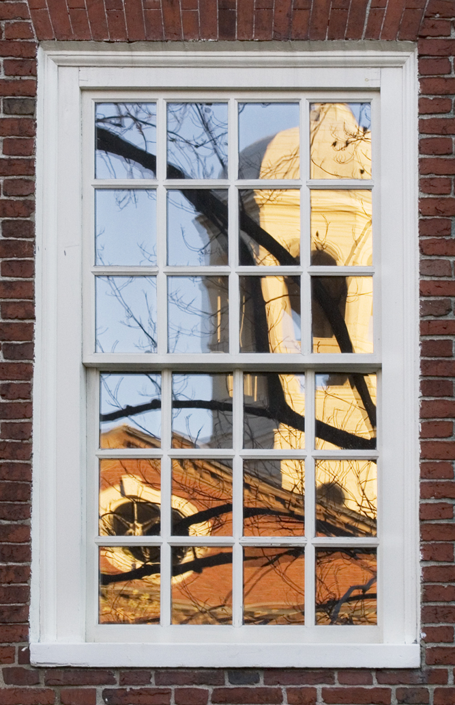
Photoshop version (perspective crop)
+ you control reflection and perspective independently

Slide 40
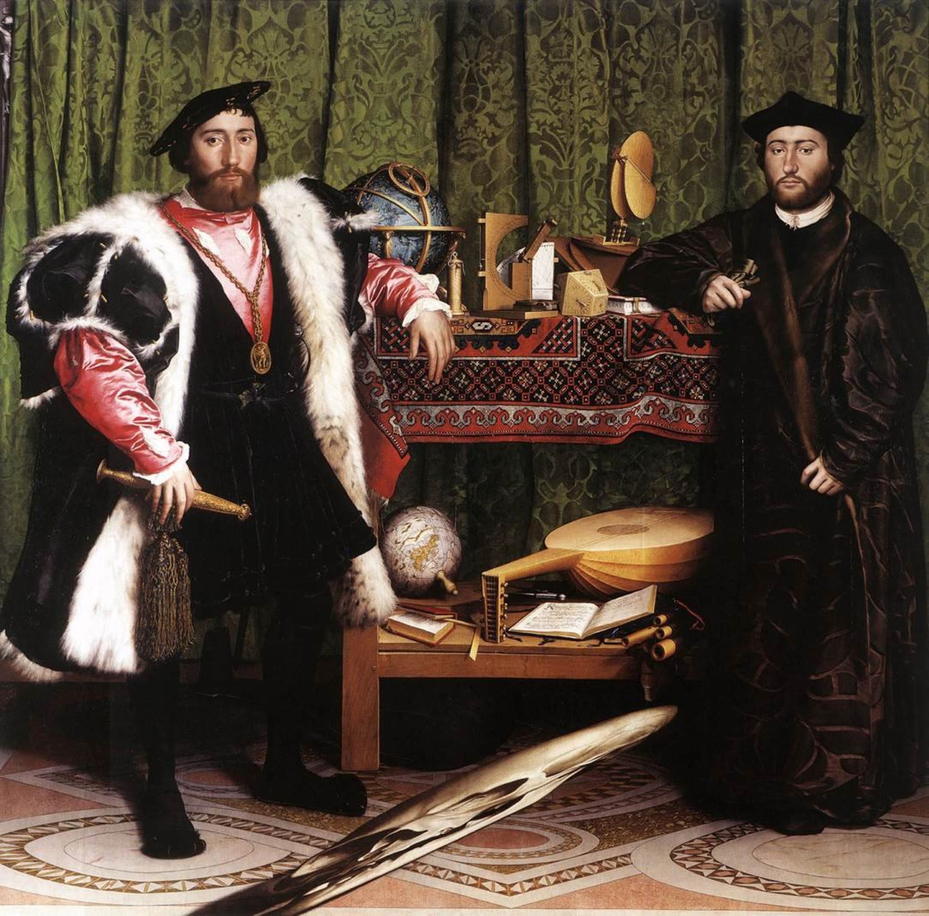
Question?
The Ambassadors, Hans Holbein the Younger, 1533

Slide 41
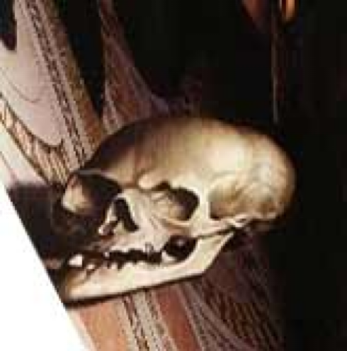
Question?
The Ambassadors, Hans Holbein the Younger, 1533

Slide 42
Cool applications of homographies
With Mok Oh.

Slide 43
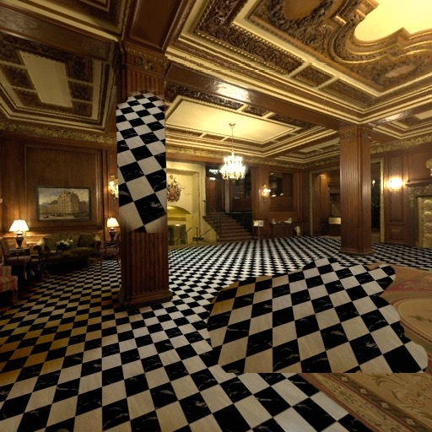
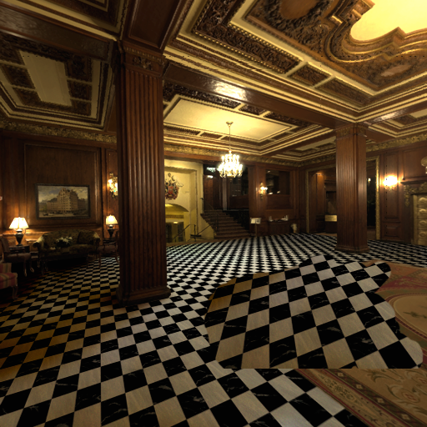
Limitations of 2D Clone Brushing
Distortions due to foreshortening and surface orientation
Notes:
Narration
If we try to remove the carpet with the 2D clone brush, its limitations become very obvious.
The perspective foreshortening and the shape of objects make it difficult to match up clone brushed regions, as shown here.

Slide 44
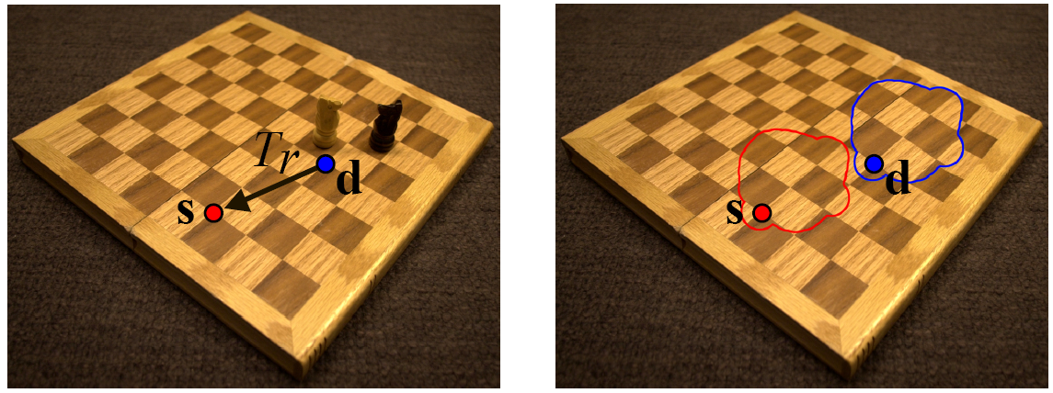
Clone brush (Photoshop)
Click on a reference pixel (blue)
Then start painting somewhere else
Copy pixel color with a translation

Slide 45
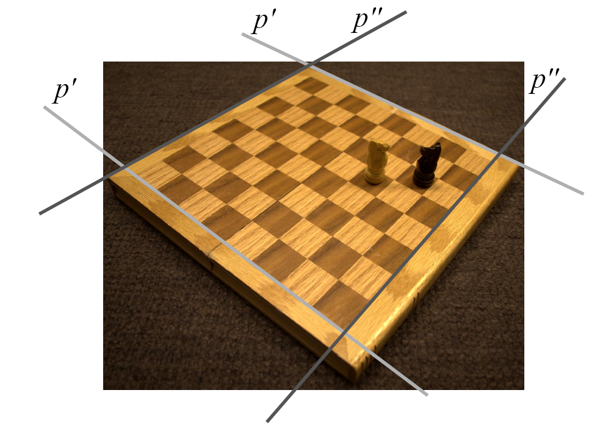
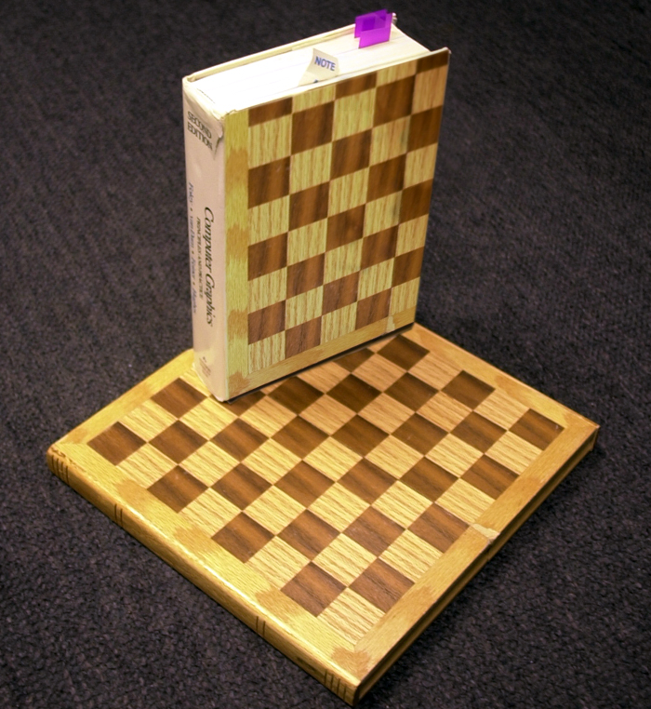
Perspective clone brush
Oh, Durand, Dorsey, unpublished
Correct for perspective
And other tricks

Slide 46
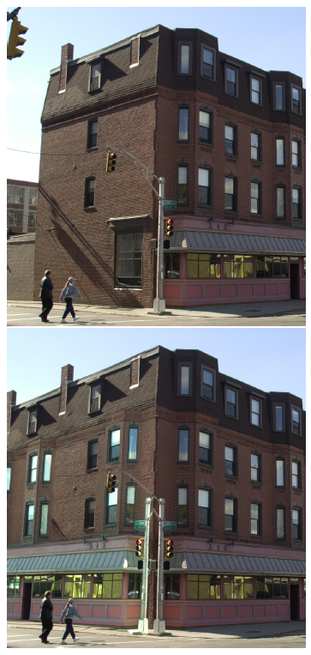
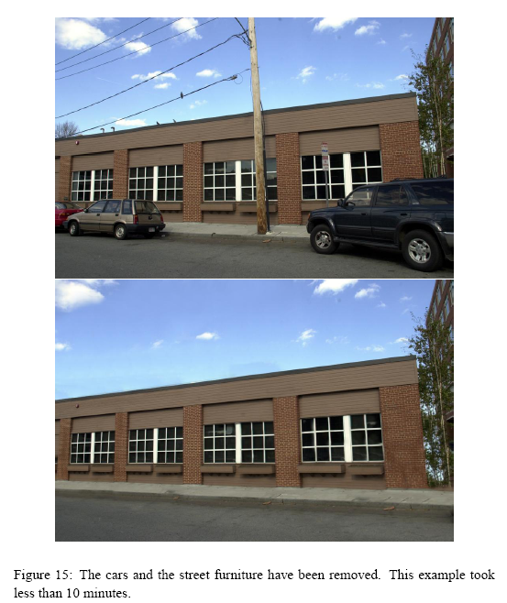

Slide 47
Questions?

Slide 48
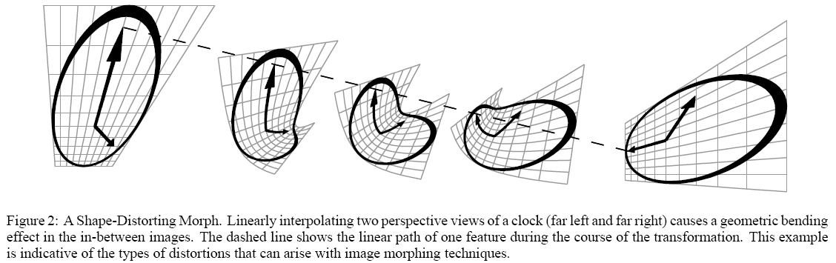
Other application: View morphing
We want to morph between two views of the same object
Standard morphing won’t give a realistic result
  Because it uses linear interpolation of image locations
  With perspective & 3D, points don’t move linearly

Slide 49
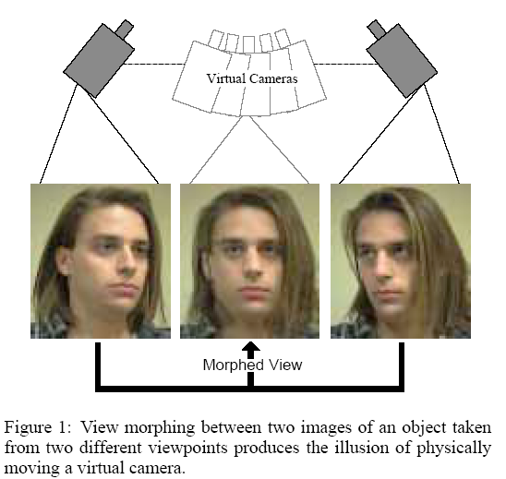
View morphing
Seitz & Dyer
http://www.cs.washington.edu/homes/seitz/vmorph/vmorph.htm
Interpolation consistent with 3D view interpolation

Slide 50
View morphing
Given view 1 and view 2 (and no depth!)
Compute intermediate views consistent with 3D
subject
viewpoint 1
viewpoint 2

Slide 51
View morphing
Reproject to a common view plane parallel to the 2 viewpoints: homographies
subject
common view plane
viewpoint 1
viewpoint 2

Slide 52
View morphing
Similar triangles: everything becomes linear
i.e. interpolate location of features linearly
subject
P1
P2
common view plane
viewpoint 1
viewpoint 2

Slide 53
View morphing
Similar triangles: everything becomes linear
Independent of depth
subject
Q1
Q2
common view plane
viewpoint 1
viewpoint 2

Slide 54
View morphing recap
When views are reprojected onto a common plane parallel to the line between the viewpoints:
Interpolating the viewpoint results in linear interpolation of feature locations
i.e.
  for viewpoint (1-t)V1+tV2
  a 3D point that was at P1 from V1 and P2 from V2 is now at
  (1-t)P1+tP2
That is, a simplistic
warp works
subject
Q1
Q2
common view plane
viewpoint 1
viewpoint 2

Slide 55
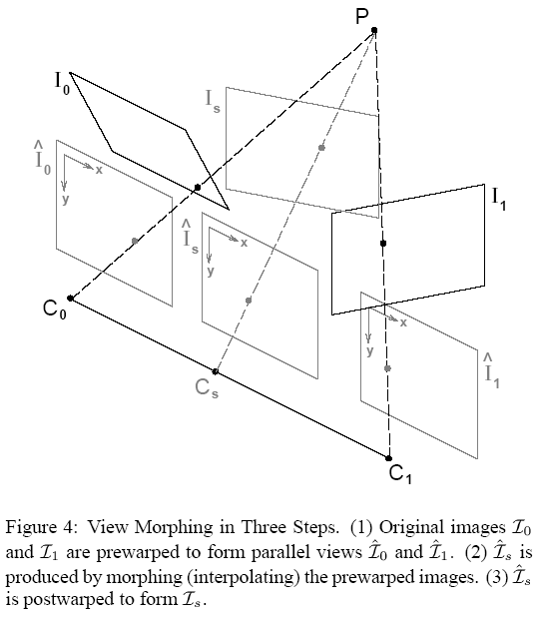
View morphing
Prewarp with a homography to "pre-align" images
So that the two views are parallel
  Because linear interpolation works when views are parallel

Slide 56
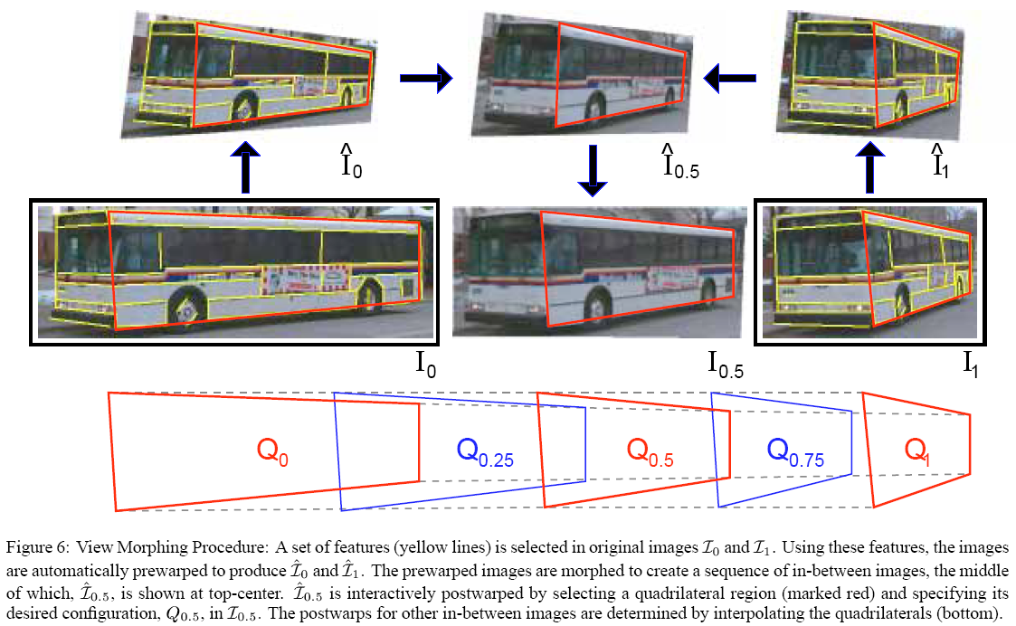
morph
morph
prewarp
prewarp
output
input
input
homographies

Slide 57
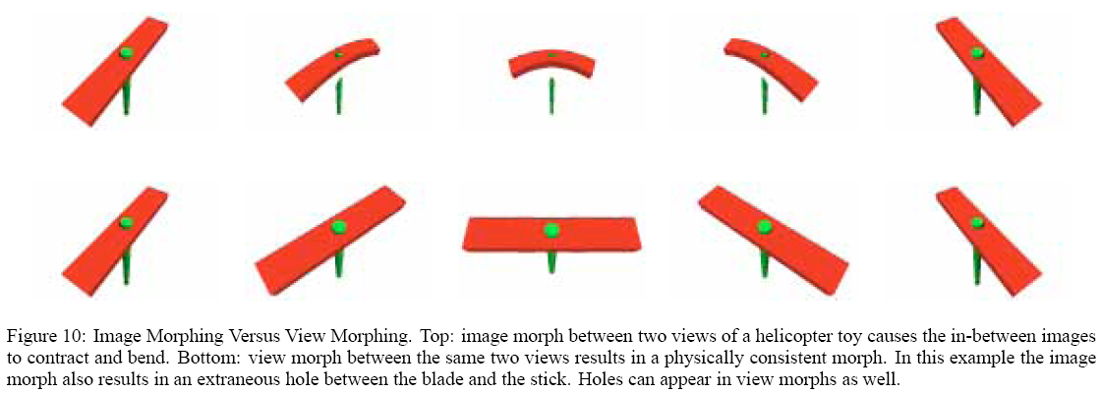

Slide 58
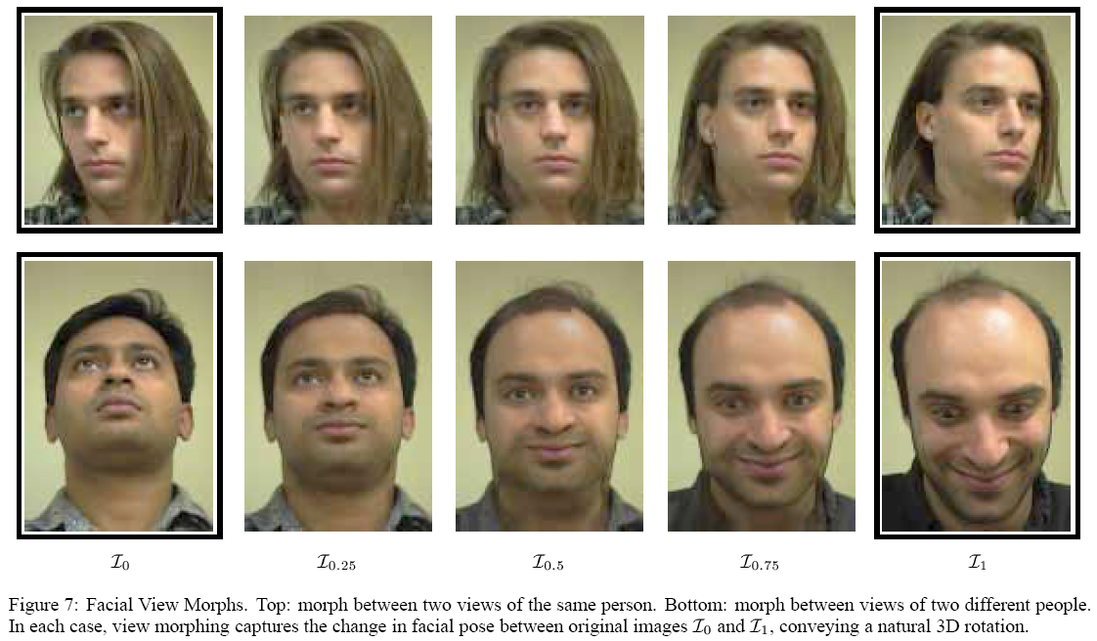

Slide 59
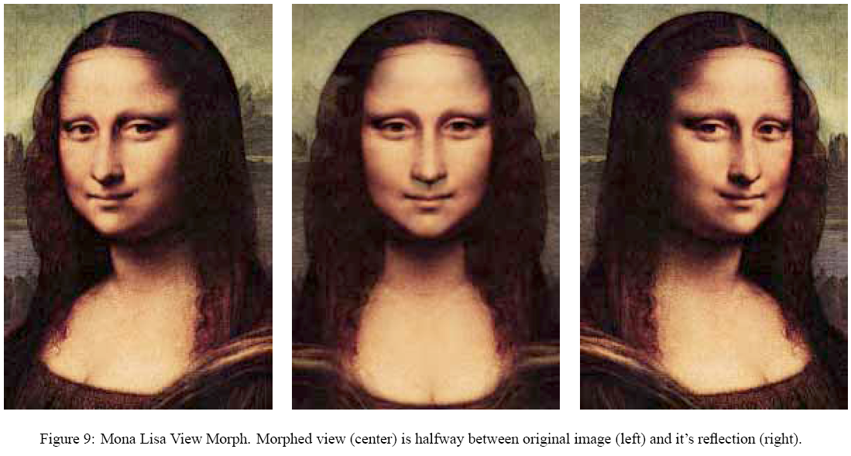

Slide 60
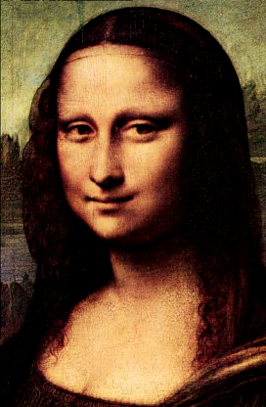

Slide 61
Extensions
Video
Additional objects
Mok’s panomorph
http://www.sarnoff.com/products_services/vision/tech_papers/kumarvb.pdf
http://www.cs.huji.ac.il/~peleg/papers/pami00-manifold.pdf
http://www.cs.huji.ac.il/~peleg/papers/cvpr00-rectified.pdf
http://www.cs.huji.ac.il/~peleg/papers/cvpr05-dynmos.pdf
http://citeseer.ist.psu.edu/cache/papers/cs/20590/http:zSzzSzwww.sarnoff.comzSzcareer_movezSztech_paperszSzpdfzSzvisrep95.pdf/kumar95representation.pdf
http://www.robots.ox.ac.uk/~vgg/publications/papers/schaffalitzky02.pdf

Slide 62
Dealing with parallax
http://research.microsoft.com/en-us/UM/people/yasumat/papers/cvpr2010_Takamatsu.pdf

Slide 63
Software
http://photocreations.ca/collage/circle.jpg
http://webuser.fh-furtwangen.de/%7Edersch/
http://www.ptgui.com/
http://hugin.sourceforge.net/
http://epaperpress.com/ptlens/
http://www.panotools.info/mediawiki/index.php?title=Tutorials
http://www.fdrtools.com/front_e.php

Slide 64
Refs
http://graphics.cs.cmu.edu/courses/15-463/2004_fall/www/Papers/MSR-TR-2004-92-Sep27.pdf
http://www.cs.ubc.ca/~mbrown/papers/iccv2003.pdf
http://www.cs.washington.edu/education/courses/csep576/05wi/readings/szeliskiShum97.pdf
http://portal.acm.org/citation.cfm?id=218395&dl=ACM&coll=portal
http://research.microsoft.com/~brown/papers/cvpr05.pdf
http://citeseer.ist.psu.edu/mann94virtual.html
http://grail.cs.washington.edu/projects/panovidtex/
http://research.microsoft.com/users/mattu/pubs/Deghosting.pdf
http://research.microsoft.com/vision/visionbasedmodeling/publications/Baudisch-OZCHI05.pdf
http://www.vision.caltech.edu/lihi/Demos/SquarePanorama.html
http://graphics.stanford.edu/papers/multi-cross-slits/

Slide 65
Debugging

Slide 66
Debugging
Testing and debugging are an inherent and fundamental part of programming
The art of coming up with good tests is critical
The tests we provide are only meant for typechecking, NOT DEBUGGING
You are in charge of your own debugging

Slide 67
Debugging
Doubt everything
Debug pieces in isolation
  Binary search/divide and conquer
Display/print everything
  In particular intermediate results
Create simple inputs
  where you can easily manually compute the result
  e.g. constant image, edge image, etc.
  use small images (e.g. 3x3)
  including (especially) inputs to intermediate stages
  use input thats isolate different failure modes
Change one thing at a time
  e.g. to verify that a given command has the effect you want, modify it to break it

Slide 68
e.g. pset 5
Check pixel values and see if the scale factor makes sense
Multiply one image by the factor and see if it matches the second one.
Look at the pixels that you declare have a non-zero weight in both images (imwrite)
Replace all factors by 1 and see what happens.
Replace images by [111] and see if the weighted sum is correctly normalized
Replace other images by black and see the contribution of one single image to the final output.
Give yourself basic weights, e.g. left is 0 and right is 1.
Generate a ramp image from 0 to 2 and see what weights you get
Generate multiple input image from a single one by multiplying it (known k).

Slide 69
Show what happens when we don’t rotate around the center of projection

Slide 70
More pano motivation

Slide 71
Gigapixel images

Slide 72
Warning
Pset 7 is not easy

Slide 73
Old-style panorama

Slide 74
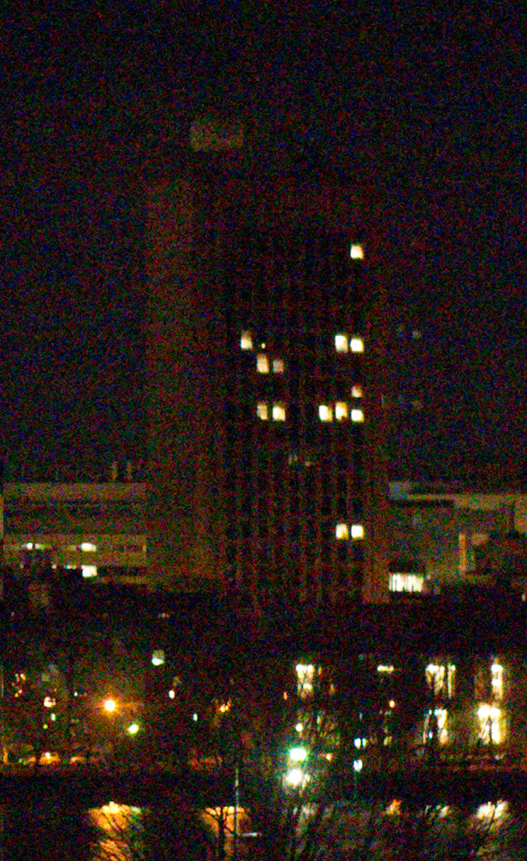
Recall brute-force alignment?
Try all possible translation
compute sum of square differences
Keep best

Slide 75
Recall brute-force alignment?
We sought a dense match:
we evaluated error for all the pixels

Slide 76
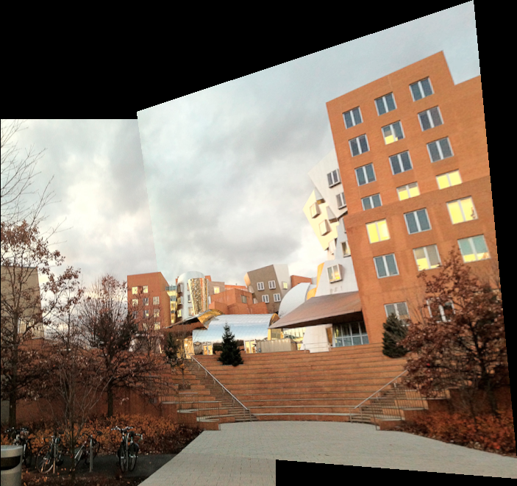
Brute force homography?
Discretize the space of 8 coefficients?
  Crazy combinatorics!
    Even if you know the focal length and reduce it to 3 rotational degrees of freedom
  Costly evaluation: need to warp and compute SSD

Slide 77
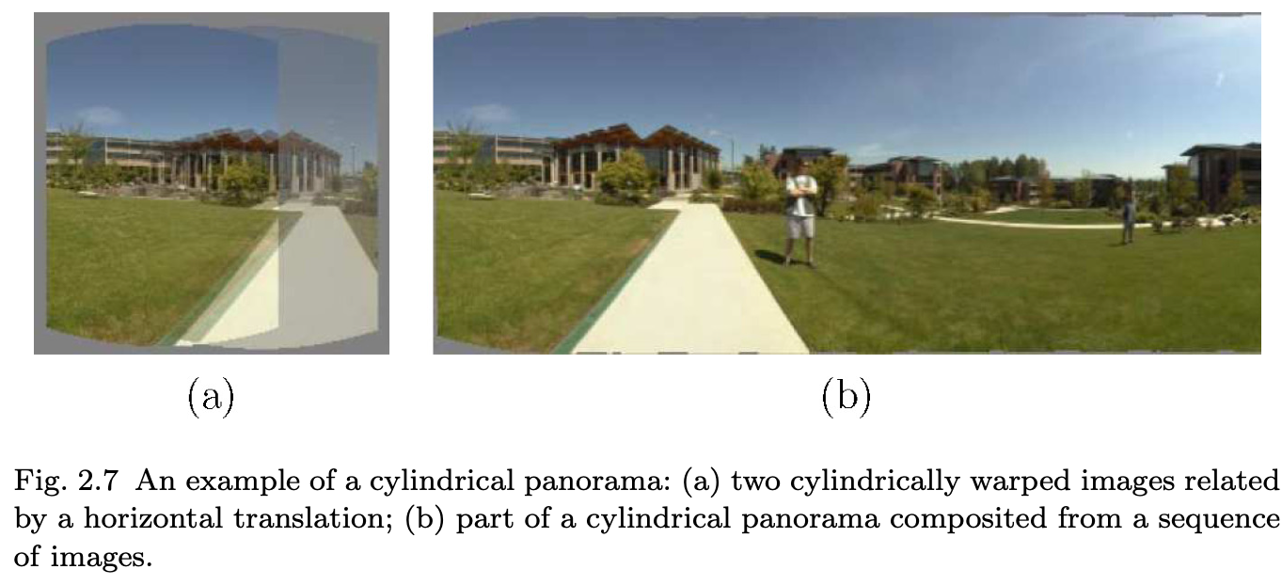
(Old) dense approach
Reduce to 1 or 2 degrees of freedom
  Assume no rotation around optical axis
  (camera stays horizontal)
  Use smart optimization, gradients
  Work in cylindrical coordinates: rotation becomes translation and warping is easier
  http://research.microsoft.com/apps/pubs/default.aspx?id=75695

Slide 78
(Old) dense approach
Problems:
  Many restrictions
    limited degrees of freedom
    SSD not robust to moving objects
    can’t deal with optical distortions
  Costly to evaluate quality of match: SSD on all pixels

Slide 79
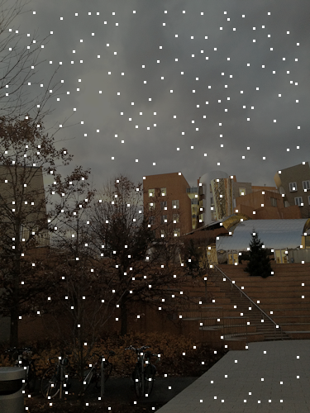
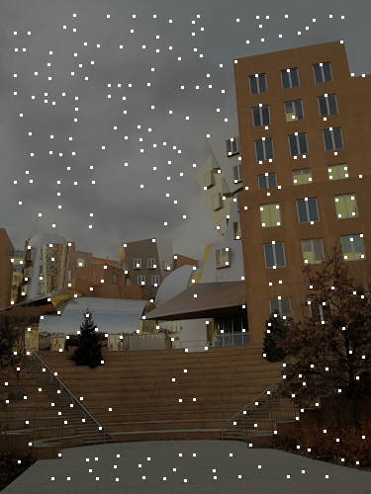
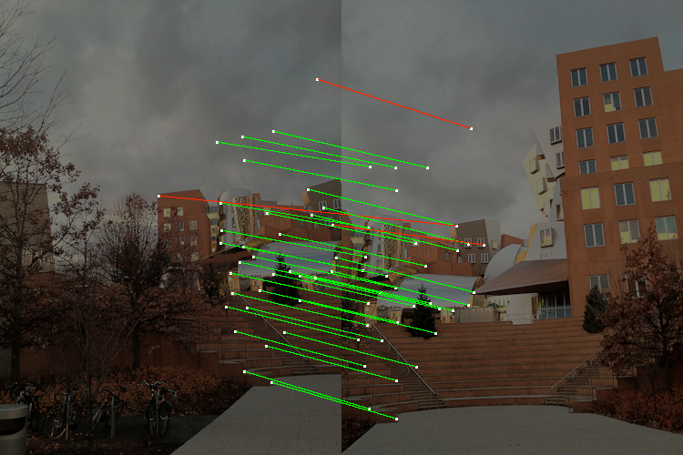
Modern sparse matching
Focus on areas that are very distinctive:
Interest points
  Forget uniform areas
Do the matching locally:
which point matches which point
Add mechanisms to be robust to local mistakes

Slide 80
Auto stitch with sparse features

Slide 81
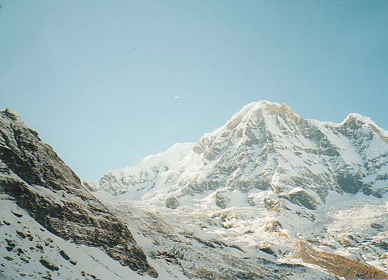
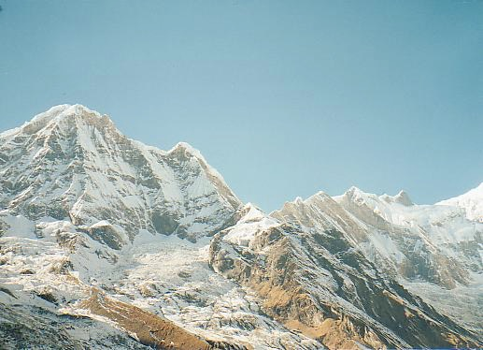
Automatic panorama
We need to match (align) images

Slide 82
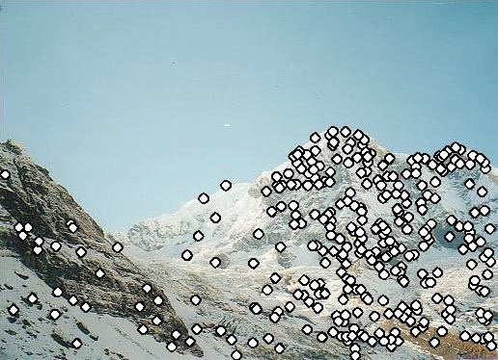
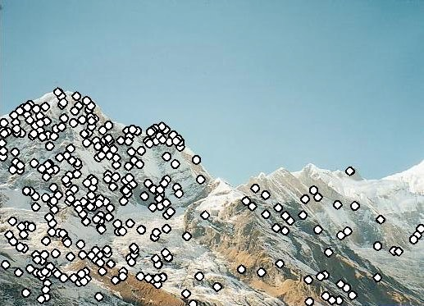
Matching with Features
Detect feature points in both images

Slide 83
Matching with Features
Detect feature points in both images
Find corresponding pairs

Slide 84
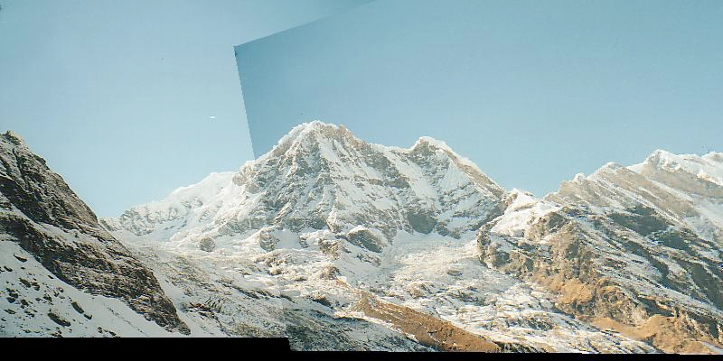
Matching with Features
Detect feature points in both images
Find corresponding pairs
Use these pairs to align images - we know this

Slide 85


Matching with Features
Problem 1:
  Detect the same point independently in both images
counter-example:
no chance to match!
We need a repeatable detector

Slide 86
Matching with Features
Problem 2:
  For each point correctly recognize the corresponding one
?
We need a reliable and distinctive descriptor

Slide 87
Public service announcement
Feature point detectors and descriptors are perhaps the most important innovation in computer vision and computational photography in the last twenty years.
Feature points are used for:
  Image alignment (homography, fundamental matrix)
  3D reconstruction
  Motion tracking
  Object recognition
  Indexing and database retrieval
  Robot navigation
  … other

Slide 88
Discussion
In this lecture, we’ll seek to derive detectors and descriptors that work perfectly
But in reality, they will never be 100% perfect
Next time, we’ll see how we can use the large number of feature points we can extract to reject outliers and get good homographies despite error.
Plus we will only implement a simplistic detector/decriptor

Slide 89
Preview of pset 7
Automatically-extracted feature points

Slide 90

Preview of pset 7
Only a subset of features are matched
In green are matches determined correct

Slide 91
In a nutshell
We will replace your manual clicks
Detectors tell us where to click
Descriptors tells us which click in an image corresponds to which one in the other one
2NN & RANSAC correct for mistakes

Slide 92

Preview
Detector: detect same scene points independently in both images
Descriptor: encode local neighboring window
  Note how scale & rotation of window are the same in both image (but computed independently)
Correspondence: find most similar descriptor in other image
detector
location
Note: here viewpoint is different, not panorama (they show off)
Descriptor

Slide 93
Important
We run the detector and compute descriptors independently in the various images.
It is only at the end, given a bag of feature points and their descriptors, that we compute correspondences
But for the derivation, we will look how the detector and descriptor behave for corresponding scene points,
to check for consistency

Slide 94
Harris corner detector

Slide 95
Harris corner detector
C.Harris, M.Stephens. “A Combined Corner and Edge Detector”. 1988

Slide 96
The Basic Idea
We should easily localize the point by looking through a small window
Shifting a window in any direction should give a large change in pixels intensities in window
  makes location precisely define

Slide 97
Corner Detector: Basic Idea
“flat” region:
no change in all directions
“edge”:
no change along the edge direction
“corner”:
significant change in all directions

Slide 98
The Moravec Detector
Compute SSD (sum square difference) between window & 8 neighbor windows (shifted by 1 pixel)
Corner strength: minimum difference with neighbors
Problem: not rotation invariant
  because we take a bigger step in diagonal,
  and we only check a small number of directions (8)

Slide 99
Contents
Harris Corner Detector
  Algorithm
  Analysis
Detectors
  Rotation invariant
  Scale invariant
Descriptors
  Rotation invariant
  Scale invariant

Slide 100
Harris Detector: Mathematics
Window-averaged change of intensity induced by shifting the image data by [u,v]:

Slide 101

Harris Detector: Mathematics
Window-averaged change of intensity induced by shifting the image data by [-u,-v]:
Window function
Shifted intensity
Intensity
Window function w(x,y) =
or
1 in window, 0 outside
Gaussian

Slide 102
Practical corner detection
Computing the error for all neighbors is costly
Let’s derive a more direct criterion
Taylor expansions to the rescue!
  derive changes in error in neighborhood of pixel

Slide 103
Taylor expansion

Slide 104

Taylor expansion
1D:
2D:

Slide 105
Taylor series approximation
Recall full equation:

Slide 106

Taylor series approximation to shifted image gives quadratic form for error as function of image shifts.
where subscripts denote derivatives
Note: derivatives computed at each x,y

Slide 107

Taylor series approximation to shifted image gives quadratic form for error as function of image shifts.
where subscripts denote derivatives
Note: derivatives computed at each x,y

Slide 108


Harris Detector: Mathematics
Expanding I(x,y) in a Taylor series expansion, we have, for small shifts [u,v], a quadratic approximation to the error surface between a patch and itself, shifted by [u,v]:
where M is a 2×2 matrix computed from image derivatives:
M is often called structure tensor

Slide 109


Structure tensor: Stata
Blue: xx, red: yy, green: xy

Slide 110
Harris Detector: Mathematics
Intensity change in shifting window: eigenvalue analysis
λ₁, λ₂ – eigenvalues of M
direction of the fastest change
Ellipse E(u,v) = const
direction of the slowest change
(λ_{max})^{-1/2}
Iso-intensity contour of E(u,v)
(λ_{min})^{-1/2}

Slide 111

Harris Detector: Mathematics
Start with Moravec:
Window-averaged change of intensity for the shift [u,v]:
Window function
Shifted intensity
Intensity
Window function w(x,y) =
or
1 in window, 0 outside
Gaussian

Slide 112
Go through Taylor series expansion on board

Slide 113


Harris Detector: Mathematics
Expanding E(u,v) in a order Taylor series expansion, we have,for small shifts [u,v], a bilinear approximation:
where M is a 2×2 matrix computed from image 1st derivatives:
M is often called structure tensor

Slide 114



Selecting Good Features
Image patch
Error surface
λ₁ and λ₂ are large

Slide 115



Selecting Good Features
Image patch
Error surface
large λ₁, small λ₂

Slide 116



Selecting Good Features
Image patch
(contrast auto-scaled)
Error surface
(vertical scale exaggerated relative to previous plots)
small λ₁, small λ₂

Slide 117
Harris Detector: Mathematics
Classification of image points using eigenvalues of M:

Slide 118
Harris Detector: Mathematics
Classification of image points using eigenvalues of M:
λ₂
“Edge”
λ₂ >> λ₁
“Corner”
λ₁ and λ₂ are large,
λ₁ ~ λ₂;
E increases in all directions
λ₁ and λ₂ are small;
E is almost constant in all directions
“Flat” region
“Edge”
λ₁ >> λ₂
λ₁

Slide 119
Harris Detector: Mathematics
Measure of corner response:

Slide 120


Harris Detector: Mathematics
Measure of corner response:
(k – empirical constant, k = 0.04-0.06)
(Shi-Tomasi variation: use min(λ1,λ2) instead of R)

Slide 121
Harris Detector: Mathematics
λ₂
“Edge”
“Corner”
R depends only on eigenvalues of M
R is large for a corner
R is negative with large magnitude for an edge
|R| is small for a flat region
R < 0
R > 0
“Flat”
“Edge”
|R| small
R < 0
λ₁

Slide 122
Harris corner detector algorithm
Compute image gradients Ix Iy for all pixels
For each pixel
  Compute
  by looping over neighbors x,y
  compute
Find points with large corner response function R (R > threshold)
Take the points of locally maximum R as the detected feature points
(ie, pixels where R is bigger than for all the kxk neighbors).

Slide 123
Algorithm
Compute image gradients Ix Iy for all pixels
For each pixel
  Compute
  by looping over neighbors x,y
  compute
Find points with large corner response function R (R > threshold)
Take the points of local maxima of R

Slide 124
Harris Detector
The Algorithm:
  Find points with large corner response function R (R > threshold)
  Take the points of local maxima of R

Slide 125

Harris Detector: Workflow

Slide 126

Harris Detector: Workflow
Compute corner response R

Slide 127

Harris Detector: Workflow
Find points with large corner response: R>threshold

Slide 128

Harris Detector: Workflow
Take only the points of local maxima of R

Slide 129

Harris Detector: Workflow

Slide 130
Structure tensor: Stata
Blue: xx, red: yy, green: xy

Slide 131


Corner response

Slide 132
Corners

Slide 133

Harris Detector: Summary
Average intensity change in direction [u,v] can be expressed as a bilinear form:
Describe a point in terms of eigenvalues of M:
measure of corner response
A good (corner) point should have a large intensity change in all directions, i.e. R should be large and positive

Slide 134
Properties of Harris corners

Slide 135
Possible changes between two images from same viewpoint
Geometry
  rotation along optical axis (2D rotation)
  perspective distortion (wide angle)
  scale (different zoom, or local scale due to perspective distortion)
  radial distortion (lens aberration)
Photometry (pixel values)
  lighting changes, clouds moves
  exposure not the same
  vignetting

Slide 136
Models of Image Change
Geometry
  Rotation
  Similarity (rotation + uniform scale)
  Affine (scale dependent on direction)
  valid for: orthographic camera, locally planar object
Photometry
  Affine intensity change (I → a I + b)

Slide 137
We want to:
detect the same interest points regardless of image changes

Slide 138


Harris Detector: Some Properties
Rotation invariance?

Slide 139
Harris Detector: Some Properties
Rotation invariance
Ellipse rotates but its shape (i.e. eigenvalues) remains the same
Corner response R is invariant to image rotation
This is a new example where eigen analysis allows us to work in the canonical frame of the linear form

Slide 140
Harris Detector: Some Properties
Invariance to image intensity change?

Slide 141
Harris Detector: Some Properties
Partial invariance to additive and multiplicative intensity changes
Only derivatives are used => invariance to intensity shift I → I + b
Intensity scaling: I → a I fine, except for the threshold that’s used to specify when R is large enough.
R
R
threshold
x (image coordinate)
x (image coordinate)

Slide 142
Harris Detector: Some Properties
Invariant to image scale?

Slide 143
Harris Detector: Some Properties
Not invariant to image scale!
All points will be classified as edges
Corner !

Slide 144
Harris Detector: Some Properties
Quality of Harris detector for different scale changes
Repeatability rate:
# correspondences
# possible correspondences
C.Schmid et.al. “Evaluation of Interest Point Detectors”. IJCV 2000

Slide 145

Harris Detector: Some Properties
Quality of Harris detector for different scale changes
Repeatability rate:
# correspondences
# possible correspondences
C.Schmid et.al. “Evaluation of Interest Point Detectors”. IJCV 2000

Slide 146
Preview
Later, we’ll see how we can better deal with image scale and rotation

Slide 147
Correspondences

Slide 148
Recall: Matching with Features
Problem 1:
  Detect the same point independently in both images
no chance to match!
Good
We need a repeatable detector: DONE FOR NOW

Slide 149
Recall: Matching with Features
Problem 2:
  For each point correctly recognize the corresponding one
?
We need a reliable and distinctive descriptor

Slide 150
Using descriptors
For each interest point (corner) in first image
Find most similar in second image
Similarity defined by descriptor difference
Goal: descriptor should stay the same around a scene feature when we rotate the camera and take the second image

Slide 151
Questions?

Slide 152
Patch descriptor

Slide 153
In this lecture

Slide 154
In this lecture
Simple patch descriptor
  Describe a corner by the local pixel values
  Blur a little to reduce effect of sampling
  Correct for brightness and contrast differences
Later: more advanced descriptors

Slide 155

Basic idea
Descriptor = kxk patch

Slide 156
Bells and whistles
In pset 7, we only use luminance values
Blur image a little before
  To reduce sampling/aliasing effects
Correct for potential brightness/contrast changes
  e.g. because of exposure, vignetting, clouds
  Subtract mean
  normalize by standard deviation
At the end of the day, a descriptor is kxk numbers

Slide 157


Descriptor Visualization
Green=positive, red=negative

Slide 158
Matching descriptors

Slide 159

Status

Slide 160
Status
We have extracted N1 corners from image 1, and N2 from image 2
For each corner, we have a kxk descriptor
The combination of a corner+descriptor is often called a feature point
Now we need to match feature points from image 1 to image 2

Slide 161
Brute force search

Slide 162
Brute force search
For each feature point i in image 1
  scan all feature points j in image 2
    compute (squared) distance between descriptors i & j
      i.e. sum of square difference for kxk numbers
    Keep descriptor with closest distance

Slide 163

Status
We have a match for each corner of an image
  But lots of wrong matches
  Even scene points that are not on the overlap between the images have a match!

Slide 164
Second-Nearest-Neighbor test

Slide 165
Problem
How do we tell good matches from bad ones?

Slide 166
Naive idea
If distance is too big, ignore match

Slide 167

Evaluating naive idea
Using ground truth
  e.g. user clicks to tell us which corner matches which
distribution of good vs. bad matches as function of descriptor difference
  slightly different descriptor from us though, smarter)
Not a clear threshold

Slide 168
Better idea: Second NN

Slide 169

Better idea: Second NN
Evaluate ratio of distance to best descriptor to that of second best
If they are too similar, the match is ambiguous
Inverse of ratio???

Slide 170
Status
We have feature points
Matches between two images
  Most of them are good
  But not all of them. There can still be error.
  Next time: RANSAC to remove remaining outliers

Slide 171
Example of outlier

Slide 172
Still to be learned
Better detector: across scales
Better descriptor
  robust to rotation and scale.
  e.g. SIFT
Homography fitting despite the presence of outliers
  RANSAC
Correct for optical distortions
Blending to make seams invisible
Deal with moving objects

Slide 173
More about homographies

