Slide 1
RANSAC
Fredo Durand
MIT EECS 6.8370/6.8371

Slide 2

Demosaicking
https://blog.kasson.com/the-last-word/camera-resolution-and-4k-viewing-a7s-a7iii-a7riii-a7riv-downsampled/

Slide 3
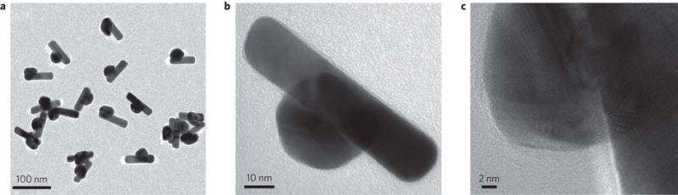
Blackest material
98 to 99% absorption
http://phys.org/news/2015-10-blackest-material.html
http://phys.org/news/2015-10-blackest-material.html

Slide 4
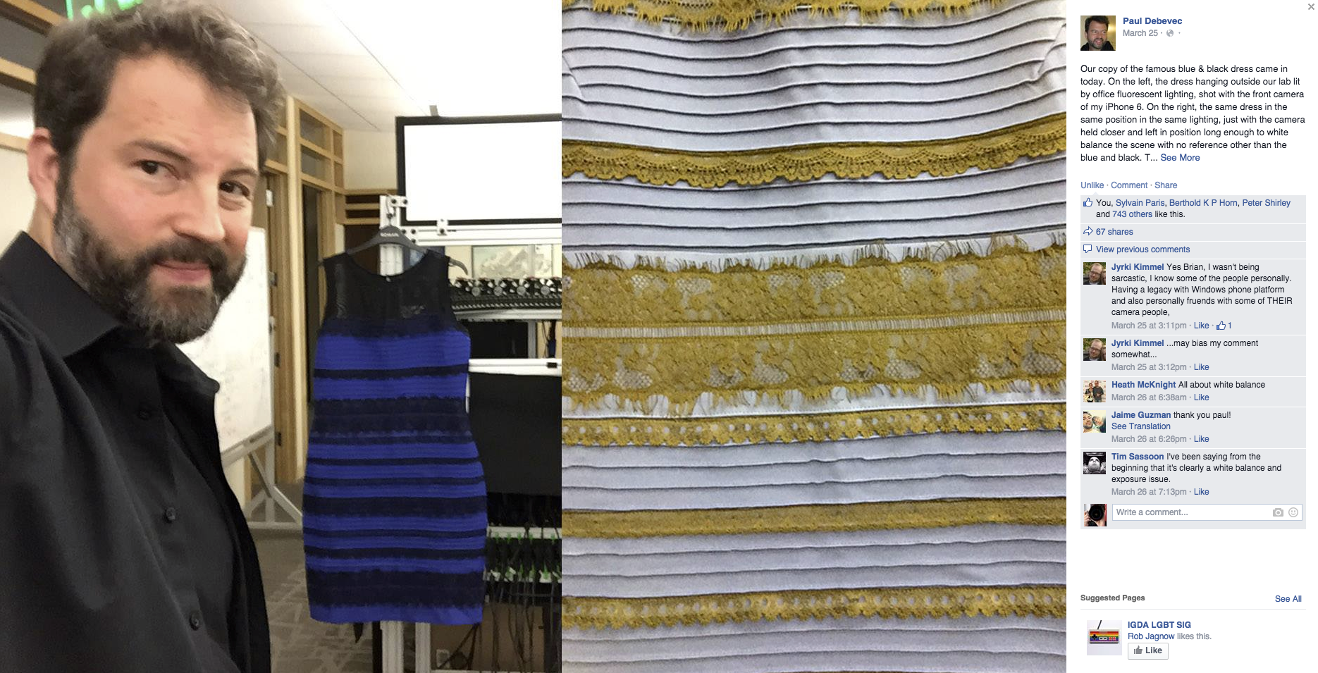
The dress, by Paul Debevec

Slide 5
Follow pset instructions
We will take points off:
  if you don’t call your methods the right way
  if you fail to include required images
  if your readme is not an ascii file
  if you don’t put things in a ZIP archive

Slide 6
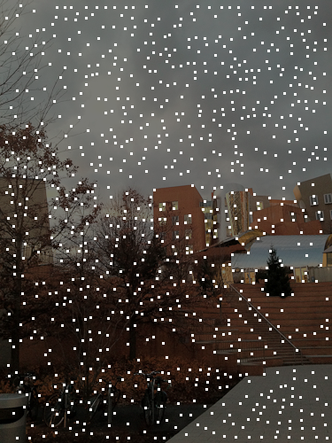
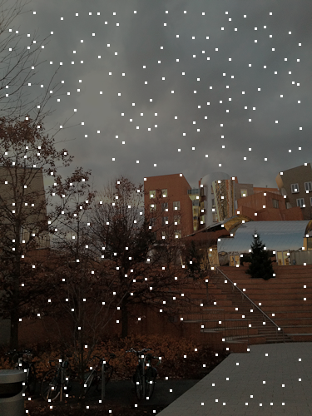
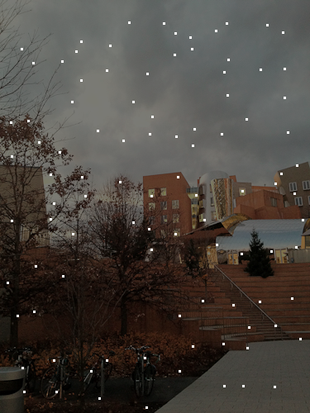


Corners and scale
Change both initial and tensor blur
Keep constant factor between the two

Slide 7
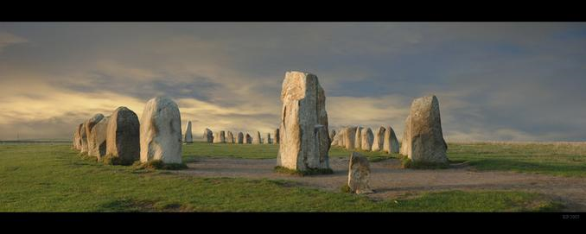
Feature Matching and RANSAC
© Krister Parmstrand
Nikon D70. Stitched Panorama. The sky has been retouched. No other image manipulation.
with a lot of slides stolen from
Alyosha Efros, Steve Seitz and Rick Szeliski

Slide 8
Patch descriptor

Slide 9


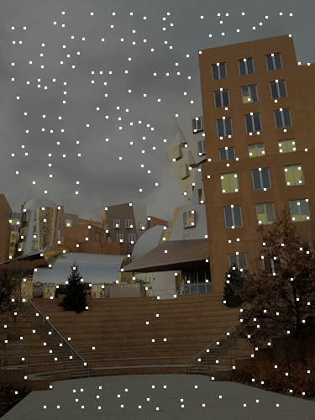
Basic idea
Descriptor = kxk patch

Slide 10
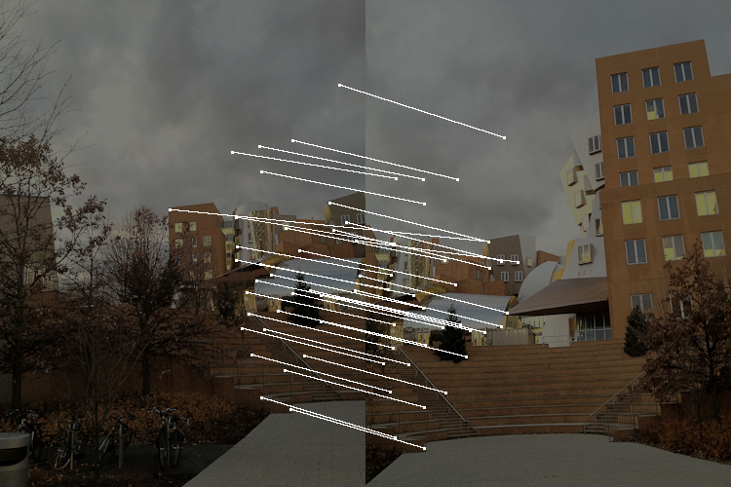
Status: after 2NN test
We have feature points
Matches between two images
  Most of them are good
  But not all of them. There can still be error.
  Today: RANSAC to remove remaining outliers

Slide 11
Example of outlier

Slide 12
Ransac idea

Slide 13
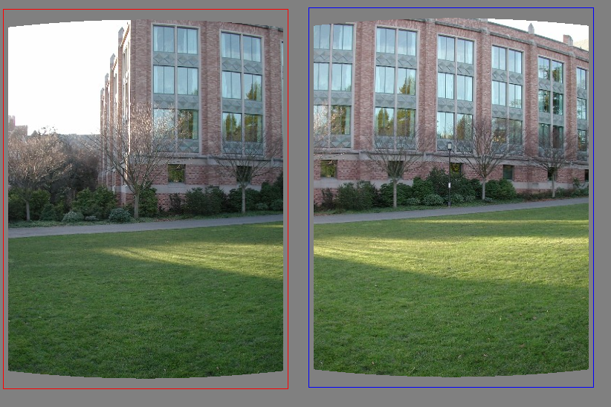
(b) Matching features at the image level--looking for a good homography
Simplified illustration with translation instead of homography
What do we do about the “bad” matches?
Note: at this point we don’t know which ones are good/bad

Slide 14
RAndom SAmple Consensus
Select one match, count inliers

Slide 15
RAndom SAmple Consensus
Select one match, count inliers
1 inliers

Slide 16
RAndom SAmple Consensus
Select one match, count inliers
5 inliers

Slide 17
RAndom SAmple Consensus
Select one match, count inliers
Select one match, count inliers
Keep match with largest set of inliers

Slide 18
At the end: Least squares fit
Find “average” translation vector,
but with only inliers

Slide 19
RANSAC

Slide 20
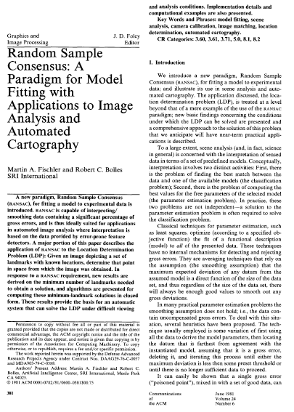
Reference
M. A. Fischler, R. C. Bolles. Random Sample Consensus: A Paradigm for Model Fitting with Applications to Image Analysis and Automated Cartography. Comm. of the ACM, Vol 24, pp 381-395, 1981.
http://portal.acm.org/citation.cfm?id=358692

Slide 21
RANSAC for estimating homography

Slide 22
RANSAC for estimating homography
RANSAC loop:
Select four feature pairs (at random)
Compute homography H (exact)
Compute inliers where ||p_{i}’, H p_{i}|| < ε
Keep largest set of inliers
Re-compute least-squares H estimate on all of the inliers

Slide 23
Simple example: fit a line
Rather than homography H (8 numbers)
fit y=ax+b (2 numbers a, b) to 2D pairs

Slide 24
Simple example: fit a line
Pick 2 points
Fit line
Count inliers
3 inlier

Slide 25
Simple example: fit a line
Pick 2 points
Fit line
Count inliers
4 inlier

Slide 26
Simple example: fit a line
Pick 2 points
Fit line
Count inliers
9 inlier

Slide 27
Simple example: fit a line
Pick 2 points
Fit line
Count inliers
8 inlier

Slide 28
Simple example: fit a line
Use biggest set of inliers
Do least-square fit

Slide 29
RANSAC for estimating homography
RANSAC loop:
Select four feature pairs (at random)
Compute homography H (exact)
Compute inliers where ||p_{i}’, H p_{i}|| < ε
Keep largest set of inliers
Re-compute least-squares H estimate on all of the inliers

Slide 30
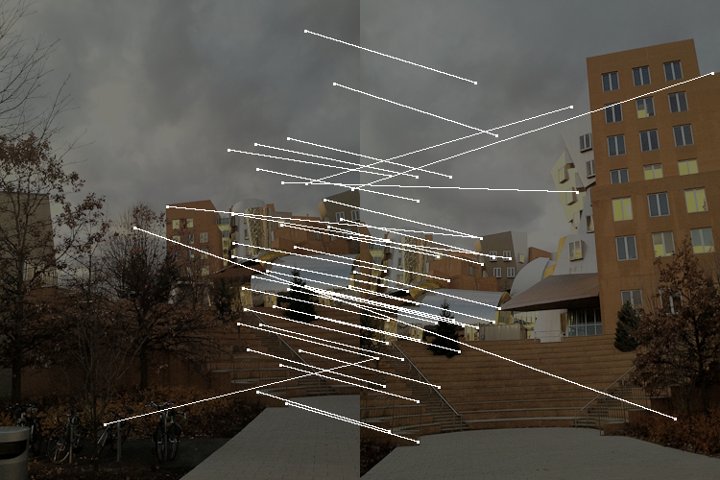
Correspondences
I lowered the 2NN threshold to make things more interesting...

Slide 31
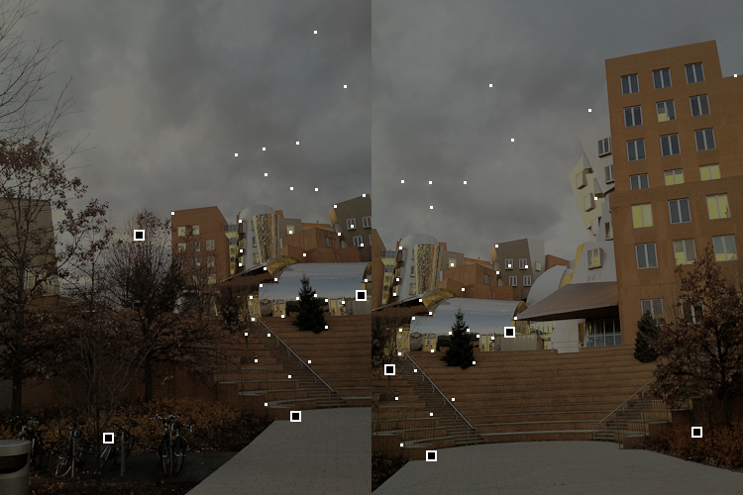
RANSAC iterations

Slide 32
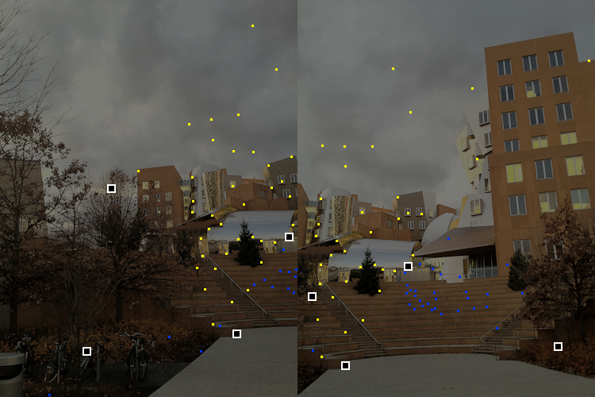
green-on-red: inlier
yellow and blue: outlier

Slide 33


Slide 34

green-on-red: inlier
yellow and blue: outlier

Slide 35


Slide 36
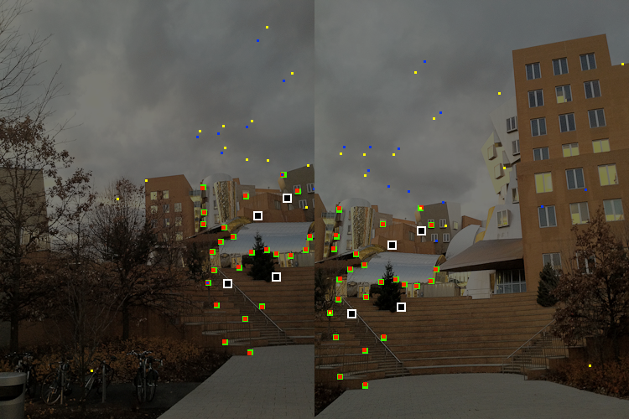

Slide 37
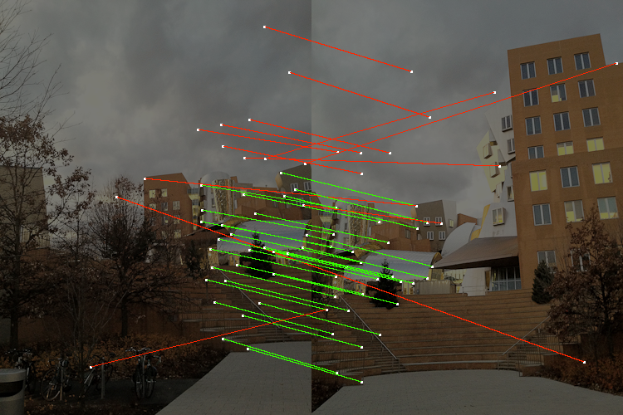
Resulting inliers

Slide 38
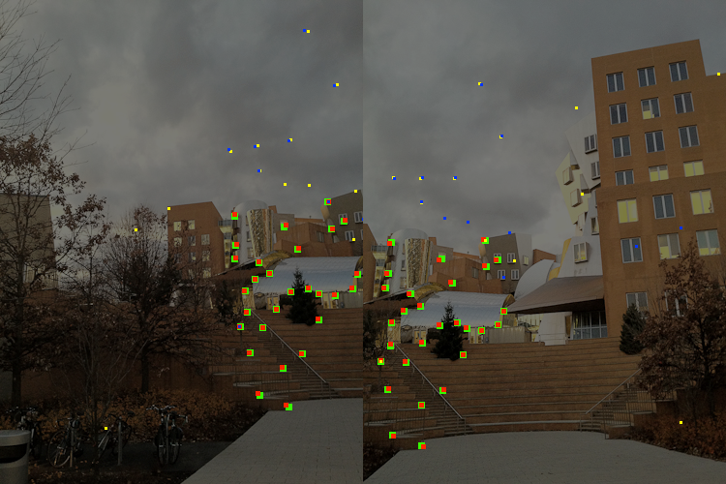
After reweighted least square
Took into account near outliers

Slide 39
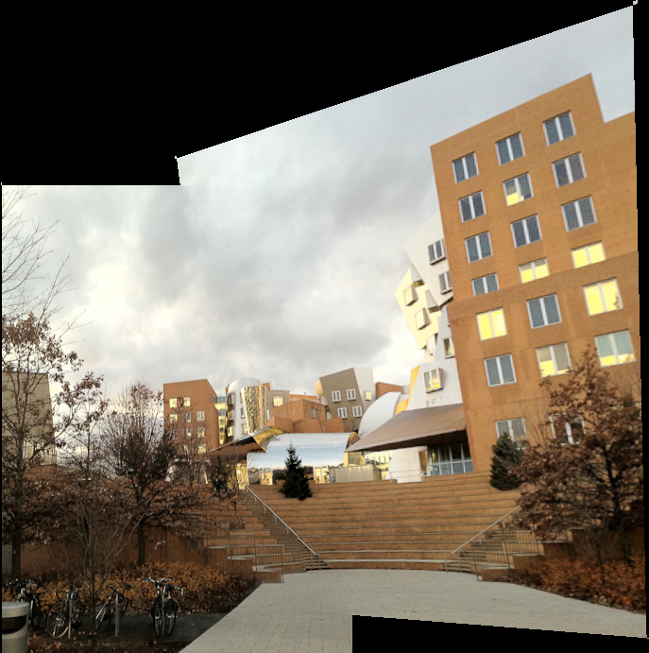
Reprojection

Slide 40
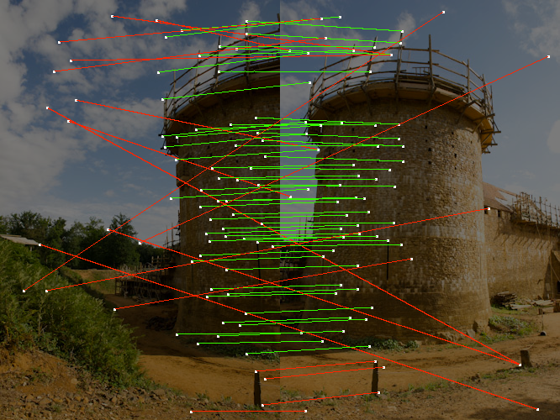
More results

Slide 41
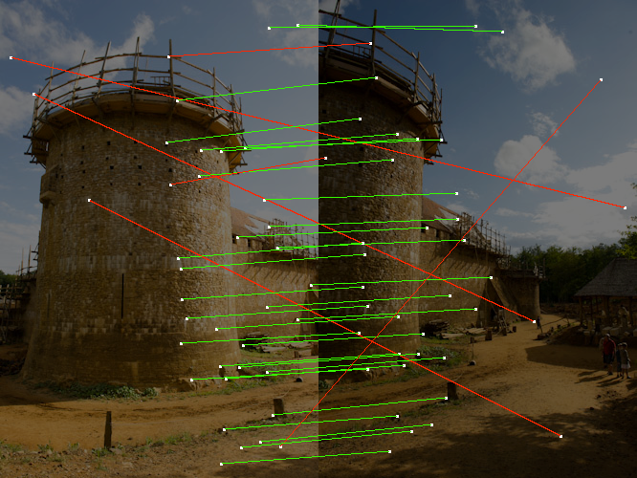

Slide 42
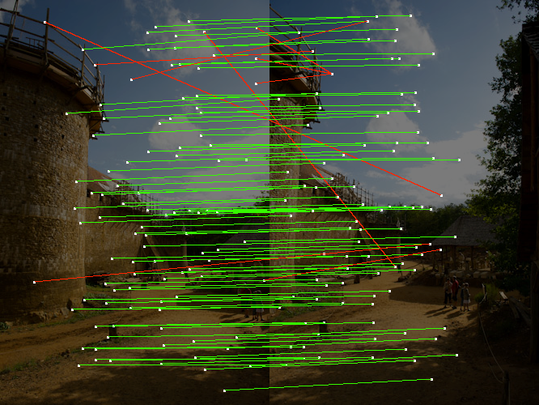

Slide 43
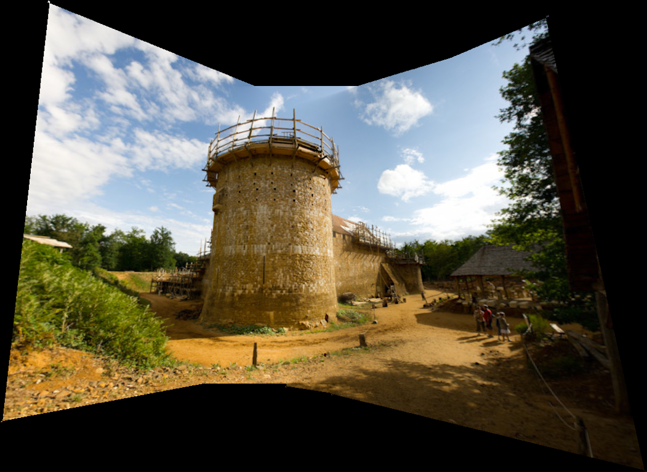

Slide 44
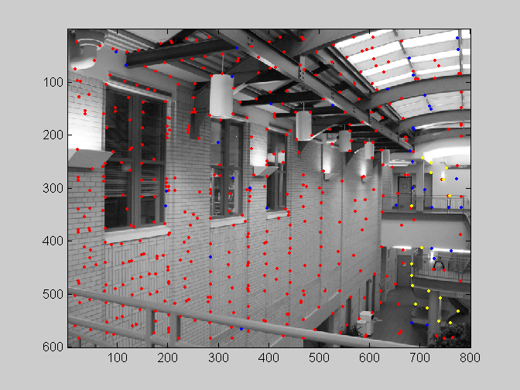
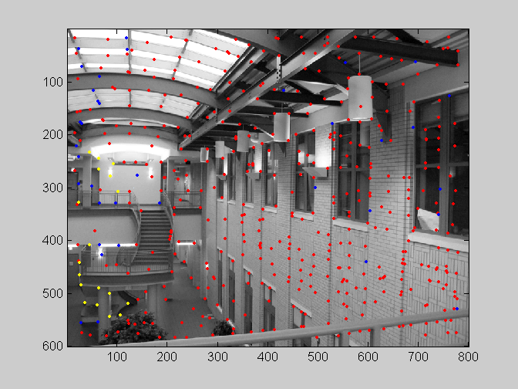
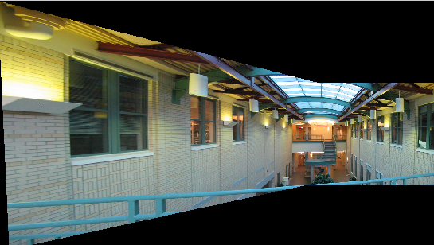
RANSAC
red:
  rejected by 2nd nearest neighbor criterion
blue:
  Ransac outliers
yellow:
  inliers

Slide 45
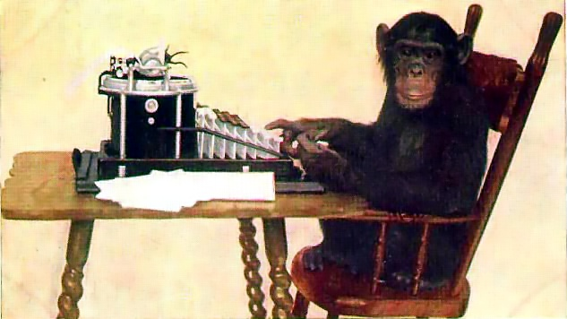
Questions?
http://en.wikipedia.org/wiki/Infinite_monkey_theorem

Slide 46
Probabilistic analysis

Slide 47
Robustness - problem statement

Slide 48
Robustness
For now, assume we know proportion of inliers in our pairs is X
Our model needs P pairs
  P=4 for homography
Probability that after N RANSAC iterations we succeed?

Slide 49
Probabilities
Failure vs. Success
AND vs. OR

Slide 50
Robustness
Proportion of inliers in our pairs is X
Our model needs P pairs
  P=4 for homography

Slide 51
Robustness
Proportion of inliers in our pairs is X
Our model needs P pairs
  P=4 for homography
Probability that we pick P inliers?
  X^{P}
Probability that after N RANSAC iterations we have not picked a set of inliers?
  (1-X^{P})^{N}

Slide 52
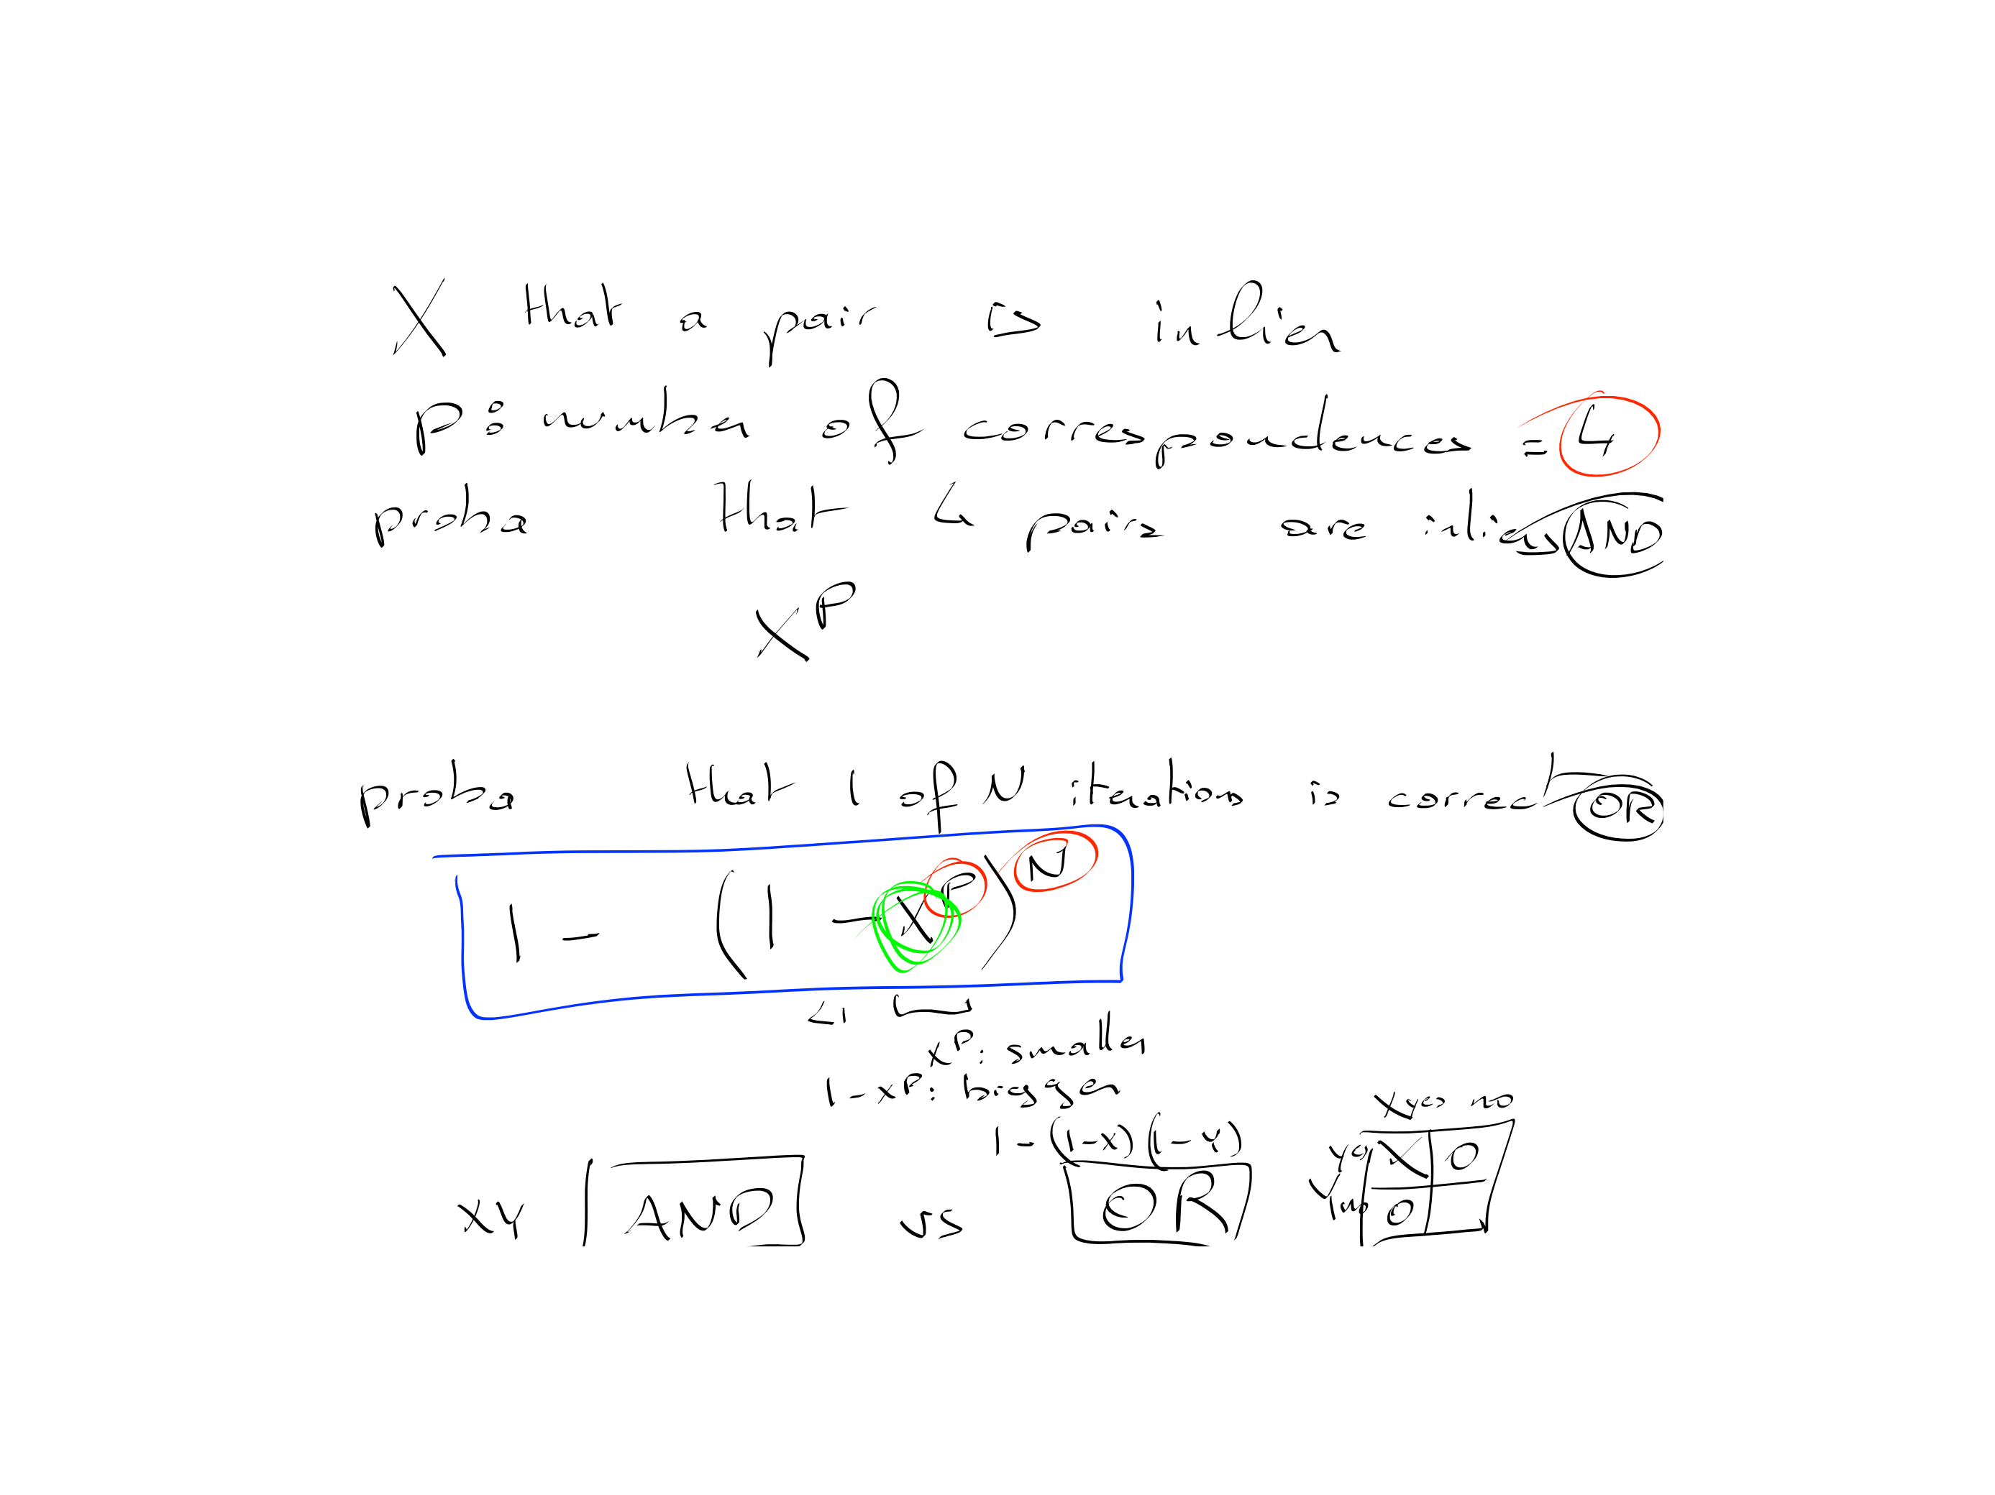

Slide 53
Robustness: example
  Matlab: p=4; x=0.5; n=1000; (1-x^p)^n
Proportion of inliers X=0.5
Probability that we pick P=4 inliers?
  0.5⁴=0.0625 (6% chances)

Slide 54
Robustness: example
  Matlab: p=4; x=0.5; n=1000; (1-x^p)^n
Proportion of inliers X=0.5
Probability that we pick P=4 inliers?
  0.5⁴=0.0625 (6% chances)
Probability that we have not picked a set of inliers?
  N=100 iterations:
  (1-0.5⁴)¹⁰⁰=0.00157 (1 chance in 600)
  N=1000 iterations:
  1 chance in 1e28

Slide 55
Robustness: example
Proportion of inliers X=0.3
Probability that we pick P=4 inliers?
  0.3⁴=0.0081 (0.8% chances)
Probability that we have not picked a set of inliers?
  N=100 iterations:
  (1-0.3⁴)¹⁰⁰=0.44 (1 chance in 2)
  N=1000 iterations:
  1 chance in 3400

Slide 56
Robustness: example
Proportion of inliers X=0.1
Probability that we pick P=4 inliers?
  0.1⁴=0.0001 (0.01% chances, 1 in 10,000)
Probability that we have not picked a set of inliers?
  N=100 iterations: (1-0.1⁴)¹⁰⁰=0.99
  N=1000 iterations: 90%
  N=10,000: 36%
  N=100,000: 1 in 22,000

Slide 57
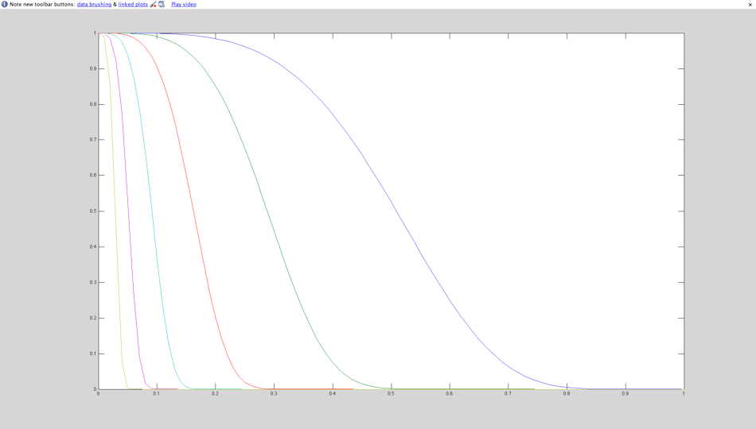
Graph
probability
to fail
N=10 iter.
100 iter.
1000
iter.
10⁴
iter.
10⁶
iter.
10⁵
iter.
percentage of inliers X

Slide 58
Robustness: conclusions
Effect of number of parameters of model/number of necessary pairs
  Bad exponential
Effect of percentage of inliers
  Base of the exponential
Effect of number of iterations
  Good exponential

Slide 59
RANSAC recap
For fitting a model with low number P of parameters (8 for homographies)
Loop
  Select P random data points
  Fit model
  Count inliers
  (other data points well fit by this model)
Keep model with largest number of inliers

Slide 60
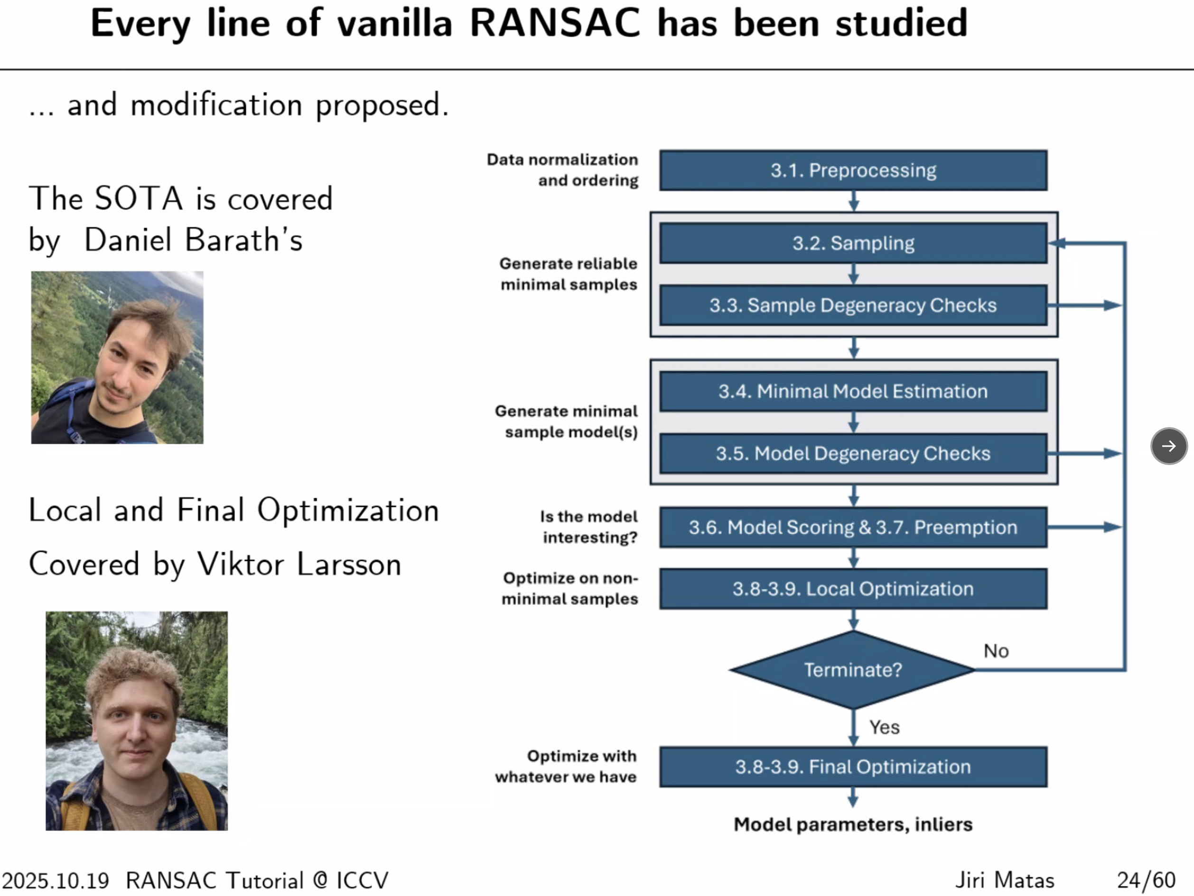

Slide 61

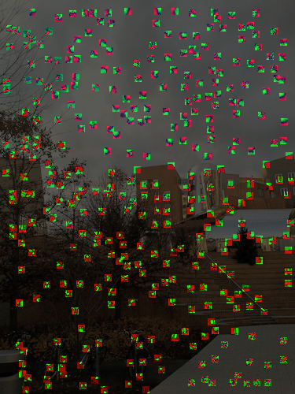
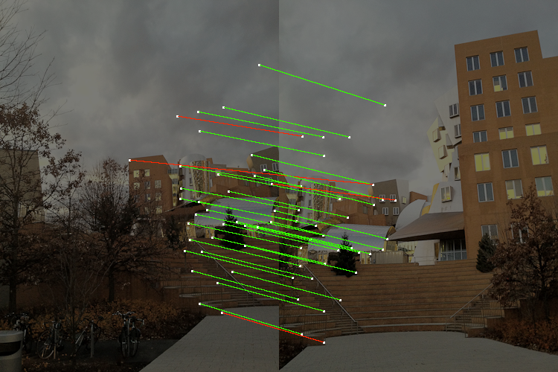
Recap: Auto pano
Extract Interest points (Harris coner)
Match with descriptors (9x9 patches)
Second-Nearest-Neighbor test rejects bad matches
RANSAC fits homography, robust to outliers

Slide 62
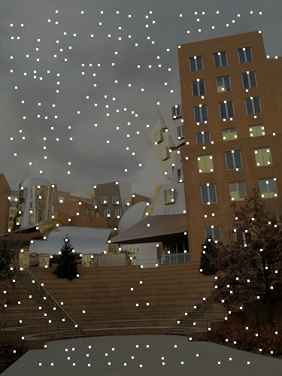
Extract Interest points (Harris)

Slide 63
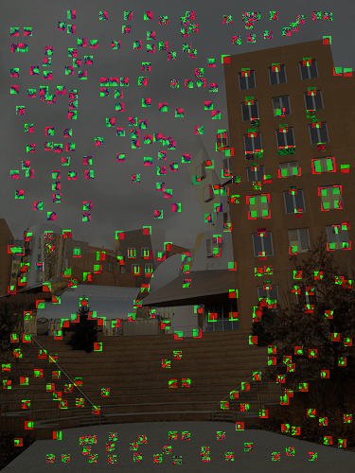
Descriptors

Slide 64
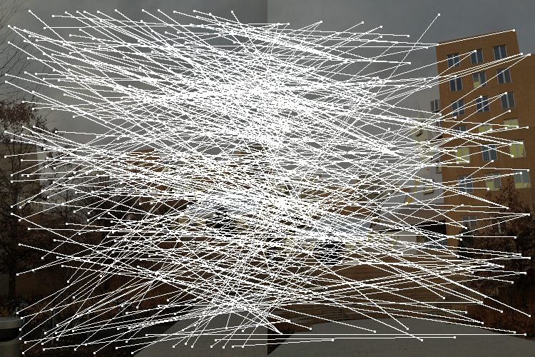
After NN match

Slide 65

After match & 2NN test

Slide 66
After Ransac

Slide 67
Result with blending

Slide 68
Mini break

Slide 69
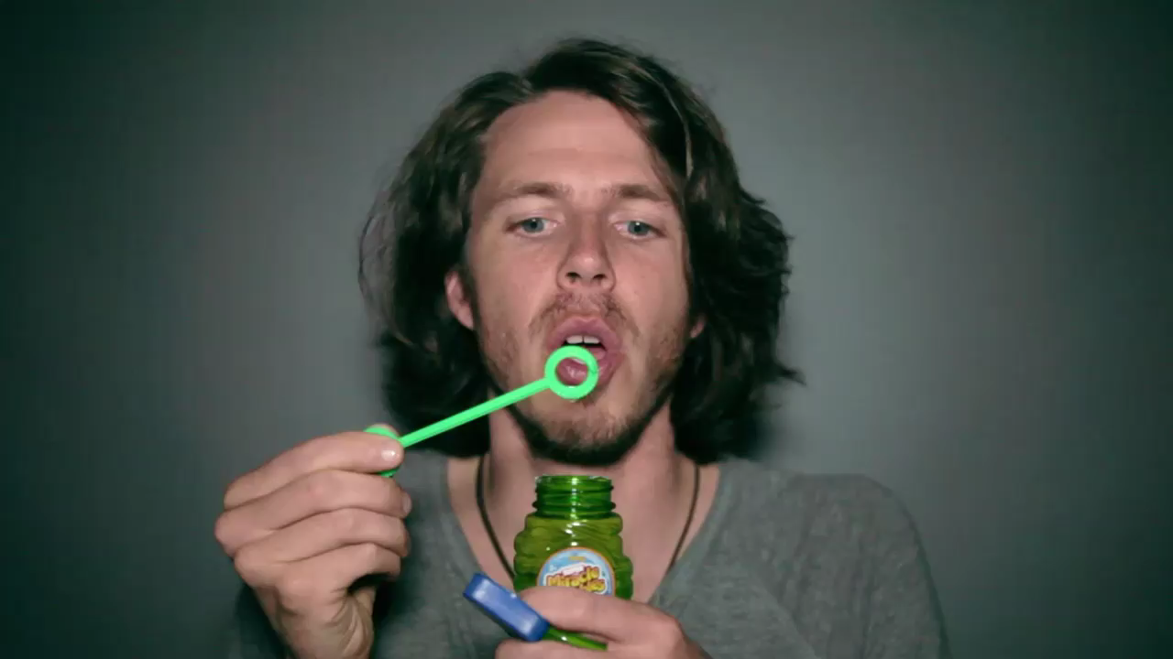
More fun with homographies
Frame of Mind from Steven Alan http://vimeo.com/38940289
http://www.youtube.com/watch?v=TOnif6BC0kc&feature=youtu.be

Slide 70
Blending

Slide 71
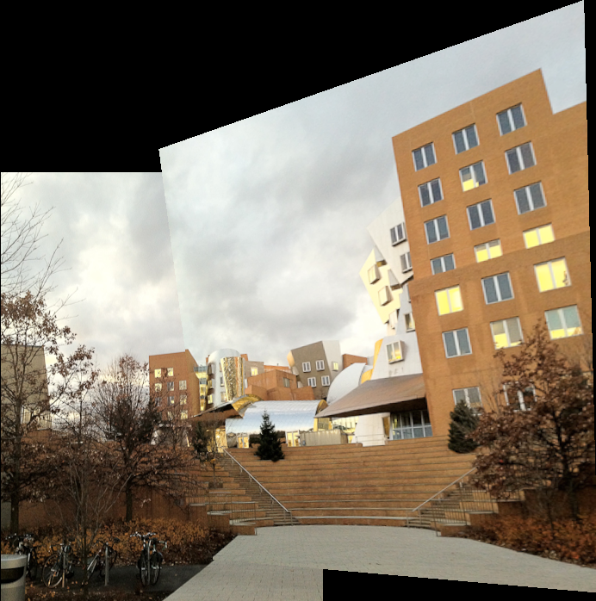
The problem

Slide 72
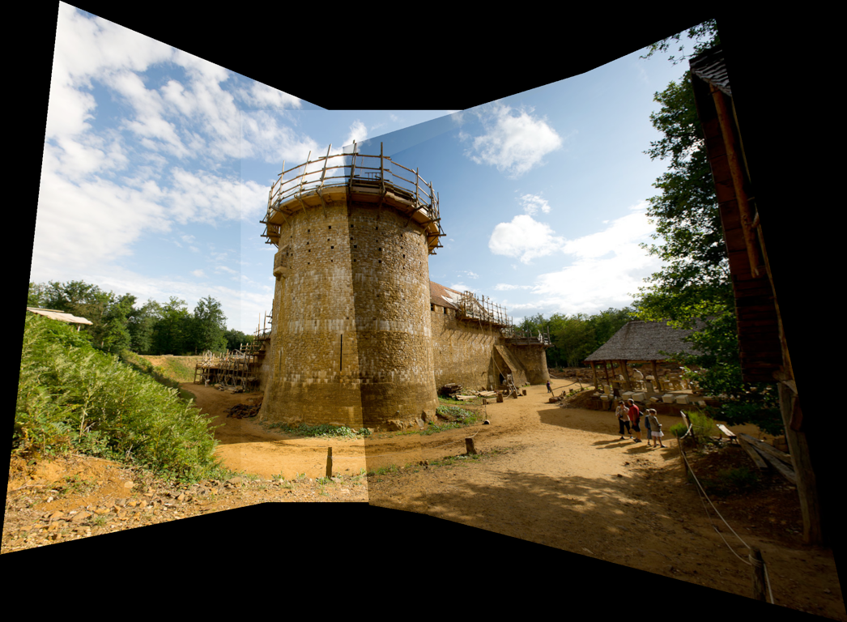
The problem

Slide 73
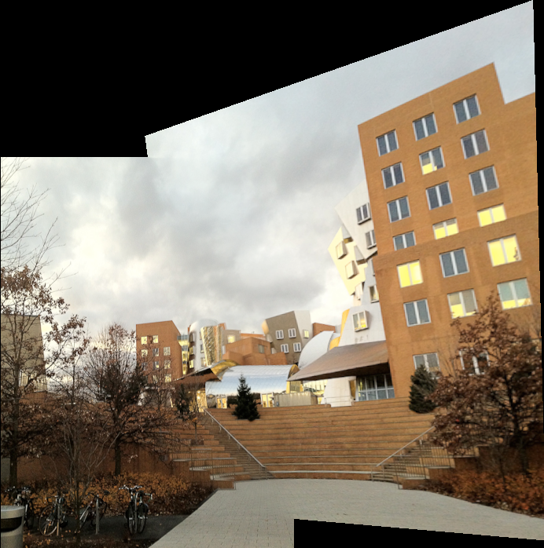
Solution 1: smooth blending

Slide 74
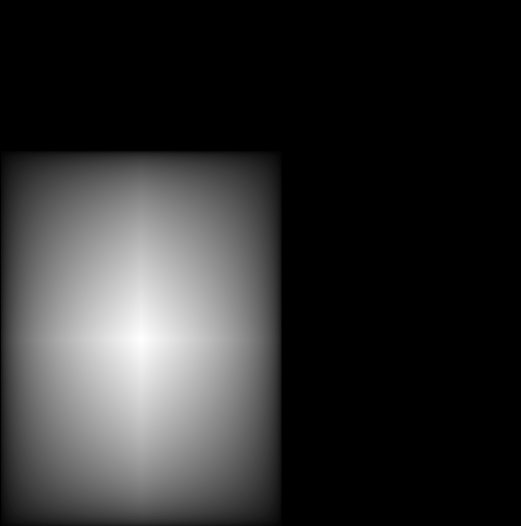
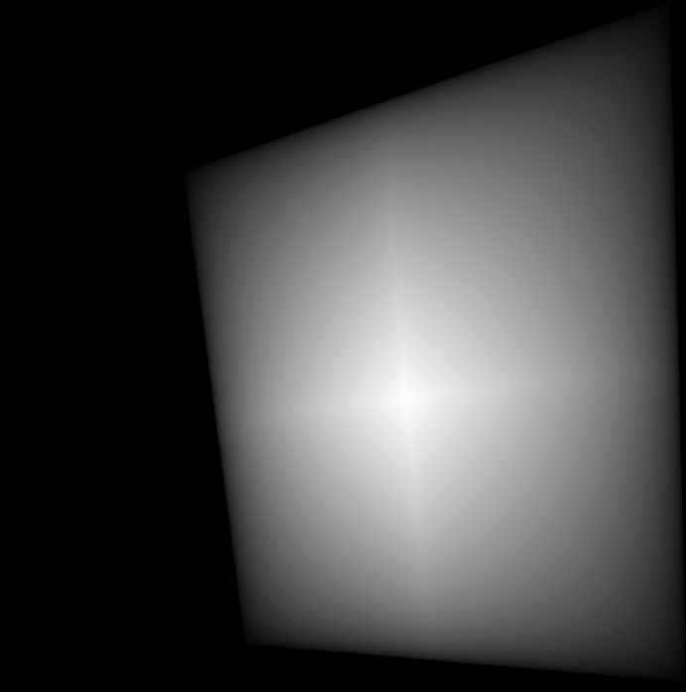
Solution 1: smooth blending
Each output pixel is weighted average of images
Weight depends on distance to source boundary
Weights of image 1
Weights of image 2

Slide 75

Computing distance
Complex in output image because of homography
But easy in the source space

Slide 76
Weights
Separable in y and x
Piecewise-linear
1 in the middle, 0 at boundary
1
0
0
0
1
0

Slide 77
Keep track of sum of weights
My advice: have an extra image that maintains the sum of the weights for each pixel.

Slide 78
Basic reprojection

Slide 79
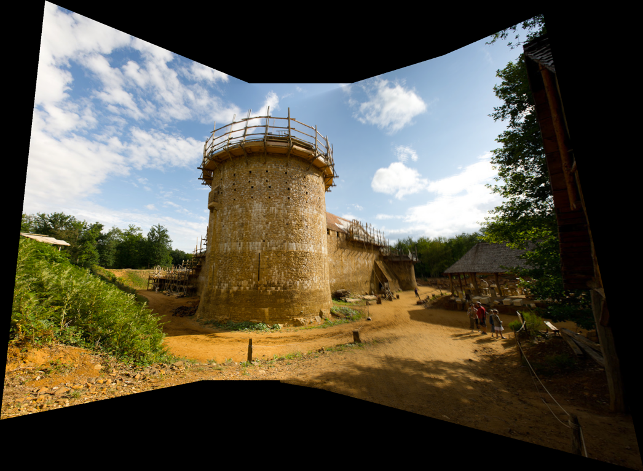
Smooth blending

Slide 80

Smooth blending: problem
Smooth blending

Slide 81
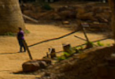
Smooth blending: problem
Smooth blending
Basic reprojection

Slide 82
Smooth blending: problem
Ghosting
Blurring
Smooth blending
Basic reprojection

Slide 83
Two-scale Blending

Slide 84
Lessons learnt
Basic reprojection has transition issues
Smooth blending leads to ghosting & blurring
Smooth blending
Basic reprojection
Basic reprojection

Slide 85
Solution: multiscale
Combine smooth and abrupt transition
Depending on scale:
  smooth for low frequencies
    Corrects effects like vignetting or exposure differences
  abrupt for high frequencies
    preserve sharpness, avoids duplicated objects

Slide 86
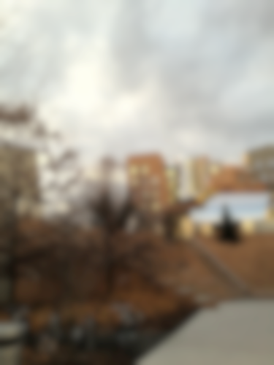
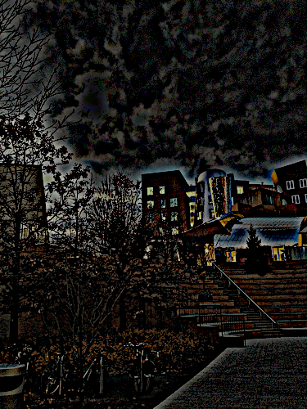
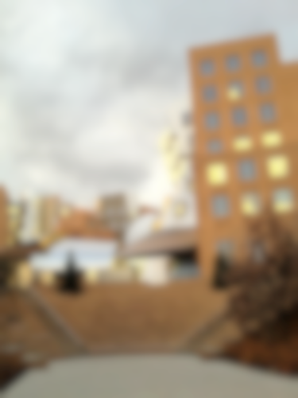
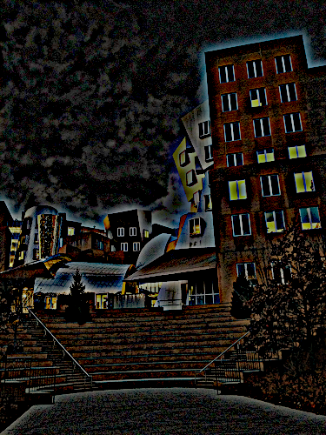
2-scale separation
Use Gaussian blur to split
=
+
=
+

Slide 87
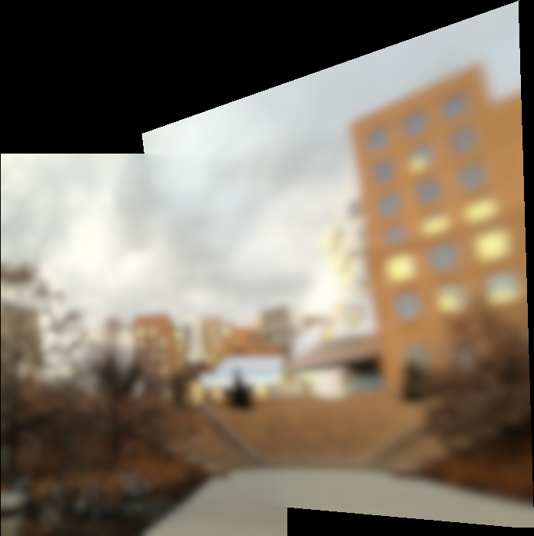
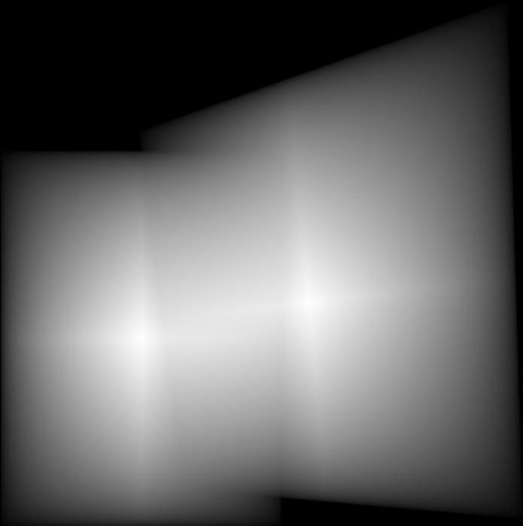
Low frequency: smooth blending

Slide 88
Low frequency: smooth blending
Low frequencies
(sum of) Weights

Slide 89
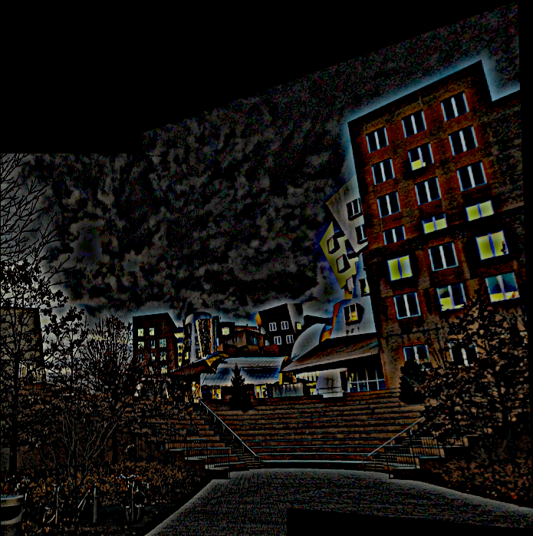
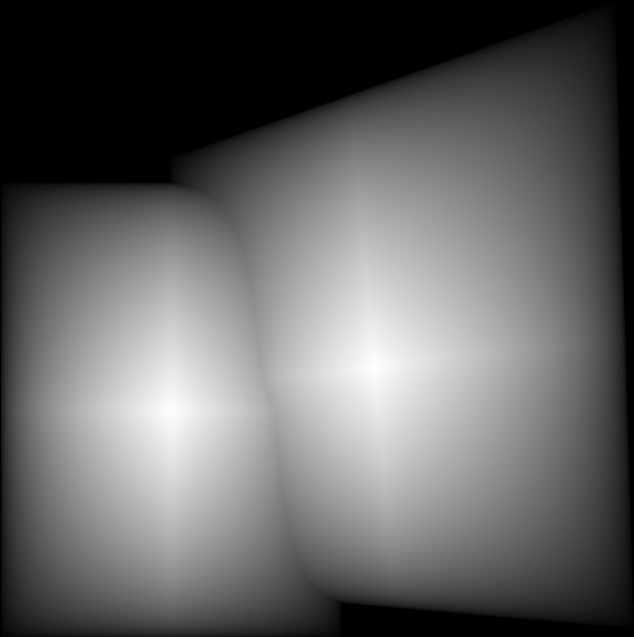
High frequency: abrupt

Slide 90
High frequency: abrupt
For a pixel, only keep the source value with the highest weight
High frequencies
Max weights

Slide 91
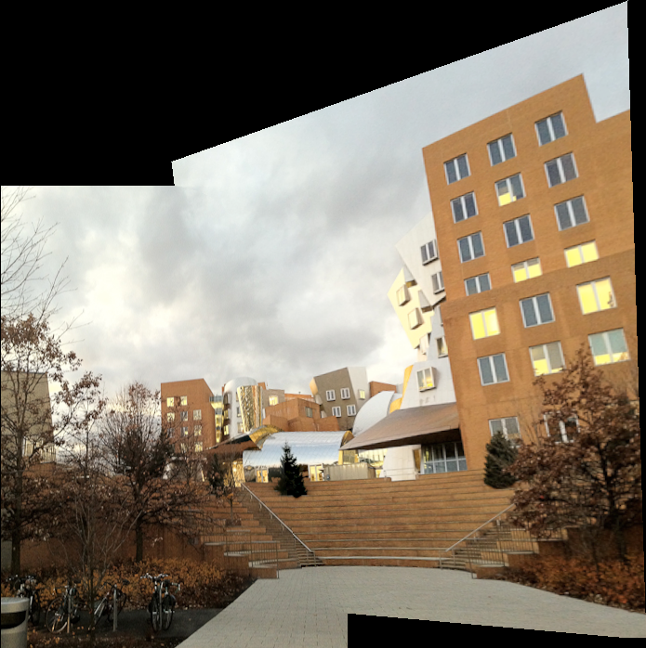
2-scale separation

Slide 92
Result

Slide 93
Basic reprojection

Slide 94
Smooth blending

Slide 95

2-scale blending

Slide 96

Comparison
Smooth blending
2-scale
Basic reprojection

Slide 97


Multiscale blending
Proposed by Adelson and Burt
  http://persci.mit.edu/pub_pdfs/spline83.pdf
Simplified to two scales by Brown and Lowe
  http://cs.bath.ac.uk/brown/papers/iccv2003.pdf

