Slide 1
High-Performance Image Processing
Frédo Durand
MIT CSAIL
many slides
by Jonathan Ragan-Kelley
Notes:
Hi. Thanks for having me, and thanks for coming.

Slide 2
The Grading System…

Slide 3

Rainbows

Slide 4
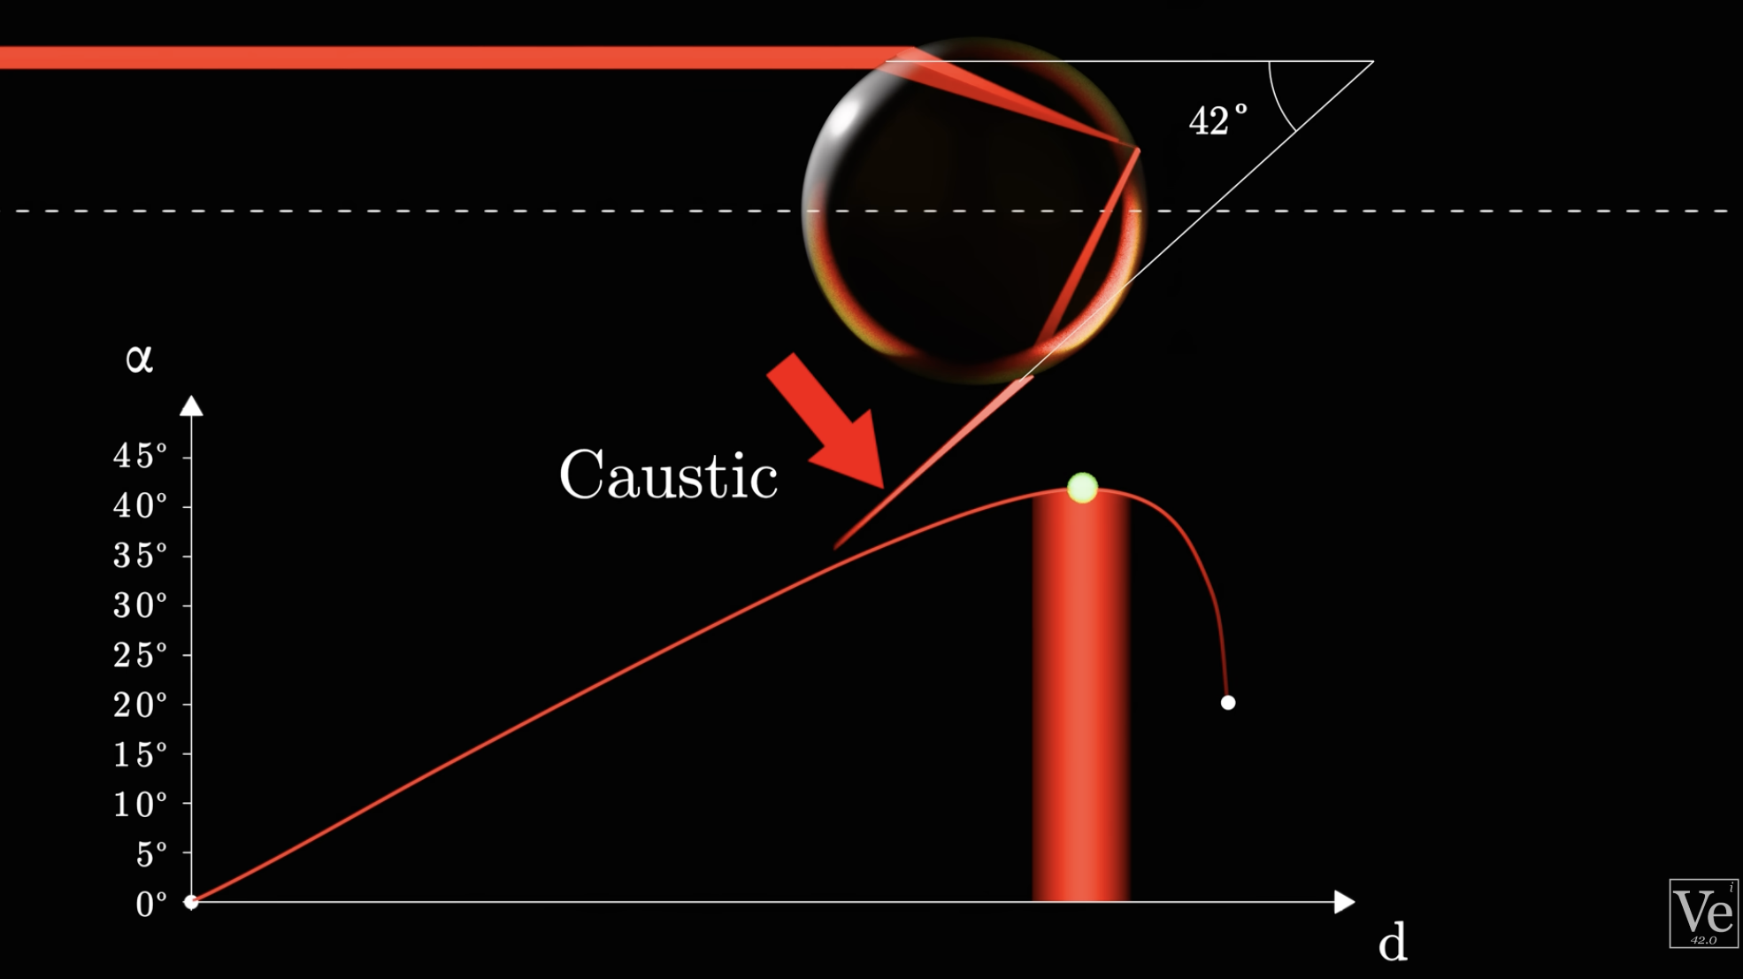
Who has seen the Veritassium video?

Slide 5

To answer an old question

Slide 6


Slide 7
Image alignment for denoising

Slide 8
Talk by Jonathan Ragan-Kelley
Creator of Halide
Tomorrow Wednesday April9 at 4pm in Kiva

Slide 9
Show more vectorization code
  also confused between simd and mimd
define terms like multithreading
  do some theoretical paralelism gain calculation (# tiles is NOT the speedup)
types are not trivial (stricter than C)
  integer division
Start directly with live coding, without even introduceng much syntax (maybe just say it’s functional and most loops are implicit.)
Add measurements of arithmetics and memory costs (pure read cost, pure arithmetic cost.)

Slide 10
Stuff you do that slows things down

Slide 11
Profiling

Slide 12
TODO
Explain templates
Explain select early
simplify set

Slide 13
Explain modern hardware architecture
  simd
  multicore
  memory hierarchy

Slide 14
TODO
teach inputs param
teach how to schedule stuff. maybe show many examples
maybe start earlier with concrete examples, explore schedules using halide, show performance tradeoffs and discuss issues such as locality and parallelism.
add long examples, e.g. camera pipe
start more rapidly with Halide. Then illustrate tradeoffs with actual schedules and numbers
have a more concrete intro to high-performance code writing and the various issues.

Slide 15
Andrew’s favorite schedule
fwiw I think tiling is over-rated. My favorite schedule for stencils
these days is something like:
consumer.split(y, yo, yi, 16).parallel(yo).vectorize(x, 4).unroll(x, 2)
producer.store_at(consumer, yo).compute_at(consumer, yi).vectorize(x,
4).unroll(x, 2)
I guess you could argue that this is just using tiles that are the
full width of the image, and it's better to use tiles of a fixed known
size to have a more predictable cache behavior. In practice that never
seems to matter, and instead you want to stay in the tight unrolled
vectorized inner loop for a long time, which means very wide tiles.
The important bit for locality is the sliding window optimization of
the producer within each tile. As long as a couple of scanlines fit in
L1 you're good
The unroll is unimportant but sometimes helps a bit.

Slide 16
more about compute_at
tiling needs interleaving
you can’t tile if you’re inline
producers of non-local consumers

Slide 17


Lytro
The best scenes have large depth variation, and an interesting close foreground
You might need to use the “creative mode”
See https://pictures.lytro.com/ for inspiration

Slide 18
Speed
Our code is slow
  Often minutes of computation for small images

Slide 19
Simple box blur
6.4 seconds
per megapixel
def box_x(im):
w,h=im.shape[1],im.shape[0]
out = numpy.empty([h, w])
for y in xrange(1,h-1):
for x in xrange(1,w-1):
out[y,x]=(im[y,x-1]+im[y,x]+im[y,x+1])/3.0
return out
def box_y(im):
w,h=im.shape[1],im.shape[0]
out = numpy.empty([h, w])
for y in xrange(1,h-1):
for x in xrange(1,w-1):
out[y,x]=(im[y-1,x]+im[y,x]+im[y+1,x])/3.0
return out
def blur(im):
return box_y(box_x(im))

Slide 20
Speed
Our code is slow
  Often minutes of computation for small images
Professional code is very fast
  e.g. Lightroom processes megapixels images in real time
  Why?

Slide 21
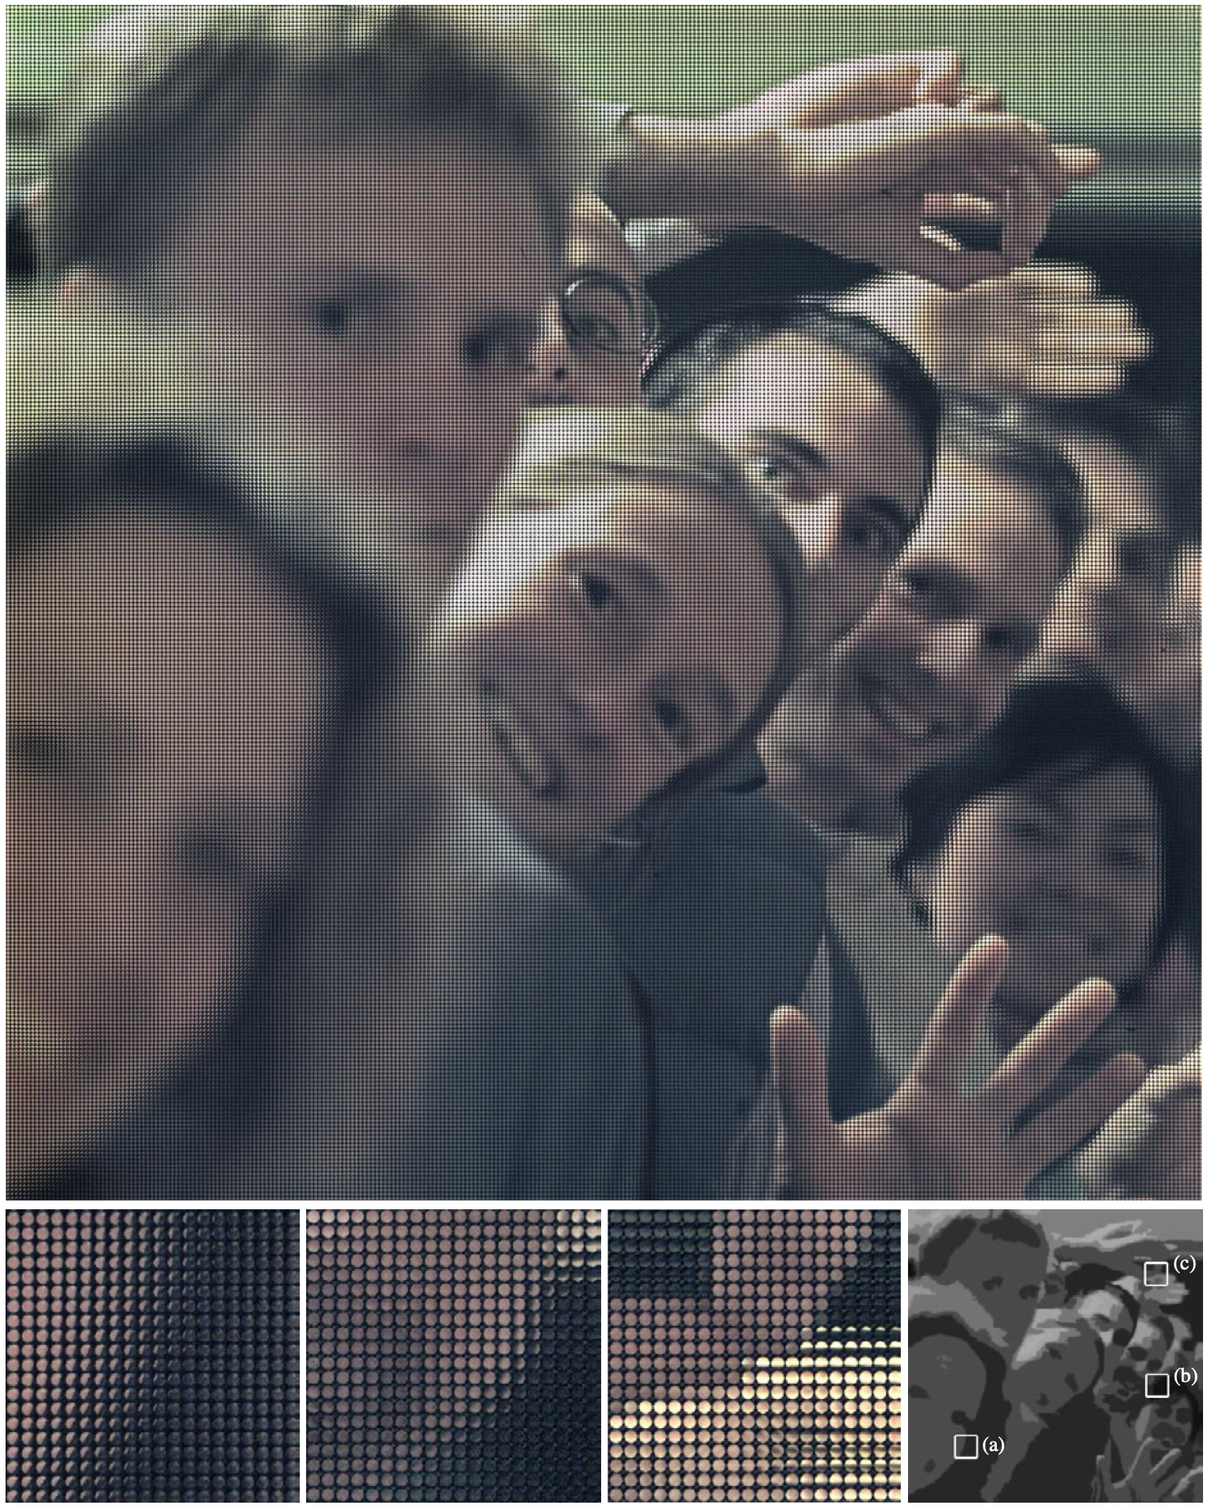
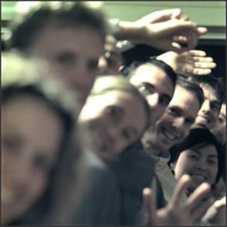
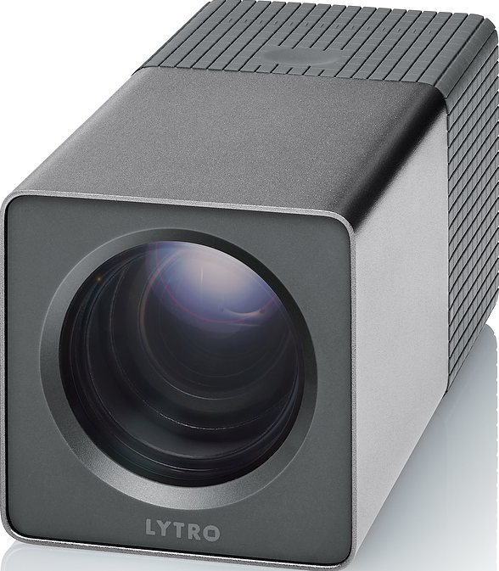
4D lightfields: orders of magnitude from “good enough”
Current Lytro
10 Mrays
<1 Mpixels
5 secs (on desktop PC)
Scale to 4k video
100 Mrays
8 Mpixels
1 min/frame (on desktop PC)
1 hour to process
1 second of video
[Ng 2005; Ng et al. 2006]
images by Ren Ng, Lytro
Notes:
Lightfield cameras are exciting.
By capturing and computationally re-integrating a 4D array of light,
- you can refocus photographs after they’re taken,
correct for aberrations in the lens,
and extract high quality depth from a single shot.
But if we wanted to produce 8 megapixel, 4K lightfield video at 60 frames per second,
current software would take an hour to for each second of lightfield video.

Slide 22

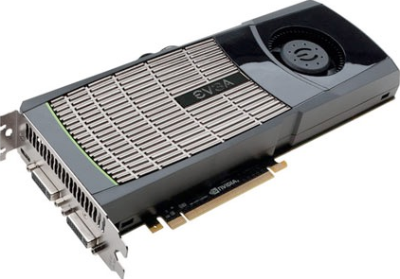

Rendering: orders of magnitude from “good enough”
Modern game:
Team Fortress 2
2 Mpixels
0.5 Mpolys
10 ms/frame
10 ms
CG movie:
5 hrs
Tintin, Avatar
8 Mpixels
5 Gpolys
5 hrs/frame
6 orders of magnitude
more computation
images by Valve, Weta
Notes:
In rendering, even using the same GPU’s used to play PC games,
a movie frame is still six orders of magnitude from real-time.

Slide 23
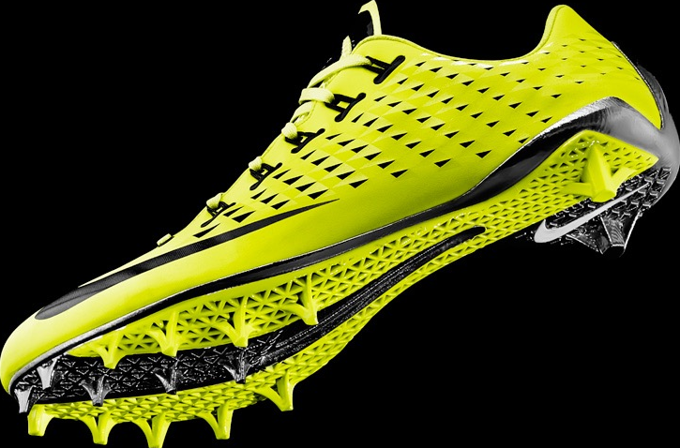
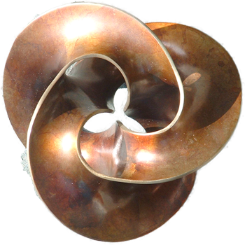
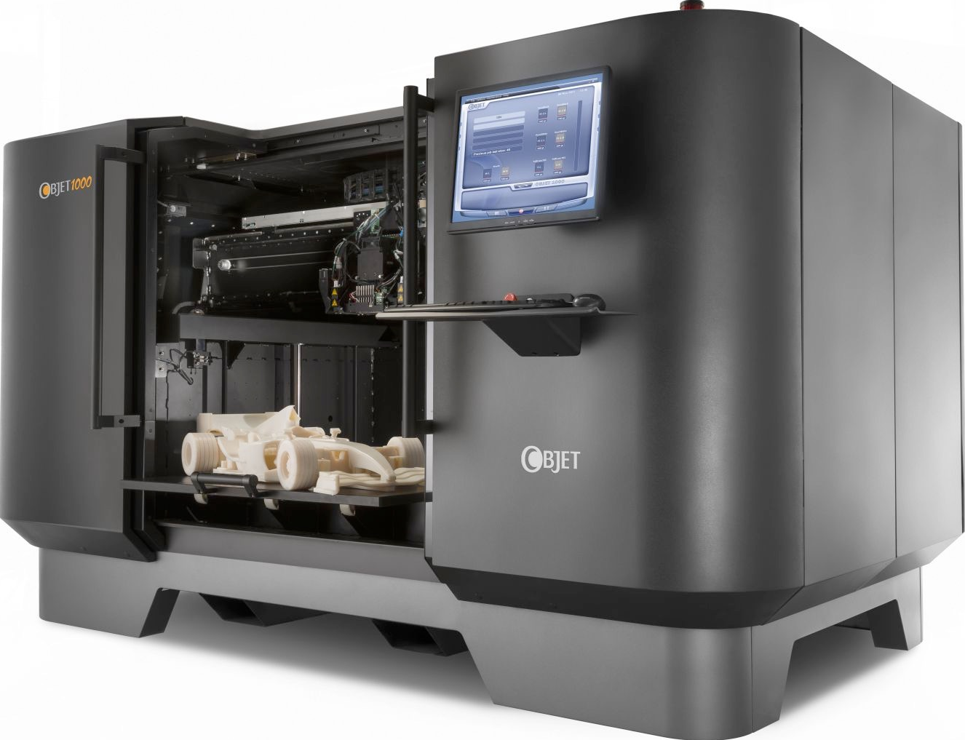
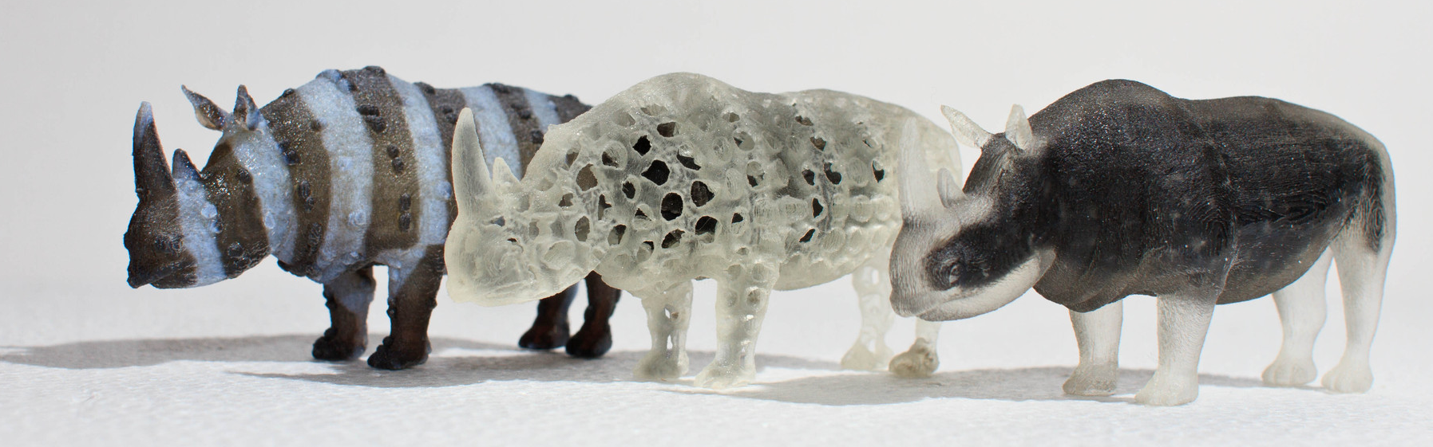
3D printing: orders of magnitude from “good enough”
1500 cm³ shoe, 10 µm detail, 16 materials
2500³ DPI
10¹² voxels
25 terabytes
10 shoes/hour =
4B voxels/sec
Notes:
Multi-material 3D printing has huge potential to transform everything from art,
like the sculptures Carlo Sequin makes,
to manufacturing.
But to directly print production-quality quality objects,
we’d need about a trillion voxels in something the size of this shoe.
The printing hardware is almost ready to do this,
but it's a ton of computation and data.
- If we wanted to finish 10 shoes an hour,
we’d need to synthesize over 4 billion voxels per second just to keep the printer busy.

Slide 24




Pervasive sensing: orders of magnitude from “good enough”
Sensor + Read out
5 Mpixels
~1 mJ/frame
☁
transmit
☁
Eulerian Video Magnification [Wu et al. 2012]
LTE radio
50 Mbit/sec
1 W
~1 J/frame
transmission power costs 1,000x capture
Notes:
Always-on image sensors are going to be all around us,
But we need to figure out what to do with the data they produce.
- Just sending it to the cloud isn’t enough,
since the best cellular radio would take at least 1000 times more energy
to send each frame
than we needed to capture it.
---[cut]---
And this isn’t just about pretty stuff.
Another exciting area is pervasive sensing, using imaging to monitor and understand the world.
This example, from my colleagues at MIT, shows how subtle changes in video
- can be amplified to monitor the exact *heart rate*
- and *respiration rate*, without placing any sensors on the baby.
- Vision-based sensing is also going to be central to augmented reality and wearable computing.
We need to radically rethink how we design systems to minimize this expensive communication.

Slide 25
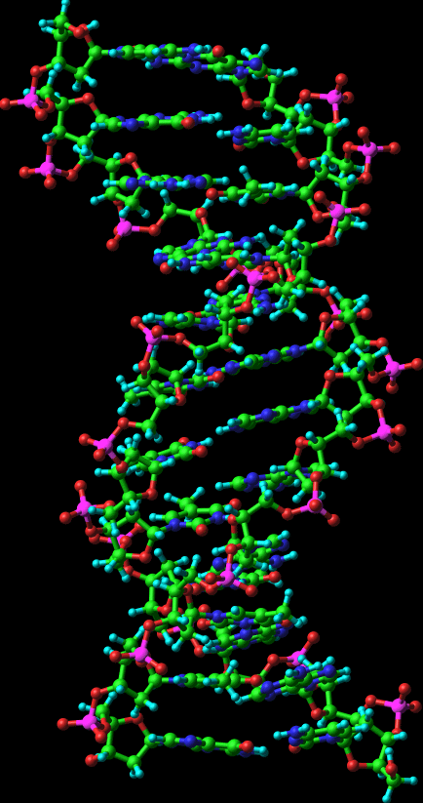
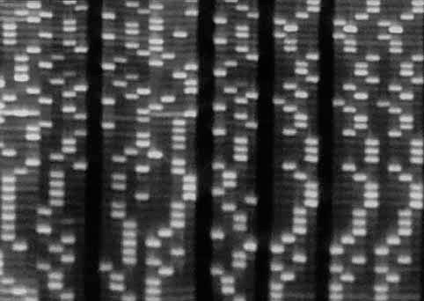
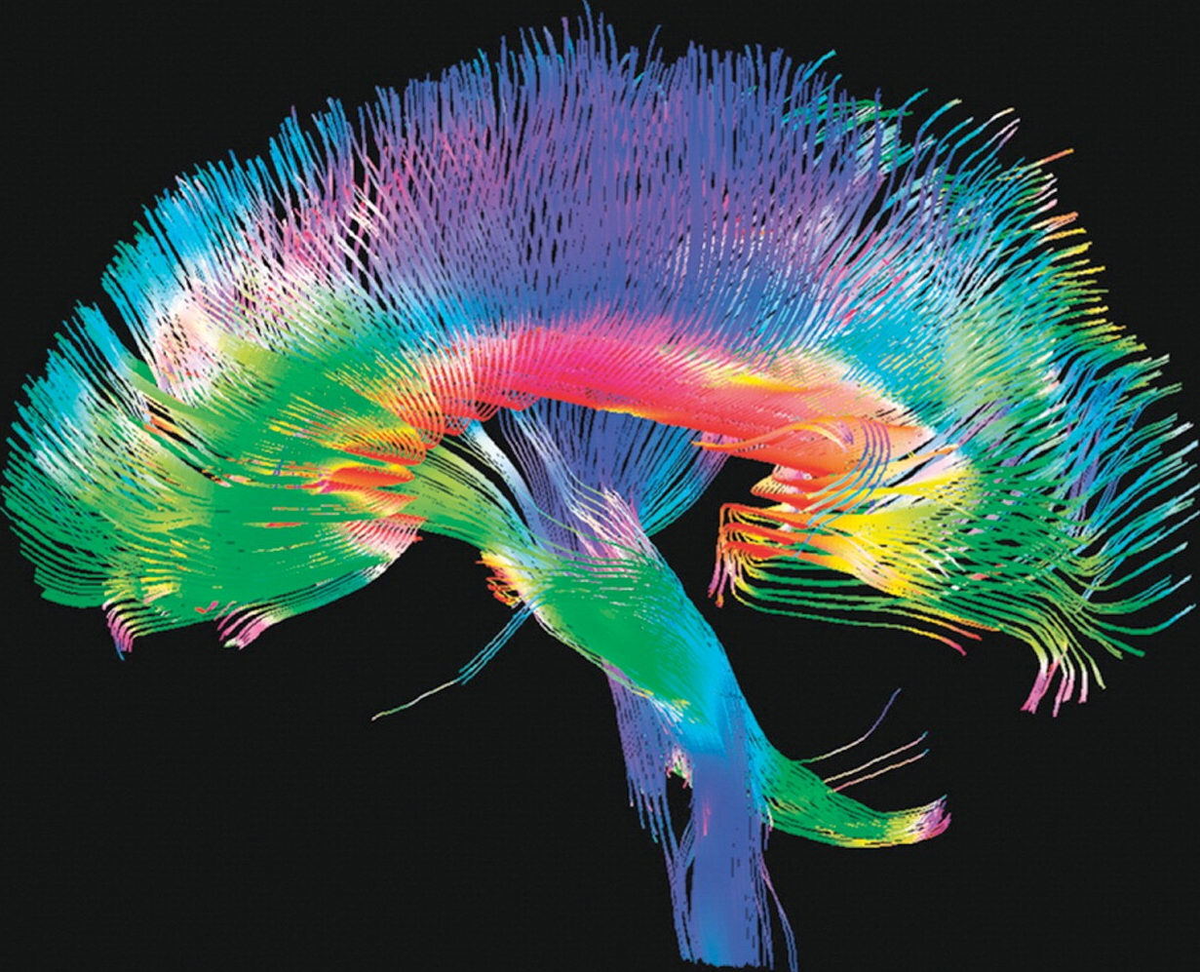
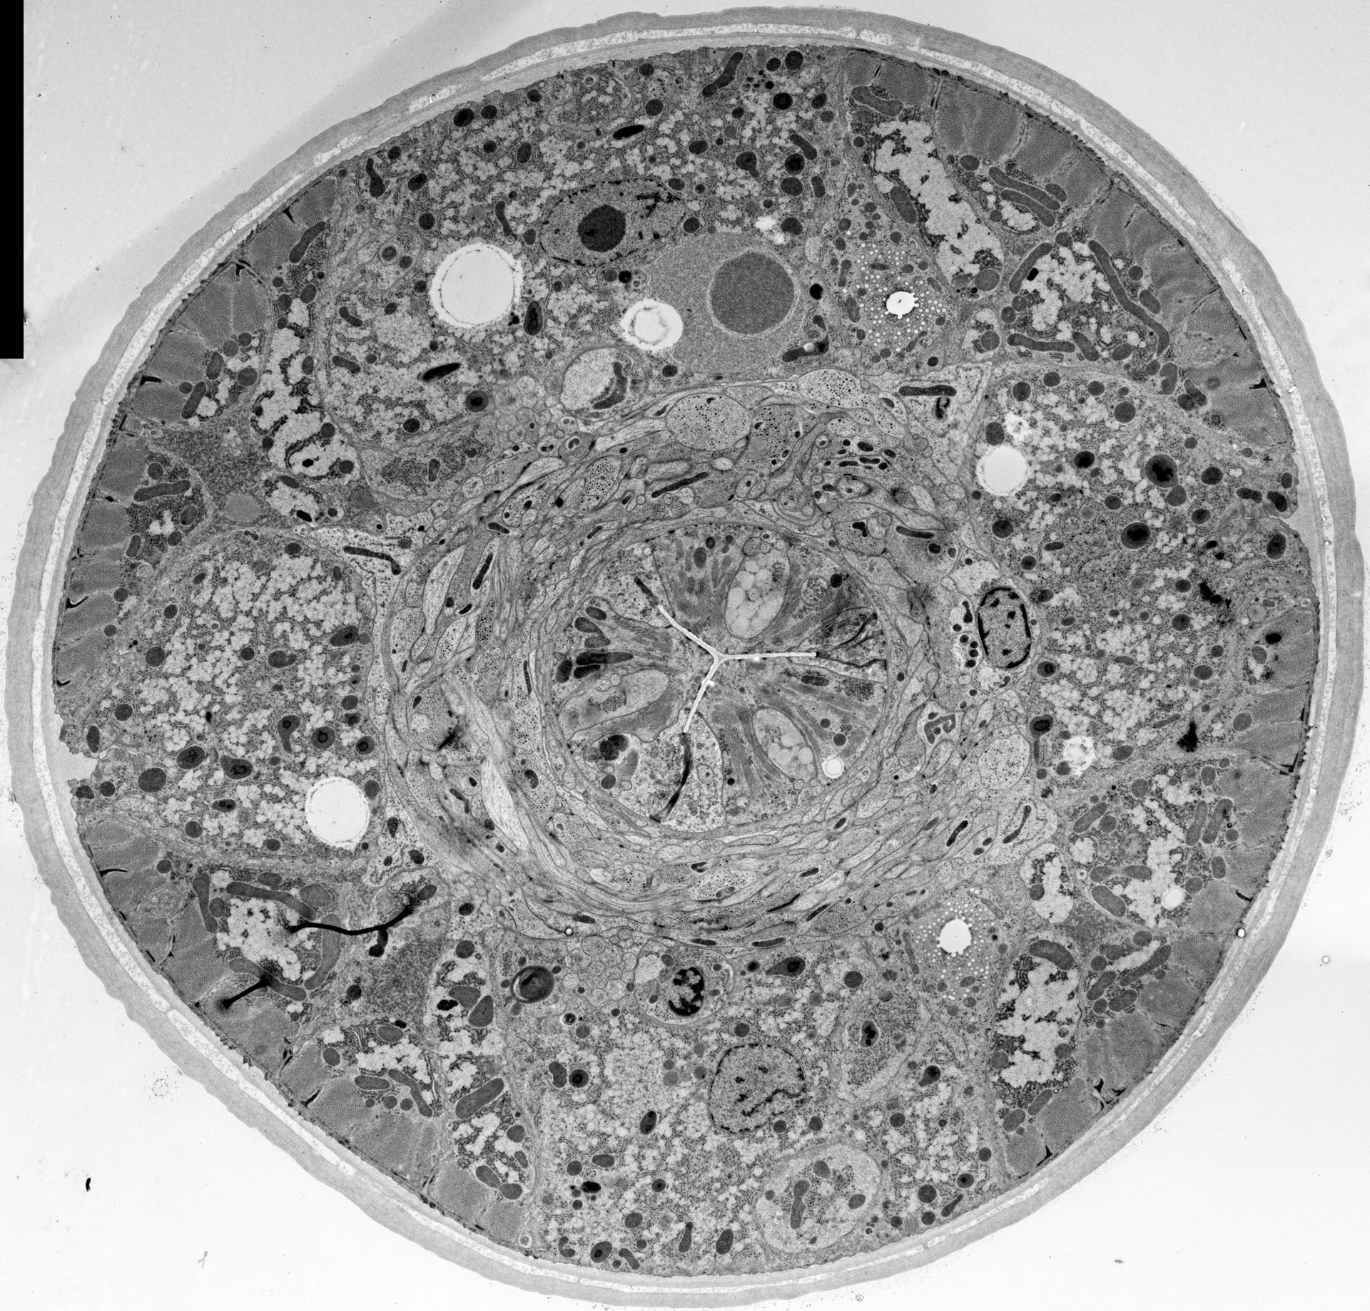
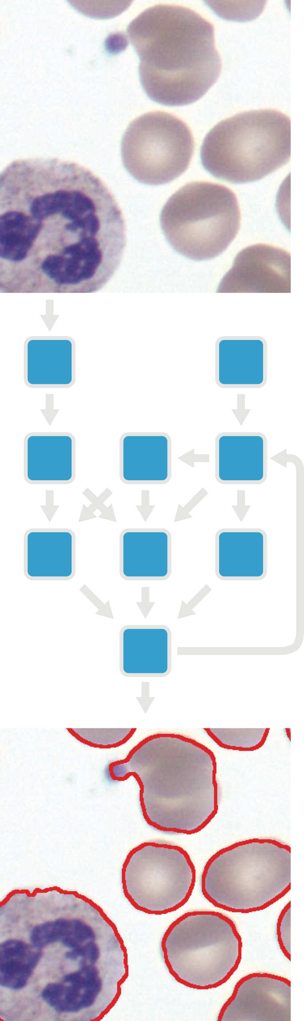
High throughput imaging: orders of magnitude from “good enough”
most sensing is “imaging”
Notes:
These days, most complex sensing uses imaging under the hood.
From high throughput gene sequencing,
to automated cell biology experiments,
to neural scanning and and connectomics.
Today, it takes a large supercomputer just to process the scan
of a single cubic millimeter of mouse brain.
But there’s hope that major increases in throughput
will eventually let us scan and study the connections in an entire human brain

Slide 26
Your data-intensive problem here…
Notes:
Really, lots of what I’m going to say applies to almost any data-intensive application,
not just those involving pixels.
---[cut]---
All these applications need orders of magnitude more computational power and energy efficiency to reach their potential.

Slide 27
Making image processing faster

Slide 28
Making image processing faster
Faster algorithms
  e.g. separable blur, FFT, recursive, bilateral grid
Faster Hardware
  More GHz, bigger better CPU/GPUs

Slide 29
Making image processing faster
Faster algorithms
Faster Hardware
Better leverage Existing Hardware
  Remove unnecessary operations
    e.g. if statements in loops, memory copy
  Parallelism
  Memory behavior

Slide 30
Inefficiencies in our/your code
IFs in loops
  Checking image boundaries for each pixel
  test which channel we’re manipulating
Create lots of intermediate images
  e.g. im2=im1*2.0
  vectors of images: copies image each time we access
Some operations are cheaper than others
  divide is more costly than multiply by inverse
Recomputing stuff over and over
  take out of loop, precompute tabulated version

Slide 31
Inefficiencies in our C++ class
Pass by value, create lots of intermediate data
Lots of bound checks

Slide 32
Algorithmic acceleration (not today’s topic though)
Sometimes exact, sometimes approximate
e.g. Fast box blur
  Separable (exact)
  Incremental (3 taps instead of 2*radius, exact)
  (box(x+1)=box(x)+input(x-radius)+input(x+radius+1)
e.g. Bilateral Grid (approximate)
e.g. lookup tables (approximate)
See e.g. Andrew Adams’ slides http://www.stanford.edu/class/cs448f/lectures/2.2/Fast%20Filtering.pdf

Slide 33
Algorithmic acceleration (not today’s topic though)
e.g. Fast Gaussian blur
  Separable (exact)
  Recursive (approximate)
  Iterated Box (approximate)
  FFT (exact up to wraparound)
See e.g. Andrew Adams’ slides
http://www.stanford.edu/class/cs448f/lectures/2.2/Fast%20Filtering.pdf

Slide 34
Faster programming language
Python is slow because it’s interpreted:
Parse (syntax)
  verify syntax
  translate into internal representation
Execute (semantics)
  All this takes time!
  for us, mostly execution

Slide 35
e.g. Norvig’s (very concise) scheme interpreter
def eval(x, env=global_env):
"Evaluate an expression in an environment."
if isa(x, Symbol): # variable reference
return env.find(x)[x]
elif not isa(x, list): # constant literal
return x
elif x[0] == 'quote': # (quote exp)
(_, exp) = x
return exp
elif x[0] == 'if': # (if test conseq alt)
(_, test, conseq, alt) = x
return eval((conseq if eval(test, env) else alt), env)
elif x[0] == 'set!': # (set! var exp)
(_, var, exp) = x
env.find(var)[var] = eval(exp, env)
elif x[0] == 'define': # (define var exp)
(_, var, exp) = x
env[var] = eval(exp, env)
elif x[0] == 'lambda': # (lambda (var*) exp)
(_, vars, exp) = x
return lambda *args: eval(exp, Env(vars, args, env))
elif x[0] == 'begin': # (begin exp*)
for exp in x[1:]:
val = eval(exp, env)
return val
else: # (proc exp*)
exps = [eval(exp, env) for exp in x]
proc = exps.pop(0)
return proc(*exps)
isa = isinstance
Symbol = str
  http://norvig.com/lispy.html

Slide 36
Some interpreters
http://norvig.com/lispy.html
http://www.jayconrod.com/posts/37/a-simple-interpreter-from-scratch-in-python-part-1
http://mitpress.mit.edu/sicp/full-text/book/book-Z-H-26.html#%%5Fsec%5F4.1

Slide 37
Faster programming language
Python is slow because it’s interpreted
Switch to a compiled language
  typically C, C++
  Java is intermediate (just-in-time compilation)
    There are compilers for Python, e.g. pypy
    BTW, numpy code is compiled.

Slide 38
Faster hardware
Faster CPU
  More GHZ
  More parallelism (multicore, SIMD vector-unit). But hard to program
  Better memory bandwidth
Graphics Hardware
  Lots of parallelism
  Can be annoying to program and debug (CUDA)

Slide 39
Modern CPUs - compute & parallelism
Moore’s law, frequency scaling, power
pipeline
multicore
vector
see e.g. 6.172, or http://www.lighterra.com/papers/modernmicroprocessors/

Slide 40
https://imgur.com/a/jbu7I

Slide 41
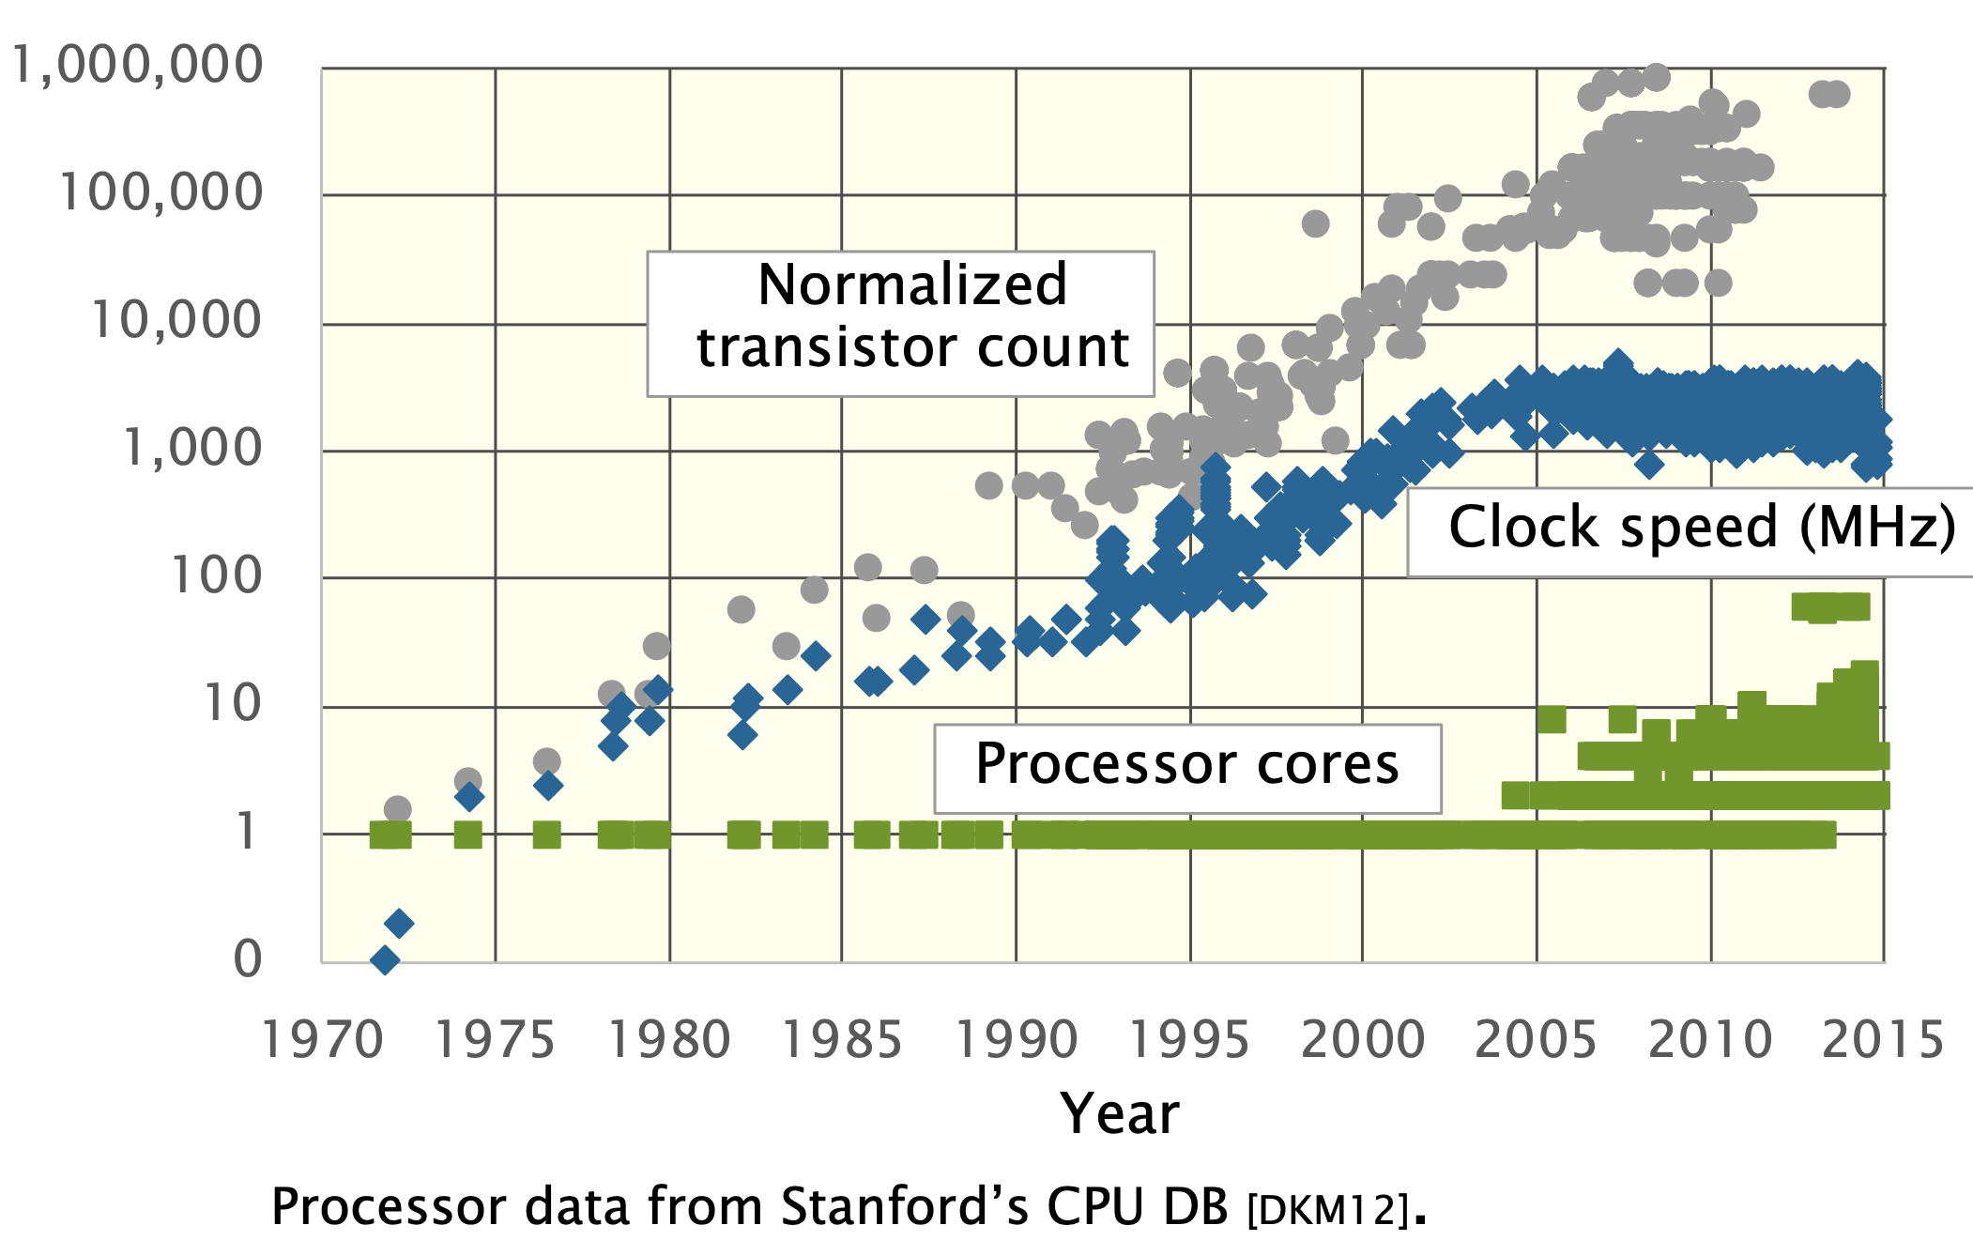

Slide 42
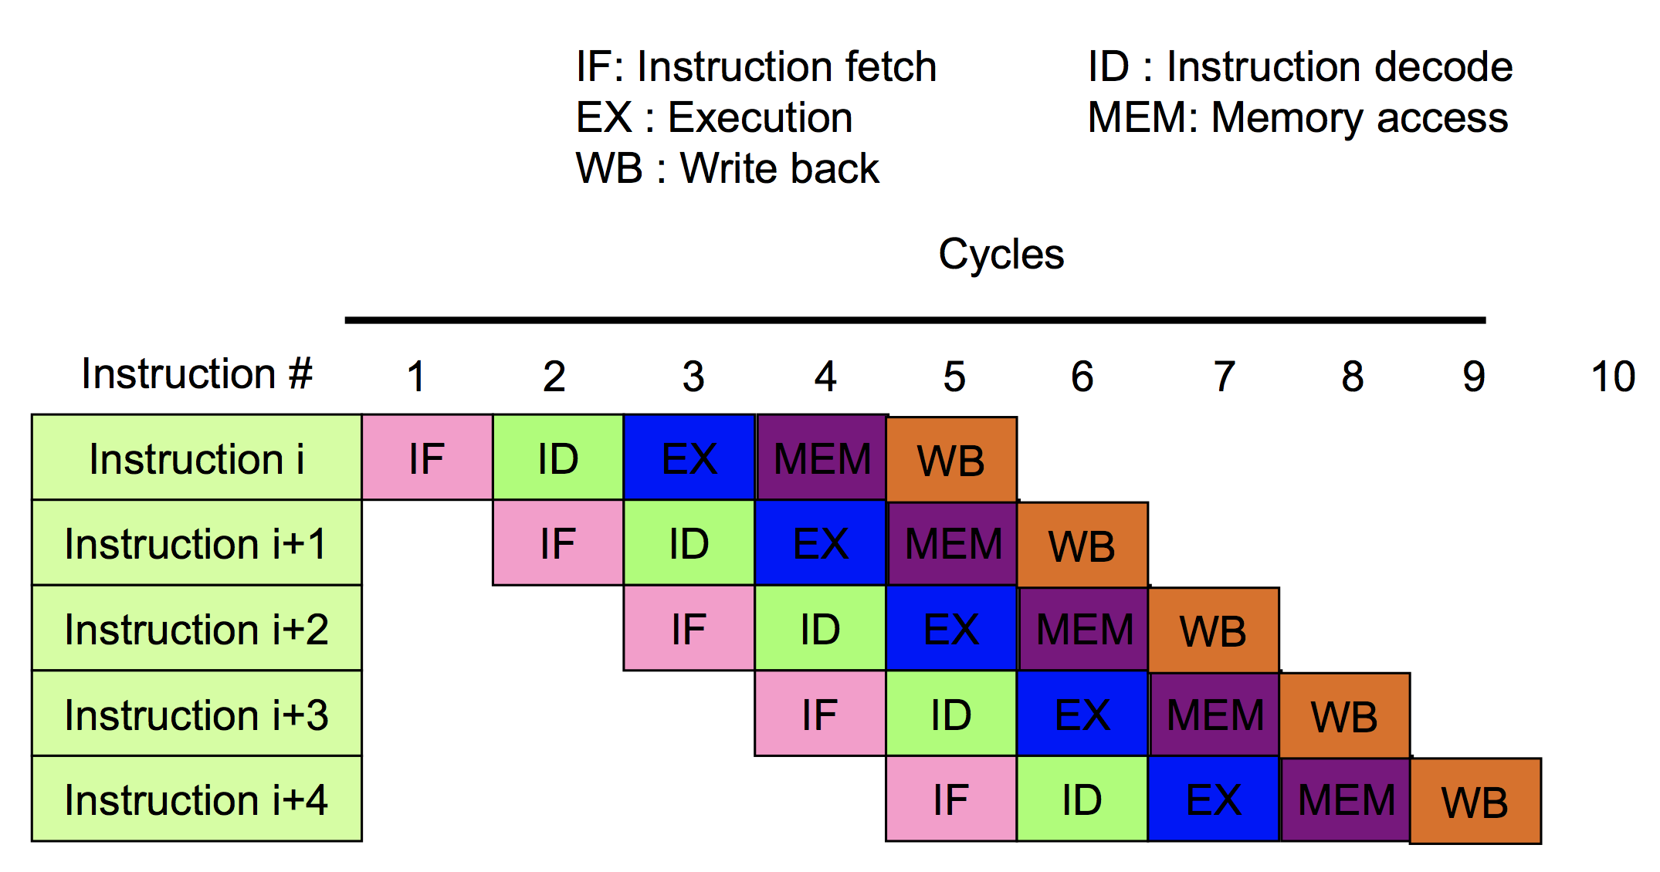
Pipeline (Instruction Level Parallelism)
Limited by dependencies
From 6.172

Slide 43
Superscalar (more ILP)
Multiple instructions at once

Slide 44
Multicore (Skylake here)
Multiple cores perform independent computation
  aka MIMD, Multiple Instructions Multiple Data

Slide 45
Vector units
Perform same operation on multiple data
e.g. add two 3D vectors component by component in parallel
benefit: share control hardware

Slide 46
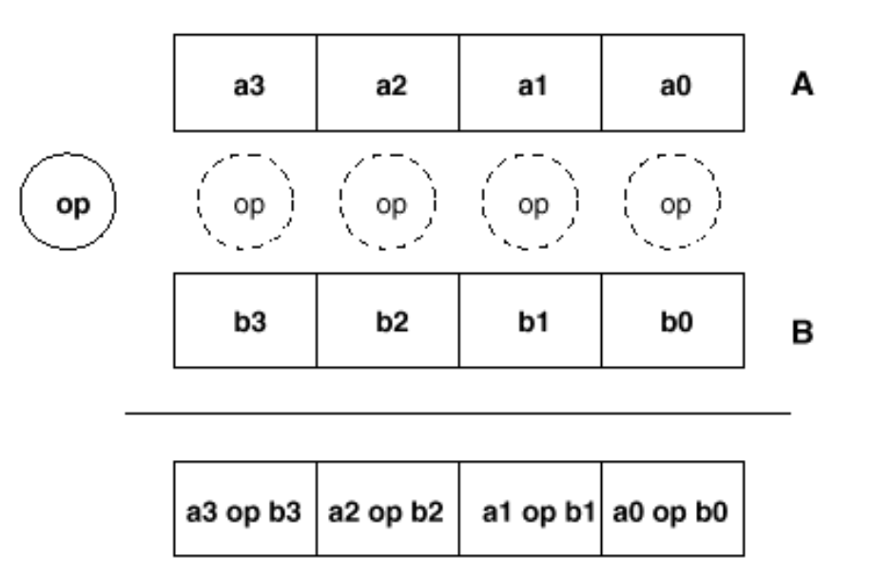
Vector units
Single Instruction Multiple Data (SIMD)

Slide 47
Vector units
Single Instruction Multiple Data (SIMD)
Data needs to be packed (contiguous, aligned)

Slide 48
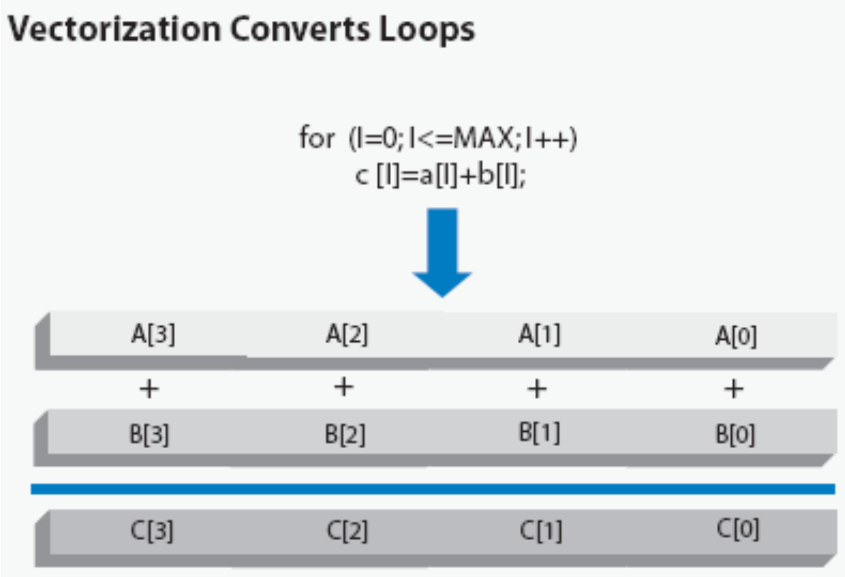

Slide 49
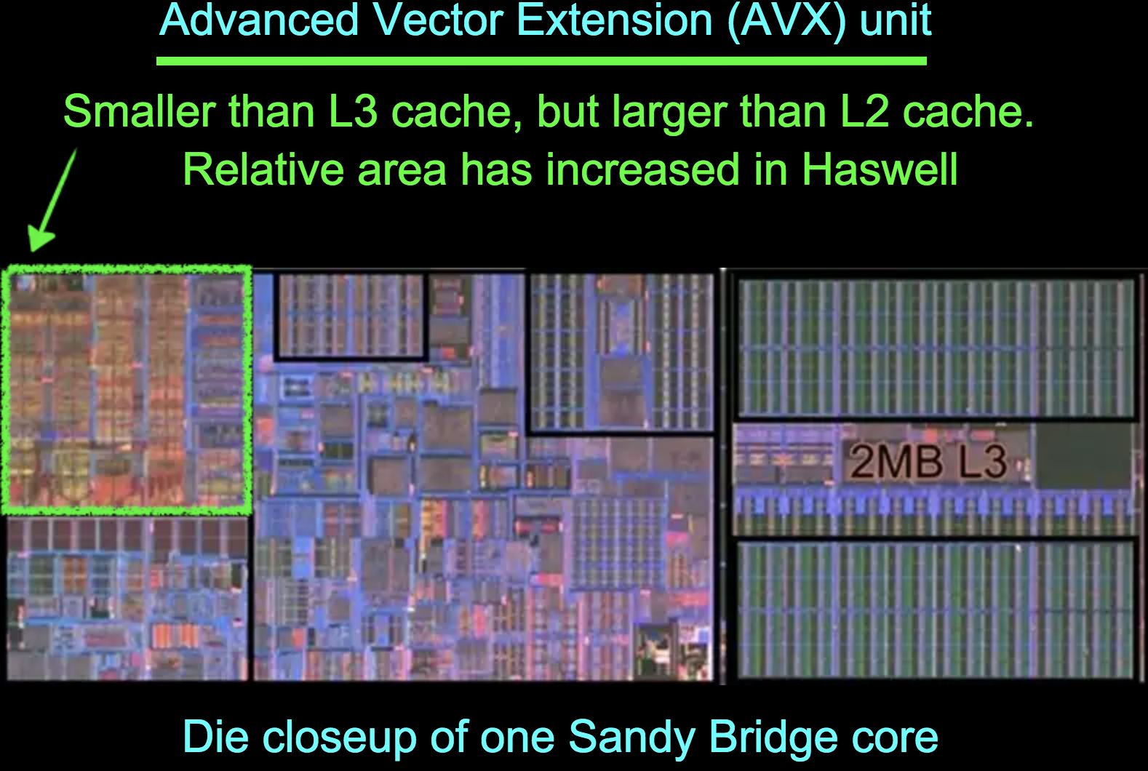
Vector units
http://slideplayer.com/slide/5779880/

Slide 50
Example: 3x3 blur — simple code
void box_filter_3x3(const Image &in, Image &blury) {
Image blurx(in.width(), in.height()); // allocate blurx array
blurx(x, y) = (in(x-1, y) + in(x, y) + in(x+1, y))/3;
blury(x, y) = (blurx(x, y-1) + blurx(x, y) + blurx(x, y+1))/3;
}
for (int x = 0; x < in.width(); x++)
for (int y = 0; y < in.height(); y++)
for (int x = 0; x < in.width(); x++)
for (int y = 0; y < in.height(); y++)
Notes:
So,
To see what I mean by the organization of computation, it’s useful to look at an example.
If we want to do a simple, 3x3 box filter as 2 3x1 passes, we could write C++ code like this.
It’s just a series of two sets of loops over the image.
The first computes a horizontal 3x1 blur and stores it in a temporary buffer.
The second computes a vertical 1x3 blur of that to produce the output.
- Now, what if we exchange the loops in each loop nest?

Slide 51
Using vector units
Special instruction set
Pack data
Reorganize loop in
chunks of 8 or 16
void box_filter_3x3(const Image &in, Image &blury) {
__m128i one_third = _mm_set1_epi16(21846);
#pragma omp parallel for
for (int yTile = 0; yTile < in.height(); yTile += 32) {
__m128i a, b, c, sum, avg;
__m128i blurx[(256/8)*(32+2)]; // allocate tile blurx array
for (int xTile = 0; xTile < in.width(); xTile += 256) {
__m128i *blurxPtr = blurx;
for (int y = -1; y < 32+1; y++) {
const uint16_t *inPtr = &(in[yTile+y][xTile]);
for (int x = 0; x < 256; x += 8) {
a = _mm_loadu_si128((__m128i*)(inPtr-1));
b = _mm_loadu_si128((__m128i*)(inPtr+1));
c = _mm_load_si128((__m128i*)(inPtr));
sum = _mm_add_epi16(_mm_add_epi16(a, b), c);
avg = _mm_mulhi_epi16(sum, one_third);
_mm_store_si128(blurxPtr++, avg);
inPtr += 8;
}}
blurxPtr = blurx;
for (int y = 0; y < 32; y++) {
__m128i *outPtr = (__m128i *)(&(blury[yTile+y][xTile]));
for (int x = 0; x < 256; x += 8) {
a = _mm_load_si128(blurxPtr+(2*256)/8);
b = _mm_load_si128(blurxPtr+256/8);
c = _mm_load_si128(blurxPtr++);
sum = _mm_add_epi16(_mm_add_epi16(a, b), c);
avg = _mm_mulhi_epi16(sum, one_third);
_mm_store_si128(outPtr++, avg);
}}}}}

Slide 52
Recap parallelism
Pipelining (ILP) — careful of dependencies/bubbles
  You don’t need to worry about it, done for you by CPU designers
Multicore (MIMD) from 2 to 22 cores on CPUS, more on GPUs
  Your responsibility
  Coarse granularity, lots of flexibility, usually outer loop
Vector units (SIMD) from 8 to 16 lanes
  Your responsibility
  Fine granularity, constrained, usually inner loop
Not discussed: superscalar, reordering, etc.

Slide 53
Skylake
https://en.wikichip.org/wiki/intel/microarchitectures/skylake_(client)

Slide 54
Communication dominates computation
in both energy and time
Operation | Energy/Op | Cost
(32-bit operands) | (28 nm) | (vs. ALU)
ALU op
Load from SRAM
Move 10mm on-chip
Send off-chip
Send to DRAM
Send over LTE
data from John Brunhaver, Bill Dally, Mark Horowitz
Notes:
Today, relative to the energy cost of doing some arithmetic operation on a piece of data,
- Loading or storing that data in a small local SRAM like a cache can be several times more expensive;
- Moving the result 10 millimeters across the chip is an order of magnitude more expensive;
- And moving it to or from off-chip RAM is 3-4 orders of magnitude more expensive
than computing the value in the first place.
And this disparity is only growing over time.

Slide 55
Communication dominates computation
in both energy and time
Operation | Energy/Op | Cost
(32-bit operands) | (28 nm) | (vs. ALU)
ALU op | 1 pJ | -
Load from SRAM | 1-5 pJ | 5x
Move 10mm on-chip | 32 pJ | 32x
Send off-chip | 500 pJ | 500x
Send to DRAM | 1 nJ | 1,000x
Send over LTE | >10 µJ | 10,000,000x
data from John Brunhaver, Bill Dally, Mark Horowitz
Notes:
Today, relative to the energy cost of doing some arithmetic operation on a piece of data,
- Loading or storing that data in a small local SRAM like a cache can be several times more expensive;
- Moving the result 10 millimeters across the chip is an order of magnitude more expensive;
- And moving it to or from off-chip RAM is 3-4 orders of magnitude more expensive
than computing the value in the first place.
And this disparity is only growing over time.

Slide 56
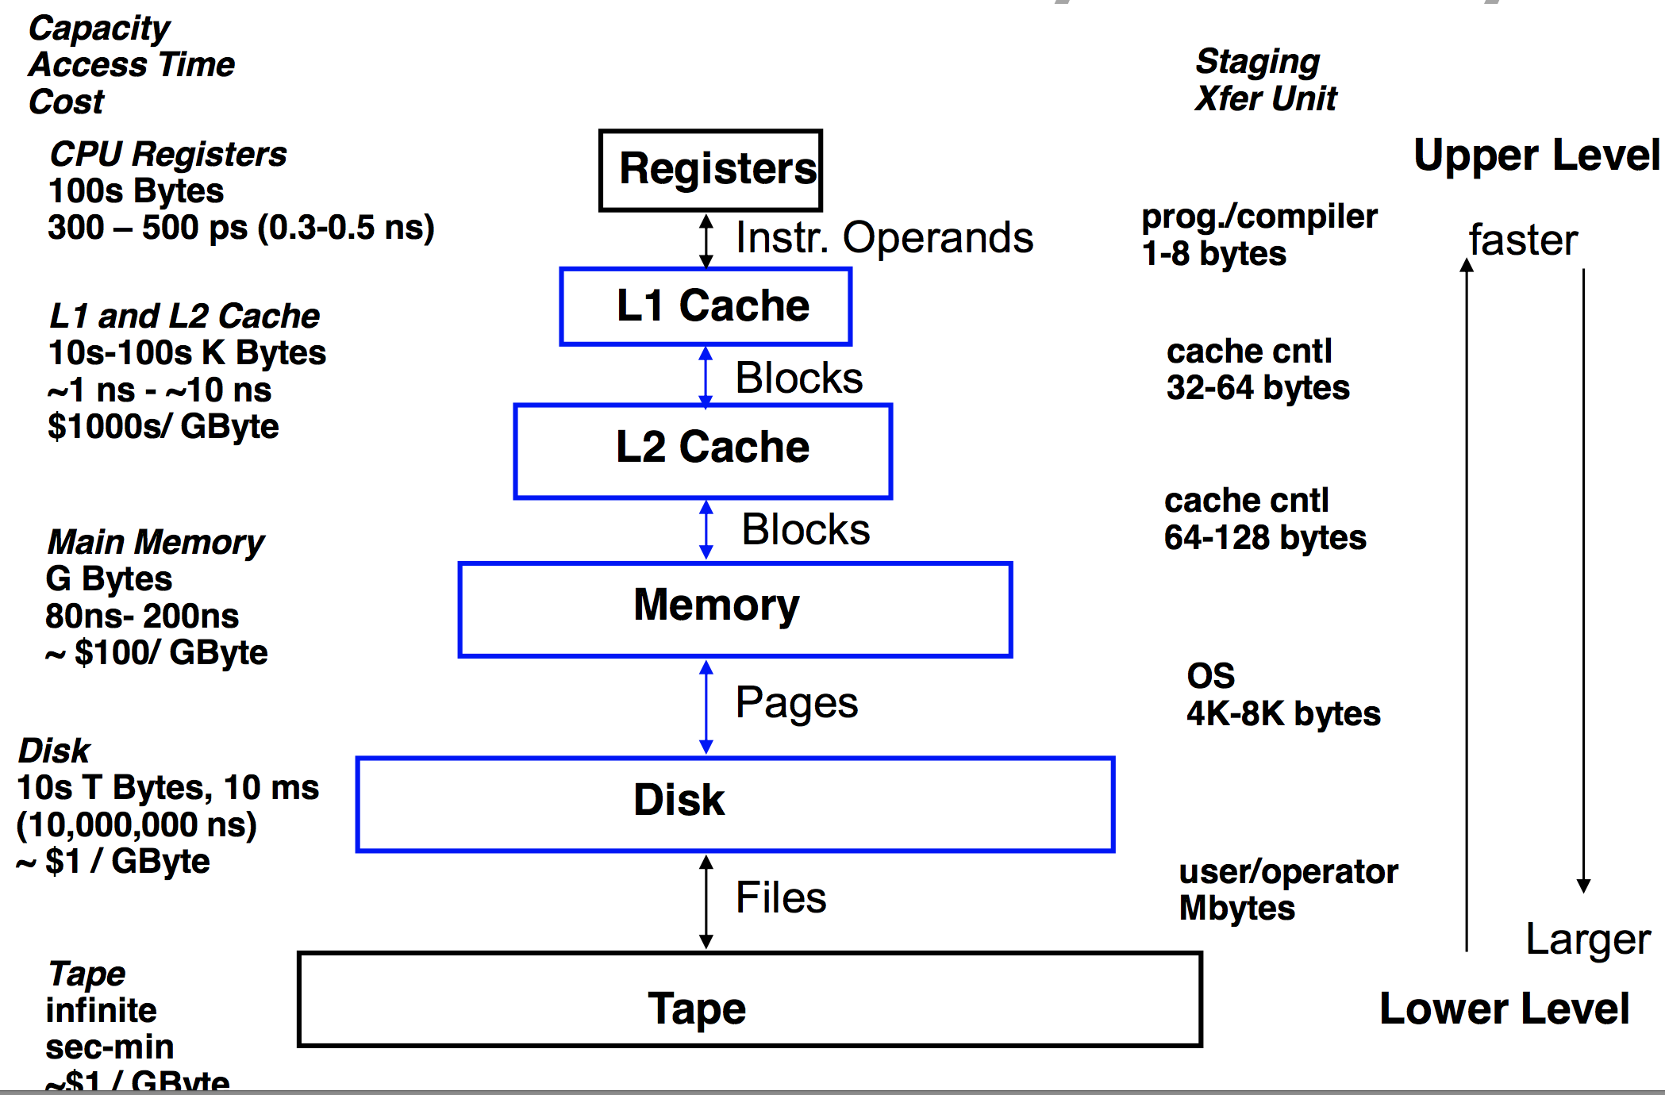
Memory hierarchy
From 6.172

Slide 57
Locality
Temporal locality
  use produced data as fast as possible
Spatial locality
  Use adjacent data

Slide 58
Locality in Image Processing

Slide 59
Extra Problems with our Image class
Lots of copies, creations of intermediate data storage with each function operation and return
  In particular no in-place operations

Slide 60
Multithreading
Execution model that splits work within a process into concurrent tasks
  Can be at different granularity
Multiple potential goals
  Make tasks independence and non-blocking
  (e.g. UI does not stop when process is computing)
  Hide memory latency
  (others threads keeps working while one waits for data from main memory)
  Parallelism (MIMD)
  (different threads are run in parallel on different cores)
Enabled/facilitated by OS and CPU
  Cost of thread switching may vary

Slide 61
Concurrency vs. Parallelism
In computer science, concurrency refers to the ability of different parts or units of a program, algorithm, or problem to be executed out-of-order or in partial order, without affecting the final outcome. [wikipedia]
Parallel computing is a type of computation in which many calculations or the execution of processes are carried out simultaneously. [wikipedia]
Concurrency is about potentially running at the same time (or out of order), parallelism is actually running at the same time.

Slide 62
Recap: Better exploit hardware
Less work
Parallelism
Good cache coherence (locality)
Requires to reorganize computation!

Slide 63


Halide motivation, e.g. Local Laplacian Filtering
Reference: 300 lines C++
Adobe: 1500 lines
  3 months of work
  10x faster (vs. reference)
Notes:
I'll show an example of how we can deliver 20 times the performance of everyday C,
or double the performance
of a hand-tuned, parallel, and vectorized imaging pipeline,
optimized over 3 months by an expert working on Photoshop,
while using 25 times less code, written in a single day.
- And I’ll show how we can generate a completely different organization, on a GPU,
delivering several times more performance, without rewriting a single line.

Slide 64
Spoiler: e.g. Local Laplacian Filtering
Reference: 300 lines C++
Adobe: 1500 lines
  3 months of work
  10x faster (vs. reference)
Parallelize (multicore)
Parallelize (SIMD vectorization)
Organized into tiles to maximize locality
Other tricks
Notes:
I'll show an example of how we can deliver 20 times the performance of everyday C,
or double the performance
of a hand-tuned, parallel, and vectorized imaging pipeline,
optimized over 3 months by an expert working on Photoshop,
while using 25 times less code, written in a single day.
- And I’ll show how we can generate a completely different organization, on a GPU,
delivering several times more performance, without rewriting a single line.

Slide 65
Spoiler: Simpler, Faster, Scalable
Reference: 300 lines C++
Adobe: 1500 lines
  3 months of work
  10x faster (vs. reference)
Halide: 60 lines
  1 intern-day
20x faster (vs. reference)
2x faster (vs. Adobe)
GPU: 70x faster (vs. reference)
Notes:
I'll show an example of how we can deliver 20 times the performance of everyday C,
or double the performance
of a hand-tuned, parallel, and vectorized imaging pipeline,
optimized over 3 months by an expert working on Photoshop,
while using 25 times less code, written in a single day.
- And I’ll show how we can generate a completely different organization, on a GPU,
delivering several times more performance, without rewriting a single line.

Slide 66
With a bit of portable Halide code you get
  faster matrix multiply than Eigen
  faster Gaussian blur than Intel Performance Primitives
  faster Fourier transform than FFTW
  faster Local Laplacian than Adobe’s
Plus
  it runs on device and in the cloud
  is supported on Linux, Windows, OSX, iOS, Android
  compiles to x86, ARM, MIPS, native client, OpenCL, OpenGL, CUDA, JavaScript, RenderScript (ISPs soon)
slide by Marc Levoy

Slide 67






Real-world adoption
  open source at http://halide-lang.org
Google
> 200 pipelines 10s of kLOC in production
Halide touches every video uploaded.
65B frames/day
Core features of Photoshop 2018 are compiled with Halide
Photoshop iPad enabled by Halide
G Photos auto-enhance
Data center
Android
Browser
HDR+
Glass
Nexus devices
Notes:
And it’s being used heavily in the real world.
It’s open source, being actively improved
by at least a half-dozen companies.
At Google, there are hundreds of pipelines and 10s of thousands of lines of Halide code in production.
Among lots of other things, this code processes every video uploaded to YouTube—all 400 hours a minute—
where performance improvements eliminate megawatts of data center capacity.
In all, Halide code is running in production on at least tens of thousands of servers
and hundreds of millions of devices,
including most of the phones in your pockets right now.

Slide 68
How can we get there?
Parallelism
“Moore’s law” growth will require exponentially more parallelism.
Locality
Data should move as little as possible.
Notes:
The good news is: Moore’s Law is continuing to give us exponentially more computational resources.
- But, as we’ve been told for the past decade, one of the major challenges we face will be exposing more and more parallelism for this hardware to exploit.
Superficially, this seems easy. All these applications are enormously data-parallel.
[It’s the scale of data-parallelism which makes these problems intensive in the first place.]
- The real challenge is that these millions of data-parallel computations aren’t independent—they need to be able to communicate with each other.
The same hardware trends which have pushed us from uniprocessors to lots of parallel cores have made communication & data movement dominate the cost of computation.
By communication, I don’t even mean over networks—I mean inside the computer, even inside each chip.
- As a result, Locality—moving data around as little as possible—is at least as big a problem for future programs as parallelism!

Slide 69
Message #1: Performance requires complex tradeoffs
redundant work
locality
tradeoff
parallelism
Notes:
Because of this,
it can often be most efficient to make surprising tradeoffs,
like redundantly recomputing values used in multiple places,
instead of storing and reloading them from memory.
[pause] This is the first key message I want you to take away from this talk:
parallelism, locality, and the total amount of work performed
interact in complex ways.
They often need to be traded off against each other
to maximize the performance and efficiency
of an application on a particular machine.
The architecture community is well aware of these pressures.
They’re trying to exploit locality and parallelism to improve energy efficiency in hardware designs.
And the software community recognizes the need to expose increasing parallelism in applications,
But these challenges are still acute in how we design software
—especially locality, at least as much as parallelism.

Slide 70
Where does performance come from?
Hardware
redundant work
locality
Program
tradeoff
parallelism
Notes:
Given these pressures, where does performance come from?
- We usually think of it in terms of two factors: the hardware and the program running on it.
But the competing pressures on locality, parallelism, and redundant work
depend heavily on how a program is mapped to the hardware.
The second key message I want you to take away from this talk is that:
Because of this,
it’s useful to think of the program
actually as two separate concerns.

Slide 71
Organization of computation
is a first-class issue
Program:
Hardware
Algorithm
Organization of computation
redundant work
locality
Program
tradeoff
parallelism
Notes:
* the algorithm - the fundamental operations which need to be performed;
* and the organization of the computation - including where and when those operations are performed, and where their results are stored and loaded.
- My work focuses on enabling and exploiting the reorganization of computation,
and its interaction with hardware and algorithms.
- In this talk I’m going to show that organizing computation
is key to the things we need, to optimize performance and efficiency.
But it’s challenging because of fundamental tensions between them.
Again, parallelism, locality, and the total amount of work performed interact in complex ways,
and how they do is determined by the way the computation is organized.
If we want to keep scaling with Moore’s Law, we need to treat the organization of computation as a first-class issue.

Slide 72
Halide
a language and compiler
for image processing
[SIGGRAPH 2012, PLDI 2013]
Ragan-Kelley, Adams, et al.
Algorithm
Organization of computation
Hardware
redundant work
locality
tradeoff
parallelism
Notes:
Halide is a programming language and compiler
for modeling and exploiting this exact set of tradeoffs
in image processing pipelines.
This is joint work with a number of people,
but most significantly Andrew Adams,
who was my day to day collaborator for the past two years at MIT.
There are papers covering different parts of this work at both SIGGRAPH and PLDI.

Slide 73
Algorithm vs. Organization: 3x3 blur
void box_filter_3x3(const Image &in, Image &blury) {
Image blurx(in.width(), in.height()); // allocate blurx array
blurx(x, y) = (in(x-1, y) + in(x, y) + in(x+1, y))/3;
blury(x, y) = (blurx(x, y-1) + blurx(x, y) + blurx(x, y+1))/3;
}
for (int x = 0; x < in.width(); x++)
for (int y = 0; y < in.height(); y++)
for (int x = 0; x < in.width(); x++)
for (int y = 0; y < in.height(); y++)
Notes:
So,
To see what I mean by the organization of computation, it’s useful to look at an example.
If we want to do a simple, 3x3 box filter as 2 3x1 passes, we could write C++ code like this.
It’s just a series of two sets of loops over the image.
The first computes a horizontal 3x1 blur and stores it in a temporary buffer.
The second computes a vertical 1x3 blur of that to produce the output.
- Now, what if we exchange the loops in each loop nest?

Slide 74
Algorithm vs. Organization: 3x3 blur
void box_filter_3x3(const Image &in, Image &blury) {
Image blurx(in.width(), in.height()); // allocate blurx array
blurx(x, y) = (in(x-1, y) + in(x, y) + in(x+1, y))/3;
blury(x, y) = (blurx(x, y-1) + blurx(x, y) + blurx(x, y+1))/3;
}
for (int y = 0; y < in.height(); y++)
for (int x = 0; x < in.width(); x++)
for (int y = 0; y < in.height(); y++)
for (int x = 0; x < in.width(); x++)
Same algorithm, different organization
One of them is 15x faster
Notes:
- Now, what if exchange the loops in each loop nest?
- A lot of compilers would say these are the same algorithm.
This loop reordering is something most compilers could do today.
It’s easy because the operations within the loops are independent.
- And it’s important.
Because of poor locality,
the column-major order is 15 times slower than the row-major version.
This is just a trivial example of reorganizing the computation—something compilers easily do
In this talk, we’re going to take this to the next level. Our inspiration is what expert programmers currently do by hand.
The key thing will be applying a domain-specific understanding of the more complex dependence across the two blur loops, not just within each one.

Slide 75
Why swapping loops make things faster/slower
Memory behavior
Images are laid out linearly in memory.
  More coherence along scanlines

Slide 76
In general
Reorganize computationto maximize parallelism & locality
  e.g. compute in tiles, merge pipeline stages
  e.g. compute blur_x and blur_y for a full tile, compute tiles in parallel, leverage SIMD vector units

Slide 77
Hand-optimized C++
11x faster
(quad core x86)
9.9 → 0.9 ms/megapixel
void box_filter_3x3(const Image &in, Image &blury) {
__m128i one_third = _mm_set1_epi16(21846);
#pragma omp parallel for
for (int yTile = 0; yTile < in.height(); yTile += 32) {
__m128i a, b, c, sum, avg;
__m128i blurx[(256/8)*(32+2)]; // allocate tile blurx array
for (int xTile = 0; xTile < in.width(); xTile += 256) {
__m128i *blurxPtr = blurx;
for (int y = -1; y < 32+1; y++) {
const uint16_t *inPtr = &(in[yTile+y][xTile]);
for (int x = 0; x < 256; x += 8) {
a = _mm_loadu_si128((__m128i*)(inPtr-1));
b = _mm_loadu_si128((__m128i*)(inPtr+1));
c = _mm_load_si128((__m128i*)(inPtr));
sum = _mm_add_epi16(_mm_add_epi16(a, b), c);
avg = _mm_mulhi_epi16(sum, one_third);
_mm_store_si128(blurxPtr++, avg);
inPtr += 8;
}}
blurxPtr = blurx;
for (int y = 0; y < 32; y++) {
__m128i *outPtr = (__m128i *)(&(blury[yTile+y][xTile]));
for (int x = 0; x < 256; x += 8) {
a = _mm_load_si128(blurxPtr+(2*256)/8);
b = _mm_load_si128(blurxPtr+256/8);
c = _mm_load_si128(blurxPtr++);
sum = _mm_add_epi16(_mm_add_epi16(a, b), c);
avg = _mm_mulhi_epi16(sum, one_third);
_mm_store_si128(outPtr++, avg);
}}}}}
Tiled, fused
Vectorized
Multithreaded
Redundant computation
Near roof-line optimum
Notes:
This is a hand-optimized version of the same blur function.
It’s tiled, multithreaded, vectorized, and fused.
The loops are restructured, and the developer had to introduce redundant computation on the tile boundaries, and change the storage layout.
It’s a big mess, given that all we’re doing is averaging together 3x3 pixels,
- But the end result is an order of magnitude faster than the previous version,
and runs near the peak throughput for this machine.
It takes less than 1 millisecond per megapixel processed on a quad-core x86,
vs. about 10 milliseconds for the clean version, optimized with the latest GCC.
In this talk,
We’re going to deconstruct the fundamental things this optimized version actually does—where its performance comes from, and what expert programmers do by hand.
First, I’ll focus on introducing a theory of the problem and its challenges,
and then I’ll show how we apply this to build a model from which we actually generate code.

Slide 78
(Re)organizing computation is hard
Optimizing parallelism, locality requires transforming program & data structure.
What transformations are legal?
What transformations are beneficial?
  libraries don’t solve this:
  BLAS, IPP, MKL, OpenCV, MATLAB
    optimized kernels compose into inefficient pipelines (no fusion)
Notes:
This kind of optimization is hard to do automatically—or even manually—because getting parallelism and locality requires transforming program and data structure.
But what transformations are legal?
And even when we know something is legal, it’s hard to know whether it’s a good idea.
The things we want to optimize are often at odds with each other,
and the optimal balance is often extremely subtle and complex.
- And libraries of optimized routines don’t solve this.
Intel Performance Primitives, for example, is extremely fast at individual operations, but no matter how much Intel’s optimization teams tune the assembly inner loops of the Math Kernel Library,
individually optimized kernels still compose into inefficient pipelines, since they can not interleave stages for locality across function boundaries.
---[cut]---
Is it safe to go from the simple C loops that compute blur to the fully optimized version?
Particularly the stencil-fusion transformation I showed is not legal in languages like C or Fortran,
where values are conflated with specific memory locations.

Slide 79
Halide’s answer: decouple algorithm from schedule
Notes:
[pause, breathe]
I believe the right answer is to explicitly decouple the definition of the algorithm from the organization of computation, which we call the schedule.
In Halide, the algorithm defines what values are computed for each pipeline stage,
while the schedule defines where and when they’re computed.
This makes it easier for the programmer to write algorithms, with lots of unnecessary details stripped away, and to compose them into pipelines.
It makes it easy for either a programmer or a compiler to specify and explore optimizations.
Unlike in C, changing the schedule can not change the meaning of the algorithm.
And it leaves the compiler free to do the painful but deterministic work of generating fast code which implements the pipeline given a defined schedule.

Slide 80
Halide’s answer: decouple algorithm from schedule
Algorithm: what is computed
Schedule: where and when it’s computed
Easy for programmers to build pipelines
Easy to specify & explore optimizations
  manual or automatic search
Easy for the compiler to generate fast code
Notes:
[pause, breathe]
I believe the right answer is to explicitly decouple the definition of the algorithm from the organization of computation, which we call the schedule.
In Halide, the algorithm defines what values are computed for each pipeline stage,
while the schedule defines where and when they’re computed.
This makes it easier for the programmer to write algorithms, with lots of unnecessary details stripped away, and to compose them into pipelines.
It makes it easy for either a programmer or a compiler to specify and explore optimizations.
Unlike in C, changing the schedule can not change the meaning of the algorithm.
And it leaves the compiler free to do the painful but deterministic work of generating fast code which implements the pipeline given a defined schedule.

Slide 81
Halide algorithm:
blurx(x, y) = (in(x-1, y) + in(x, y) + in(x+1, y))/3;
blury(x, y) = (blurx(x, y-1) + blurx(x, y) + blurx(x, y+1))/3;
Notes:
That will let us do the same thing as the hand-optimized version,
with just four lines of code
—or just two, if we use autotuning to find a good schedule.
And even though I’m going to focus on Halide,
a lot of the lessons & principles apply throughout graphics & imaging.

Slide 82
Halide algorithm:
blurx(x, y) = (in(x-1, y) + in(x, y) + in(x+1, y))/3;
blury(x, y) = (blurx(x, y-1) + blurx(x, y) + blurx(x, y+1))/3;
Halide schedule:
blury.tile(x, y, xi, yi, 256, 32).vectorize(xi, 8).parallel(y);
blurx.compute_at(blury, x).store_at(blury, x).vectorize(x, 8);
Notes:
That will let us do the same thing as the hand-optimized version,
with just four lines of code
—or just two, if we use autotuning to find a good schedule.
And even though I’m going to focus on Halide,
a lot of the lessons & principles apply throughout graphics & imaging.

Slide 83
Recall Hand-optimized C++
11x faster
(quad core x86)
9.9 → 0.9 ms/megapixel
void box_filter_3x3(const Image &in, Image &blury) {
__m128i one_third = _mm_set1_epi16(21846);
#pragma omp parallel for
for (int yTile = 0; yTile < in.height(); yTile += 32) {
__m128i a, b, c, sum, avg;
__m128i blurx[(256/8)*(32+2)]; // allocate tile blurx array
for (int xTile = 0; xTile < in.width(); xTile += 256) {
__m128i *blurxPtr = blurx;
for (int y = -1; y < 32+1; y++) {
const uint16_t *inPtr = &(in[yTile+y][xTile]);
for (int x = 0; x < 256; x += 8) {
a = _mm_loadu_si128((__m128i*)(inPtr-1));
b = _mm_loadu_si128((__m128i*)(inPtr+1));
c = _mm_load_si128((__m128i*)(inPtr));
sum = _mm_add_epi16(_mm_add_epi16(a, b), c);
avg = _mm_mulhi_epi16(sum, one_third);
_mm_store_si128(blurxPtr++, avg);
inPtr += 8;
}}
blurxPtr = blurx;
for (int y = 0; y < 32; y++) {
__m128i *outPtr = (__m128i *)(&(blury[yTile+y][xTile]));
for (int x = 0; x < 256; x += 8) {
a = _mm_load_si128(blurxPtr+(2*256)/8);
b = _mm_load_si128(blurxPtr+256/8);
c = _mm_load_si128(blurxPtr++);
sum = _mm_add_epi16(_mm_add_epi16(a, b), c);
avg = _mm_mulhi_epi16(sum, one_third);
_mm_store_si128(outPtr++, avg);
}}}}}
Tiled, fused
Vectorized
Multithreaded
Redundant computation
Near roof-line optimum
Notes:
This is a hand-optimized version of the same blur function.
It’s tiled, multithreaded, vectorized, and fused.
The loops are restructured, and the developer had to introduce redundant computation on the tile boundaries, and change the storage layout.
It’s a big mess, given that all we’re doing is averaging together 3x3 pixels,
- But the end result is an order of magnitude faster than the previous version,
and runs near the peak throughput for this machine.
It takes less than 1 millisecond per megapixel processed on a quad-core x86,
vs. about 10 milliseconds for the clean version, optimized with the latest GCC.
In this talk,
We’re going to deconstruct the fundamental things this optimized version actually does—where its performance comes from, and what expert programmers do by hand.
First, I’ll focus on introducing a theory of the problem and its challenges,
and then I’ll show how we apply this to build a model from which we actually generate code.

Slide 84
Final 3x3 blur: add parallelism and vectorization
Var x, y;
Fun blur_x, blur_y ;
blur_x(x,y) = (input(x,y)+input(x+1,y)+input(x+2,y))/3.0;
blur_y(x,y) = (blur_x(x,y)+blur_x(x,y+1)+blur_x(x,y+2))/3.0;
Var xi, yi ;
blur_y.tile(x, y, xi, yi, 8, 4) \
.parallel(y) \
.vectorize(xi, 8);
blur_x.compute_at(blur_y, x) \
.vectorize(x, 8);
output=blur_y.realize(input.width()-2, input.height()-2);

Slide 85
More general box blur, 5x5, 35 MPixels on 12 cores
default schedule
took 5.80736255646 seconds

Slide 86
More general box blur, 5x5, 35 MPixels on 12 cores
default schedule
took 5.80736255646 seconds
root first stage
took 1.99803357124 seconds

Slide 87
More general box blur, 5x5, 35 MPixels on 12 cores
default schedule
took 5.80736255646 seconds
root first stage
took 1.99803357124 seconds
tile 256 x 256 + interleave
took 1.7552740097 seconds
tile 256 x 256 + parallel+vector
took 0.550438785553 seconds
tile 256 x 256 + parallel+vector without interleaving
took 1.10970659256 seconds

Slide 88
More general box blur, 5x5, 35 MPixels on 12 cores
default schedule
took 5.80736255646 seconds
root first stage
took 1.99803357124 seconds
tile 256 x 256 + interleave
took 1.7552740097 seconds
tile 256 x 256 + parallel+vector
took 0.550438785553 seconds
tile 256 x 256 + parallel+vector without interleaving
took 1.10970659256 seconds
  Note the exact doubling (memory bound)

Slide 89
Same as Hand-optimized C++
11x faster
(quad core x86)
9.9 → 0.9 ms/megapixel
void box_filter_3x3(const Image &in, Image &blury) {
__m128i one_third = _mm_set1_epi16(21846);
#pragma omp parallel for
for (int yTile = 0; yTile < in.height(); yTile += 32) {
__m128i a, b, c, sum, avg;
__m128i blurx[(256/8)*(32+2)]; // allocate tile blurx array
for (int xTile = 0; xTile < in.width(); xTile += 256) {
__m128i *blurxPtr = blurx;
for (int y = -1; y < 32+1; y++) {
const uint16_t *inPtr = &(in[yTile+y][xTile]);
for (int x = 0; x < 256; x += 8) {
a = _mm_loadu_si128((__m128i*)(inPtr-1));
b = _mm_loadu_si128((__m128i*)(inPtr+1));
c = _mm_load_si128((__m128i*)(inPtr));
sum = _mm_add_epi16(_mm_add_epi16(a, b), c);
avg = _mm_mulhi_epi16(sum, one_third);
_mm_store_si128(blurxPtr++, avg);
inPtr += 8;
}}
blurxPtr = blurx;
for (int y = 0; y < 32; y++) {
__m128i *outPtr = (__m128i *)(&(blury[yTile+y][xTile]));
for (int x = 0; x < 256; x += 8) {
a = _mm_load_si128(blurxPtr+(2*256)/8);
b = _mm_load_si128(blurxPtr+256/8);
c = _mm_load_si128(blurxPtr++);
sum = _mm_add_epi16(_mm_add_epi16(a, b), c);
avg = _mm_mulhi_epi16(sum, one_third);
_mm_store_si128(outPtr++, avg);
}}}}}
Tiled, fused
Vectorized
Multithreaded
Redundant computation
Near roof-line optimum
Notes:
This is a hand-optimized version of the same blur function.
It’s tiled, multithreaded, vectorized, and fused.
The loops are restructured, and the developer had to introduce redundant computation on the tile boundaries, and change the storage layout.
It’s a big mess, given that all we’re doing is averaging together 3x3 pixels,
- But the end result is an order of magnitude faster than the previous version,
and runs near the peak throughput for this machine.
It takes less than 1 millisecond per megapixel processed on a quad-core x86,
vs. about 10 milliseconds for the clean version, optimized with the latest GCC.
In this talk,
We’re going to deconstruct the fundamental things this optimized version actually does—where its performance comes from, and what expert programmers do by hand.
First, I’ll focus on introducing a theory of the problem and its challenges,
and then I’ll show how we apply this to build a model from which we actually generate code.

Slide 90
Prior work*
*a tiny sample. Thousands have come before us.
Streaming languages
  Ptolemy [Buck et al. 1993]
  StreamIt [Thies et al. 2002]
  Brook [Buck et al. 2004]
Loop optimization
  Systolic arrays [Gross & Lam 1984]
  Polyhedral model [Ancourt & Irigoin 1991,
  Amarasinghe & Lam 1993]
Parallel work scheduling
  Cilk [Blumhofe et al. 1995]
  NESL [Blelloch et al. 1993]
Region-based languages
  ZPL [Chamberlain et al. 1998]
  Chapel [Callahan et al. 2004]
  Stencil optimization & DSLs
    [Frigo & Strumpen 2005]
    [Krishnamoorthy et al. 2007]
    [Kamil et al. 2010]
  Mapping-based languages & DSLs
    SPL/SPIRAL [Püschel et al. 2005]
    Sequoia [Fatahalian et al. 2006]
  Shading languages
    RSL [Hanrahan & Lawson 1990]
    Cg, HLSL [Mark et al. 2003; Blythe 2006]
  Image processing systems
    [Shantzis 1994], [Levoy 1994]
    PixelBender, CoreImage
Notes:
This example, and the work I’m going to focus on, is at the intersection of stream programs and stencil computation.
But it also draws heavily on ideas from loop optimization,
parallel work scheduling,
and region based languages.
Even this is just a tiny sample.
Relative to most prior languages and compilers,
the two biggest differences are that
We focus on explicitly decoupling algorithms from organization,
similar to the split design of languages like Sequoia and SPIRAL,
while treating organization as a first-class part of the programming models.
And we don’t just optimize parallelism and locality,
but we put particular emphasis on the potential value of introducing redundant computation
to optimize the overall organization.
---[cut]---
All the work I’m going to show is standing on the shoulders of
literally thousands who’ve come before.
And domain experts have known how to hand code the sorts of optimizations I’m going to show for a long time.
I’m going to focus on modeling and automating what used to be mostly hand-coded optimizations.

Slide 91
Organizing a data-parallel pipeline
input
…
…
blurx
…
…
blury
…
…
Notes:
For the type of data parallel application I’m focussed on,
it’s often easier to understand the organization of computation if we look at it as a pipeline.
For our simple blur example,
the execution of the pipeline looks like this.
I’ve reduced it to 1D, but the problems are the same.
The input image is at the top, flowing down through the blurx and blury stages below.
And I’m showing the actual pixels on the right.
I’m going to use this to introduce a theory of the types of reorganization we do in Halide.

Slide 92
Simple loops execute breadth-first across stages
input
…
…
blurx
…
…
blury
…
…
Notes:
So, what’s most significant here is not what happens within each stage,
but what happens across the stages.
The versions we’ve looked at so far execute each stage bread-first.
- So they first compute every pixel in the first stage
- before computing anything in the second stage.

Slide 93
Simple loops execute breadth-first across stages
input
…
…
…
…
…
blurx
…
write to memory
blury
…
…
read from memory
Notes:
That means the first stage produces lots of intermediate data,
before it ever gets used in the second stage.
As a result,
- it has to be sent far away, and written to memory…
- before computing the next stage, which has to slowly read it back in.

Slide 94
Breadth-first execution sacrifices locality
input
…
…
blurx
…
…
locality is a
function of
reuse distance
blury
…
…
Notes:
This is because the way we’ve organized the computation has poor locality.
So,
- once we compute a given value in the first stage,
- we have to compute lots of other, unrelated values
before we actually need to use it in the second stage.
- In this view, locality is a function of the reuse distance
along this red path we take through our computation.

Slide 95
Interleaved execution improves locality
input
…
…
blurx
…
…
blury
…
…
(simplified)
Notes:
We can improve locality by interleaving the stages instead.
- I’m gonna give you a cartoon version, ignoring the dependencies, and we’ll take care of the details later.
In this organization,
- We first compute a small piece of blurx,
- and then immediately send the results down…
- to compute the corresponding piece of blury.
- After we’re done, we can throw away the intermediate results,
and move on to the next piece of blurx.
- There, we repeat the same process
to compute the two stages
on the next part of the image.

Slide 96
Interleaved execution improves locality
input
…
…
reduce reuse distance from
producer
to
consumer
blurx
…
…
blury
…
…
Notes:
Repeating this interleaving across the whole image
improves producer-consumer locality.
- It does this by reducing the reuse distance between where values are produced in the first stage,
to when they’re consumed in the second stage.
In practice, this means they can be kept nearby,
like in registers or a cache,
rather than having to move long distances
to and from main memory.
- This reorganization of the computation is often called fusion,
because we’ve merged the computation of the two stages.
- In practice, it makes optimization a global problem of carefully interleaving the computation and storage of the entire pipeline.
So I want to emphasize:
You can not address locality by just locally tweaking operations in your inner loops.

Slide 97
Fusion improves locality
input
…
…
blurx
…
…
fusion globally interleaves computation
(fused)
blury
…
…
Notes:
Repeating this interleaving across the whole image
improves producer-consumer locality.
- It does this by reducing the reuse distance between where values are produced in the first stage,
to when they’re consumed in the second stage.
In practice, this means they can be kept nearby,
like in registers or a cache,
rather than having to move long distances
to and from main memory.
- This reorganization of the computation is often called fusion,
because we’ve merged the computation of the two stages.
- In practice, it makes optimization a global problem of carefully interleaving the computation and storage of the entire pipeline.
So I want to emphasize:
You can not address locality by just locally tweaking operations in your inner loops.

Slide 98
Understanding dependencies
input
…
…
blurx
blury
Notes:
Now, fusion is something the compiler community has done for decades,
but I’ll show in a second how this type of pipeline is actually more complex than most what people traditionally do.
To understand exactly how we can fuse a given computation,
we have to look at the dependencies.
These are the details I was ignoring in the cartoon version.
The dependencies are a fundamental characteristic of the algorithm we’ve defined.
In this case,
- Looking at one pixel in blury,
- it depends on three neighboring pixels in blurx.
- It’s neighbor depends on an overlapping set of pixels.

Slide 99
Stencils have overlapping dependencies
input
…
…
blurx
blury
Notes:
This means that,
- the pieces, or tiles, that we interleaved during fusion,
- actually depend on overlapping tiles further up the pipeline.
We usually want want to decouple the execution of the tiles—both to minimize the reuse distance across tiles,
and to execute them in parallel.
- To do this, we need to break the dependencies between them.
But splitting them up means,
- we need to duplicate the shared computations along the boundary,
introducing redundant work.
This is a key tradeoff experts make when hand-optimizing this sort of pipeline,
but it’s not something most compilers can consider.
---[cut]---
For this domain, it’s extremely important, and it’s a key part of our design.

Slide 100
Breaking dependencies introduces redundant work
input
…
…
blurx
blury
redundant work
Notes:
This means that,
- the pieces, or tiles, that we interleaved during fusion,
- actually depend on overlapping tiles further up the pipeline.
We usually want want to decouple the execution of the tiles—both to minimize the reuse distance across tiles,
and to execute them in parallel.
- To do this, we need to break the dependencies between them.
But splitting them up means,
- we need to duplicate the shared computations along the boundary,
introducing redundant work.
This is a key tradeoff experts make when hand-optimizing this sort of pipeline,
but it’s not something most compilers can consider.
---[cut]---
For this domain, it’s extremely important, and it’s a key part of our design.

Slide 101
Decoupled tiles optimize parallelism & locality
input
…
…
…
…
blurx
blury
locality
(short reuse distance)
parallelism
(independence)
Notes:
By removing the dependency,
we can execute in parallel both within each tile of each stage,
and across tiles.
Now, we can independently
- compute a tile of the first stage,
- send it down,
- and immediately compute a tile of the second stage.
Then each of these independent computations
- can throw out its intermediate data,
before moving on to the next tile it needs to process.
- So we not only have parallelism,
We also get good locality
from the short, fixed reuse distance in each of these computations.
But to get there, we had to make a tradeoff:
we had to introduce redundant work
to break the dependencies in the algorithm,
and enable this reorganization of the computation.
In this case, that made sense.
But this isn’t always the right choice.

Slide 102

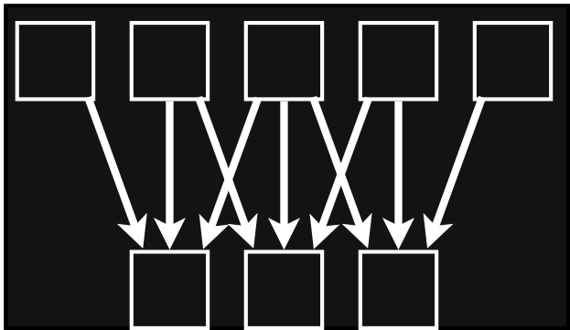
Organization requires global tradeoffs
input
input
blurx
blury
local Laplacian filters
[Paris et al. 2010, Aubry et al. 2011]
3x3 box filter
Notes:
Blur is a trivial 2-stage pipeline,
but a more realistic pipeline looks like this.
Local Laplacian filters has about 100 stages, in a complex graph.
- Locally, most of the dependencies are simple, like in our blur.
But globally they're extremely far reaching and complex.
This gives us lots of choices about the organization and degree of fusion at each of dozens of stages.
Each strategy can mean a totally different set of dozens of kernels or loop nests—completely restructuring our code—
and the difference between two plausible strategies can be an order of magnitude in efficiency.
---[cut for time]---
So reorganizing the computation is hard not just because it globally interleaves the computation of the whole pipeline,
but also because it requires tradeoffs—like introducing redundant computation in exchange for saving bandwidth.
These can be hard to reason about, and often need to be explored before you know what works best

Slide 103
Message #1: performance requires tradeoffs
trade off with granularity of fusion
input
…
…
redundant work
locality
blurx
blury
parallelism
trade off by constraining order
Notes:
This brings us back to the first message I gave you,
which was that:
Optimizing performance requires fundamental tradeoffs.
- So we saw that there’s a tension between
locality—or reuse distance,
and introducing redundant work to break long dependency chains.
- We can trade off along this axis by varying the granularity at which we interleave these stages,
using smaller tiles for greater locality,
or bigger tiles to minimize the fraction of duplicated nodes on the tile boundaries.
- There’s also a tension between these and parallelism,
which requires independent work, within or across stages.
----[cut]----
I’ll show this side of the tradeoff more later.

Slide 104
Message #2: algorithm vs. organization
input
…
…
blurx
…
…
algorithm
organization
blury
…
…
order and interleaving
radically alter performance
of the same algorithm
Notes:
The second message was that these tradeoffs are determined by the organization of computation.
- We’ve seen that
changing the order and granularity of computation has a huge impact on performance.
In this visualization we’ve been using,
- these aspects of the organization
are given by the red path we take through the computation.
- and the algorithm defines the dependencies between the individual tasks.

Slide 105
Message #3: dependencies limit choices of organization
input
…
…
blurx
…
…
dependencies
organization
blury
…
…
Notes:
--- [20mins-ish?] ---
And this leads to the last major message of my talk,
Which is that:
The ways we can reorganize this graph,
and the effect each choice has on locality, parallelism, and the amount of work,
is a function of the fundamental dependencies in the algorithm.
This is also the place where domain-specific knowledge can the biggest difference.

Slide 106
Tradeoffs, organization, dependencies
input
…
…
blurx
…
…
dependencies
organization
blury
…
…
Notes:
for this pipeline, the biggest observation is that
it made sense to duplicate some tasks and redundantly compute some values,
to break a dependency chain,
in exchange for the locality and storage improvement.
But this isn’t always the right choice.
But for now, how does our optimized organization look in current languages?

Slide 107
This is a general task graph
input
task
blurx
dependencies
task schedule
blury
reuse distance
independent tasks
redundant work
locality
tradeoff
parallelism
Notes:
Putting it all together,
really,
this is a very general problem formulation:
What we have is a task graph.
- We have the tasks themselves.
- Tasks are linked by their dependencies.
- And then we can organize the computation by choosing the order in which we traverse the graph,
or the task schedule.
We can change the schedule,
- either to minimize reuse distance for locality,
- or maximize the number of independent tasks for parallelism,
as long as we respect the dependencies.

Slide 108
This is a general task graph
input
task
blurx
dependencies
task schedule
blury
redundant work
locality
tradeoff
parallelism
Notes:
And we can also break dependencies,
- and split the graph,
- but this introduces redundant computation on the boundaries.
[pause]
So we have all these choices.
But most traditional languages
deeply conflate the underlying algorithm
with these choices about how to order and schedule its computation.

Slide 109
This is a general task graph
input
task
blurx
dependencies
task schedule
blury
redundant work
locality
tradeoff
parallelism
Notes:
And we can also break dependencies,
- and split the graph,
- but this introduces redundant computation on the boundaries.
[pause]
So we have all these choices.
But most traditional languages
deeply conflate the underlying algorithm
with these choices about how to order and schedule its computation.

Slide 110
Organizing a data-parallel pipeline
input
blurx
blury
Notes:
For the type of data parallel application I’m focussed on,
it’s often easier to understand the organization of computation if we look at it as a pipeline.
For our simple blur example,
the execution of the pipeline looks like this.
The input image is at the top, flowing down through the blurx and blury stages below.

Slide 111
Column-major traversal
input
blurx
blury
Notes:
The first version we looked at walks down the iteration space in columns.

Slide 112
Simple loops execute breadth-first across stages
input
blurx
write to
memory
blury
Notes:
What’s most significant here is not what happens within each stage,
but what happens across the stages.
The versions we’ve looked at so far execute each stage bread-first.
- So they compute every pixel in the first stage, writing them out to memory,
- That means there’s lots of intermediate data, so it has to be sent far away
- before computing the next stage, which has to slowly read it back in.

Slide 113
Simple loops execute breadth-first across stages
input
blurx
read from
memory
blury
Notes:
What’s most significant here is not what happens within each stage,
but what happens across the stages.
The versions we’ve looked at so far execute each stage bread-first.
- So they compute every pixel in the first stage, writing them out to memory,
- That means there’s lots of intermediate data, so it has to be sent far away
- before computing the next stage, which has to slowly read it back in.

Slide 114
Fusing stages globally interleaves execution
input
blurx
(fused)
blury
Notes:
We can improve locality by interleaving the stages instead
- fusing them together, at the level of tiles, sized to fit into nearby caches.
In this organization,
- To compute a tile of blury,
- we first need the corresponding tile of blurx,
- which loads a tile of the input.
- The blurx stage filters the input,
- and blury immediately consumes it to compute a tile of the output.
Next, we throw out that tile of blurx data…

Slide 115
Fusing stages globally interleaves execution
input
blurx
(fused)
blury
Notes:
We can improve locality by interleaving the stages instead
- fusing them together, at the level of tiles, sized to fit into nearby caches.
In this organization,
- To compute a tile of blury,
- we first need the corresponding tile of blurx,
- which loads a tile of the input.
- The blurx stage filters the input,
- and blury immediately consumes it to compute a tile of the output.
Next, we throw out that tile of blurx data…

Slide 116
Fusing stages globally interleaves execution
input
blurx
(fused)
blury
Notes:
…Next, we throw out tile chunk of blurx data,
- load the next tile of the input,
- and compute the next tile of blurx,
- followed immediately by the corresponding tile of blury.
We’ve moved the computation of each tile of pixels in the consumer stage closer in time to the computation of its inputs.
This improves producer-consumer locality by keeping all the intermediate data nearby, in local caches,
but it makes optimization a global problem of carefully interleaving the computation and storage of the entire pipeline.
You can not address locality by just locally tweaking operations in your inner loops.

Slide 117
Fusion is a complex tradeoff
input
blurx
(fused)
blury
Notes:
And also, we’re making a tradeoff.
We’re saying that, for each chunk of blury,
we should independently compute, consume, and throw away the required chunk of blurx.

Slide 118
Fusion is a complex tradeoff
input
redundant work
blurx
(fused)
blury
Notes:
This means that neighboring chunks,
- which depend on overlapping pixels from higher up the pipeline,
do redundant work where they overlap.
This is one of the fundamental tradeoffs I described earlier:
For this pipeline, it made sense to redundantly compute some values, in exchange for the locality and storage improvement
[of never letting the intermediate values move out of the cache into main memory.]
But this isn’t always the right choice.

Slide 119
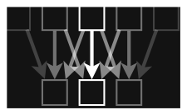
Fusion is a complex tradeoff
input
input
blurx
blury
local Laplacian filters
[Paris et al. 2010, Aubry et al. 2011]
3x3 box filter
Notes:
Blur is a trivial 2-stage pipeline,
but a more realistic pipeline looks like this.
Local Laplacian filters has about 100 stages, in a complex graph.
- Locally, most of the dependencies are simple, like in our blur.
But globally they're extremely far reaching and complex.
This gives us lots of choices about the degree of fusion at each of dozens of stages.
Each strategy can mean a totally different set of dozens of kernels or loop nests—completely restructuring our code—
and the difference between two plausible strategies can be a factor of 2 or more in efficiency.
So reorganizing the computation is hard not just because it globally interleaves the computation of the whole pipeline,
but also because it requires tradeoffs—like introducing redundant computation in exchange for saving bandwidth.
These can be hard to reason about, and often need to be explored before you know what works best
So let me recap…

Slide 120
Organization determines efficiency
input
order and interleaving
radically alter performance
of the same algorithm
blurx
blury
Notes:
We've established two things:
The first is that changing the order and granularity of computation has a huge impact on performance.

Slide 121
Organization is driven by a fundamental tension
input
trade off with granularity of fusion
redundant work
locality
blurx
parallelism
trade off by constraining order
blury
Notes:
The second is that there is a fundamental tension between locality, and introducing redundant work.
- We can trade off along this axis by varying the granularity at which we interleave these stages,
using smaller tiles for greater locality,
or bigger tiles to minimize the area of overlap on the tile boundaries.
- Of course, we also want to execute our computation in parallel.
In this case, we can easily distribute tiles across parallel threads, and internally vectorize the computation of each tile.
- But it turns out there’s also another axis to this tradeoff space.
Parallelism can be traded off to reduce redundant work while maintaining locality
by constraining the order of evaluation.
I’ll show how this works later.
But for now, how does our optimized organization look in current languages?

Slide 122
High Performance Graphics & Imaging
Hardware
Algorithm
Organization of computation
redundant work
locality
tradeoff
parallelism
Notes:
So again, my work focuses on
the organization of computation,
its interaction with hardware architecture and algorithms,
and the competing pressures for locality,
parallelism,
and minimizing work.

Slide 123
Message #3: dependencies limit choices of organization
input
blurx
blury
Notes:
And this leads to the last major message of my talk,
Which is that:
The ways we can reorganize computation,
and the effect each choice has on locality, parallelism, and the amount of work,
is a function of the fundamental dependencies in the algorithm.
This is also the place where domain-specific knowledge can the biggest difference.

Slide 124
Traditional languages conflate algorithm & organization
void box_filter_3x3(const Image &in, Image &blury) {
__m128i one_third = _mm_set1_epi16(21846);
#pragma omp parallel for
for (int yTile = 0; yTile < in.height(); yTile += 32) {
__m128i a, b, c, sum, avg;
__m128i blurx[(256/8)*(32+2)]; // allocate tile blurx array
for (int xTile = 0; xTile < in.width(); xTile += 256) {
__m128i *blurxPtr = blurx;
for (int y = -1; y < 32+1; y++) {
const uint16_t *inPtr = &(in[yTile+y][xTile]);
for (int x = 0; x < 256; x += 8) {
a = _mm_loadu_si128((__m128i*)(inPtr-1));
b = _mm_loadu_si128((__m128i*)(inPtr+1));
c = _mm_load_si128((__m128i*)(inPtr));
sum = _mm_add_epi16(_mm_add_epi16(a, b), c);
avg = _mm_mulhi_epi16(sum, one_third);
_mm_store_si128(blurxPtr++, avg);
inPtr += 8;
}}
blurxPtr = blurx;
for (int y = 0; y < 32; y++) {
__m128i *outPtr = (__m128i *)(&(blury[yTile+y][xTile]));
for (int x = 0; x < 256; x += 8) {
a = _mm_load_si128(blurxPtr+(2*256)/8);
b = _mm_load_si128(blurxPtr+256/8);
c = _mm_load_si128(blurxPtr++);
sum = _mm_add_epi16(_mm_add_epi16(a, b), c);
avg = _mm_mulhi_epi16(sum, one_third);
_mm_store_si128(outPtr++, avg);
}}}}}
void box_filter_3x3(const Image &in, Image &blury) {
Image blurx(in.width(), in.height()); // allocate blurx array
for (int y = 0; y < in.height(); y++)
for (int x = 0; x < in.width(); x++)
blurx(x, y) = (in(x-1, y) + in(x, y) + in(x+1, y))/3;
for (int y = 0; y < in.height(); y++)
for (int x = 0; x < in.width(); x++)
blury(x, y) = (blurx(x, y-1) + blurx(x, y) + blurx(x, y+1))/3;
}
not readable
architecture-specific
hard to change organization or algorithm
Notes:
Looking at the optimized version, again, it’s completely different than the original.
This code uses different instructions,
different data layout,
and deeper loop nests.
It’s barely readable, and architecture specific.
It shares almost no code with the initial version.
But all that’s happened is the reorganization we talked about
to optimize for parallelism and locality.

Slide 125
Optimized 3x3 blur in C++
void box_filter_3x3(const Image &in, Image &blury) {
__m128i one_third = _mm_set1_epi16(21846);
#pragma omp parallel for
for (int yTile = 0; yTile < in.height(); yTile += 32) {
__m128i a, b, c, sum, avg;
__m128i blurx[(256/8)*(32+2)]; // allocate tile blurx array
for (int xTile = 0; xTile < in.width(); xTile += 256) {
__m128i *blurxPtr = blurx;
for (int y = -1; y < 32+1; y++) {
const uint16_t *inPtr = &(in[yTile+y][xTile]);
for (int x = 0; x < 256; x += 8) {
a = _mm_loadu_si128((__m128i*)(inPtr-1));
b = _mm_loadu_si128((__m128i*)(inPtr+1));
c = _mm_load_si128((__m128i*)(inPtr));
sum = _mm_add_epi16(_mm_add_epi16(a, b), c);
avg = _mm_mulhi_epi16(sum, one_third);
_mm_store_si128(blurxPtr++, avg);
inPtr += 8;
}}
blurxPtr = blurx;
for (int y = 0; y < 32; y++) {
__m128i *outPtr = (__m128i *)(&(blury[yTile+y][xTile]));
for (int x = 0; x < 256; x += 8) {
a = _mm_load_si128(blurxPtr+(2*256)/8);
b = _mm_load_si128(blurxPtr+256/8);
c = _mm_load_si128(blurxPtr++);
sum = _mm_add_epi16(_mm_add_epi16(a, b), c);
avg = _mm_mulhi_epi16(sum, one_third);
_mm_store_si128(outPtr++, avg);
}}}}}
parallelism
  distribute across threads
  SIMD parallel vectors
Notes:
The parallelism comes from distributing work across threads,
and from computing in 8-wide SIMD chunks on each core’s SSE units.
But just exposing the parallelism isn’t the biggest challenge in optimizing this program.

Slide 126
Optimized 3x3 blur in C++
void box_filter_3x3(const Image &in, Image &blury) {
__m128i one_third = _mm_set1_epi16(21846);
#pragma omp parallel for
for (int yTile = 0; yTile < in.height(); yTile += 32) {
__m128i a, b, c, sum, avg;
__m128i blurx[(256/8)*(32+2)]; // allocate tile blurx array
for (int xTile = 0; xTile < in.width(); xTile += 256) {
__m128i *blurxPtr = blurx;
for (int y = -1; y < 32+1; y++) {
const uint16_t *inPtr = &(in[yTile+y][xTile]);
for (int x = 0; x < 256; x += 8) {
a = _mm_loadu_si128((__m128i*)(inPtr-1));
b = _mm_loadu_si128((__m128i*)(inPtr+1));
c = _mm_load_si128((__m128i*)(inPtr));
sum = _mm_add_epi16(_mm_add_epi16(a, b), c);
avg = _mm_mulhi_epi16(sum, one_third);
_mm_store_si128(blurxPtr++, avg);
inPtr += 8;
}}
blurxPtr = blurx;
for (int y = 0; y < 32; y++) {
__m128i *outPtr = (__m128i *)(&(blury[yTile+y][xTile]));
for (int x = 0; x < 256; x += 8) {
a = _mm_load_si128(blurxPtr+(2*256)/8);
b = _mm_load_si128(blurxPtr+256/8);
c = _mm_load_si128(blurxPtr++);
sum = _mm_add_epi16(_mm_add_epi16(a, b), c);
avg = _mm_mulhi_epi16(sum, one_third);
_mm_store_si128(outPtr++, avg);
}}}}}
parallelism
  distribute across threads
  SIMD parallel vectors
locality
  reorganize computation:
  fuse two blurs,
  compute in tiles
Notes:
Just as important—and often a lot harder to think about or express—is locality
In this case that meant:
making sure the pixels produced by the first stage
are still in the cache when the next stage reads them.
Without locality optimization, even a well parallelized pipeline
will be severely bottlenecked by memory bandwidth.
- Here, the optimized code improves locality by computing each stage in tiles,
interleaving the computation of tiles across stages,
and keeping intermediate data in local buffers which never leave the cache.
It redundantly recomputes values on the boundary of the intermediate tiles to decouple them.
This complicates the code because it globally interleaves the computation of each stage.
----[cut]----
[These code changes are global,
and the resulting addressing math and other logic gets complicated very fast.]

Slide 127
Same algorithm, different organization
void box_filter_3x3(const Image &in, Image &blury) {
__m128i one_third = _mm_set1_epi16(21846);
#pragma omp parallel for
for (int yTile = 0; yTile < in.height(); yTile += 32) {
__m128i a, b, c, sum, avg;
__m128i blurx[(256/8)*(32+2)]; // allocate tile blurx array
for (int xTile = 0; xTile < in.width(); xTile += 256) {
__m128i *blurxPtr = blurx;
for (int y = -1; y < 32+1; y++) {
const uint16_t *inPtr = &(in[yTile+y][xTile]);
for (int x = 0; x < 256; x += 8) {
a = _mm_loadu_si128((__m128i*)(inPtr-1));
b = _mm_loadu_si128((__m128i*)(inPtr+1));
c = _mm_load_si128((__m128i*)(inPtr));
sum = _mm_add_epi16(_mm_add_epi16(a, b), c);
avg = _mm_mulhi_epi16(sum, one_third);
_mm_store_si128(blurxPtr++, avg);
inPtr += 8;
}}
blurxPtr = blurx;
for (int y = 0; y < 32; y++) {
__m128i *outPtr = (__m128i *)(&(blury[yTile+y][xTile]));
for (int x = 0; x < 256; x += 8) {
a = _mm_load_si128(blurxPtr+(2*256)/8);
b = _mm_load_si128(blurxPtr+256/8);
c = _mm_load_si128(blurxPtr++);
sum = _mm_add_epi16(_mm_add_epi16(a, b), c);
avg = _mm_mulhi_epi16(sum, one_third);
_mm_store_si128(outPtr++, avg);
}}}}}
void box_filter_3x3(const Image &in, Image &blury) {
Image blurx(in.width(), in.height()); // allocate blurx array
for (int y = 0; y < in.height(); y++)
for (int x = 0; x < in.width(); x++)
blurx(x, y) = (in(x-1, y) + in(x, y) + in(x+1, y))/3;
for (int y = 0; y < in.height(); y++)
for (int x = 0; x < in.width(); x++)
blury(x, y) = (blurx(x, y-1) + blurx(x, y) + blurx(x, y+1))/3;
}
For a given algorithm,
organize to optimize:
redundant work
locality
tradeoff
parallelism
Notes:
As programmers, we usually think of this as a different algorithm from the original.
But just like the simple loop interchange I showed first,
I argue it’s more useful to see them as the same algorithm,
but where the computation has been reorganized.
Now, I don’t expect everyone to agree with my choice of the word “algorithm,”
but I do hope you can see that this separation of concerns is useful.
- Then, for a given algorithm,
we want to find the organization
that optimizes performance and efficiency
by making the best overall use of
parallelism & locality,
while minimizing the total amount of work.
The compiler community has done heroic work to automatically extract the necessary understanding to reorganize computation like this, but it's fundamentally hard problem.

Slide 128
Traditional languages conflate algorithm & organization
void box_filter_3x3(const Image &in, Image &blury) {
__m128i one_third = _mm_set1_epi16(21846);
#pragma omp parallel for
for (int yTile = 0; yTile < in.height(); yTile += 32) {
__m128i a, b, c, sum, avg;
__m128i blurx[(256/8)*(32+2)]; // allocate tile blurx array
for (int xTile = 0; xTile < in.width(); xTile += 256) {
__m128i *blurxPtr = blurx;
for (int y = -1; y < 32+1; y++) {
const uint16_t *inPtr = &(in[yTile+y][xTile]);
for (int x = 0; x < 256; x += 8) {
a = _mm_loadu_si128((__m128i*)(inPtr-1));
b = _mm_loadu_si128((__m128i*)(inPtr+1));
c = _mm_load_si128((__m128i*)(inPtr));
sum = _mm_add_epi16(_mm_add_epi16(a, b), c);
avg = _mm_mulhi_epi16(sum, one_third);
_mm_store_si128(blurxPtr++, avg);
inPtr += 8;
}}
blurxPtr = blurx;
for (int y = 0; y < 32; y++) {
__m128i *outPtr = (__m128i *)(&(blury[yTile+y][xTile]));
for (int x = 0; x < 256; x += 8) {
a = _mm_load_si128(blurxPtr+(2*256)/8);
b = _mm_load_si128(blurxPtr+256/8);
c = _mm_load_si128(blurxPtr++);
sum = _mm_add_epi16(_mm_add_epi16(a, b), c);
avg = _mm_mulhi_epi16(sum, one_third);
_mm_store_si128(outPtr++, avg);
}}}}}
not readable
architecture-specific
hard to change organization or algorithm
result: hard to optimize performance, efficiency
(both for humans and compilers!)
Notes:
Because of how deeply traditional languages conflate the algorithm and the organization,
the optimized code is hideously complex,
and it’s also hard-coded to a specific architecture.
But most significantly, it’s really hard to change either algorithm or the organization.
This destroys modularity & composability.
—because if I want to add a new stage to the pipeline, I have to rewrite everything.
And it makes it hard to transform the organization.
It’s hard both for human programmers, and for compilers.
So that’s how I see the problem.
The compiler community has done heroic work to analyze and optimize existing programs like this
but it’s just a hard problem.

Slide 129
Halide’s answer:
decouple algorithm from schedule
Algorithm: what is computed
Schedule: where and when it’s computed
Notes:
[pause, breathe]
Halide’s answer is to make the problem easier,
by explicitly decoupling the definition of the algorithm
from the organization of computation, which we call the schedule.
So the algorithm defines what values are computed for each pipeline stage, and their dependencies,
while the schedule defines where and when they’re computed.

Slide 130

Domain scope
of the programming model
All computation is over regular grids (up to 4D).
Only feed-forward pipelines
  Recursive/reduction computations are a (partial) escape hatch.
Recursion must have bounded depth.
Dependence must be inferable.
  User-defined clamping can impose tight bounds, when needed.
Long, heterogeneous pipelines.
  Complex graphs, deeper than traditional stencil computations.
not
Turing
complete
Notes:
The specific scope of this programming model
is what lets us have lots of flexibility in scheduling.
First, we only model functions over regular grids—up to 4 dimensions in the current version.
Second, we focus on feed-forward pipelines, like the examples I’ve shown so far.
This is a good fit for image processing, but not everything.
We can express recursive functions and reductions, which give a partial escape hatch,
but these have to have bounded depth at the time they’re invoked.
- This means our programming model is not technically Turing-complete,
because we’d need potentially infinite-sized pipelines to express arbitrary complexity computations.
To work well, we need to be able to infer accurate dependence patterns for how functions access each other.
For most patterns like stencils, our analyses are general and effective.
But in some cases, the programmer might have to explicitly clamp an index expression to a reasonable range,
so we don’t allocate unnecessarily large intermediate buffers.
Finally, our problem domain is different than most work on stencil computations and scientific computing, because our applications are large graphs of heterogeneous computations—often 100 different stages or more, with complex and varying dependence.
We potentially need to schedule them all differently.

Slide 131
The schedule defines intra-stage order, inter-stage interleaving
show pipeline and domain.
schedule specifies:
- interleaving (up/down)
- order (across domain)
input
For each stage:
In what order should it compute its values?
When should it compute its inputs?
how we specify choices:
- order of domain (loop synthesis)
- granularity at which to allocate, store and reuse values (loop level)
- granularity at which to interleave computation
blurx
blury
Notes:
Given that, the schedule is responsible for two things.
- First, for each stage, in what order should it compute its values?
Remember we’re computing whole grids of pixels for each function. In what order should we compute the points in this grid?
- Second, when should each stage compute its inputs? —at what granularity?
This defines the interleaving of evaluation between producers and consumers in the pipeline,
which determines the degree of fusion between stages.

Slide 132
The schedule defines order & parallelism within stages
Notes:
So first, the schedule defines the order we compute the values within each stage.

Slide 133
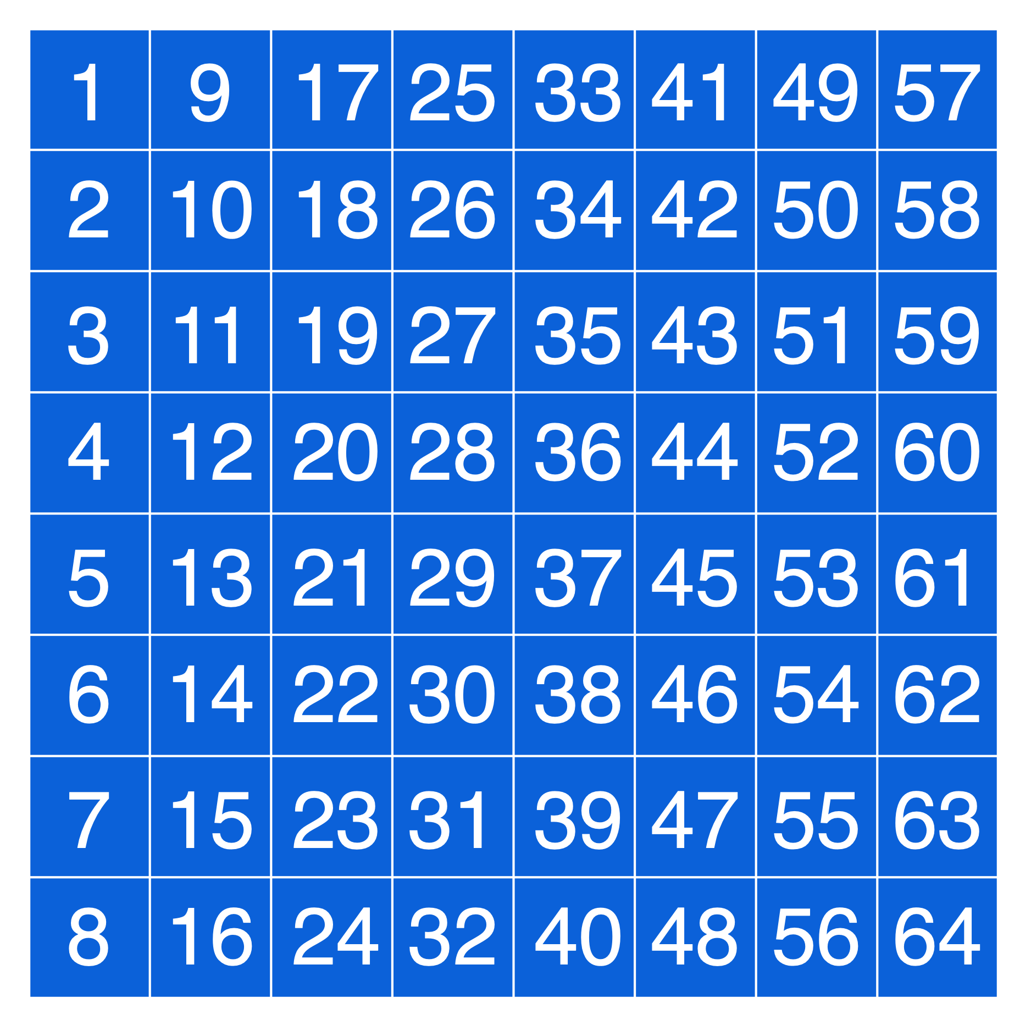
The schedule defines order & parallelism within stages
Serial x,
Serial y
Notes:
For example, we could traverse this 2D function sequentially across y, and within that sequentially across x.
This walks down columns, just like the first loops we wrote in C.

Slide 134
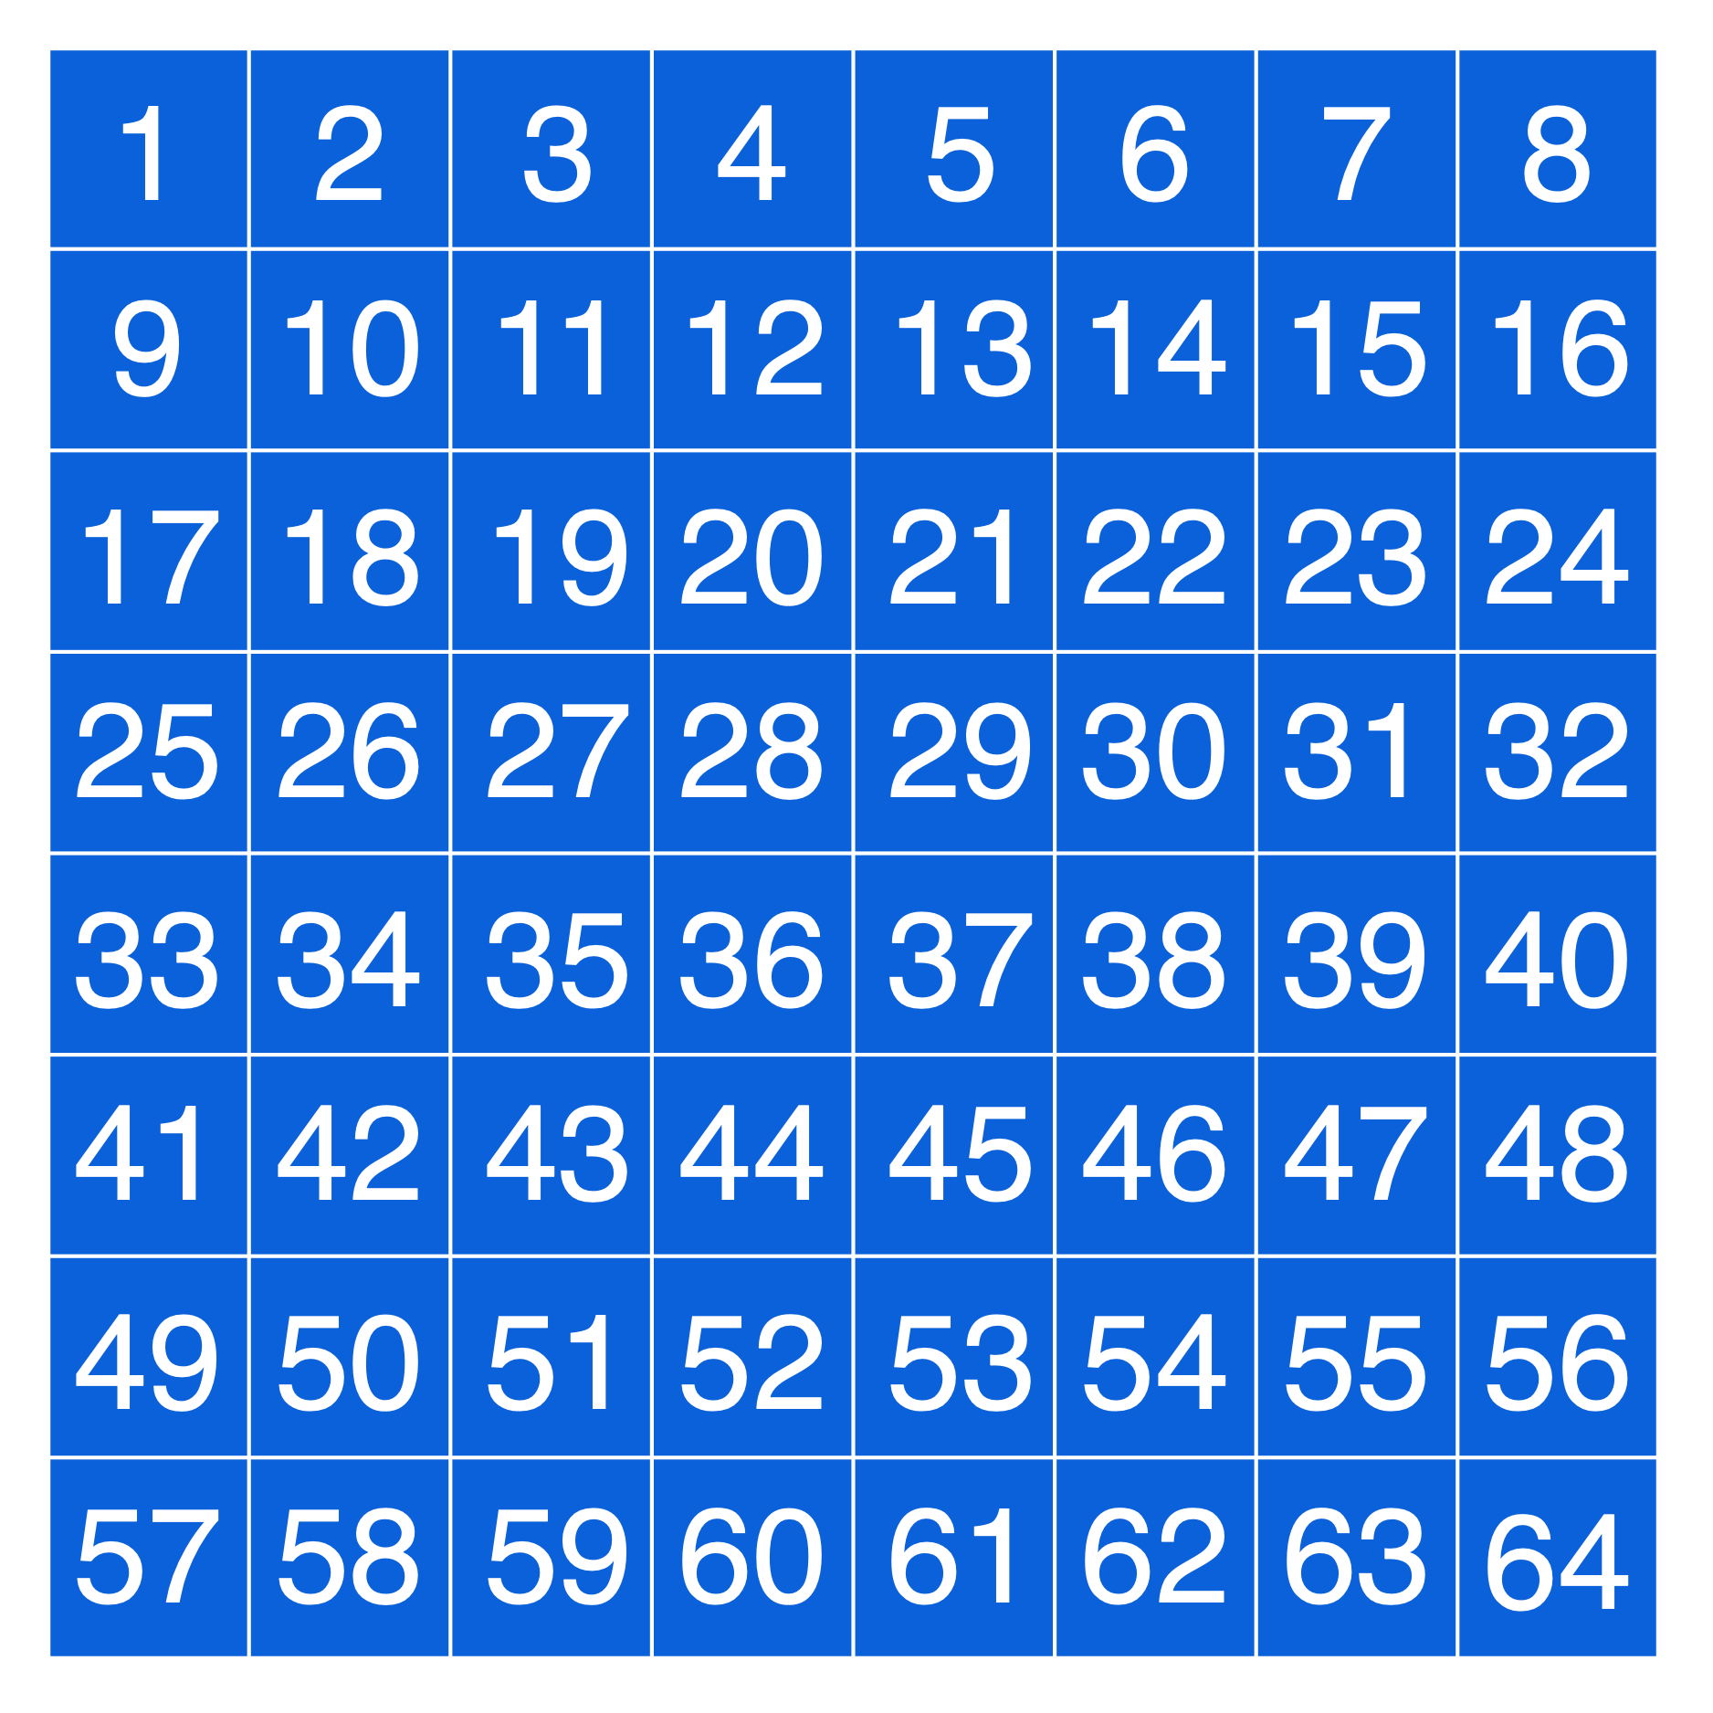
The schedule defines order & parallelism within stages
Serial y,
Serial x
Notes:
So we could process this 2D function sequentially across y, and within that sequentially across x,
giving a simple scanline order.

Slide 135
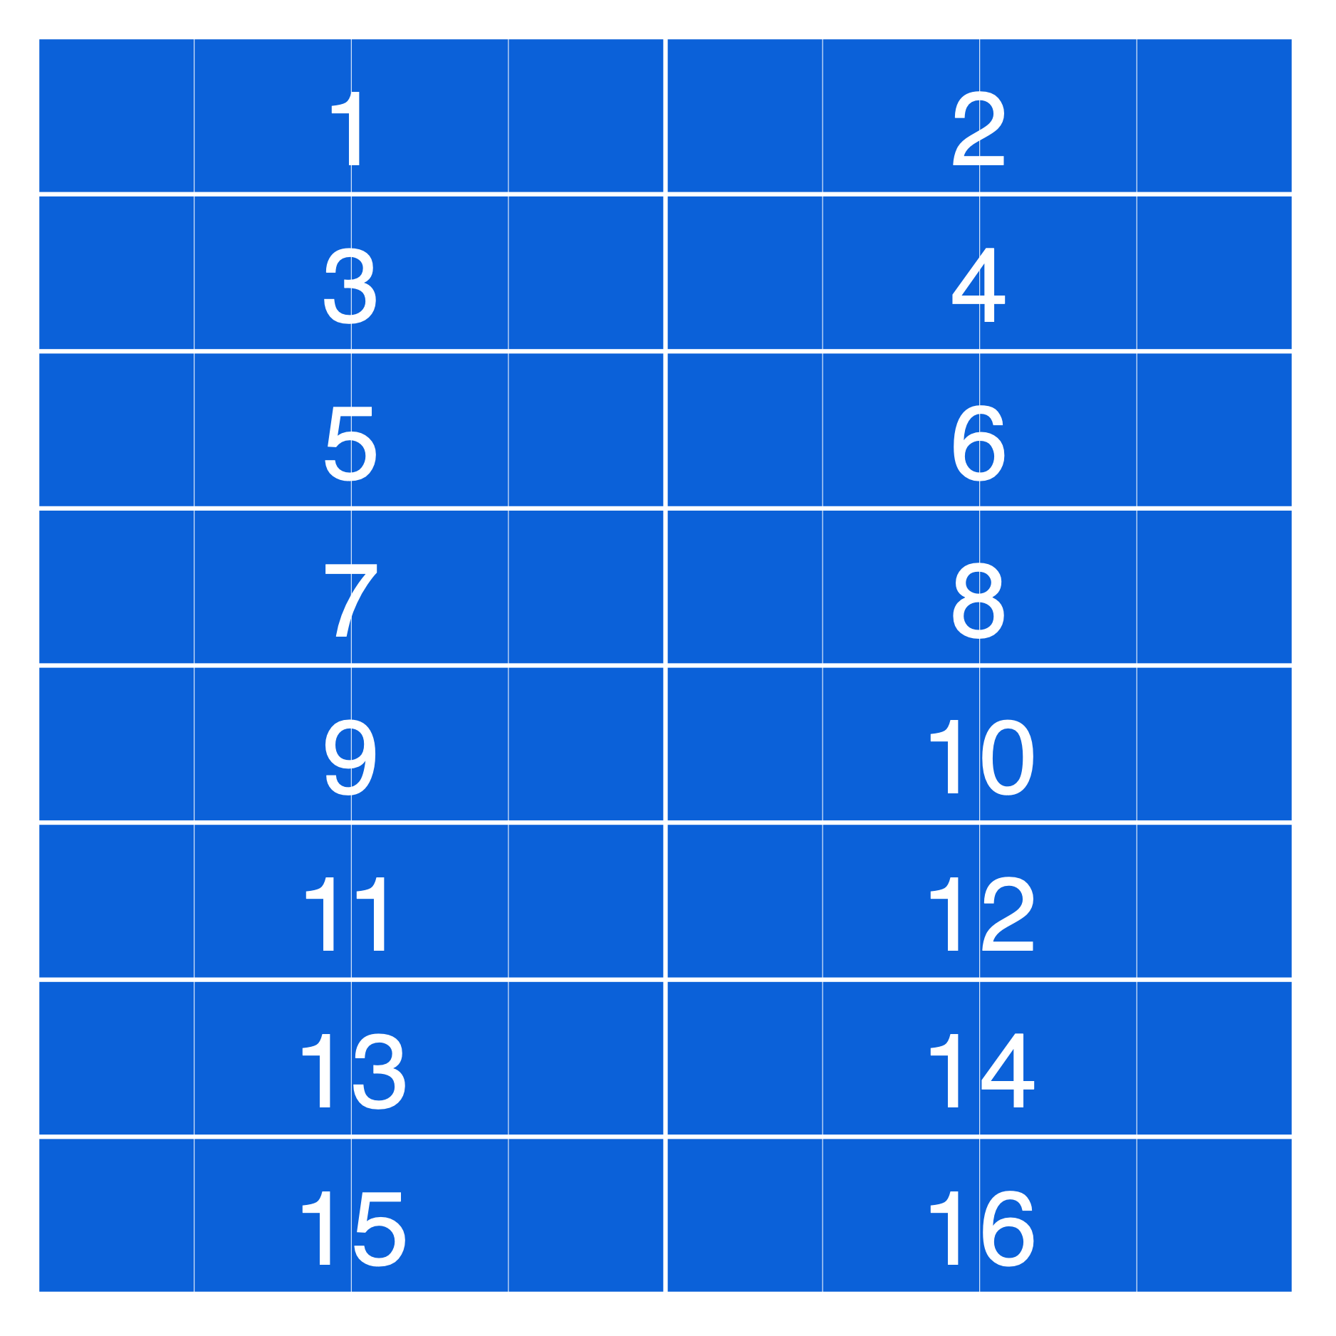
The schedule defines order & parallelism within stages
Serial y,
Vectorize x by 4
Notes:
We can compute the X dimension in vectors of width 4.

Slide 136
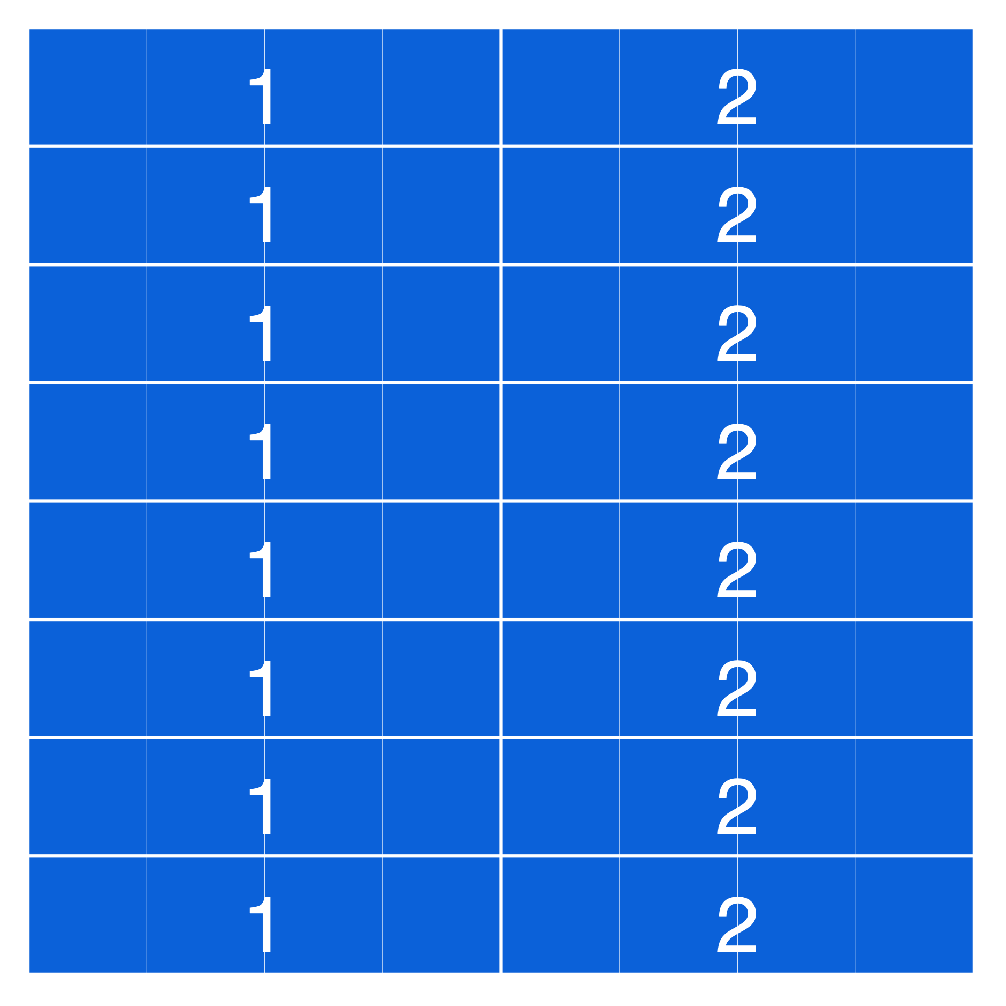
The schedule defines order & parallelism within stages
Parallel y,
Vectorize x by 4
Notes:
We can distribute the scanlines across parallel threads.

Slide 137
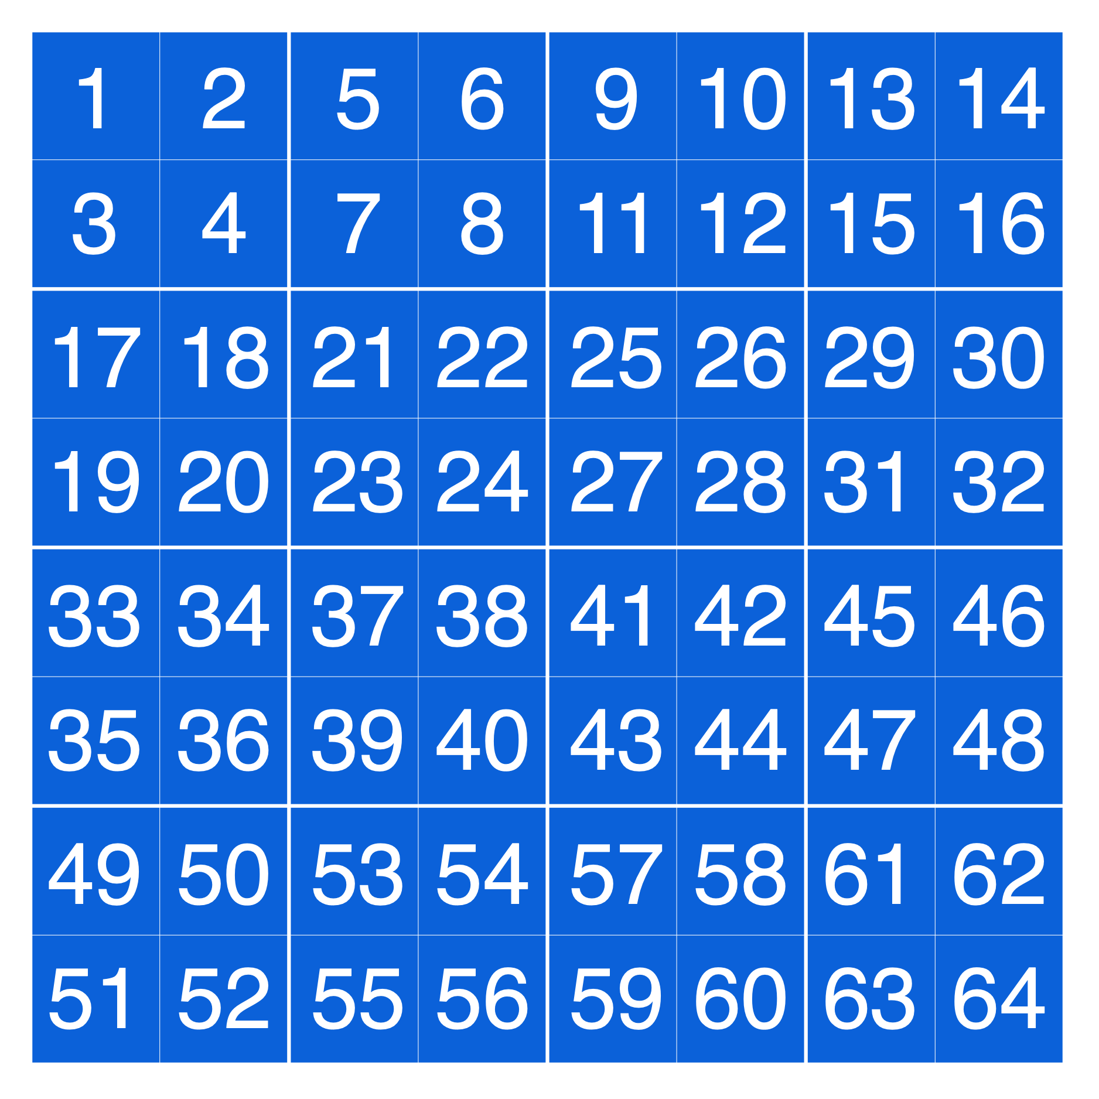
The schedule defines order & parallelism within stages
Split x by 2,
Split y by 2.
Serial youter,
Serial xouter,
Serial yinner,
Serial xinner
Notes:
Finally, we can split the X & Y dimensions into tiles,
which opens up further recursive choices for the order of the outer and inner components of each dimension.
- By traversing the outer components outside the inner components, we get a tiled traversal over 2x2 pixel tiles.

Slide 138
Domain order defines a loop nest for each function
Serial y,
Serial x
for (y : ymin..ymax)
for (x : xmin..xmax) {
eval[ f(x, y) ]
}
Split x by 2,
Split y by 2.
parfor (yo : yo_min..yo_max)
for (xo : xo_min..xo_max)
for (yi : yi_min..yi_max)
simdfor(xi : xi_min..xi_max by 4) {
eval<4>[ f(xo*2+xi, yo*2+yi) ]
}
Parallel yo,
Serial xo,
Serial yi,
Vectorize xi by 4
Notes:
What all these choices actually do is specify a loop nest to traverse the required region of each function.
- For example, the simple serial y, serial x order defines a basic row-major loop nest over which to evaluate the required region of the function.
- Putting all these ideas together, we can make a more complex schedule,
where we split the x & y dimensions into 2x2 tiles,
evaluate the outer y dimension in parallel,
and the inner x dimension in 4-wide vectors.
The specific complexities here don’t matter,
but I want to give a sense that the choices here are both rich and recursive.
- This synthesizes a 4-deep loop nest,
including a multithreaded parallel loop and an inner vector loop.
To be clear: this isn’t code a programmer writes,
it’s just a pseudocode to help show the structure these scheduling rules create.

Slide 139
The schedule defines producer-consumer interleaving
input
input
interleave
producers
blurx
with
consumers
blury
Notes:
Once we have the loop nests for evaluating each function’s own domain,
we need to decide how to interleave them with each other to compute the whole pipeline.
So the other thing the schedule defines is the order of evaluation between producers and consumers in the pipeline,
which determines the degree of fusion between stages.

Slide 140
The schedule defines producer-consumer interleaving
tone curve
  Fine-grained fusion optimizes locality for point-wise operations
color correct
Notes:
For simple point-wise operations, like a sequence of local tone and color adjustments,
it makes sense to fully fuse the pipeline by inlining the computation of each point in the first stage into the corresponding point in the second stage.
On the right, I’m showing a few pixels flowing down through these two stages.
- If we fully fuse, then as soon as we apply the tone adjustment to one pixel, we can immediately color correct it and then throw it away, maximizing locality.
- Doing this across the image, we produce and consume individual pixels down through the pipeline.
But this only works because of the simple, 1-to-1 dependence between pixels in these two stages.

Slide 141
The schedule defines producer-consumer interleaving
tone curve
  Fine-grained fusion optimizes locality for point-wise operations
color correct
tone curve
gaussian blur
Notes:
If instead we had a large blur as the second stage,
then each pixel in the blur depends on lots of pixels from the first stage.
- the dependence between even far away pixels has lots of overlap,
so if we fused,
we’d have to recompute or reload lots of the same pixels over and over again
for each point in the blur.

Slide 142
The schedule defines producer-consumer interleaving
tone curve
  Fine-grained fusion optimizes locality for point-wise operations
color correct
tone curve
  Breadth-first execution minimizes recomputation for large kernels
gaussian blur
Notes:
In this case, it makes more sense to
- pre-compute the entire producer stage,
- before evaluating the entire consumer stage.
So we sacrifice locality to avoid too much wasted work.

Slide 143
The schedule defines producer-consumer interleaving
tone curve
  Fine-grained fusion optimizes locality for point-wise operations
color correct
tone curve
  Breadth-first execution minimizes recomputation for large kernels
gaussian blur
tone curve
median filter
Notes:
For stencil operations, like our 3x1 blur,
each point in the consumer stage depends on a bounded window of the previous stage.
In this case,
full fusion would inline lots of redundant computation where the stencils overlapped,
but computing breadth-first would completely sacrifice producer-consumer locality.
The right answer is somewhere in between.

Slide 144
The schedule defines producer-consumer interleaving
tone curve
  Fine-grained fusion optimizes locality for point-wise operations
color correct
tone curve
  Breadth-first execution minimizes recomputation for large kernels
gaussian blur
  Tile-level fusion trades off locality vs. recomputation for stencils
tone curve
median filter
Notes:
We can schedule the stages to be computed in smaller tiles, sized to fit into nearby caches.
- We then interleave the computation of a producer tile
- …with the corresponding consumer tile
- …and so on
- …across the image.
This is the choice we saw with the optimized 3x3 blur example earlier.

Slide 145
The schedule defines producer-consumer interleaving
tone curve
  Fine-grained fusion optimizes locality for point-wise operations
color correct
tone curve
  Breadth-first execution minimizes recomputation for large kernels
gaussian blur
  Tile-level fusion trades off locality vs. recomputation for stencils
tone curve
median filter
Notes:
We may have to redundantly compute the values on the shared boundary between tiles.
But by changing the granularity of tiles,
we can span the space of choices between total fusion and breadth-first execution.
This gets back to my first beg message:
it lets us trade off between locality and redundant work.

Slide 146
The schedule defines producer-consumer interleaving
tone curve
  Fine-grained fusion optimizes locality for point-wise operations
color correct
tone curve
  Breadth-first execution minimizes recomputation for large kernels
gaussian blur
  Tile-level fusion trades off locality vs. recomputation for stencils
tone curve
median filter
Notes:
We may have to redundantly compute the values on the shared boundary between tiles.
But by changing the granularity of tiles,
we can span the space of choices between total fusion and breadth-first execution.
This gets back to my first beg message:
it lets us trade off between locality and redundant work.

Slide 147
The schedule defines producer-consumer interleaving
tone curve
  Fine-grained fusion optimizes locality for point-wise operations
color correct
tone curve
  Breadth-first execution minimizes recomputation for large kernels
gaussian blur
  Tile-level fusion trades off locality vs. recomputation for stencils
tone curve
median filter
Notes:
We may have to redundantly compute the values on the shared boundary between tiles.
But by changing the granularity of tiles,
we can span the space of choices between total fusion and breadth-first execution.
This gets back to my first beg message:
it lets us trade off between locality and redundant work.

Slide 148
The schedule defines producer-consumer interleaving
  Fine-grained fusion optimizes locality for point-wise operations
  Halide’s schedule is designed to span these tradeoffs
  Breadth-first execution minimizes recomputation for large kernels
redundant work
locality
  Tile-level fusion trades off locality vs. recomputation for stencils
tradeoff
parallelism
Notes:
Our model of scheduling is specifically designed to span this space of locality tradeoffs,
and to describe them separately for every pair of stages in the pipeline.

Slide 149
Model of interleaving: compute & storage granularities
for (g.x : g.xmin..g.xmax) {
eval[ g(g.x) ]
}
g(x) = in(x)+1
parfor (f.xo : f.xo_min..f.xo_max) {
for(f.xi : f.xi_min..f.xi_max) {
eval[ f(f.xo*2+f.xi) ]
}}
f(x) = 2*g(x)
Notes:
How this actually works is we specify a point in the loop nest of the caller

Slide 150
Tradeoff space modeled by granularity of interleaving
breadth-first
execution
coarse interleaving
low locality
tile-level
fusion
valid
schedules
compute
granularity
total
fusion
capturing reuse
constrains order
(less parallelism)
high locality,
no redundancy?
fine interleaving
high locality
redundant
computation
storage
granularity
no redundant
computation
Notes:
The way we actually trade this off is the most fundamental idea in Halide’s design.
[pause]
We do it by controlling the granularity at which the storage and computation of each stage is interleaved.
- the granularity with which we interleave computation determines how soon you use values after you compute them.
- Fine interleaving provides high temporal locality, quickly switching back and forth between computing and consuming values.
- Coarse interleaving provides poor locality, computing lots of values before using any of them.
[pause]
- The storage granularity determines how long we hold onto values for potential reuse.
- Fine-grained storage only keeps values for a short time before throwing them away, which can cause redundant computation if they’re needed again later.
- Coarse-grained storage keeps values around longer to capture more potential reuse.
[pause]
Using the examples from the previous slide,
- Full fusion interleaves the storage and computation of two stages at very fine granularity. This maximizes locality, but potentially introduces lots of redundant work.
- Breadth-first execution avoids any redundant work, but sacrifices locality.
- And tile-level fusion trades off between these extremes, depending on the size of the tiles the are interleaved.
- Now what about this bottom right corner?
- It turns out it’s also possible to maximize locality while doing no redundant work.
But doing this requires constraining the order of execution, which limits parallelism.

Slide 151
Sliding window execution sacrifices parallelism
tone curve
median filter
fixed order,
constrains
parallelism
Notes:
By setting the storage granularity to the coarsest level, while interleaving computation per-pixel, we get a sliding-window pattern like this.
- after computing the first two values in the first stage
- for each new value computed,
we can immediately consume it to compute the corresponding value in the second stage…
continuing this ways across the image.
this has excellent locality, and computes every value only once, wasting no work.
- But to do this, we have to walk across the images together in a fixed order,
so we’ve sacrificed potential data parallelism
to optimize locality and redundant work.
[pause]
I want to emphasize that this is not just a laundry list of scheduling options.
Fundamentally, it is a parameterization of the space of tradeoffs.
Our schedules directly model and span this space.

Slide 152
The schedule defines intra-stage order, inter-stage interleaving
what we’ve done: create a co-language for scheduling choices.
choices are specified per-edge in the pipeline (graph)
composing these choices (recursively) lets us span the space of locality/parallelism/redundant work tradeoffs
choices are orthogonal to algorithm;
compiler synthesizes resulting program
For each stage:
In what order should it compute its values?
When should it compute its inputs?
defines per-function loop nest
defines interleaving of functions’ loop nests within each other
This is a co-language for scheduling choices.
  Choices specified per-function called
  Orthogonal to algorithm
Notes:
So to pop back up,
For each stage in the pipeline, the schedule specifies 2 things:
First, in what order should that stage compute its values.
- This effectively defines a loop nest per-function, including choices like multithreaded parallelism and vectorization.
Second, the schedule defines when each function should compute each of its inputs.
- This defines an interleaving of the loop nests for all of the functions in the pipeline, within each other,
and determines the tradeoff between locality, reuse granularity, and redundant work.
- Effectively what we’ve done is create a co-language,
as part of Halide,
for modeling this space of scheduling choices.
Composing these choices in different ways for different stages
spans the space of tradeoffs, globally, for an entire pipeline.
---[cut]---
These choices are specified for each function in an entire pipeline or graph.
They’re orthogonal to the definition of the algorithm.
And they unambiguously define the organization of the resulting program for the compiler to synthesize.

Slide 153
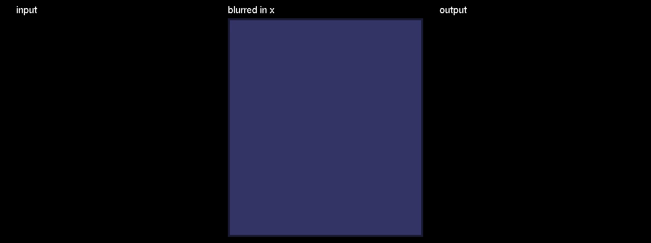
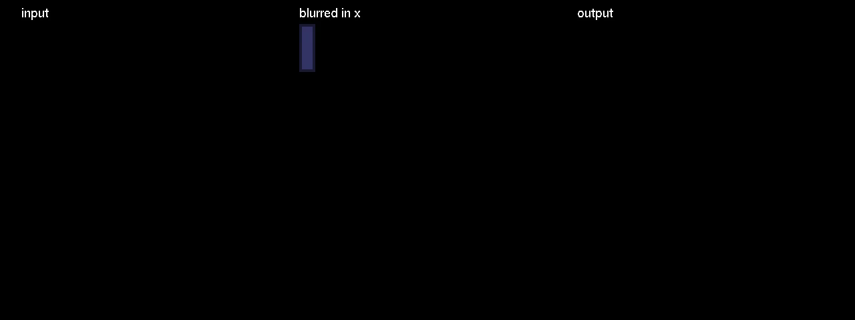

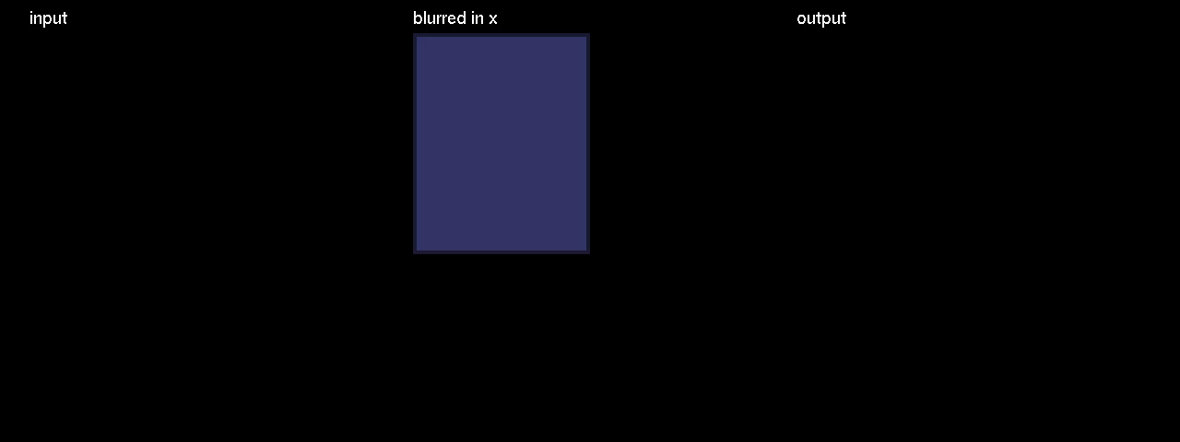

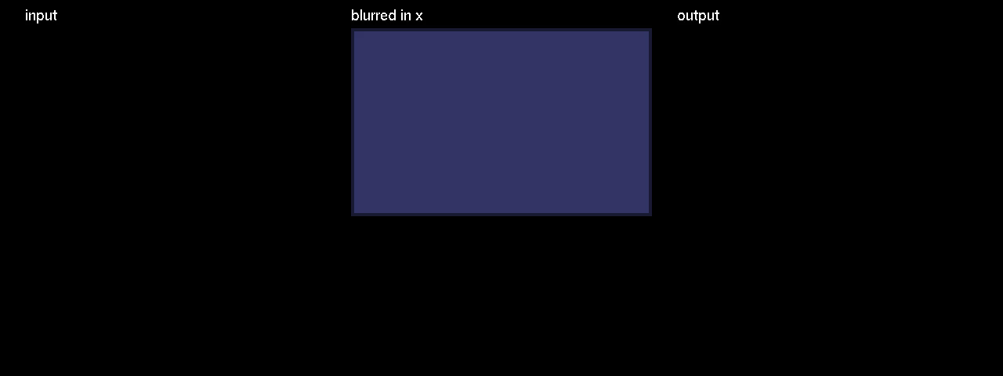
Schedule primitives compose to create many organizations
blur_x.compute_at_root() | blur_x.compute_at(blury, x) | blur_x.compute_at(blury, x) .store_at_root()
blur_x.compute_at(blury, x) .vectorize(x, 4) blur_y.tile(x, y, xi, yi, 8, 8) .parallel(y) .vectorize(xi, 4) | blur_x.compute_at(blury, y) .store_at_root() .split(x, x, xi, 8) .vectorize(xi, 4) .parallel(x) blur_y.split(x, x, xi, 8) .vectorize(xi, 4) .parallel(x) | blur_x.compute_at(blury, y) .store_at(blury, yi) .vectorize(x, 4) blur_y.split(y, y, yi, 8) .parallel(y) .vectorize(x, 4)
in
blurx
blury
in
blurx
blury
in
blurx
blury
redundant work
locality
redundant work
locality
redundant work
locality
parallelism
parallelism
parallelism
in
blurx
blury
in
blurx
blury
in
blurx
blury
redundant work
locality
redundant work
locality
redundant work
locality
parallelism
parallelism
parallelism
Notes:
Even for a pipeline as simple as the two-stage blur,
we can express an infinite range of choices in how to organize the computation.
You don’t have to follow what’s going on in all these,
but it gives a flavor of what I mean.
The top three versions sit at extremes of the tradeoff space,
while the bottom three balance them all in different ways.
- And here’s what they actually look like running.
Different strategies will be best, depending on
* the exact algorithms being used,
* the structure of the pipeline into which they’re composed,
* and how they interact with the hardware architecture on which they’re running.
and the difference between them can be more than an order of magnitude in performance and efficiency.

Slide 154
Halide
0.9 ms/megapixel
Func box_filter_3x3(Func in) {
Func blurx, blury;
Var x, y, xi, yi;
// The algorithm - no storage, order
blurx(x, y) = (in(x-1, y) + in(x, y) + in(x+1, y))/3;
blury(x, y) = (blurx(x, y-1) + blurx(x, y) + blurx(x, y+1))/3;
// The schedule - defines order, locality; implies storage
blury.tile(x, y, xi, yi, 256, 32)
.vectorize(xi, 8).parallel(y);
blurx.compute_at(blury, x).store_at(blury, x).vectorize(x, 8);
return blury;
}
Notes:
Putting this all together to describe an optimized blur looks like this.
This is the same blur algorithm from before,
annotated with a schedule equivalent to the optimized C++ from the beginning.
- First, it schedules blury to be evaluated in tiles of 256x32 pixels.
Each of these tiles is computed in 8-wide vectors across the x dimension,
and across parallel threads in the y dimension.
- Then it schedules the intermediate stage, blurx, to computed and stored as needed at each tile of blury,
and also vectorizes it across x.

Slide 155
Halide
C++
0.9 ms/megapixel
0.9 ms/megapixel
Func box_filter_3x3(Func in) {
Func blurx, blury;
Var x, y, xi, yi;
// The algorithm - no storage, order
blurx(x, y) = (in(x-1, y) + in(x, y) + in(x+1, y))/3;
blury(x, y) = (blurx(x, y-1) + blurx(x, y) + blurx(x, y+1))/3;
// The schedule - defines order, locality; implies storage
blury.tile(x, y, xi, yi, 256, 32)
.vectorize(xi, 8).parallel(y);
blurx.compute_at(blury, x).store_at(blury, x).vectorize(x, 8);
return blury;
}
void box_filter_3x3(const Image &in, Image &blury) {
__m128i one_third = _mm_set1_epi16(21846);
#pragma omp parallel for
for (int yTile = 0; yTile < in.height(); yTile += 32) {
__m128i a, b, c, sum, avg;
__m128i blurx[(256/8)*(32+2)]; // allocate tile blurx array
for (int xTile = 0; xTile < in.width(); xTile += 256) {
__m128i *blurxPtr = blurx;
for (int y = -1; y < 32+1; y++) {
const uint16_t *inPtr = &(in[yTile+y][xTile]);
for (int x = 0; x < 256; x += 8) {
a = _mm_loadu_si128((__m128i*)(inPtr-1));
b = _mm_loadu_si128((__m128i*)(inPtr+1));
c = _mm_load_si128((__m128i*)(inPtr));
sum = _mm_add_epi16(_mm_add_epi16(a, b), c);
avg = _mm_mulhi_epi16(sum, one_third);
_mm_store_si128(blurxPtr++, avg);
inPtr += 8;
}}
blurxPtr = blurx;
for (int y = 0; y < 32; y++) {
__m128i *outPtr = (__m128i *)(&(blury[yTile+y][xTile]));
for (int x = 0; x < 256; x += 8) {
a = _mm_load_si128(blurxPtr+(2*256)/8);
b = _mm_load_si128(blurxPtr+256/8);
c = _mm_load_si128(blurxPtr++);
sum = _mm_add_epi16(_mm_add_epi16(a, b), c);
avg = _mm_mulhi_epi16(sum, one_third);
_mm_store_si128(outPtr++, avg);
}}}}}
Notes:
This generates nearly identical machine code to the C++,
but with just 2 lines each of algorithm and schedule.
Unlike the C,
the Halide version makes it easy to add new stages,
change the algorithm,
or change the organization.
It can also compile not just to x86, but to fast ARM NEON code,
and with a few tweaks to the schedule,
we can express a range of GPU implementations.

Slide 156
More language features
beyond the scope of this lecture
Computed, data-dependent reads (gather)
  f(x) = g(floor(2.3*in(x)))
Computed, data-dependent writes (scatter)
  f(g(floor(2.3*in(x)))) = in(x)
Recursive functions (IIR convolution, scan)
  cdf(i) = cdf(i-1) + pdf(i)
Reductions
histogram, etc.
Notes:
Halide also has a number of language features beyond the scope of this talk,
to represent things more complex than simple stencils.
Functions can access other functions at arbitrary, computed, or data-dependent coordinates.
Functions can also define their own values at computed or data-dependent coordinates.
And functions can be defined recursively, to encode scans computations like IIR filters.
- Composing these last two features,
we can implement general reductions for things like histograms.

Slide 157
The Halide Compiler
Halide Functions
Halide Schedule
Imperative Pipeline
Vectorization &
peephole optimization
LLVM bitcode
x86
(with SSE)
ARM
(with NEON)
CUDA
(host+kernel graph)
Notes:
Our current implementation is an embedded DSL in C++,
and it uses the LLVM compiler infrastructure for code generation.
To compile a pipeline, we take the Halide function definitions and the schedule,
and combine those to a single piece of scheduled imperative code,
describing the entire fused pipeline
for a given architecture.
After our own vectorization pass and other optimizations,
we pass it to LLVM to compile into vectorized X86 or ARM code,
or to CUDA kernels and x86 code, including all the logic to launch and manage them.
In the last case, we can actually generate heterogeneous mixtures of vectorized and multithreaded CPU code, intertwined with GPU kernels, based on the structure defined in the schedule.

Slide 158
How can we determine good schedules?
Explicit programmer control
The compiler does exactly what you say.
Schedules cannot influence correctness.
Exploration is fast and easy.
Stochastic search (autotuning)
Pick your favorite high-dimensional search.
(We used Petabricks’ genetic algorithm tuner [Ansel et al. 2009])
Notes:
But to pop back up, the last question is: how do we determine good schedules?
So far, we’ve worked on two ways.
- First, you can write them partially or completely by hand.
This is much easier than traditional hand-optimization,
because schedules can’t change the meaning of the algorithm, and the compiler does all the work of synthesizing the complex control flow and data management your schedule implies.
You can think of this like a rapid prototyping tool for high performance imaging.
Expert developers—including people using this at places like Adobe and Google—really love the control and predictability this gives them.
You can also use this to quickly try out different schedules for the same algorithm on different hardware,
when porting from PC to mobile or GPU, or potentially more specialized hardware.
- Second, we can automatically search the space of schedules for a given pipeline on a given architecture using auto-tuning. The dimensionality of the problem is large, so we’ve focussed on stochastic search, and in practice we used a derivative of Petabricks’ genetic algorithm-based tuner.
I’m going to present results from a few real computational photography and imaging applications built in Halide.
I chose them because they represent a wide range of different program structures and levels of optimization in this domain.
For all of these, I’m going to include the complexity of the best hand-tuned schedule we found.
But our autotuner has matched or beaten our hand-tuned performance on all of these apps,
entirely automatically.

Slide 159
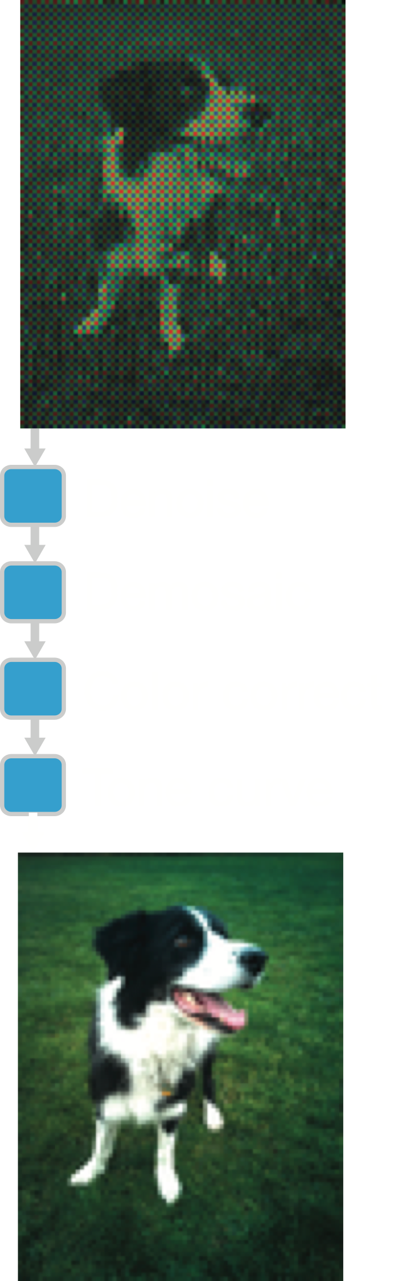
The Frankencamera Raw Pipeline
[Adams et al. 2010]
Converts raw image sensor data into an image
Original: 463 lines of ARM assembly and intrinsics in one big function
Rewritten in Halide, it is 2.75x less code, and runs 5% faster
redundant work
locality
parallelism
Notes:
Our first application was rewriting the software post-processing pipeline from the frankencamera project, which does the basic steps necessary to turn raw sensor data into a usable image.
Andrew Adams, my coauthor, wrote the original code. It painful to write, because it needed to be very fast on the ARM processor in the frankencamera
It was 500 lines of C with vector intrinsics and sections of hand-tuned assembly where we couldn’t get the compiler to do what they wanted.
Each time he wanted to try some new strategy for optimizing it, for example fusing two of the stages, he had to move around large blocks of code, and then fix the bugs he introduced in the process.
- We rewrote it in Halide. The resulting code was significantly shorter, and ran slightly faster, because we were able to find a better schedule fairly quickly.
This is a deep pipeline of several dozen individual operations and small stencils.
- The best schedules fuse the entire pipeline in tiles, sized to fit in the ARM core’s L1 cache.
This introduces redundant computation on tile boundaries, but saves enormous bandwidth loading and storing intermediate data.
The tiles are spread across parallel threads, and internally vectorized, for a near-linear speedup.
---
So here we found we could meet the performance of carefully hand-written code, but we make it much easier to explore alternative strategies, which means we’ll often find something faster.

Slide 160
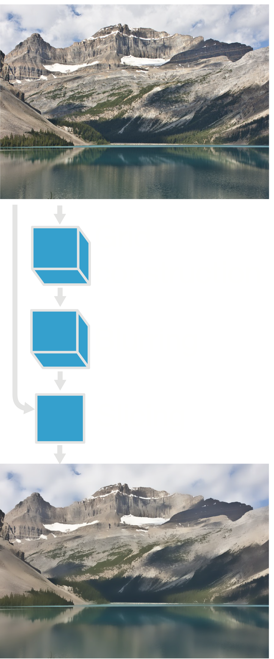
The Bilateral Grid
[Chen et al. 2007]
An accelerated bilateral filter
Original: 122 lines of (clean) C++
Halide: 34 lines of algorithm, 6 lines of schedule
On the CPU, 5.9x faster
On the GPU, 2x faster than Chen’s hand-written CUDA version
redundant work
locality
parallelism
Notes:
First, we looked at the bilateral grid—a fast algorithm for the bilateral filter.
We implemented it in Halide, and compared to a pretty efficient but clean C++ version done by the original authors.
- Our version uses one third of the code,
- and runs six times faster
With a different schedule, we can run on the GPU instead.
- We looked at author’s hand-written CUDA version, and started with a schedule that matched their strategy. We tried a few alternative schedules, and found a slightly nonintuitive one that was twice as fast as the hand-tuned CUDA.
- Now, Halide isn’t doing anything here that you couldn’t do yourself, manually,
but with Halide it’s easier to try out different organizations of the computation that might pay off.
In this case, the ideal tradeoff sacrificed a little parallelism to improve locality during the reduction step that constructs the grid.

Slide 161
“Snake” Image Segmentation
[Li et al. 2010]
Segments objects in an image using level-sets
Original: 67 lines of matlab
Halide: 148 lines of algorithm, 7 lines of schedule
On the CPU, 70x faster
  matlab is memory-bandwidth limited
On the GPU, 1250x faster
redundant work
locality
parallelism
Notes:
Next, we implemented a level-sets segmentation algorithm used in medical computer vision.
The reference implementation is in MATLAB, and is extremely terse, so the Halide version is longer.
- But the Halide version is 70 times faster on the same CPU.
Now it’s easy to make MATLAB slow, but this code doesn’t hit any of the usual pitfalls.
It’s all expressed as single-line, whole-image operations, so there’s almost no interpreter overhead.
- The big difference is in locality. MATLAB takes the library approach.
So under the hood, these whole-image operations are highly optimized,
but when you stitch them together the pipeline is hopelessly memory bandwidth limited.
The Halide version expresses the algorithm as the same sequence of whole-image operations,
but our schedule fuses them all together into a single parallel loop over pixels.
So the reason why we’re better than MATLAB isn’t because MATLAB is interpreted and we’re compiled.
It’s actually because we’ve totally reorganized the computation to maximize locality.
- If we want to beat up on MATLAB a little more,
we can change a single line of code to run on the GPU instead,
where we’re over a thousand times faster.

Slide 162
Stable Fluids
[Stam 1999]

Slide 163

Local Laplacian Filters
[Paris et al. 2010, Aubry et al. 2011]
Pyramid-based algorithm for increasing local contrast
Over 100 stages,
with complex dependence
Notes:
The last application I want to look at is also the most complex:
local Laplacian filters works by processing an image in many different ways,
and then combining them using a Laplacian pyramid.
It's a recent development from SIGGRAPH, and is already used in a bunch of applications.

Slide 164
Local Laplacian Filters
prototype for Adobe Photoshop Camera Raw / Lightroom
Adobe: 1500 lines of expert-optimized C++
  multi-threaded, SSE
  3 months of work
  10x faster than original C++
Halide: 60 lines
  1 intern-day
2x faster on CPU,
7x faster on GPU
Notes:
It’s used heavily in Adobe’s Camera Raw pipeline,
which is a major component of Photoshop and Lightroom.
- It’s used for shadow/highlight tone adjustment, and the clarity filter.
- Their original version was written by one of their best developers, in over 1000 lines of optimized C++.
It’s multithreaded, and hand-coded for SSE.
It took him about three months to implement and optimize.
Just like our blur example,
this optimized version is 10 times faster than a clean version written in about 300 lines of C++.
- Last summer, I took a single day to rewrite their version of local laplacian filters in Halide, and integrate it into Lightroom.
It took 60 lines of code, and ran twice as fast as their version on the same 8 core machine.
We would have been happy to even approach the speed of this expert implementation with our much simpler description.
At the time, Adobe was starting to investigate GPU acceleration,
but they were scared by the cost of completely rewriting tens of thousands of lines of code.
But on that same day, by changing just a few lines in the Halide schedule,
we also generated mixed CPU/GPU code that runs 7 times faster than the CPU version.

Slide 165
Local Laplacian Filters
Adobe: 1500 lines of expert-optimized C++
  multi-threaded, SSE
  3 months of work
    10x faster than original C++
Halide: 60 lines
  1 intern-day
2x faster on CPU,
7x faster on GPU
…
…
…
…
Notes:
So how did we beat expert-tuned code?
The win came mostly from fusing stages to different degrees,
and accepting some redundant computation in exchange for better locality.
- But our implementation didn't just make a few extra optimizations:
it had to fuse and schedule
each of the hundred stages differently,
to globally balance parallelism,
locality,
and the total amount of work, across the whole pipeline.
The best organization of the computation was just too hard for the original developer to find.
He stopped after 3 months of rewriting and optimizing for a specific machine.
But with Halide, it was orders of magnitude easier to globally reorganize the computation,
and as a result we were able to find something more efficient overall, in a single day!
And again, our version is also easily portable across different architectures,
where different schedules give the best performance.

Slide 166
Recap so far: The Halide language & compiler
Decouples algorithm from organization
through a scheduling co-language to navigate fundamental tradeoffs.
redundant work
locality
parallelism
Simpler programs
Faster than hand-tuned code
Scalable across architectures
  open source at http://halide-lang.org
Notes:
So that’s our experience so far with Halide.
- To recap: The big idea was to explicitly decouple the definition of the algorithm,
from the organization of computation.
We went further than most prior languages by making the scheduling co-language,
a first-class part of the design
—rather than just implementation choices inside a compiler backend.
We designed the model of scheduling specifically to span the space of tradeoffs
fundamental to organizing computation in data parallel image processing pipelines.
We put particular emphasis on the potential of redundant computation to break dependencies,
and minimize communication.
- The end result are:
* simpler programs
* that run faster than hand-tuned code,
* while giving composable & portable components,
which can scale from ARM mobile phones to massively parallel GPUs.
- Our implementation is open source, and is being actively developed
in collaboration with Google and Adobe,
And people are already using it at both companies.
----[cut]-----
including the former lead engineer of Photoshop Camera Raw and Lightroon.

Slide 167
Message #1: Performance requires complex tradeoffs
redundant work
locality
tradeoff
parallelism
Notes:
Because of this,
it can often be most efficient to make surprising tradeoffs,
like redundantly recomputing values used in multiple places,
instead of storing and reloading them from memory.
[pause] This is the first key message I want you to take away from this talk:
parallelism, locality, and the total amount of work performed
interact in complex ways.
They often need to be traded off against each other
to maximize the performance and efficiency
of an application on a particular machine.
The architecture community is well aware of these pressures.
They’re trying to exploit locality and parallelism to improve energy efficiency in hardware designs.
And the software community recognizes the need to expose increasing parallelism in applications,
But these challenges are still acute in how we design software
—especially locality, at least as much as parallelism.

Slide 168
Message #2: algorithm vs. organization
input
…
…
blurx
…
…
algorithm
organization
blury
…
…
order and interleaving
radically alter performance
of the same algorithm
Notes:
The second message was that these tradeoffs are determined by the organization of computation.
- We’ve seen that
changing the order and granularity of computation has a huge impact on performance.
In this visualization we’ve been using,
- these aspects of the organization
are given by the red path we take through the computation.
- and the algorithm defines the dependencies between the individual tasks.

Slide 169
Message #3: dependencies limit choices of organization
input
…
…
blurx
…
…
dependencies
organization
blury
…
…
Notes:
--- [20mins-ish?] ---
And this leads to the last major message of my talk,
Which is that:
The ways we can reorganize this graph,
and the effect each choice has on locality, parallelism, and the amount of work,
is a function of the fundamental dependencies in the algorithm.
This is also the place where domain-specific knowledge can the biggest difference.

Slide 170
The Halide Language

Slide 171
References
http://halide-lang.org/
http://people.csail.mit.edu/jrk/halide12
http://people.csail.mit.edu/jrk/halide-pldi13.pdf
http://www.connellybarnes.com/documents/halide/

Slide 172
The algorithm defines pipelines as pure functions
Pipeline stages are functions from coordinates to values
Execution order and storage are unspecified
3x3 blur as a Halide algorithm:
Func blurx, blury;
Var x, y;
blurx(x, y) = (in(x-1, y) + in(x, y) + in(x+1, y))/3;
blury(x, y) = (blurx(x, y-1) + blurx(x, y) + blurx(x, y+1))/3;
Notes:
Once we strip out the concerns of scheduling
the algorithm is defined as a series of functions from pixel coordinates to expressions giving the values at those coordinates.
These functions have no side effects.
They can be evaluated over any point in an infinite domain, and the required region of each stage is inferred by the compiler.
The execution order and storage of points in each function are unspecified.
Points can be evaluated, or reevaluated, in any order.
The results can be cached, duplicated, thrown away, or recomputed without changing the meaning.
- The resulting code looks like this for the 3x3 blur.
The first stage, blurx, is defined at any point x,y as the average of 3 points in the input.
Then blury at any point x,y is the average of 3 points in blurx.

Slide 173
Basic Halide program (default schedule)
Image<float> input = load<float>("images/rgb.png");
Var x, y;
Func blur_x;
Func blur_y;
blur_x(x,y) = (input(x,y)+input(x+1,y)+input(x+2,y))/3.0;
blur_y(x,y) = (blur_x(x,y)+blur_x(x,y+1)+blur_x(x,y+2))/3.0;
Image<float> output = blur_y.realize(input.width()-2, input.height()-2);

Slide 174
Halide is an embedded language
Image<float> input = load<float>("images/rgb.png");
Var x, y;
Func blur_x;
Func blur_y;
blur_x(x,y) = (input(x,y)+input(x+1,y)+input(x+2,y))/3.0;
blur_y(x,y) = (blur_x(x,y)+blur_x(x,y+1)+blur_x(x,y+2))/3.0;
Image<float> output = blur_y.realize(input.width()-2, input.height()-2);

Slide 175
Halide
Halide is an embedded language
Uses metaprogramming

Slide 176
Metaprogramming
Halide is an embedded language (in C++)
Create C++ objects that describe a Halide program

Slide 177
Metaprogramming
Image<float> input = load<float>("images/rgb.png");
Var x, y;
Func blur_x;
Func blur_y;
blur_x(x,y) = (input(x,y)+input(x+1,y)+input(x+2,y))/3.0;
blur_y(x,y) = (blur_x(x,y)+blur_x(x,y+1)+blur_x(x,y+2))/3.0;

Slide 178
Metaprogramming
Create C++ objects that describe a Halide program
Essentially algebraic trees (Abstract Syntax Tree, AST)
Once the representation is constructed, call .realize() to compile and execute
  This calls the C++ Halide compiler, creates binary, executes it
Metaprogramming
  Makes it easy to embed in an existing language and codebase
  Avoids the need to parse

Slide 179
Syntax: Main types/keywords
Func : pure functions over an integer domain
Var : pure abstract variables for domain of Funcs
Expr: algebraic expressions of Funcs and Var
  including standard operators and functions (+,-,&, /, **, sqrt, sin, cos...)
Image: arrays used as inputs and outputs

Slide 180
Basic Halide program (default schedule)
Image<float> input = load<float>("images/rgb.png");
Var x, y;
Func blur_x;
Func blur_y;
blur_x(x,y) = (input(x,y)+input(x+1,y)+input(x+2,y))/3.0;
blur_y(x,y) = (blur_x(x,y)+blur_x(x,y+1)+blur_x(x,y+2))/3.0;
Image<float> output = blur_y.realize(input.width()-2, input.height()-2);

Slide 181
Basic Halide program: Metaprogramming

Slide 182
Halide schedule
0.9 ms/megapixel
Func box_filter_3x3(Func in) {
Func blurx, blury;
Var x, y, xi, yi;
// The algorithm - no storage, order
blurx(x, y) = (in(x-1, y) + in(x, y) + in(x+1, y))/3;
blury(x, y) = (blurx(x, y-1) + blurx(x, y) + blurx(x, y+1))/3;
// The schedule - defines order, locality; implies storage
blury.tile(x, y, xi, yi, 256, 32)
.vectorize(xi, 8).parallel(y);
blurx.compute_at(blury, x).store_at(blury, x).vectorize(x, 8);
return blury;
}
Notes:
Putting this all together to describe an optimized blur looks like this.
This is the same blur algorithm from before,
annotated with a schedule equivalent to the optimized C++ from the beginning.
- First, it schedules blury to be evaluated in tiles of 256x32 pixels.
Each of these tiles is computed in 8-wide vectors across the x dimension,
and across parallel threads in the y dimension.
- Then it schedules the intermediate stage, blurx, to computed and stored as needed at each tile of blury,
and also vectorizes it across x.

Slide 183
Loops are implicit !!!!!!
Image<float> input = load<float>("images/rgb.png");
Var x, y;
Func blur_x;
Func blur_y;
blur_x(x,y) = (input(x,y)+input(x+1,y)+input(x+2,y))/3.0;
blur_y(x,y) = (blur_x(x,y)+blur_x(x,y+1)+blur_x(x,y+2))/3.0;
Image<float> output = blur_y.realize(input.width()-2, input.height()-2);

Slide 184
Hand-optimized C++
11x faster
(quad core x86)
9.9 → 0.9 ms/megapixel
void box_filter_3x3(const Image &in, Image &blury) {
__m128i one_third = _mm_set1_epi16(21846);
#pragma omp parallel for
for (int yTile = 0; yTile < in.height(); yTile += 32) {
__m128i a, b, c, sum, avg;
__m128i blurx[(256/8)*(32+2)]; // allocate tile blurx array
for (int xTile = 0; xTile < in.width(); xTile += 256) {
__m128i *blurxPtr = blurx;
for (int y = -1; y < 32+1; y++) {
const uint16_t *inPtr = &(in[yTile+y][xTile]);
for (int x = 0; x < 256; x += 8) {
a = _mm_loadu_si128((__m128i*)(inPtr-1));
b = _mm_loadu_si128((__m128i*)(inPtr+1));
c = _mm_load_si128((__m128i*)(inPtr));
sum = _mm_add_epi16(_mm_add_epi16(a, b), c);
avg = _mm_mulhi_epi16(sum, one_third);
_mm_store_si128(blurxPtr++, avg);
inPtr += 8;
}}
blurxPtr = blurx;
for (int y = 0; y < 32; y++) {
__m128i *outPtr = (__m128i *)(&(blury[yTile+y][xTile]));
for (int x = 0; x < 256; x += 8) {
a = _mm_load_si128(blurxPtr+(2*256)/8);
b = _mm_load_si128(blurxPtr+256/8);
c = _mm_load_si128(blurxPtr++);
sum = _mm_add_epi16(_mm_add_epi16(a, b), c);
avg = _mm_mulhi_epi16(sum, one_third);
_mm_store_si128(outPtr++, avg);
}}}}}
Tiled, fused
Vectorized
Multithreaded
Redundant computation
Near roof-line optimum
Notes:
This is a hand-optimized version of the same blur function.
It’s tiled, multithreaded, vectorized, and fused.
The loops are restructured, and the developer had to introduce redundant computation on the tile boundaries, and change the storage layout.
It’s a big mess, given that all we’re doing is averaging together 3x3 pixels,
- But the end result is an order of magnitude faster than the previous version,
and runs near the peak throughput for this machine.
It takes less than 1 millisecond per megapixel processed on a quad-core x86,
vs. about 10 milliseconds for the clean version, optimized with the latest GCC.
In this talk,
We’re going to deconstruct the fundamental things this optimized version actually does—where its performance comes from, and what expert programmers do by hand.
First, I’ll focus on introducing a theory of the problem and its challenges,
and then I’ll show how we apply this to build a model from which we actually generate code.

Slide 185
Halide is a purely Functional language
No side effect, no environments!
  Define your algorithm as a pipeline of pure functions
Loops are NOT specified in the Halide algorithm
  That’s the job of the schedule

Slide 186
Main Halide elements
Func: pure functions defined over integer domain
  These are the central objects in Halide
  e.g. blur, brighten, harris, etc.
Var: abstract variable representing the domain
  e.g. x, y, c
Expr: Algebraic expression of Halide Funcs and Vars
  e.g. x**2+y+blur(x,y,c)
  Most operators and functions you expect are available (+, -, *, /, **, sqrt, cos..)
Image: represents inputs and output image
  Can be created from our numpy arrays.
  Careful: convention is that order is x, y

Slide 187
Under the hood
Func, Var, Expr, Image are C++ classes representing Halide programs
Declare Halide Funcs, Vars, etc. by calling the C++ constructor of these classes
Define Funcs and Expr with operator overloading: (), =, +,*, etc.
Manipulate Halide schedules with methods of the Func class
Types are more complicated/strict than C

Slide 188
Realize
Func.realize calls the Halide compiler on the C++ representation
  Lots of magic happens behind the scene
  Will depend on the schedule
  More later
then executes your code and returns a Halide Image
Always call on last stage
  unless you’re debugging earlier stages

Slide 189
Swept under the rug so far
Reductions
  sum, histogram, general convolution
Types and precision
  floats, 16 bits, 8 bits, etc.
  It’s annoying to work with 8-bit integers because of overflow
Clamping to image boundary
  like black/edge padding. easy.
and of course, scheduling not explained yet

Slide 190
Halide good news and bad news
Halide syntax is easy
Halide is cross platform (Linux, Mac, Windows)
  Although some better than others (I’m looking at you Windows)
Supports many targets (x86, GPU, ARM)
Halide generates really fast executables
Halide is easy to embed in C++
Halide is not Turing complete and cannot represent everything
  e.g. the iteration loop of conjugate gradient would have to be in the host language, not Halide
Halide doesn’t always give useful error messages

Slide 191
Halide algorithm:
blurx(x, y) = (in(x-1, y) + in(x, y) + in(x+1, y))/3;
blury(x, y) = (blurx(x, y-1) + blurx(x, y) + blurx(x, y+1))/3;
Halide schedule:
blury.tile(x, y, xi, yi, 256, 32).vectorize(xi, 8).parallel(y);
blurx.compute_at(blury, x).store_at(blury, x).vectorize(x, 8);
Notes:
That will let us do the same thing as the hand-optimized version,
with just four lines of code
—or just two, if we use autotuning to find a good schedule.
And even though I’m going to focus on Halide,
a lot of the lessons & principles apply throughout graphics & imaging.

Slide 192

Recap & Questions?
Functional (no side effect, no loop in algorithms (mostly))
  Pipeline of functions
Embedded in C++:
  Under the hood: C++ classes represent the Halide program
Simple syntax: Func, Var, Expr
Call realize to compile and execute
Image<float> input = load<float>("images/rgb.png");
Var x, y;
Func blur_x, blur_y;
blur_x(x,y) = (input(x,y)+input(x+1,y)+input(x+2,y))/3.0;
blur_y(x,y) = (blur_x(x,y)+blur_x(x,y+1)+blur_x(x,y+2))/3.0;
Image<float> output = blur_y.realize(input.width()-2, input.height()-2);

Slide 193
Halide Box Blur
Image<float> input = load<float>("images/rgb.png");
Var x, y;
Func blur_x;
Func blur_y;
blur_x(x,y) = (input(x,y)+input(x+1,y)+input(x+2,y))/3.0;
blur_y(x,y) = (blur_x(x,y)+blur_x(x,y+1)+blur_x(x,y+2))/3.0;
Image<float> output = blur_y.realize(input.width()-2, input.height()-2);

Slide 194
Quirks
Reductions are a little more complicated
  e.g. sums, histograms, general convolutions
  More later

Slide 195
Why Embedded / Metaprogramming?
Makes it easy to embed in an existing language and codebase
Avoids the need to parse
Enables cool tricks
  e.g. use a C++ for loop to programmatically generate a complex Halide program
  that’s the ‘meta’ part
  It’ll blow your mind

Slide 197
Schedule
Given an algorithm defined as a pipeline of Func
Specifies the order of computation

Slide 198
Schedule
Given an algorithm defined as a pipeline of Func
Specifies the order of computation
  within each Func
  across Func (the more interesting part)
Boils down to specifying nested loops
  e.g. tiled computation for one stage:
  for y_tile_index:
  for x_tile_index:
  for y_within_tile:
  for x_within_tile:
  out(y_tile_index*tile_height+y_within_tile,
  x_tile_index*tile_width+x_within_tile)=…

Slide 199
Scheduling seeks to optimize tradeoffs
redundant work
locality
tradeoff
parallelism
Notes:
Because of this,
it can often be most efficient to make surprising tradeoffs,
like redundantly recomputing values used in multiple places,
instead of storing and reloading them from memory.
[pause] This is the first key message I want you to take away from this talk:
parallelism, locality, and the total amount of work performed
interact in complex ways.
They often need to be traded off against each other
to maximize the performance and efficiency
of an application on a particular machine.
The architecture community is well aware of these pressures.
They’re trying to exploit locality and parallelism to improve energy efficiency in hardware designs.
And the software community recognizes the need to expose increasing parallelism in applications,
But these challenges are still acute in how we design software
—especially locality, at least as much as parallelism.

Slide 200
Schedule within stages

Slide 201
Schedule across stages
e.g. separable blur: blur_y of blur_x
blur_y (later stage) is the consumer
blur_x (earlier) is the producer

Slide 202
Schedule across stages
e.g. separable blur: blur_y of blur_x
blur_y (later stage) is the consumer
blur_x (earlier) is the producer
Locality: have values consumed soon after they are produced
Scheduling is driven by the consumer
Specify when the producer is computed with respect to the consumer

Slide 203
Why start with consumer
In general, schedule from the output to the input
Because consumer knows dependencies, producer doesn’t
  while data flow from producer to consumer,
  dependencies flow from consumer to producer
essentially pull perspective rather than push

Slide 204
Compute_root

Slide 205
Root schedule (across)

Slide 206
Root schedule
Most similar to what you’d do in C++
Compute the producer on the entire image before starting the consumer
Specified with Func.compute_root()
Default and only option for the output (last stage)
blur_x(x,y) = (input(x,y)+input(x+1,y)+input(x+2,y))/3;
blur_y(x,y) = (blur_x(x,y)+blur_x(x,y+1)+blur_x(x,y+2))/3;
blur_y.compute_root();
blur_x.compute_root();

Slide 207
Root schedule equivalent

Slide 208
Root schedule equivalent
allocate tmp(width, height+2)
for y in(0..height+2):
for x in(0..width):
tmp[x,y]=(input[x,y]+input[x+1,y]+input[x+2,y])/3
for y in(0..height):
for x in (0..width):
out[x,y] = (tmp[x,y]+tmp[x,y+1]+tmp[x,y+2])/3

Slide 209
Root pross and cons
no redundant work
locality
tradeoff
parallelism

Slide 210
Recap: root
redundant work
locality
tradeoff
Most similar to what you’d do in C++
Compute the producer on the entire image before starting the consumer
Specified with Func.compute_root()
Default and only option for the output (last stage)
blur_x(x,y) = (input(x,y)+input(x+1,y)+input(x+2,y))/3;
blur_y(x,y) = (blur_x(x,y)+blur_x(x,y+1)+blur_x(x,y+2))/3;
blur_y.compute_root();
blur_x.compute_root();
parallelism

Slide 211
inline

Slide 212
Inline schedule (across)

Slide 213
Inline schedule
Opposite of root: compute producer right when needed,
for each value of the consumer
  No loop for the producer, all inside consumer
blur_x[x,y] = (input[x,y]+input[x+1,y]+input[x+2,y])/3
blur_y[x,y] = (blur_x[x,y]+blur_x[x,y+1]+blur_x[x,y+2])/3
  blur_y.compute_root()
  blur_x.compute_inline()
  # both could be skipped since they are the default

Slide 214
Inline schedule equivalent
//reminder, Halide algorithm:
// blur_x[x,y] = (input[x,y]+input[x+1,y]+input[x+2,y])/3
// blur_y[x,y] = (blur_x[x,y]+blur_x[x,y+1]+blur_x[x,y+2])/3
allocate out (width, height)

Slide 215
Inline schedule equivalent
//reminder, Halide algorithm:
// blur_x[x,y] = (input[x,y]+input[x+1,y]+input[x+2,y])/3
// blur_y[x,y] = (blur_x[x,y]+blur_x[x,y+1]+blur_x[x,y+2])/3
allocate out (width, height)
for y in (0..height):
for x in(0..width):
out[x,y] = ((inputP[x,y]+inputP[x+1,y]+inputP[x+2,y])/3
+ (inputP[x,y+1]+inputP[x+1,y+1]+inputP[x+2,y+1])/3
+ (inputP[x,y+2]+inputP[x+1,y+2]+inputP[x+2,y+2])/3 )/3

Slide 216
Inline schedule
Opposite of root: compute producer right when needed,
for each value of the consumer
  No loop for the producer, all inside consumer
Specified with Func.compute_inline()
Default schedule (except output)
  This makes it easier to use many intermediate Funcs for complex algebraic calculations.
blur_x[x,y] = (input[x,y]+input[x+1,y]+input[x+2,y])/3
blur_y[x,y] = (blur_x[x,y]+blur_x[x,y+1]+blur_x[x,y+2])/3
  blur_y.compute_root()
  blur_x.compute_inline()
  # both could be skipped since they are the default

Slide 217
Inline pros and cons
redundant work
locality
tradeoff
parallelism

Slide 218
Root vs. Inline
Scheduling is often about finding a compromise halfway between root and inline
  good locality like inline
  limit redundancy like root
redundant work
locality
tradeoff
parallelism

Slide 219
More general box blur, 5x5, 35 MPixels on 12 cores
default schedule (inline)
took 5.80736255646 seconds
root first stage
took 1.99803357124 seconds

Slide 220
Producer-consumer
First schedule consumer (start with output)
  so far trivial, root (more interesting soon)
For producer, at what granularity of the consumer is it computed?
  root: prepare all producer values needed for entire image
  inline: produce on the fly, for each individual consumer pixel
  (lots of redundancy but super local)
  more options soon
  Once you specify consumer granularity
  Halide figures out how much is needed, allocates buffers, etc.
Then maybe schedule within producer

Slide 221
Tiling

Slide 222
Tiling (within)
Split the domain into inner and outer loops
Specified with Func.tile()
  requires new Vars for inner and outer indices

Slide 223
Tiling (within stage)
Split the domain into inner and outer loops
Specified with Func.tile()
  requires new Vars for inner and outer indices
Let’s look at a single-stage pipeline function that only blurs vertically
Var x, y; Func blur_y;
blur_y(x,y) = (input(x,y)+input(x,y+1)+input(x,y+2))/3;
Var xo, yo, xi, yi;
blur_y.tile(x, y, xo, yo, xi, yi, 256, 32);

Slide 224
Tiling: equivalent
allocate out (width, height)

Slide 225
Tiling: equivalent
allocate out (width, height)
for yo in (0..height/32): #assuming height%32=0
for xo in (0..width/256): #assuming width%256=0
for yi in (0..32):
y=yo*32+yi
for xi in (0..256):
x=xo*256+xi
out[x,y] = (input[x,y]+input[x,y+1]+input[x,y+2])/3

Slide 226
Tiling: equivalent for non-integer multiple
width, height = input.width()-2, input.height()-2
out=numpy.empty((width, height))
for yo in (0..(height+31)/32): #+31 to get the ceiling int
for xo in(0..(width+255)/256):#+255 to get the ceiling int
for yi in(0..32):
y=yo*32+yi
# make sure y doesn’t go beyond height
# worst case we’ll recompute the last rows multiple times
if y>=height: y=height-1
for xi in(0..256):
x=xo*256+xi
# make sure x doesn’t go beyond width
# worst case we’ll recompute the last columns
if x>=width: x=width-1
out[x,y] = (input[x,y]+input[x,y+1]+input[x,y+2])/3

Slide 227
Why tile?
Parallelism
Soon: parallelism+locality+limited redundant work

Slide 228
Parallel
func.parallel(var)
turns the for of this var into a parallel for

Slide 229
vectorize
vectorize(var)
always innermost var
Use systematically

Slide 230
More general box blur, 5x5, 35 MPixels on 12 cores
default schedule
took 5.80736255646 seconds
root first stage
took 1.99803357124 seconds
tile 256 x 256 + parallel + vector
took 1.10970659256 seconds

Slide 231
Tiling under the hood

Slide 232
Tiling under the hood
Tiling is a sugar for split+reorder
split y into yo, yi
split x into xo, xi
reorder from yo, yi, xo, xi
to yo, xo, yi, xi

Slide 233
Tiling & fusion

Slide 234
Tiling II (within+across)
Back to 2-stage pipeline, tile the consumer (blur_y)
what about the producer, blur_x?

Slide 235
Tiling II
Back to 2-stage pipeline, tile the consumer (blur_y)
what about the producer, blur_x?
default: inline
could do : compute_root + tile
  but Halide will compute all tiles of blur_x before starting blur_y
  bad locality
  note that tile without compute_root doesn’t make sense:
  you can’t tile something that’s inline
Instead, we want to compute each tile of blur_x before the corresponding tile of blur_Y

Slide 236
Tiling and Fusion (within and across tiles)
Split consumer into tiles and compute producer for the whole tile just before computing the consumer tile.
Specified using .tile() on consumer and
.compute_at() on producer
compute_at inserts the producer loop at a specified level of the nested consumer loops
Halfway between root and inline:
  ~root within tile: produce full tile before consuming it
  ~inline across tile: compute a tile when it is needed

Slide 237
Tiling and Fusion (within and across tiles)
Often requires to enlarge the producer tile
  Because the consumer footprint might need extra pixels
  e.g. blur_y needs extra pixels vertically
  Inferred automatically by Halide

Slide 238
Tiling and Fusion (within and across tiles)
Split consumer into tiles and compute producer for the whole tile just before computing the consumer tile.
Specified using .tile() on consumer and
.compute_at() on producer
blur_x(x,y) = (input(x,y)+input(x+1,y)+input(x+2,y))/3;
blur_y(x,y) = (blur_x(x,y)+blur_x(x,y+1)+blur_x(x,y+2))/3;
Var xo, yo, xi, yi;
blur_y.tile(x, y, xo, yo, xi, yi, 256, 32);
blur_x.compute_at(blur_y, xo);
compute_at inserts the producer loop at a given level of the nested consumer loops (xo here, x coordinate of tile)

Slide 239
Tiling and Fusion: equivalent

Slide 240
Tiling and Fusion: equivalent
width, height = input.width()-2, input.height()-2
allocate out((width, height))
for yo in(0..(height+31)/32):
for xo in (0..(width+255)/256):
allocate tmp((256, 32+2))
for yi in (0..32+2):
y=yo*32+yi
if y>=height: y=height-1
for xi in (0..256):
x=xo*256+xi
if x>=width: x=width-1
tmp[xi,yi]=(inputP[x,y]+inputP[x+1,y]+inputP[x+2,y])/3
for yi in (0..32):
y=yo*32+yi
if y>=height: y=height-1
for xi in (0..256):
x=xo*256+xi
if x>=width: x=width-1
out[x,y] = (tmp[xi,yi]+tmp[xi,yi+1]+tmp[xi,yi+2])/3

Slide 241
Tiling and Fusion: equivalent
indexing code affected by schedule in green
width, height = input.width()-2, input.height()-2
allocate out((width, height))
for yo in (0..(height+31)/32): #loops over tile
for xo in (0..(width+255)/256):
allocate tmp((256, 32+2)) #tile to store blur_x. Note +2 for enlargement
for yi in (0..32+2): #loops for blur_x nested inside xo yo of blur_y
y=yo*32+yi
if y>=height: y=height-1 # for boundary tiles
for xi in (0..256):
x=xo*256+xi
if x>=width: x=width-1 # for boundary tiles
tmp[xi,yi]=(inputP[x,y]+inputP[x+1,y]+inputP[x+2,y])/3
#computation on x,y but store at xi, yi
for yi in (0..32): #loops for blur_y
y=yo*32+yi
if y>=height: y=height-1 # for boundary tiles
for xi in (0..256):
x=xo*256+xi
if x>=width: x=width-1 # for boundary tiles
out[x,y] = (tmp[xi,yi]+tmp[xi,yi+1]+tmp[xi,yi+2])/3
#computation on xi,yi but store at x, y (opposite of blur_x)

Slide 242
Tiling and fusion pros and cons
redundant work
locality
tradeoff
parallelism

Slide 243
Tiling and fusion pros and cons
Scheduling is often about finding a compromise halfway between root and inline
  good locality like inline
  limit redundancy like root
Tile size controls the tradeoff
redundant work
locality
tradeoff
parallelism

Slide 244
Performance

Slide 245
Final 3x3 blur: add parallelism and vectorization
Var x, y;
Fun blur_x, blur_y ;
blur_x(x,y) = (input(x,y)+input(x+1,y)+input(x+2,y))/3.0;
blur_y(x,y) = (blur_x(x,y)+blur_x(x,y+1)+blur_x(x,y+2))/3.0;
Var xi, yi ;
blur_y.tile(x, y, xi, yi, 8, 4) \
.parallel(y) \
.vectorize(xi, 8);
blur_x.compute_at(blur_y, x) \
.vectorize(x, 8);
output=blur_y.realize(input.width()-2, input.height()-2);

Slide 246
More general box blur, 5x5, 35 MPixels on 12 cores
default schedule
took 5.80736255646 seconds

Slide 247
More general box blur, 5x5, 35 MPixels on 12 cores
default schedule
took 5.80736255646 seconds
root first stage
took 1.99803357124 seconds

Slide 248
More general box blur, 5x5, 35 MPixels on 12 cores
default schedule
took 5.80736255646 seconds
root first stage
took 1.99803357124 seconds
tile 256 x 256 + interleave
took 1.7552740097 seconds
tile 256 x 256 + parallel+vector
took 0.550438785553 seconds
tile 256 x 256 + parallel+vector without interleaving
took 1.10970659256 seconds

Slide 249
More general box blur, 5x5, 35 MPixels on 12 cores
default schedule
took 5.80736255646 seconds
root first stage
took 1.99803357124 seconds
tile 256 x 256 + interleave
took 1.7552740097 seconds
tile 256 x 256 + parallel+vector
took 0.550438785553 seconds
tile 256 x 256 + parallel+vector without interleaving
took 1.10970659256 seconds
  Note the exact doubling (memory bound)

Slide 250
Same as Hand-optimized C++
11x faster
(quad core x86)
9.9 → 0.9 ms/megapixel
void box_filter_3x3(const Image &in, Image &blury) {
__m128i one_third = _mm_set1_epi16(21846);
#pragma omp parallel for
for (int yTile = 0; yTile < in.height(); yTile += 32) {
__m128i a, b, c, sum, avg;
__m128i blurx[(256/8)*(32+2)]; // allocate tile blurx array
for (int xTile = 0; xTile < in.width(); xTile += 256) {
__m128i *blurxPtr = blurx;
for (int y = -1; y < 32+1; y++) {
const uint16_t *inPtr = &(in[yTile+y][xTile]);
for (int x = 0; x < 256; x += 8) {
a = _mm_loadu_si128((__m128i*)(inPtr-1));
b = _mm_loadu_si128((__m128i*)(inPtr+1));
c = _mm_load_si128((__m128i*)(inPtr));
sum = _mm_add_epi16(_mm_add_epi16(a, b), c);
avg = _mm_mulhi_epi16(sum, one_third);
_mm_store_si128(blurxPtr++, avg);
inPtr += 8;
}}
blurxPtr = blurx;
for (int y = 0; y < 32; y++) {
__m128i *outPtr = (__m128i *)(&(blury[yTile+y][xTile]));
for (int x = 0; x < 256; x += 8) {
a = _mm_load_si128(blurxPtr+(2*256)/8);
b = _mm_load_si128(blurxPtr+256/8);
c = _mm_load_si128(blurxPtr++);
sum = _mm_add_epi16(_mm_add_epi16(a, b), c);
avg = _mm_mulhi_epi16(sum, one_third);
_mm_store_si128(outPtr++, avg);
}}}}}
Tiled, fused
Vectorized
Multithreaded
Redundant computation
Near roof-line optimum
Notes:
This is a hand-optimized version of the same blur function.
It’s tiled, multithreaded, vectorized, and fused.
The loops are restructured, and the developer had to introduce redundant computation on the tile boundaries, and change the storage layout.
It’s a big mess, given that all we’re doing is averaging together 3x3 pixels,
- But the end result is an order of magnitude faster than the previous version,
and runs near the peak throughput for this machine.
It takes less than 1 millisecond per megapixel processed on a quad-core x86,
vs. about 10 milliseconds for the clean version, optimized with the latest GCC.
In this talk,
We’re going to deconstruct the fundamental things this optimized version actually does—where its performance comes from, and what expert programmers do by hand.
First, I’ll focus on introducing a theory of the problem and its challenges,
and then I’ll show how we apply this to build a model from which we actually generate code.

Slide 252
TODO
compute_at
figure out loop level
figure out consumer rectangle
figure out bound expansion for producer
introduce loops for this rectangle (as a function of within scheduling)

Slide 253
Warning
There are two hard things about Halide:
compute_at
reductions (histogram, convolutio, etc.)

Slide 254
compute_at : across
producer.compute_at(some_consumer, var)

Slide 255
compute_at
producer.compute_at(some_consumer, var)
given the nested loops of the consumer,
performs computation of producer at loop for var
Halide infers everything needed by consumer for loops below var
  i.e. rectangle xmin, xmax, ymin, ymax (and other coordinates if applicable)
The resulting rectangle can then be scheduled within

Slide 256
producer.compute_at(consumer, var_k)
  for var1
  …
  for var_k
  //Insert computation of producer here
  // whatever is needed for the consumer loops below
  allocate temp buffer of appropriate size
  for producer_var1
  for producer_var2
  …
  temp(var1, var2, …) = …
  for var_k+1
  …
  for var_n
  consumer(index1, index2,…) =…

Slide 257
compute_at example
blur_x[x,y] = (input[x,y]+input[x+1,y]+input[x+2,y])/3;
blur_y[x,y] = (blur_x[x,y]+blur_x[x,y+1]+blur_x[x,y+2])/3;
Var xo, yo, xi, yi;
blur_y.tile(x, y, xo, yo, xi, yi, 256, 32);
blur_x.compute_at(blur_y, );

Slide 258
compute_at example
blur_x[x,y] = (input[x,y]+input[x+1,y]+input[x+2,y])/3;
blur_y[x,y] = (blur_x[x,y]+blur_x[x,y+1]+blur_x[x,y+2])/3;
Var xo, yo, xi, yi;
blur_y.tile(x, y, xo, yo, xi, yi, 256, 32);
blur_x.compute_at(blur_y, );

Slide 259
compute_at
producer.compute_at(some_consumer, var)
given the nested loops of the consumer,
performs computation of producer at loop for var
Halide infers everything needed by consumer for loops below var
  i.e. rectangle xmin, xmax, ymin, ymax (and other coordinates if applicable)
The resulting rectangle can then be scheduled within
Could be any consumer above the producer
  typically in multi-stage pipeline,
  there are key consumers that everybody compute_at

Slide 260
multistage(>2) pipeline

Slide 261
root & inline as compute_at

Slide 263
Extra scheduling options
Reorder
  e.g. for x for y => for y for x
Split
  e.g. for x => for xo for xi
    Tiling combines a set of splits and a reorder
Unroll
Vectorize
Parallel
some CUDA-specifc
See paper or tutorial

Slide 264
Final 3x3 blur: add parallelism and vectorization
Var x, y;
Fun blur_x, blur_y ;
blur_x(x,y) = (input(x,y)+input(x+1,y)+input(x+2,y))/3.0;
blur_y(x,y) = (blur_x(x,y)+blur_x(x,y+1)+blur_x(x,y+2))/3.0;
Var xi, yi ;
blur_y.tile(x, y, xi, yi, 8, 4) \
.parallel(y) \
.vectorize(xi, 8);
blur_x.compute_at(blur_y, x) \
.vectorize(x, 8);
output=blur_y.realize(input.width()-2, input.height()-2);

Slide 265
Parallel
func.parallel(var)
turns the for of this var into a parallel for

Slide 266
vectorize
Don’t worry too much about vectorize for 6.815/6.865
It can be finicky

Slide 267
Hand-optimized C++
11x faster
(quad core x86)
9.9 → 0.9 ms/megapixel
void box_filter_3x3(const Image &in, Image &blury) {
__m128i one_third = _mm_set1_epi16(21846);
#pragma omp parallel for
for (int yTile = 0; yTile < in.height(); yTile += 32) {
__m128i a, b, c, sum, avg;
__m128i blurx[(256/8)*(32+2)]; // allocate tile blurx array
for (int xTile = 0; xTile < in.width(); xTile += 256) {
__m128i *blurxPtr = blurx;
for (int y = -1; y < 32+1; y++) {
const uint16_t *inPtr = &(in[yTile+y][xTile]);
for (int x = 0; x < 256; x += 8) {
a = _mm_loadu_si128((__m128i*)(inPtr-1));
b = _mm_loadu_si128((__m128i*)(inPtr+1));
c = _mm_load_si128((__m128i*)(inPtr));
sum = _mm_add_epi16(_mm_add_epi16(a, b), c);
avg = _mm_mulhi_epi16(sum, one_third);
_mm_store_si128(blurxPtr++, avg);
inPtr += 8;
}}
blurxPtr = blurx;
for (int y = 0; y < 32; y++) {
__m128i *outPtr = (__m128i *)(&(blury[yTile+y][xTile]));
for (int x = 0; x < 256; x += 8) {
a = _mm_load_si128(blurxPtr+(2*256)/8);
b = _mm_load_si128(blurxPtr+256/8);
c = _mm_load_si128(blurxPtr++);
sum = _mm_add_epi16(_mm_add_epi16(a, b), c);
avg = _mm_mulhi_epi16(sum, one_third);
_mm_store_si128(outPtr++, avg);
}}}}}
Tiled, fused
Vectorized
Multithreaded
Redundant computation
Near roof-line optimum
Notes:
This is a hand-optimized version of the same blur function.
It’s tiled, multithreaded, vectorized, and fused.
The loops are restructured, and the developer had to introduce redundant computation on the tile boundaries, and change the storage layout.
It’s a big mess, given that all we’re doing is averaging together 3x3 pixels,
- But the end result is an order of magnitude faster than the previous version,
and runs near the peak throughput for this machine.
It takes less than 1 millisecond per megapixel processed on a quad-core x86,
vs. about 10 milliseconds for the clean version, optimized with the latest GCC.
In this talk,
We’re going to deconstruct the fundamental things this optimized version actually does—where its performance comes from, and what expert programmers do by hand.
First, I’ll focus on introducing a theory of the problem and its challenges,
and then I’ll show how we apply this to build a model from which we actually generate code.

Slide 268
More general box blur, 5x5, 35 MPixels on 12 cores
default schedule
took 5.80736255646 seconds

Slide 269
More general box blur, 5x5, 35 MPixels on 12 cores
default schedule
took 5.80736255646 seconds
root first stage
took 1.99803357124 seconds

Slide 270
More general box blur, 5x5, 35 MPixels on 12 cores
default schedule
took 5.80736255646 seconds
root first stage
took 1.99803357124 seconds
tile 256 x 256 + interleave
took 1.7552740097 seconds
tile 256 x 256 + parallel+vector
took 0.550438785553 seconds
tile 256 x 256 + parallel+vector without interleaving
took 1.10970659256 seconds

Slide 271
More general box blur, 5x5, 35 MPixels on 12 cores
default schedule
took 5.80736255646 seconds
root first stage
took 1.99803357124 seconds
tile 256 x 256 + interleave
took 1.7552740097 seconds
tile 256 x 256 + parallel+vector
took 0.550438785553 seconds
tile 256 x 256 + parallel+vector without interleaving
took 1.10970659256 seconds
  Note the exact doubling (memory bound)

Slide 272
Basic Halide program (default schedule)
Image<float> input = load<float>("images/rgb.png");
Var x, y;
Func blur_x;
Func blur_y;
blur_x(x,y) = (input(x,y)+input(x+1,y)+input(x+2,y))/3.0;
blur_y(x,y) = (blur_x(x,y)+blur_x(x,y+1)+blur_x(x,y+2))/3.0;
Var xi, yi;
blur_y.tile(x, y, xi, yi, 8, 4).parallel(y).vectorize(xi, 8);
blur_x.compute_at(blur_y, x).vectorize(x, 8);
Image<float> output = blur_y.realize(input.width()-2, input.height()-2);

