Slide 1

Lenses
Frédo Durand
MIT EECS

Slide 2
DO PINHOLES AGAIN?

Slide 3
Questions?

Slide 4
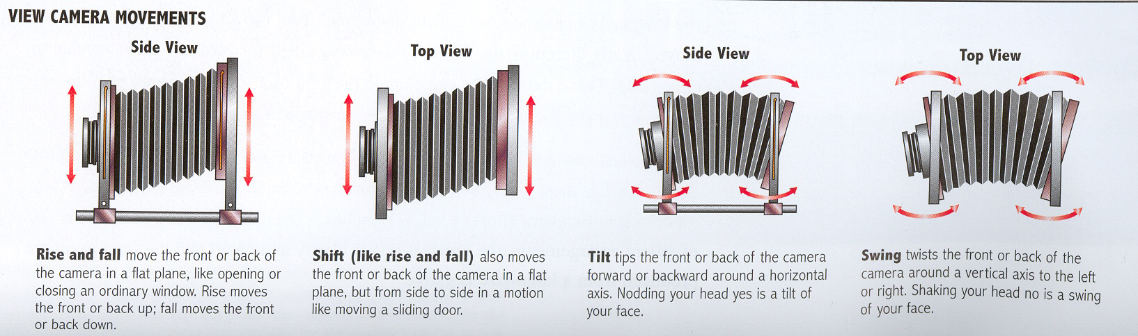
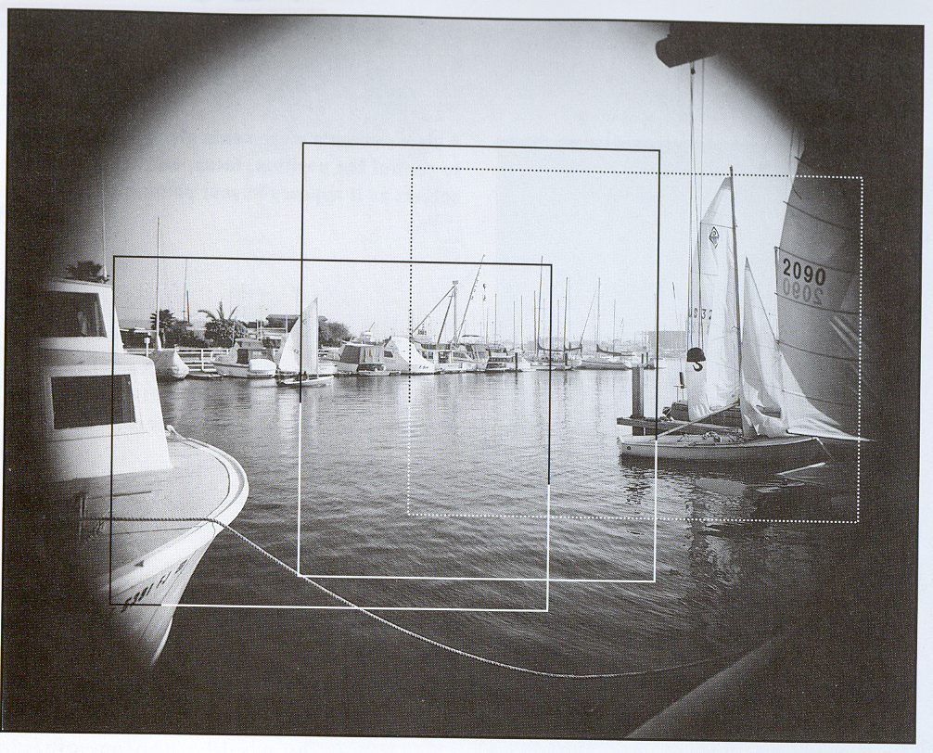
From Photography, London et al.

Slide 5
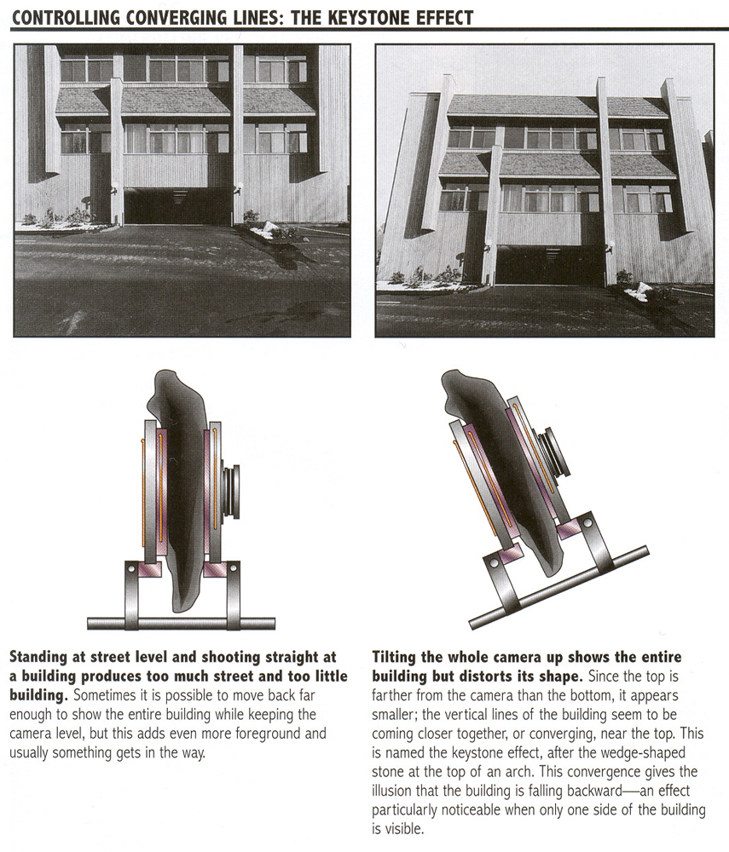
From Photography, London et al.

Slide 6
From Photography, London et al.

Slide 7
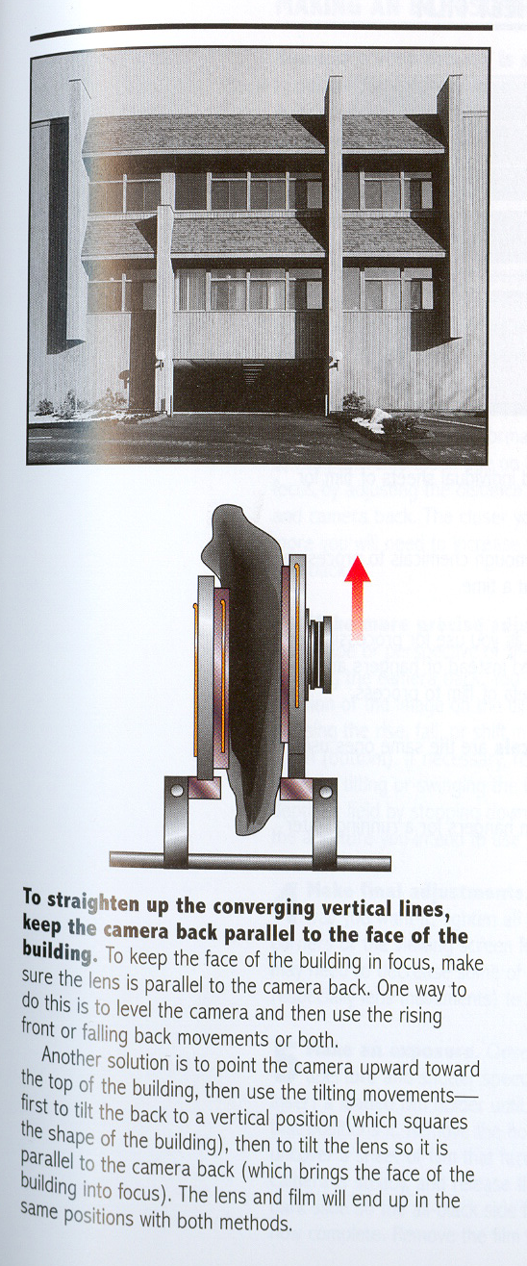
From Photography, London et al.

Slide 8
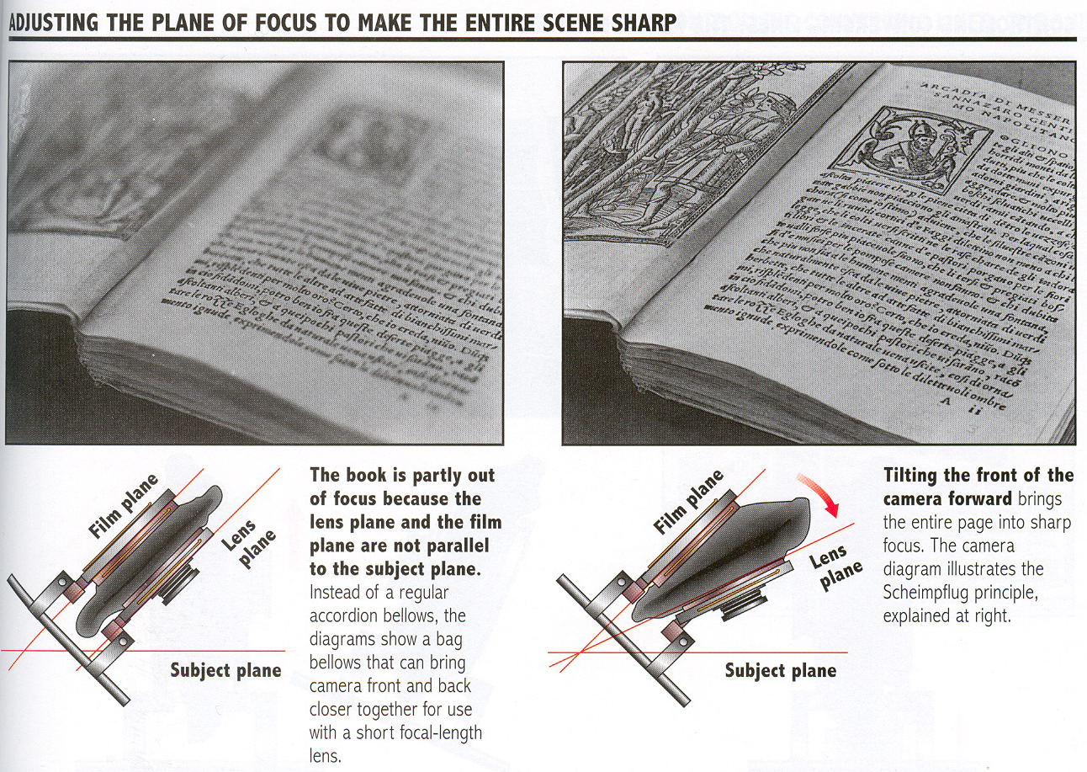
From Photography, London et al.

Slide 9
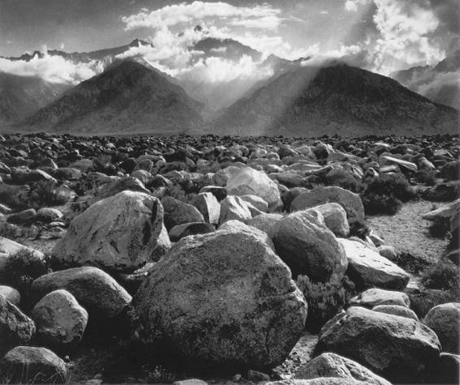
Useful for
landscape
to get depth of field from foreground to infinity
Ansel Adams

Slide 10
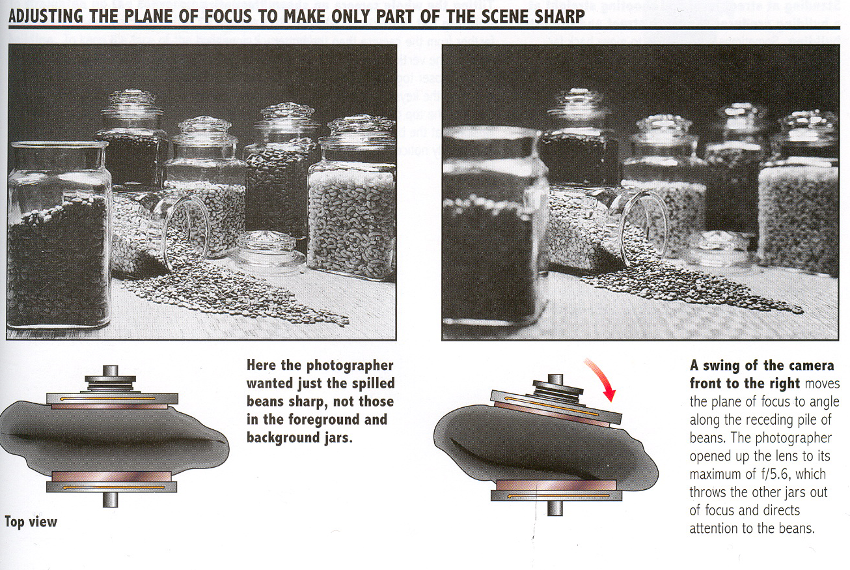
From Photography, London et al.

Slide 11
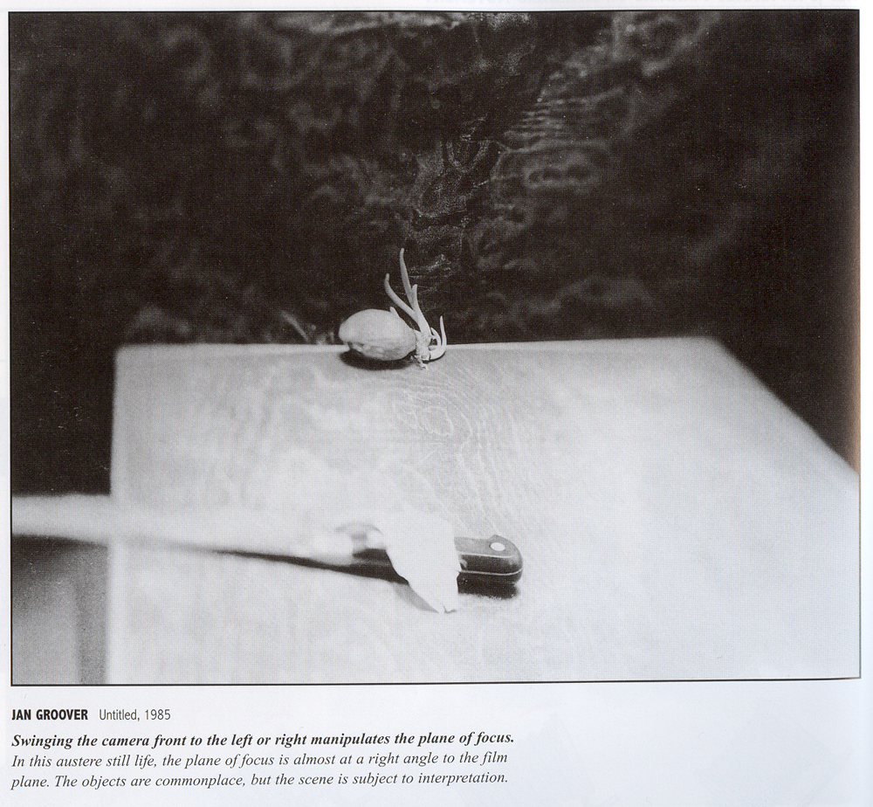
From Photography, London et al.

Slide 12

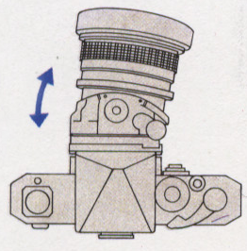
Tilt-shift lens
35mm SLR version

Slide 13
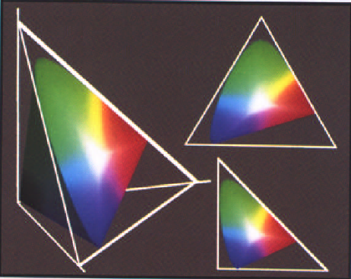
Next time: color

Slide 14
Appendix

Slide 15
Equation of projection
From Ponce & Forsyth

Slide 16
Equation of projection
Cartesian coordinates:
  We have, by similar triangles, that
  (x, y, z) → (f x/z, f y/z, -f)
  Ignore the third coordinate, and get
  (x,y,z) → (f x/z , f y/z)

Slide 17
Effect of projection
Points go to points
Lines go to lines
Planes go to a half plane
Parallel lines go to converging lines
Polygons go to polygons
Degenerate cases:
  Line through the pinhole go to points
  Planes through the pinhole go to a line
  Parallels parallel to the image plane stay parallel
  Planes parallel to the image plane goes to full planes

Slide 18
Equipment
Do get an SLR, compacts are way too limited
Don't worry about brand
Don't worry about the body, get the cheapest one
Worry about lenses
  Zooms are convenient but quality can be a problem
    avoid the basic zoom, but the one above is usually great
    Maximum aperture matters (the smaller the number, the better)
  Get a prime in the 35-85mm range
  (cheap, high quality, wide aperture)
  50mm f/1.8
Get a tripod
Get an external flash if you want to take “event” pictures
  And orient towards (white) wall/ceiling
  Good flash photography is very difficult
Count ~1k for camera+standard zoom+50mm

Slide 19
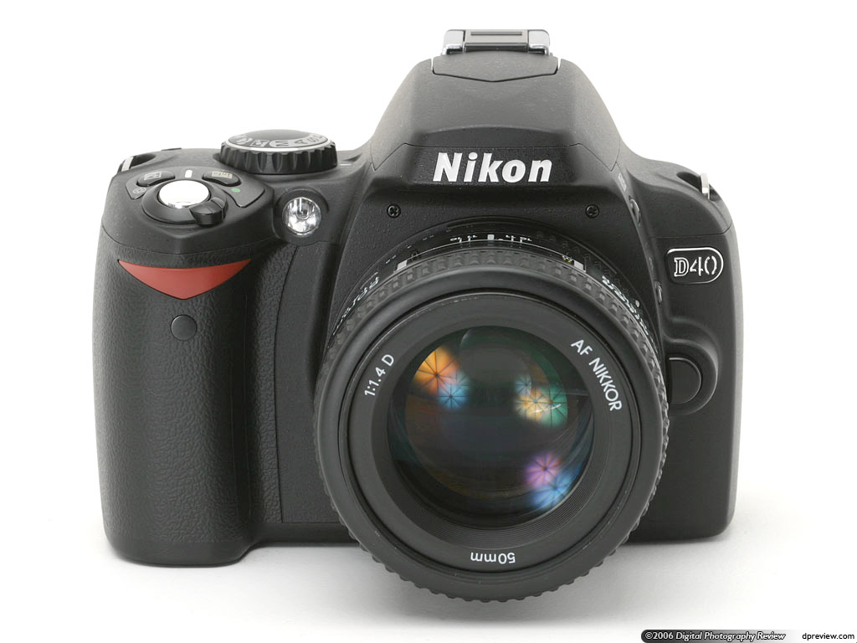
Nikon
Tends to be a tad cheaper
D40 is a great body. D80 is a little better.
18-70
55-200 is surprisingly not so bad and super cheap
Get the 50mm f/1.8

Slide 20
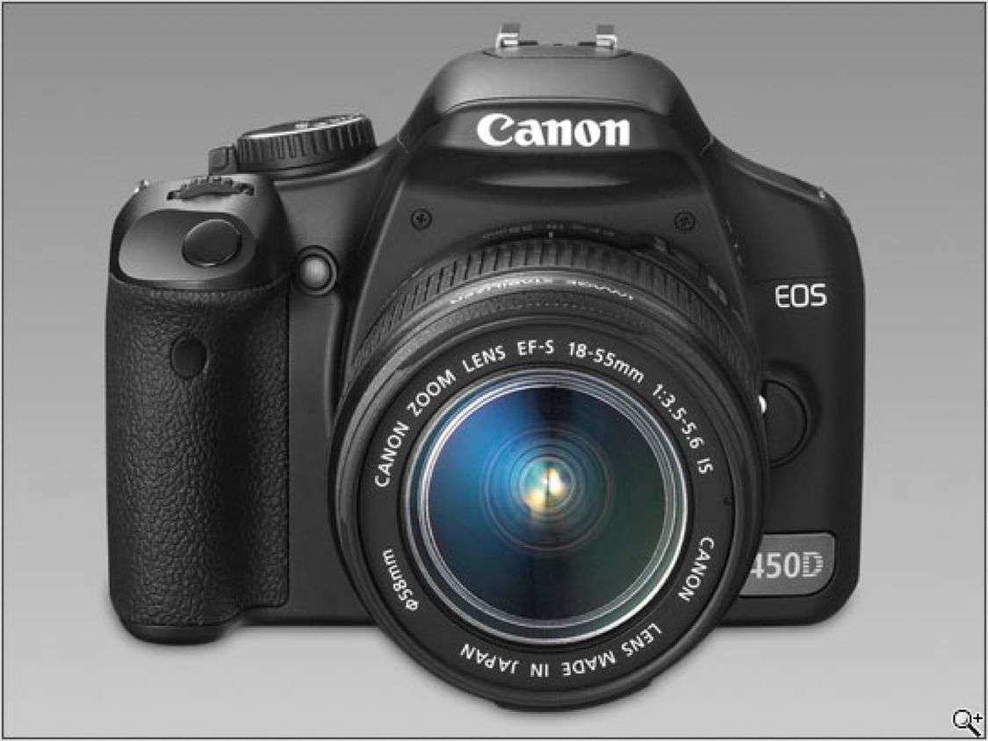
Canon
Rebel Xsi
17-85
70-200 f/4.0
(amazing lens)
50mm f/1.8
100mm f/2.8 macro
(great also for portraits)

Slide 21
Other brands
Not as big a range, future not always clear (see Minolta), have been slower to get to digital SLR
Olympus
  Good system, but smaller sensor
Pentax
  Good entry camera
Sigma
  Intriguing sensor (Foveon), limited system
Fuji
  One-trick pony (the sensor)
  Nikon body
Sony
  Interesting hybrid, the R1
  Very silent, good images, crappy viewfinder, no interchangeable lenses
  New SLR, alpha. Pretty good.
  Lens selection not as good as Nikon/Canon

Slide 22
Shooting
Use aperture priority, work on depth of field
Change your viewpoint
Don't center things
Learn to adjust ISO
Shoot raw
Check your histogram

Slide 23
Software
Photo management +lightweight editing
  Lightroom, Aperture, Lightzone
Crop to improve composition
Manage contrast using curve and adjustment layers
Add light to dark areas
Sharpen a bit
Convert to black and white
Use Photoshop only if you really need to

Slide 24
Questions?

Slide 25
Next time: exposure, color

Slide 26

Metering
Photosensitive sensors measure scene luminance
Usually TTL (through the lens)
Simple version: center-weighted average
Assumption? Failure cases?
  Usually assumes that a scene is 18% gray
  Problem with dark and bright scenes

Slide 27
Challenge: high or low key scenes
This photo is not 18% grey on average
I had to tell the camera to make it 4 times brighter

Slide 28
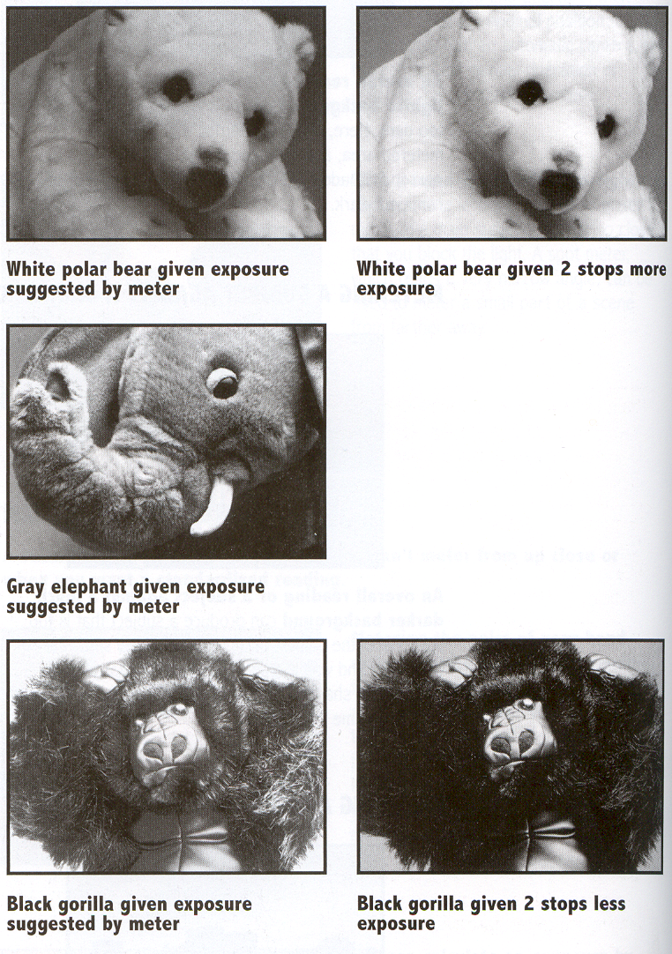
From Photography, London et al.

Slide 29
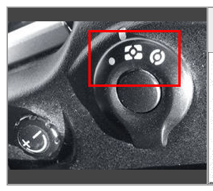

Metering
Choice on Nikon
Centered average
Spot
Smart metering
  Nikon 3D matrix
  Canon evaluative
Incident
  Measure incoming light
Next slide
http://www.mir.com.my//
http://www.mir.com.my/rb/photography/hardwares/classics/eos/EOS-1n/metering/index.htm

Slide 30
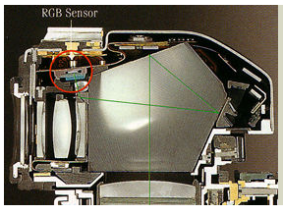
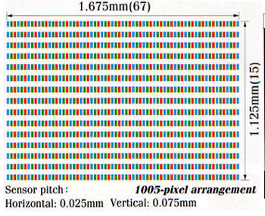
Nikon 3D Color Matrix
http://www.mir.com.my/rb/photography/hardwares/classics/NikonF5/metering/
Learning from database of 30,000 photos
Multiple captors (segments)
Exposure depends on
  Brightness from each segments
  Color
  Contrast
  Distance
  Focus (where is the subject)

Slide 31
Exposure & metering
The camera metering system measures how bright the scene is
In Aperture priority mode, the photographer sets the aperture, the camera sets the shutter speed
In Shutter-speed priority mode, the photographers sets the shutter speed and the camera deduces the aperture
  In both cases, reciprocity is exploited
In Program mode, the camera decides both exposure and shutter speed (middle value more or less)
In Manual, the user decides everything (but can get feedback)
http://www.karbosguide.com/books/photobook/chapter22.htm

Slide 32
Pros and cons of various modes
Aperture priority (My favorite, I use it 90% of the time)
  Direct depth of field control
  Cons: can require impossible shutter speed (e.g. with f/1.4 for a bright scene)
Shutter speed priority
  Direct motion blur control
  Cons: can require impossible aperture (e.g. when requesting a 1/1000 speed for a dark scene)
    Note that aperture is somewhat more restricted
Program
  Almost no control, but no need for neurons
Manual
  Full control, but takes more time and thinking
http://www.zazzle.com/canon_camera_mode_dial_tshirt-235252453011181628

Slide 33
Recap: Metering
Measure scene brightness
Some advanced modes that take multiple sources of information
Still an open problem

Slide 34
Questions?

Slide 35
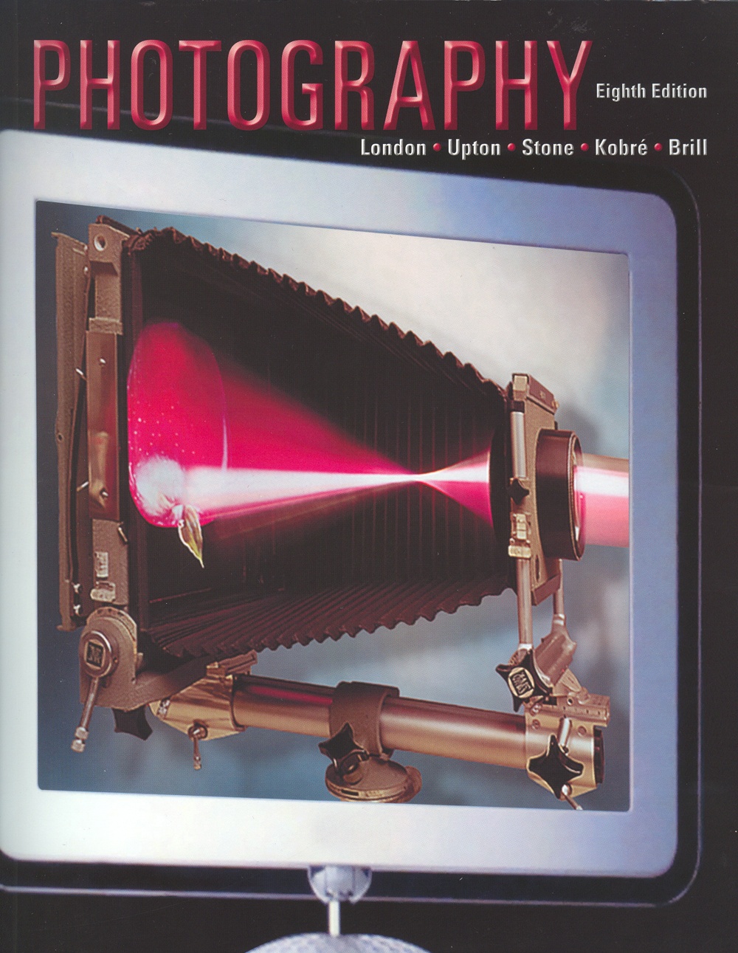
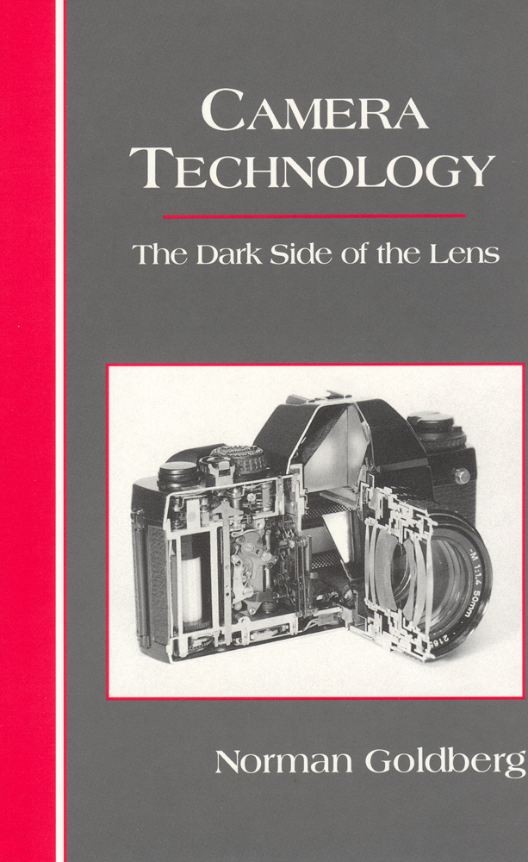

Reference
http://courses.csail.mit.edu/6.869/lectnotes/lect1
http://en.wikipedia.org/wiki/Lens_(optics)
The slides use illustrations from these books

Slide 36
Halide, impact, academia
See also my slides
https://docs.google.com/presentation/d/1lILcOIT0iS-UXfD9oiSZS_FUL0LktCvFczNN3YK8G4E/edit?slide=id.g15f11a8a27f_7_80#slide=id.g15f11a8a27f_7_80

Slide 37
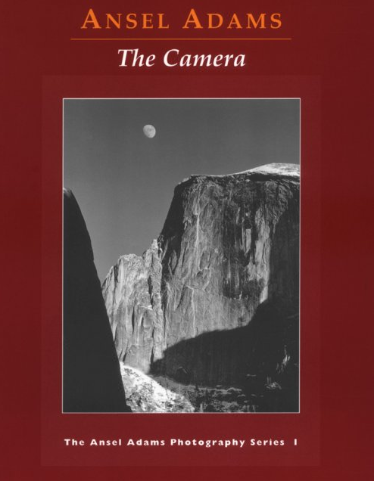
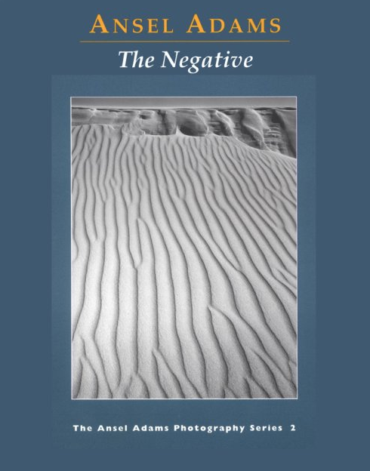

More references

Slide 38
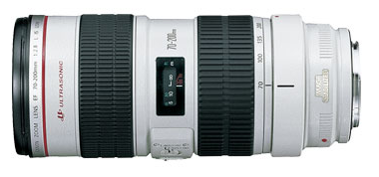
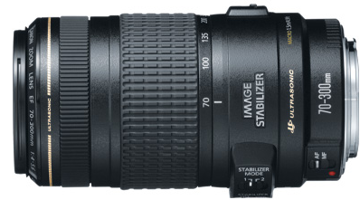
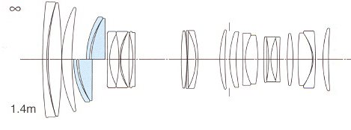
Important question
Why is this toy so expensive
  EF 70-200mm f/2.8L IS USM
  $1700
Why is it better than this toy?
  EF 70-300mm f/4-5.6 IS USM
  $550
Why is it so complicated?
What do these buzzwords and acronyms mean?

Slide 39
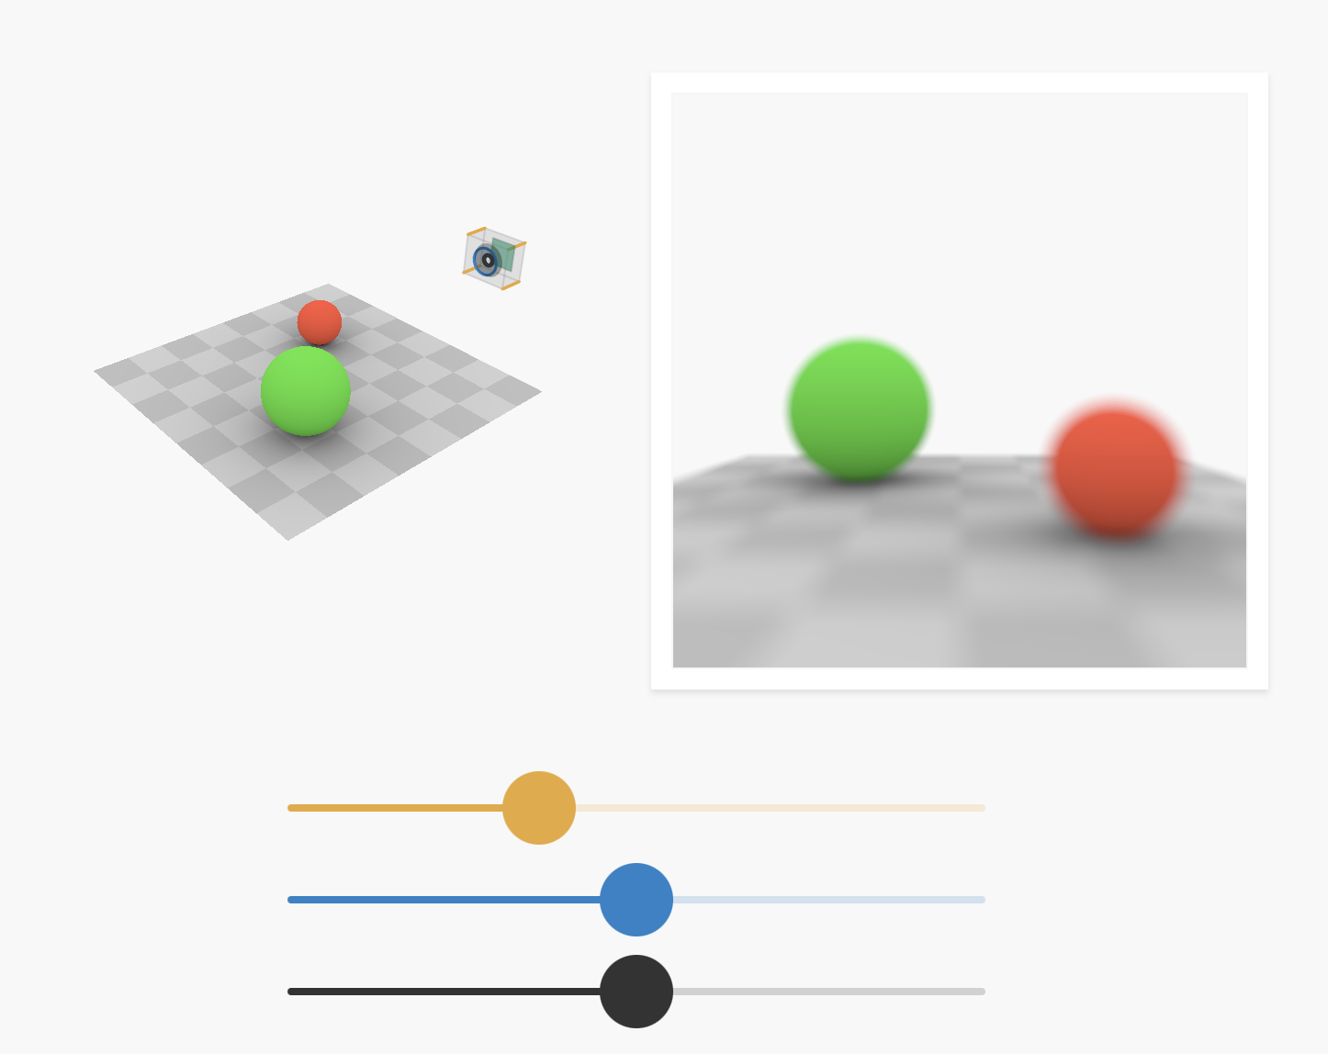
Cool ref on camera and lenses
https://ciechanow.ski/cameras-and-lenses/

Slide 40
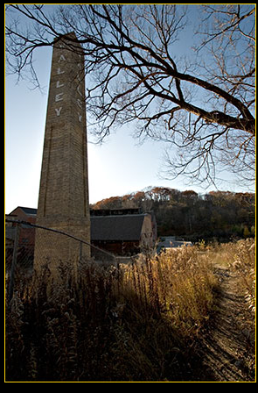
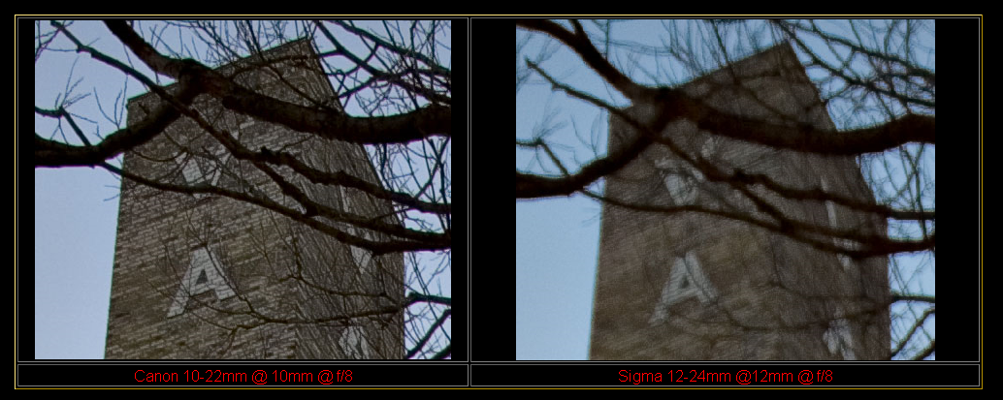
Lens quality varies!
source: the luminous landscape

Slide 41
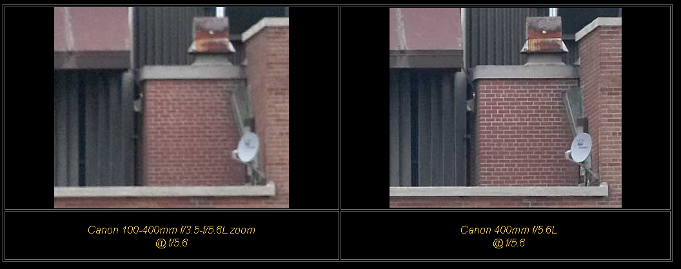
source: the luminous landscape

Slide 42
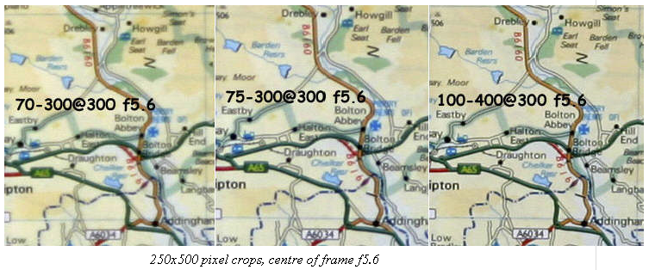
Center is usually OK
http://www.photo.net/equipment/canon/70-300do_2/

Slide 43
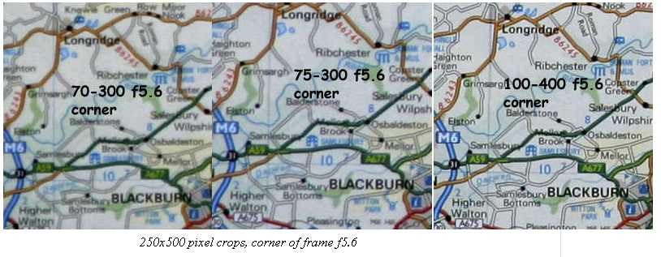
Image corners are often sacrificed
http://www.photo.net/equipment/canon/70-300do_2/

Slide 44
Max aperture is tough
http://www.photo.net/equipment/canon/70-300do_2/

Slide 45
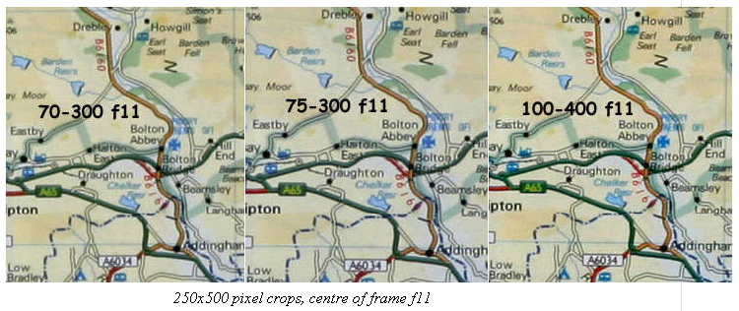
Gets better when stopped down
http://www.photo.net/equipment/canon/70-300do_2/

Slide 46
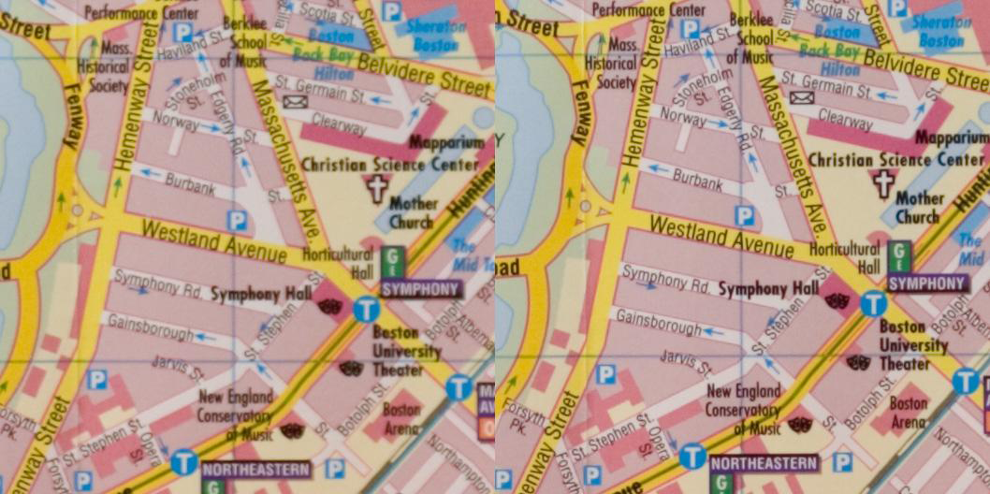
Copy variation
Left: Addy's 100-400; Right: Frédo's
(full aperture, 135mm)

Slide 47
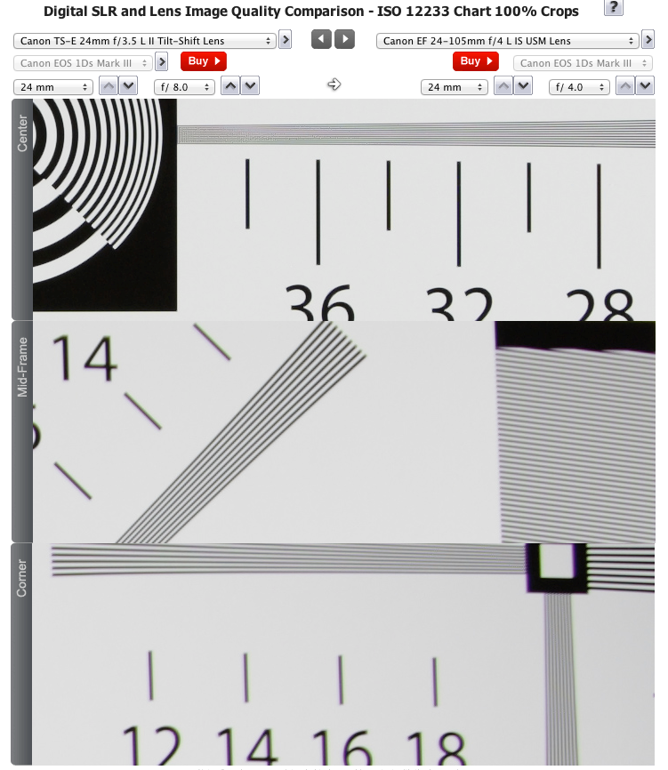
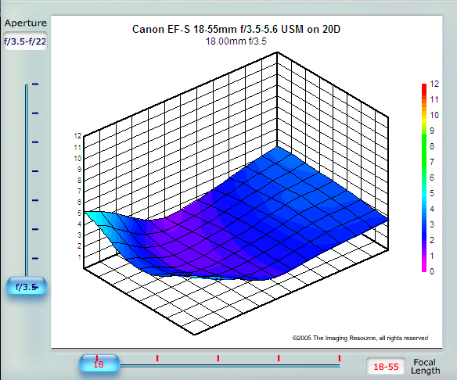
Cool evaluation sites
http://www.the-digital-picture.com/Reviews/ISO-12233-Sample-Crops.aspx?Lens=486&Camera=453&Sample=0&FLI=0&API=3&LensComp=355&CameraComp=0&FLIComp=0&APIComp=0
http://www.slrgear.com/reviews/index.php
  e.g. http://www.slrgear.com/reviews/showproduct.php/product/145/cat/11

Slide 48
Blog
http://www.lensrentals.com/blog

Slide 49
http://www.lensrentals.com/blog/2011/10/notes-on-lens-and-camera-variation

Slide 50
Zoom vs. Prime
source: the luminous landscape

Slide 51
Lenses
In a photo system, the lens is most critical
Lenses are characterized by
  Prime vs. zoom
  Focal length (field of view)
  Maximum aperture (the f number like f/2.8)
  Various gizmos (e.g. image stabilization, faster autofocus)
  Minimum focusing distance
  More complex quality issues
Max aperture is usually correlated with quality
Warning: lenses are addictive

Slide 52
Bottom line
Yes, you can get a cheap & razor sharp high-quality lens:
look for a prime in the 35-100mm range
  e.g. Canon 50mm f/1.8, 85mm f/1.8, Nikon 50mm f/1.8
See also http://www.photozone.de/3Technology/lenstec4.htm

Slide 53
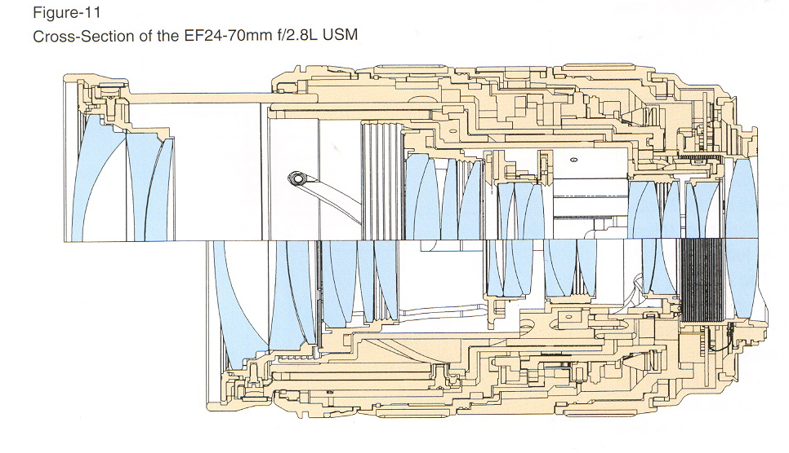
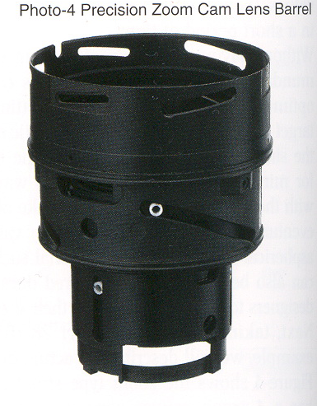
Why are lenses so complex?
It’s not so easy to send light where it should go
source: canon red book

Slide 54
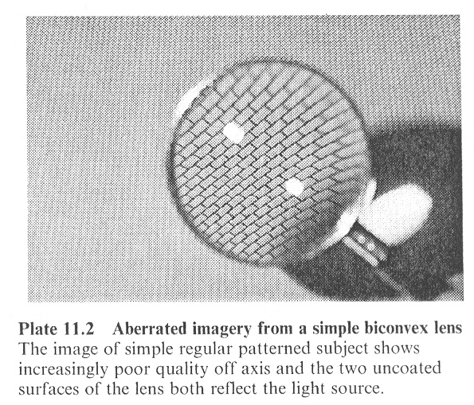
Simple lenses are not so good
From Ray's Applied Photographic Optics

Slide 55
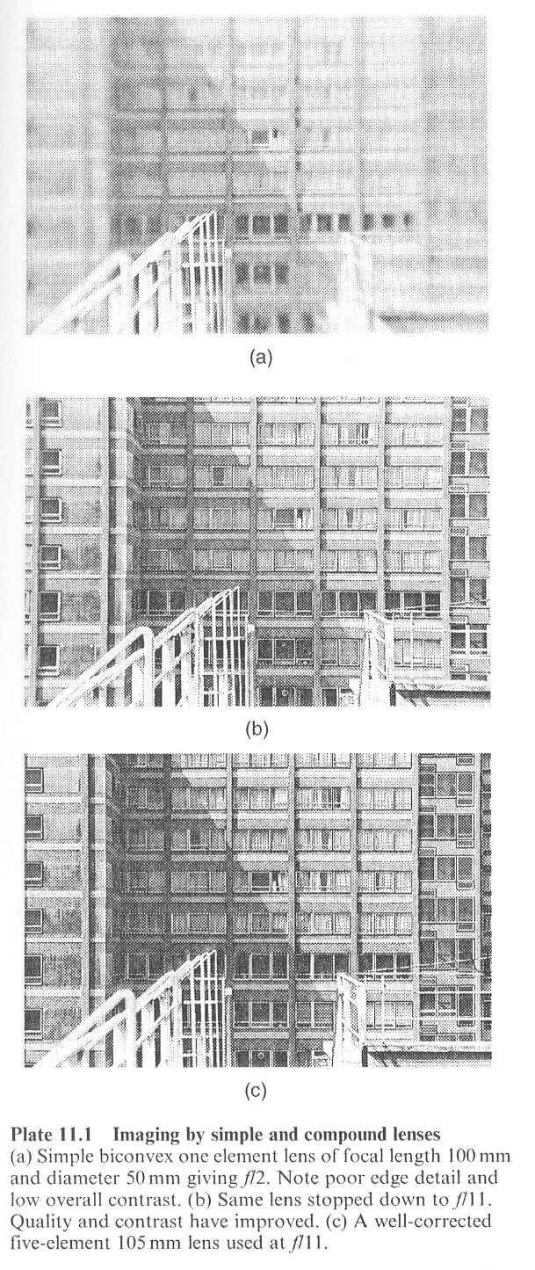
Complex lenses are better!
From Ray's Applied Photographic Optics

Slide 56
Question?

Slide 57
Lens 101 review

Slide 58
Thin lens optics
Simplification of geometrical optics All parallel rays converge to one point on a plane located at the focal length f
All rays going through the center are not deviated
  Hence same perspective as pinhole
f
TODAY WE GO BEYOND THESE SIMPLIFICATIONS

Slide 59
Focal length (in mm)
  Determines the field of view.
  wide angle (<30mm) to telephoto (>100mm)
Focusing distance
  Which distance in the scene is sharp
Depth of field
  Given tolerance, zone around the focus distance that is sharp
Aperture (in f number)
  Ratio of used diameter and focal length.
  Number under the divider ➔ small number = large aperture
  (e.g. f/2.8 is a large aperture, f/16 is a small aperture)

Slide 60
Quantities
focal
length
focus distance
depth of field
field
of
view
sensor
size
aperture
lens

Slide 61
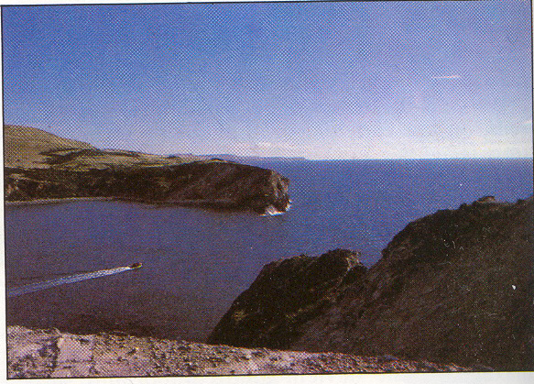
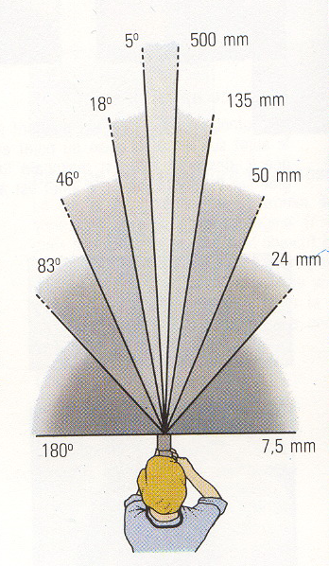
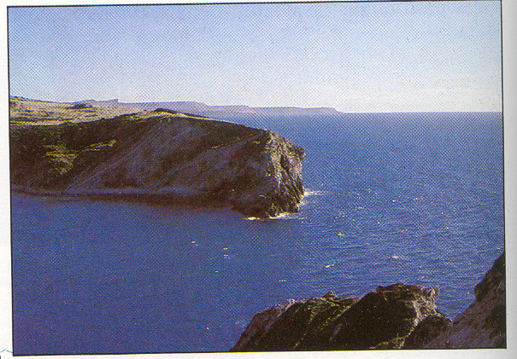
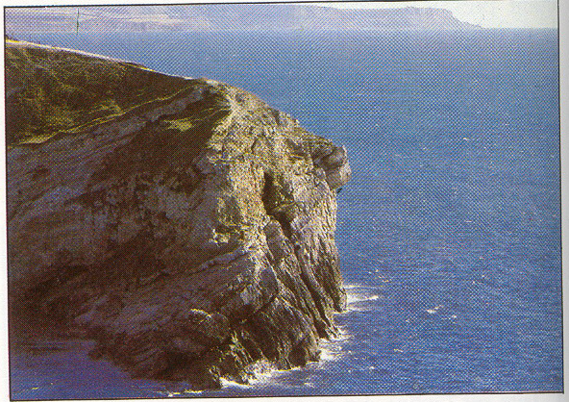
Focal length
24mm
<30mm: wide angle
50mm: standard
>100mm telephoto
Affected by sensor size
(crop factor)
50mm
focal length
135mm
field
of
view

Slide 62
Geometric optics
Snell’s law bends geometrical rays
  I mean, Descartes’ law
Most aberrations can be expressed in this framework

Slide 63
View #2 of lenses (Wave/Fermat)
Light is focused because all paths have same length
  Higher index of refraction (speed of light) compensates for length
  Constructive interference

Slide 64
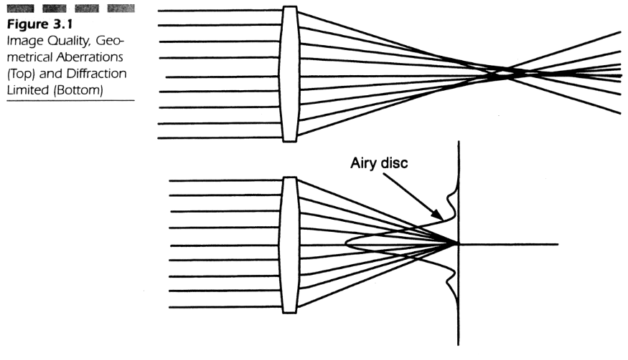
Image quality
Geometrical optics: hard to focus all rays
Wave optics: diffraction problems
From Optical System Design by Fisher and Tadic

Slide 65
Geometrical perspective

Slide 66
Back to thin lenses
Snell’s law bends geometrical rays

Slide 67
Thin lens optics
Simplification of geometrical optics for well-behaved lenses
All parallel rays converge to one point on a plane located at the focal length f
All rays going through the center are not deviated
  Hence same perspective as pinhole
f

Slide 68
Simplification of first-order optics
Snell’s law: η₁ sinθ₁ = η₂ sin θ₂
First order/thin lens optics: use sin θ = θ

Slide 69
Third-order optics
Sin θ = θ - θ³/6
The extra term leads to third-order aberrations

Slide 70
Third-order aberrations

Slide 71
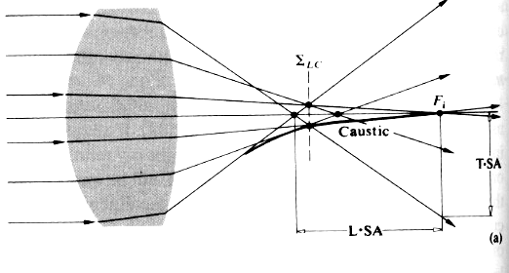
Spherical aberration
Rays don’t focus at same position
source: Hecht Optics

Slide 72
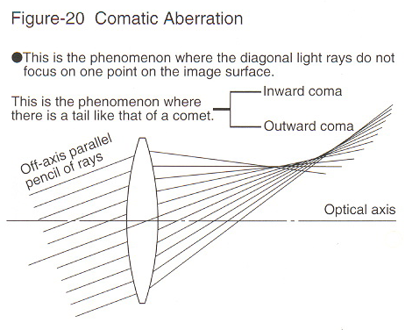
Comatic aberration
source: canon red book

Slide 73
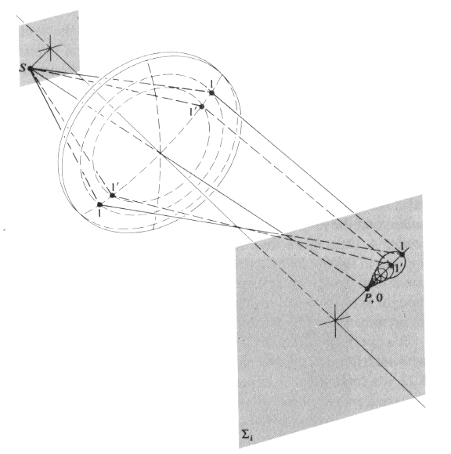
Comatic aberration
From Hecht's Optics

Slide 74
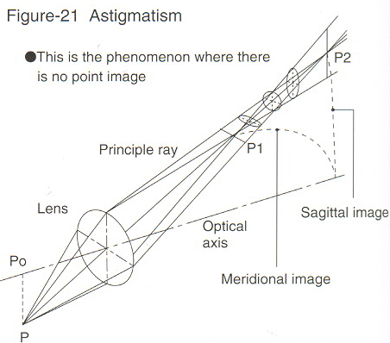
Astigmatism
source: canon red book

Slide 75
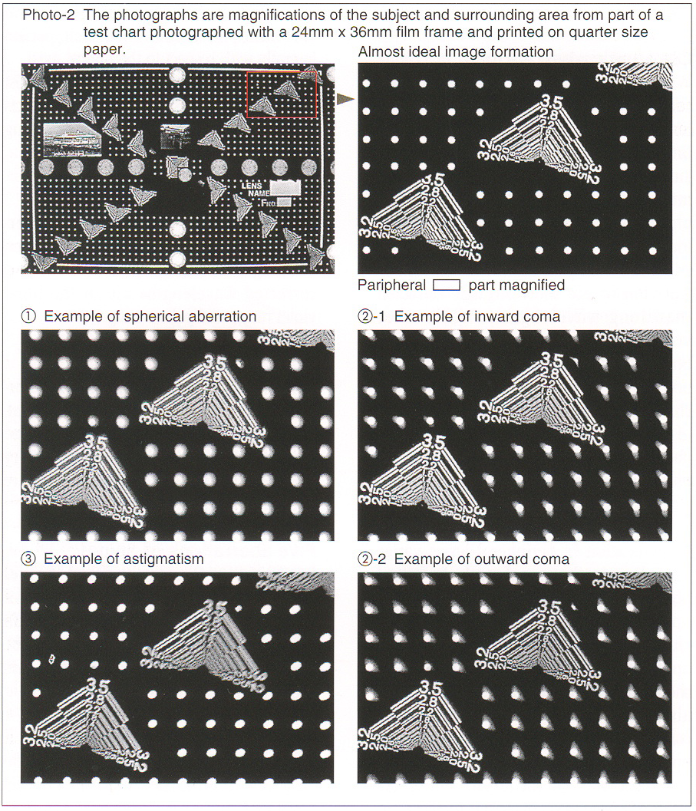
Defects
source: canon red book

Slide 76
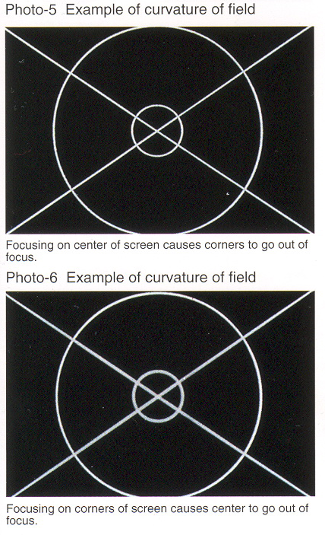
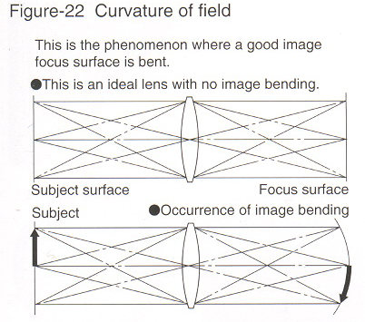
Curvature of field
source: canon red book

Slide 77
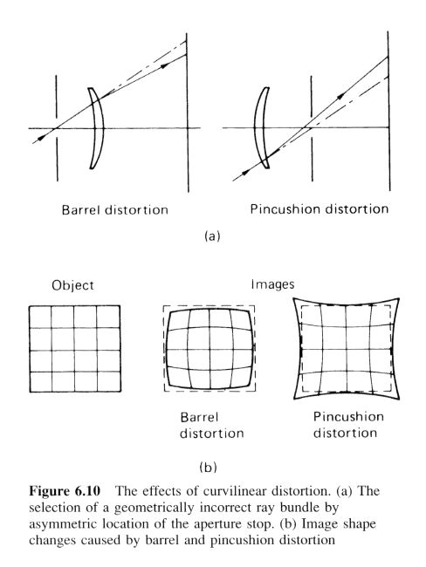
Curvilinear/radial distortion
http://www.dxo.com/us/photo/dxo_optics_pro/optics_geometry_corrections/distortion
From "The Manual of Photography" Jacobson et al
http://en.wikipedia.org/wiki/Distortion_(optics)

Slide 78

Radial distortion
source digital outback

Slide 79



Radial distortion
Correct for “bending” in wide field of view lenses
e.g. parametric warp,
specified by two lens-dependent parameters k1 and k2

Slide 80

Why spherical lenses?
Because they are easy to manufacture
(Start from whatever shape, if you grind enough, it will become spherical)
From Optical System Design by Fisher and Tadic

Slide 81


Aspherical lenses
source: canon red book

Slide 82

Aspherical lenses
Harder to manufacture ➔ used with parsimony
source: canon red book

Slide 83
Chromatic aberrations

Slide 84


Chromatic aberration
The previous aberrations depend on wavelength (because of varying index of refraction)
source: canon red book

Slide 85
In images

Slide 87

Achromatic doublet
From Hecht's Optics

Slide 88

Apochromatic & others
Optimize for multipel wavelengths
http://www.vanwalree.com/optics/chromatic.html

Slide 89

Apochromatic glass
APO" elements (UD, SUD, CaF2, LD, SLD, ED etc.) improve contrast and sharpness by reducing chromatic aberration (color defects) that usually occur in tele lenses. These elements are able to focus different wave lengths of one light ray in one point (see picture below). These elements are quite expensive and usually not used for cheaper lenses. The problem is however that the quality of these special elements varies heavily so the effect is often downgraded to a marketing gag - this is especially true for some third-party manufacturers!
As a rule-of-thumbs a good long tele lens will always feature two or more of these special elements. Recently the first ultra-wide and wide-angle lenses emerged using APO elements besides aspericals in order to reduce problems with lateral color shifts.
http://www.photozone.de/3Technology/lenstec8.htm

Slide 90



Fluorite
Low dispersion
source: canon red book

Slide 91
Bottomline
Fighting chromatic aberrations is the main cause of lens complexity

Slide 93
Chromatic aberration correction

Slide 94
Observation: radial structure
Here:
red towards center,
blue towards periphery

Slide 95
Observation: radial structure
Here:
red towards center,
blue towards periphery

Slide 96
Observation: radial structure
Some wavelength are more deviated away from center
source: canon red book

Slide 97


Idea
Calibrate using black-and-white target
Scale the channels by a slightly different scale factor
  Try to align R, G & B

Slide 98

Procedure
Optimize error between Green channel and scaled other channel

Slide 99
Procedure
Optimize error between Green channel and scaled other channel
Make sure we normalize pixel values by a global factor average(G)/average(otherChannel)
  to avoid white balance issue

Slide 100
At the end of the day
Red gets scaled by a factor kr
Blue gets scaled by a factor kb
  Both factors are very close to 1
  e.g. for my 24-105 at 24mm:
  kr=1.0003125
  kb=1.0006875
  Not necessarily bigger than 1

Slide 101
In action

Slide 102
At the end of the day
Calibrate once, then
use for all images of that lens in that configuration
Ideally, calibrate for each
  focal length
  focusing distance
e.g. on my 24-105
  At 24mm:
    kr=1/1.0003125
    kb=1/1.0006875
  At 105mm
    kr= 1/0.99953125
    kb=1/1.0001875

Slide 103
Results
Before
After

Slide 104
Results
Before
After

Slide 105
Flare

Slide 106

Flare
From "The Manual of Photography" Jacobson et al

Slide 107

Example of flare "bug"
Some of the first copies of the Canon 24-105 L had big flare problems
http://www.the-digital-picture.com/Reviews/Canon-EF-24-105mm-f-4-L-IS-USM-Lens-Review.aspx

Slide 108

Use a hood! (and a good one)
Flare ray
Hood is to short
Flare
Good hood
Adapted from Ray's Applied Photographic Optics

Slide 109

Coating
Apply thin layer with different index of refraction
Use destructive interferences
One of the most important advances in optics
From "The Manual of Photography" Jacobson et al
http://en.wikipedia.org/wiki/Optical_coating

Slide 110

Coating
Optimized for one wavelength
From "The Manual of Photography" Jacobson et al

Slide 111

Coating
From Ray's Applied Photographic Optics

Slide 112
Coating
Image taken with an uncoated lens
Note the muted color
http://www.alliedforum.net/viewtopic.php?f=106&t=2093

Slide 113
Radial distortion

Slide 114
Curvilinear/radial distortion
http://www.dxo.com/us/photo/dxo_optics_pro/optics_geometry_corrections/distortion
From "The Manual of Photography" Jacobson et al
http://en.wikipedia.org/wiki/Distortion_(optics)

Slide 115
24-105

Slide 116
Correcting radial distortion
Warp!
People have come up with parametric equations, e.g.
  e.g.

Slide 117





Warp
k1=-0.5
k1=-0.25
k1=0.0 (input)
k1=0.25
k1=0.5

Slide 118

Calibration
Harris, + measure of colinearity
Only apply warp to corners
Careful with forward/inverse warp

Slide 119


Before

Slide 120
After (k1=0.33, k2=0)

Slide 121
Vignetting

Slide 122

Vignetting
Corners look darker
http://www.photozone.de/3Technology/lenstec3.htm

Slide 123
Why vignetting
Many factors!
  Angle of incidence
  Occlusion by lens elements
  Occlusion at the photosite

Slide 124

Vignetting
Occlusion by lens elements
The periphery does not get as much light
source: canon red book

Slide 125

Occlusion

Slide 126
Vignetting correction
Brighten periphery pixels
  Often using parametric curve f(r)
  e.g. polynomial
  Can be messy
Calibrate
  Multiple images of same subject at different locations

Slide 127
Vignetting correction (ACR)
Before
After

Slide 128

Special case: panorama
We have multiple observations of the same point in overlapping regions
  Can be used to calibrate vignetting
Discrepancy from homography reprojection can be used to correct for radial distortion
e.g. http://www.cs.jhu.edu/~misha/ReadingSeminar/Papers/Triggs00.pdf

Slide 129
Software
Panorama software
DXO
  Also removes blur
  http://www.dxo.com/us/photo
Adobe Camera Raw (Lightroom, Photoshop)
  http://labs.adobe.com/technologies/lensprofile_creator/

Slide 130
Quality evaluation

Slide 131

LPIs
Line pair per inch
http://www.optikos.com/Pdf_files/how_to_measure_mtf.pdf
http://www.imatest.com/docs/tour.html
Input
After lens
http://www.imatest.com/docs/sharpness.html

Slide 132

Sharpness

Slide 133


MTF
Modulation
Transfer
Function
Pretty much Fourier transform of lens response
Complex because needs to be measured at multiple location
source: canon red book
Here the x axis is image location

Slide 134
Blur index based on Photoshop!
Lens sharpness (or lack thereof) expressed as the amount of Photoshop blur that would blur the image similarly
http://www.imatest.com/
http://www.dxo.com/en/measure/dxo_analyser/default.php
Cool vis at http://www.slrgear.com/reviews/index.php
100 macro: http://www.slrgear.com/reviews/showproduct.php/product/157/sort/2/cat/10/page/1
50mm f/1.4 http://www.slrgear.com/reviews/showproduct.php/product/140/sort/2/cat/10/page/2
16-35mm http://www.slrgear.com/reviews/showproduct.php/product/142/sort/2/cat/11/page/1
55-200 http://www.slrgear.com/reviews/showproduct.php/product/141/sort/2/cat/11/page/1
28-135 http://www.slrgear.com/reviews/showproduct.php/product/139/sort/2/cat/11/page/1
18-55 http://www.slrgear.com/reviews/showproduct.php/product/137/sort/2/cat/11/page/1
17-85 http://www.slrgear.com/reviews/showproduct.php/product/136/sort/2/cat/11/page/1
10-22 http://www.slrgear.com/reviews/showproduct.php/product/135/sort/2/cat/11/page/1

Slide 135
Lens design

Slide 136

Optimization software
Has revolutionized lens design
E.g. zooms are good now
From Hecht's Optics

Slide 137

Lens design, ray tracing
source: canon red book

Slide 138
Optimization
Free parameters
  Lens curvature, width, position, type of glass
  Some can be fixed, other vary with focal length, focus (e.g. floating elements)
  Multiplied by number of lens elements
Energy/merit function
  MTF, etc.
  Black art of massaging the merit function
Optimize for
  All image locations
  All wavelengths
  All apertures
  All focusing distances
  All focal lengths (zoom only)
Usually uses simulated annealing

Slide 139
Autofocus

Slide 140
How would you build an Auto Focus?

Slide 142

Triangulation
Rotating mirror sweeps the scene until the image is aligned with fixed image from mirror M
  pretty much stereovision and window correlation)
From The Manual of Photography

Slide 143
Different types of autofocus
From The Manual of Photography

Slide 144

Contrast
Focus = highest contrast
http://electronics.howstuffworks.com/autofocus3.htm

Slide 145

From Ray’s Applied Photographic Optics

Slide 146

From Ray’s Applied Photographic Optics

Slide 147

http://graphics.stanford.edu/courses/cs178/applets/autofocusCD.html

Slide 148


Phase detection focusing
Used e.g. in SLRs
From The Manual of Photography
From the Canon red book

Slide 149


Phase detection focusing
Stereo vision from two portions of the lens on the periphery
Not at the equivalent
film plane but farther
➔ can distinguish
too far and too close
Look at the phase
difference between
the two images
Detector
In focus
phase
Too close
Too far
From The Manual of Photography

Slide 150

Applet
http://graphics.stanford.edu/courses/cs178/applets/autofocusPD.html

Slide 151
Autofocus
http://www.fredmiranda.com/forum/topic/241524
When you half-press the shutter release, the activated AF sensor "looks" at the image projected by the lens from two different directions (each line of pixels in the array looks from the opposite direction of the other) and identifies the phase difference of the light from each direction. In one "look," it calculates the distance and direction the lens must be moved to cancel the phase differences. It then commands the lens to move the appropriate distance and direction and stops. It does not "hunt" for a best focus, nor does it take a second look after the lens has moved (it is an "open loop" system).
If the starting point is so far out of focus that the sensor can't identify a phase difference, the camera racks the lens once forward and once backward to find a detectable difference. If it can't find a detectable difference during that motion, it stops.
Although the camera does not take a "second look" to see if the intended focus has been achieved, the lens does take a "second look" to ensure it has moved the direction and distance commanded by the camera (it is a "closed loop" system). This second look corrects for any slippage or backlash in the lens mechanism, and can often be detected as a small "correction" movement at the end of the longer initial movements.

Slide 152
compute phase difference,
deduce distance

Slide 153

Multiple focus sensors
source arthur morris

Slide 154


Polaroid Ultrasound (Active AF)
Time of flight (sonar principle)
Limited range, stopped by glass
Paved the way for use in robotics
http://www.acroname.com/robotics/info/articles/sonar/sonar.html
http://www.uoxray.uoregon.edu/polamod/
http://electronics.howstuffworks.com/autofocus2.htm
http://www.uoxray.uoregon.edu/polamod/
From Ray’s Applied Photographic Optics

Slide 155
Infrared (Active AF)
Intensity of reflected IR is assumed to be proportional to distance
There are a number of obvious limitations
Advantage: works in the dark
This is different from Flash assistant for AF where the IR only provides enough contrast so that standard passive AF can operate

Slide 156
Special lenses

Slide 157
Some special lenses
Mirror lenses
Tilt-shift lenses
Macro lenses
  Why sharpness is always great (thanks Gauss)
  Why you lose light

Slide 158

From "The Manual of Photography" Jacobson et al

Slide 159

catadioptric (mirror)
http://www.digit-life.com/articles2/rubinar/
http://www.telescopes.net/HOW_TO_-_Cat_Animation.gif

Slide 160

500mm vivitar ($100)

Slide 161

500mm Canon (5k)

Slide 162



Slide 163

Mirror lens

Slide 164


Slide 165


Slide 166


Slide 167

http://www.digit-life.com/articles2/rubinar/

Slide 168
Perspective correction

Slide 169
Perspective correction
Perspective makes
parallel lines converge
Sometimes objectionable
In particular, architecture
photography
  photo looks more formal
  if verticals stay vertical
But if lines are parallel
to the image plane,
parallel lines don’t converge

Slide 170
Perspective correction
From Photography, London et al.

Slide 171
From Photography, London et al.

Slide 172
From Photography, London et al.

Slide 173
Tilt
Equivalent to using a
wider-angle view
and cropping
{
virtual
centered
sensor
{
physical
sensor
=crop
From Photography, London et al.

Slide 174
Perspective correction
The lens creates an image bigger than the sensor
Tilting and shifting aligns the sensor with the part we want
From Photography, London et al.

Slide 175
The two images are related by a homography
From Photography, London et al.

Slide 176

Tilt-shift lens
35mm SLR version

Slide 177


Photoshop version (perspective crop)
Just a homography!

Slide 178
Photoshop version (perspective crop)
+ you control reflection and perspective independently

Slide 179
Lightroom demo

Slide 180

Question?
The Ambassadors, Hans Holbein the Younger, 1533

Slide 181

Question?
The Ambassadors, Hans Holbein the Younger, 1533

Slide 182


Questions?
Julian Beever
e.g. http://users.skynet.be/J.Beever/
http://www.crystalinks.com/julian_beever.html

Slide 183
Image stabilization

Slide 184


Image stabilization
source: canon red book

Slide 185

Image stabilization
source: canon red book

Slide 186

Image stabilization
source: canon red book

Slide 187

1000mm, 1/100s, monopod, IS

Slide 188


Image stabilization hacking
http://www.cim.mcgill.ca/~scott/papers/ICCP_2011.pdf
Enables custom blur

Slide 189
Different versions
Canon, Nikon: in the lens
Panasonic, Konica/Minolta: move sensor

Slide 190





References

Slide 191
Links
http://en.wikipedia.org/wiki/Chromatic_aberration
http://www.dpreview.com/learn/?/key=chromatic+aberration
http://hyperphysics.phy-astr.gsu.edu/hbase/geoopt/aberrcon.html#c1
http://en.wikipedia.org/wiki/Spherical_aberration
http://en.wikipedia.org/wiki/Lens_(optics)
http://en.wikipedia.org/wiki/Optical_coating
http://www.vanwalree.com/optics.html
http://en.wikipedia.org/wiki/Aberration_in_optical_systems
http://www.imatest.com/docs/iqf.html
http://www.luminous-landscape.com/tutorials/understanding-series/understanding-mtf.shtml
http://mansurovs.com/what-is-chromatic-aberration
http://www.dvinfo.net/articles/optics/lensdefects.php

Slide 192
Quality evaluation

Slide 193
LPIs
Line pair per inch
http://www.optikos.com/Pdf_files/how_to_measure_mtf.pdf
http://www.imatest.com/docs/tour.html
Input
After lens
http://www.imatest.com/docs/sharpness.html

Slide 194
Sharpness

Slide 195
MTF
Modulation
Transfer
Function
Preety much Fourier transform of lens response
Complex because needs to be measured at multiple location
source: canon red book
Here the x axis is image location

Slide 196
Blur index based on Photoshop!
Lens sharpness (or lack thereof) expressed as the amount of Photoshop blur that would blur the image similarly
http://www.imatest.com/
http://www.dxo.com/en/measure/dxo_analyser/default.php
Cool vis at http://www.slrgear.com/reviews/index.php
100 macro: http://www.slrgear.com/reviews/showproduct.php/product/157/sort/2/cat/10/page/1
50mm f/1.4 http://www.slrgear.com/reviews/showproduct.php/product/140/sort/2/cat/10/page/2
16-35mm http://www.slrgear.com/reviews/showproduct.php/product/142/sort/2/cat/11/page/1
55-200 http://www.slrgear.com/reviews/showproduct.php/product/141/sort/2/cat/11/page/1
28-135 http://www.slrgear.com/reviews/showproduct.php/product/139/sort/2/cat/11/page/1
18-55 http://www.slrgear.com/reviews/showproduct.php/product/137/sort/2/cat/11/page/1
17-85 http://www.slrgear.com/reviews/showproduct.php/product/136/sort/2/cat/11/page/1
10-22 http://www.slrgear.com/reviews/showproduct.php/product/135/sort/2/cat/11/page/1

