Slide 1

Focus, defocus and focal stacks
Frédo Durand
MIT EECS

Slide 2
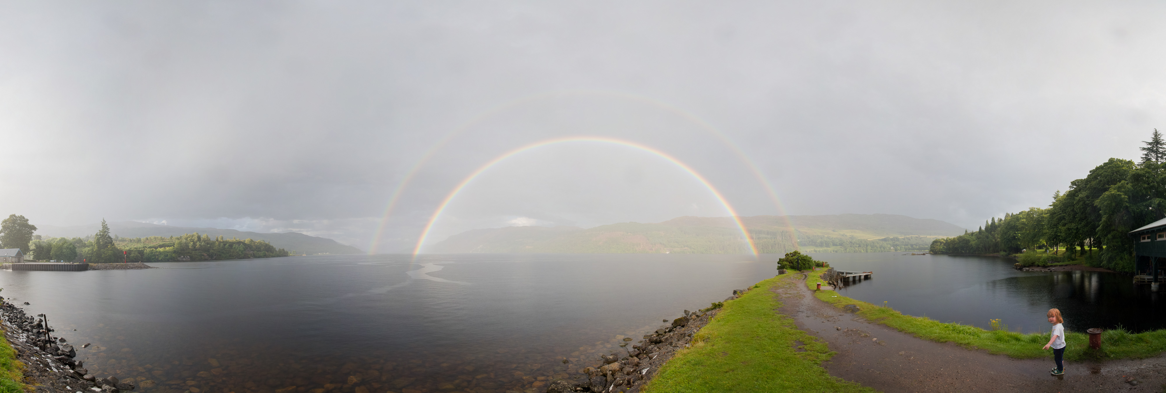

Slide 4
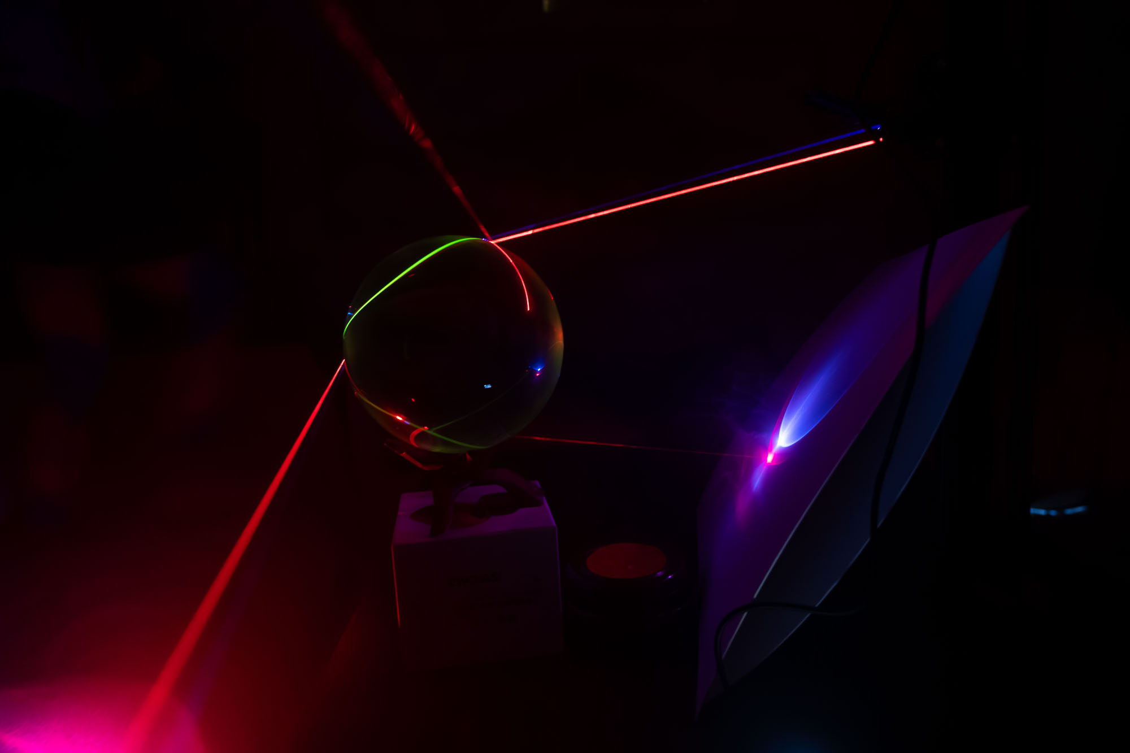

Slide 5
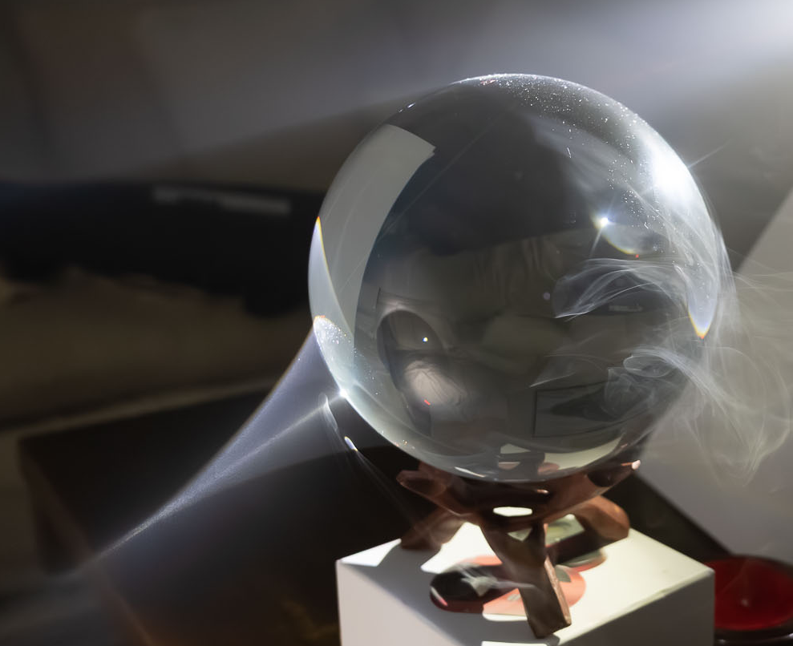

Slide 6
Writeup about DSLR vs. mirrorless
https://www.diyphotography.net/the-dslr-will-probably-die-are-mirrorless-the-future-of-large-standalone-cameras/

Slide 7
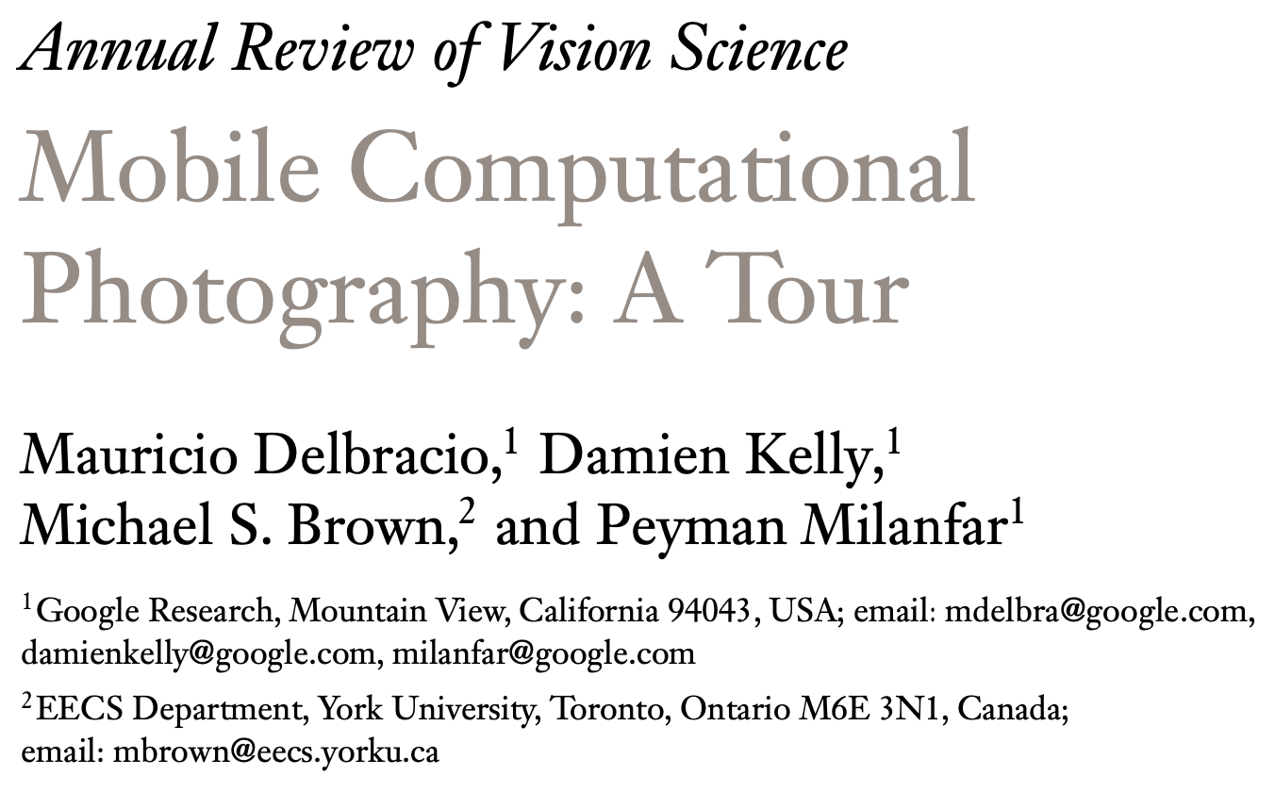
Paper on mobile photography
https://www.annualreviews.org/doi/pdf/10.1146/annurev-vision-093019-115521

Slide 8
Don’t forget the survey on LLMs
https://docs.google.com/forms/d/e/1FAIpQLScJDDd7k4ZVIvwejXMoLyQ3impDdKwDShqyhIpEcd20sWf-WQ/viewform

Slide 9
Depth of field

Slide 10


Why you need shallow depth of field
Photo with fake shallow depth of field

Slide 11
Why you need shallow depth of field
Original photo

Slide 12
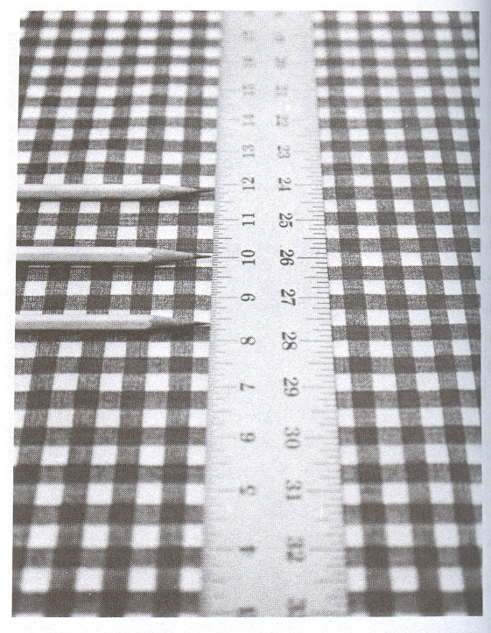

Slide 13
Size of permissible circle?
Assumption on print size, viewing distance, human vision
  Typically for 35mm film: diameter = 0.02mm
Film/sensor resolution
(8μ photosites for high-end SLR )
Best lenses are around 60 lp/mm (line pair per mm)
Diffraction limit

Slide 14
Depth of field: Object space
Simplistic view: double cone
  Tells you about the value of one pixel
sensor
Point in focus
lens
Object with texture

Slide 15
Depth of field: Object space
Simplistic view: double cone
  Only tells you about the value of one pixel
  Things are in fact a little more complicated to assess circles of confusion across the image
  We're missing the magnification factor
  (proportional to 1/distance and focal length)
sensor
Point in focus
lens
Object with texture

Slide 16
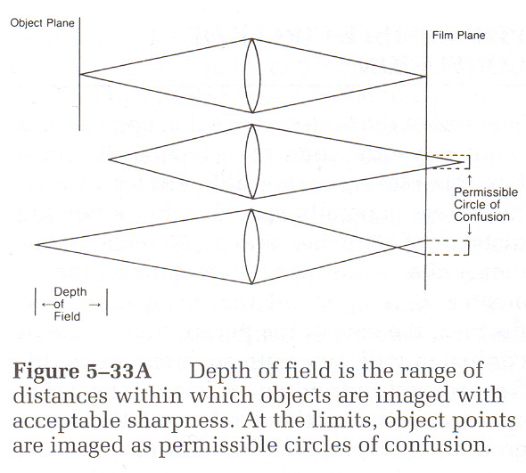
Circle of confusion
circle of confusion
From Basic Photographic Materials and Processes, Stroebel et al.

Slide 17
Depth of focus
From Basic Photographic Materials and Processes, Stroebel et al.

Slide 18
Focusing
Points on focal plane project into a point on sensor plane
lens
focal
plane

Slide 19
Misfocus
Points too far focus too close and project into a circle
  called circle of confusion
lens
focal
plane

Slide 20
Misfocus
Points too far focus too close and project into a circle
  called circle of confusion
lens
focal
plane

Slide 21
Depth of focus: more accurate view
Points too far focus too close and project into a circle
Points too close focus too far and project into a circle
When the circle exceeds a given size, we declare the point out of focus
lens
focal
plane

Slide 22
Depth of focus: more accurate view
Points too far focus too close and project into a circle
Points too close focus too far and project into a circle
When the circle exceeds a given size, we declare the point out of focus
lens
focal
plane

Slide 23
Depth of focus: more accurate view
Max circle of confusion can be achieved in two ways
  point that focuses too close, or too far
The distance between those points is the depth of focus
  Conjugate of depth of field
Depth
of focus
Depth
of field
lens
focal
plane

Slide 24
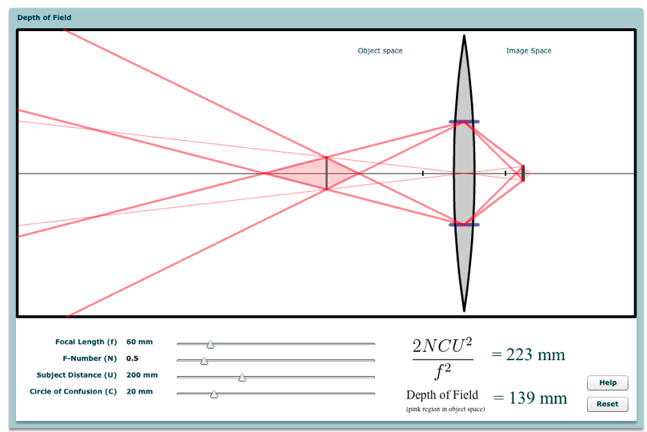
Applet demo
http://graphics.stanford.edu/courses/cs178/applets/dof.html

Slide 25
Bottom line
Depth of field is increased by using a smaller aperture
But lets in less light =>noise
And also diffraction gets worse
Can only be done up to a point
Especially challenging for macro photography
Bottom light: even at smallest possible aperture,
often not enough depth of field

Slide 26
Depth of field calculation

Slide 27
Depth of focus: more accurate view
Goal: compute depth of field
lens

Slide 28
Depth of focus: more accurate view
Goal: compute depth of field
  distance d1 and d2 in front and behind the focal plane
  given max circle of confusion
Depth
of field
lens
d₁
d₂

Slide 29
Depth of focus: more accurate view
Goal: compute depth of field
  distance d1 and d2 in front and behind the focal plane
  given max circle of confusion
Solution: similar triangles
Depth
of field
lens
d₁
d₂

Slide 30
Depth of focus: more accurate view
Circle of confusion C,
Focusing distance D, focal length f, aperture N
~f
D
C
lens
d₁
d₂

Slide 31
Depth of focus: more accurate view
Backproject the circle of confusion diameter C onto the focal plane
  Depends on magnification factor ~ f/D
~f
D
C
f/N
CD/f
lens
d₁
d₂

Slide 32
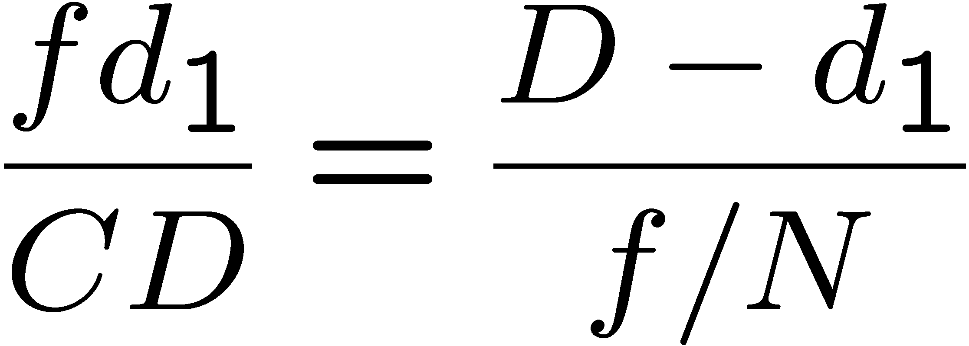
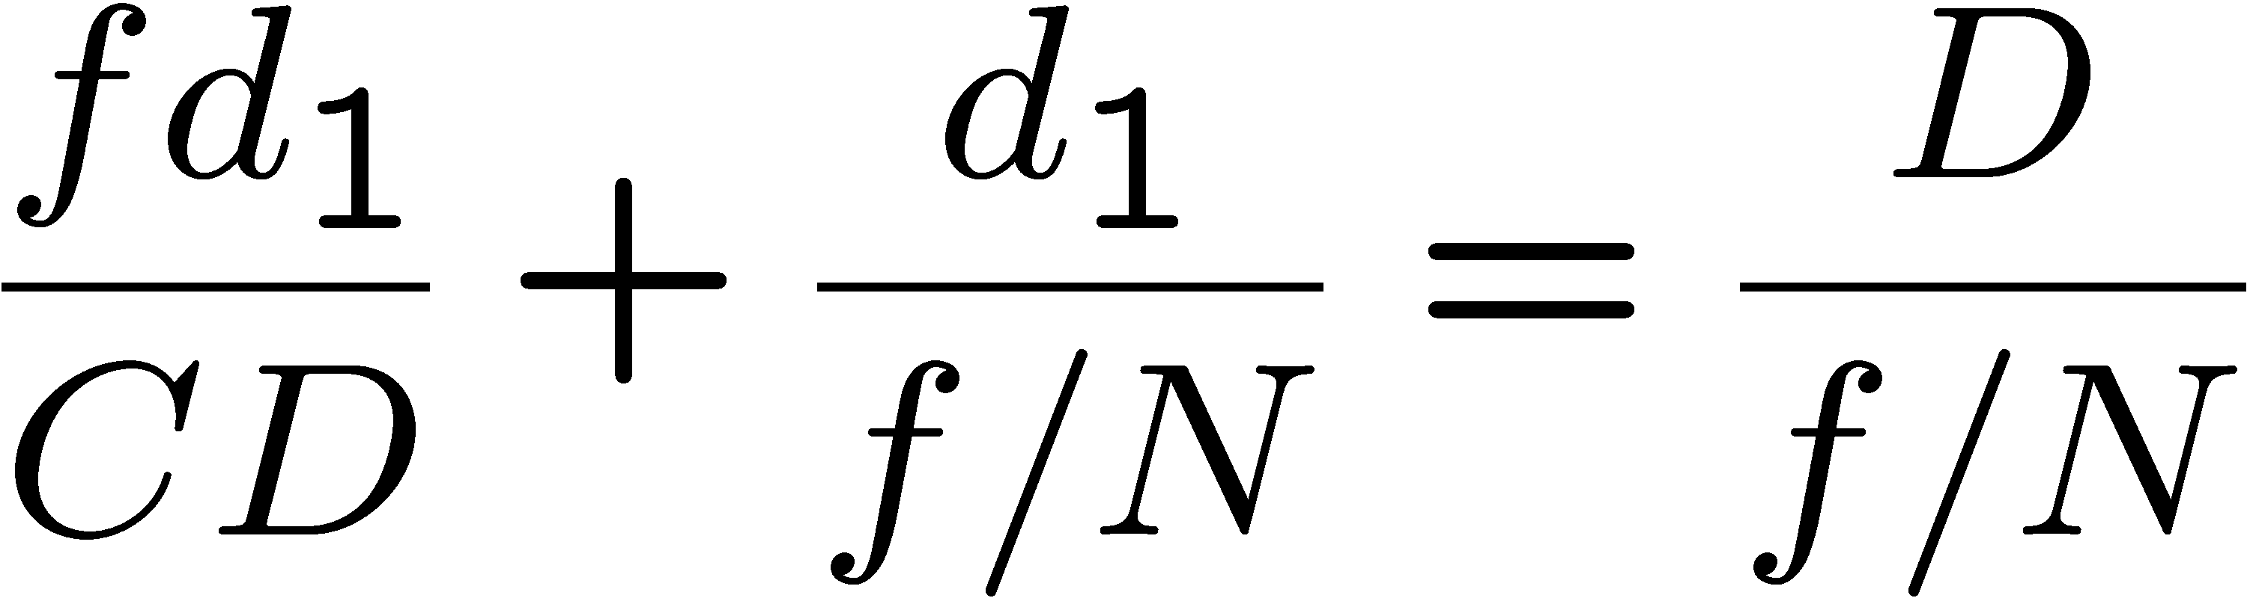
Depth of focus: derivation
~f
D
C
f/N
CD/f
lens
d₁
d₂

Slide 33
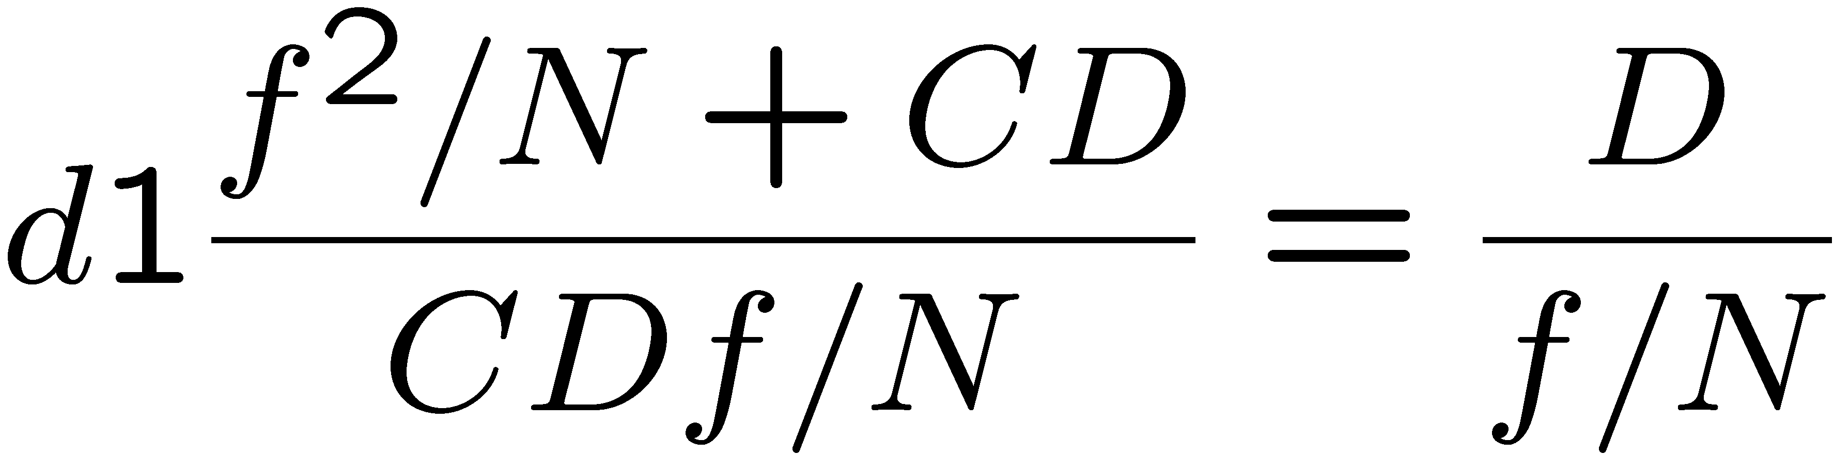
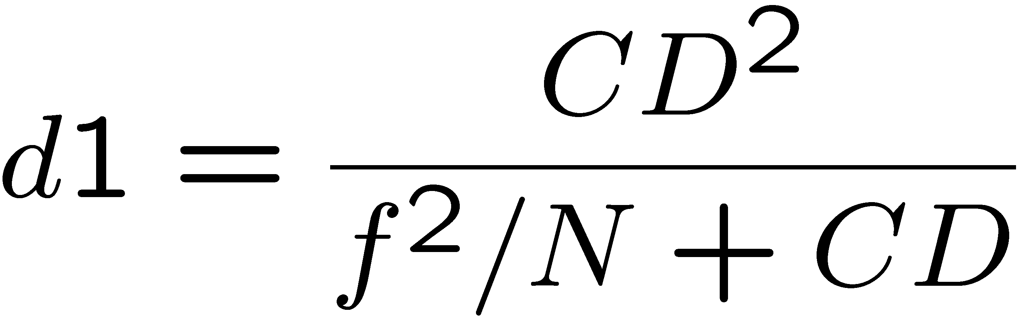
Depth of focus: more accurate view
~f
D
C
CD/f
lens
d₁
d₂

Slide 34
Depth of field: more accurate view
Backproject the image onto the plane in focus
  Backproject circle of confusion
  Depends on magnification factor
Depth of field is slightly asymmetrical
Conjugate of
circle of confusion
Point in focus
lens
Depth of field

Slide 35
Depth of focus: more accurate view
Max circle of confusion can be achieved in two ways
  point that focuses too close, or too far
The distance between those points is the depth of focus
  Conjugate of depth of field
Depth of focus
lens

Slide 36
Depth of field: more accurate view
Backproject the image onto the plane in focus
  Backproject circle of confusion
  Depends on magnification factor ~ f/D
~f
D
C
CD/f
lens

Slide 37
Deriving depth of field
Circle of confusion C, magnification m
Simplification: m=f/D
Focusing distance D, focal length f, aperture N
As usual, similar triangles
D
f/N
CD/f
d₁
d₂

Slide 38
Deriving depth of field
D-d₁
f/N
CD/f
d₁

Slide 39
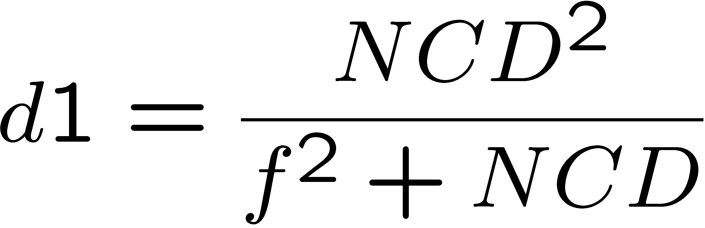
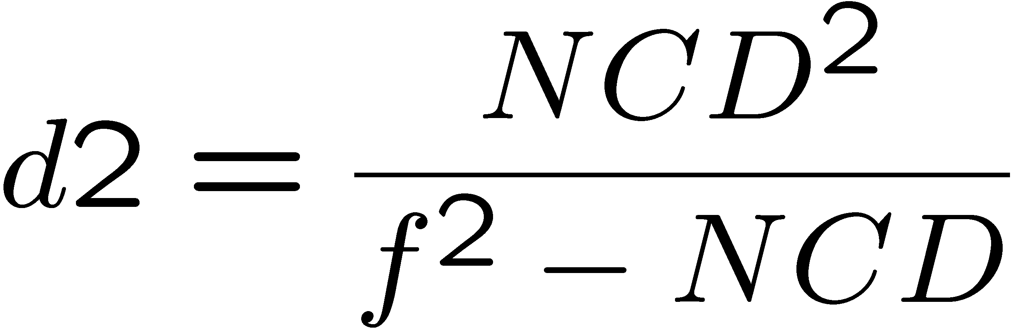
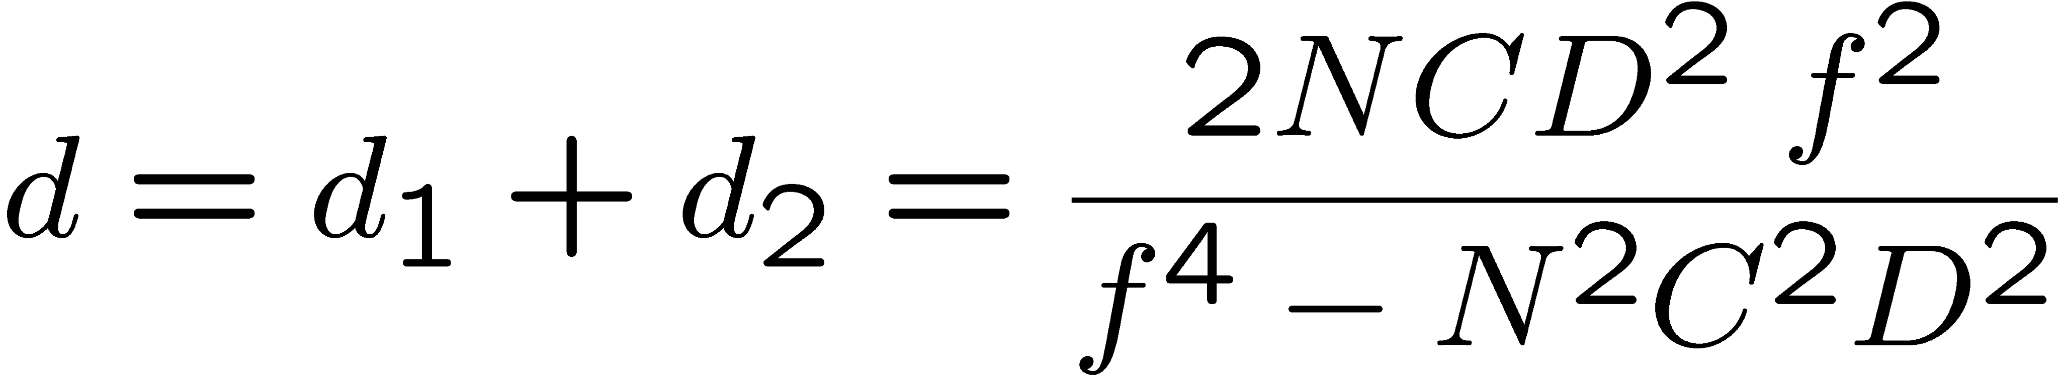
Deriving depth of field
D
f/N
CD/f
d₁
d₂

Slide 40
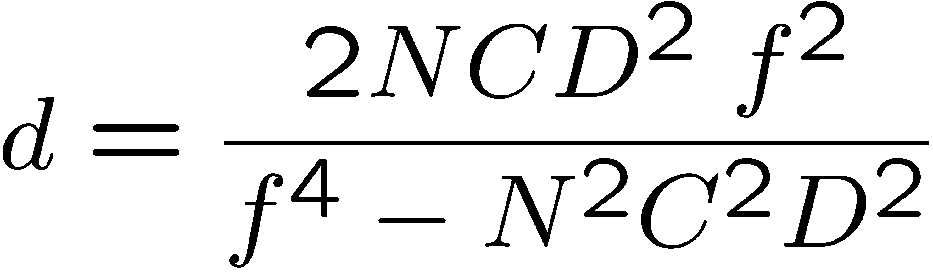
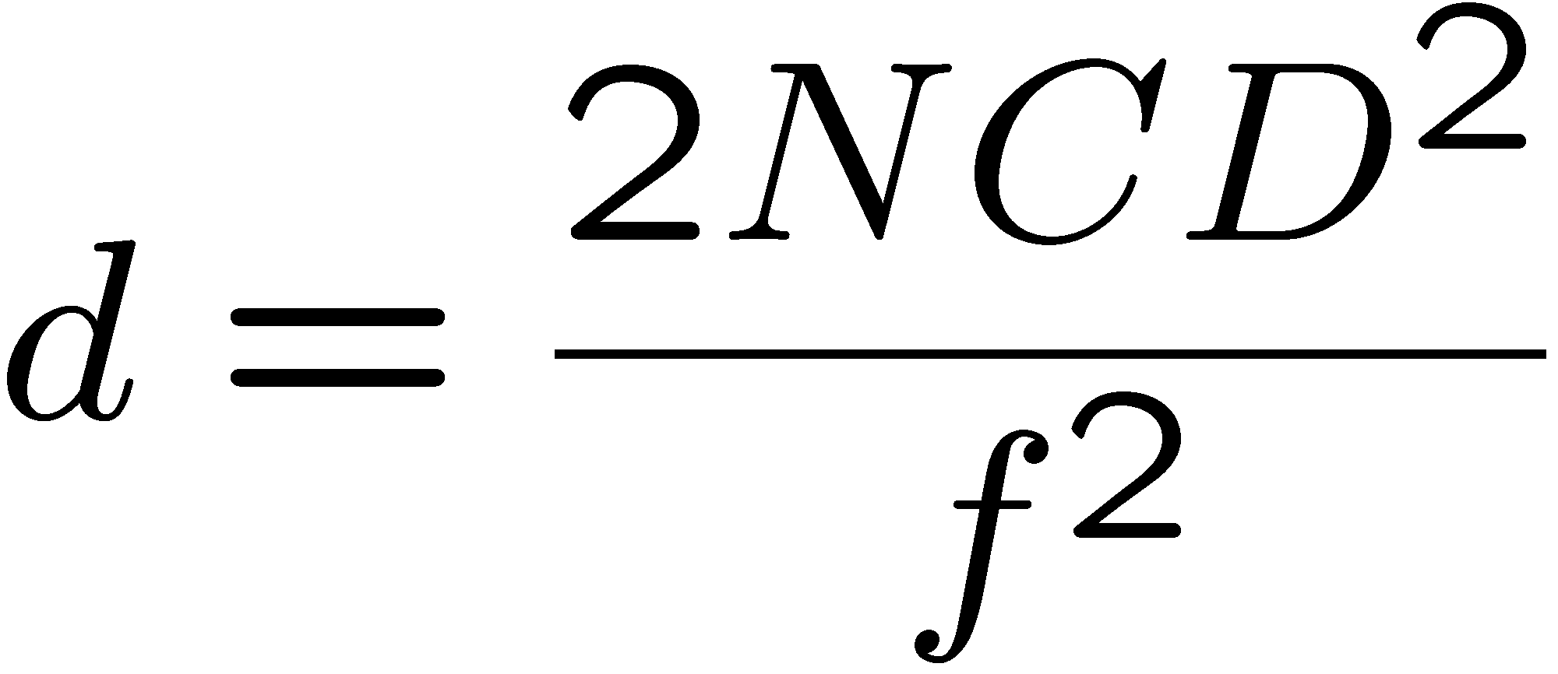
Deriving depth of field
N²C²D² term can often be neglected when DoF is small
(conjugate of circle of confusion is smaller than lens aperture)
D
f/N
CD/f
d₁
d₂

Slide 41
Depth of field and aperture
f/N
CD/f
d₁
d₂

Slide 42
Depth of field and aperture
Linear: proportional to f number
Recall: big f number N
means small physical aperture
f/N
CD/f
d₁
d₂

Slide 43
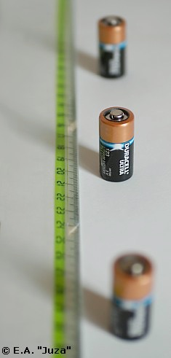
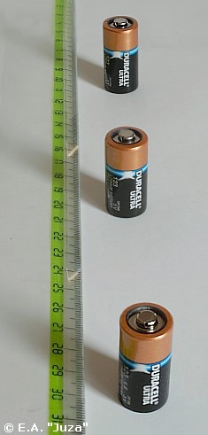
DoF & aperture
http://www.juzaphoto.com/eng/articles/depth_of_field.htm
f/2.8
f/32

Slide 44
SLR viewfinder & aperture
By default, an SLR always shows you the biggest aperture
Brighter image
Shallow depth of field help judge focus
Depth of field preview button:
  Stops down to the aperture you have chosen
  Darker image
  Larger depth of field

Slide 45
Depth of field and focusing distance
Quadratic (bad news for macro)
(but careful, our simplifications
are not accurate for macro)
D
f/N
CD/f
d₁
d₂

Slide 46
Back to Double cone perspective
Recall I said it was simplistic
Seems to say that relationship is linear
But if you add the magnification factor, it's actually quadratic
Point in focus
sensor
lens

Slide 47
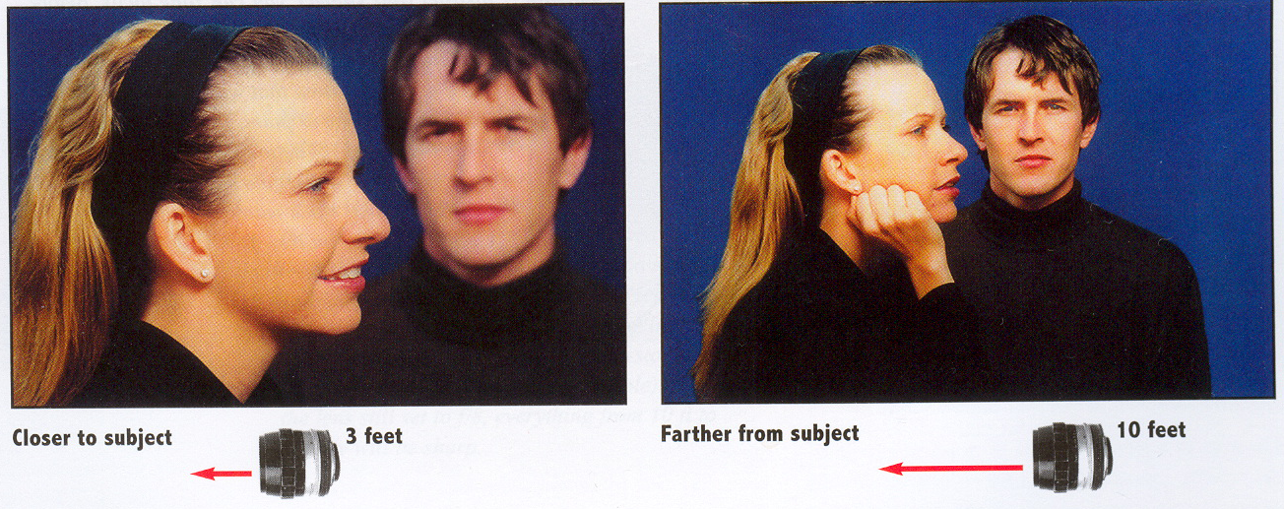
Depth of field & focusing distance
From Photography, London et al.

Slide 48
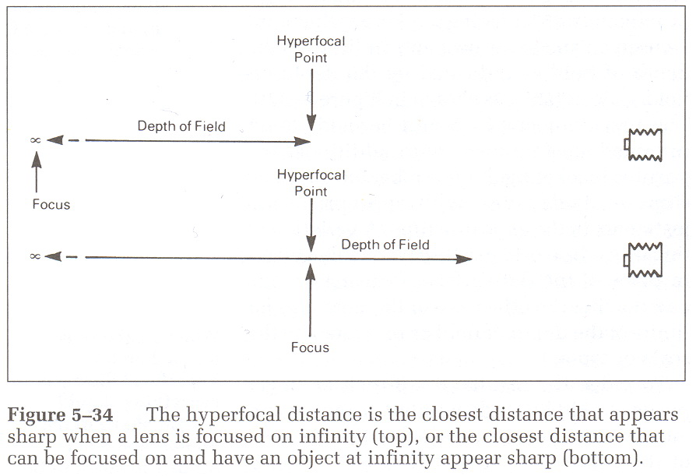
Hyperfocal distance
From Basic Photographic Materials and Processes, Stroebel et al.

Slide 49
Hyperfocal distance
Recall full formula
f/N
CD/f
CD/f
d₁
d₂

Slide 50
Hyperfocal distance
When CD/f becomes bigger than f/N
focus at D=f²/NC and sharp from D/2 till infinity
Our other simplifications do not work anymore there: the denominator term has to be taken into account in
f/N
CD/f
CD/f
d₁
d₂

Slide 51
Depth of field and focal length
Inverse quadratic:
the lens gets bigger,
the magnification is higher
D
f/N
CD/f
d₁
d₂

Slide 52
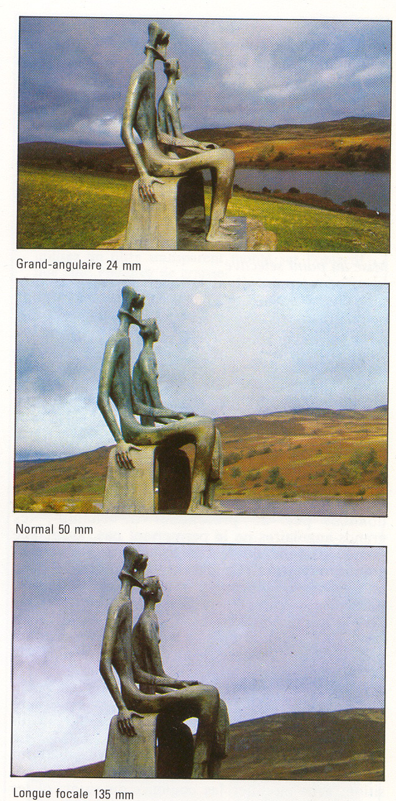
Depth of field & focal length
Recall that to get the same image size,
we can double the focal length and the distance
Recall what happens to physical aperture size when we double the focal length for the same f number?
  It is doubled
24mm
50mm

Slide 53
Depth of field & focal length
Same image size (same magnification),
same f number
Same depth of field!
DoF
Wide-angle
lens
DoF
Telephoto
lens (2x f), same aperture

Slide 54
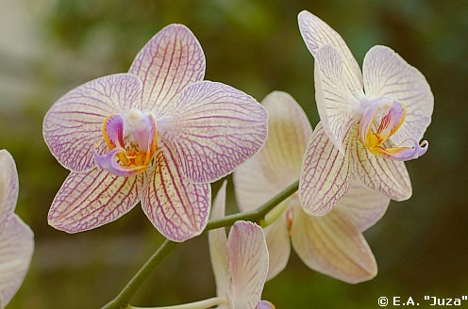
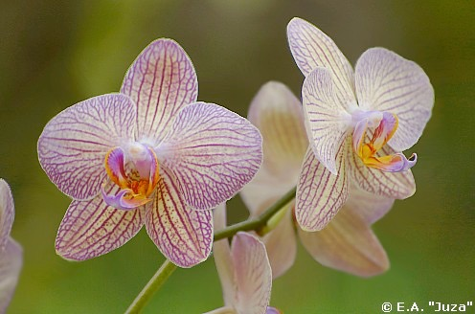
DoF & Focal length
http://www.juzaphoto.com/eng/articles/depth_of_field.htm
50mm f/4.8
200mm f/4.8
(from 4 times farther)
See also http://luminous-landscape.com/tutorials/dof2.shtml

Slide 55
Important conclusion
For a given image size and a given f number, the depth of field (in object space) is the same.
  Might be counter intuitive.
  Although only true if assumption respected
  (far from hyperlocal distance)
Very useful for macro where DoF is critical. You can change your working distance without affecting depth of field
Now what happens to the background blur far far away?

Slide 56
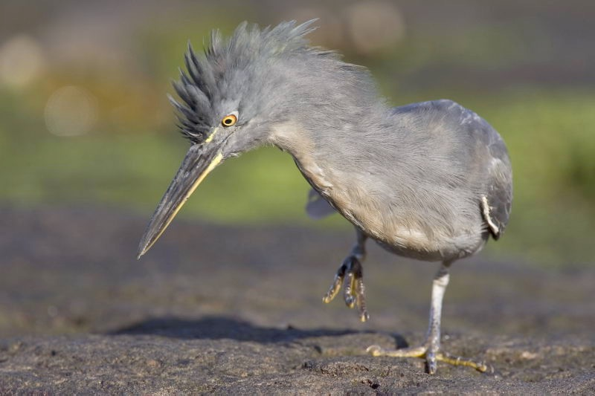
Important conclusion
For a given image size and a given f number, the depth of field (in object space) is the same.
  The depth of acceptable sharpness is the same
But background far far away looks more blurry
Because it gets magnified more
Plus, usually, you don't keep magnification constant

Slide 57
To learn more
http://toothwalker.org/optics/dof.html
Figure 2. The circle of confusion versus distance at a fixed image magnification for a range of focal lengths.

Slide 58
Figure 3. A: Gromit photographed with a 100-mm lens at f/4. B: Gromit photographed with a 28-mm lens at f/4. DOF is the same.

Slide 59
Same object space blur
Figure 4. Background crop from the photographs in Fig. 3. A: 100-mm lens. B: 28-mm lens.

Slide 60
Good tutorials
http://petapixel.com/2011/05/10/a-detailed-explanation-of-depth-of-field-and-the-factors-that-affect-it/
http://snodart.com/tutorials.php

Slide 61
Recap

Slide 62
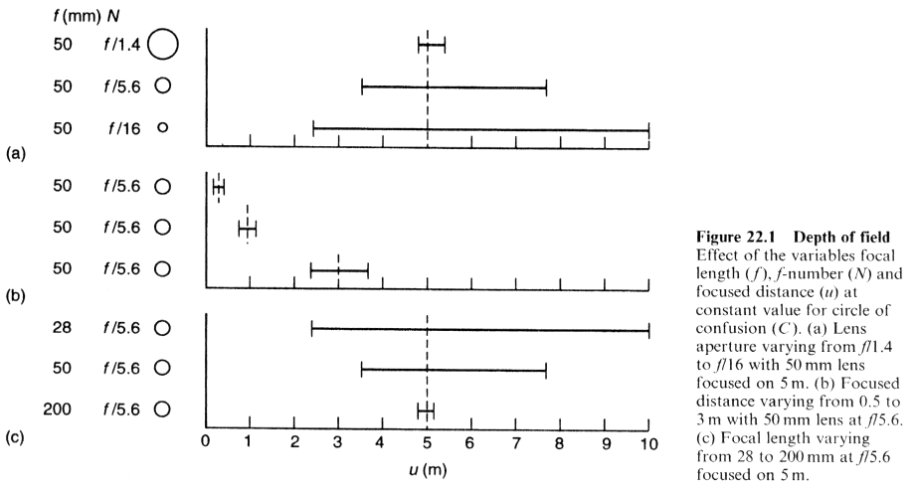
Effect of parameters
aperture
focusing distance
focal length
From applied photographic optics

Slide 63
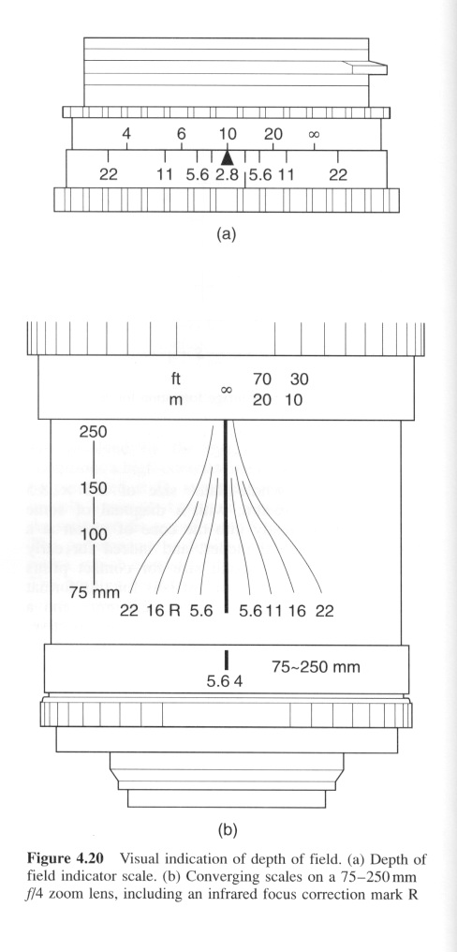
DoF guides
From "The Manual of Photography" Jacobson et al

Slide 64
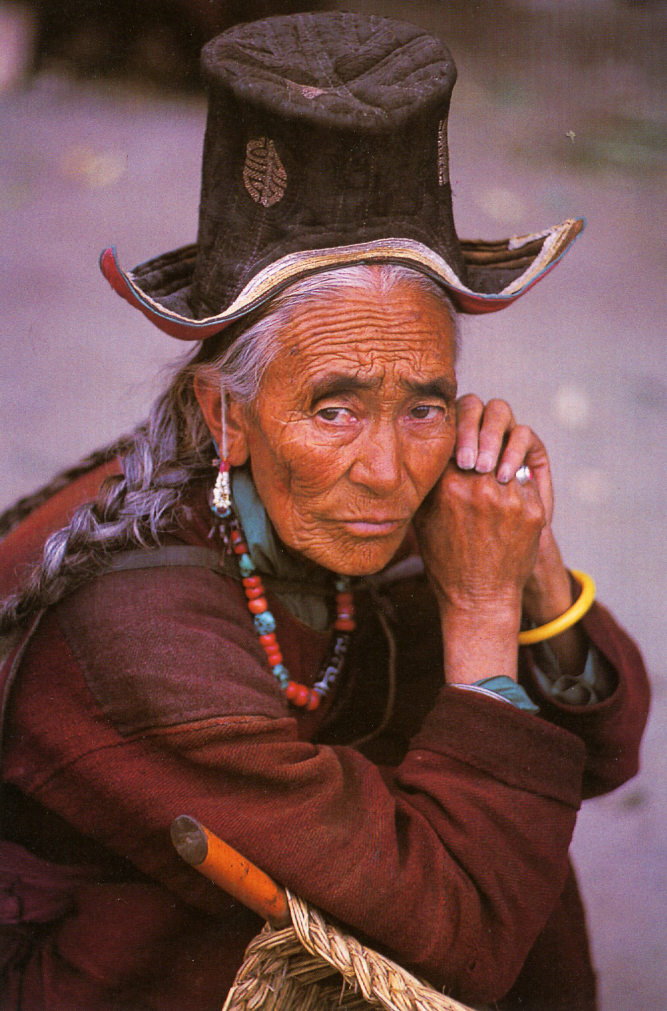
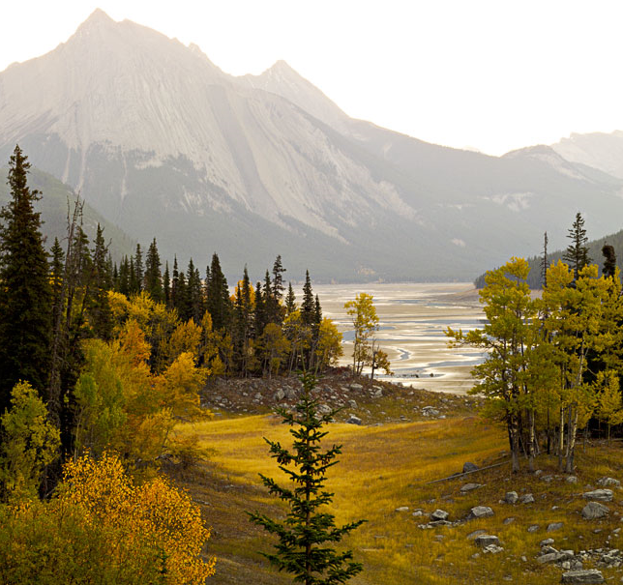
Is depth of field good or evil?
It depends, little grasshopper
Want huge DoF: landscape,
photojournalists, portrait with
environment
Shallow DoF: portrait, wildlife
Michael Reichman
Steve McCurry

Slide 65
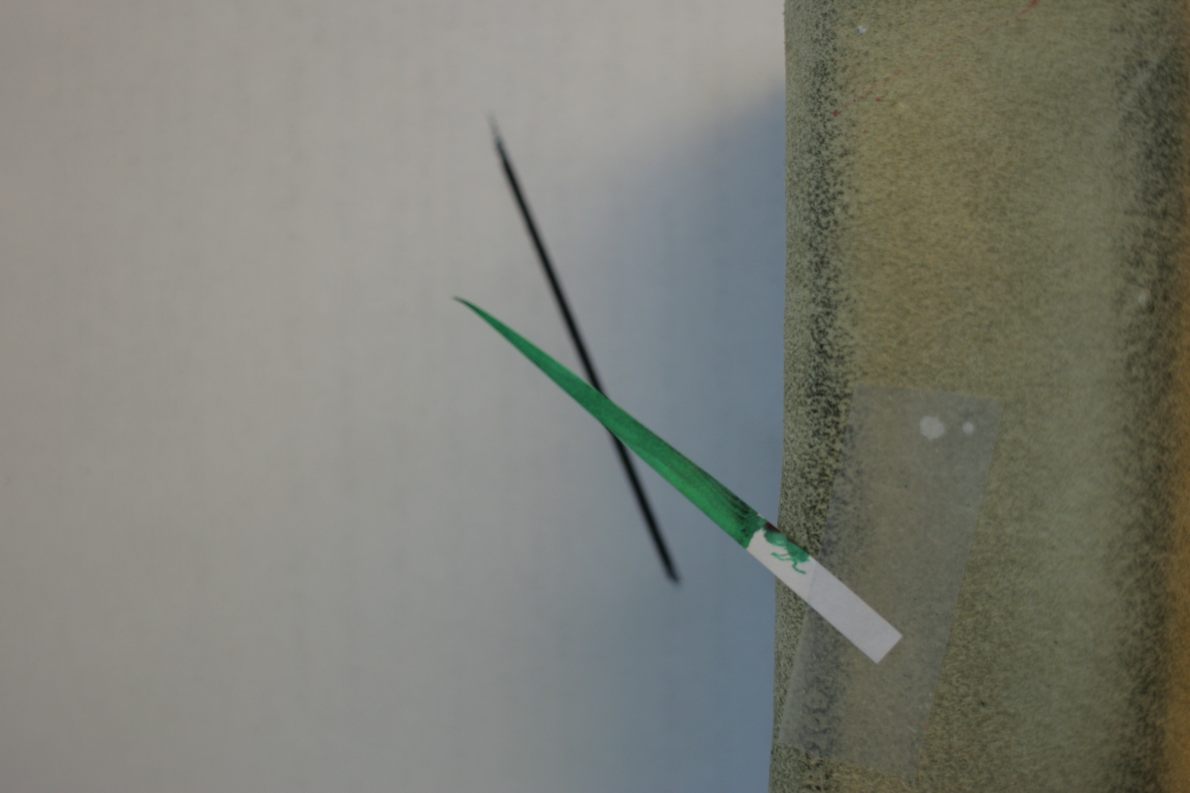

Crazy DoF images
By Matthias Zwicker
The focus is between the two sticks
Sharp version
Really wide aperture version

Slide 66
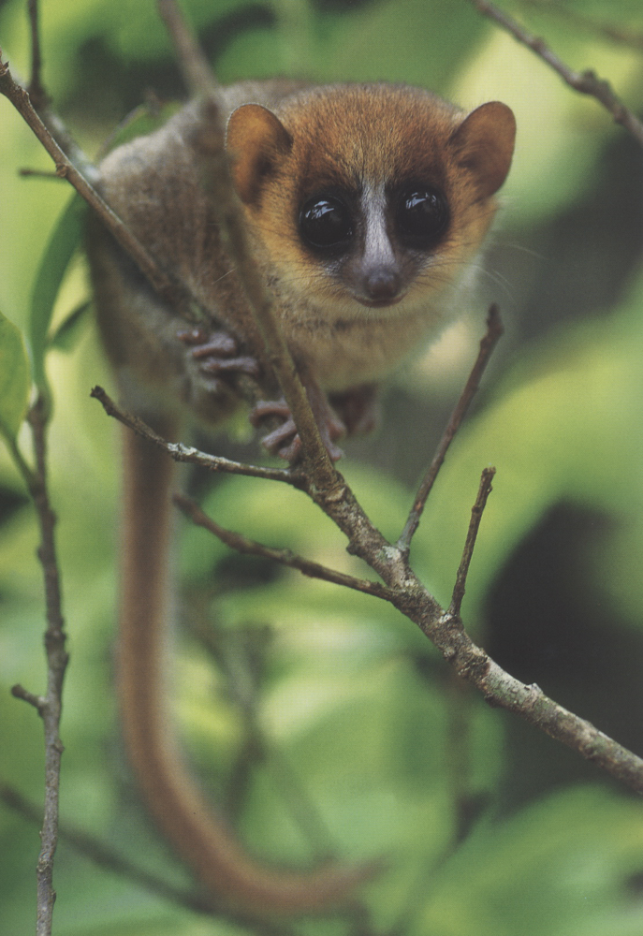
Is depth of field a blur?
Depth of field is NOT a convolution of the image
The circle of confusion varies with depth
There are interesting occlusion effects
(If you really want a convolution, there is one, but in 4D space… more about this in ten days)
From Macro Photography

Slide 67
Sensor size

Slide 68
Depth of field
It’s all about the size of the lens aperture
Point in focus
sensor
lens
Object with texture
lens
sensor
Point in focus
Object with texture

Slide 69
Equation
Smaller sensor
  smaller C
  smaller f
But the effect of f is quadratic
Bottom line: the size of the sensor linearly scales the depth of field
  for same field of view, focusing distance and f number (aperture).

Slide 70
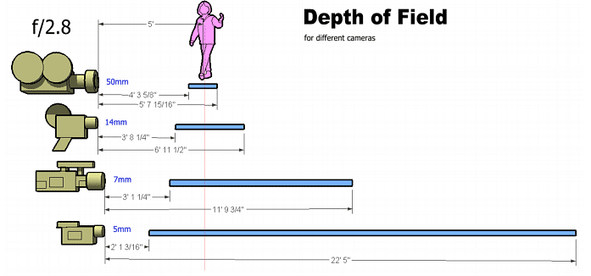
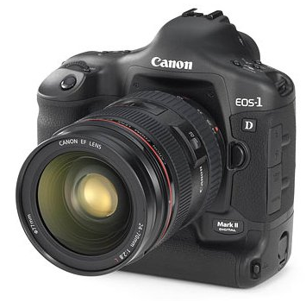
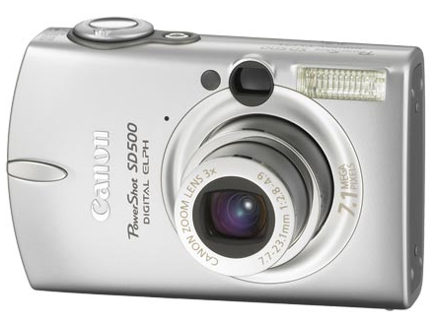
Sensor size
http://www.mediachance.com/dvdlab/dof/index.htm

Slide 71
The coolest depth of field solution
http://www.mediachance.com/dvdlab/dof/index.htm
Use two optical systems
lens
sensor
Point in focus
lens
Object
with
texture
diffuser

Slide 72
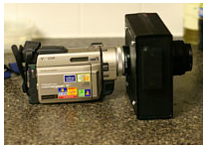
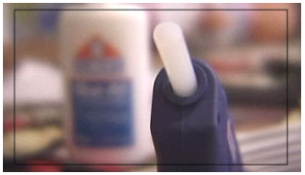
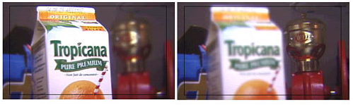
The coolest depth of field solution
http://www.mediachance.com/dvdlab/dof/index.htm
lens
sensor
Point in focus
diffuser
lens
Object
with
texture

Slide 73
The Frazier lens
The opposite: relay optics for large depth of field in macro shots.
http://photo.stackexchange.com/questions/11124/how-can-a-frazier-lens-achieve-that-massive-dof

Slide 74
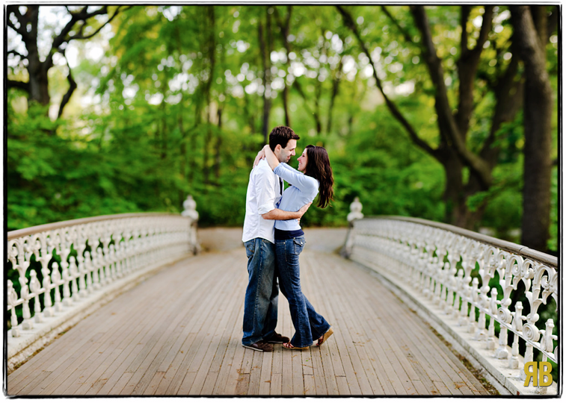
Brenizer method
Simulate larger sensor using panorama stitching
http://www.amazon.com/gp/blog/post/PLNK1UFLDXXBLDMN3

Slide 75
Seeing through occlusion

Slide 76
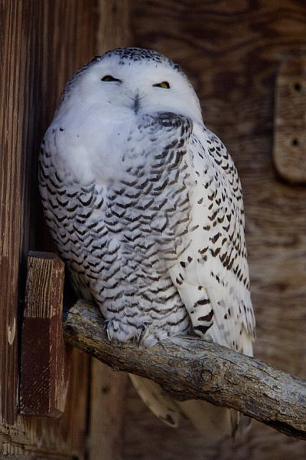
Seeing beyond occlusion
Photo taken through zoo
bars
Telephoto at full aperture
The bars are so blurry
that they are invisible

Slide 77
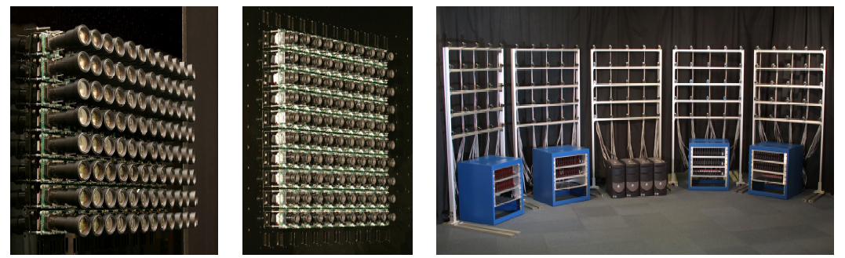
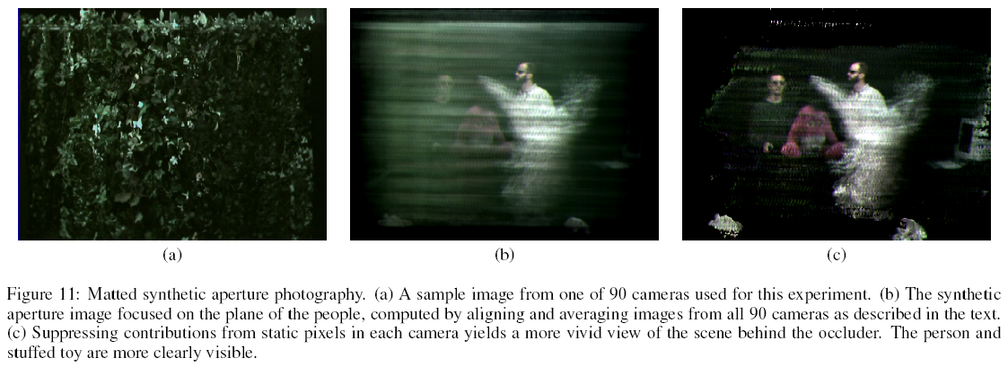
Synthetic aperture
Stanford Camera array (Willburn et al.
http://graphics.stanford.edu/papers/CameraArray/)

Slide 78
Aperture

Slide 79
Why a bigger aperture
To make things blurrier
  Depth of field
  outside the focal plane
To make things sharper
  Diffraction limit
  on the focal plane
Sharpness & aperture (e.g. for the Canon 50mm f/1.4)
http://www.slrgear.com/reviews/showproduct.php/product/140/sort/2/cat/10/page/3
f/1.4: soft (geometrical aberrations), super shallow Dof. Lots of light!
f/2.8 getting really sharp, shallow depth of field
f/5.6: best sharpness
f/16: diffraction kicks in, loses sharpness. But dpoth of field is big

Slide 80
Depth of field
More narrow when focusing close
More narrow with bigger sensors
For the same magnification, independent of focal length

Slide 81
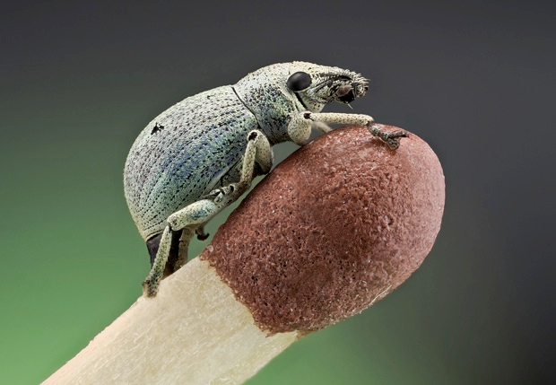
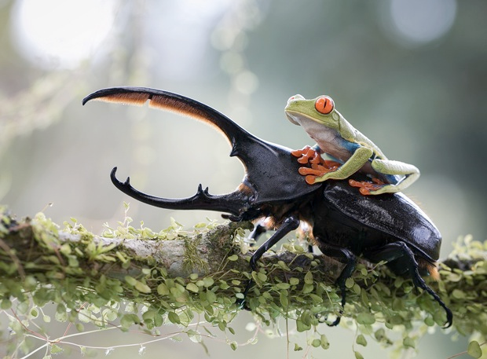
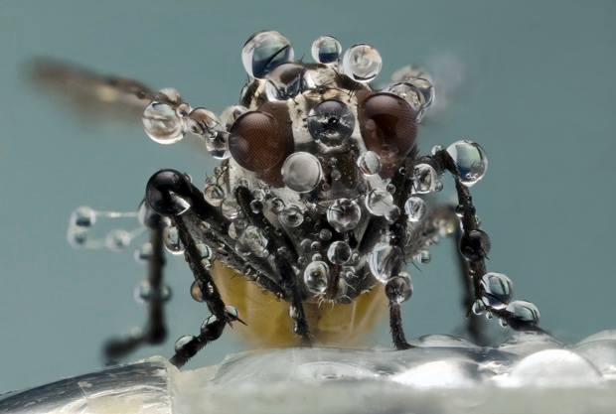
http://petapixel.com/2013/05/17/focus-stacked-macro-photos-of-bugs-by-photographer-nicolas-reusens/

Slide 82
Focal stack
aka
Focus stack

Slide 83
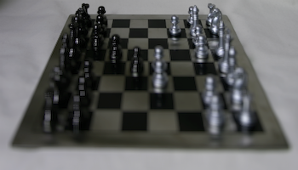
Problem: limited depth of field

Slide 84
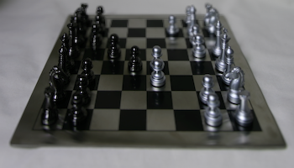

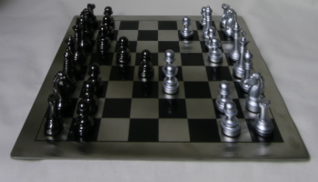
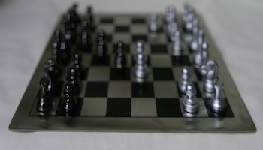
Idea
Take images with different focusing distances
Merge into a full-focus image
  For each pixel, pick sharpest image
  Similar to autofocus
Similar to HDR, panorama
  But along focus dimension
focus
focus
focus

Slide 85
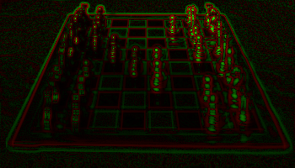
Evaluating sharpness
Local amount of high-frequency content
green: positive, red: negative
here image focused in the back

Slide 86
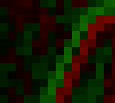
Need for smoothing
The high frequency around an edge goes from positive to negative, through zero
We want high “sharpness” all around the edge
Plus we want spatial coherence in our choice of pixels

Slide 87
We can’t smooth directly
High frequency has positive and negative values
Local average is zero
By construction: we removed low frequencies!

Slide 88
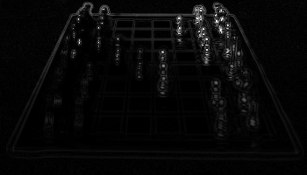
Local high frequency energy
Take the square of the high frequencies
  All positive

Slide 89

Local high frequency energy
Take the square of the high frequencies
  All positive
Take local average using Gaussian filter

Slide 90


Focal Stack Compositing
Weighted sum of all input images (normalize!)
Each pixel weighted by sharpness value
x
x
+
and divide by sum of weights
x

Slide 91
Compositing (17 input images)
Weighted sum of all input images
Each pixel weighted by sharpness value

Slide 92
Compare to single image

Slide 93

Bells and whistle
So far, simple weights
But we want to give more weight to best image
Potential solution: just use the max
Simpler solution: raise the sharpness to a high exponent (e.g. 4)

Slide 94
With exponent 1
(The previous version)

Slide 95

With exponent 4
Subtle difference, but sharper

Slide 96

Visualization of image weights
Random color for each input image

Slide 97

Visualization of image weights
Random color for each input image
With exponent =1 : blurrier

Slide 98

More results: input

Slide 99

More results: input

Slide 100

More results: input

Slide 101

More results: input

Slide 102

More results: input

Slide 103

More results: input

Slide 104

More results: input

Slide 105

More results: input

Slide 106

More results: input

Slide 107

More results: input

Slide 108

More results: input

Slide 109

More results: input

Slide 110

More results

Slide 111

More results

Slide 112

More advanced
Choose max image for each pixel
Regularize for spatial coherence
Poisson (gradient) blending
From Agarwala et al.
http://grail.cs.washington.edu/projects/photomontage/

Slide 113
Focal stack DoF extensions
Capture N images focused at different distances
For each output pixel, choose the sharpest image
  e.g. look at local variance, gradient.

Slide 114













Focal stack

Slide 115

Interactive Digital Photomontage

Slide 116
Compared to our result

Slide 117

Macro montage
55 images here
Not my code

Slide 118

How to get the focal stack?
http://www.cognisys-inc.com/stackshot/stackshot.php
Although here we change the viewpoint as well

Slide 119
Swept under the rug
We also need to scale images
recall that changing the focus changes the field of view / magnification
film
focused
close
film
focused
at
infinity

Slide 120
Macro

Slide 121

Scanning: combination in 1 exposure
From Macro photography: Learning from a Master

Slide 122
Macro is easy with small sensors
1/ minimum focusing distance is way smaller
2/ depth of field is bigger
Summary: you've scaled down the camera, you can take pictures of a scaled-down world
Point in focus
sensor
lens
Object with texture
Well, except for diffraction
(we did not scale wavelength!)
lens
sensor
Point in focus
Object with texture

Slide 123
More
http://grail.cs.washington.edu/projects/photomontage/
http://www.heliconsoft.com/heliconfocus.html
http://people.csail.mit.edu/hasinoff/pubs/hasinoff-timeconstrained-2009.pdf
http://people.csail.mit.edu/hasinoff/pubs/hasinoff-timeconstrained-2009.pdf
http://layersmagazine.com/extended-depth-of-field-with-auto-blend-layers-in-photoshop-cs4.html
http://www1.cs.columbia.edu/CAVE/projects/flexible_dof/images/FocalStack/pool_table/
http://en.wikipedia.org/wiki/Focus_stacking
http://en.wikipedia.org/wiki/Microscopy#Deconvolution
http://www.equisetites.de/palbot/tools/focus_stacking.html
http://www.youtube.com/watch?v=fJiEw4VCcYU
http://www.janrik.net/insects/ExtendedDOF/LepSocNewsFinal/EDOF_NewsLepSoc_2005summer.htm
https://alliance.seas.upenn.edu/~cis581/wiki/Lectures/Pyramid.pdf

Slide 124
Fake depth of field

Slide 125
Challenge
Shallow depth of field hard with small sensors
Point in focus
sensor
lens
Object with texture
lens
sensor
Point in focus
Object with texture

Slide 126

Challenge
Shallow depth of field hard with small sensors
Point in focus
sensor
lens
Object with texture
lens
sensor
Point in focus
Object with texture

Slide 127

https://people.csail.mit.edu/soonmin/dof/

Slide 128

Portrait mode
https://research.google/blog/portrait-mode-on-the-pixel-2-and-pixel-2-xl-smartphones/
https://arxiv.org/pdf/1806.04171

Slide 129

Machine learning-based foreground-background segmentation
Use dual pixels to get a depth map
(or analyze local defocus)
Predict desired per-pixel blur radius
Render with non-linear blur
(more later)

Slide 130


Slide 131

Challenge with defocus blur
Remember, not a convolution!
Blur radius depends on input scene depth,
not output pixel location
Plus occlusion matters

Slide 132
*
Point in focus
sensor
lens

Slide 133


Slide 134
Occlusion
Divide the image into k (=5) depth layers with opacity values
Process each layer independently
Composite back to front (with “over” operator)

Slide 137
Challenges
Masks are hard, especially around hair!
Need notion of sub-pixel coverage

Slide 138

Some more recent work
https://arxiv.org/abs/1904.05822
https://imaging.cs.cmu.edu/dual_pixels/

