Slide 1
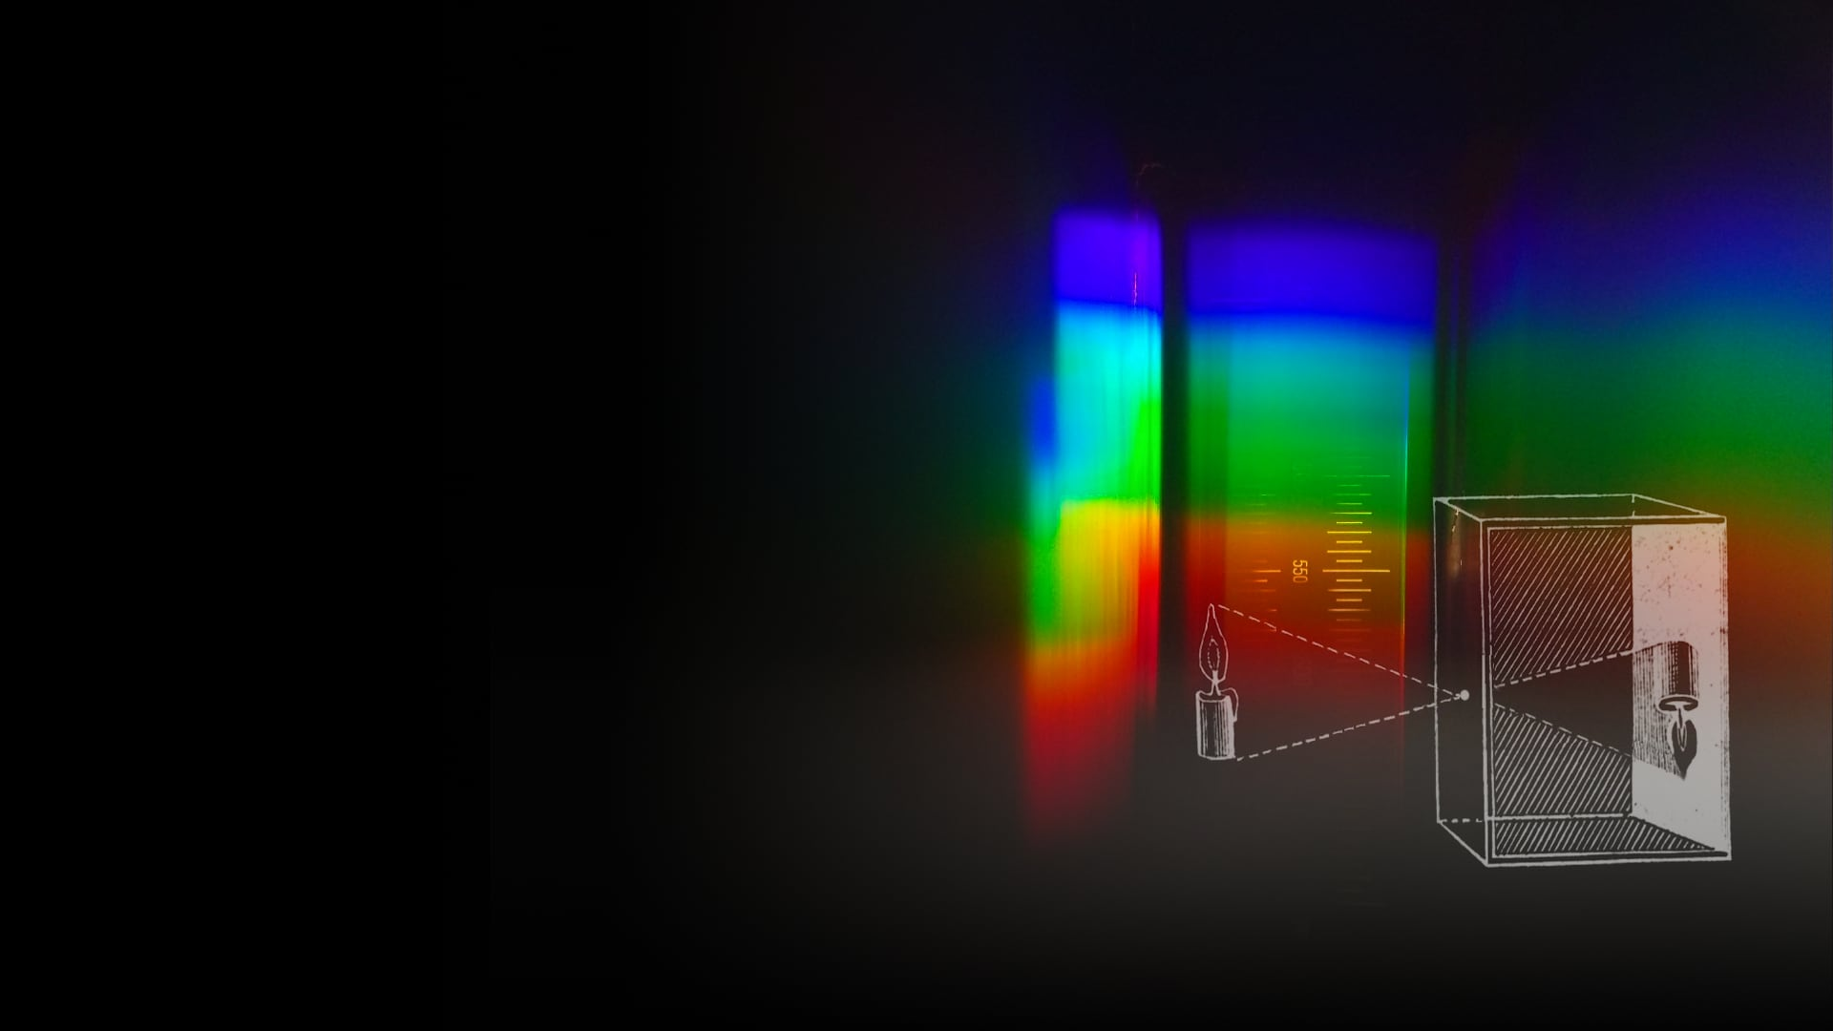


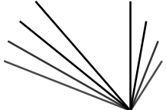
  Image Formation
Module 1:
Geometry
Some slides adapted from
CMU 16-889: Learning for 3D Vision
Prof. Shubham Tulsiani
CMU 16-385: Computer Vision
Prof. Kris Kitani
MIT 6.819/6.869: Advances in Computer Vision,
Profs. Bill Freeman, Phillip Isola, Antonio Torralba
Prof. Vincent Sitzmann
Prof. Fredo Durand

Slide 2
Fredo’s notes
Inductive bias, perspective, ray marching, projection
Discuss triangle to image transformers
Maybe skip camera obscura for the sake of time?
Also homographies
Get pinhole demo with digital camera
Surprisingly I had time for a lot of digressions. Maybe because I skipped exercises and the details of 2D camera coordinate transformations
  Maybe revive scene, rays, light, physics.
Plucker inductive bias

Slide 3
Some Slides adapted from…
CMU 16-889: Learning for 3D Vision
Prof. Shubham Tulsiani
CMU 16-385: Computer Vision
Prof. Kris Kitani
MIT 6.819/6.869: Advances in Computer Vision,
Profs. Bill Freeman, Phillip Isola, Antonio Torralba

Slide 4
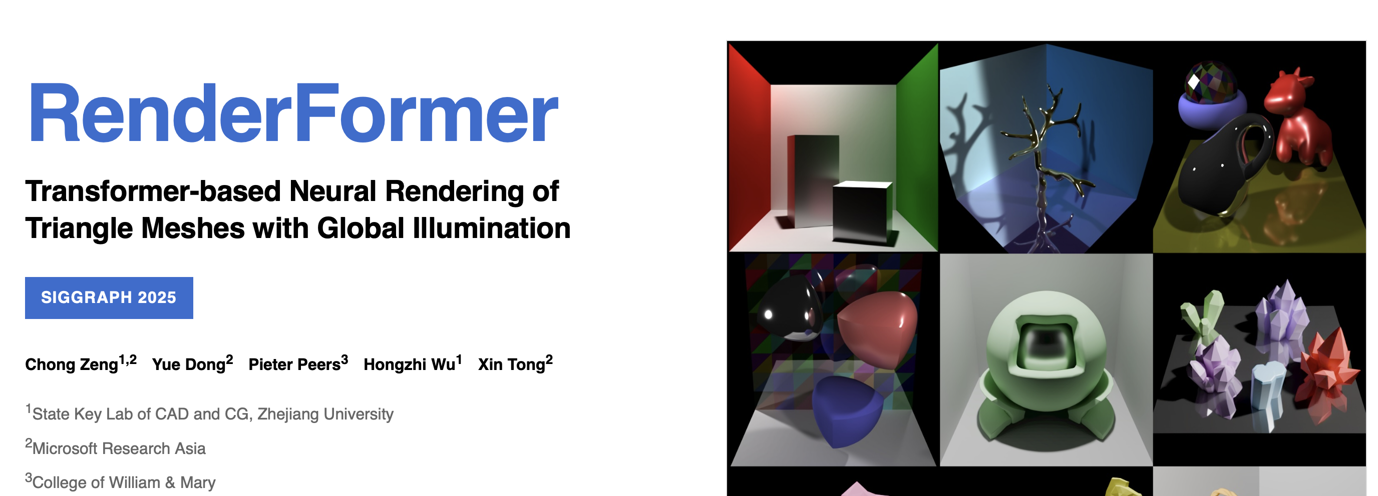
Philosophical discussion
Ingredients of Vision include 2D and 3D image
The connection between the two (image formation, perspective) is important
So far still mostly hand-coded
  Inductive bias
Who knows if it will eventually be learned
  e.g. transformers to learn mapping from 3D triangles to image
  https://microsoft.github.io/renderformer/

Slide 5
What is a 3D scene?
materials, light sources, 3D shape, color, weight, density, friction coefficients, etc

Slide 6
How do we observe scenes?
An eye (or a camera) observes a subset of all the light rays in a scene.

Slide 7
Why don’t we get an image if we hold up a piece of paper?

Slide 8
Every “pixel” on the paper is the average of all the rays in the scene.

Slide 9
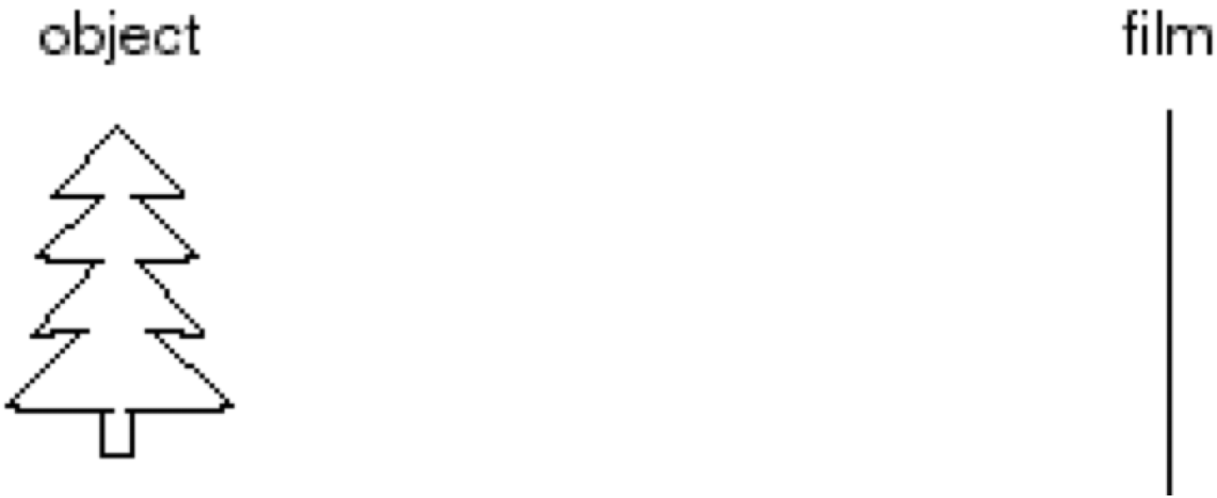
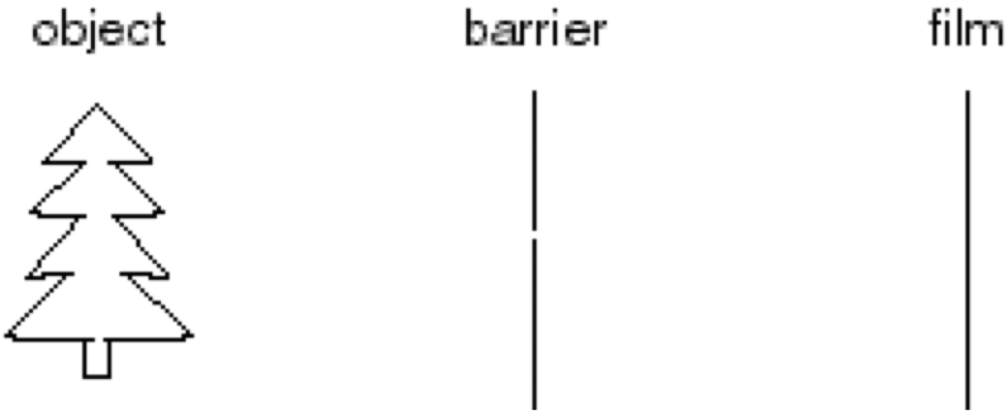
Let’s make a Camera!
Idea 1: Put piece of film in front of an object
Add a barrier to block most rays.
Slide credit: Steve Seitz

Slide 10
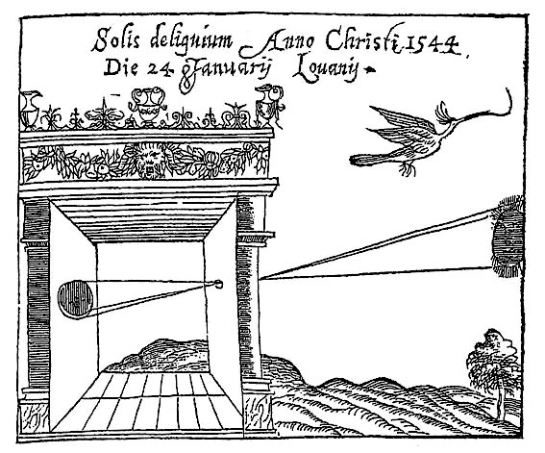
Camera Obscura
Basic principle known to Mozi (470-390 BCE), Aristotle (384-322 BCE)
Drawing aid for artists: described by Leonardo da Vinci (1452-1519)
Gemma Frisius, 1558
Slide credit: Lana Lazebnik
Image source

Slide 11
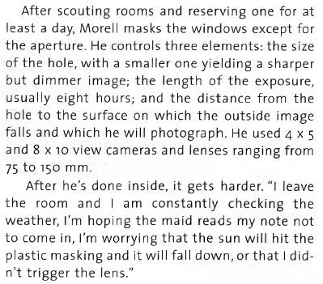
Camera Obscura (Dark Room)
http://www.abelardomorell.net/project/camera-obscura/
Camera Obscura: View of Central Park Looking West in Bedroom. Summer, 2018
Slide credit: Lana Lazebnik

Slide 12
Today: Model the camera, describe the rays.

Slide 13
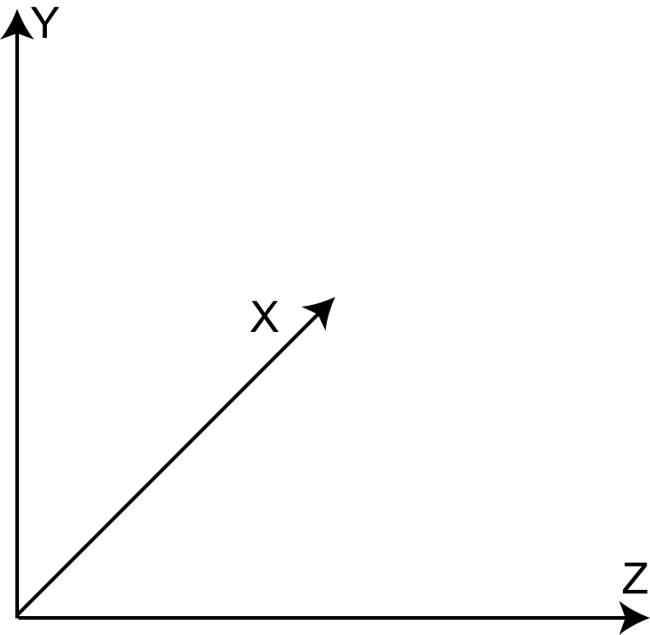
Perspective projection
Pinhole
Camera center

Slide 14
Perspective projection
Image Plane
$$f$$
$$x$$
Pinhole
Camera center
$$y$$

Slide 15
Perspective projection
$$X$$
Capital case:
World Coordinates
$$f$$
$$x$$
$$y$$
$$x$$
Lowercase:
Pixel / Image Coordinates

Slide 16
Perspective projection
$$X$$
Capital case:
World Coordinates
$$f$$
$$f$$
$$x$$
$$y$$
$$x$$
Lowercase:
Pixel / Image Coordinates

Slide 17
Perspective projection
$$X$$
Capital case:
World Coordinates
$$y$$
$$f$$
$$x$$
$$O$$
Camera
Center
$$x$$
Lowercase:
Pixel / Image Coordinates

Slide 18
Perspective projection
$$Y$$
$$X$$
$$y$$
$$x$$
$$Z$$

Slide 19
Perspective projection
$$Y$$
$$X$$
$$y$$
$$x$$
$$Z$$

Slide 20
Perspective projection
$$Y$$
$$X$$
$$X$$
$$y$$
$$x$$
$$x$$
$$Z$$

Slide 21
Perspective projection
$$Y$$
$$Y$$
$$y$$
$$f$$
$$Z$$
$$\frac{y}{f}=\frac{Y}{Z}$$
$$y=f\frac{Y}{Z}$$

Slide 22
Depth of a pixel / 3D point
$$Y$$
$$Y$$
$$y$$
$$f$$
$$Z$$
= Depth of pixel $y$ / 3D point $Y$
$$y=f\frac{Y}{Z}$$

Slide 23
Depth vs. Ray Length
$$Y$$
This is *not* the depth, but the “ray length”
$$Y$$
$$y$$
$$f$$
$$Z$$
= Depth of pixel $y$ / 3D point $Y$
$$y=f\frac{Y}{Z}$$

Slide 24
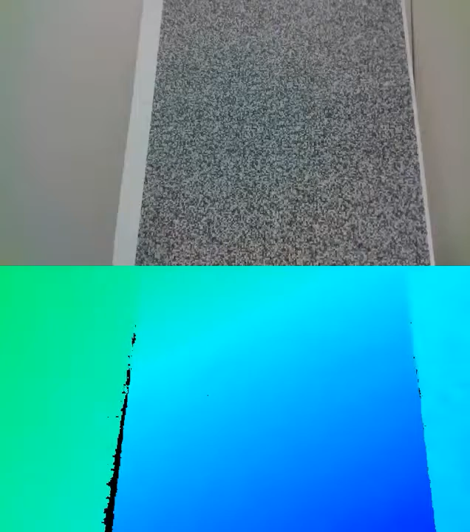
Side note : there exists Depth Sensors
Output of Intel RealSense Camera
https://www.youtube.com/watch?v=t-X7tnT8CVY

Slide 25
Perspective projection
$$Y$$
$$X$$
$$X$$
$$y$$
$$x$$
$$x$$
$$Z$$
$$x=\left(\begin{aligned}x,y\end{aligned}\right)=\left(\begin{aligned}X,Y\end{aligned}\right)⋅\frac{f}{Z}$$
Image / Pixel
Coordinates
World Coordinates

Slide 26
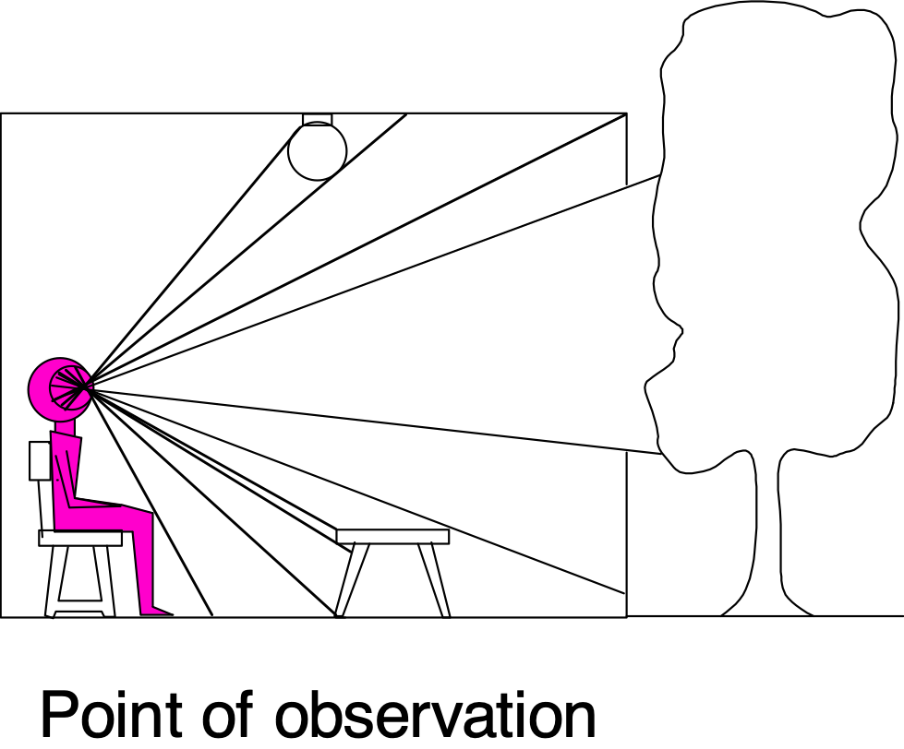

Perspective Projection
3D world
2D image
What properties of the world are preserved?
  Straight lines, incidence
What properties are not preserved?
  Angles, lengths
Slide by A. Efros
Figures © Stephen E. Palmer, 2002

Slide 27
Vanishing point
sensor plane
y
z
Vanishing point for this 3-d line

Slide 28
Perspective projection of that line
Line in 3-space
$$X(t)=X_{0}+at$$
$$x(t)=\frac{fX}{Z}=\frac{fX_{0}+fat}{Z_{0}+ct}$$
$$Y(t)=Y_{0}+bt$$
$$y(t)=\frac{fY}{Z}=\frac{fY_{0}+fbt}{Z_{0}+ct}$$
$$Z(t)=Z_{0}+ct$$

Slide 29
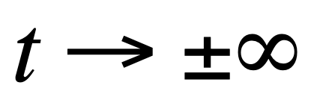
Perspective projection of that line
Line in 3-space
$$X(t)=X_{0}+at$$
$$x(t)=\frac{fX}{Z}=\frac{fX_{0}+fat}{Z_{0}+ct}$$
$$Y(t)=Y_{0}+bt$$
$$y(t)=\frac{fY}{Z}=\frac{fY_{0}+fbt}{Z_{0}+ct}$$
$$Z(t)=Z_{0}+ct$$
In the limit as
we have (for ):
$$c≠0$$

Slide 30
Perspective projection of that line
Line in 3-space
$$X(t)=X_{0}+at$$
$$x(t)=\frac{fX}{Z}=\frac{fX_{0}+fat}{Z_{0}+ct}$$
$$Y(t)=Y_{0}+bt$$
$$y(t)=\frac{fY}{Z}=\frac{fY_{0}+fbt}{Z_{0}+ct}$$
$$Z(t)=Z_{0}+ct$$
$$x(t→∞)→\frac{fa}{c}$$
In the limit as
we have (for ):
$$c≠0$$
$$y(t→∞)→\frac{fb}{c}$$
Any set of parallel lines (same a, b, c) converge to the same point
(called the vanishing point).

Slide 31
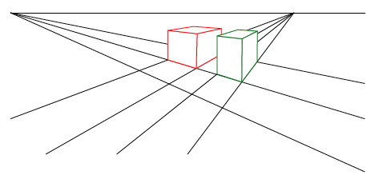
Vanishing points
Each set of parallel lines (=direction) meets at a different point
  The vanishing point for this direction
Sets of parallel lines on the same plane lead to colinear vanishing points.
  The line is called the horizon for that plane

Slide 32
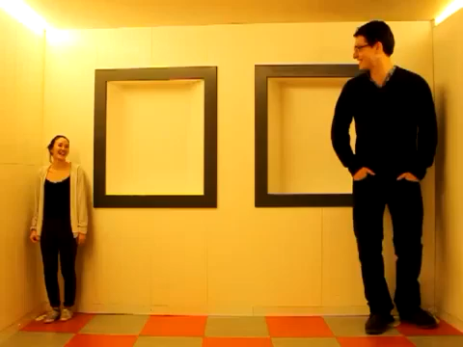
Perspective Projection
Video source: Camera Obscura & World of Illusions
Slide credit: CMU 16-889: Learning for 3D Vision, Prof. Shubham Tulsiani

Slide 33
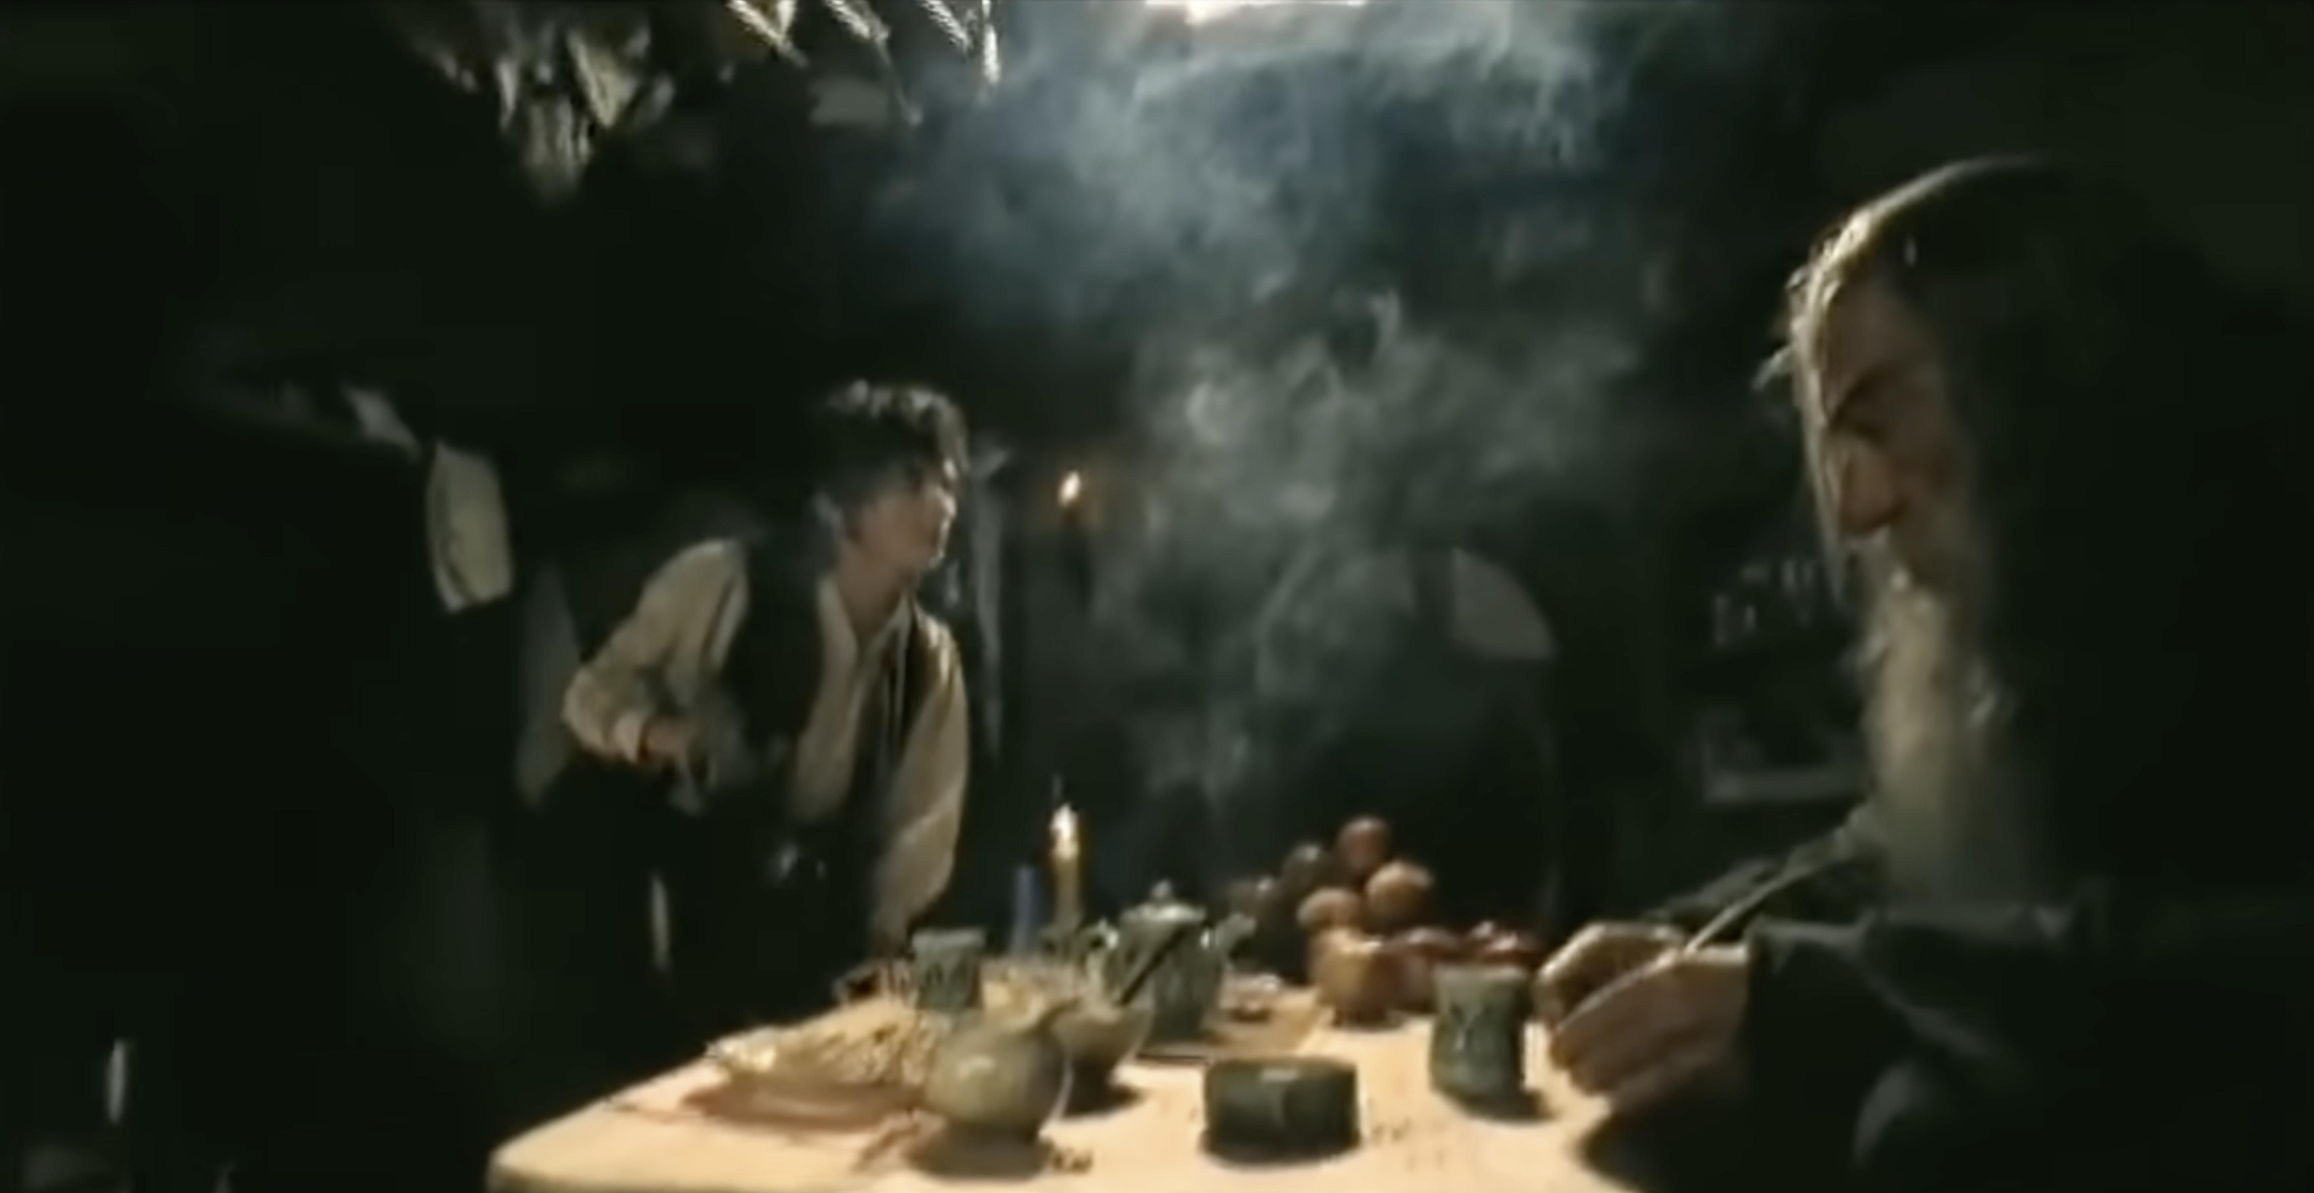
See also Lord of The Ring’s version with a moving camera
https://www.youtube.com/watch?v=QWMFpxkGO_s
https://nofilmschool.com/lord-of-the-rings-forced-perspective

Slide 34
Questions?

Slide 35
Perspective projection
$$Y$$
$$X$$
$$X$$
$$y$$
$$x$$
$$x$$
$$Z$$
$$x=\left(\begin{aligned}x,y\end{aligned}\right)=\left(\begin{aligned}X,Y\end{aligned}\right)⋅\frac{f}{Z}$$
This is awkward… Not a linear operator.

Slide 36
Homogeneous coordinates
2D
$$y$$
$$x$$
$$x$$
$$\overset{˜}{x}=\left[\begin{aligned}x \\ y \\ 1\end{aligned}\right]$$
$$x=\left(\begin{aligned}x,y\end{aligned}\right)$$
heterogeneous
coordinates
homogeneous
coordinates

Slide 37
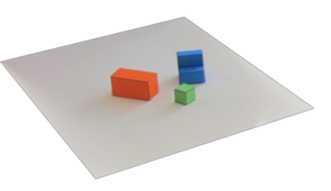
Homogeneous coordinates
Y
2D
$$y$$
3D
$$x$$
X
Z
$$x$$
$$\overset{˜}{X}=\left[\begin{aligned}X \\ Y \\ Z \\ 1\end{aligned}\right]$$
$$\overset{˜}{x}=\left[\begin{aligned}x \\ y \\ 1\end{aligned}\right]$$
$$x=\left(\begin{aligned}x,y\end{aligned}\right)$$
$$X=\left(\begin{aligned}X,Y,Z\end{aligned}\right)$$
heterogeneous
coordinates
homogeneous
coordinates

Slide 38

From heterogeneous to homogeneous:
$$\overset{˜}{x}=\left[\begin{aligned}x \\ y \\ 1\end{aligned}\right]=\left[\begin{aligned}w⋅x \\ w⋅y \\ w⋅1\end{aligned}\right]$$
scale invariant
(all w represent the same point)
$$x=\left(\begin{aligned}x,y\end{aligned}\right)$$
For w≠0
From homogeneous to heterogeneous:
$$\overset{˜}{x}=\left[\begin{aligned}x \\ y \\ w\end{aligned}\right]$$
$$x=\left(\begin{aligned}x/w,y/w\end{aligned}\right)$$

Slide 39
Homogeneous coordinates
2D
3D
$$P^{3}$$
$$R^{2}$$
$$P^{2}$$
$$\left[\begin{aligned}X \\ Y \\ Z \\ 1\end{aligned}\right]$$
$$R^{3}$$
$$\left[\begin{aligned}x \\ y \\ 1\end{aligned}\right]$$
$$\left(\begin{aligned}x,y\end{aligned}\right)$$
$$\left(\begin{aligned}X,Y,Z\end{aligned}\right)$$
$$\left[\begin{aligned}X \\ Y \\ Z \\ W\end{aligned}\right]$$
$$\left[\begin{aligned}x \\ y \\ w\end{aligned}\right]$$
$$\left(\begin{aligned}x/w,y/w\end{aligned}\right)$$
$$\left(\begin{aligned}X/W,Y/W,Z/W\end{aligned}\right)$$

Slide 40
Questions?

Slide 41
Perspective projection
$$Y$$
$$X$$
$$X$$
$$y$$
$$x$$
$$x$$
$$Z$$
$$x=\left(\begin{aligned}x,y\end{aligned}\right)=\left(\begin{aligned}X,Y\end{aligned}\right)⋅\frac{f}{Z}$$
This is awkward… Not a linear operator.

Slide 42
Perspective projection
Heterogeneous coordinates
Homogeneous coordinates
?
$$x=\left(\begin{aligned}x,y\end{aligned}\right)=\left(\begin{aligned}X,Y\end{aligned}\right)⋅\frac{f}{Z}$$
$$\left[\begin{aligned}x \\ y \\ w\end{aligned}\right]=\left[\begin{matrix}? & ? & ? & ? \\ ? & ? & ? & ? \\ ? & ? & ? & ?\end{matrix}\right]\left[\begin{aligned}X \\ Y \\ Z \\ 1\end{aligned}\right]$$
Image / Pixel
Coordinates
World Coordinates
Image / Pixel
Coordinates
World
coords.

Slide 43
Perspective projection
Heterogeneous coordinates
Homogeneous coordinates
$$x=\left(\begin{aligned}x,y\end{aligned}\right)=\left(\begin{aligned}X,Y\end{aligned}\right)⋅\frac{f}{Z}$$
$$\left[\begin{aligned}x \\ y \\ w\end{aligned}\right]=\left[\begin{matrix}1 & 0 & 0 & 0 \\ 0 & 1 & 0 & 0 \\ 0 & 0 & 1/f & 0\end{matrix}\right]\left[\begin{aligned}X \\ Y \\ Z \\ 1\end{aligned}\right]$$
Image / Pixel
Coordinates
World Coordinates
Image / Pixel
Coordinates
Projection Matrix
World
coords.

Slide 44
Perspective projection
Homogeneous coordinates
Heterogeneous coordinates
$$x=\left(\begin{aligned}x,y\end{aligned}\right)=\left(\begin{aligned}X,Y\end{aligned}\right)⋅\frac{f}{Z}$$
$$\left[\begin{aligned}x \\ y \\ w\end{aligned}\right]=\left[\begin{matrix}1 & 0 & 0 & 0 \\ 0 & 1 & 0 & 0 \\ 0 & 0 & 1/f & 0\end{matrix}\right]\left[\begin{aligned}X \\ Y \\ Z \\ 1\end{aligned}\right]=\left[\begin{aligned}X \\ Y \\ Z/f\end{aligned}\right]$$
Image / Pixel
Coordinates
World Coordinates
Image / Pixel
Coordinates
Projection Matrix
World
coords.

Slide 45

Perspective projection
Homogeneous coordinates
$$\left[\begin{aligned}x \\ y \\ w\end{aligned}\right]=\left[\begin{matrix}1 & 0 & 0 & 0 \\ 0 & 1 & 0 & 0 \\ 0 & 0 & 1/f & 0\end{matrix}\right]\left[\begin{aligned}X \\ Y \\ Z \\ 1\end{aligned}\right]=\left[\begin{aligned}X \\ Y \\ Z/f\end{aligned}\right]$$
Image / Pixel
Coordinates
Projection Matrix
World
coords.

Slide 46
Perspective projection
$$\left[\begin{aligned}x \\ y \\ w\end{aligned}\right]=\left[\begin{matrix}1 & 0 & 0 & 0 \\ 0 & 1 & 0 & 0 \\ 0 & 0 & 1/f & 0\end{matrix}\right]\left[\begin{aligned}X \\ Y \\ Z \\ 1\end{aligned}\right]=\left[\begin{aligned}X \\ Y \\ Z/f\end{aligned}\right]$$
Image / Pixel
Coordinates
Projection Matrix
World
coords.
$$\overset{˜}{x}=\left[\begin{aligned}X \\ Y \\ Z/f\end{aligned}\right]$$
$$x=\left(\begin{matrix}f\frac{X}{Z}, & f\frac{Y}{Z}\end{matrix}\right)$$

Slide 47
Perspective projection, equivalently
$$\overset{˜}{x}=\left[\begin{matrix}1 & 0 & 0 & 0 \\ 0 & 1 & 0 & 0 \\ 0 & 0 & 1/f & 0\end{matrix}\right]\overset{˜}{X}=\left[\begin{aligned}X \\ Y \\ Z/f\end{aligned}\right]$$
$$x=\left(\begin{matrix}f\frac{X}{Z}, & f\frac{Y}{Z}\end{matrix}\right)$$
$$\overset{˜}{x}=\left[\begin{matrix}f & 0 & 0 & 0 \\ 0 & f & 0 & 0 \\ 0 & 0 & 1 & 0\end{matrix}\right]\overset{˜}{X}=\left[\begin{aligned}f⋅X \\ f⋅Y \\ Z\end{aligned}\right]$$
$$x=\left(\begin{matrix}f\frac{X}{Z}, & f\frac{Y}{Z}\end{matrix}\right)$$

Slide 48
Perspective projection
$$\overset{˜}{x}=\left[\begin{matrix}f & 0 & 0 & 0 \\ 0 & f & 0 & 0 \\ 0 & 0 & 1 & 0\end{matrix}\right]\overset{˜}{X}$$

Slide 49
Perspective projection recap & questions?
$$Y$$
$$X$$
$$X$$
$$y$$
$$x$$
$$x$$
$$\overset{˜}{x}=\left[\begin{matrix}f & 0 & 0 & 0 \\ 0 & f & 0 & 0 \\ 0 & 0 & 1 & 0\end{matrix}\right]\overset{˜}{X}$$
$$Z$$
Image / Pixel
coords.
World
coords.
Projection Matrix

Slide 50
Questions?

Slide 51
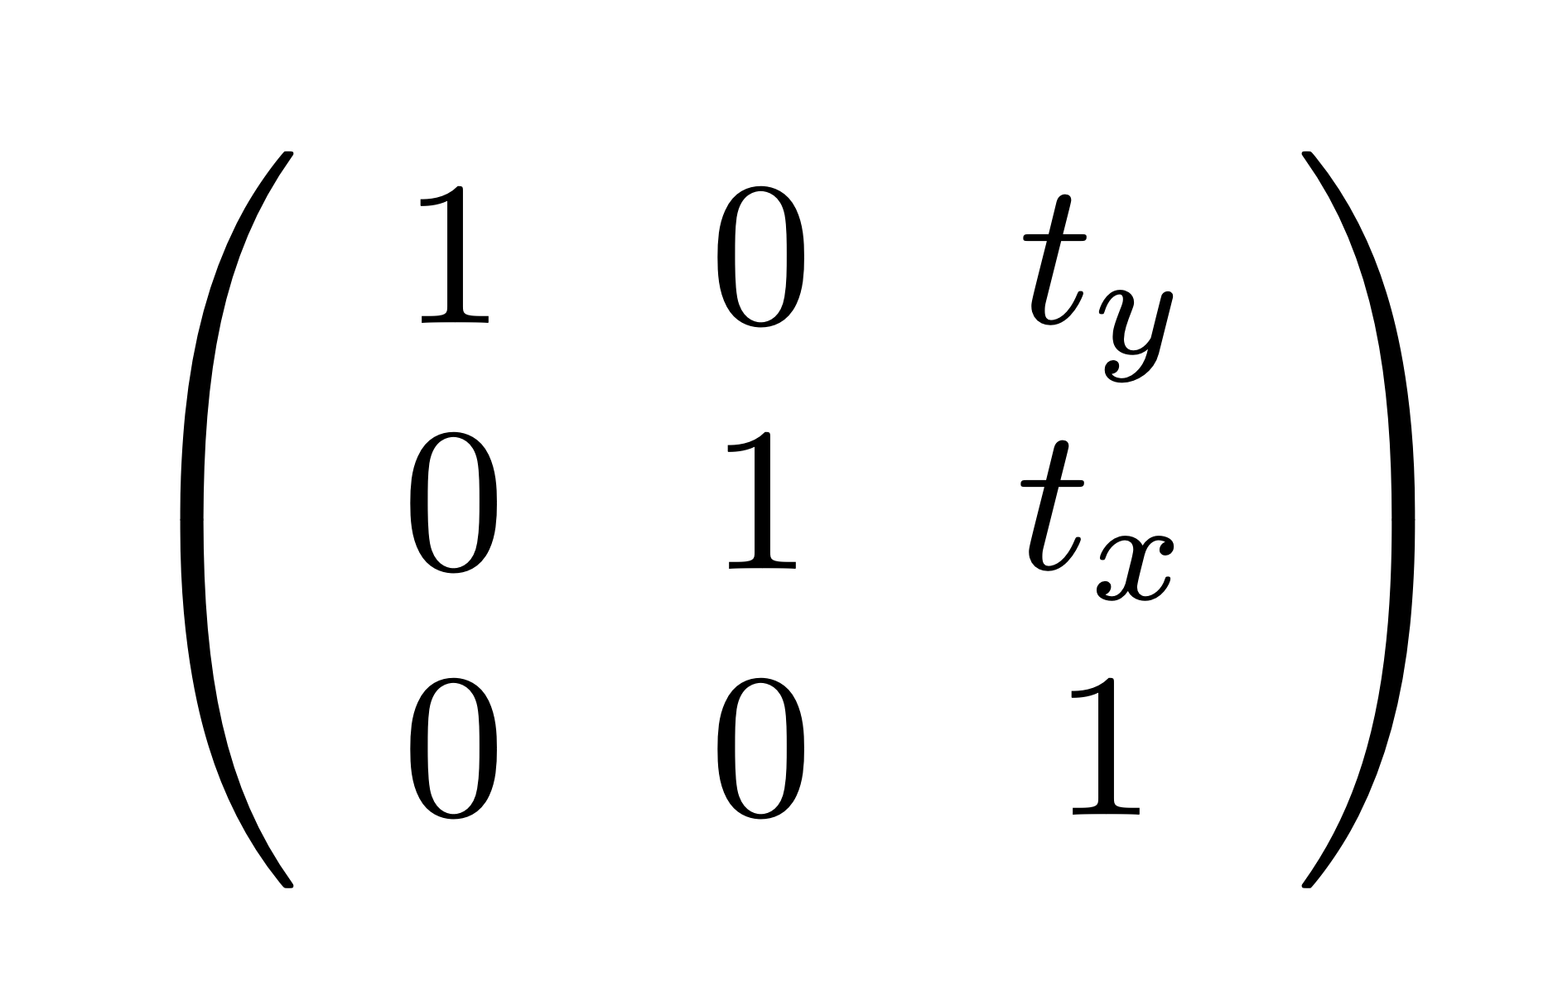
Bonus: Translations are now matrices!
e.g. in 2D

Slide 52
Also cool duality lines-points in 2D
Line ax+by+c = 0 represented by (a, b, c), up to a scale factor
Point (x, y) represented by (wx, wy, w) up to a scale factor w

Slide 53
Also cool duality lines-points in 2D
Line ax+by+c = 0 represented by (a, b, c), up to a scale factor
Point (x, y) represented by (wx, wy, w) up to a scale factor w
A point is on a line if the dot product (a, b, c).(x, y,1) is zero
  Points and lines are perfectly symmetrical in this equation
  Anything you say about point & lines is also true of lines & points
In general true of points-hyperplanes

Slide 54
Questions?

Slide 55

Perspective projection
$$Y$$
Assumes that center of image is (0, 0)!
$$X$$
$$X$$
$$y$$
$$x$$
$$x$$
$$Z$$
$$\overset{˜}{x}=\left[\begin{matrix}f & 0 & 0 & 0 \\ 0 & f & 0 & 0 \\ 0 & 0 & 1 & 0\end{matrix}\right]\overset{˜}{X}$$
Image / Pixel
coords.
World
coords.
Projection Matrix

Slide 56
More General Case: Arbitrary Image Centre
image plane
camera coordinate system
image coordinate system
Slide credit: CMU 16-385 (Yannis, Kris)

Slide 57
More General Case: Arbitrary Image Centre
image plane
camera coordinate system
image coordinate system
How does the projection matrix change?
$$\left[\begin{matrix}f & 0 & p_{x} & 0 \\ 0 & f & p_{y} & 0 \\ 0 & 0 & 1 & 0\end{matrix}\right]$$
shift vector transforming camera origin to image origin
Slide credit: CMU 16-385 (Yannis, Kris)

Slide 58
Decomposing the Projection Matrix
We can decompose the projection matrix like this:
$$\left[\begin{matrix}f & 0 & p_{x} & 0 \\ 0 & f & p_{y} & 0 \\ 0 & 0 & 1 & 0\end{matrix}\right]=\left[\begin{matrix}f & 0 & p_{x} \\ 0 & f & p_{y} \\ 0 & 0 & 1\end{matrix}\right]\left[\begin{matrix}1 & 0 & 0 & 0 \\ 0 & 1 & 0 & 0 \\ 0 & 0 & 1 & 0\end{matrix}\right]$$
What does each part of the matrix represent?
Slide credit: CMU 16-385 (Yannis, Kris)

Slide 59
Decomposing the Projection Matrix
We can decompose the projection matrix like this:
$$\left[\begin{matrix}f & 0 & p_{x} & 0 \\ 0 & f & p_{y} & 0 \\ 0 & 0 & 1 & 0\end{matrix}\right]=\left[\begin{matrix}f & 0 & p_{x} \\ 0 & f & p_{y} \\ 0 & 0 & 1\end{matrix}\right]\left[\begin{matrix}1 & 0 & 0 & 0 \\ 0 & 1 & 0 & 0 \\ 0 & 0 & 1 & 0\end{matrix}\right]$$
(homogeneous) transformation from 2D to 2D, accounting for not unit focal length and origin shift
(homogeneous) perspective projection from 3D to 2D, assuming image plane at z = 1 and shared camera/image origin
where $K=\left[\begin{matrix}f & 0 & p_{x} \\ 0 & f & p_{y} \\ 0 & 0 & 1\end{matrix}\right]$
Also written as: $K\left[\begin{aligned}I|0\end{aligned}\right]$
Slide credit: CMU 16-385 (Yannis, Kris)

Slide 60
Perspective projection
$$Y$$
$$X$$
$$X$$
$$y$$
$$x$$
$$x$$
$$Z$$
$$\overset{˜}{x}=\left[\begin{matrix}f & 0 & p_{x} & 0 \\ 0 & f & p_{y} & 0 \\ 0 & 0 & 1 & 0\end{matrix}\right]\overset{˜}{X}$$
Image / Pixel
coords.
World
coords.
Projection Matrix

Slide 61
In practice: Decoupling Projection from Image Size
(0, 0)
(0,0)
(1, 1)
(255,255)
Normalized Image Frame (here OpenCV convention)
3D in Camera Frame
Slide credit: CMU 16-889: Learning for 3D Vision, Prof. Shubham Tulsiani

Slide 62
Exercise: Focal Length as Function of FOV
$$\left[\begin{matrix}\frac{1}{2tan(Θ)} & 0 & 0.5 & 0 \\ 0 & \frac{1}{2tan(Θ)} & 0.5 & 0 \\ 0 & 0 & 1 & 0\end{matrix}\right]$$
(0, 0)
(0, 0.5, f)
(1, 0.5, f)
(0, 0.5)
(1, 0.5)
(1, 1)
$Θ$ (0.5 FOV)
(0, 0, 0)
Slide credit: CMU 16-889: Learning for 3D Vision, Prof. Shubham Tulsiani

Slide 63
Exercise: Cropping an Image
(Cropping is the same as changing the focal length f)
Slide credit: CMU 16-889: Learning for 3D Vision, Prof. Shubham Tulsiani

Slide 64
In practice: Decoupling Projection from Image Size
(0, 0)
(1, 1)
Helps (conceptually and in implementation) to reason in normalized image coordinates
Slide credit: CMU 16-889: Learning for 3D Vision, Prof. Shubham Tulsiani

Slide 65
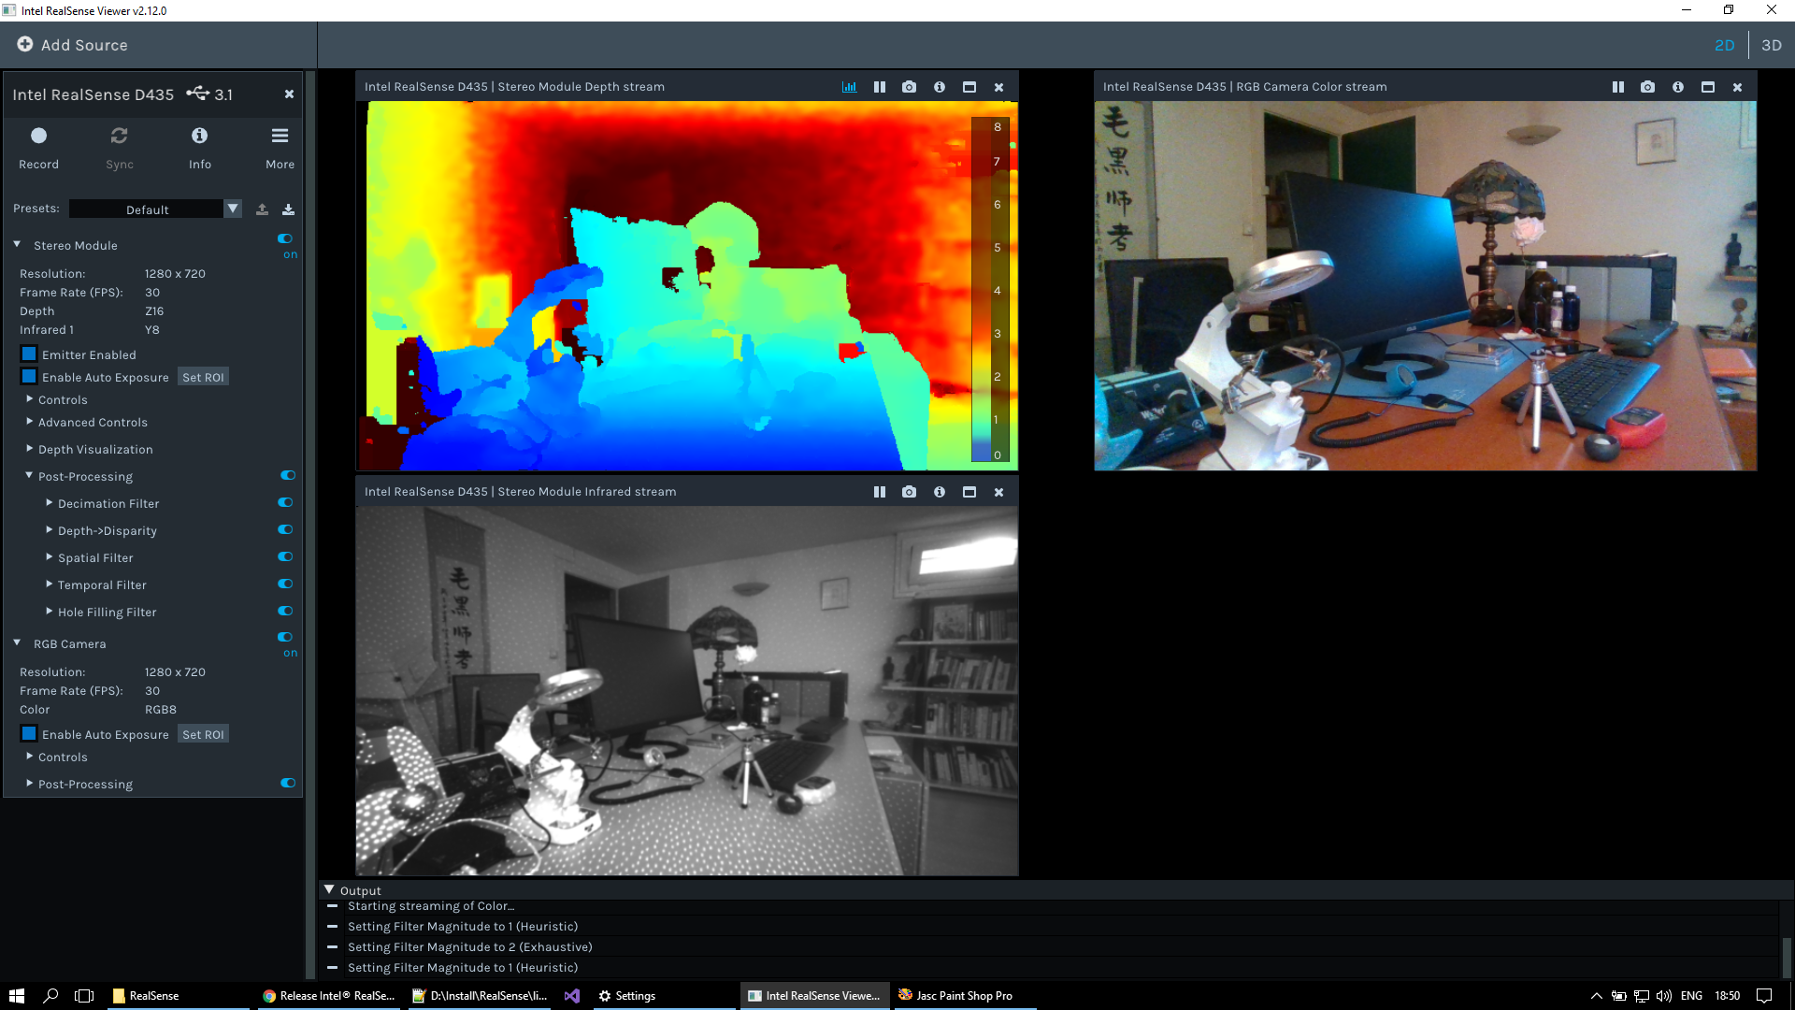
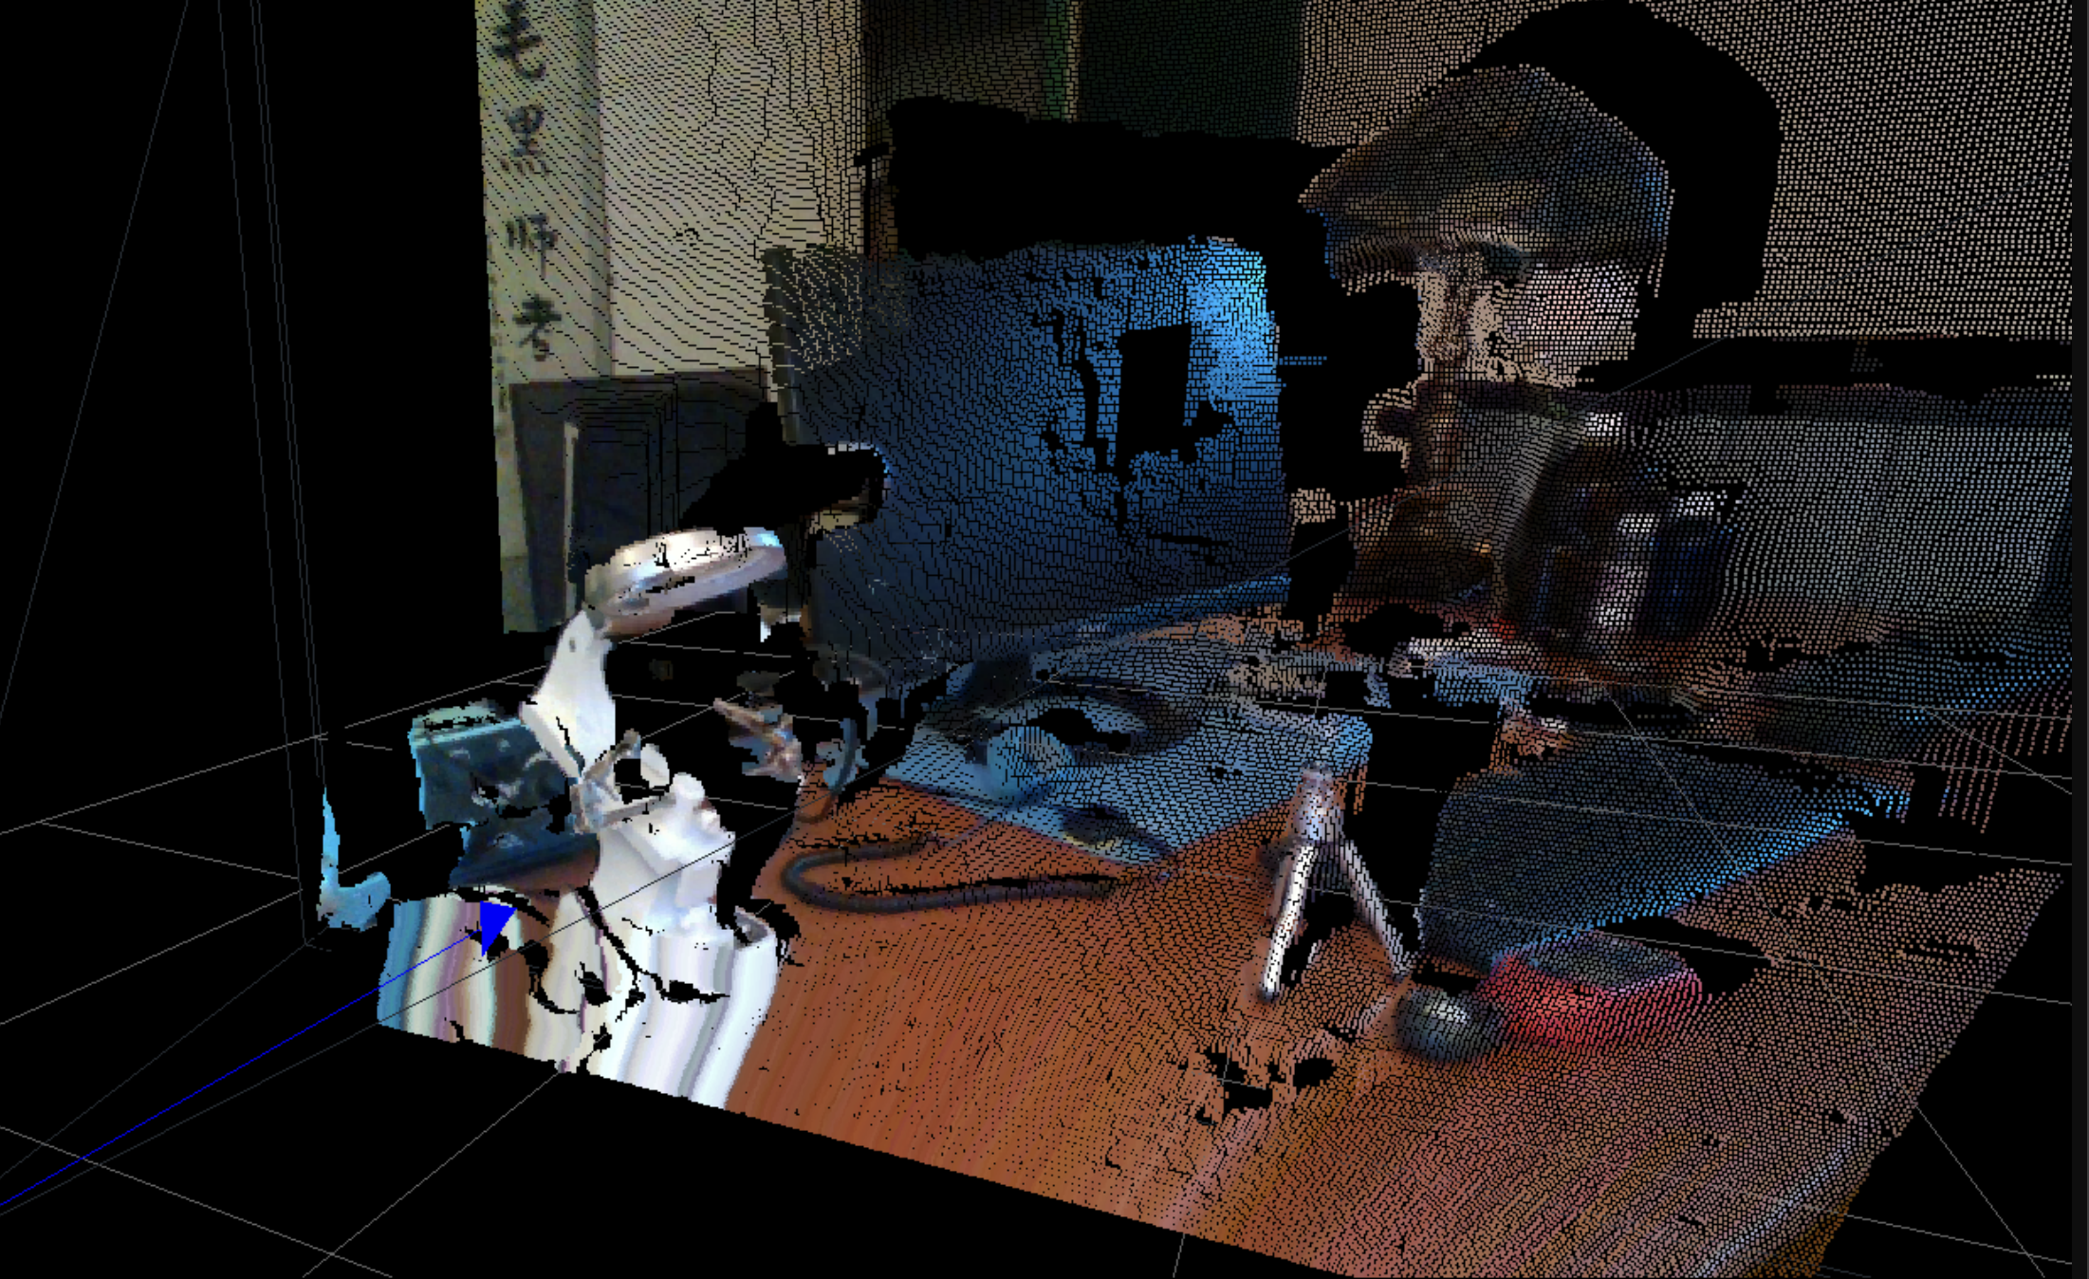
“Unproject”: Go from pixel and depth to 3D point
Image source: https://www.calvert.ch/maurice/2018/06/12/intel-realsense-d435-review/

Slide 66
“Unproject”: Go from pixel and depth to 3D point
$$\begin{matrix}(\begin{aligned}f⋅X+Z⋅p_{x} \\ f⋅Y+Z⋅p_{y} \\ Z\end{aligned}) & =K\left(\begin{aligned}X \\ Y \\ Z\end{aligned}\right)\end{matrix}$$

Slide 67
“Unproject”: Go from pixel and depth to 3D point
$$\begin{matrix}(\begin{aligned}f⋅X+Z⋅p_{x} \\ f⋅Y+Z⋅p_{y} \\ Z\end{aligned}) & =K\left(\begin{aligned}X \\ Y \\ Z\end{aligned}\right)\end{matrix}$$
$$\begin{matrix}(\begin{aligned}X \\ Y \\ Z\end{aligned}) & =K^{-1}\left(\begin{aligned}f⋅X+Z⋅p_{x} \\ f⋅Y+Z⋅p_{y} \\ Z\end{aligned}\right)\end{matrix}$$

Slide 68
“Unproject”: Go from pixel and depth to 3D point
$$\begin{matrix}(\begin{aligned}f⋅X+Z⋅p_{x} \\ f⋅Y+Z⋅p_{y} \\ Z\end{aligned}) & =K\left(\begin{aligned}X \\ Y \\ Z\end{aligned}\right)\end{matrix}$$
$$\begin{matrix}(\begin{aligned}X \\ Y \\ Z\end{aligned}) & =Z⋅K^{-1}\left(\begin{aligned}\frac{f⋅X}{Z}+p_{x} \\ \frac{f⋅Y}{Z}+p_{y} \\ 1\end{aligned}\right)\end{matrix}$$
$$\begin{matrix}(\begin{aligned}X \\ Y \\ Z\end{aligned}) & =K^{-1}\left(\begin{aligned}f⋅X+Z⋅p_{x} \\ f⋅Y+Z⋅p_{y} \\ Z\end{aligned}\right)\end{matrix}$$

Slide 69
“Unproject”: Go from pixel and depth to 3D point
$$\begin{matrix}(\begin{aligned}f⋅X+Z⋅p_{x} \\ f⋅Y+Z⋅p_{y} \\ Z\end{aligned}) & =K\left(\begin{aligned}X \\ Y \\ Z\end{aligned}\right)\end{matrix}$$
$$\begin{matrix}(\begin{aligned}X \\ Y \\ Z\end{aligned}) & =Z⋅K^{-1}\left(\begin{aligned}\frac{f⋅X}{Z}+p_{x} \\ \frac{f⋅Y}{Z}+p_{y} \\ 1\end{aligned}\right)\end{matrix}$$
$$\begin{matrix}(\begin{aligned}X \\ Y \\ Z\end{aligned}) & =K^{-1}\left(\begin{aligned}f⋅X+Z⋅p_{x} \\ f⋅Y+Z⋅p_{y} \\ Z\end{aligned}\right)\end{matrix}$$
$$\begin{matrix}X & =Z⋅K^{-1}\left(\begin{aligned}x_{pix} \\ y_{pix} \\ 1\end{aligned}\right)\end{matrix}$$

Slide 70
“Unproject”: Go from pixel and depth to 3D point
$$\begin{matrix}X & =Z⋅K^{-1}\left(\begin{aligned}x_{pix} \\ y_{pix} \\ 1\end{aligned}\right)\end{matrix}$$

Slide 71
“Unproject”: Go from pixel and depth to 3D point
$$\begin{matrix}X & =Z⋅K^{-1}\left(\begin{aligned}x_{pix} \\ y_{pix} \\ 1\end{aligned}\right)\end{matrix}$$
$$\begin{matrix}unproject(x,Z) & =Z⋅K^{-1}\left(\begin{aligned}x_{pix} \\ y_{pix} \\ 1\end{aligned}\right)\end{matrix}$$

Slide 72
Questions?

Slide 73
Camera parameters
What if the camera origin
is NOT at the world coordinates origin?
Y_{W}
World coordinates
X_{W}
Y_{C}
Z_{W}
X_{C}
$$t$$
Z_{C}
Camera coordinates

Slide 74
Camera parameters
Y_{W}
World coordinates
$$X_{w}$$
X_{W}
Y_{C}
$$X_{c}$$
Z_{W}
X_{C}
$$t$$
Z_{C}
Camera coordinates
In heterogeneous coordinates:
$$X_{c}=X_{w}-t$$

Slide 75
Camera parameters: rotation R
Y_{W}
World coordinates
$$X_{w}$$
X_{W}
Y_{C}
$$X_{c}$$
Z_{W}
$$R$$
X_{C}
$$t$$
In heterogeneous coordinates:
Z_{C}
$$X_{c}=R(X_{w}-t)$$
Camera coordinates

Slide 76
Camera parameters
Y_{W}
World coordinates
$$X_{w}$$
X_{W}
Y_{C}
$$X_{c}$$
Z_{W}
$$R$$
X_{C}
$$t$$
In heterogeneous coordinates:
Z_{C}
$$X_{c}=R(X_{w}-t)$$
Camera coordinates
In homogeneous coordinates:
$${\overset{˜}{X}}_{c}=\left[\begin{matrix}R & -Rt \\ 0 & 1\end{matrix}\right]{\overset{˜}{X}}_{w}$$

Slide 77
Cam2World vs. World2Cam extrinsic parameters
Y_{W}
$$X_{w}$$
X_{W}
Y_{C}
$$X_{c}$$
Z_{W}
$$R$$
World
X_{C}
$$t$$
Z_{C}
$${\overset{˜}{X}}_{c}=\left[\begin{matrix}R & -Rt \\ 0 & 1\end{matrix}\right]{\overset{˜}{X}}_{w}=C^{W2C}{\overset{˜}{X}}_{w}$$
Camera
$${\overset{˜}{X}}_{w}=\left[\begin{matrix}R^{T} & t \\ 0 & 1\end{matrix}\right]{\overset{˜}{X}}_{c}=(C^{W2C})^{-1}{\overset{˜}{X}}_{c}=C^{C2W}{\overset{˜}{X}}_{c}$$

Slide 78
Camera parameters
Y_{W}
$$X_{w}$$
X_{W}
Y_{C}
$$X_{c}$$
World coordinates
$$R$$
Z_{W}
X_{C}
$$t$$
Z_{C}
Camera coordinates
World coordinates to camera coordinates
Camera coordinates to image coordinates
$$\overset{˜}{x}=\left[\begin{matrix}f & 0 & p_{x} & 0 \\ 0 & f & p_{y} & 0 \\ 0 & 0 & 1 & 0\end{matrix}\right]{\overset{˜}{X}}_{c}$$
$${\overset{˜}{X}}_{c}=\left[\begin{matrix}R & -Rt \\ 0 & 1\end{matrix}\right]{\overset{˜}{X}}_{w}$$

Slide 79
Camera parameters
Y_{W}
$$X_{w}$$
X_{W}
Y_{C}
$$X_{c}$$
World coordinates
$$R$$
Z_{W}
X_{C}
$$t$$
Z_{C}
Camera coordinates
World coordinates to image coordinates
$$\overset{˜}{x}=\left[\begin{matrix}? & ? & ? & ? \\ ? & ? & ? & ? \\ ? & ? & ? & ?\end{matrix}\right]{\overset{˜}{X}}_{w}$$

Slide 80
Camera parameters
Y_{W}
$$X_{w}$$
X_{W}
Y_{C}
$$X_{c}$$
World coordinates
$$R$$
Z_{W}
X_{C}
$$t$$
Z_{C}
Camera coordinates
World coordinates to image coordinates
$$\overset{˜}{x}=\left[\begin{matrix}f & 0 & p_{x} & 0 \\ 0 & f & p_{y} & 0 \\ 0 & 0 & 1 & 0\end{matrix}\right]\left[\begin{matrix}R & -Rt \\ 0 & 1\end{matrix}\right]{\overset{˜}{X}}_{w}$$

Slide 81

Camera parameters
Y_{W}
$$X_{w}$$
X_{W}
Y_{C}
$$X_{c}$$
World coordinates
$$R$$
Z_{W}
X_{C}
$$t$$
Z_{C}
Camera coordinates
World coordinates to image coordinates
$$\overset{˜}{x}=\left[\begin{matrix}f & 0 & p_{x} & 0 \\ 0 & f & p_{y} & 0 \\ 0 & 0 & 1 & 0\end{matrix}\right]\left[\begin{matrix}R & -Rt \\ 0 & 1\end{matrix}\right]{\overset{˜}{X}}_{w}=P{\overset{˜}{X}}_{w}$$
Intrinsic parameters
Extrinsic parameters

Slide 82
Camera parameters
Y_{W}
$$X_{w}$$
X_{W}
Y_{C}
$$X_{c}$$
World coordinates
$$R$$
Z_{W}
X_{C}
$$t$$
Z_{C}
Camera coordinates
World coordinates to image coordinates
$$\overset{˜}{x}=\left[\begin{matrix}f & 0 & p_{x} & 0 \\ 0 & f & p_{y} & 0 \\ 0 & 0 & 1 & 0\end{matrix}\right]\left[\begin{matrix}R & -Rt \\ 0 & 1\end{matrix}\right]{\overset{˜}{X}}_{w}=P{\overset{˜}{X}}_{w}$$
Properties of the
camera+lens that
don’t change
(unless you zoom/crop)
Parameters that vary when
you move the camera around
Intrinsic parameters
Extrinsic parameters

Slide 83
World2Camera Transformations: Exercise
What are R, t for an upright (world and camera y-directions align) origin-facing camera 2m away from origin located at (0,0,-2)?
What are R, t for an upright (world and camera y-directions align) origin-facing camera 2m away from origin located at (-2,0,0)?
Slide credit: CMU 16-889: Learning for 3D Vision, Prof. Shubham Tulsiani

Slide 84
Beware of Conventions
X=left or right? Y=up or down? etc..
If you externally obtain transformation matrices (e.g. using someone else’s code), make sure of convention compatibility (one of the most common sources of bugs!)
read https://pytorch3d.org/docs/cameras
Slide credit: Shubham Tulsiani. Image courtesy: Christoph Krautz

Slide 85
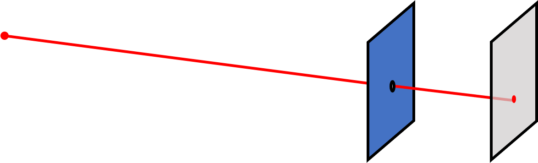
Summary
Projection — associating rays to points in a plane
Camera Transformation — from world to camera coordinates
Slide credit: CMU 16-889: Learning for 3D Vision, Prof. Shubham Tulsiani

Slide 86
Questions?

Slide 87
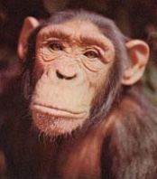
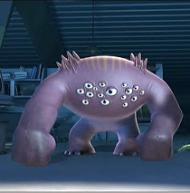

Vision systems
Two cameras
N cameras
One camera

Slide 88
Let’s consider two eyes
Two cameras
N cameras
One camera

Slide 89
Stereo images of the Titanic

Slide 90
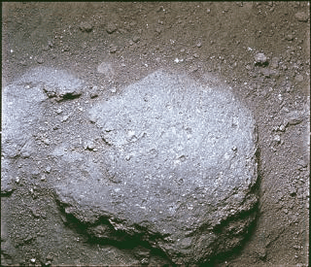
Stereo images of lunar rocks from Apollo 11
http://www.earthtothemoon.com/ap_11_Stereo_slide.html
https://www.hq.nasa.gov/alsj/a11/A11wigglestereo6712.gif

Slide 91
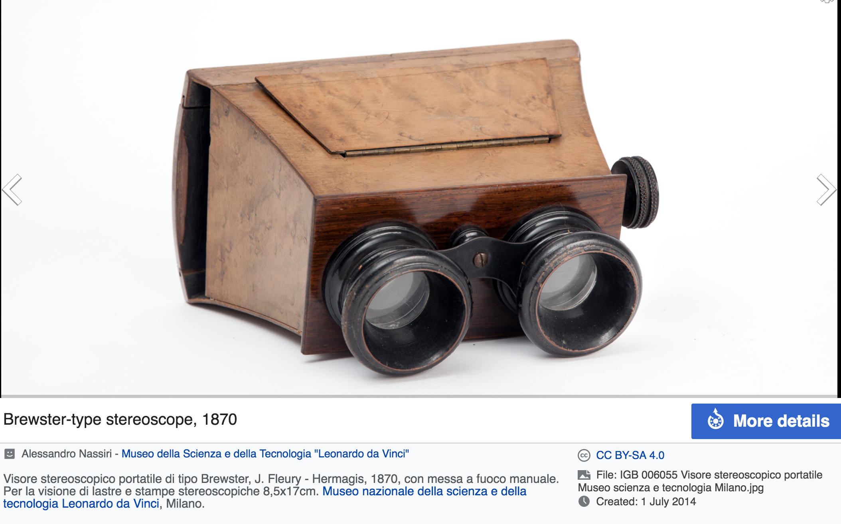
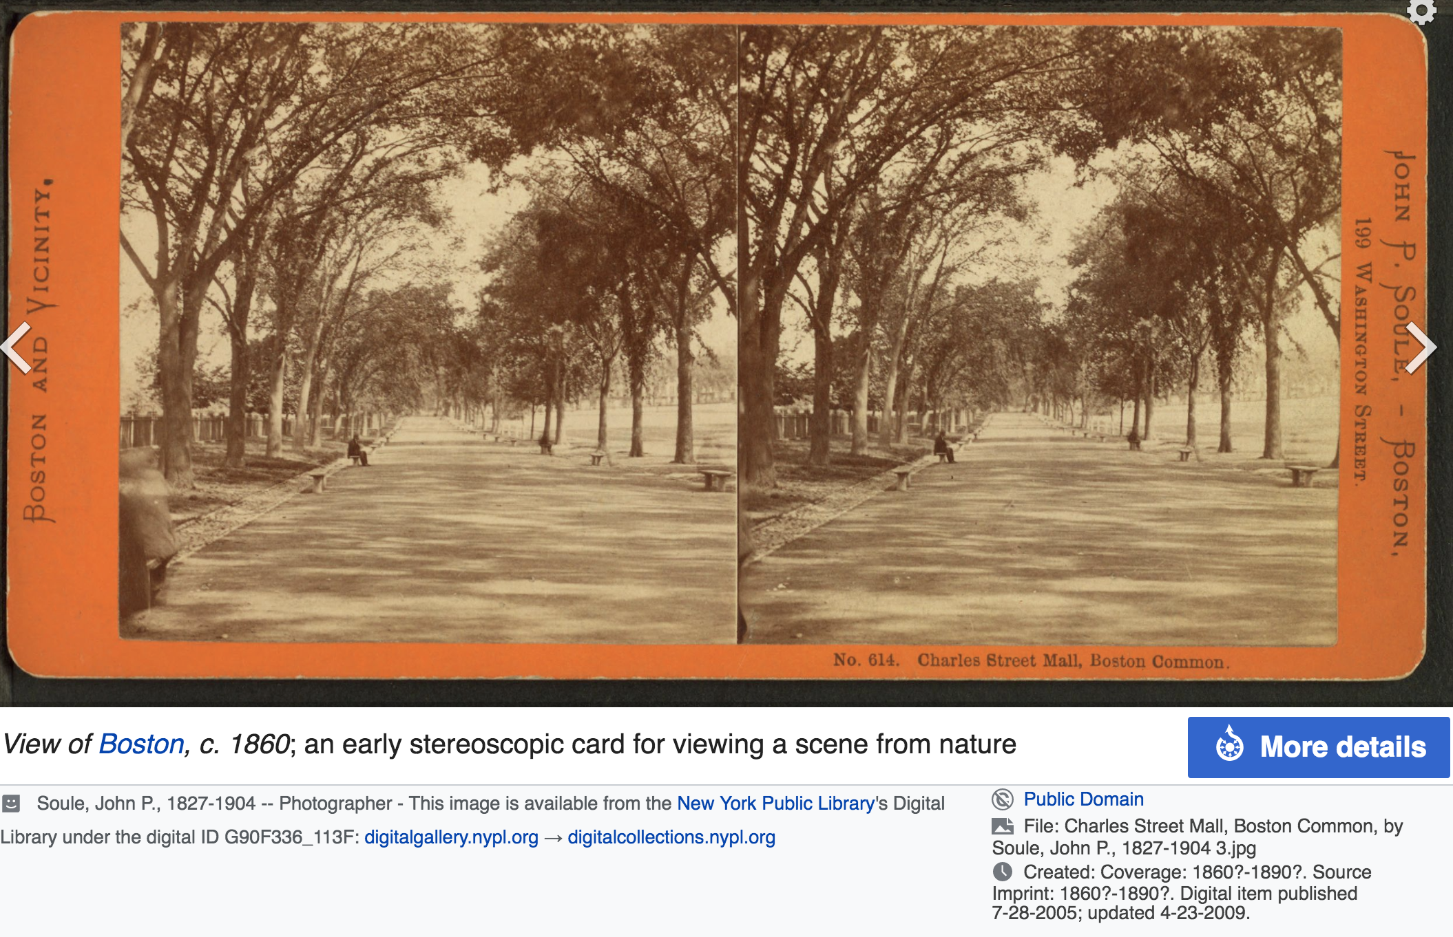
Stereoscope

Slide 92
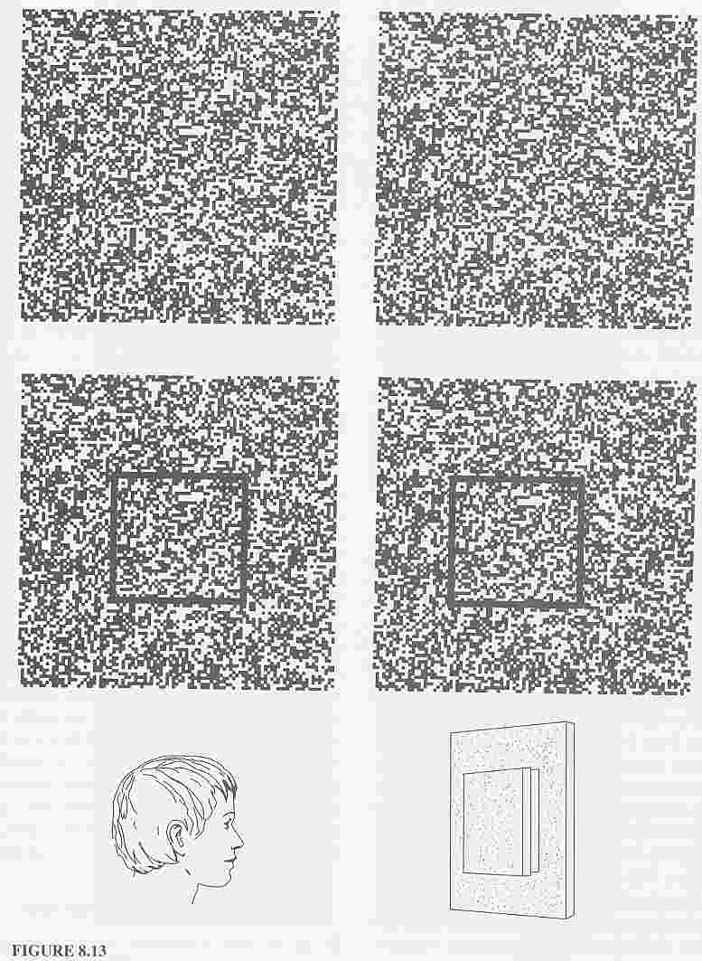

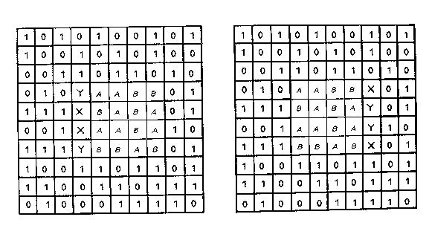
Depth without objects
Random dot stereograms (Bela Julesz)
Julesz, 1971

Slide 93
Geometry for a simple stereo system
$$x_{l}$$
$$f$$
$$X_{1}$$

Slide 94
Geometry for a simple stereo system
$$Z?$$
$$x_{l}$$
$$f$$
$$X_{1}$$

Slide 95
Geometry for a simple stereo system
$$Z?$$
$$x_{l}$$
$$x_{r}$$
$$f$$
$$f$$
$$X_{1}$$
$$X_{2}$$

Slide 96
Geometry for a simple stereo system
$$Z?$$
$$x_{l}$$
$$x_{r}$$
$$f$$
$$f$$
$$X_{1}$$
$$X_{2}$$
$$T$$

Slide 97
Geometry for a simple stereo system
$$Z?$$
$$x_{l}$$
$$x_{r}$$
$$f$$
$$f$$
$$X_{1}$$
$$X_{2}$$
$$T$$

Slide 98
Geometry for a simple stereo system
Similar Triangles!
$$Z?$$
$$x_{l}$$
$$x_{r}$$
$$f$$
$$f$$
$$X_{1}$$
$$X_{2}$$
$$T$$

Slide 99
Geometry for a simple stereo system
Similar Triangles:
$$\frac{T+x_{r}-x_{l}}{Z-f}=$$
$$Z?$$
$$x_{l}$$
$$x_{r}$$
$$f$$
$$f$$
$$X_{1}$$
$$X_{2}$$
$$T$$

Slide 100
Geometry for a simple stereo system
Similar Triangles:
$$\frac{T+x_{r}-x_{l}}{Z-f}=\frac{T}{Z}$$
$$Z?$$
$$x_{l}$$
$$x_{r}$$
$$f$$
$$f$$
$$X_{1}$$
$$X_{2}$$
$$T$$

Slide 101
Geometry for a simple stereo system
Similar Triangles:
$$\frac{T+x_{r}-x_{l}}{Z-f}=\frac{T}{Z}$$
$$Z?$$
Solve for Z:
$$x_{l}$$
$$x_{r}$$
$$Z=f\frac{T}{x_{l}-x_{r}}$$
$$f$$
$$f$$
$$X_{1}$$
$$X_{2}$$
$$T$$
Disparity

Slide 102
Measuring disparity
Left image
Right image
I took one picture, then I moved ~1m to the right and took a second picture.

Slide 103
Measuring disparity
Left image
Right image

Slide 104
Measuring disparity
Left image
Right image

Slide 105
Disparity map
$$I(x,y)$$
$$I^{′}(x,y)=I(x+D(x,y),y)$$
$$D(x,y)$$
Depth map
$$Z=f\frac{T}{D(x,y)}$$

Slide 106
If the cameras are not parallel?
Reproject so that they are (rectification)
  2D projective transform (homography)

Slide 107
Also useful for panorama stitching
  Images from the same viewpoint but in different directions
    2D projective transform (homography)
Diagram created with nano banana

Slide 108
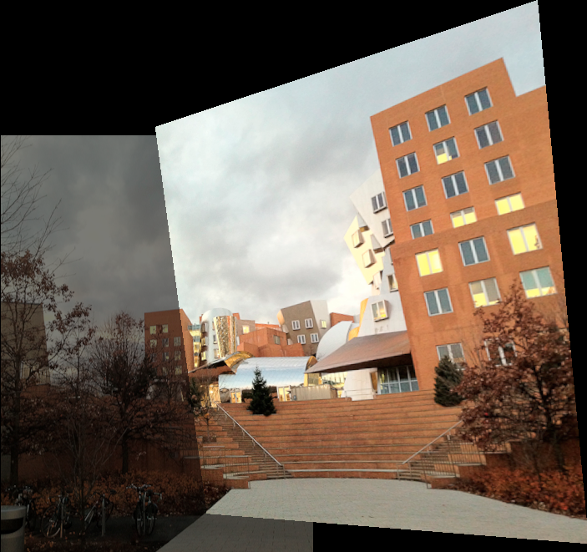

Reprojection with homography
Take my computational photography class (6.8370/1)

Slide 109

Contrarian take
https://people.csail.mit.edu/bkph/articles/Harmful.pdf

Slide 110
Philosophical discussion
Ingredients of Vision include 2D and 3D image
The connection between the two (image formation, perspective) is important
So far still mostly hand-coded
  Inductive bias
Who knows if it will eventually be learned
  e.g. transformers to learn mapping from 3D triangles to image
  https://microsoft.github.io/renderformer/

Slide 111
Degrees of classical vs neural
Compute extrinsic / intrinsics using traditional vision
Have a projective transform hard coded but let neural network figure out coefficients
Light rays Plucker coordinates (see later)
All through learning?

