Slide 1

Depth of Field. Light field cameras
Frédo Durand
MIT EECS

Slide 2
Light fields and plenoptic cameras

Slide 3
Focusing and defocus
Each pixel is the integral of many light rays across the aperture
Which rays are integrated at which pixel changes the focus
Idea: capture rays, not pixels
focal
plane
lens

Slide 4
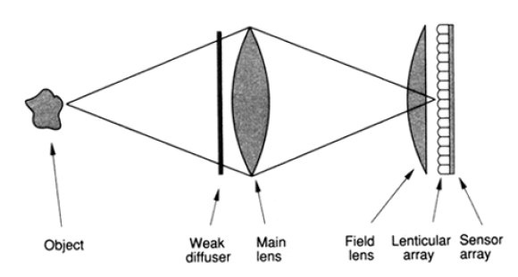
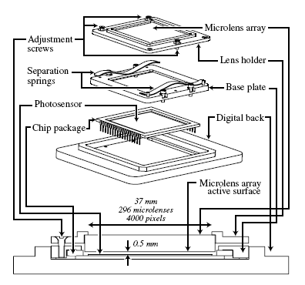
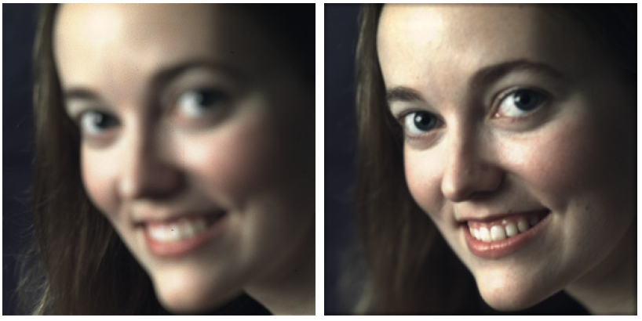
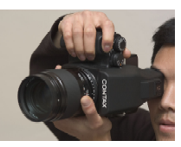
Plenoptic/light field cameras
Different goals
  reproduce 3D impression
  enable refocusing
  do computer vision

Slide 5
Plenoptic/light field cameras
Lipmann 1908
  "Window to the world"
Adelson and Wang, 1992
  Depth computation
Revisited by Ng et al. for refocusing
  turned into Lytro

Slide 6
Light fields

Slide 7
For a camera
Capture all rays reaching the lens
4D:
  2D for lens aperture
  2D for focal plane (or any other plane)
focal
plane
lens

Slide 8
For a camera: conjugate
Same on the image side
4D:
  2D for lens aperture
  2D for sensor
focal
plane
lens

Slide 9
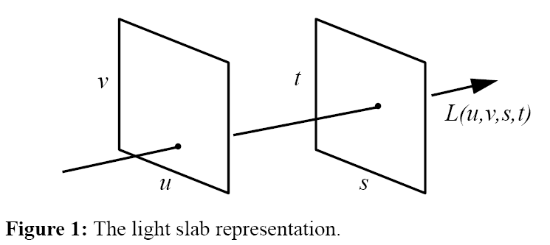
Two-plane parameterization
Line parameterized by intersection with 2 planes
  Careful, there are different "isotopes" of such parameterization (slightly different meaning of stuv)

Slide 10
Let's make life simpler: 2D
How many dimensions for 2D lines?
  Only 2, e.g. y=ax+b <> (a,b)

Slide 11
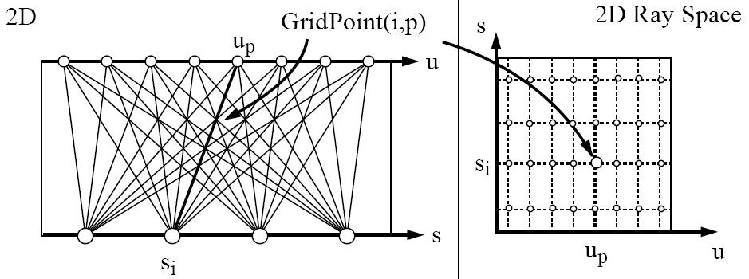
Let's make life simpler: 2D
2-line parameterization

Slide 12
View?

Slide 13
View?
View ➔ line in Ray space
Kind of cool: ray ➔ point,
and view around point ➔line
There is a duality

Slide 14
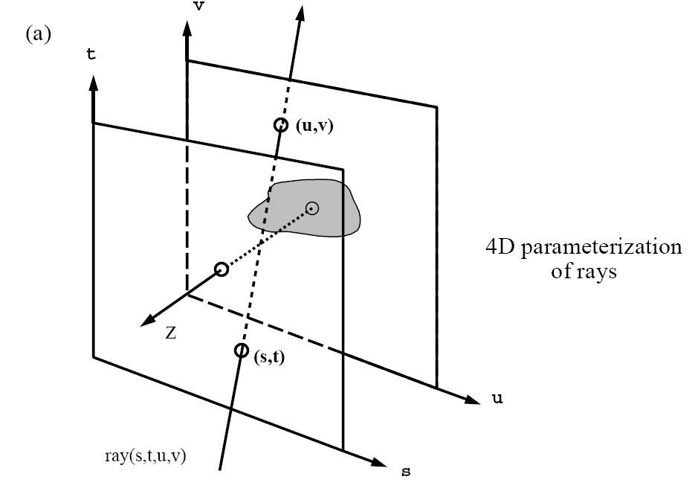
Back to 3D/4D
From Gortler et al.

Slide 15
Understanding 4D
2D slices
  constant u, v: regular pinhole images from different aperture points
  constant x, y: aperture view
    how much the color of a point on the focal plane varies with angle (but depends on depth)
u,v
s, t (or y, x)
u,v
s, t (or y, x)
focal
plane
focal
plane
lens
lens

Slide 16
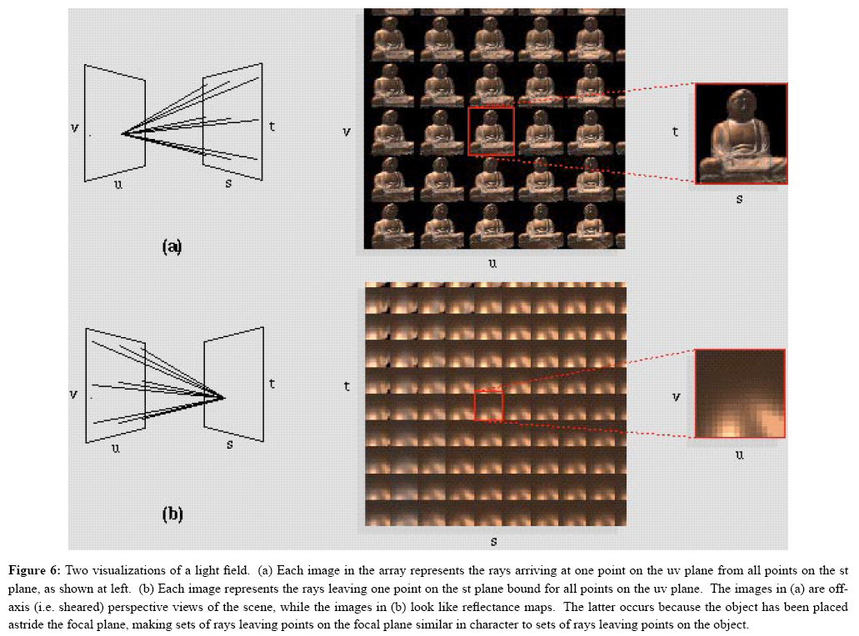

Slide 17
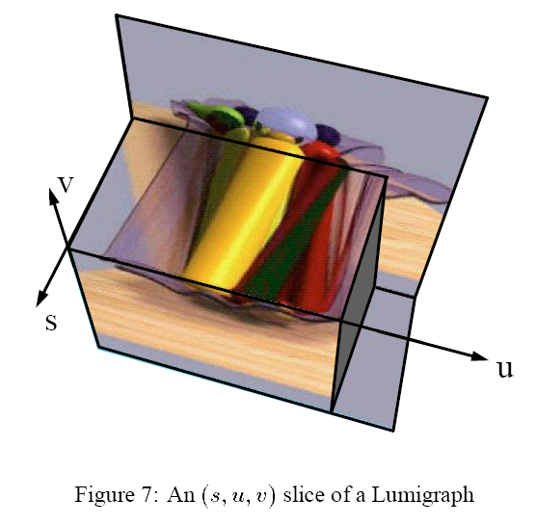
Cool visualization
From Gortler et al.

Slide 18
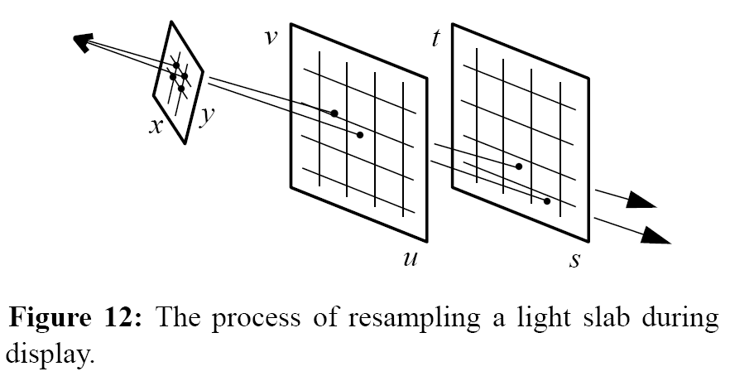
View = 2D plane in 4D
With various resampling issues

Slide 19
Light field pinhole rendering
For each pixel x,y in new view
  consider ray from viewpoint to pixel
  compute intersection with two planes => s, t, u, v
  lookup RGB in light field at s, t, u, v

Slide 20
Demo light field viewer
http://lightfield.stanford.edu/lfs.html

Slide 21
Light field cameras

Slide 22
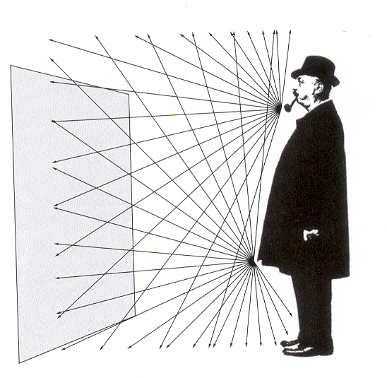
Plenoptic/light field cameras
[Lipmann 1908, Adelson and Wang, 1992, Ng et al. 06]
Record 4D set of rays
  using microlens array in front of sensor
Main lens
microlenses
aperture
sub-image

Slide 23
Lippmann 1908
http://people.csail.mit.edu/fredo/PUBLI/Lippmann.pdf
http://www.tgeorgiev.net/RadianceCameras/EpreuvesReversibles.pdf

Slide 24
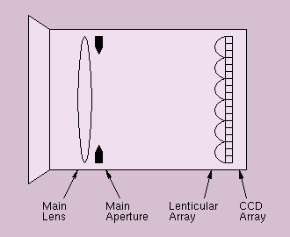
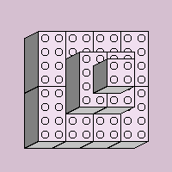

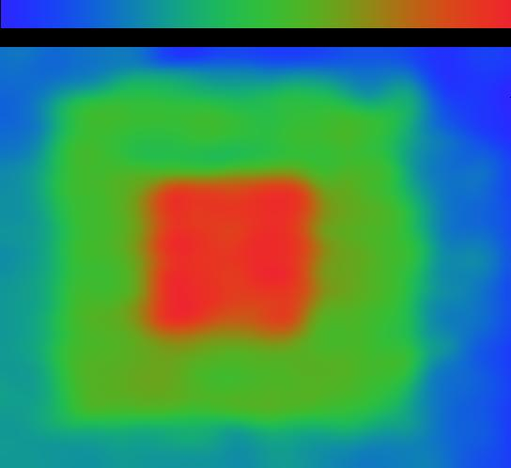
Plenoptic camera
For depth extraction
Adelson & Wang 92
http://www-bcs.mit.edu/people/jyawang/demos/plenoptic/plenoptic.html

Slide 25
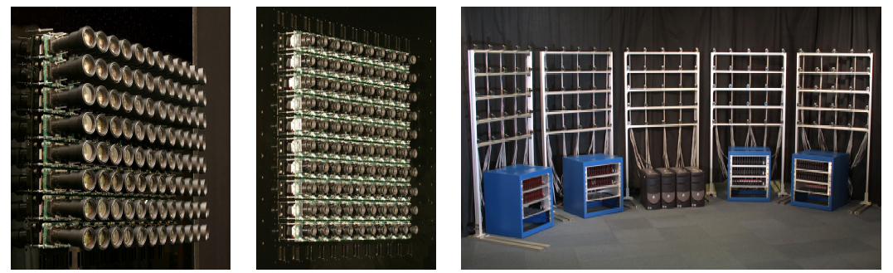
Camera array
Willburn et al. http://graphics.stanford.edu/papers/CameraArray/

Slide 26
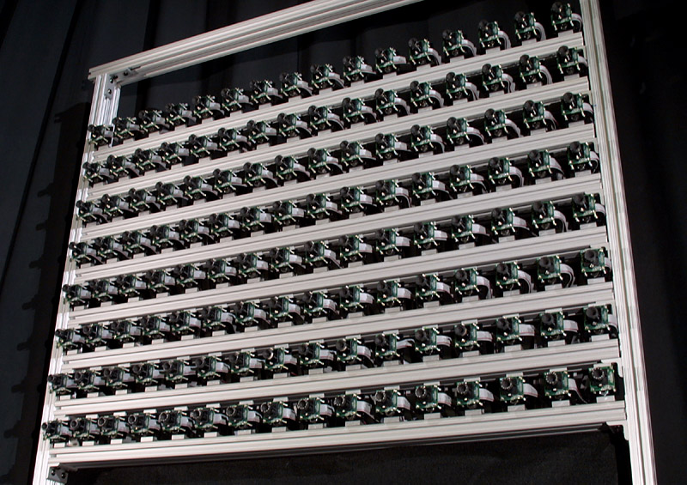
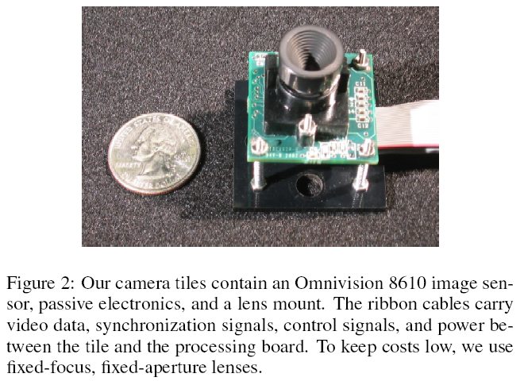
Camera arrays
http://graphics.stanford.edu/projects/array/

Slide 27
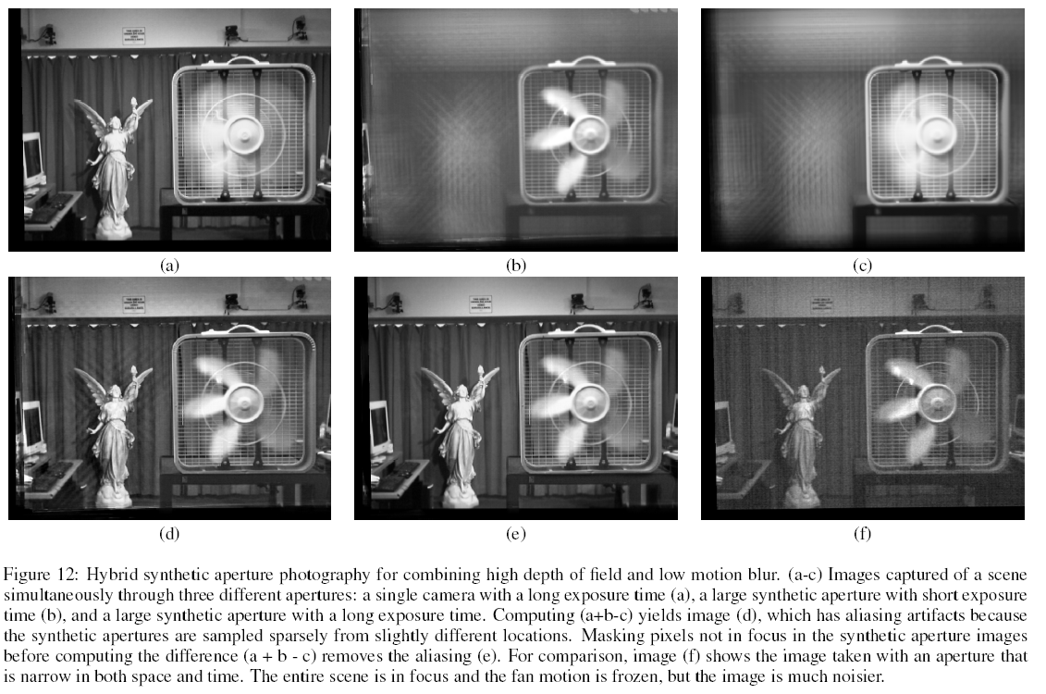

Slide 28
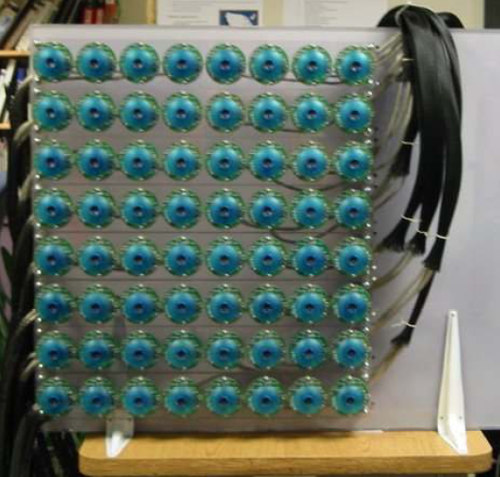
MIT version
Jason Yang

Slide 29
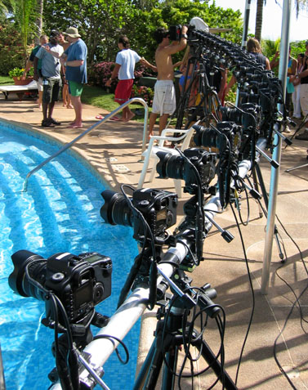
Bullet time
Time splice http://www.ruffy.com/frameset.htm

Slide 30
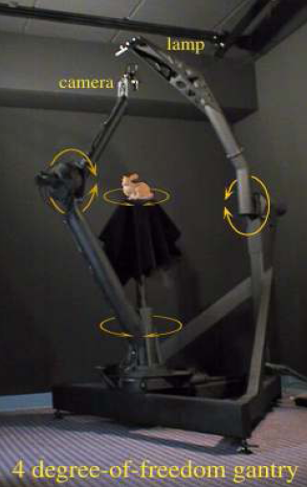
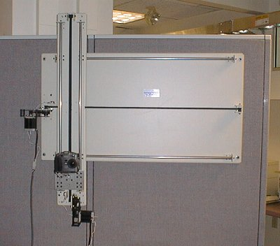
Robotic Camera
Image Leonard McMillan
Image Levoy et al.

Slide 31
Legos
http://lightfield.stanford.edu/aperture.swf?lightfield=data/self_portrait_lf/preview.zip&zoom=1

Slide 32
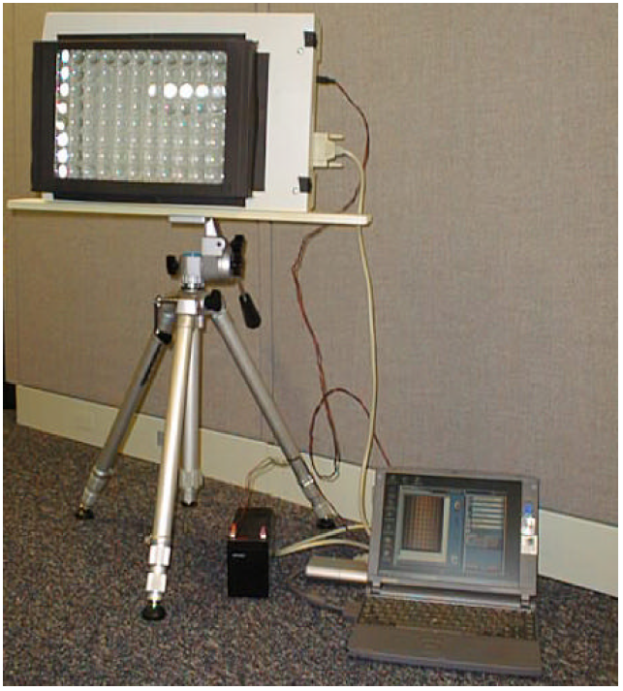
Flatbed scanner camera
By Jason Yang

Slide 33
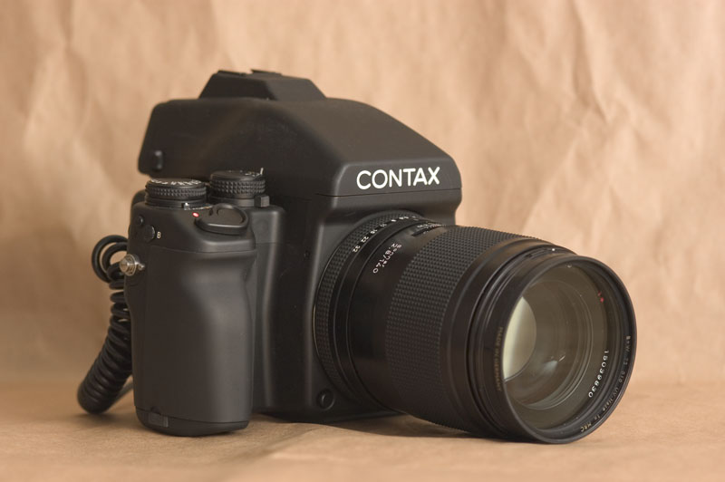
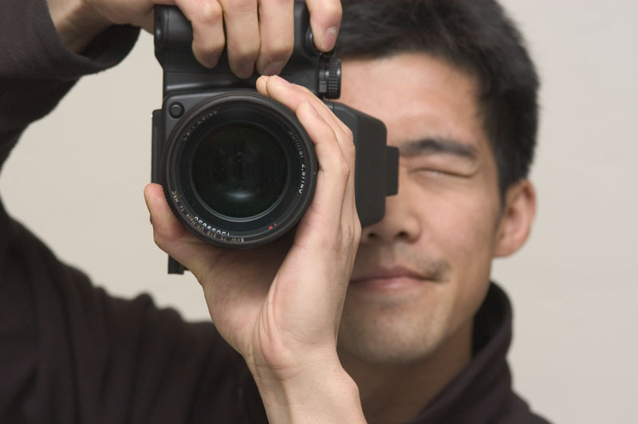
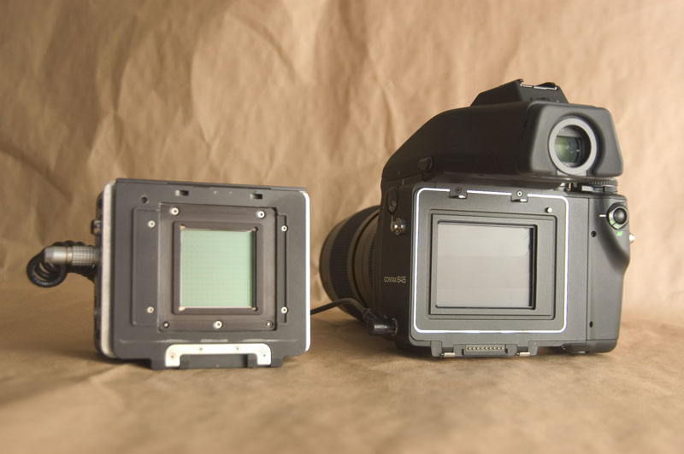
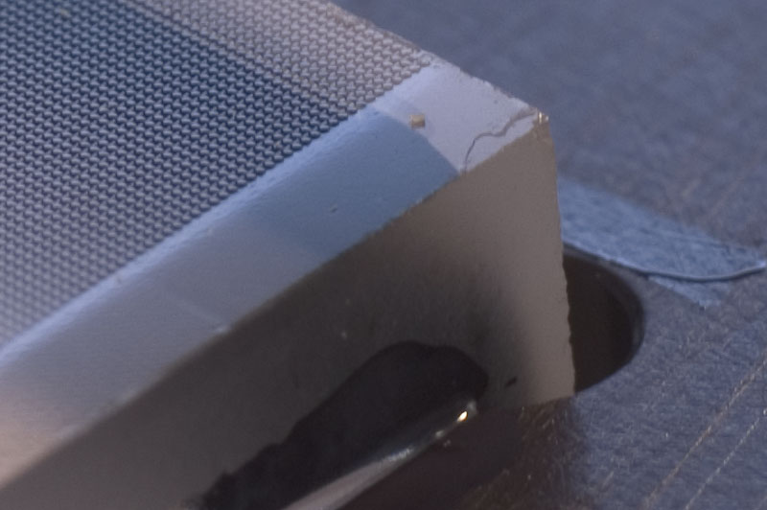
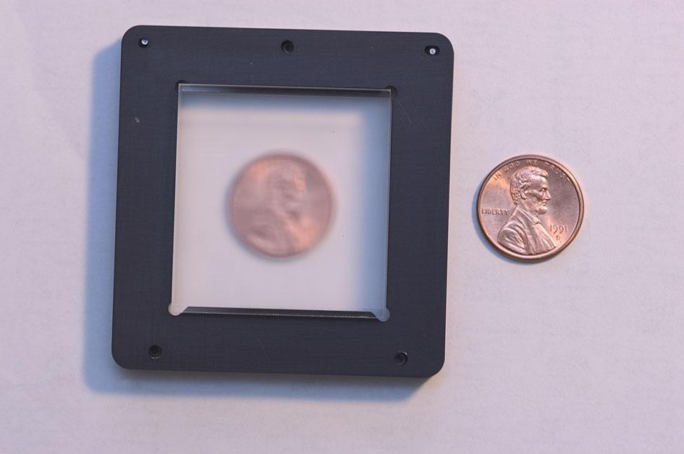
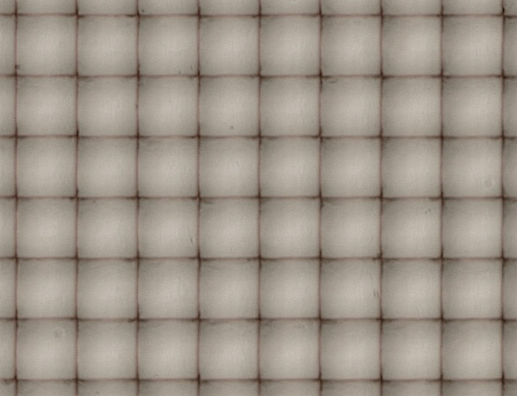
Hand-Held Light Field Camera
Medium format digital camera
Camera in-use
16 megapixel sensor
Microlens array
Slide by Ren Ng.

Slide 34
New version: Lytro
http://www.lytro.com/
hexagonal microlens array

Slide 36
Plenoptic camera refocusing

Slide 37
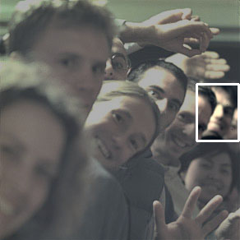
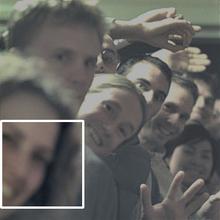
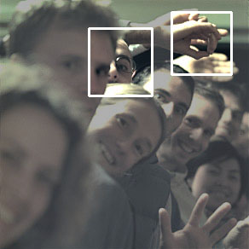

Conventional Photograph
Slide by Ren Ng.
Notes:
Okay, so here’s the conventional photograph that we would have gotten. Notice that it’s focused on Matt, and that Jacquie and Matt are out of focus.

Slide 38
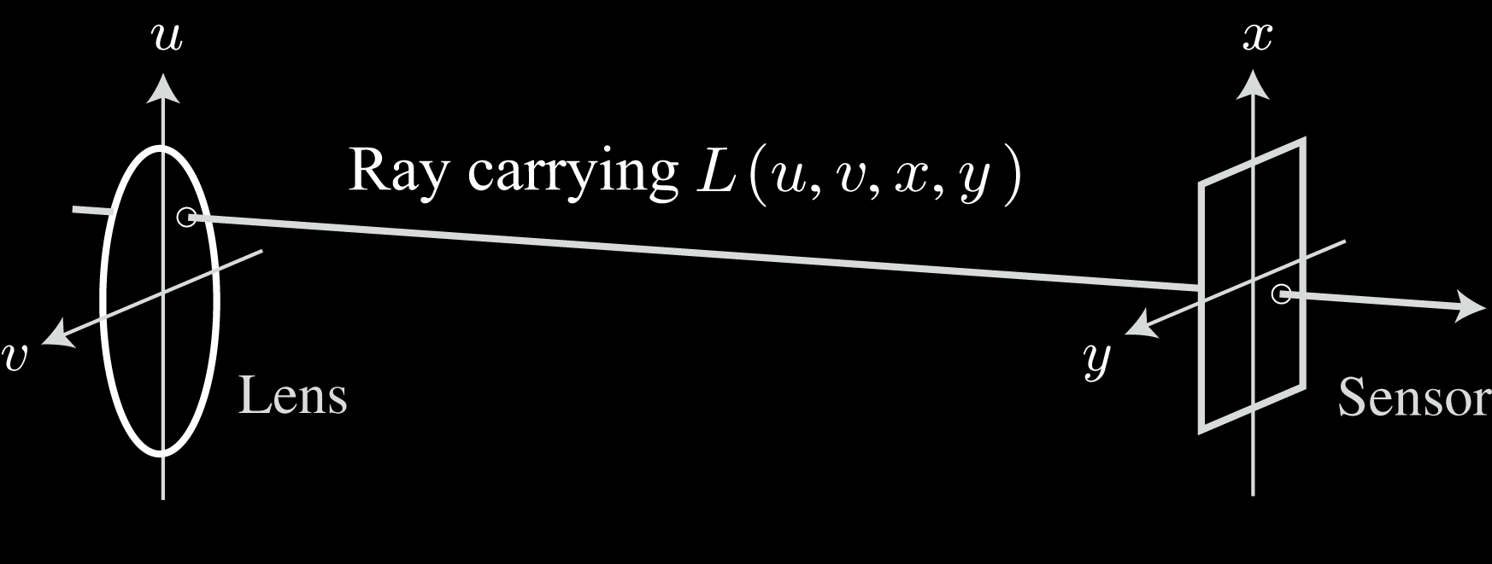
Light Field Photography
Capture the light field inside the camera body
Slide by Ren Ng.
Notes:
Okay, the first thing that I want to do is define this “light field” term that I’ve been using. The light field is just a representation for the light traveling along all rays in free space. Inside the camera, we can parameterize all the rays by where they originate on the lens plane, and where they terminate on the sensor.
So the light traveling from (u,v) on the lens to (x,y) on the sensor is given by L(u,v,x,y). Note that this is a four dimensional function – the space of rays is 4D.
The concept of the light field is the second most cited idea in computer graphics. It was introduced in 1996 by Marc and Pat at Stanford, and by Steve Gortler and colleagues at Harvard and Microsoft Research.

Slide 39
Plenoptic/light field cameras
[Lipmann 1908, Adelson and Wang, 1992, Ng et al. 06]
Record 4D set of rays
  using microlens array in front of sensor
sensor+
microlens array
microlens array

Slide 40
Hand-Held Light Field Camera
Medium format digital camera
Camera in-use
16 megapixel sensor
Microlens array
Slide by Ren Ng.

Slide 41
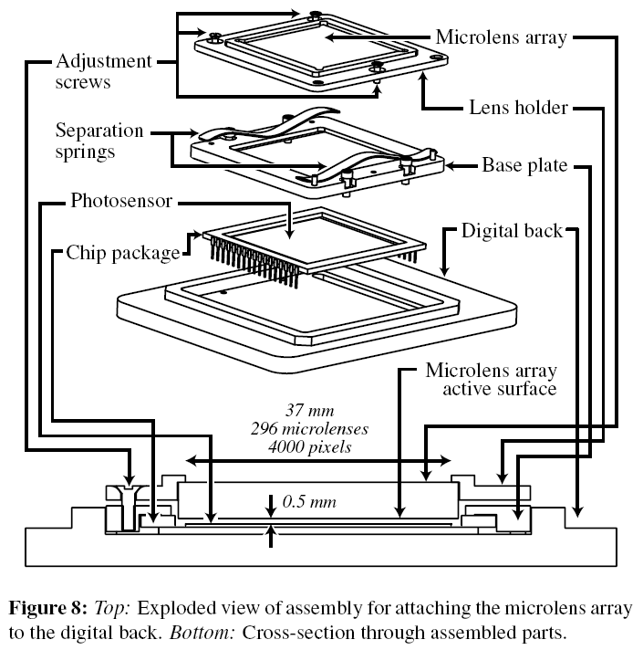

Slide 42
New version: Lytro
http://www.lytro.com/
hexagonal microlens array

Slide 43

Light Field in a Single Exposure
Slide by Ren Ng.

Slide 44
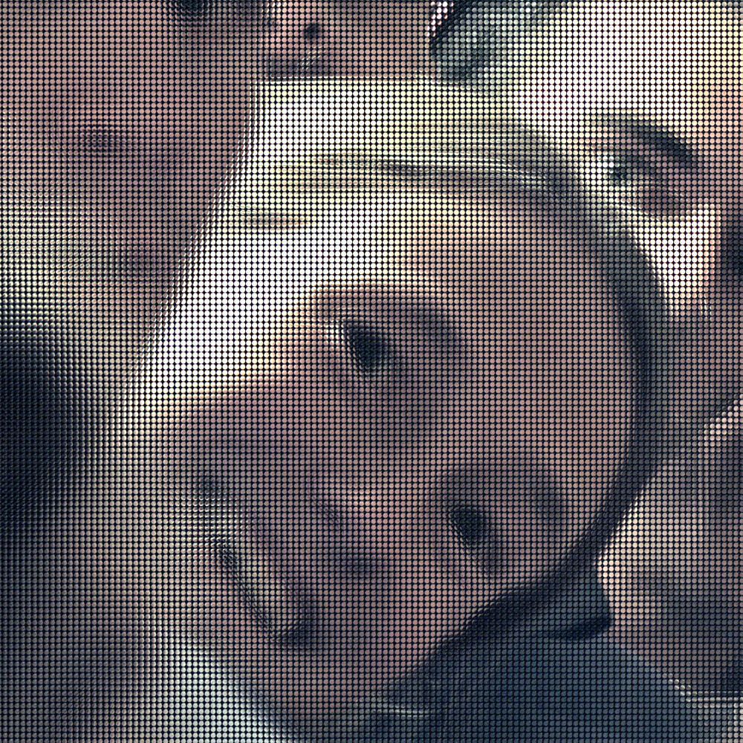
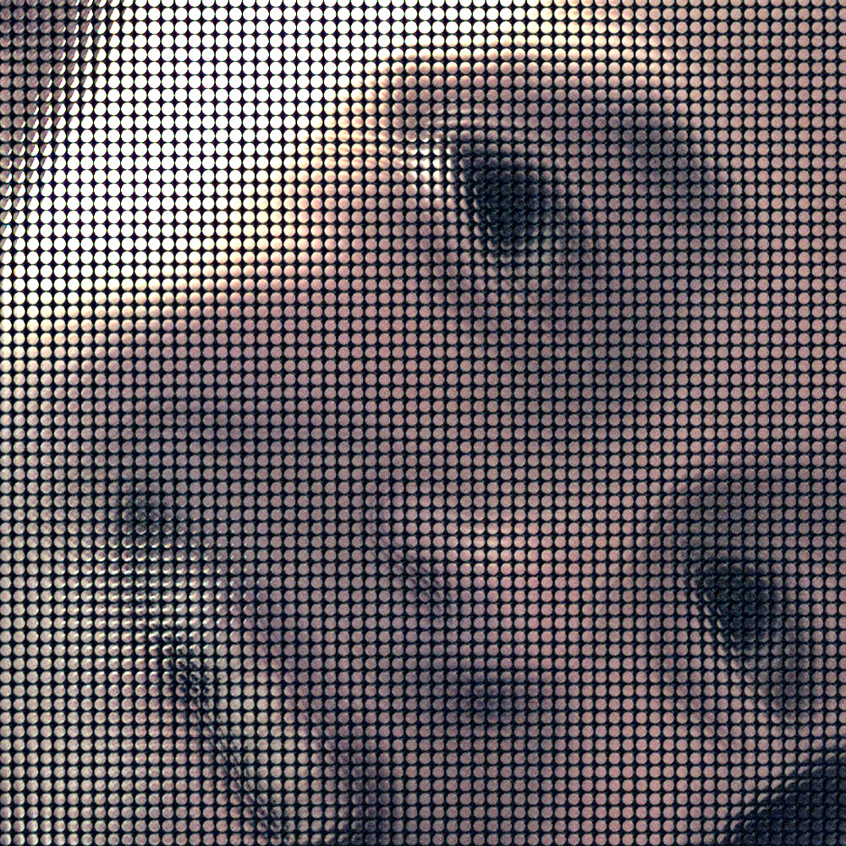
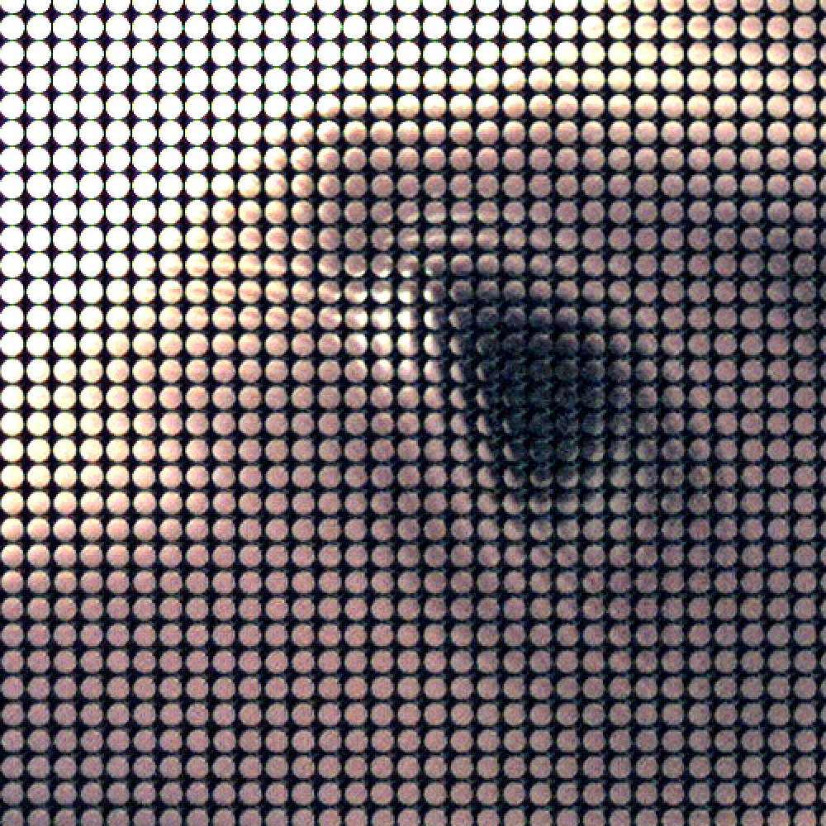
Light Field in a Single Exposure
Slide by Ren Ng.

Slide 45
Light Field Inside the Camera Body
Slide by Ren Ng.
Notes:
Okay, the first thing that I want to do is define this “light field” term that I’ve been using. The light field is just a representation for the light traveling along all rays in free space. Inside the camera, we can parameterize all the rays by where they originate on the lens plane, and where they terminate on the sensor.
So the light traveling from (u,v) on the lens to (x,y) on the sensor is given by L(u,v,x,y). Note that this is a four dimensional function – the space of rays is 4D.
The concept of the light field is the second most cited idea in computer graphics. It was introduced in 1996 by Marc and Pat at Stanford, and by Steve Gortler and colleagues at Harvard and Microsoft Research.

Slide 46
Recap & Questions?
Record 4D set of rays
  using microlens array in front of sensor
Main lens
microlenses
aperture
sub-image

Slide 47
Reconstructing a normal image
Just integrate all the pixels in an aperture sub-image
Main lens
microlenses
aperture
sub-image

Slide 48
Stopping down the lens
Just integrate the pixels only in the center of an aperture sub-image
Main lens
microlenses
aperture
sub-image

Slide 49


Digitally stopping-down
Σ
Σ
stopping down = summing only the central portion of each microlens

Slide 50
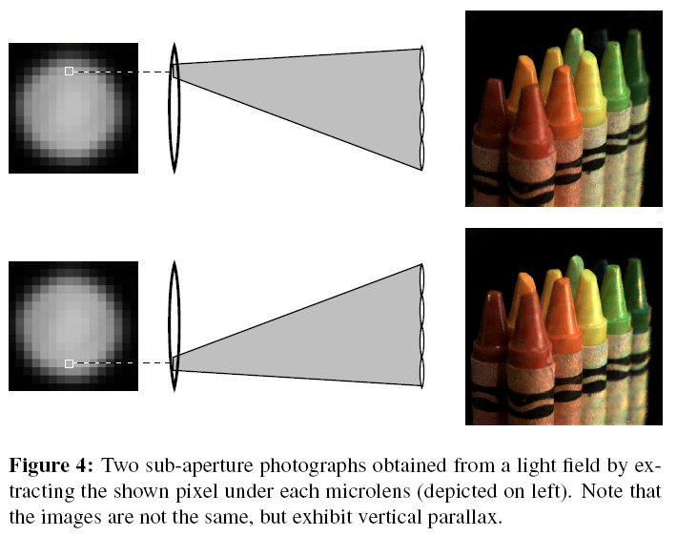
Changing the viewpoint
Just take one given pixel in each aperture sub-image
  Viewpoint limited to the lens aperture

Slide 51
Digital Refocusing by Ray-Tracing
We have all the light rays
We can generate any virtual view
u
x
Lens
Sensor
Slide by Ren Ng.

Slide 52

Digital Refocusing by Ray-Tracing
u
x
Lens
new virtual
sensor
original
Sensor
Slide by Ren Ng.

Slide 53
Digital Refocusing by Ray-Tracing
For each pixel of the new view
Integrate light rays
from different original
aperture images
u
x
Lens
new virtual
sensor
original
Sensor
Slide by Ren Ng.

Slide 54

Digital Refocusing by Ray-Tracing
u
x
Imaginary film
Lens
Sensor
Slide by Ren Ng.

Slide 55
Digital Refocusing by Ray-Tracing
u
x
Imaginary film
Lens
Sensor
Slide by Ren Ng.

Slide 56
Digital Refocusing
Slide by Ren Ng.
Notes:
Okay, so here’s the conventional photograph that we would have gotten. Notice that it’s focused on Matt, and that Jacquie and Matt are out of focus.

Slide 57
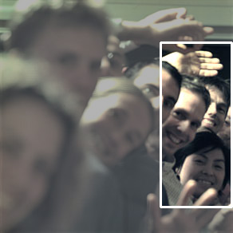



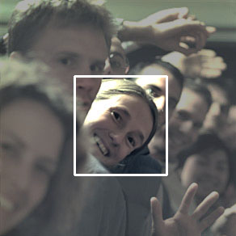

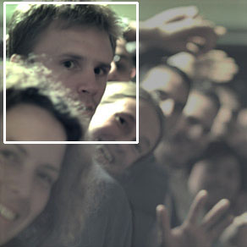
Digital Refocusing
Slide by Ren Ng.
Notes:
But by simulating the light light… etc…

Slide 58
Web demo
http://lytro.com/gallery/

Slide 59
Light Field Refocusing in Practice

Slide 60
recorded
lens

Slide 61
Digital Refocusing by Ray-Tracing
Let’s see where different aperture locations get reprojected
u
x
Lens
new virtual
sensor
original
Sensor

Slide 62
Digital Refocusing by Ray-Tracing
Let’s see where different aperture locations get reprojected
Similar triangles:
  The rays from u1 are shifted with respect to the rays from u0 by the same amount
  This amount is proportional to ||u1u0||
u
x
u1
d
u0
d
Lens
new virtual
sensor
original
Sensor

Slide 63
Algorithm
For all aperture locations u, v in [-1, 1]
  translate image along y, x by ku, kv
  add to final image
Note: we ignore a scale factor (recall, field of view changes with refocusing)
u
x
u1
d
u0
d
Lens
new virtual
sensor
original
Sensor

Slide 64
Input light field
Yes, the focal stack was synthetic!

Slide 65
Input light field

Slide 66
Input light field
Aperture images are square because it’s captured with a a robotics rig

Slide 67
Epipolar slices
y, v = constant

Slide 68
Results

Slide 69
Results

Slide 70
Results

Slide 71
Results

Slide 72
Results

Slide 73
Results

Slide 74
More results

Slide 75
More results

Slide 76
Epipolar slice

Slide 77
More results

Slide 78
More results

Slide 79
More results

Slide 80
More results

Slide 81
More results

Slide 82

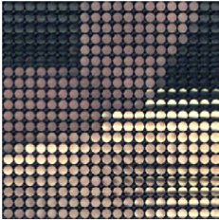
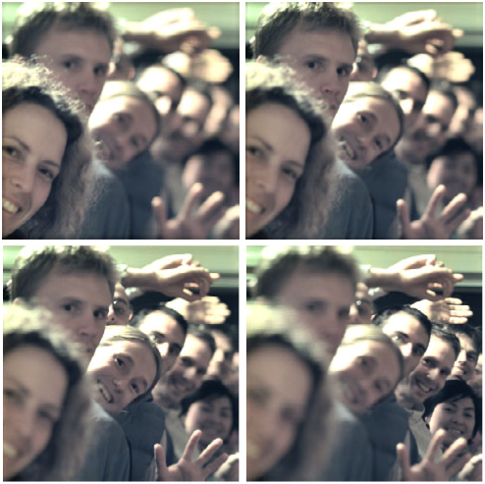
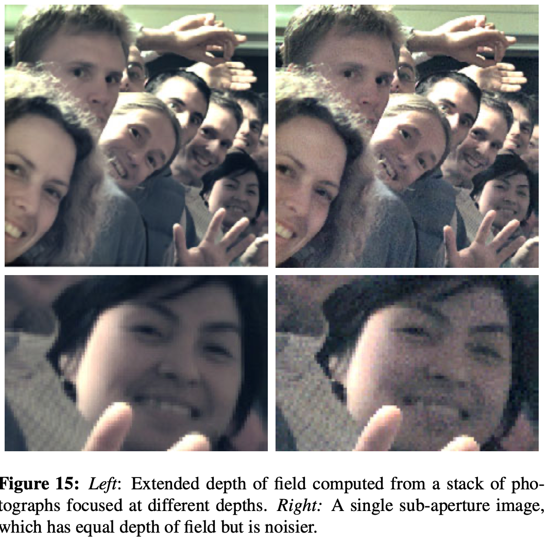
Focal stack & plenoptic camera
  Light Field Photography with a Hand-Held Plenoptic Camera, Ren Ng, Marc Levoy, Mathieu Brédif, Gene Duval, Mark Horowitz, Pat Hanrahan
See next time
Capture light field
Refocus to create focal stack
Use photomontage to
generate all-focus image

Slide 83
Focal stack & plenoptic camera
From Ng et al. http://graphics.stanford.edu/papers/lfcamera/

Slide 84
Autofocus

Slide 85
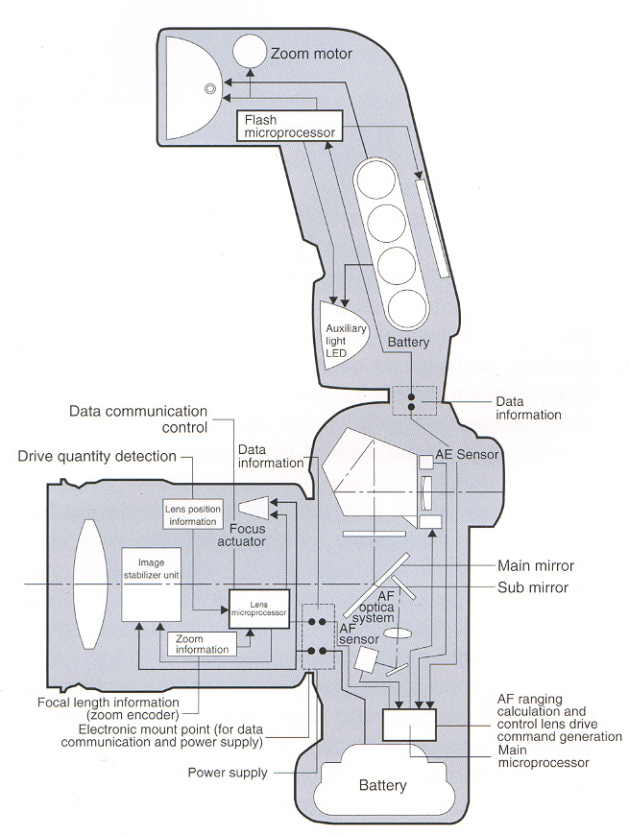
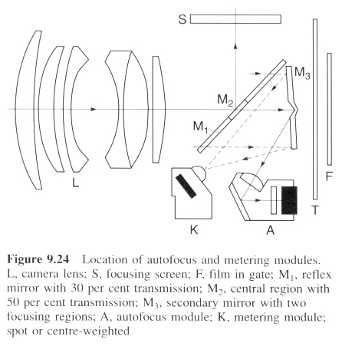
Phase detection focusing
Used e.g. in SLRs
From The Manual of Photography
From the Canon red book

Slide 86
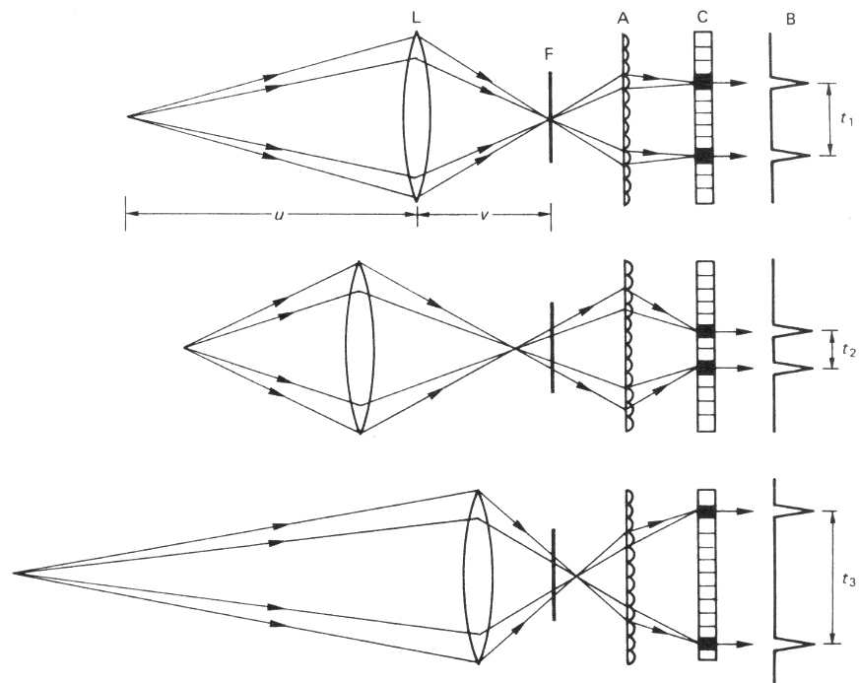
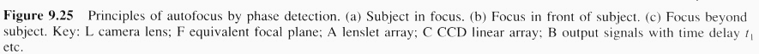
Phase detection focusing
Stereo vision from two portions of the lens on the periphery
Not at the equivalent
film plane but farther
➔ can distinguish
too far and too close
Look at the phase
difference between
the two images
Detector
In focus
phase
Too close
Too far
From The Manual of Photography

Slide 87
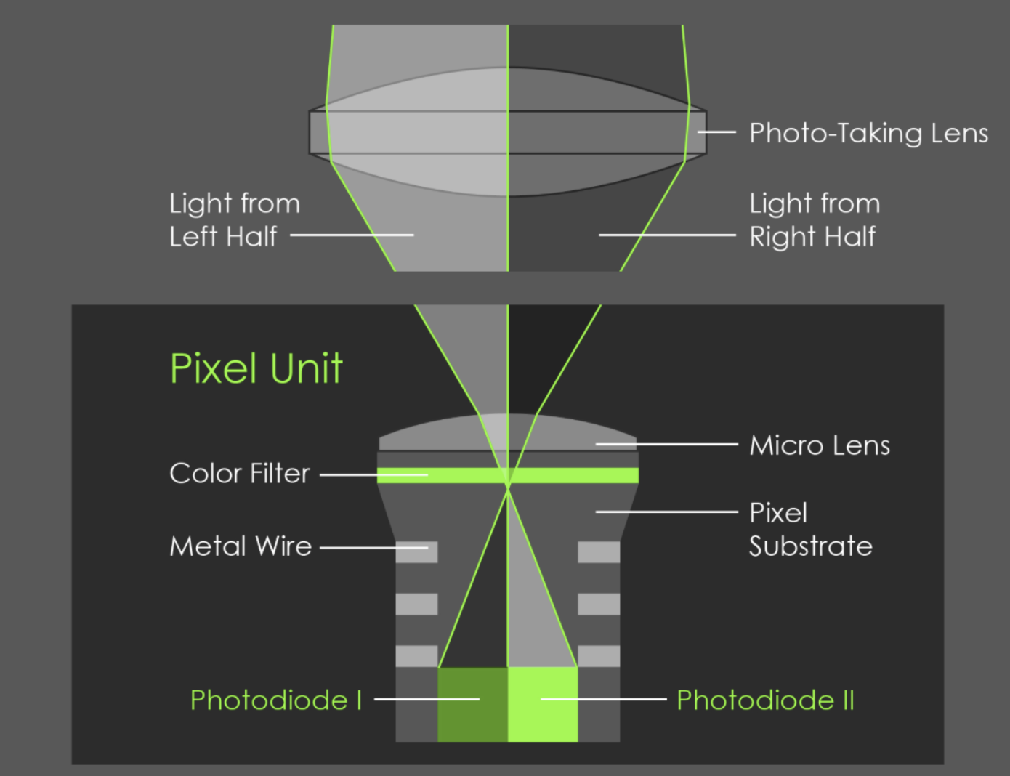
On-sensor phase autofocus
https://research.googleblog.com/2017/10/portrait-mode-on-pixel-2-and-pixel-2-xl.html

Slide 88
Optical aberration correction

Slide 89
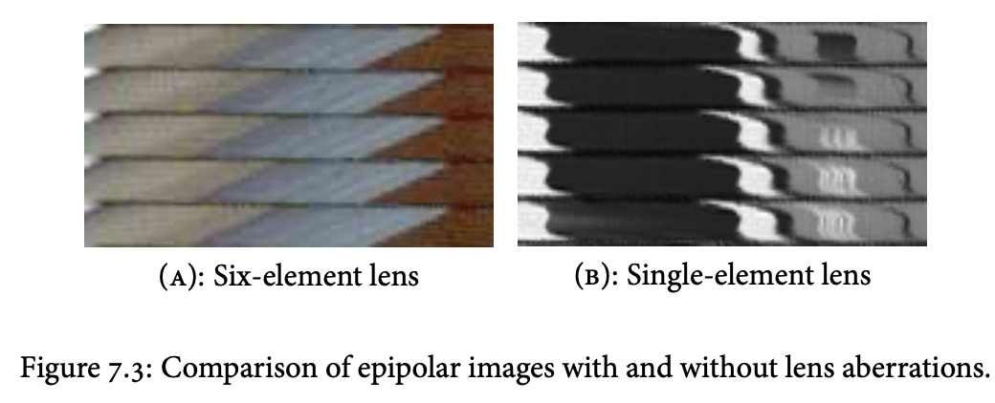

The less known (and possibly most important) chapter in Ren Ng’s thesis.
https://stanford.edu/class/ee367/reading/Ren%20Ng-thesis%20Lytro.pdf
https://www.spiedigitallibrary.org/conference-proceedings-of-spie/6342/63421E/Digital-correction-of-lens-aberrations-in-light-field-photography/10.1117/12.692290.full

Slide 90


Slide 91


Slide 93

Related work
https://www.nature.com/articles/s41586-022-05306-8

Slide 94
Fredo’s vision

Slide 95
Practical matters

Slide 96
Do you lose all that resolution?
It’s complicated

Slide 97
Can you do video
Bandwidth is the challenge

Slide 98
Is it practical?
Full frame sensor with cell phone density
24x36mm ->
Sony a7riii has 4.5micron pitch
Bandwidth of phantom high speed camera: 6,600 fps at 2048 x 1920 4MPixel. -> 660 at 40MPixels -> 30fps at 40*4.5*4.5 [they say 26GPixels/sec] 12 bits
XQD: 400MB/s -> budget of 1/8bit per pixel at full burst
JPEG vs RAW: 70MB vs 7MB; 1 to 10 -> gets us still 1 order of magnitude short
Big challenge: quick, local light field compression. Can dimensionality gap help? Steer DCT?
Alternative: 2 microns, factor of 4 obviously, 10MPixels with 4.5x4.5

Slide 99
Diaphragm (or lack thereof)
Main lens
microlenses
aperture
sub-image

Slide 100
Fake depth of field for cell phones
(no light field)

Slide 101
Challenge
Shallow depth of field hard with small sensors
Point in focus
sensor
lens
Object with texture
lens
sensor
Point in focus
Object with texture

Slide 102

Challenge
Shallow depth of field hard with small sensors
Point in focus
sensor
lens
Object with texture
lens
sensor
Point in focus
Object with texture

Slide 103

https://people.csail.mit.edu/soonmin/dof/

Slide 104

Portrait mode
https://research.google/blog/portrait-mode-on-the-pixel-2-and-pixel-2-xl-smartphones/
https://arxiv.org/pdf/1806.04171

Slide 105

Machine learning-based foreground-background segmentation
Use dual pixels to get a depth map
(or analyze local defocus)
Predict desired per-pixel blur radius
Render with non-linear blur
(more later)

Slide 106


Slide 107

Challenge with defocus blur
Remember, not a convolution!
Blur radius depends on input scene depth,
not output pixel location
Plus occlusion matters

Slide 108
*
Point in focus
sensor
lens

Slide 109


Slide 110
Occlusion
Divide the image into k (=5) depth layers with opacity values
Process each layer independently
Composite back to front (with “over” operator)

Slide 113
Challenges
Masks are hard, especially around hair!
Need notion of sub-pixel coverage

Slide 114

Some more recent work
https://arxiv.org/abs/1904.05822
https://imaging.cs.cmu.edu/dual_pixels/

