Slide 1

Fake Depth of Field, Wavefront coding
Frédo Durand
MIT EECS

Slide 2
De deblurring lecture first

Slide 3

Is depth of field a blur?
Depth of field is NOT a convolution of the image
The circle of confusion varies with depth
There are interesting occlusion effects
(If you really want a convolution, there is one, but in the light field...)
From Macro Photography

Slide 4
Fake depth of field

Slide 5
Challenge
Shallow depth of field hard with small sensors
Point in focus
sensor
lens
Object with texture
lens
sensor
Point in focus
Object with texture

Slide 6
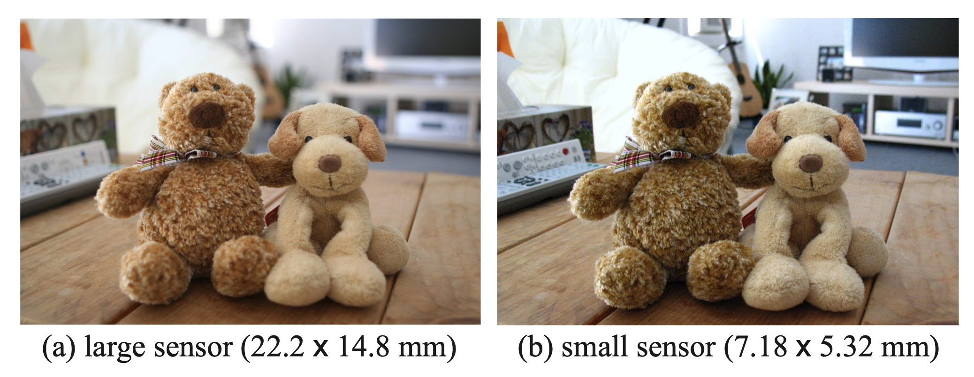
Challenge
Shallow depth of field hard with small sensors
Point in focus
sensor
lens
Object with texture
lens
sensor
Point in focus
Object with texture

Slide 7
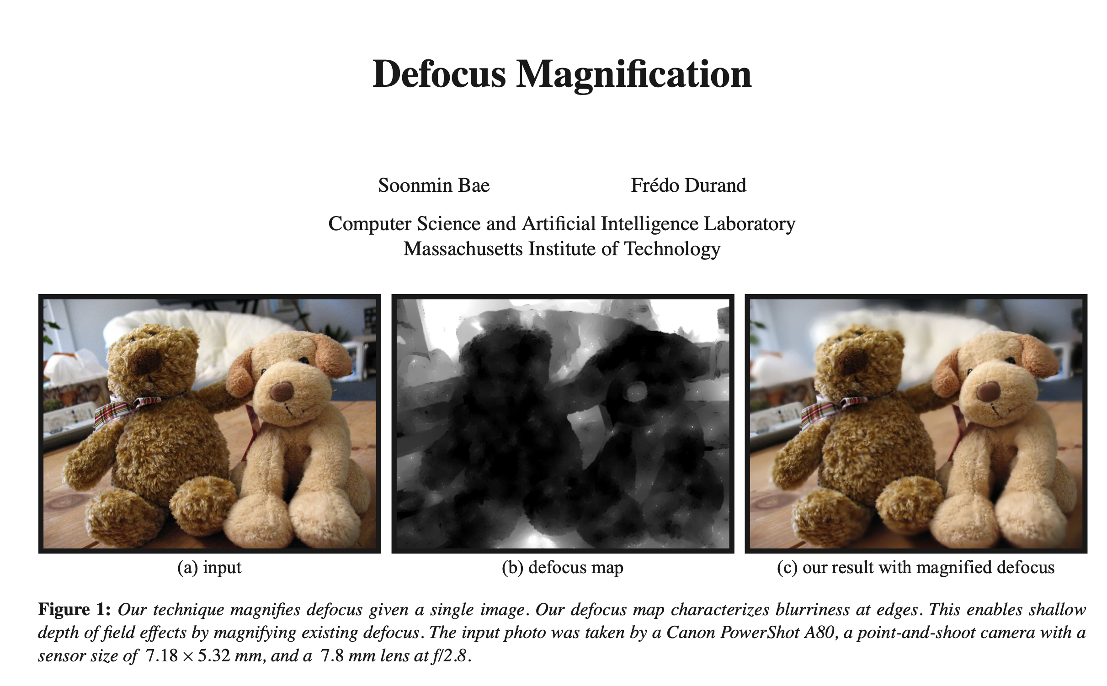
https://people.csail.mit.edu/soonmin/dof/

Slide 8
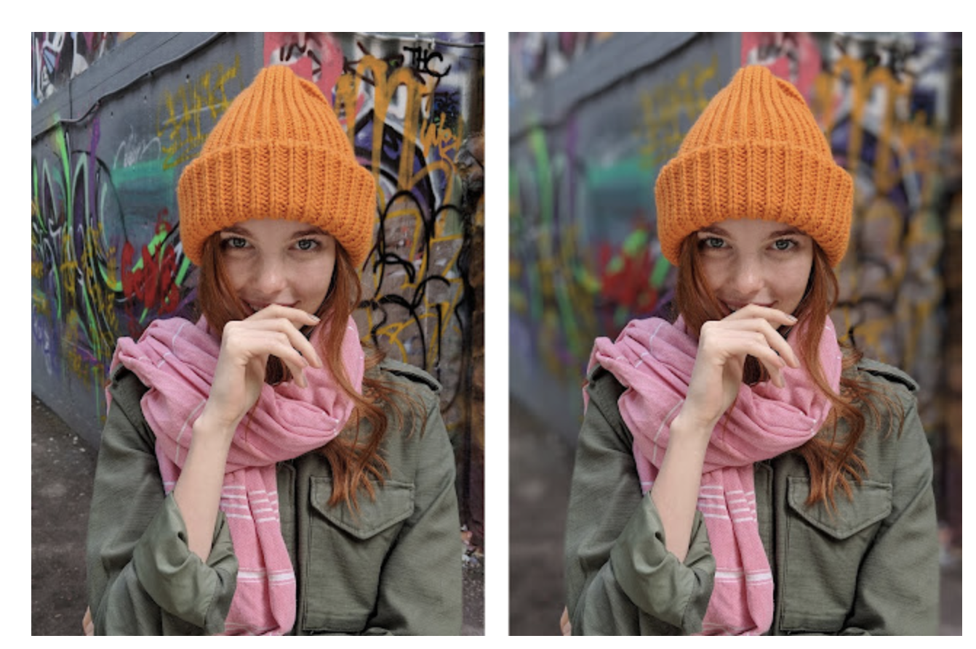
Portrait mode
https://research.google/blog/portrait-mode-on-the-pixel-2-and-pixel-2-xl-smartphones/
https://arxiv.org/pdf/1806.04171

Slide 9
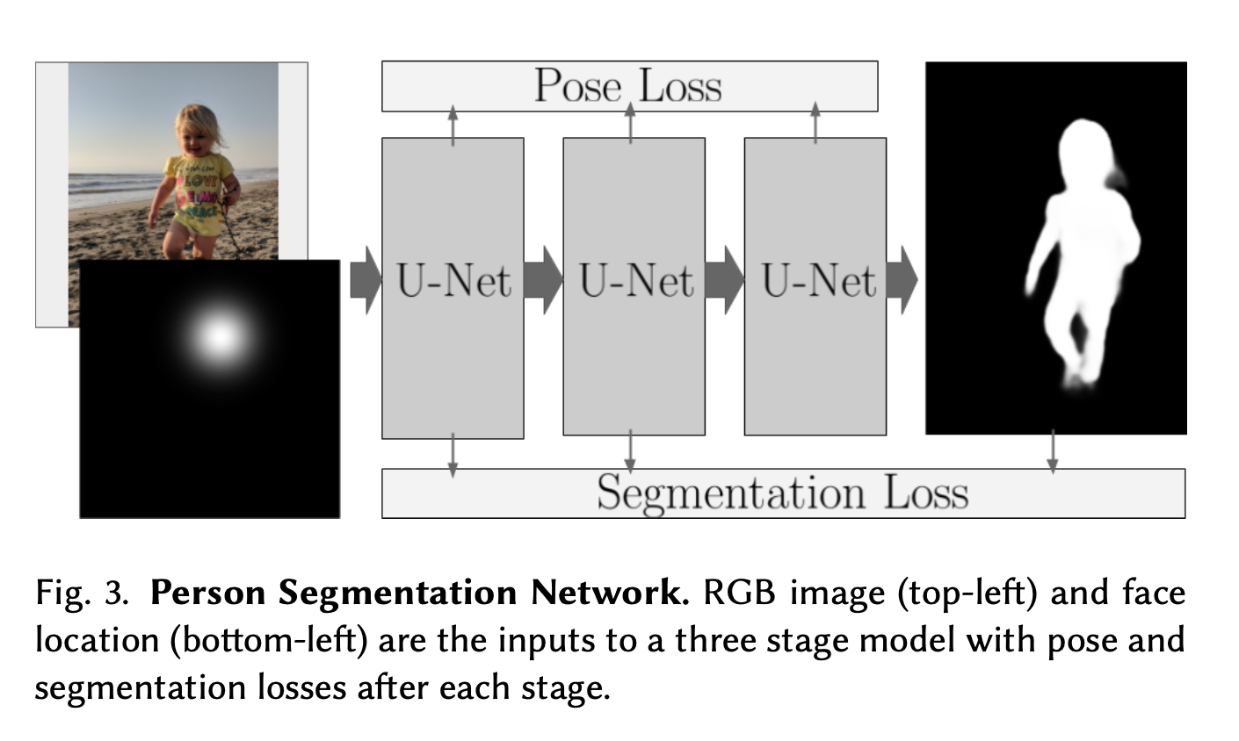
Machine learning-based foreground-background segmentation
Use dual pixels to get a depth map
(or analyze local defocus)
Predict desired per-pixel blur radius
Render with non-linear blur
(more later)

Slide 10
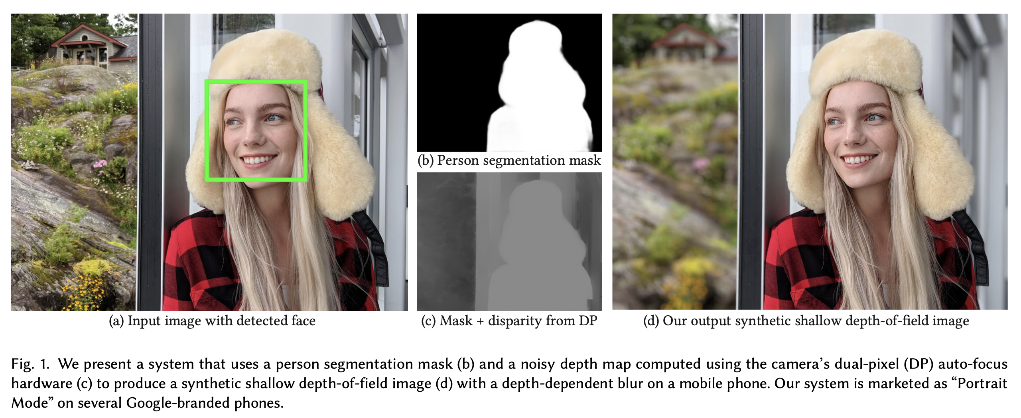

Slide 11
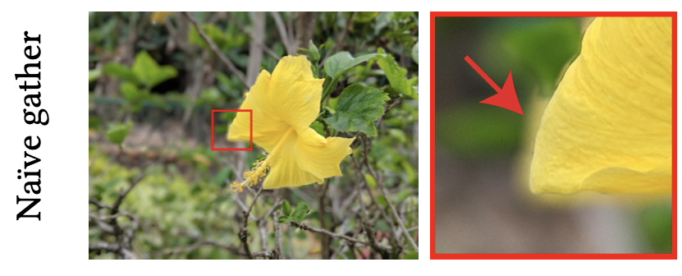
Challenge with defocus blur
Remember, not a convolution!
Blur radius depends on input scene depth,
not output pixel location
Plus occlusion matters

Slide 12
*
Point in focus
sensor
lens

Slide 13
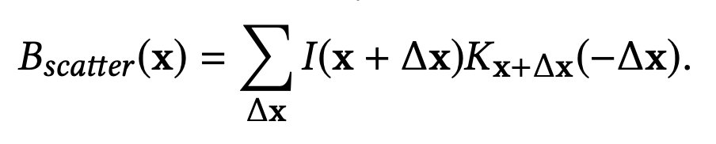

Slide 14
Occlusion
Divide the image into k (=5) depth layers with opacity values
Process each layer independently
Composite back to front (with “over” operator)

Slide 17
Challenges
Masks are hard, especially around hair!
Need notion of sub-pixel coverage

Slide 18
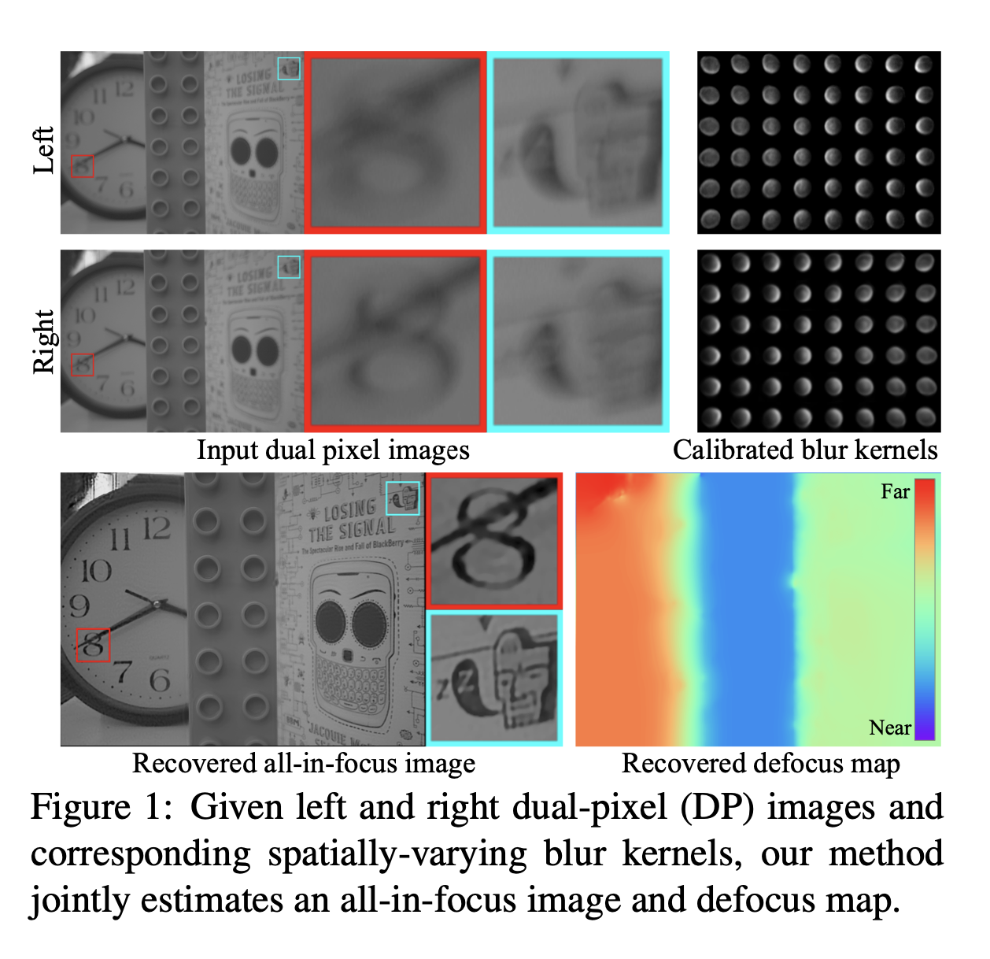
Some more recent work
https://arxiv.org/abs/1904.05822
https://imaging.cs.cmu.edu/dual_pixels/

Slide 19
Wavefront coding

Slide 20
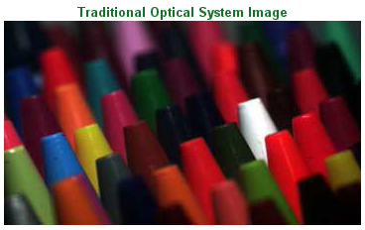
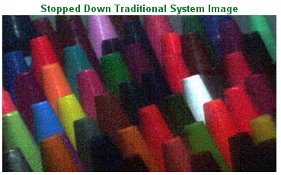
Hardware depth of field solution
Stop down! (use smaller aperture)
problem: noise
  http://www.cdm-optics.com/site/publications.php

Slide 21
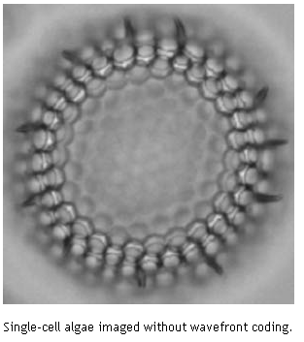
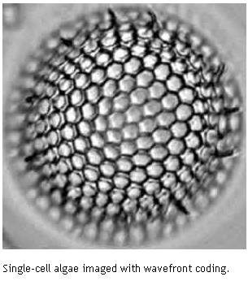
Wavefront coding
CDM-Optics, U of Colorado, Boulder
Improve depth of field using weird optics & deconvolution
http://www.cdm-optics.com/site/publications.php
  The worst title ever: "A New Paradigm for Imaging Systems", Cathey and Dowski, Appl. Optics, 2002

Slide 22
Wavefront coding
Idea: deconvolution to deblur out of focus regions
Sometimes, we can cancel a convolution by another convolution
  This is called deconvolution
Best studied in the Fourier domain (of course!)
  Convolution = multiplication of spectra
  Deconvolution = multiplication by inverse spectrum

Slide 23
Deconvolution
Assume we know blurring kernel k
f' = f ⊗ k
➔ F' = F K (in Fourier space)
Invert by: F=F'/K (in Fourier space)
Well-known problem with deconvolution:
  Impossible to invert for ω where K(ω)=0
  Numerically unstable when K(ω) is small

Slide 24
Wavefront coding
Idea: deconvolution to deblur out of focus regions
Problem 1: depth of field blur is not shift-invariant
  Depends on depth
  ➔If depth of field is not a convolution,
  it's harder to use deconvolution ;-(
Problem 2: Depth of field blur "kills information"
  Fourier transform of blurring kernel has low frequency response

Slide 25
Wavefront coding
Idea: deconvolution to deblur out of focus regions
  Problem 1: depth of field blur is not shift-invariant
  Problem 2: Depth of field blur "kills information"
Solution: change optical system so that
  Rays don't converge anymore
  Image blur is the same for all depth
  Blur spectrum is higher

Slide 26
Wavefront coding
Idea: deconvolution to deblur out of focus regions
  Problem 1: depth of field blur is not shift-invariant
  Problem 2: Depth of field blur "kills information"
Solution: change optical system so that
  Rays don't converge anymore
  Image blur is the same for all depth
  Blur spectrum is higher
How it's done
  Phase plate (cubic lens z=y³+x³)
  Will do things similar to spherical aberrations

Slide 27
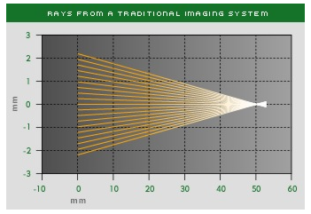
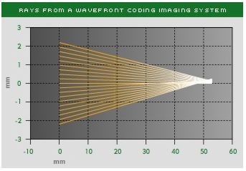
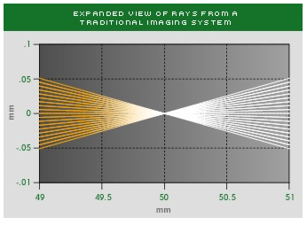
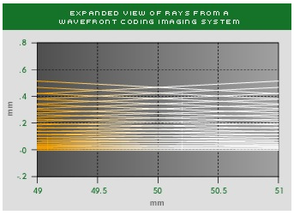
Ray version

Slide 28
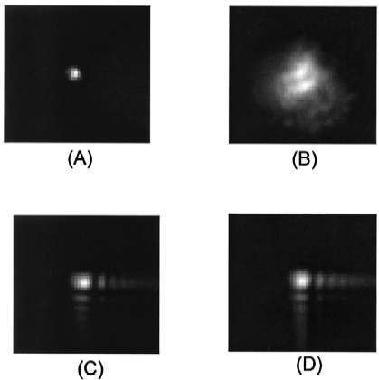
Image of a point source
aka Point Spread Function (PSF), same as kernel
In focus
Out of focus
Normal lens
Wavefront coding

Slide 29
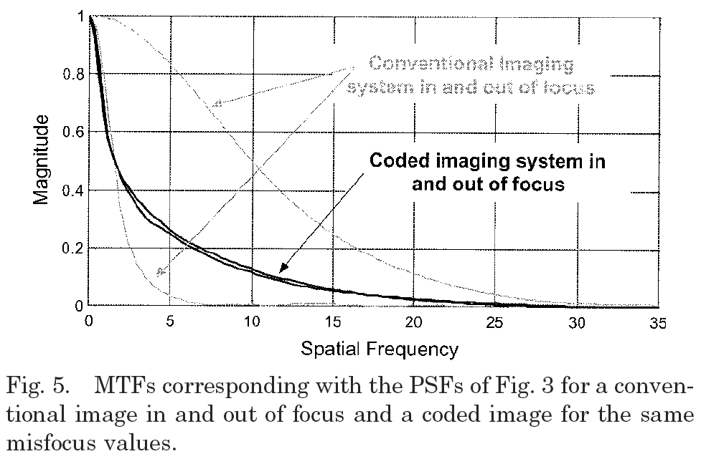
Frequency response (MTF)
Magnitude of the Fourier transform of the PSF
Higher is better (noise less amplified by deconvolution)

Slide 30
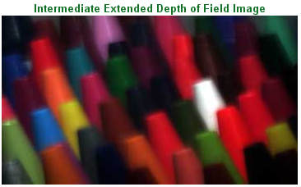
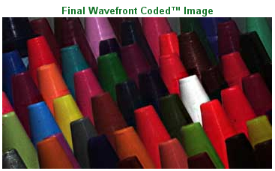
Results

Slide 31
Questions?

Slide 32
In General: Coded Imaging

Slide 33
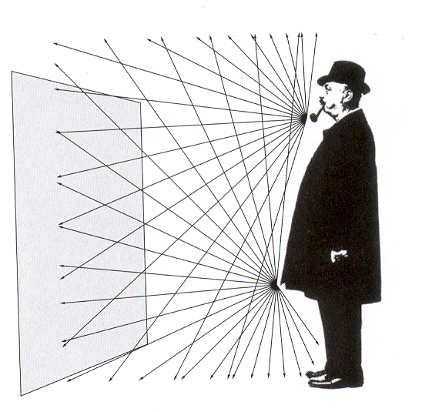
Philosophy: Image capture
A sensor placed alone in the middle of the visual world does not record an image

Slide 34
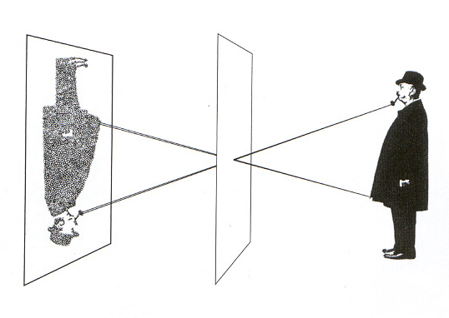
Image capture
Pinhole allows you to select light rays

Slide 35
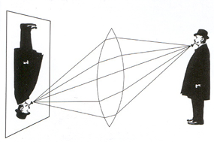
Image formation: optics
Optics forms an image: selects and integrates light rays

Slide 36
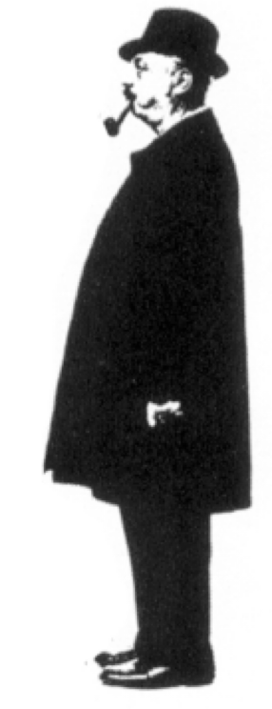
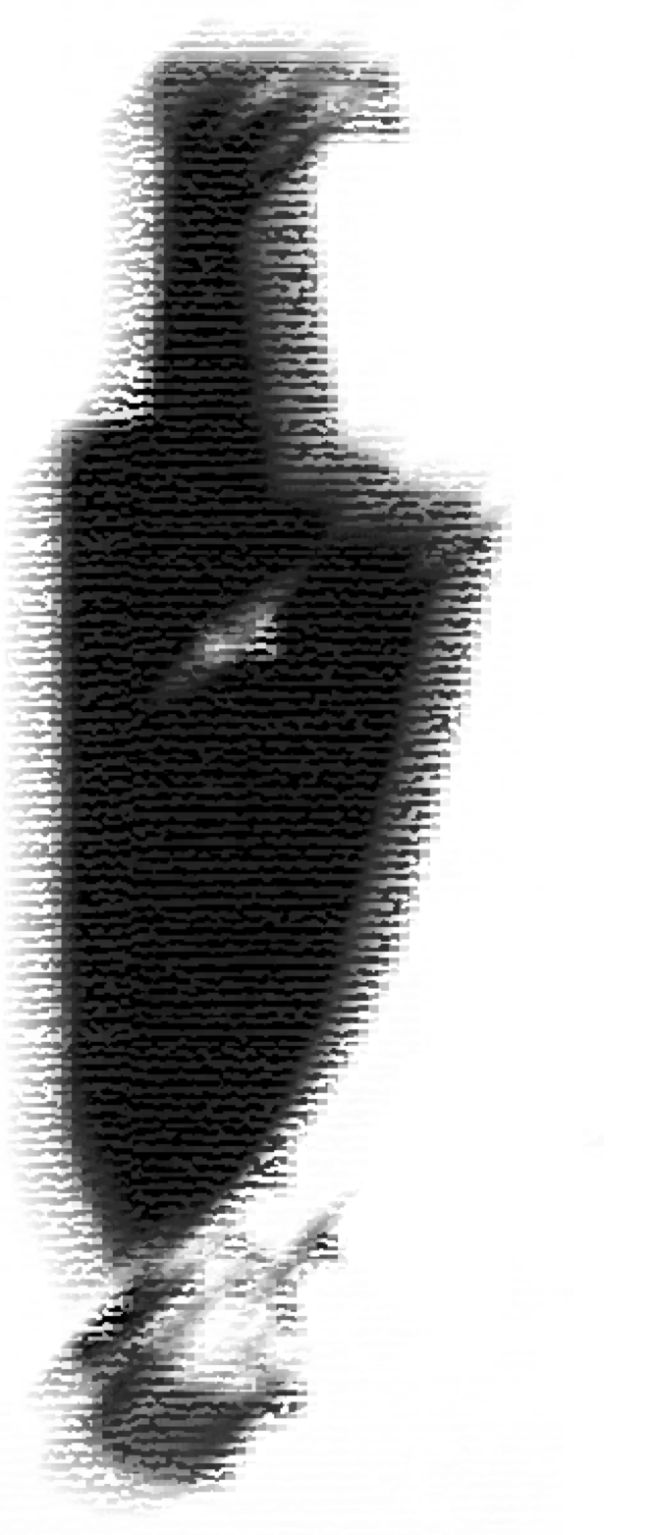
Image formation: computation
The combination of optics & computation forms the image: selects and combines rays
Generalized
optics
Computation
Final
image
Intermediate
optical image

Slide 37
Computational imaging goals
Better capture information
Form image as a post-process
Generalized
optics
Computation
Final
image
Intermediate
optical image

Slide 38
Better capture information
Same as communication theory:
optics encodes , computation decodes
Code seeks to minimize distortion
Generalized
optics
Computation
Final
image
Intermediate
optical image

Slide 39
Form images as a post-process
The computational part of formation can be done later and multiple times
e.g., enable refocusing
Generalized
optics
Computation
Final
image
Intermediate
optical image

Slide 40
Lattice focal lens

Slide 41
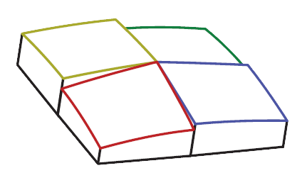
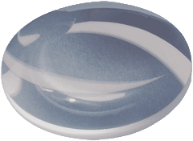
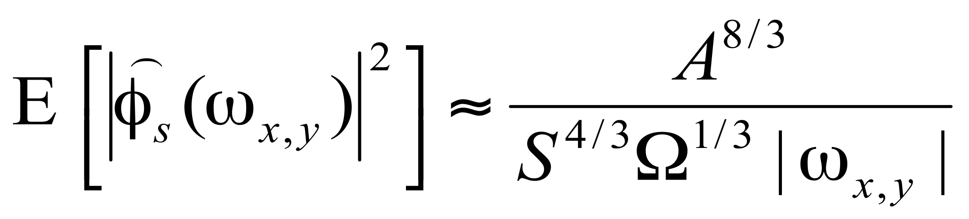
32
New solution: The lattice-focal lens
Levin et al. 09: assembly of subsquares with different focal powers
each element focuses on a different depth
toy lattice-focal lens with 4 elements
Notes:
Our new lattice focal lens is an assembly of subsquares. The subsquares are cut out of a lenses with different focal power, which means that they focus rays from different depths. In this slide we show a toy lattice focal lens with only 4 subsquares but in practice we have a larger number of sublenses.

Slide 42
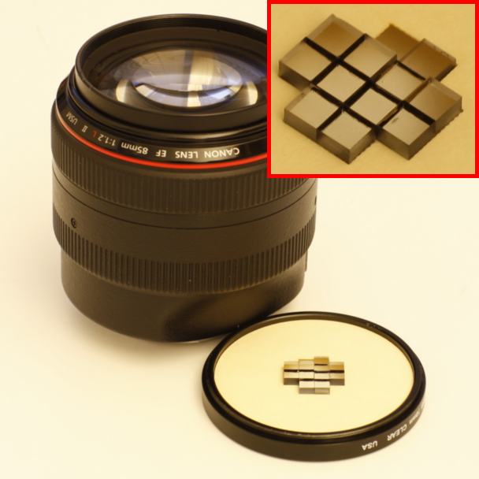
36
Hardware construction
Proof of concept
12 subsquares cut from plano-convex spherical lenses
Attached to main lens
extra focal power needed very low
Modest DOF extension with only 12 subsquares
Notes:
We have built a proof-of-concept lattice-focal lens with just 12 elements. By attaching the lattice-focal elements to a high-quality main lens, the focal power we need for each of the subsquares is much lower. This lets us use simple plano-convex glass lenses without suffering from too many aberrations.

Slide 43
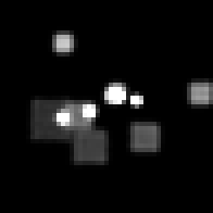
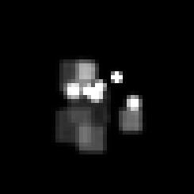
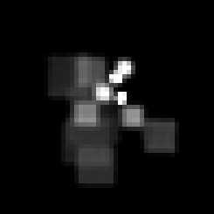
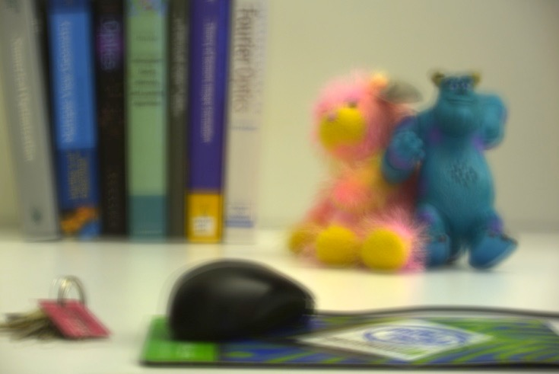

37
Depth estimation
Defocus kernels vary with depth
defocus kernels at different depths
Depth estimation as for the coded aperture camera [Levin et al. 07]
input
depth map
Notes:
The defocus kernels of the lattice-focal lens vary with depth. and therefore to process an image we estimate depth in the same way this was done for the coded aperture camera.

Slide 44

38
Standard lens reference
Notes:
Here are real results.
This is the input from a standard lens, which has a very shallow depth of field.

Slide 45
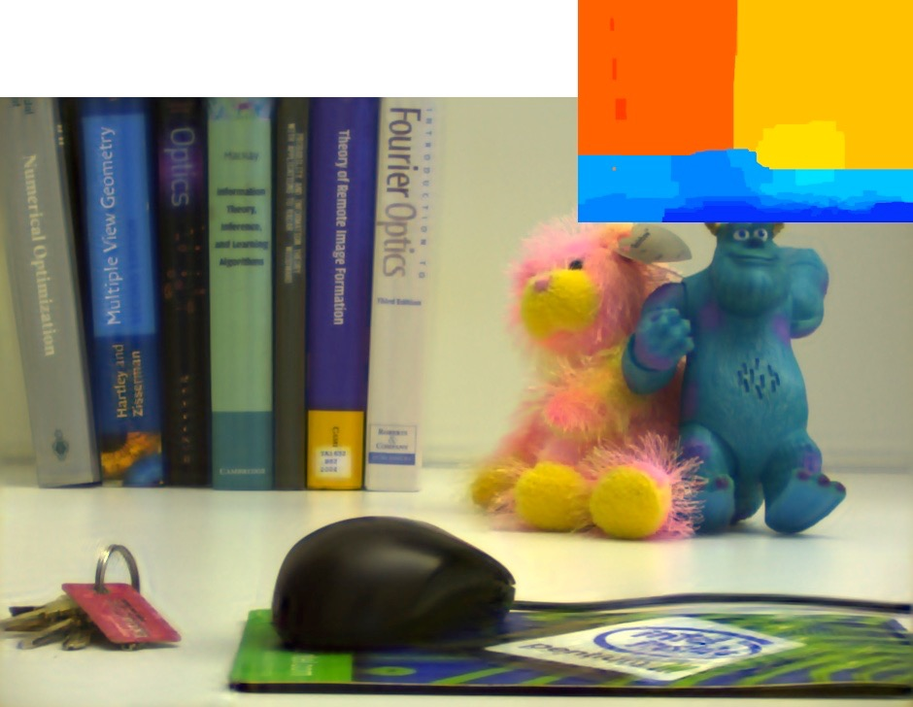
Lattice-focal lens
Notes:
And here's an extended-depth of field image produced with our lattice-focal lens.

Slide 46
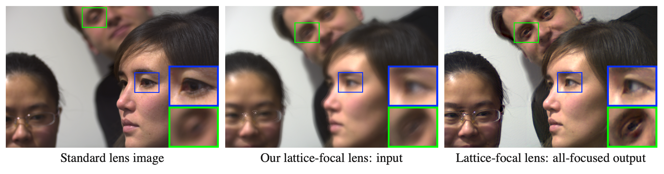
Lattice focal lens

Slide 47

44
Application: Refocusing from single captured image
Notes:
The lattice-focal lens provides us with a coarse depth map, and this can be used for post-processing effects. One example is synthetic refocusing from a single image.
We can refocus on the back, or any depth in the middle.

Slide 48
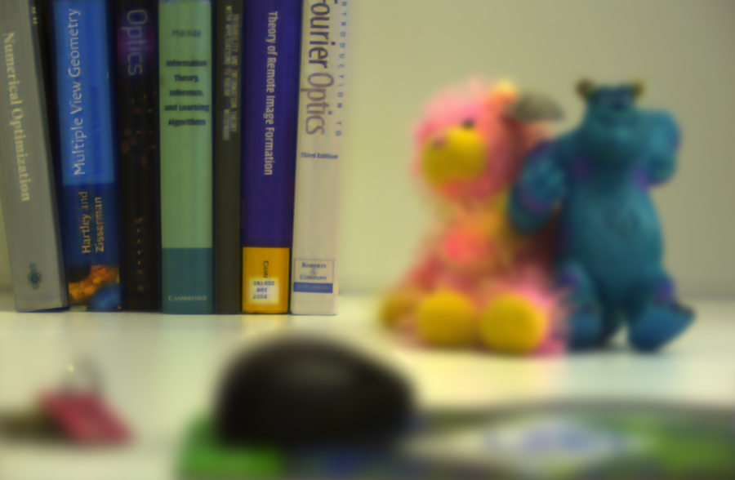
45
Application: Refocusing from single captured image
Notes:
.

Slide 49

46
Application: Refocusing from single captured image
Notes:
.

Slide 50
Depth of field analysis
How do different cameras compare?
What is the best that can be done?

Slide 51
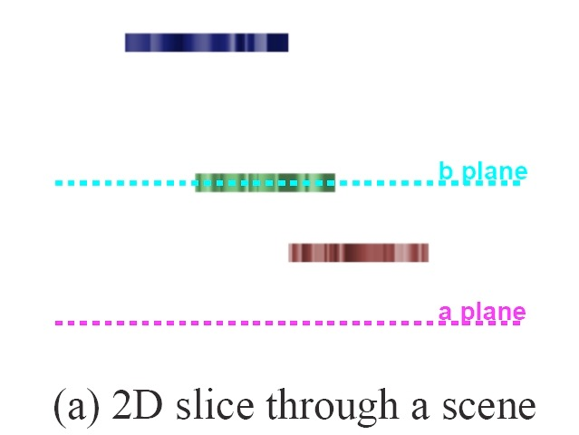
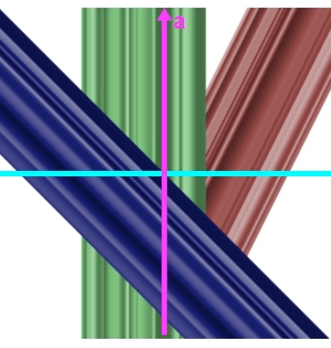

Analysis tool: light field
flatworld 1D scene
2D lightfield
horizontal position
a
a
b plane
depth
b
b
a plane
2 plane parameterization [Levoy and Hanrahan 96]
hello
9
Notes:
If we go through the same exercise for every surface in our toy world, we’ll get the depiction of the lightfield shown here. its dominant characteristics are the slowly varying structures along slopes determined by the object depths, and with faster variations from surface textures in the horizontal direction.
So that’s the lightfield. Now, what do different cameras do, examined in this lightfield domain? studying this gives us insight into the photographic problem.

Slide 52
Pinhole camera
flatworld 1D scene
2D lightfield
horizontal position
a
a
b plane
depth
b
b
a plane
aperture
sensor plane
y =
T
x
hello
10
Notes:
let’s start with the simplest camera, a pinhole camera. we open a very small aperture, and individual light rays pass through the aperture and land on a single sensor element. We’ve color coded each sensor element. Here we show you that operation with our two different parameterizations of the lightfield--the vector-matrix equation form, and in the 2-d form, for better intuition.
We measure only a small part of the lightfield--not much light gets into a pinhole camera. We sample the intensities along a single row of the lightfield, determined by where the aperture lies.

Slide 53
Lens, focused at green object
flatworld 1D scene
2D lightfield
horizontal position
a
a
b plane
depth
b
b
a plane
aperture
sensor plane
y =
T
x
hello
11
Notes:
Now the 2nd simplest camera--a single lens, bringing the sufrace at the b plane into focus at the camera sensor elements. Each sensor element now records all the rays leaving a point at the b plane over the range of a values set by the lens aperture. so each pixel integrates over a vertical swath of the lightfield. We’re recording a lot more of the lightfield, which you can see in each of the 2 lightfield parameterizations depicted here. Because it gives more intuition, from now on, we’ll just show the lightfield in the 2d parameterization.

Slide 54
Lens, focused at blue object
flatworld 1D scene
2D lightfield
horizontal position
a
a
b plane
depth
b
b
a plane
aperture
sensor plane
hello
12
Notes:
let’s change the focus of our lens camera. now it brings points on the surface of the blue object into focus at the detector. so every pixel will integrate over a slanted line in the lightfield space, at the same slope as the blue object.

Slide 55
Coded aperture lens
flatworld 1D scene
2D lightfield
horizontal position
a
depth
b
aperture
sensor plane
hello
13

Slide 56
Stereo
flatworld 1D scene
2D lightfield
horizontal position
a
a
b plane
depth
b
b
a plane
apertures
sensor plane
hello
14
Notes:
to build more intuition about what cameras record, lets look at some other cameras as patches of integration over the lightfield. a stereo camera has two arrays of lightfield integration patches, offset in a and b according to the baseline of the stereo camera. Here we’re depicting a fixed total number of sensors for each camera, so the spatial resolution of each stereo camera is cut in two.

Slide 57
Plenoptic camera
flatworld 1D scene
2D lightfield
horizontal position
a
a
b plane
depth
b
b
a plane
main lens
aperture
micro-lenses
sensor plane
Adelson and Wang 92, Ng et al 05
hello
15
Notes:
a so-called “plenoptic” camera has a second set of microlenses behind a main lens. placed properly, this allows for both lightray angle as well as position to be recorded, giving a sensing pattern something like that shown schematically here. we measure a lot of angular information, but lose detail in the horizontal dimension.

Slide 58
Wavefront coding
flatworld 1D scene
2D lightfield
horizontal position
a
a
b plane
depth
b
b
a plane
cubic phase plate
aperture
sensor plane
Dowski and Cathey,94
hello
16
Notes:
finally, the lightray integration curves don’t need to be rectilinear patches; they can be curves in the lightfield space as well. One famous camera system that we’ve shown has parabolic lightfield integration paths is wavefront coding. a cubic phase plate leads to the parabolic integration paths, which you can show lead to depth invariant depth-of-focus blur.

Slide 59
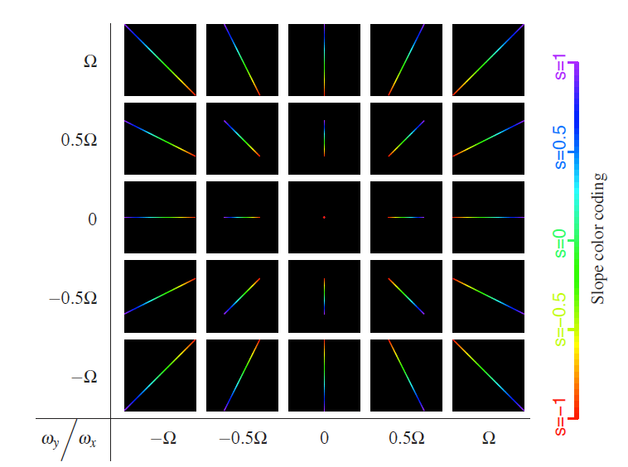
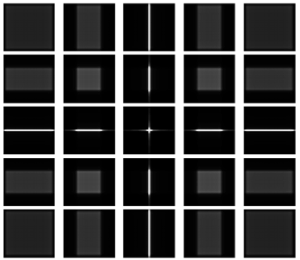
Our new theoretical analysis
http://www.wisdom.weizmann.ac.il/~levina/papers/lattice/
In the 4D light field
  Fourier analysis
Shows that only a 3D subset of the 4D spectrum is useful
(dimensionality gap)
Inspires new lens design:
lattice-focal lens
Only a 3D subset of the 4D spectrum is useful
Previous designs spend energy outside the useful subset

Slide 60

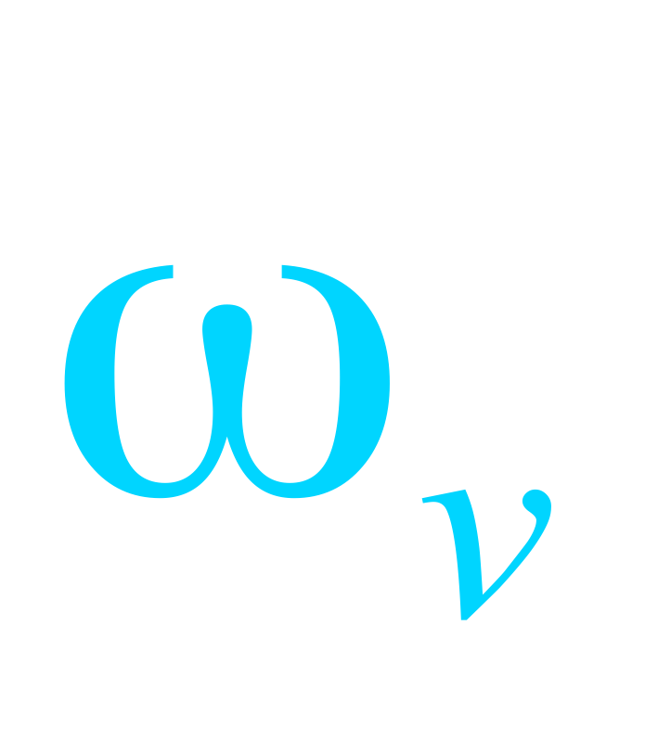
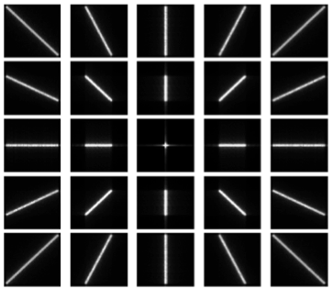

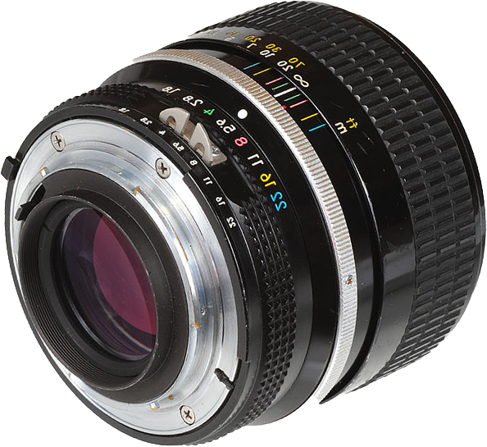

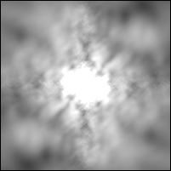
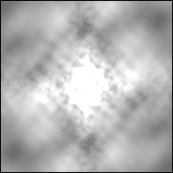
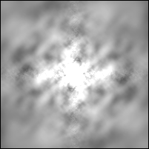
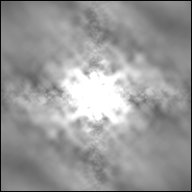
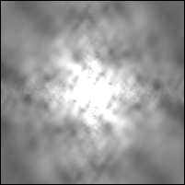
34
The lattice-focal lens focuses on 3D subset
v
y
x
u
4D Fourier Transform
Sliced 2D OTFs at varying depths:
Notes:
When we increase the number of sublenses the collection of sincs can cover the full focal segment. This is more or less the lens spectrum we wanted- energy over the full focal segment and not outside that segment.

Slide 61
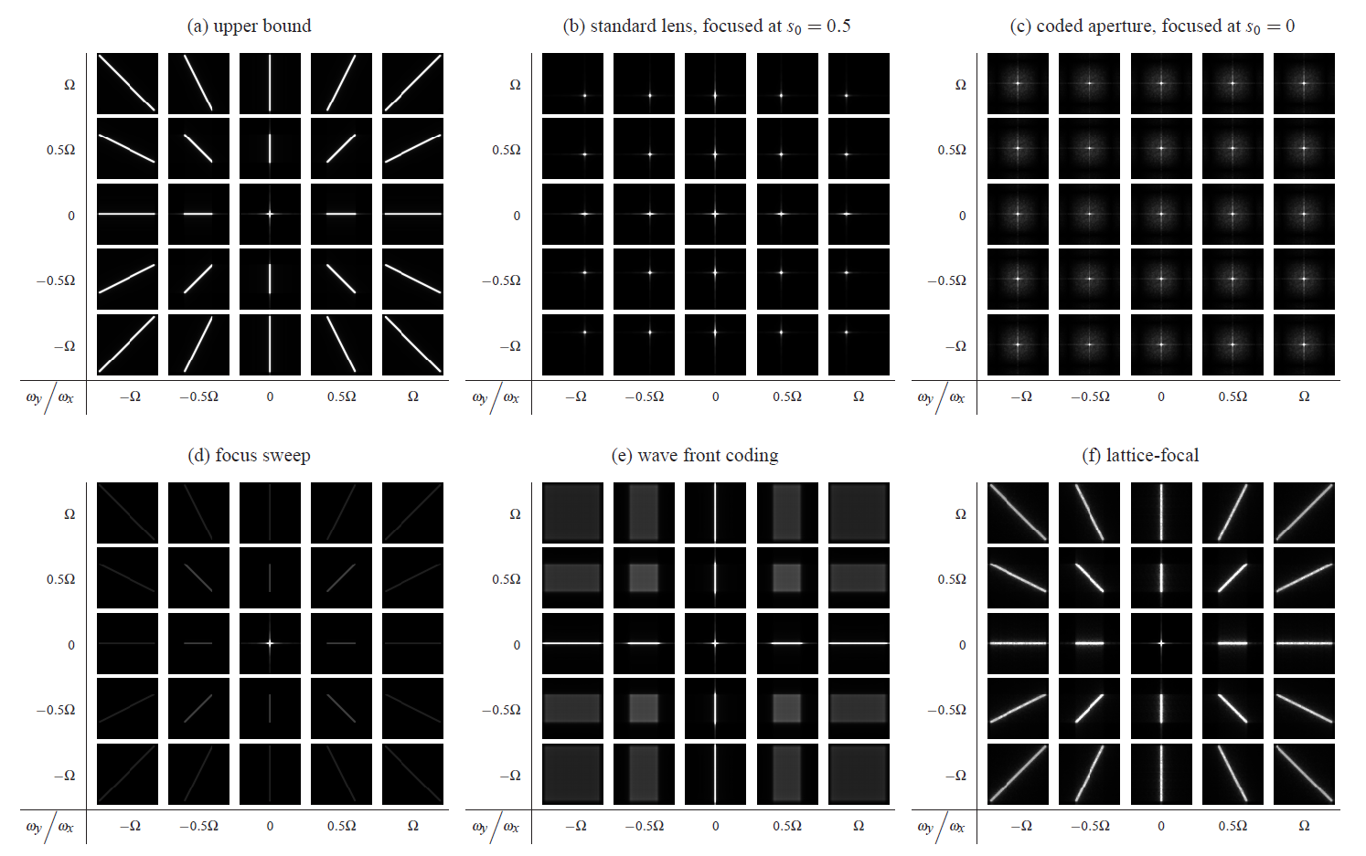
Comparison of different cameras

Slide 62
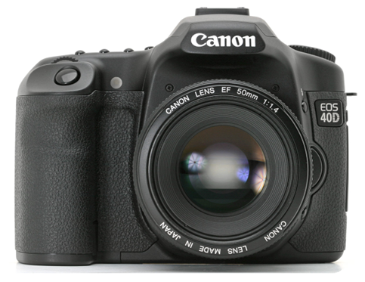













35
Comparing image reconstruction (simulation)
<
<
<
<
<
standard
lens
coded
aperture
focus
sweep
wavefront
coding
lattice-focal
lens
Object at in-focus depth
Object at extreme depth
Notes:
Now I show a comparison of computational cameras using synthetic data. We simulate the defocus blur, add Gaussian noise, and deconvolve using Wiener filtering.
The first row corresponds to a planar object at the in-focus depth for a standard lens, in the middle of the range. The second row is for the same object at the extreme end of the depth range.
The standard lens on the left and the coded aperture to its right capture a perfectly sharp image at the in-focus depth. but for an extreme depth it's so defocused that the reconstruction we get is quite poor, as see in the lower left of the slide.
By contrast, the focus sweep camera, wavefront coding and our new lattice-focal lens achieve about the same quality regardless of the depth. Although the standard lens is still better at the in-focus depth, all these computational cameras are much better for out-of-focus depths.
As you can see in the rightmost column, the lattice-focal lens achieves the best image quality.
This ranking of the designs agrees with the formal spectrum derivations in our paper.

Slide 63
References
http://www.cdm-optics.com/site/publications.php
http://www.wisdom.weizmann.ac.il/~levina/papers/lattice/
http://www1.cs.columbia.edu/CAVE/publications/pdfs/Nagahara_ECCV08.pdf
http://groups.csail.mit.edu/graphics/CodedAperture/
http://web.media.mit.edu/~raskar/Mask/

Slide 64
In cell phones
e.g. Nokia E7
Also exploits chromatic aberrations to focus R, G & B at different depths
http://www.allaboutsymbian.com/features/item/12789_EDoF_versus_Auto-focus_Underst.php
http://www.tessera.com/Pages/tessera.aspx
http://www.tessera.com/technologies/imagingandoptics/Documents/OptiML_Focus.pdf

Slide 65

Other application
Single-image depth sensing
  Blur depends A LOT on depth
  Passive Ranging Through Wave-Front Coding: Information and Application. Johnson, Dowski, Cathey
  http://graphics.stanford.edu/courses/cs448a-06-winter/johnson-ranging-optics00.pdf

Slide 66



Single image depth sensing

Slide 67
Important take-home idea
Coded imaging
What the sensor records is not the image we want, it's been coded (like in communication theory)
Image processing decodes it

Slide 68





Image and Depth from a Conventional Camera with a Coded Aperture
With Anat Levin, Rob Fergus,
Bill Freeman [Siggraph 2007]
RGB & coarse depth from single image
Notes:
Now let me tell you about computational photography. We design both algorithms and optics to allow you to take better pictures and to get more information with your pictures. For example, we designed a coded aperture where we insert a small binary mask in the middle of a lens, which allows you to depth depth information together with your normal image. Better than that, we can also give you a sharper image without out-of focus regions.

Slide 69









Coded Aperture: a paradigm of computational photography
Reconstruct
light-field / depth
Coding optics,
decoding algorithm
Prior on “natural” images
(sparse derivative)
Notes:
As this work shows, the power of computational photography is in designing both the optics and the algorithm together

Slide 70

Input
Notes:
Here is the kind of image it captures. It’s hard to see at this resolution but the defocus is a little weird.

Slide 71
Deconvolved (all-focus)
Notes:
Now we can use a new deconvolution algorithm we have developed to remove the defocus.

Slide 72
Depth
Notes:
And we get depth information as well.

Slide 73

Refocusing (from single image!)
Notes:
Now with this information, we can do cool things after the fact. We can increase the defocus to get a nice blurry background.

Slide 74

Refocusing (from single image!)

Slide 75

Refocusing (from single image!)

Slide 76

Refocusing (from single image!)

Slide 77


Results

Slide 78

Refocusing (from single image!)

Slide 79

Refocusing (from single image!)

Slide 80

Refocusing (from single image!)

Slide 81


    50mm f/1.8:
$79.95
    Cardboard:
$1
    Tape:
$1
    Depth acquisition:
priceless

Slide 82
Motion-Invariant Photography

Slide 83
Our counter intuitive solution:
To reduce motion blur, increase it!
- move camera as picture is taken
Makes blur invariant to motion- can be removed with spatially uniform deconvolution
- kernel is known (no need to estimate motion)
- kernel identical over the image (no need to segment)
Makes blur easy to invert
Notes:
The solution we propose might sound counter intuitive- to reduce motion blur we increase it. We move the camera during exposure time, so that we also blur the static parts of the scene.
However the motion is designed in a special way which makes blur invariant to object velocity. That means that the entire scene is blurred equally, with a known kernel.
The advantage is that we can remove the blur with a single deconvolution, without any motion estimation and without segmentation.
Another advantage is that our special motion preserve high frequency information and makes the blur easy to invert.

Slide 84






Motion invariant PSF
Anat Levin, Taeg Sang Cho, Peter Sand, Fredo Durand, William Freeman, SIGGRAPH 2008
integration curves
sheared integration curves
projected PSF
Static
Parabolic
Image data
Up to tail clipping, PSF is invariant to slope
Velocity

Slide 85
Parabolic sweep
Start by moving very fast to the right
Continuously slow down until stop
Continuously accelerate to the left
Intuition: For any velocity, there is one instant where we track perfectly.
We spend an equal amount of time
tracing each velocity.

Slide 86

Time 1

Slide 87

Time 2

Slide 88

Static camera

Slide 89

Parabolic motion camera

Slide 90






Comparing camera reconstruction
Static
Flutter Shutter
Parabolic
Blurred input
Deblurred output
Note: synthetic rendering, exact PSF is known
Notes:
Here is a visual comparison. We synthetically blurred a scene according to all 3 camera models and add an equal amount of noise. The inversion of a static camera blur is worst, a flutter shutter model does better, but the parabolic motion preserves much more information.

Slide 91







Upper bound given velocity range
Primal Domain
Frequency Domain
t
Frequencies from possible motions
Objects
x
t
?
Camera integration curve
x
For each spatial frequency,
max budget across velocity range
Notes:
In each column the best thing to do is to distribute the bounded budget uniformly within the wedge.
Therefore we end up with an upper bound on the optimal power spectrum that we can hope to achieve.

Slide 92



Cameras and information preservation
slope wedge
slope wedge
slope wedge
slope wedge
Static
Flutter shutter
Parabolic
Upper bound
Constant horizontally
Spends frequency “budget” outside wedge
Handles 2D motion
Near optimal “budget” usage at all frequencies
Bounded “budget” per column
Notes:
Now let’s see how different cameras do with respect to this upper bound.
We note that the power spectrum of a flutter shutter camera must be constant horizontally. Therefore it must spend budget outside the wedge. Since the norm of each column is bounded, this means less budget for the desired velocities range.
In contrast to this, the power spectrum of the parabolic curve fits the wedge shape and does not spend much budget outside the wedge.
In fact, in the paper we prove that it is getting very close to the optimal upper bound.

Slide 93

Experimental set-up
Ideally move sensor (requires same hardware as existing stabilization systems)

Slide 94


Linear rail
Static camera input-Unknown and variable blur
Our parabolic input- Blur is invariant to velocity
Notes:
We move to some real results.
Here is an image from a static camera- the scene contains multiple depth layers which translate into multiple motion velocities.
In contrast, here is the input from our camera. It is blurred everywhere, but blurred equally everywhere.

Slide 95

Linear rail
Static camera input-Unknown and variable blur
Our output after deblurring- NON-BLIND deconvolution
Notes:
Therefore we can remove the blur with single uniform deconvolution without estimating the motion or segmenting the image.
One can notice some information loss at the static background but the moving parts are significantly improved.
The objects in this scene were moving on a perfect linear rail.

Slide 96



Input from a static camera
Input from our parabolic camera- identical blur over both static and moving parts
Deblurred output- entire image deblurred with identical known PSF, no segmentation and no motion estimation

Slide 97
Comp Photo @MIT

Slide 98
Computational Imaging at MIT
Ted Adelson (BCS)
George Barbastathis (Mechanical Engineering)
Fredo Durand (EECS)
Bill Freeman (EECS)
Berthold Horn (EECS)
Wojciech Matusik (EECS)
Ramesh Raskar (Medialab)

