Slide 1



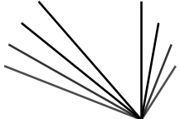
Module 1:
Geometry
  Correspondence I:
  Optical Flow
Prof. Vincent Sitzmann

Slide 2
Fredo Notes
From Vincent 2025:
Took 1.4 hours to finish optical flow
Cost volume and multi-scale cost volume explanations not great. Better explanation for multi-scale cost volume: laplacian pyramid, where you get the optical flow for blurry images, then get the high-free optical flow as residual
Raft could be explained better
The contrast of inductive bias (raft) vs. learned diffusion model was good
Could explain diffusion model better
Simply notation
I found the existing slides on Lukas-Kanade ambiguous at least in their transition to the correlation volume.
(When) should warping be discussed? And how ill-defined the problem even is
Coarse to fine vs. regularization
Eulerian vs. Lagrangian
  Link to multiview
One big missing discussion is connection to video models and their tokenization
My slides don’t discuss enough the shift from RGB differentials to patch to features (see slide I just added next slide. Figure out where to put it)

Slide 3
Addendum to flow/matching
Progression of approaches/definition of correspondence
1/ per pixel RGB value, color constancy, 1st order Taylor and image gradient
2/ neighborhood match (sum of square difference over a window
3/ Sophisticated hand-designed features (SIFT, HOG)
4/ learned features, often part of end-to-end

Slide 4
Why study old method
Understand the problem
Understand challenges
Harder with deep learning

Slide 5
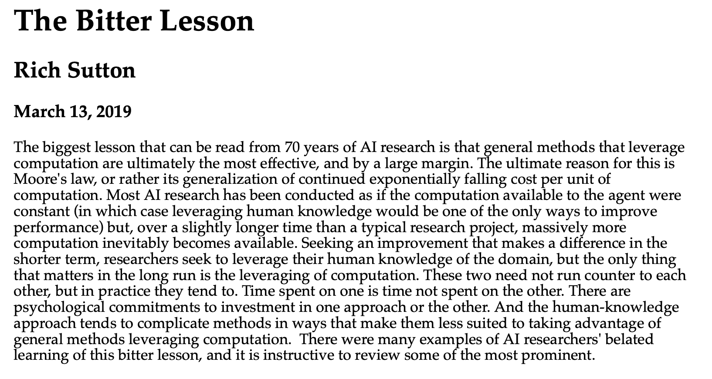
The bitter lesson
https://www.cs.utexas.edu/~eunsol/courses/data/bitter_lesson.pdf
Also https://arxiv.org/pdf/2410.09649

Slide 6
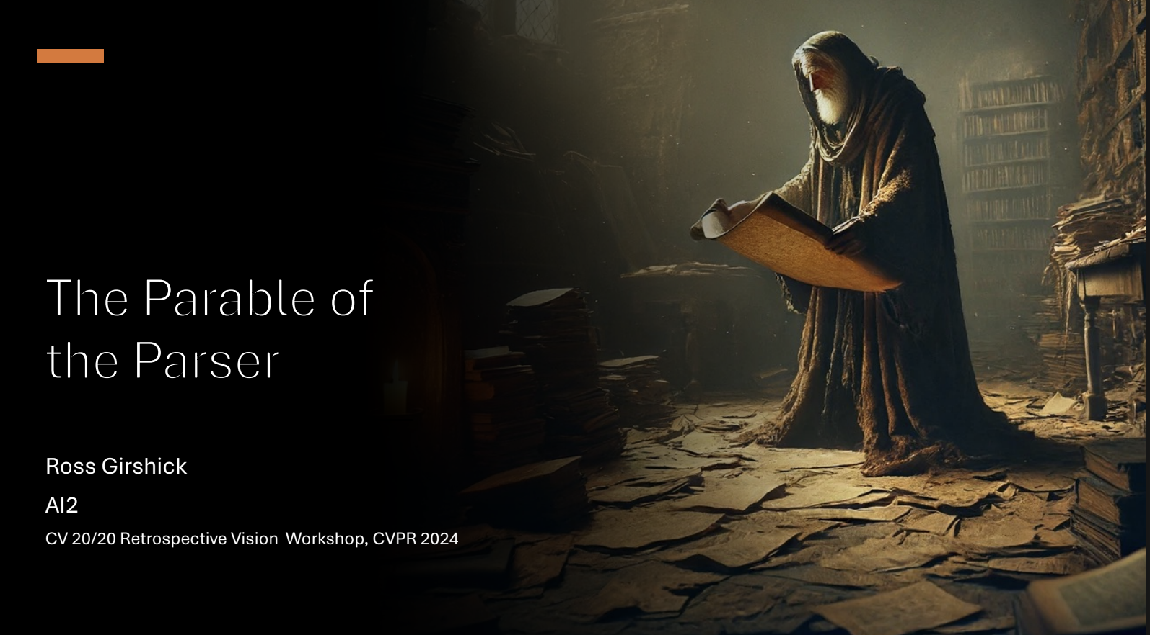
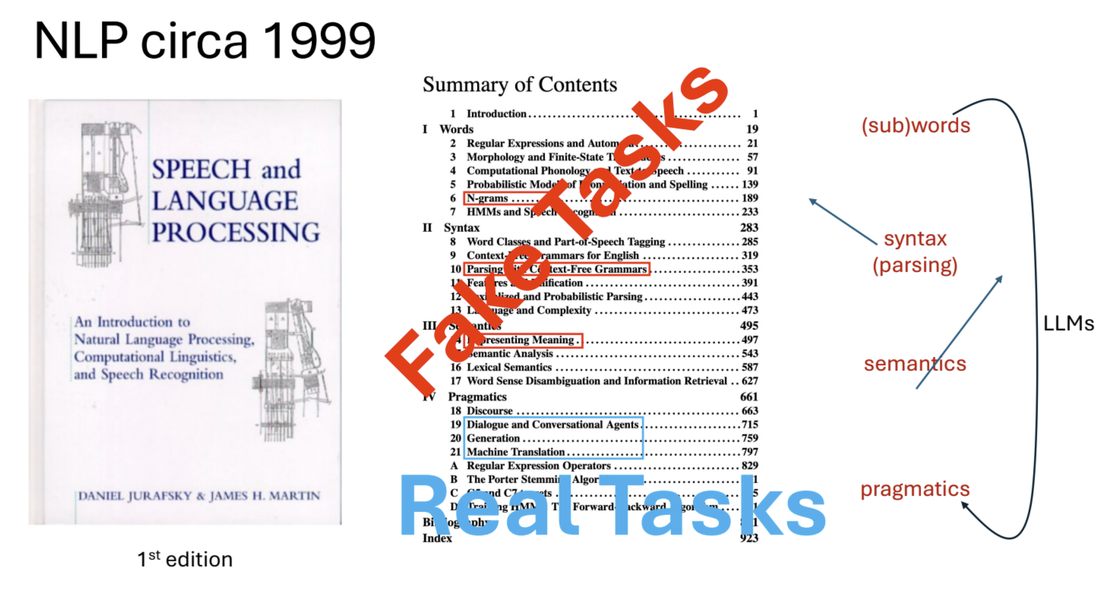
Parable of Parser
https://drive.google.com/file/d/1VodGljuEhBKwZIXQwN-ApH6g2wBAVAdK/view\

Slide 7
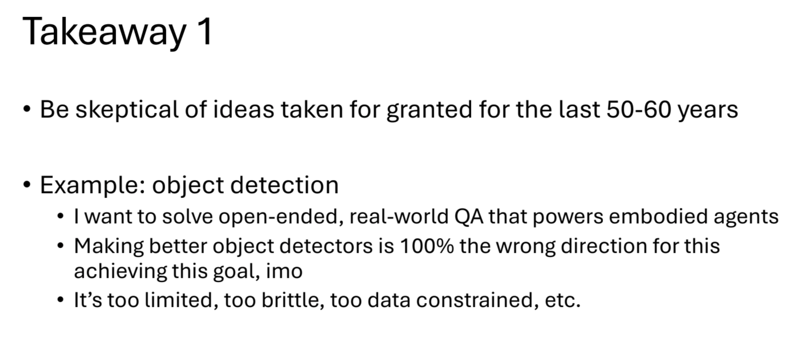
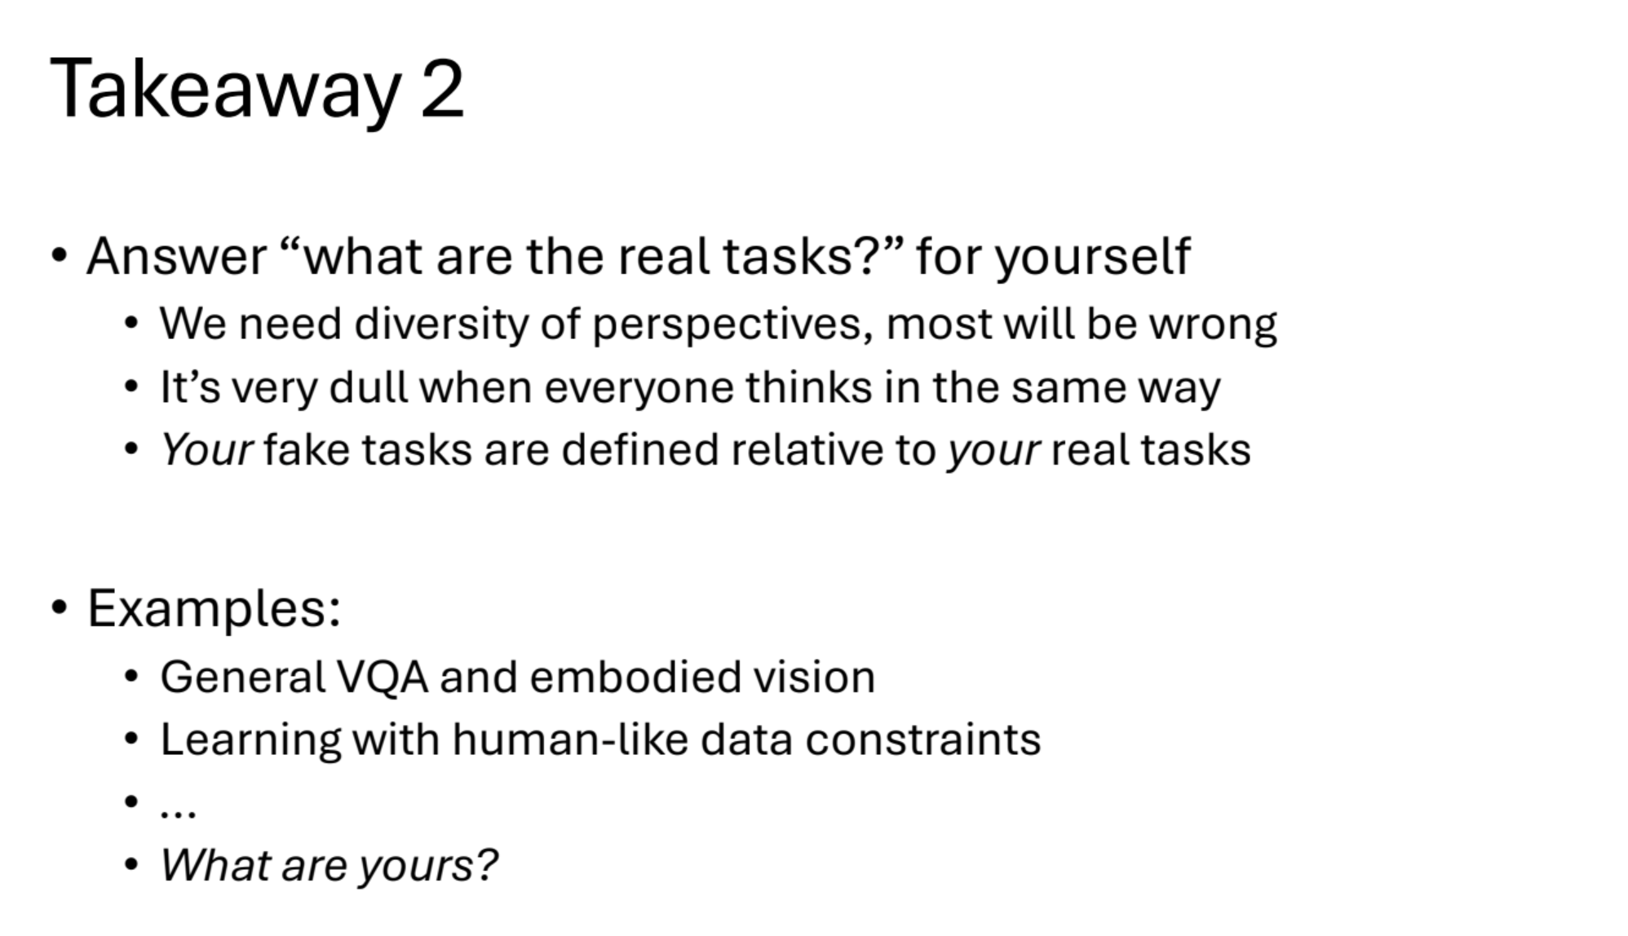
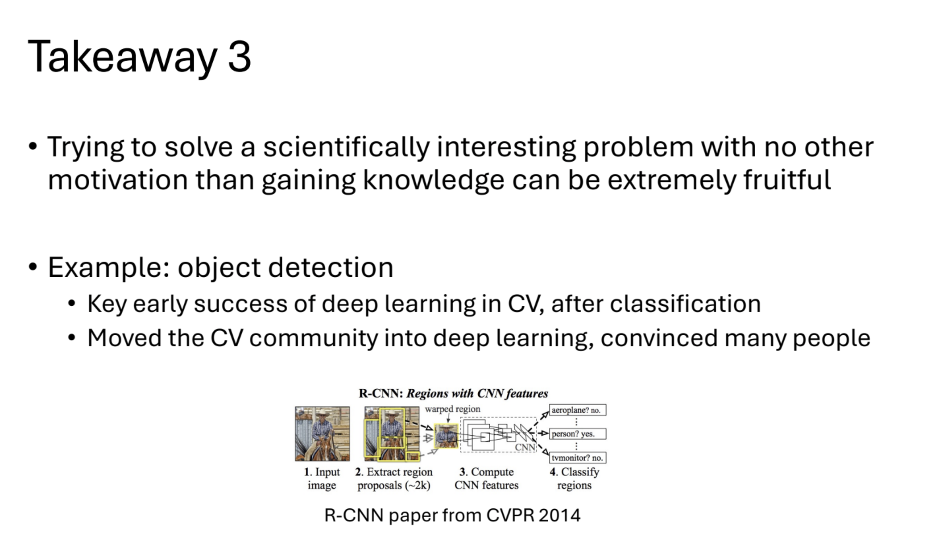

Slide 8
When to discuss Moravec’s paradox?

Slide 9
Vincent’s blog post
https://www.vincentsitzmann.com/blog/bitter_lesson_of_cv/
Response : https://ivl.cs.brown.edu/blogs/bittersweet_lesson_cv

Slide 10
My CG experience ?
Z buffer
Path Tracing
Triangles

Slide 11
Fredo Office Hours
Fridays 1pm in Stata 32-D424 (D side)

Slide 12
Credits
Base of this lecture: Deqing Sun & Charles Herrmann
Some slides, images, and videos from
Dr. Ce Liu@Microsoft
Dr. Huaizu Jiang@Northeastern
Dr. David Fouhey@UMich
Dr. Justin Johnson@UMich
Dr. Svetlana Lazebnik@UIUC
Dr. Shree K. Nayar@Columbia
Dr. Jia Deng@Princeton
Dr. Ming-Hsuan Yang@UC Merced
Dr. Rick Szeliski’s book
Book by Antonio, Phillip, and Bill
Dr. Christian Rupprecht@Oxford
Suggestions from Dr. Bill Freeman, Dr. Rick Szeliski, Dr. Noah Snavely and Dr. Junhwa Hur

Slide 13
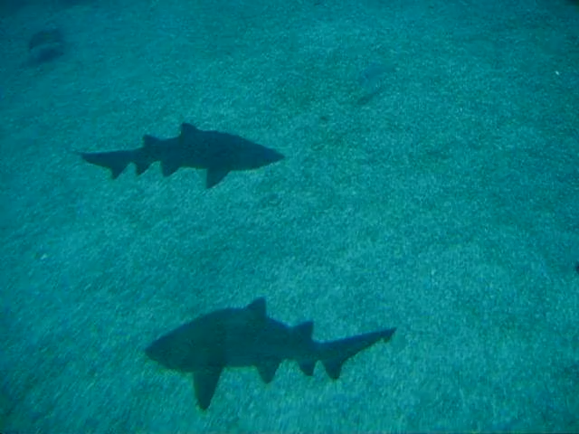
We live in a dynamic world
Perceiving, understanding and predicting motion is an important part of our daily lives
Notes:
Simple idea: we live in a dynamic world.
Motion is key to our understanding of the world.
Most obvious is navigating through the world.
A bit more abstracted. How do you know the diff between a high five and a slap?
Limping.

Slide 14
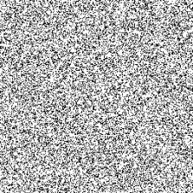
Motion and perceptual organization
Sometimes motion is the only cue!
Slide Credit: S. Lazebnik, but idea of random dot sterogram is due to B. Julesz
Notes:
Now take it away. And count to 3…

Slide 15
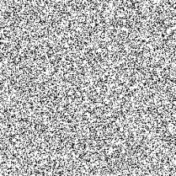
Motion and perceptual organization
Sometimes motion is the only cue!
Slide Credit: S. Lazebnik, but idea of random dot sterogram is due to B. Julesz
Notes:
Now take it away. And count to 3…

Slide 16
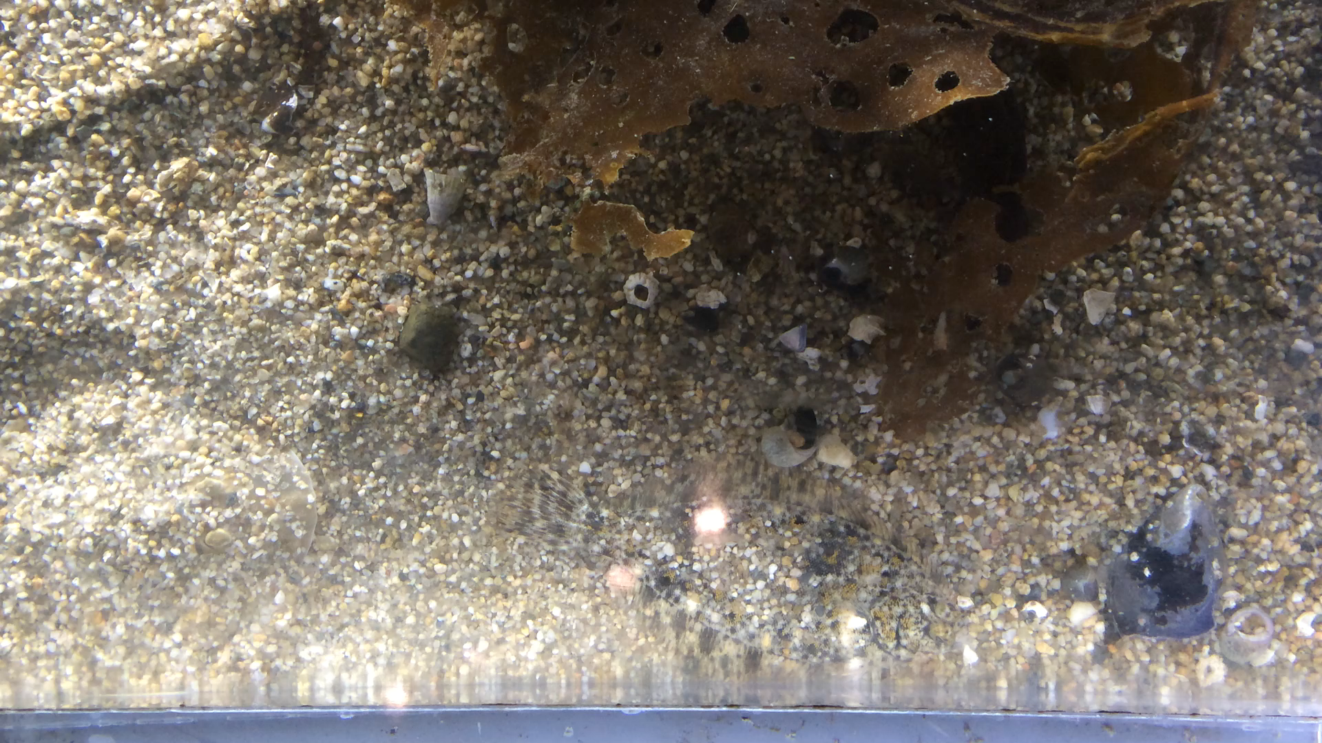
Notes:
For example, what can you see from this 2D image? Hardly anything interesting, right?
How about now? This is because our world is dynamic and the most interesting information is stored in motion.
Chicken head tracking https://www.youtube.com/watch?v=_dPlkFPowCc

Slide 17
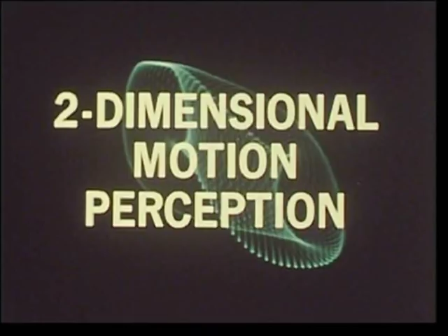
Slide Credit:
C. Rupprecht
Johansson, “Visual perception of biological motion and a model for its analysis.” 1973
source

Slide 18
Slide Credit:
C. Rupprecht
Johansson, “Visual perception of biological motion and a model for its analysis.” 1973
source

Slide 19
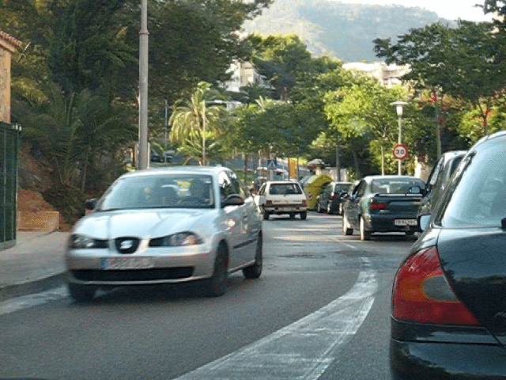
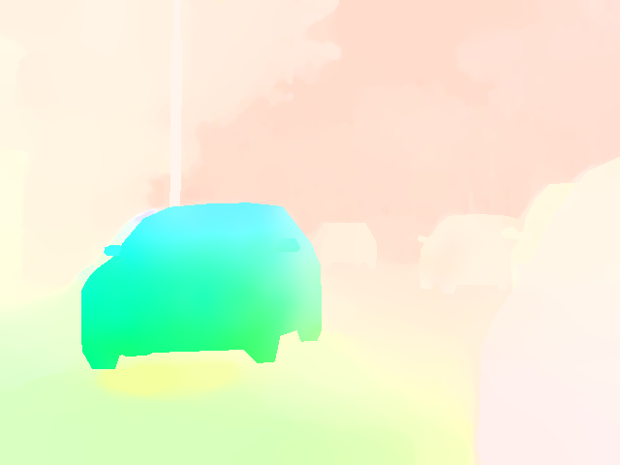
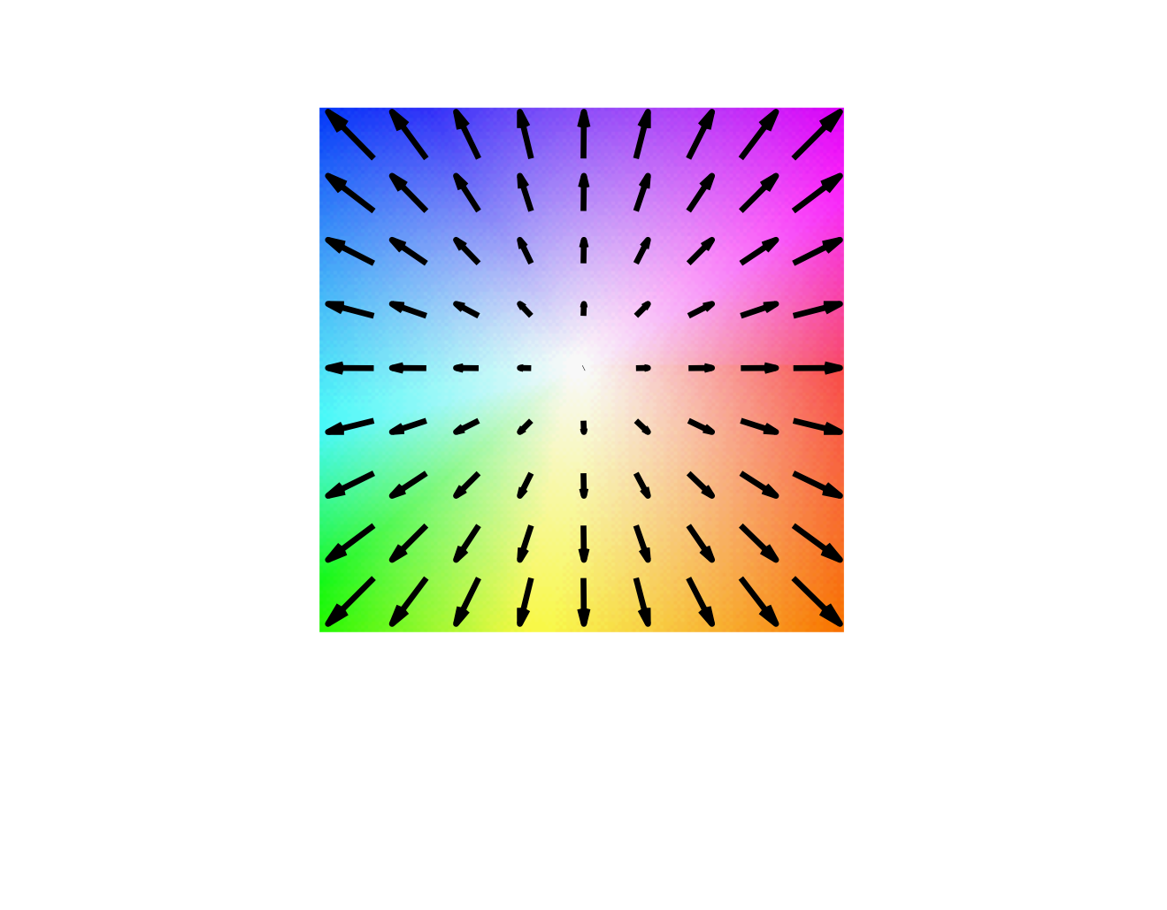
Optical flow: 2D motion of every pixel
Usually for a pair of successive frames
Input [Liu et al. CVPR’08]
Optical flow (2D motion vector)
Color key
[Baker et al. IJCV’11]
Slide credit: Deqing Sun
Notes:
Optical flow is enabling technology to explore the opportunities in video,
because it provides the motion information and highlights the dynamics of the scene
Now let’s see formally the optical flow estimation problem.
The goal of is to predict a 2D motion vector for every pixel, as shown in this color plot.
Hue: direction. Saturation magnitude.

Slide 20
Relation to stereo vision
Disparity ~ optical flow in the case of static scenes and camera baseline
Stereo is more constrained once cameras are calibrated: 1D vs 2D unknown
    Only unknown per pixel is depth (or disparity)
    Epipolar geometry
$$Z?$$
$$x_{l}$$
$$x_{r}$$
$$f$$
$$f$$
$$X_{1}$$
$$X_{2}$$
$$T$$
$$I(x,y)$$
$$I^{′}(x,y)=I(x+D(x,y),y)$$
$$D(x,y)$$

Slide 21
(Why) is Optical flow interesting?
Yes because it’s non-local yet fairly simple
Yes because traditional method shed much understanding
Yes because an example of dense (today) vs sparse (next week)
Yes because not fully solved, especially not by universal convergence models
No because it may be a fake task
No because it’s ill-defined

Slide 22
Is optical flow a fake task?
Downstream tasks:
  Video editing, slow motion (frame interpolation), video super resolution, in-painting, special effects, video stabilization
  Action recognition, object tracking and surveillance
  Egomotion, SLAM
  Connection to video compression
  Medical imaging: very similar to dense correspondences
  Optical mice
  Non-destructive testing, analysis of machinery, physics (e.g. Fluid flow)
  Generative video??
  Biological cognition understanding, time to contact (looming)

Slide 23
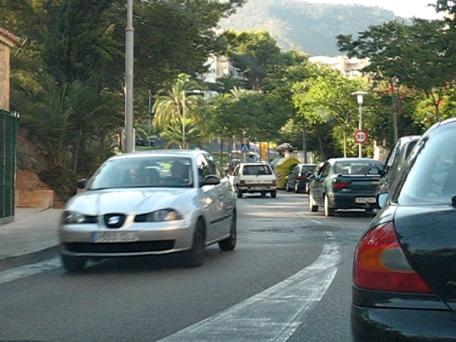
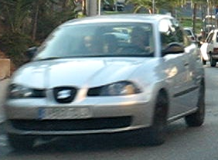
Fundamental assumption: Brightness constancy
[Horn & Schunck AI’81]
Assume a pixel at $(x,y,t)$ with intensity $I(x,y,t)$ has moved by $(Δx,Δy)$ in space during a timestep $Δt$.
Color constancy assumption (CCA):
$I(x,y,t)=I(x+Δx,y+Δy,t+Δt)$
First image (t)
Second image (t+1)

Slide 24
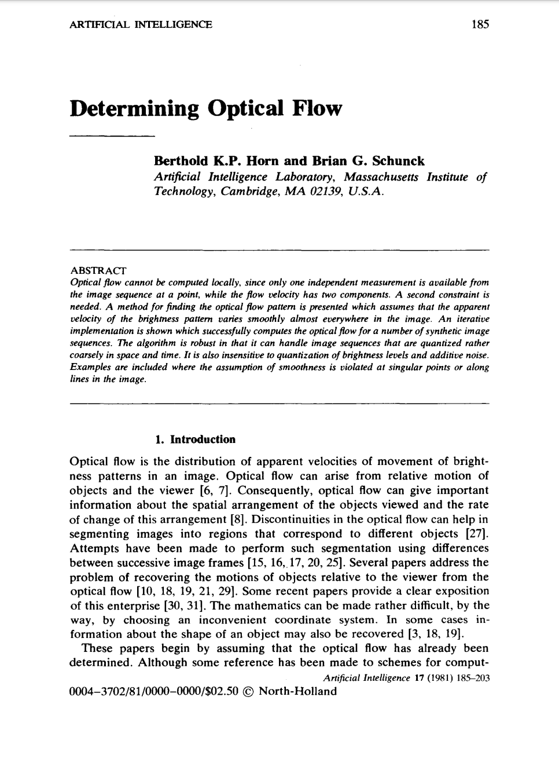
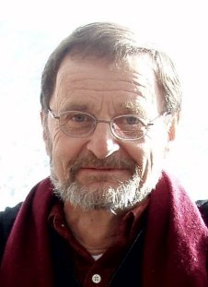
Berthold Horn

Slide 25
Horn & Schunck Optical Flow
Taylor expansion:
$I(x+Δx,y+Δy,t+Δt)≈I(x,y,t)+\frac{∂I}{∂x}Δx+\frac{∂I}{∂y}Δy+\frac{∂I}{∂t}Δt$

Slide 26
Horn & Schunck Optical Flow
Taylor expansion:
$I(x+Δx,y+Δy,t+Δt)≈I(x,y,t)+\frac{∂I}{∂x}Δx+\frac{∂I}{∂y}Δy+\frac{∂I}{∂t}Δt$
With Color Constancy Assumption:
$\frac{∂I}{∂x}Δx+\frac{∂I}{∂y}Δy+\frac{∂I}{∂t}Δt=0\text{or}\frac{∂I}{∂x}\frac{Δx}{Δt}+\frac{∂I}{∂y}\frac{Δy}{Δt}+\frac{∂I}{∂t}=0$

Slide 27
Horn & Schunck Optical Flow
Taylor expansion:
$I(x+Δx,y+Δy,t+Δt)≈I(x,y,t)+\frac{∂I}{∂x}Δx+\frac{∂I}{∂y}Δy+\frac{∂I}{∂t}Δt$
With Color Constancy Assumption:
$\frac{∂I}{∂x}Δx+\frac{∂I}{∂y}Δy+\frac{∂I}{∂t}Δt=0\text{or}\frac{∂I}{∂x}\frac{Δx}{Δt}+\frac{∂I}{∂y}\frac{Δy}{Δt}+\frac{∂I}{∂t}=0$
Using $∇I={\left[\begin{aligned}\frac{∂I}{∂x},\frac{∂I}{∂y}\end{aligned}\right]}^{T}$and $μ={\left[\begin{aligned}\frac{Δx}{Δt},\frac{Δy}{Δt}\end{aligned}\right]}^{T}$yields the motion constraint equation:
$∇Iμ=-\frac{δI}{δt}$

Slide 28
Thinking About Horn & Schunck Optical Flow
$∇Iμ=-\frac{δI}{δt}$
To use for optical flow estimation, put into a loss function:
$E=\min_{μ}\left[(∇^{T}I_{1}μ-(I_{2}-I_{1}))^{2}\right]$
It’s convex (can be solved via gradient descent or closed-form)!

Slide 29
Thinking About Horn & Schunck Optical Flow
$∇Iμ=-\frac{δI}{δt}$
To use for optical flow estimation, put into a loss function:
$E=\min_{μ}\left[(∇^{T}I_{1}μ-(I_{2}-I_{1}))^{2}\right]$
It’s convex (can be solved via gradient descent or closed-form)!
But remember we had to simplify the problem to get there:
Color constancy, linearization with Taylor expansion

Slide 30
Thinking About Horn & Schunck Optical Flow
$∇Iμ=-\frac{δI}{δt}$
Remarkable: Only the image gradient matters for time evolution!
Why? Think about it.

Slide 31
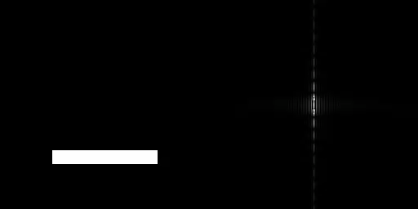
Thinking About Horn & Schunck Optical Flow
$∇Iμ=-\frac{δI}{δt}$

Slide 32
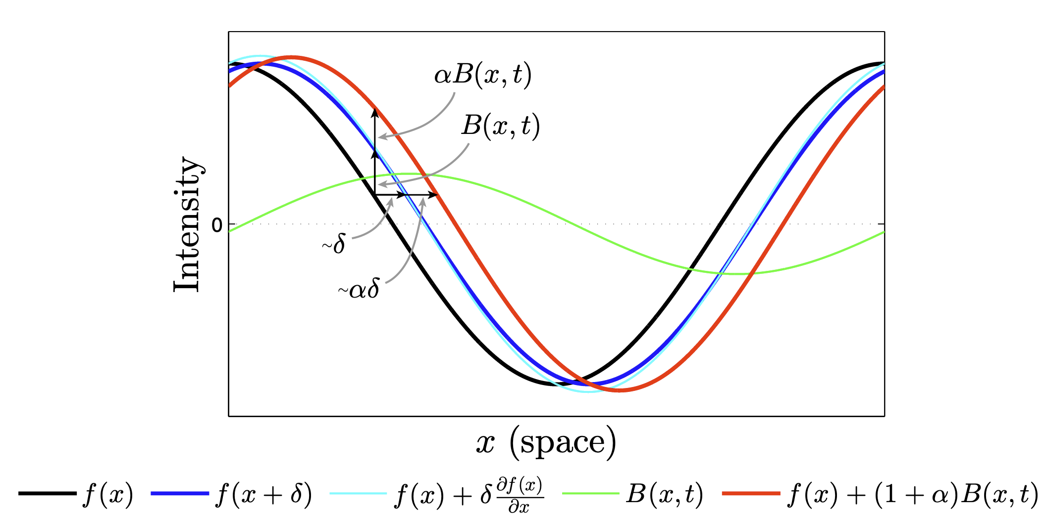
Recall Eulerian Video Magnification

Slide 33
Estimating Motion in Direction of Constant Brightness: The Aperture Problem
Slide Credit: S. Lazebnik

Slide 34
Estimating Motion in Direction of Constant Brightness: The Aperture Problem
Slide Credit: S. Lazebnik

Slide 35
Other invisible flow
Slide credit: D Fouhey & J Johnson

Slide 36
Other invisible flow
Slide credit: D Fouhey & J Johnson
Notes:
NeruIPS paper

Slide 37
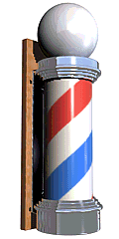
What do you perceive?
Notes:
https://www.newworldencyclopedia.org/entry/Barberpole_illusion
TODO: check solutions by flow methods

Slide 38
The math warned us
$$∇I.μ=-\frac{δI}{δt}$$
$$∇I$$

Slide 39
The math warned us
$$∇I.μ=-\frac{δI}{δt}$$
$$-\frac{1}{||∇I||}\frac{δI}{δt}$$
$$μ?$$
$$∇I$$
$$μ?$$
$$μ?$$

Slide 40
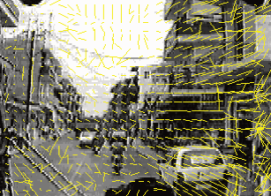
Optical Flow – The Beginnings
[Horn & Schunck AI’81]
Raw estimate

Slide 41
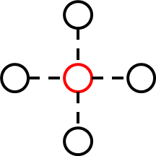
Optical Flow – The Beginnings
[Horn & Schunck AI’81]
Prior term (Smoothness)
Raw estimate

Slide 42
Optimization/energy minimization
[Horn & Schunck AI’81]
( ) +
Data term (Constancy)
Prior term (Smoothness)
$E=\min_{μ}\left[(∇^{T}I_{1}μ-(I_{2}-I_{1}))^{2}+α(|∇μ_{x}|^{2}+|∇μ_{y}|^{2})\right]$
Notes:
What is the problem? L2, formulation, optimization?
Audience is the experts.

Slide 43
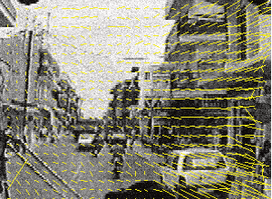
Optical Flow – The Beginnings
[Horn & Schunck AI’81]
[Horn & Schunck AI’81]
Raw estimate
Smoothed estimate

Slide 44
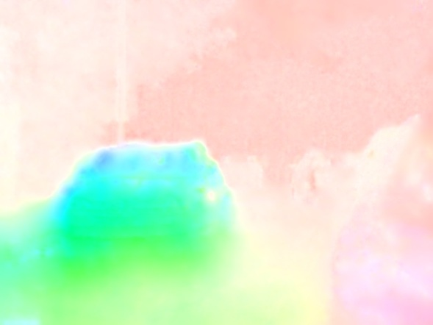
Horn & Schunck on a more recent scene

Slide 45
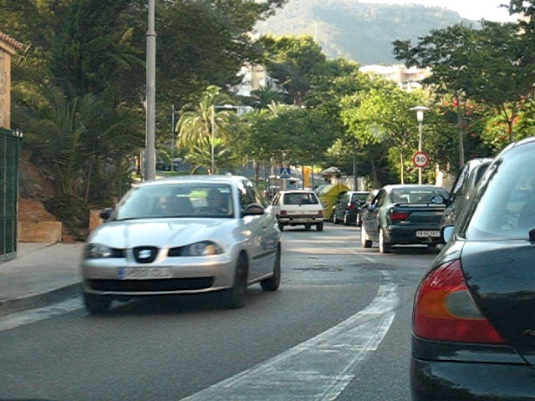
Matching-based motion estimation
Generally: Energy to measure similarity between a pixel in image 1 with pixels in image 2:
$$\min_{w_{p}}{\left(I_{t}(p)-I_{t+1}\left(p+w_{p}\right)\right)}^{2}$$
Image 1
Image 2

Slide 46
Matching-based motion estimation
Generally: Energy to measure similarity between a pixel in image 1 with pixels in image 2:
$$\min_{w_{p}}{\left(I_{t}(p)-I_{t+1}\left(p+w_{p}\right)\right)}^{2}$$
We kept color constancy
but dropped linearization
(Becomes more Lagrangian!)
Image 1
Image 2

Slide 47
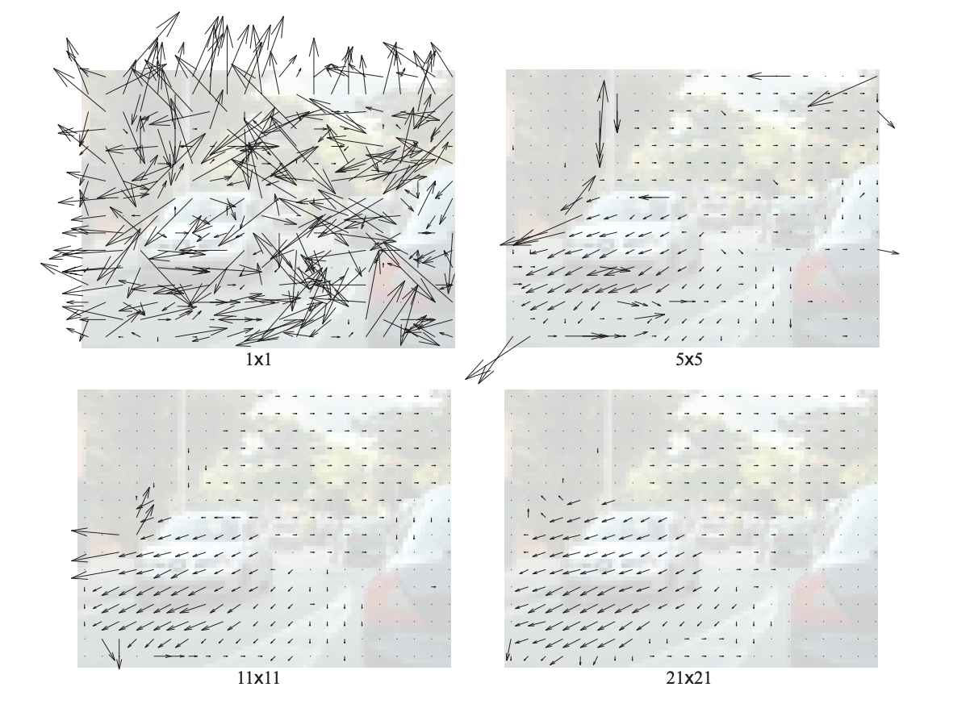
Comparing pixel colors directly

Slide 48
Matching-based motion estimation
Generally: Energy to measure similarity between a pixel in image 1 with pixels in image 2:
$$\min_{w_{p}}{\left(I_{t}(p)-I_{t+1}\left(p+w_{p}\right)\right)}^{2}$$
Image 1
Image 2

Slide 49
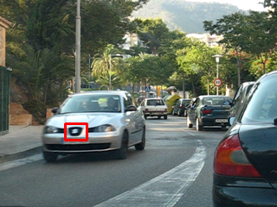
Resolving ambiguities: Lucas-Kanade
Insight: Pixels in the same patch generally share the same motion
$$\min_{w_{p}}\underset{q∈N_{p}}{∑}{\left(I_{t}(q)-I_{t+1}\left(q+w_{p}\right)\right)}^{2}$$
Image 1
Image 2

Slide 50
Lukas Kanade
Per-patch linear system
  Essentially aggregate info from multiple pixels to
  1/ resolve aperture problem 2/ regularize
  Can be seen as per-patch 1-step Horn-Schunk with strong constant smoothness
Assumes small motion (~1 pixel max)
Later extended to use coarse-to-fine pyramids

Slide 51
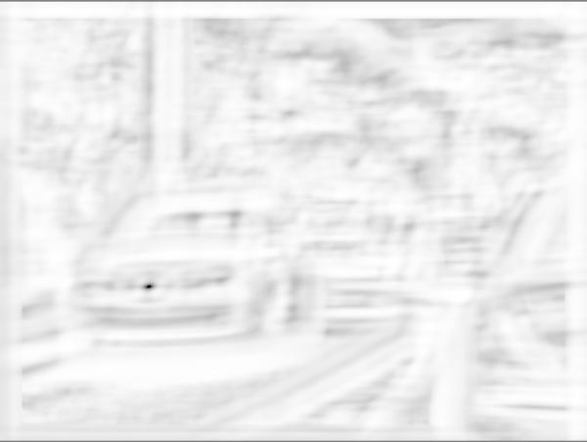
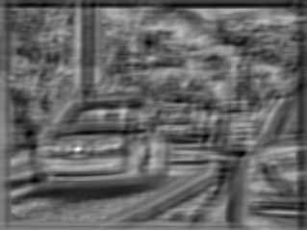
Similarity between patches (cost volume)
[Scharstein & Szeliski 2002, Hosni et al. 2013, Zbontar & LeCun 2016]
Image 1
Cost volume (darker, more similar)
Notes:
We use normalized cross correlation to compare patches.
This actually constructs the cost volume.
It is widely used for stereo matching.
It stores the “cost”, or similarity, of every motion vector for the current pixel.
We can see that there is peak around the correct motion
TODO: ADD example for 1 pixel

Slide 52
Effect of patch size

Slide 53
Issue: Brute force is too expensive
Quadratic in number of pixels:
each pixel in image 1 could be correlated with any pixel in image 2
Possible pairs are 4D: (x1,y1, x2, y2)
Image 1
Image 2
Notes:
One issue is the computation.
Let’s look at the search range for stereo. It’s along a 1D line.
However, for flow, the search range is for the whole image and very large.
This is one bottleneck for several recent work that uses cost volume for flow, including FlowNet.
EXPLAIN SETUP OF STEREO; TWO CAMERAS, TWO FRAMES,

Slide 54
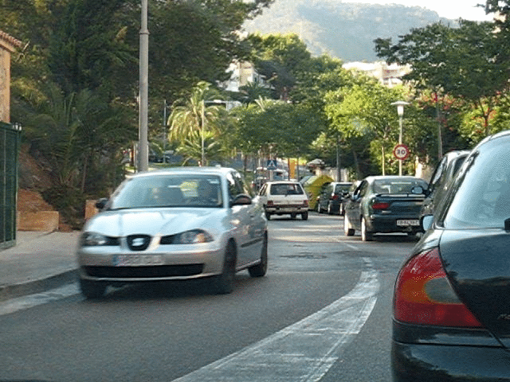
Coarse-to-fine iterative estimation
w=1.25px
w=2.5px
image 1
w=5px
image 2
image 1
Start from top or bottom?
Slide credit: S. Lazebnik
Notes:
Which direction to go: top to bottom or bottom to top?

Slide 55
Coarse-to-fine iterative estimation
w=1.25px
w=2.5px
image 1
w=5px
image 2
image 1
How to use estimates from the upper level?
Slide credit: S. Lazebnik
Notes:
Which direction to go: top to bottom or bottom to top?

Slide 56
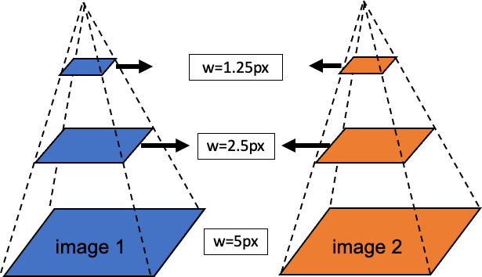
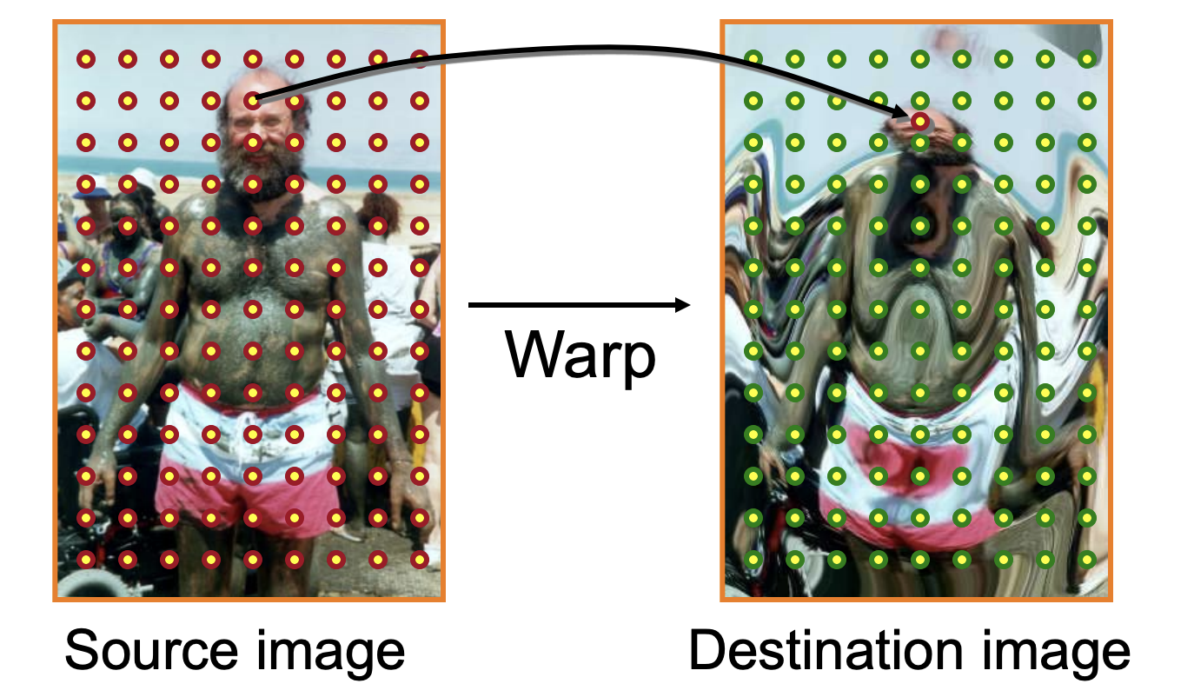
Coarse-to-fine iterative estimation
Current estimate
$$I_{t+1}\left(q+w_{p}\right)=I_{t+1}\left(q+{w_{p}}^{k}+δw_{p}\right)=I_{w}(q+δw_{p})$$
Small increment
Warped image:
$$I_{w}\left(q\right)=I_{t+1}\left(q+w_{p}^{k}\right)$$

Slide 57
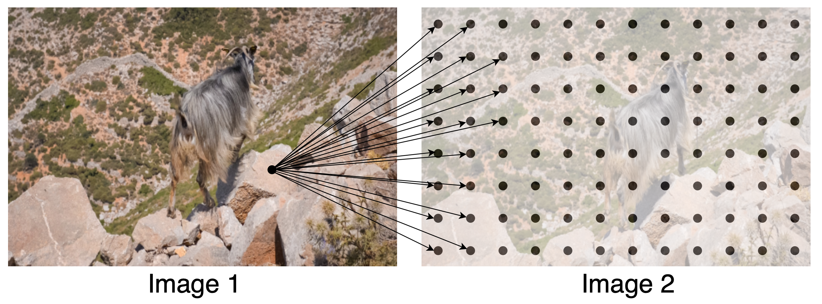
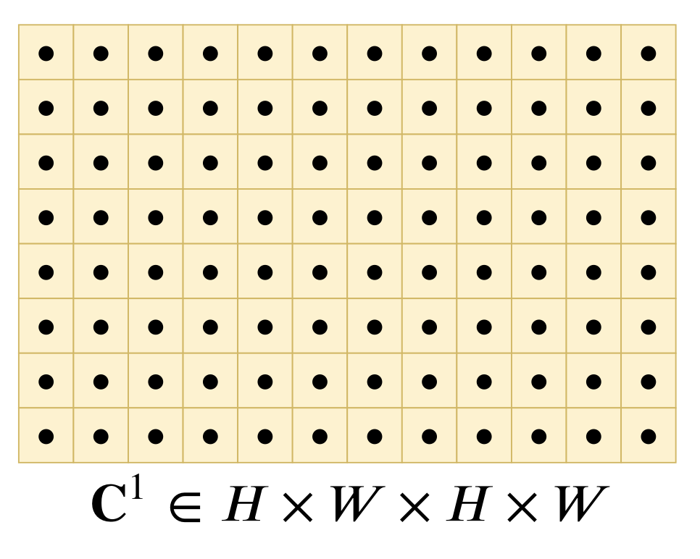
Cost / Correspondence Volumes
CMU 16-889, Spring 2022
Idea: Correlate every pixel / patch in image 1 with every pixel in image 2, yielding a 4D correlation volume.
Image Courtesy: RAFT. Teed et. al.
Notes:
https://geoml.github.io/Lectures/L5_Shape_Representation.pdf

Slide 58
Explain correlation volume

Slide 59
Warping operation
$$I_{w}\left(q\right)=I_{t+1}\left(q+w_{p}^{k}\right)$$
Input images t and t+1
Image t and warped image

Slide 60
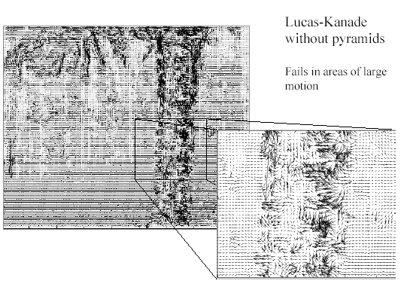
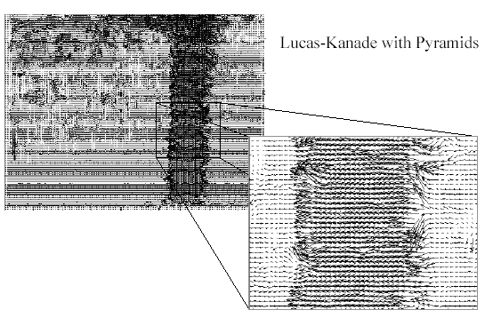
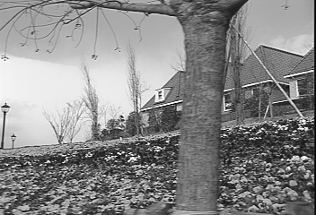
Optical Flow Results
Slide credit: S. Lazebnik
Notes:
TODO: replace with car examples

Slide 61
Horn-Schunk vs. Lucas Kanade
Patch vs regularization
One-step vs iterative optimization

Slide 62
Issue: Motion Boundaries
No matches can be found at motion boundaries…
Also at frame boundary

Slide 63
Black Anandan
+TV-L1

Slide 64
Issue: Ambiguous patch details
Flat regions of the image are underconstrained

Slide 65
Solving ambiguities: Horn & Schunck
Smoothness: neighboring pixels have similar motion

Slide 66
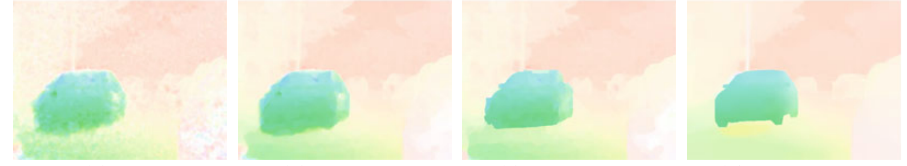
Horn & Schunck
Input
Horn & Schunck
Ground truth
Color key
[Baker et al. IJCV’11]
Notes:
Shown: Ce’s implementation
Hidden: mine implementation

Slide 67
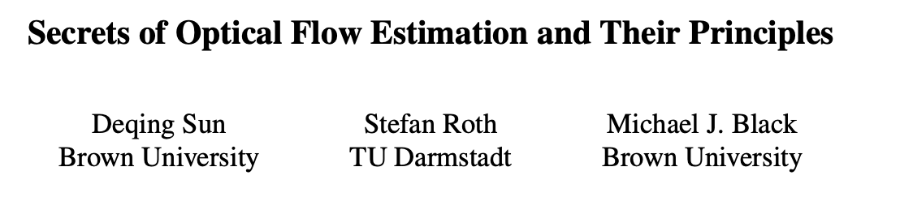
Secrets paper
https://cs.brown.edu/people/dqsun/pubs/cvpr_2010_flow.pdf

Slide 68
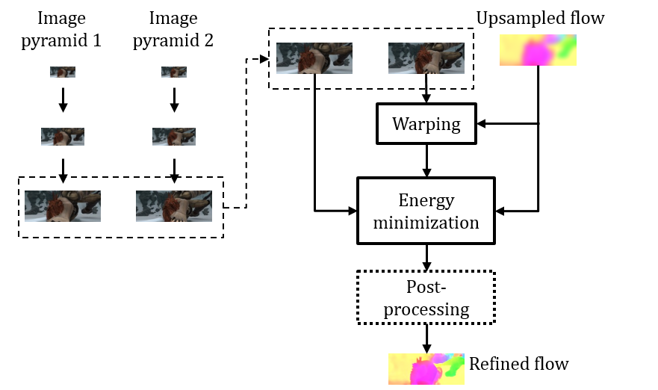
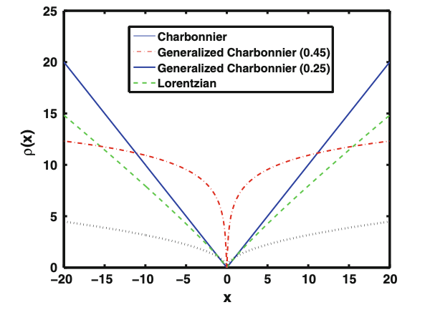
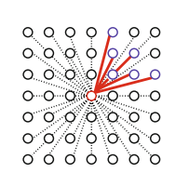
Improving Horn & Schunck
[Sun et al. CVPR’10, IJCV’14]
$$E\left(w\right)=\sum_{p}{{\left|I_{t}\left(p\right)−I_{t+1}\left(p+w_{p}\right)\right|}^{2}+}λ\sum_{q∈N_{p}}{{\left|w_{p}−w_{q}\right|}^{2}}$$
Multi-Scale
Pyramid
“Old”
Robust function
Non-local term
Ground truth
Notes:
Shown: Ce’s implementation
Hidden: mine implementation

Slide 69
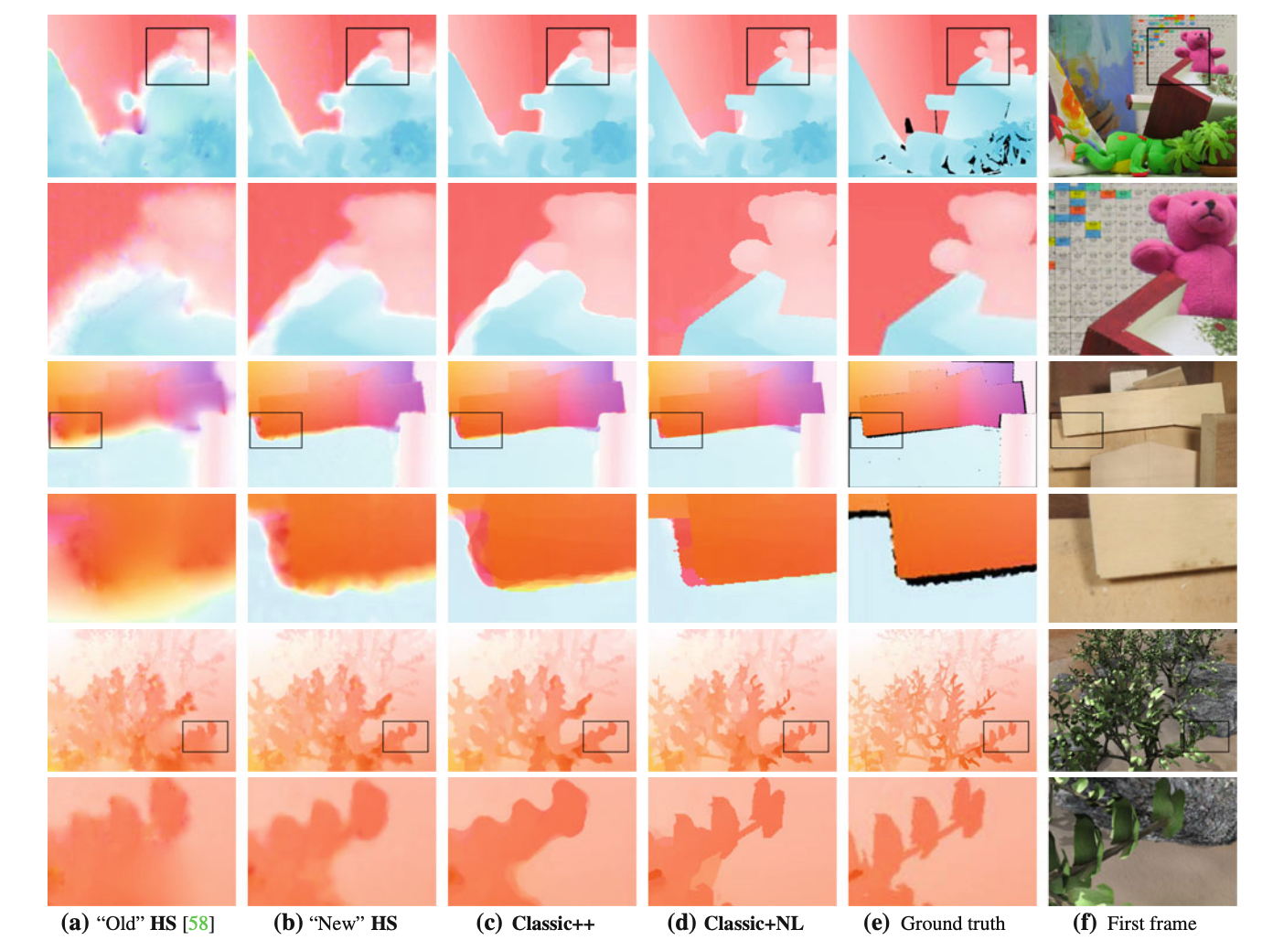
Improving Horn & Schunck
[Sun et al. CVPR’10, IJCV’14]
Implementation
Robust function
Non-local smoothness term
Notes:
TODO: add visual explanations of techniques
Use car example

Slide 70
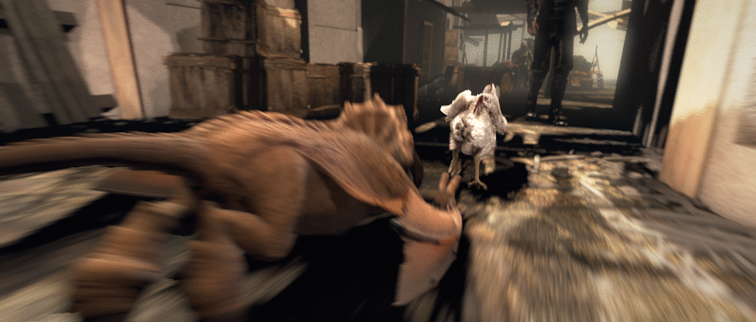
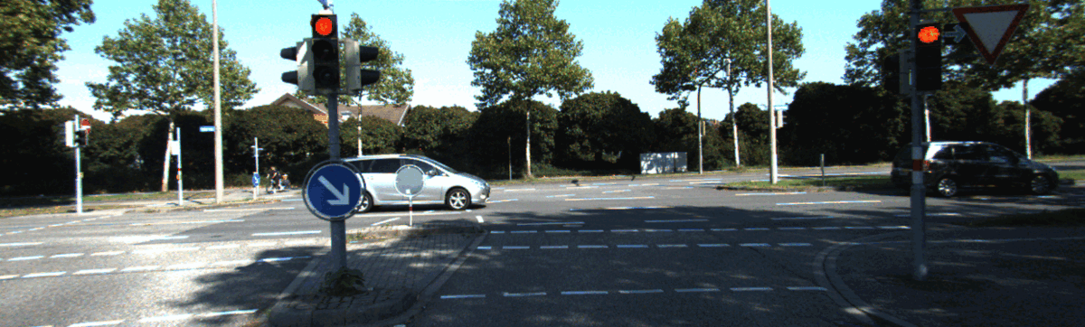
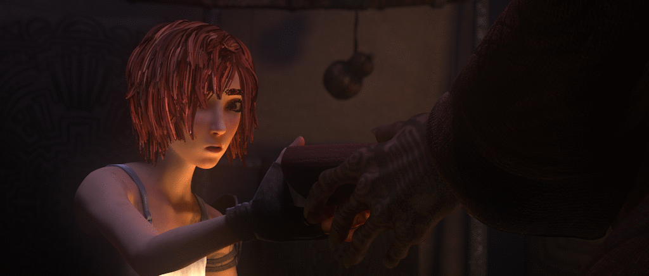
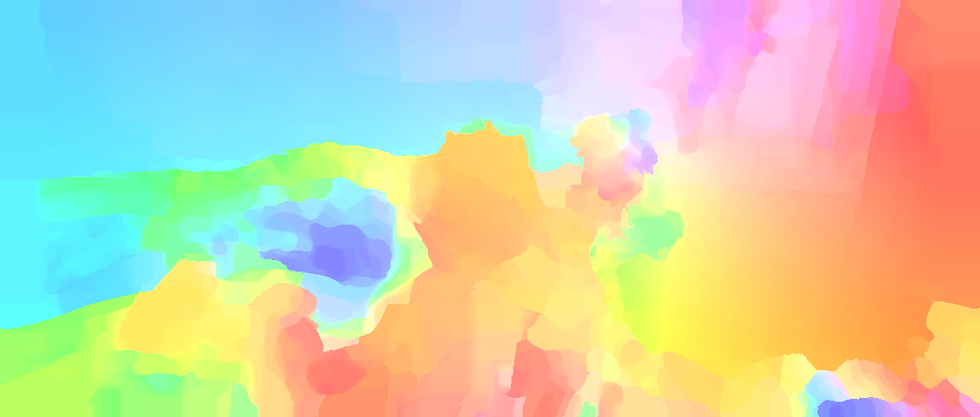
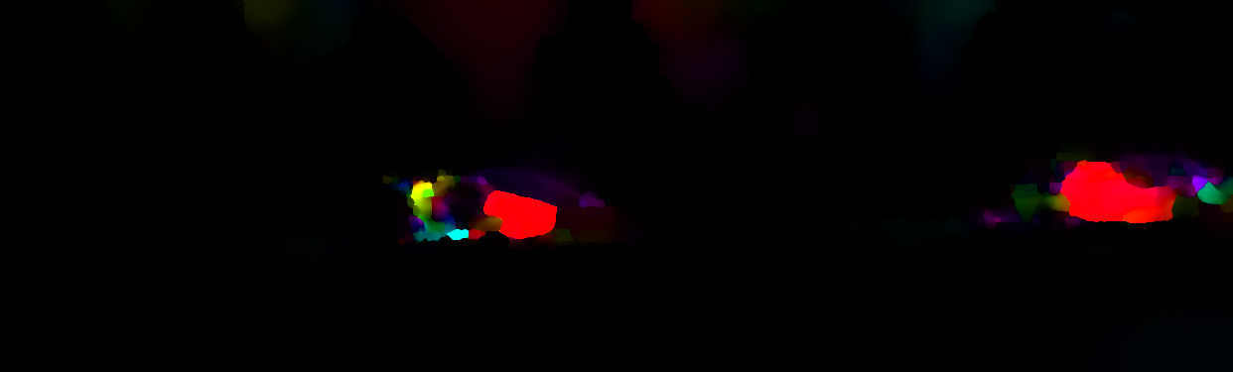



Challenges for classical methods
Large motion
Motion blur
Occlusions
Lighting changes
Noise…
Small objects
Hard to modify objective function
and even harder to optimize it
Classic+NL
EpicFlow
Shadows
Ground truth
Error map (red, larger)
Notes:
There are many challenges, such as large motion and motion blur, …
Show results by Classic+NL

Slide 71



SIFT flow and Large Displacement Optical Flow (LDOF)

Slide 72
Recap
Flow is a dense 2D vector field between two frames
Energy minimization (+regularization+iterative solver)
vs. 1-step prediction (maybe with coarse to fine)
Edge aware regularization
RGB vs features

Slide 73

Summary
Classical approach
  Constancy assumption -> matching by comparison (cost volume)
Image 1
Image 2
Cost volume
Notes:
Show visual examples about key concepts

Slide 74
Summary
Classical approach
  Constancy assumption -> matching by comparison (cost volume)
  Coarse-to-fine, warping-based iterative estimation
Input images t and t+1
Image t and warped image
Notes:
Show visual examples about key concepts

Slide 75
Why optical flow took longer to get the CNN treatment
Non-local

Slide 76

Supervised optical flow
[Dosovitskiy et al. ICCV’15]

Slide 77


Single feedforward applied to stacked pair of frames
Refinement of features and flow field

Slide 78




Training Data:
FlyingChairs
Seriously!

Slide 79




Two widely-used benchmarks for optical flow
Sintel (Blender movie)
KITTI (driving)
One big issue with optical flow : limited ground truth data
Notes:
Sintel, KITTI, Middlebury, VIPER, HD1K

Slide 80


Slide 81

RAFT: Recurrent All-pairs Field Transforms
[Teed and Deng ECCV 2020 Best paper]

Slide 82
RAFT idea : Neuralize old approach
Traditional approach:
Data term: similarity of RGB
Iterative minimization :
  Current estimate of flow
  (2D vector field)
  At each step, update flow estimate based on data similarity and neighbors (regularization)

Slide 83
RAFT idea : Neuralize old approach
+ precompute
all similarities
(2Dx2D -> 4D)
Replace RGB
by learned features
Data term: similarity of RGB
Iterative minimization :
  Current estimate of flow
  (2D vector field)
  At each step, update flow estimate based on data similarity and neighbors (regularization)
Iterations with serialized recurrent network
(shared weights)
Unchanged!
Learn update
Look up precomputed correlations
Provide image context
so that update can regularize based
on edges and the such

Slide 84
RAFT: Recurrent All-pairs Field Transforms
[Teed and Deng ECCV 2020 Best paper]

Slide 85
RAFT: Recurrent All-pairs Field Transforms
[Teed and Deng ECCV 2020 Best paper]
Correlation 4D Volume / pyramids
(~precompute similarity for performance)
Learn
features
Update operator:
Learn to minimize
Update flow vector field + hidden state
Context (~ for smart regularization)
All differentiable and learned end-to-end

Slide 86

RAFT: Recurrent All-pairs Field Transforms
[Teed and Deng ECCV 2020 Best paper]
In the authors’ words:

Slide 87

RAFT: Recurrent All-pairs Field Transforms
[Teed and Deng ECCV 2020 Best paper]
Key ideas
Learned features
All-pairs cost volume (4D) across scales
Recurrent module for iterative refinement of flow
Better training schemes
Slide credit: Teed and Deng

Slide 88

All-pairs visual similarity (cost volume)
Inner product/correlation between features

Slide 89
Cost volume pyramid
Spatial pooling

Slide 90

Look up cost volume
Retrieve using current motion estimates

Slide 91

Recurrent update
Like classical optimization algorithms

Slide 92

Recurrent update

Slide 93
From the paper
“The RAFT architecture
is motivated by traditional optimization-based approaches.
The feature encoder extracts per-pixel features.
The correlation layer computes visual similarity between pixels.
The update operator mimics the steps of an iterative optimization algorithm. But unlike traditional approaches, features and motion priors are not handcrafted but learned—learned by the feature encoder and the update operator respectively.”

Slide 94

Significant improvement over prior art
[Teed and Deng ECCV 2020 Best paper]
Slide credit: Teed and Deng

Slide 95

Visual results on Davis (real-world)

Slide 96
Discussion
Specific architecture hand-crafted for the problem
Still largely feed-forward (well, unrolled recurrence)
Scaffolding with traditional methods and inductive bias
  Historically it all happened progressively in the span of multiple papers : traditional pieces of the approach got replaced with learnable ones
Non-local matching is hard and requires specialized architectures

Slide 97
Is the hand-crafted structure (cost-volume, unrolled optimization on cost volume) really necessary?

Slide 98

Is the hand-crafted structure (cost-volume, unrolled optimization on cost volume) really necessary?

Slide 99
Use generative approach (diffusion)
  Conditioned on two frames,
  denoise flow
Still supervised (ground truth flow)
  Existing data not good enough
  Merge four large synthetic flow dataset for pre-training:
  FlyingThings3D, AutoFlow, Kubric, TartanAir
Also applied to depth prediction

Slide 100


Slide 101


Slide 102
Key contributions:
Merge four large synthetic flow dataset:
FlyingThings3D, AutoFlow, Kubric, TartanAir
Training with real data is tricky: Has holes! Diffusion model would generate optical flow maps with holes as well…
Coarse-to-fine training strategy

Slide 103

Fully supervised… Any self-supervised models out there?

Slide 104
Self-Supervised Optical Flow
[Stone, Maurer et al. 2021, Jonschkowski et al. 2020, Meister et al. 2018, …]
(see SMURF for good discussion!)
$$\begin{matrix} & \underset{p}{∑}{\left|I_{t}(p)-I_{t+1}\left(p+w_{p}\right)\right|}^{2} \\ & +λ\underset{q∈N_{p}}{∑}{\left|w_{p}-w_{q}\right|}^{2} \\ & +...\end{matrix}$$
Warp using flow,
Multiscale,
…
Estimate flow with Neural Network…
…but supervise flow with warping-based losses & regularizers!

Slide 105


SMURF
Motivation:
The model learns to ignore photometric augmentations
The model learns to make better predictions at the borders and in occluded areas of the image (with other tricks, see paper)
Early iterations of the recurrent model learn from the output at the final iteration

Slide 106
Bag of tricks
Range-map based occlusion reasoning
the Census loss for photometric consistency
edge aware smoothness
and self supervision
Use crops at training time to make sure boundaries are correct
Multiple frame refinement

Slide 107




Loss
Essentially the loss is where the inductive bias is
Architecture itself mostly RAFT

Slide 108
Loss
Still fair amount of inductive bias in loss and architecture
Element-wise multiplication
Warp
Flow field
Data augmentation
Occlusion mask
based on off-the-shelf inferred depth
Fancy photometric (pixel) loss based on census transform (brightness ordering rather than value)
Architecture itself mostly RAFT
Edge-aware regularization based on image and flow derivatives
Leverage flow ${\overset{̂}{V}}_{1}$ computed on uncropped version of frame to improve things at frame boundary

Slide 109


Slide 110

SMURF results

Slide 111


Slide 112



Transformers
Transformers are good at non-local stuff
But quadratic cost makes them challenging with 4D cost volume
Requires smart encoding

Slide 113


Flowformer
Cost volume
Patchification + tokenization
-> latent 4D cost volume
Alternate-Group Transformer Layer
Memory, self attention
Decoder still recurrent

Slide 114

FlowFormer++
Better cost volume encoding with Masked AutoEncoder

Slide 115


Slide 116
Flowformer discussion
Still specialized : cost volume, recurrence, special encoding
Transformers are great but memory is a huge challenge
(especially with 4D data)

Slide 117
Optical Flow Discussion
Challenge: non-local matching, Lagrangian nature
  Sometimes convergence with depth estimate, sometimes not
Has moved from manually crafted to supervised to self-supervised
Still requires some inductive biases and specialized architecture
  Not fully bitter-lessoned.
Still a fair question whether it’s a real task
How connected is it to generative video models? Their tokenization?

Slide 118
Summary
Discussed two key approaches to motion tracking: Optical flow and point tracking
Went in-depth on how to think about the motion estimation problem: infinitesimal perspective, finite perspective, cost volumes, smoothness, etc.
Discussed SOTA supervised optical flow estimators.
Discussed options for self-supervised methods.
Discussed point tracking paradigm.

